Slide 1
CHAPTER 02
Defining Nonfunctional Requirements
Designing Data-Intensive Applications, Second Edition
Detailed English Study Edition
01 / 19
Notes:
Source: Martin Kleppmann and Chris Riccomini, Designing Data-Intensive Applications, 2nd ed., Chapter 2, book pages 33-56.
Source file: /Users/eve/projects/Designing-Data-Intensive-Applications/Designing Data Intensive Applications 2nd.pdf

Slide 2
CHAPTER 02
Chapter map
01
Turning goals into metrics
Functional requirements state what the system does.
02
Latency and throughput
Response time includes service time, queueing, and network delay.
03
Reliability and fault tolerance
Fault tolerance prevents component faults from becoming service failures.
04
Scalability
Describe load with request rate, read/write mix, data size, and skew.
05
Maintainability
Operability makes state visible and incidents diagnosable.
02 / 19
Notes:
Source: Martin Kleppmann and Chris Riccomini, Designing Data-Intensive Applications, 2nd ed., Chapter 2, book pages 33-56.
Source file: /Users/eve/projects/Designing-Data-Intensive-Applications/Designing Data Intensive Applications 2nd.pdf

Slide 3
CHAPTER 02
Turning goals into metrics
01
Functional requirements state what the system does.
Nonfunctional requirements define measurable levels of service.
Every metric needs a workload, observation window, and user journey.
Core question
What problem does it solve, and what does it cost under failure, growth, and change?
03 / 19
Notes:
Source: Martin Kleppmann and Chris Riccomini, Designing Data-Intensive Applications, 2nd ed., Chapter 2, book pages 33-56.
Source file: /Users/eve/projects/Designing-Data-Intensive-Applications/Designing Data Intensive Applications 2nd.pdf

Slide 4
CHAPTER 02
Turning goals into metrics: design trade-offs
01
Fit: Functional requirements state what the system does.
Cost: evaluate latency, throughput, consistency, and operational complexity.
Failure check: what state becomes visible when a node, network path, or dependency fails?
Evolution check: can formats, interfaces, and topology change through rolling upgrades?
04 / 19
Notes:
Source: Martin Kleppmann and Chris Riccomini, Designing Data-Intensive Applications, 2nd ed., Chapter 2, book pages 33-56.
Source file: /Users/eve/projects/Designing-Data-Intensive-Applications/Designing Data Intensive Applications 2nd.pdf

Slide 5
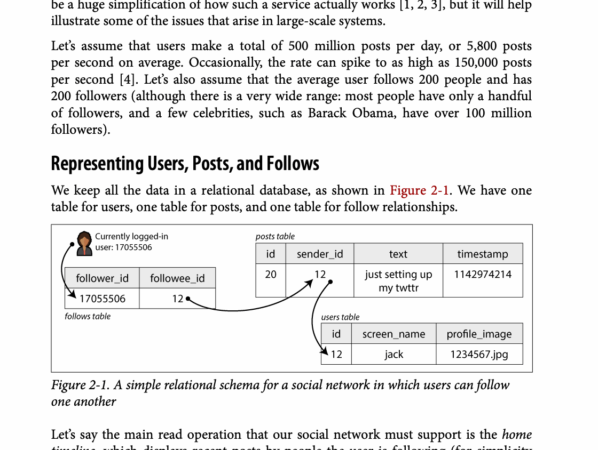
CHAPTER 02
Figure 2-1: mechanism explained
What it shows
The diagram shows how entities and relationships are represented by keys, nesting, or joins.
Why it matters
The model changes read locality, duplication, and update complexity.
What to watch
Follow the arrows or timeline and test whether the conclusion still holds under failure, retry, and concurrency.
05 / 19
Notes:
Source: Martin Kleppmann and Chris Riccomini, Designing Data-Intensive Applications, 2nd ed., Chapter 2, book pages 33-56. Figure 2-1, PDF page 58. Original caption: Figure 2-1. A simple relational schema for a social network in which users can follow
Explanation: The diagram shows how entities and relationships are represented by keys, nesting, or joins. The model changes read locality, duplication, and update complexity. Follow the arrows or timeline and test whether the conclusion still holds under failure, retry, and concurrency.
Source file: /Users/eve/projects/Designing-Data-Intensive-Applications/Designing Data Intensive Applications 2nd.pdf

Slide 6
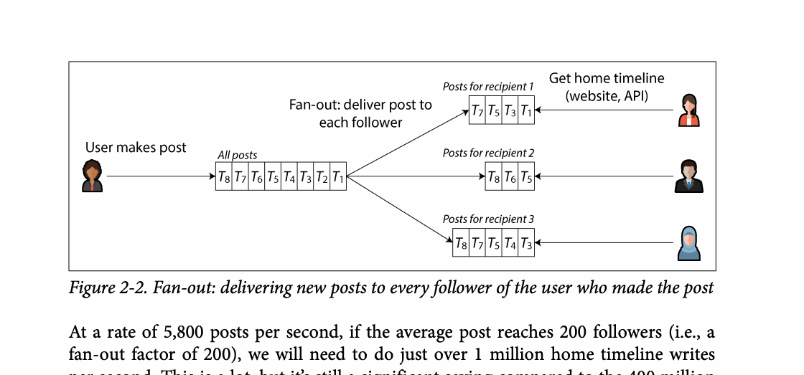
CHAPTER 02
Figure 2-2: mechanism explained
What it shows
A write is copied into many follower timelines.
Why it matters
Reads become cheap, but popular users create severe write amplification.
What to watch
Follow the arrows or timeline and test whether the conclusion still holds under failure, retry, and concurrency.
06 / 19
Notes:
Source: Martin Kleppmann and Chris Riccomini, Designing Data-Intensive Applications, 2nd ed., Chapter 2, book pages 33-56. Figure 2-2, PDF page 60. Original caption: Figure 2-2. Fan-out: delivering new posts to every follower of the user who made the post
Explanation: A write is copied into many follower timelines. Reads become cheap, but popular users create severe write amplification. Follow the arrows or timeline and test whether the conclusion still holds under failure, retry, and concurrency.
Source file: /Users/eve/projects/Designing-Data-Intensive-Applications/Designing Data Intensive Applications 2nd.pdf

Slide 7
CHAPTER 02
Latency and throughput
02
Response time includes service time, queueing, and network delay.
The median describes typical behavior while high percentiles expose tail latency.
Fan-out requests amplify the probability of encountering a slow dependency.
Core question
What problem does it solve, and what does it cost under failure, growth, and change?
07 / 19
Notes:
Source: Martin Kleppmann and Chris Riccomini, Designing Data-Intensive Applications, 2nd ed., Chapter 2, book pages 33-56.
Source file: /Users/eve/projects/Designing-Data-Intensive-Applications/Designing Data Intensive Applications 2nd.pdf

Slide 8
CHAPTER 02
Latency and throughput: design trade-offs
02
Fit: Response time includes service time, queueing, and network delay.
Cost: evaluate latency, throughput, consistency, and operational complexity.
Failure check: what state becomes visible when a node, network path, or dependency fails?
Evolution check: can formats, interfaces, and topology change through rolling upgrades?
08 / 19
Notes:
Source: Martin Kleppmann and Chris Riccomini, Designing Data-Intensive Applications, 2nd ed., Chapter 2, book pages 33-56.
Source file: /Users/eve/projects/Designing-Data-Intensive-Applications/Designing Data Intensive Applications 2nd.pdf

Slide 9
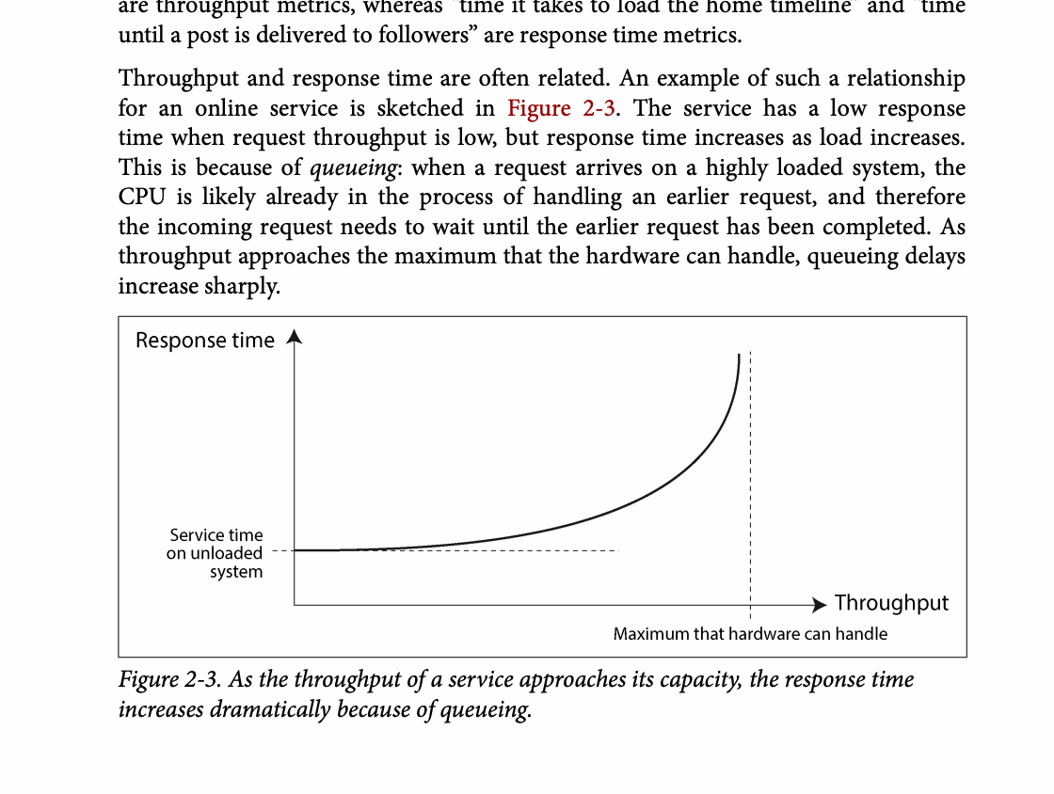
CHAPTER 02
Figure 2-3: mechanism explained
What it shows
The chart connects load, queueing, and the distribution of response times.
Why it matters
Tail latency grows before averages look alarming, especially with fan-out.
What to watch
Follow the arrows or timeline and test whether the conclusion still holds under failure, retry, and concurrency.
09 / 19
Notes:
Source: Martin Kleppmann and Chris Riccomini, Designing Data-Intensive Applications, 2nd ed., Chapter 2, book pages 33-56. Figure 2-3, PDF page 61. Original caption: Figure 2-3. As the throughput of a service approaches its capacity, the response time
Explanation: The chart connects load, queueing, and the distribution of response times. Tail latency grows before averages look alarming, especially with fan-out. Follow the arrows or timeline and test whether the conclusion still holds under failure, retry, and concurrency.
Source file: /Users/eve/projects/Designing-Data-Intensive-Applications/Designing Data Intensive Applications 2nd.pdf

Slide 10
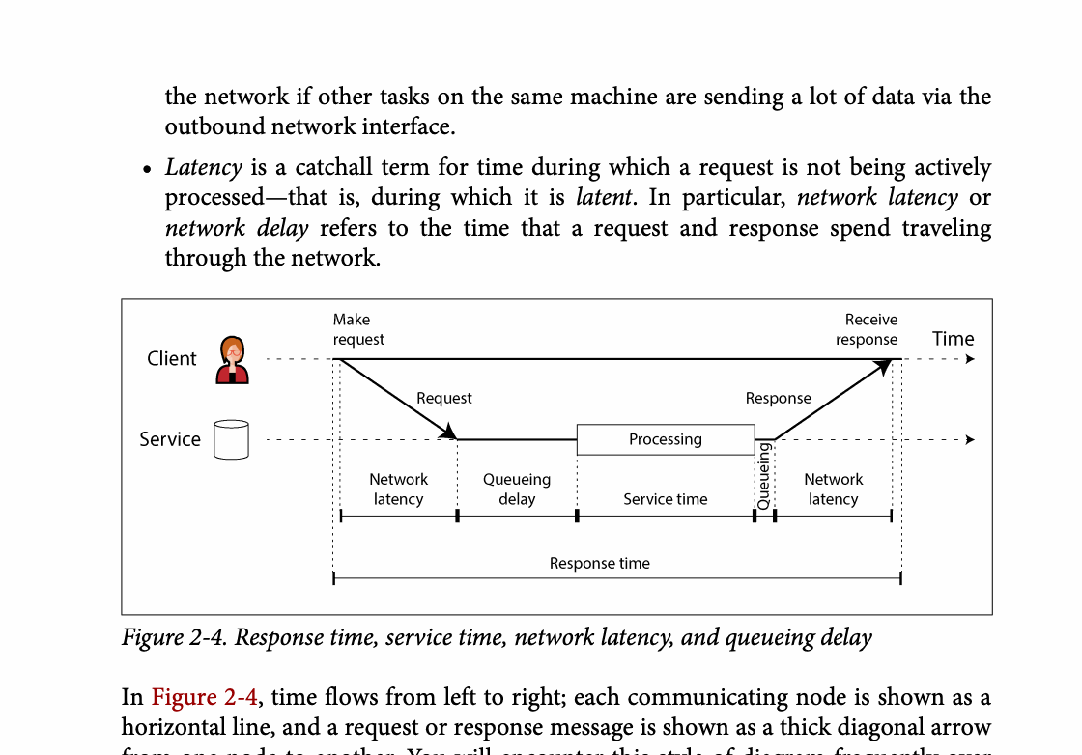
CHAPTER 02
Figure 2-4: mechanism explained
What it shows
The chart connects load, queueing, and the distribution of response times.
Why it matters
Tail latency grows before averages look alarming, especially with fan-out.
What to watch
Follow the arrows or timeline and test whether the conclusion still holds under failure, retry, and concurrency.
10 / 19
Notes:
Source: Martin Kleppmann and Chris Riccomini, Designing Data-Intensive Applications, 2nd ed., Chapter 2, book pages 33-56. Figure 2-4, PDF page 63. Original caption: Figure 2-4. Response time, service time, network latency, and queueing delay
Explanation: The chart connects load, queueing, and the distribution of response times. Tail latency grows before averages look alarming, especially with fan-out. Follow the arrows or timeline and test whether the conclusion still holds under failure, retry, and concurrency.
Source file: /Users/eve/projects/Designing-Data-Intensive-Applications/Designing Data Intensive Applications 2nd.pdf

Slide 11
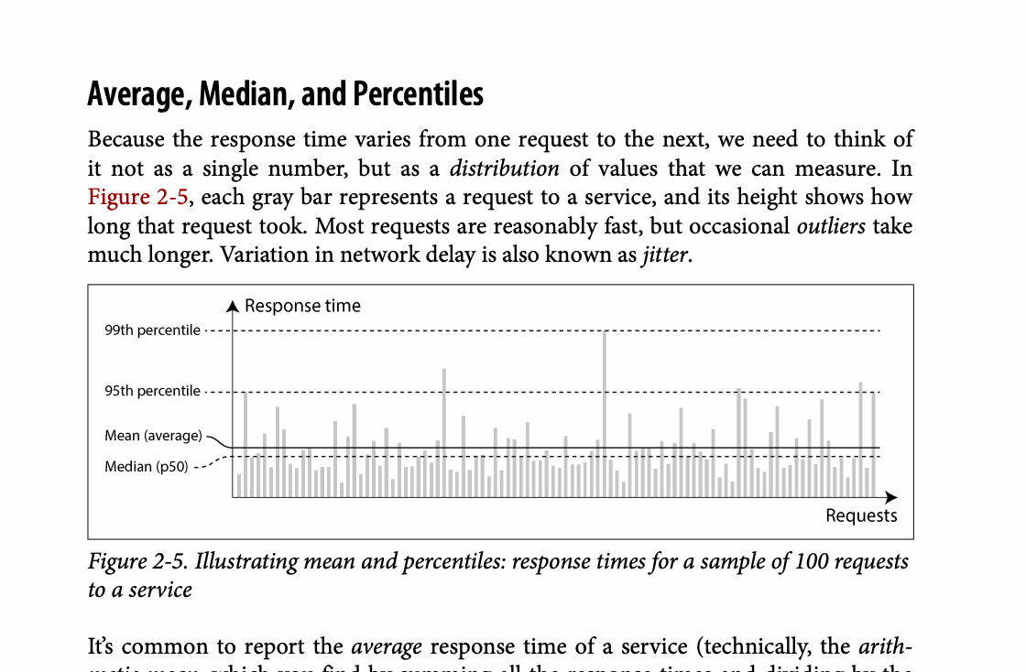
CHAPTER 02
Figure 2-5: mechanism explained
What it shows
The chart connects load, queueing, and the distribution of response times.
Why it matters
Tail latency grows before averages look alarming, especially with fan-out.
What to watch
Follow the arrows or timeline and test whether the conclusion still holds under failure, retry, and concurrency.
11 / 19
Notes:
Source: Martin Kleppmann and Chris Riccomini, Designing Data-Intensive Applications, 2nd ed., Chapter 2, book pages 33-56. Figure 2-5, PDF page 64. Original caption: Figure 2-5. Illustrating mean and percentiles: response times for a sample of 100 requests
Explanation: The chart connects load, queueing, and the distribution of response times. Tail latency grows before averages look alarming, especially with fan-out. Follow the arrows or timeline and test whether the conclusion still holds under failure, retry, and concurrency.
Source file: /Users/eve/projects/Designing-Data-Intensive-Applications/Designing Data Intensive Applications 2nd.pdf

Slide 12
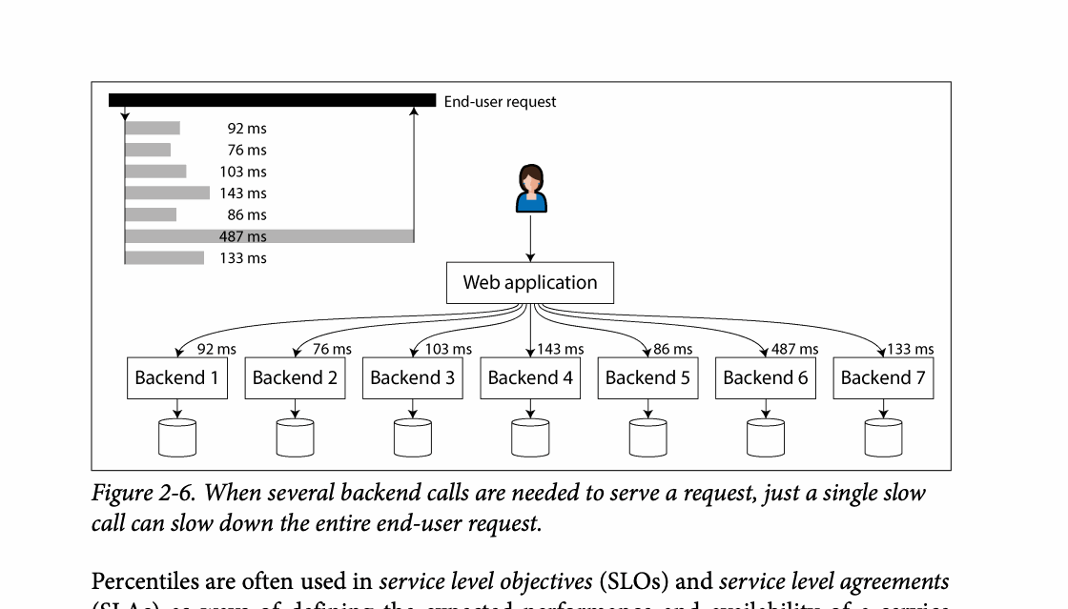
CHAPTER 02
Figure 2-6: mechanism explained
What it shows
The chart connects load, queueing, and the distribution of response times.
Why it matters
Tail latency grows before averages look alarming, especially with fan-out.
What to watch
Follow the arrows or timeline and test whether the conclusion still holds under failure, retry, and concurrency.
12 / 19
Notes:
Source: Martin Kleppmann and Chris Riccomini, Designing Data-Intensive Applications, 2nd ed., Chapter 2, book pages 33-56. Figure 2-6, PDF page 66. Original caption: Figure 2-6. When several backend calls are needed to serve a request, just a single slow
Explanation: The chart connects load, queueing, and the distribution of response times. Tail latency grows before averages look alarming, especially with fan-out. Follow the arrows or timeline and test whether the conclusion still holds under failure, retry, and concurrency.
Source file: /Users/eve/projects/Designing-Data-Intensive-Applications/Designing Data Intensive Applications 2nd.pdf

Slide 13
CHAPTER 02
Reliability and fault tolerance
03
Fault tolerance prevents component faults from becoming service failures.
Hardware, software, configuration, and human faults require different defenses.
Recovery exercises provide stronger evidence than assumptions about perfect components.
Core question
What problem does it solve, and what does it cost under failure, growth, and change?
13 / 19
Notes:
Source: Martin Kleppmann and Chris Riccomini, Designing Data-Intensive Applications, 2nd ed., Chapter 2, book pages 33-56.
Source file: /Users/eve/projects/Designing-Data-Intensive-Applications/Designing Data Intensive Applications 2nd.pdf

Slide 14
CHAPTER 02
Reliability and fault tolerance: design trade-offs
03
Fit: Fault tolerance prevents component faults from becoming service failures.
Cost: evaluate latency, throughput, consistency, and operational complexity.
Failure check: what state becomes visible when a node, network path, or dependency fails?
Evolution check: can formats, interfaces, and topology change through rolling upgrades?
14 / 19
Notes:
Source: Martin Kleppmann and Chris Riccomini, Designing Data-Intensive Applications, 2nd ed., Chapter 2, book pages 33-56.
Source file: /Users/eve/projects/Designing-Data-Intensive-Applications/Designing Data Intensive Applications 2nd.pdf

Slide 15
CHAPTER 02
Scalability
04
Describe load with request rate, read/write mix, data size, and skew.
Shared-memory, shared-disk, and shared-nothing designs scale differently.
A scaling claim should explain how resources grow as load grows.
Core question
What problem does it solve, and what does it cost under failure, growth, and change?
15 / 19
Notes:
Source: Martin Kleppmann and Chris Riccomini, Designing Data-Intensive Applications, 2nd ed., Chapter 2, book pages 33-56.
Source file: /Users/eve/projects/Designing-Data-Intensive-Applications/Designing Data Intensive Applications 2nd.pdf

Slide 16
CHAPTER 02
Scalability: design trade-offs
04
Fit: Describe load with request rate, read/write mix, data size, and skew.
Cost: evaluate latency, throughput, consistency, and operational complexity.
Failure check: what state becomes visible when a node, network path, or dependency fails?
Evolution check: can formats, interfaces, and topology change through rolling upgrades?
16 / 19
Notes:
Source: Martin Kleppmann and Chris Riccomini, Designing Data-Intensive Applications, 2nd ed., Chapter 2, book pages 33-56.
Source file: /Users/eve/projects/Designing-Data-Intensive-Applications/Designing Data Intensive Applications 2nd.pdf

Slide 17
CHAPTER 02
Maintainability
05
Operability makes state visible and incidents diagnosable.
Simplicity reduces accidental complexity and cognitive load.
Evolvability lets schemas, interfaces, and implementations change gradually.
Core question
What problem does it solve, and what does it cost under failure, growth, and change?
17 / 19
Notes:
Source: Martin Kleppmann and Chris Riccomini, Designing Data-Intensive Applications, 2nd ed., Chapter 2, book pages 33-56.
Source file: /Users/eve/projects/Designing-Data-Intensive-Applications/Designing Data Intensive Applications 2nd.pdf

Slide 18
CHAPTER 02
Maintainability: design trade-offs
05
Fit: Operability makes state visible and incidents diagnosable.
Cost: evaluate latency, throughput, consistency, and operational complexity.
Failure check: what state becomes visible when a node, network path, or dependency fails?
Evolution check: can formats, interfaces, and topology change through rolling upgrades?
18 / 19
Notes:
Source: Martin Kleppmann and Chris Riccomini, Designing Data-Intensive Applications, 2nd ed., Chapter 2, book pages 33-56.
Source file: /Users/eve/projects/Designing-Data-Intensive-Applications/Designing Data Intensive Applications 2nd.pdf

Slide 19
CHAPTER 02
Review and application
State the chapter’s central problem in one sentence.
Choose one mechanism and list the assumptions it relies on.
Describe a failure scenario and explain the recovery path.
Apply one trade-off from the chapter to a system you are designing.
19 / 19
Notes:
Source: Martin Kleppmann and Chris Riccomini, Designing Data-Intensive Applications, 2nd ed., Chapter 2, book pages 33-56.
Source file: /Users/eve/projects/Designing-Data-Intensive-Applications/Designing Data Intensive Applications 2nd.pdf

