Slide 1
CHAPTER 03
Data Models and Query Languages
Designing Data-Intensive Applications, Second Edition
Detailed English Study Edition
01 / 22
Notes:
Source: Martin Kleppmann and Chris Riccomini, Designing Data-Intensive Applications, 2nd ed., Chapter 3, book pages 65-107.
Source file: /Users/eve/projects/Designing-Data-Intensive-Applications/Designing Data Intensive Applications 2nd.pdf

Slide 2
CHAPTER 03
Chapter map
01
Data models shape applications
Relational models organize facts as tables and relationships.
02
Normalization and denormalization
Normalization reduces duplication and update anomalies.
03
Relational and graph queries
SQL expresses declarative set operations.
04
Event sourcing and CQRS
Event sourcing preserves an immutable history of state changes.
05
Model selection
Use relational data for stable structure and strong constraints.
02 / 22
Notes:
Source: Martin Kleppmann and Chris Riccomini, Designing Data-Intensive Applications, 2nd ed., Chapter 3, book pages 65-107.
Source file: /Users/eve/projects/Designing-Data-Intensive-Applications/Designing Data Intensive Applications 2nd.pdf

Slide 3
CHAPTER 03
Data models shape applications
01
Relational models organize facts as tables and relationships.
Document models preserve aggregate locality for whole-object access.
Graph models make connections and multi-hop traversal primary.
Core question
What problem does it solve, and what does it cost under failure, growth, and change?
03 / 22
Notes:
Source: Martin Kleppmann and Chris Riccomini, Designing Data-Intensive Applications, 2nd ed., Chapter 3, book pages 65-107.
Source file: /Users/eve/projects/Designing-Data-Intensive-Applications/Designing Data Intensive Applications 2nd.pdf

Slide 4
CHAPTER 03
Data models shape applications: design trade-offs
01
Fit: Relational models organize facts as tables and relationships.
Cost: evaluate latency, throughput, consistency, and operational complexity.
Failure check: what state becomes visible when a node, network path, or dependency fails?
Evolution check: can formats, interfaces, and topology change through rolling upgrades?
04 / 22
Notes:
Source: Martin Kleppmann and Chris Riccomini, Designing Data-Intensive Applications, 2nd ed., Chapter 3, book pages 65-107.
Source file: /Users/eve/projects/Designing-Data-Intensive-Applications/Designing Data Intensive Applications 2nd.pdf

Slide 5
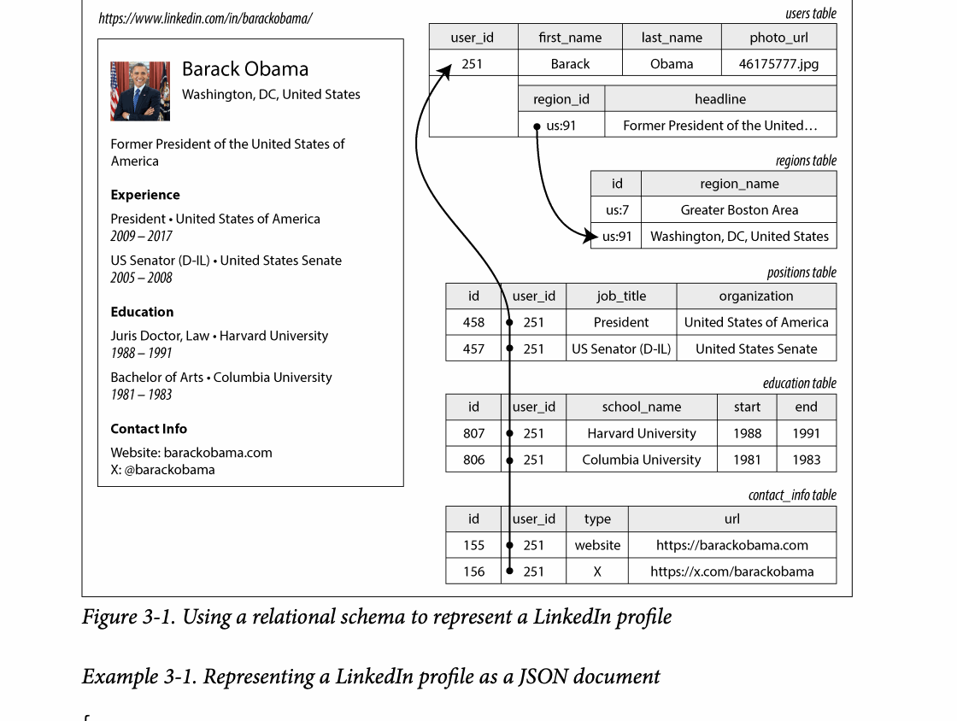
CHAPTER 03
Figure 3-1: mechanism explained
What it shows
The diagram shows how entities and relationships are represented by keys, nesting, or joins.
Why it matters
The model changes read locality, duplication, and update complexity.
What to watch
Follow the arrows or timeline and test whether the conclusion still holds under failure, retry, and concurrency.
05 / 22
Notes:
Source: Martin Kleppmann and Chris Riccomini, Designing Data-Intensive Applications, 2nd ed., Chapter 3, book pages 65-107. Figure 3-1, PDF page 94. Original caption: Figure 3-1. Using a relational schema to represent a LinkedIn profile
Explanation: The diagram shows how entities and relationships are represented by keys, nesting, or joins. The model changes read locality, duplication, and update complexity. Follow the arrows or timeline and test whether the conclusion still holds under failure, retry, and concurrency.
Source file: /Users/eve/projects/Designing-Data-Intensive-Applications/Designing Data Intensive Applications 2nd.pdf

Slide 6
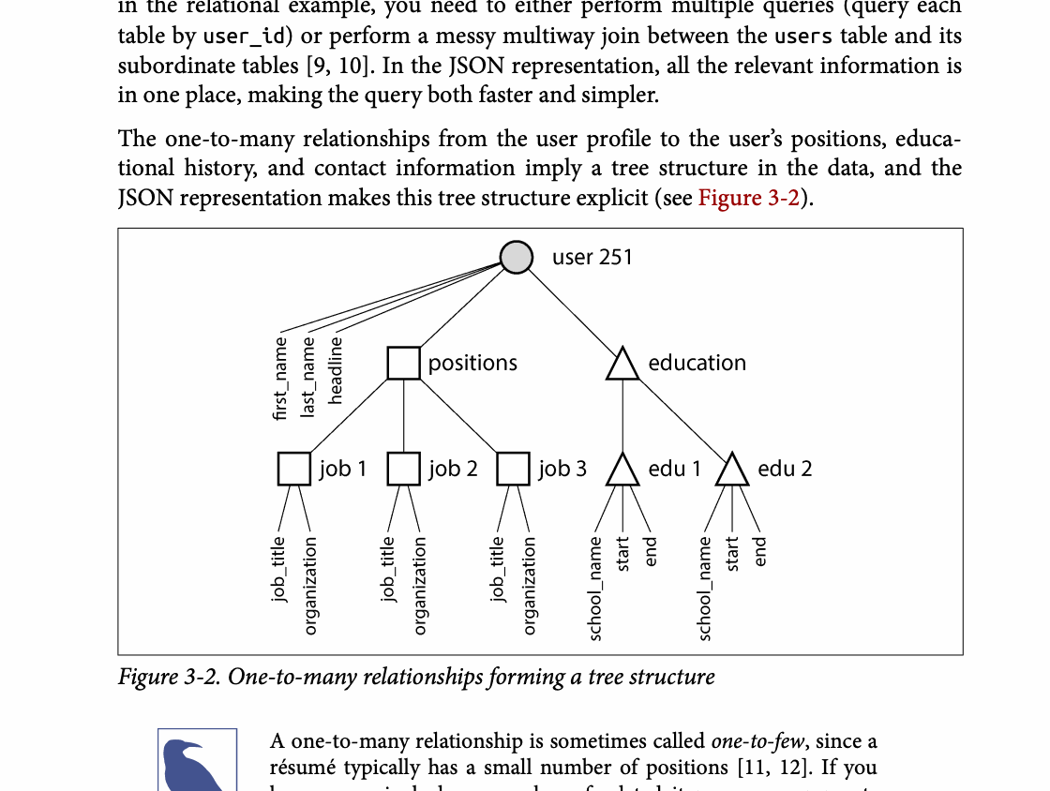
CHAPTER 03
Figure 3-2: mechanism explained
What it shows
The diagram shows how entities and relationships are represented by keys, nesting, or joins.
Why it matters
The model changes read locality, duplication, and update complexity.
What to watch
Follow the arrows or timeline and test whether the conclusion still holds under failure, retry, and concurrency.
06 / 22
Notes:
Source: Martin Kleppmann and Chris Riccomini, Designing Data-Intensive Applications, 2nd ed., Chapter 3, book pages 65-107. Figure 3-2, PDF page 95. Original caption: Figure 3-2. One-to-many relationships forming a tree structure
Explanation: The diagram shows how entities and relationships are represented by keys, nesting, or joins. The model changes read locality, duplication, and update complexity. Follow the arrows or timeline and test whether the conclusion still holds under failure, retry, and concurrency.
Source file: /Users/eve/projects/Designing-Data-Intensive-Applications/Designing Data Intensive Applications 2nd.pdf

Slide 7
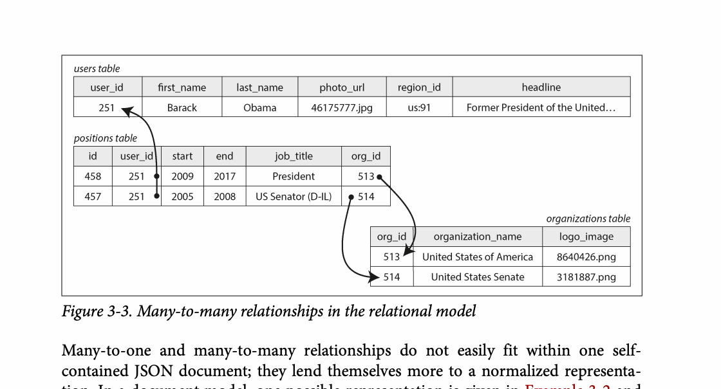
CHAPTER 03
Figure 3-3: mechanism explained
What it shows
The diagram shows how entities and relationships are represented by keys, nesting, or joins.
Why it matters
The model changes read locality, duplication, and update complexity.
What to watch
Follow the arrows or timeline and test whether the conclusion still holds under failure, retry, and concurrency.
07 / 22
Notes:
Source: Martin Kleppmann and Chris Riccomini, Designing Data-Intensive Applications, 2nd ed., Chapter 3, book pages 65-107. Figure 3-3, PDF page 100. Original caption: Figure 3-3. Many-to-many relationships in the relational model
Explanation: The diagram shows how entities and relationships are represented by keys, nesting, or joins. The model changes read locality, duplication, and update complexity. Follow the arrows or timeline and test whether the conclusion still holds under failure, retry, and concurrency.
Source file: /Users/eve/projects/Designing-Data-Intensive-Applications/Designing Data Intensive Applications 2nd.pdf

Slide 8
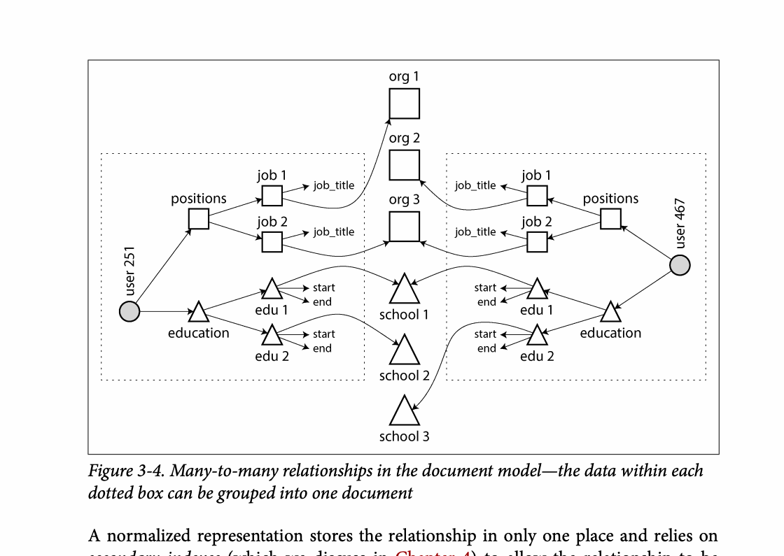
CHAPTER 03
Figure 3-4: mechanism explained
What it shows
The diagram shows how entities and relationships are represented by keys, nesting, or joins.
Why it matters
The model changes read locality, duplication, and update complexity.
What to watch
Follow the arrows or timeline and test whether the conclusion still holds under failure, retry, and concurrency.
08 / 22
Notes:
Source: Martin Kleppmann and Chris Riccomini, Designing Data-Intensive Applications, 2nd ed., Chapter 3, book pages 65-107. Figure 3-4, PDF page 101. Original caption: Figure 3-4. Many-to-many relationships in the document model—the data within each
Explanation: The diagram shows how entities and relationships are represented by keys, nesting, or joins. The model changes read locality, duplication, and update complexity. Follow the arrows or timeline and test whether the conclusion still holds under failure, retry, and concurrency.
Source file: /Users/eve/projects/Designing-Data-Intensive-Applications/Designing Data Intensive Applications 2nd.pdf

Slide 9
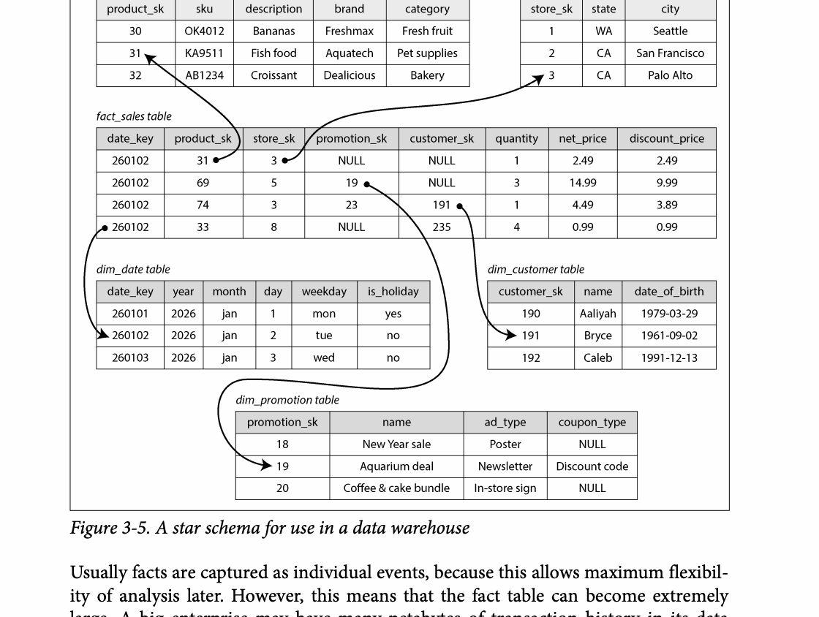
CHAPTER 03
Figure 3-5: mechanism explained
What it shows
Data moves from operational sources through transformation into an analytical store.
Why it matters
The warehouse is derived data, so repeatable loads and lineage are essential.
What to watch
Follow the arrows or timeline and test whether the conclusion still holds under failure, retry, and concurrency.
09 / 22
Notes:
Source: Martin Kleppmann and Chris Riccomini, Designing Data-Intensive Applications, 2nd ed., Chapter 3, book pages 65-107. Figure 3-5, PDF page 102. Original caption: Figure 3-5. A star schema for use in a data warehouse
Explanation: Data moves from operational sources through transformation into an analytical store. The warehouse is derived data, so repeatable loads and lineage are essential. Follow the arrows or timeline and test whether the conclusion still holds under failure, retry, and concurrency.
Source file: /Users/eve/projects/Designing-Data-Intensive-Applications/Designing Data Intensive Applications 2nd.pdf

Slide 10
CHAPTER 03
Normalization and denormalization
02
Normalization reduces duplication and update anomalies.
Denormalization improves read locality but adds synchronization work.
Choose using access patterns, update rates, and constraint strength.
Core question
What problem does it solve, and what does it cost under failure, growth, and change?
10 / 22
Notes:
Source: Martin Kleppmann and Chris Riccomini, Designing Data-Intensive Applications, 2nd ed., Chapter 3, book pages 65-107.
Source file: /Users/eve/projects/Designing-Data-Intensive-Applications/Designing Data Intensive Applications 2nd.pdf

Slide 11
CHAPTER 03
Normalization and denormalization: design trade-offs
02
Fit: Normalization reduces duplication and update anomalies.
Cost: evaluate latency, throughput, consistency, and operational complexity.
Failure check: what state becomes visible when a node, network path, or dependency fails?
Evolution check: can formats, interfaces, and topology change through rolling upgrades?
11 / 22
Notes:
Source: Martin Kleppmann and Chris Riccomini, Designing Data-Intensive Applications, 2nd ed., Chapter 3, book pages 65-107.
Source file: /Users/eve/projects/Designing-Data-Intensive-Applications/Designing Data Intensive Applications 2nd.pdf

Slide 12
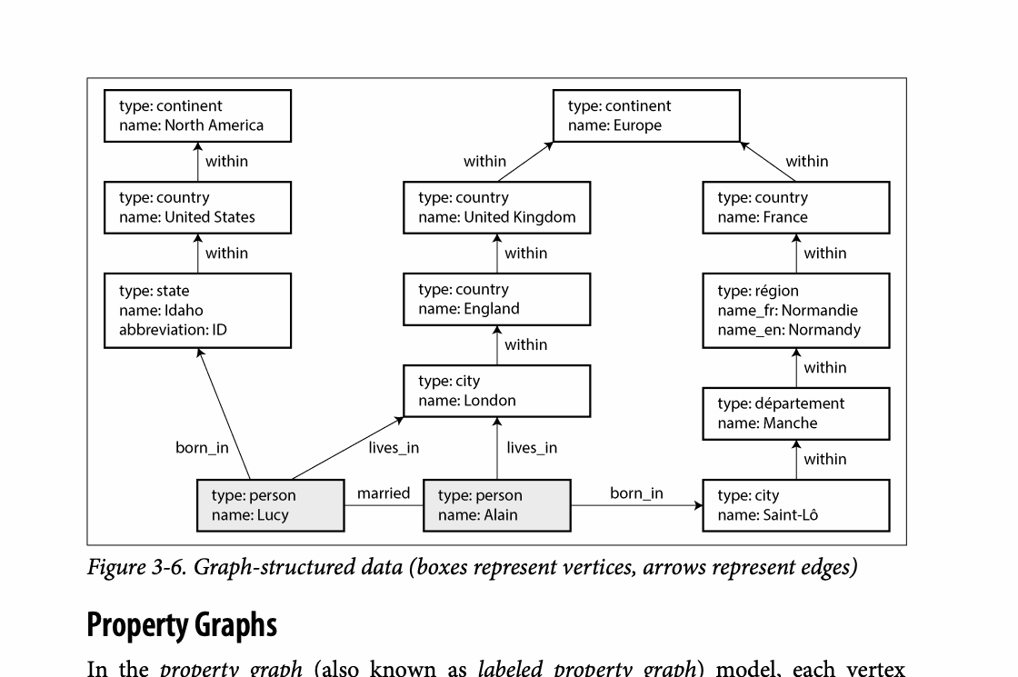
CHAPTER 03
Figure 3-6: mechanism explained
What it shows
Nodes, edges, or recursive rules express multi-hop relationships.
Why it matters
The representation makes traversal and transitive queries explicit.
What to watch
Follow the arrows or timeline and test whether the conclusion still holds under failure, retry, and concurrency.
12 / 22
Notes:
Source: Martin Kleppmann and Chris Riccomini, Designing Data-Intensive Applications, 2nd ed., Chapter 3, book pages 65-107. Figure 3-6, PDF page 110. Original caption: Figure 3-6. Graph-structured data (boxes represent vertices, arrows represent edges)
Explanation: Nodes, edges, or recursive rules express multi-hop relationships. The representation makes traversal and transitive queries explicit. Follow the arrows or timeline and test whether the conclusion still holds under failure, retry, and concurrency.
Source file: /Users/eve/projects/Designing-Data-Intensive-Applications/Designing Data Intensive Applications 2nd.pdf

Slide 13
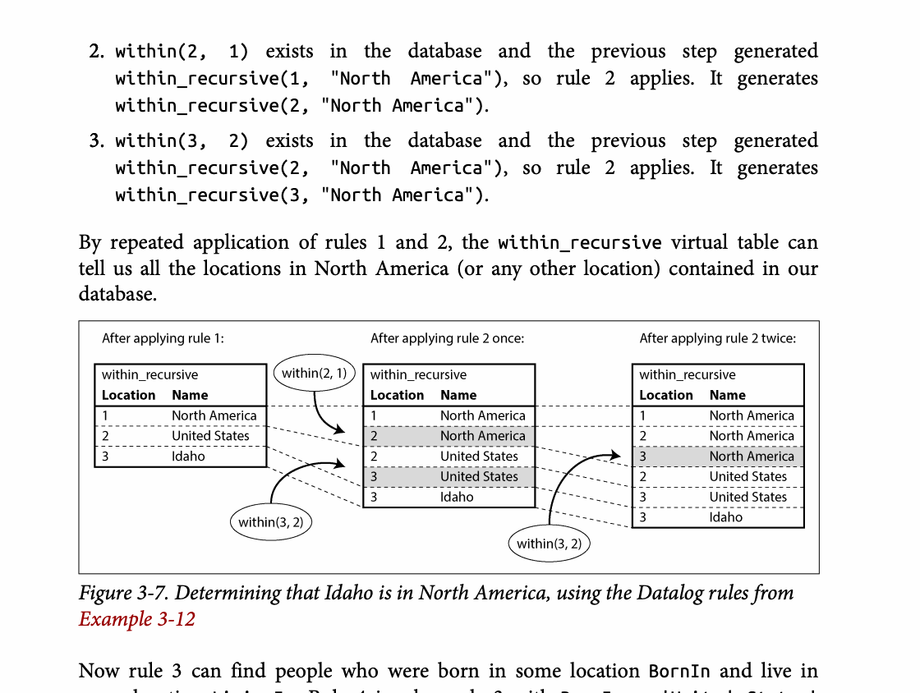
CHAPTER 03
Figure 3-7: mechanism explained
What it shows
Nodes, edges, or recursive rules express multi-hop relationships.
Why it matters
The representation makes traversal and transitive queries explicit.
What to watch
Follow the arrows or timeline and test whether the conclusion still holds under failure, retry, and concurrency.
13 / 22
Notes:
Source: Martin Kleppmann and Chris Riccomini, Designing Data-Intensive Applications, 2nd ed., Chapter 3, book pages 65-107. Figure 3-7, PDF page 122. Original caption: Figure 3-7. Determining that Idaho is in North America, using the Datalog rules from
Explanation: Nodes, edges, or recursive rules express multi-hop relationships. The representation makes traversal and transitive queries explicit. Follow the arrows or timeline and test whether the conclusion still holds under failure, retry, and concurrency.
Source file: /Users/eve/projects/Designing-Data-Intensive-Applications/Designing Data Intensive Applications 2nd.pdf

Slide 14
CHAPTER 03
Relational and graph queries
03
SQL expresses declarative set operations.
Cypher and SPARQL describe graph patterns directly.
Recursive SQL and Datalog handle transitive relationships and rules.
Core question
What problem does it solve, and what does it cost under failure, growth, and change?
14 / 22
Notes:
Source: Martin Kleppmann and Chris Riccomini, Designing Data-Intensive Applications, 2nd ed., Chapter 3, book pages 65-107.
Source file: /Users/eve/projects/Designing-Data-Intensive-Applications/Designing Data Intensive Applications 2nd.pdf

Slide 15
CHAPTER 03
Relational and graph queries: design trade-offs
03
Fit: SQL expresses declarative set operations.
Cost: evaluate latency, throughput, consistency, and operational complexity.
Failure check: what state becomes visible when a node, network path, or dependency fails?
Evolution check: can formats, interfaces, and topology change through rolling upgrades?
15 / 22
Notes:
Source: Martin Kleppmann and Chris Riccomini, Designing Data-Intensive Applications, 2nd ed., Chapter 3, book pages 65-107.
Source file: /Users/eve/projects/Designing-Data-Intensive-Applications/Designing Data Intensive Applications 2nd.pdf

Slide 16
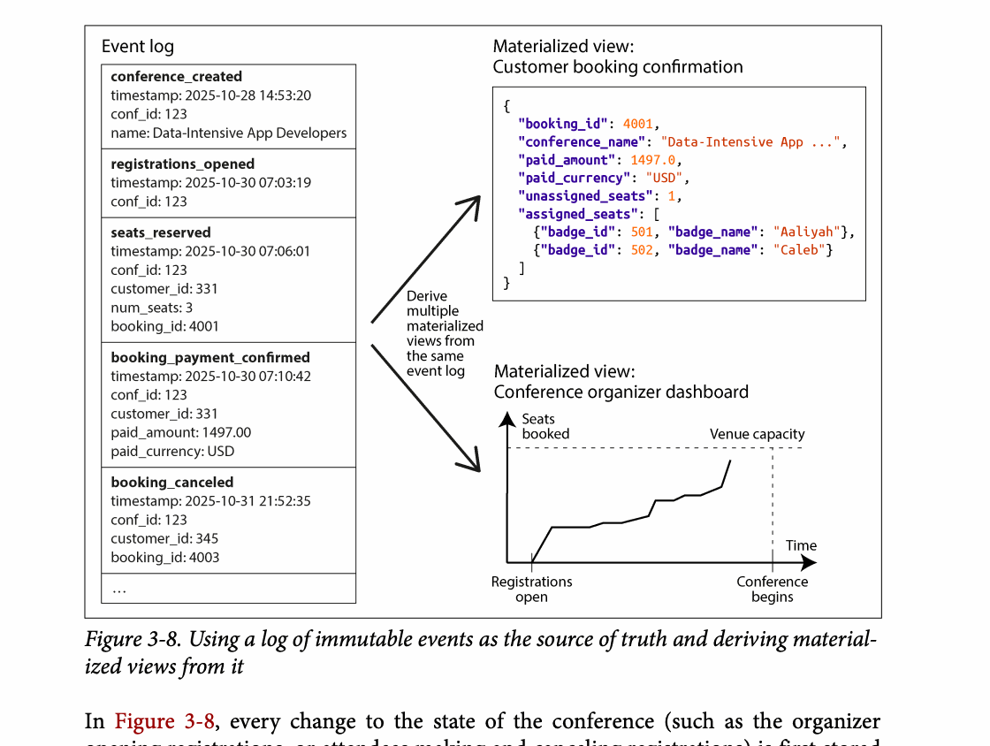
CHAPTER 03
Figure 3-8: mechanism explained
What it shows
The source representation is transformed into a derived view suited to a different workload.
Why it matters
Rebuildability improves, while synchronization and schema evolution need care.
What to watch
Follow the arrows or timeline and test whether the conclusion still holds under failure, retry, and concurrency.
16 / 22
Notes:
Source: Martin Kleppmann and Chris Riccomini, Designing Data-Intensive Applications, 2nd ed., Chapter 3, book pages 65-107. Figure 3-8, PDF page 126. Original caption: Figure 3-8. Using a log of immutable events as the source of truth and deriving material‐
Explanation: The source representation is transformed into a derived view suited to a different workload. Rebuildability improves, while synchronization and schema evolution need care. Follow the arrows or timeline and test whether the conclusion still holds under failure, retry, and concurrency.
Source file: /Users/eve/projects/Designing-Data-Intensive-Applications/Designing Data Intensive Applications 2nd.pdf

Slide 17
CHAPTER 03
Event sourcing and CQRS
04
Event sourcing preserves an immutable history of state changes.
CQRS separates write models from read-optimized projections.
Auditability and rebuilds come with eventual consistency and operational cost.
Core question
What problem does it solve, and what does it cost under failure, growth, and change?
17 / 22
Notes:
Source: Martin Kleppmann and Chris Riccomini, Designing Data-Intensive Applications, 2nd ed., Chapter 3, book pages 65-107.
Source file: /Users/eve/projects/Designing-Data-Intensive-Applications/Designing Data Intensive Applications 2nd.pdf

Slide 18
CHAPTER 03
Event sourcing and CQRS: design trade-offs
04
Fit: Event sourcing preserves an immutable history of state changes.
Cost: evaluate latency, throughput, consistency, and operational complexity.
Failure check: what state becomes visible when a node, network path, or dependency fails?
Evolution check: can formats, interfaces, and topology change through rolling upgrades?
18 / 22
Notes:
Source: Martin Kleppmann and Chris Riccomini, Designing Data-Intensive Applications, 2nd ed., Chapter 3, book pages 65-107.
Source file: /Users/eve/projects/Designing-Data-Intensive-Applications/Designing Data Intensive Applications 2nd.pdf

Slide 19
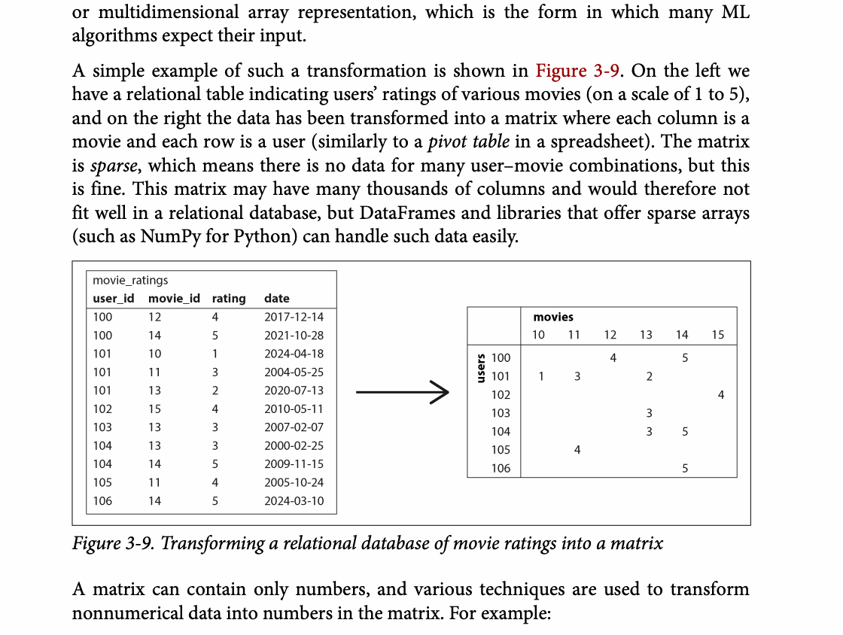
CHAPTER 03
Figure 3-9: mechanism explained
What it shows
The diagram shows how entities and relationships are represented by keys, nesting, or joins.
Why it matters
The model changes read locality, duplication, and update complexity.
What to watch
Follow the arrows or timeline and test whether the conclusion still holds under failure, retry, and concurrency.
19 / 22
Notes:
Source: Martin Kleppmann and Chris Riccomini, Designing Data-Intensive Applications, 2nd ed., Chapter 3, book pages 65-107. Figure 3-9, PDF page 130. Original caption: Figure 3-9. Transforming a relational database of movie ratings into a matrix
Explanation: The diagram shows how entities and relationships are represented by keys, nesting, or joins. The model changes read locality, duplication, and update complexity. Follow the arrows or timeline and test whether the conclusion still holds under failure, retry, and concurrency.
Source file: /Users/eve/projects/Designing-Data-Intensive-Applications/Designing Data Intensive Applications 2nd.pdf

Slide 20
CHAPTER 03
Model selection
05
Use relational data for stable structure and strong constraints.
Use documents when aggregate boundaries and whole-object access dominate.
Use graphs when relationships and traversals are the core workload.
Core question
What problem does it solve, and what does it cost under failure, growth, and change?
20 / 22
Notes:
Source: Martin Kleppmann and Chris Riccomini, Designing Data-Intensive Applications, 2nd ed., Chapter 3, book pages 65-107.
Source file: /Users/eve/projects/Designing-Data-Intensive-Applications/Designing Data Intensive Applications 2nd.pdf

Slide 21
CHAPTER 03
Model selection: design trade-offs
05
Fit: Use relational data for stable structure and strong constraints.
Cost: evaluate latency, throughput, consistency, and operational complexity.
Failure check: what state becomes visible when a node, network path, or dependency fails?
Evolution check: can formats, interfaces, and topology change through rolling upgrades?
21 / 22
Notes:
Source: Martin Kleppmann and Chris Riccomini, Designing Data-Intensive Applications, 2nd ed., Chapter 3, book pages 65-107.
Source file: /Users/eve/projects/Designing-Data-Intensive-Applications/Designing Data Intensive Applications 2nd.pdf

Slide 22
CHAPTER 03
Review and application
State the chapter’s central problem in one sentence.
Choose one mechanism and list the assumptions it relies on.
Describe a failure scenario and explain the recovery path.
Apply one trade-off from the chapter to a system you are designing.
22 / 22
Notes:
Source: Martin Kleppmann and Chris Riccomini, Designing Data-Intensive Applications, 2nd ed., Chapter 3, book pages 65-107.
Source file: /Users/eve/projects/Designing-Data-Intensive-Applications/Designing Data Intensive Applications 2nd.pdf

