Slide 1
CHAPTER 04
Storage and Retrieval
Designing Data-Intensive Applications, Second Edition
Detailed English Study Edition
01 / 24
Notes:
Source: Martin Kleppmann and Chris Riccomini, Designing Data-Intensive Applications, 2nd ed., Chapter 4, book pages 115-150.
Source file: /Users/eve/projects/Designing-Data-Intensive-Applications/Designing Data Intensive Applications 2nd.pdf

Slide 2
CHAPTER 04
Chapter map
01
OLTP storage engines
Log-structured storage converts random writes into sequential appends.
02
LSM trees
Writes enter an in-memory table and later flush to sorted files.
03
B-trees and indexes
Page splits and write-ahead logging preserve recoverability.
04
Analytical storage
Columnar files read only requested columns and compress similar values.
05
Specialized indexes
Full-text indexes support term retrieval and ranking.
02 / 24
Notes:
Source: Martin Kleppmann and Chris Riccomini, Designing Data-Intensive Applications, 2nd ed., Chapter 4, book pages 115-150.
Source file: /Users/eve/projects/Designing-Data-Intensive-Applications/Designing Data Intensive Applications 2nd.pdf

Slide 3
CHAPTER 04
OLTP storage engines
01
Log-structured storage converts random writes into sequential appends.
B-trees maintain ordered pages and predictable point or range lookups.
Both trade read, write, and space amplification.
Core question
What problem does it solve, and what does it cost under failure, growth, and change?
03 / 24
Notes:
Source: Martin Kleppmann and Chris Riccomini, Designing Data-Intensive Applications, 2nd ed., Chapter 4, book pages 115-150.
Source file: /Users/eve/projects/Designing-Data-Intensive-Applications/Designing Data Intensive Applications 2nd.pdf

Slide 4
CHAPTER 04
OLTP storage engines: design trade-offs
01
Fit: Log-structured storage converts random writes into sequential appends.
Cost: evaluate latency, throughput, consistency, and operational complexity.
Failure check: what state becomes visible when a node, network path, or dependency fails?
Evolution check: can formats, interfaces, and topology change through rolling upgrades?
04 / 24
Notes:
Source: Martin Kleppmann and Chris Riccomini, Designing Data-Intensive Applications, 2nd ed., Chapter 4, book pages 115-150.
Source file: /Users/eve/projects/Designing-Data-Intensive-Applications/Designing Data Intensive Applications 2nd.pdf

Slide 5
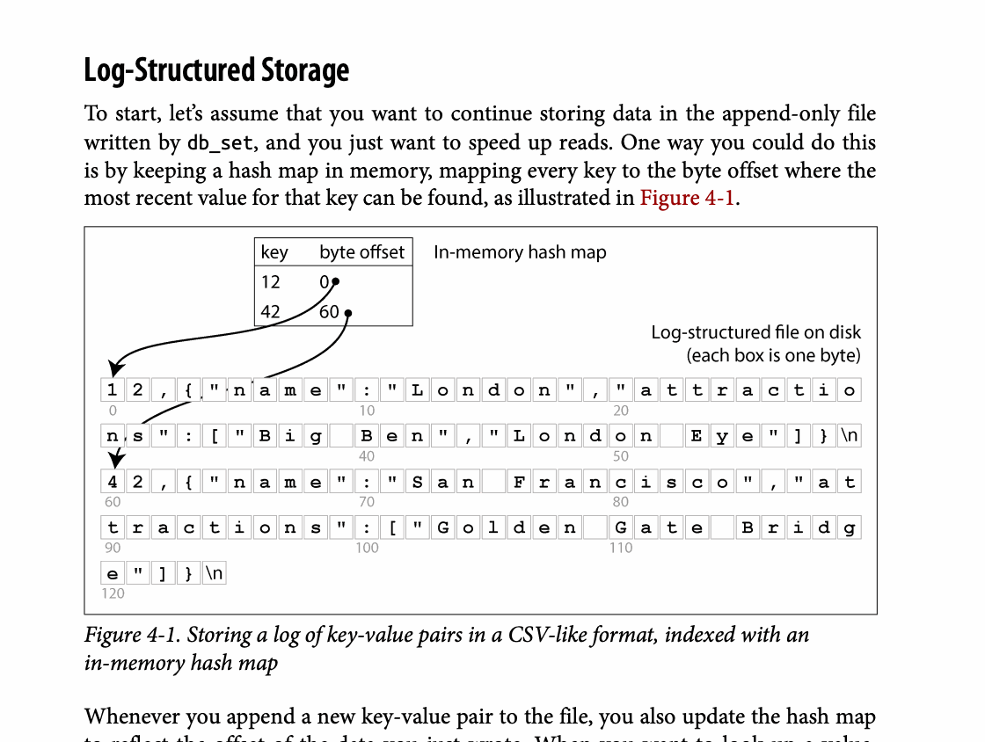
CHAPTER 04
Figure 4-1: mechanism explained
What it shows
Storing a log of key-value pairs in a CSV-like format, indexed with an
Why it matters
It turns the chapter concept into a concrete dataflow, timeline, or state transition.
What to watch
Check the actors, data direction, operation order, and hidden system assumptions.
05 / 24
Notes:
Source: Martin Kleppmann and Chris Riccomini, Designing Data-Intensive Applications, 2nd ed., Chapter 4, book pages 115-150. Figure 4-1, PDF page 142. Original caption: Figure 4-1. Storing a log of key-value pairs in a CSV-like format, indexed with an
Explanation: Storing a log of key-value pairs in a CSV-like format, indexed with an It turns the chapter concept into a concrete dataflow, timeline, or state transition. Check the actors, data direction, operation order, and hidden system assumptions.
Source file: /Users/eve/projects/Designing-Data-Intensive-Applications/Designing Data Intensive Applications 2nd.pdf

Slide 6
CHAPTER 04
LSM trees
02
Writes enter an in-memory table and later flush to sorted files.
Background compaction merges levels and removes obsolete versions.
Bloom filters and compaction policy reduce unnecessary reads.
Core question
What problem does it solve, and what does it cost under failure, growth, and change?
06 / 24
Notes:
Source: Martin Kleppmann and Chris Riccomini, Designing Data-Intensive Applications, 2nd ed., Chapter 4, book pages 115-150.
Source file: /Users/eve/projects/Designing-Data-Intensive-Applications/Designing Data Intensive Applications 2nd.pdf

Slide 7
CHAPTER 04
LSM trees: design trade-offs
02
Fit: Writes enter an in-memory table and later flush to sorted files.
Cost: evaluate latency, throughput, consistency, and operational complexity.
Failure check: what state becomes visible when a node, network path, or dependency fails?
Evolution check: can formats, interfaces, and topology change through rolling upgrades?
07 / 24
Notes:
Source: Martin Kleppmann and Chris Riccomini, Designing Data-Intensive Applications, 2nd ed., Chapter 4, book pages 115-150.
Source file: /Users/eve/projects/Designing-Data-Intensive-Applications/Designing Data Intensive Applications 2nd.pdf

Slide 8
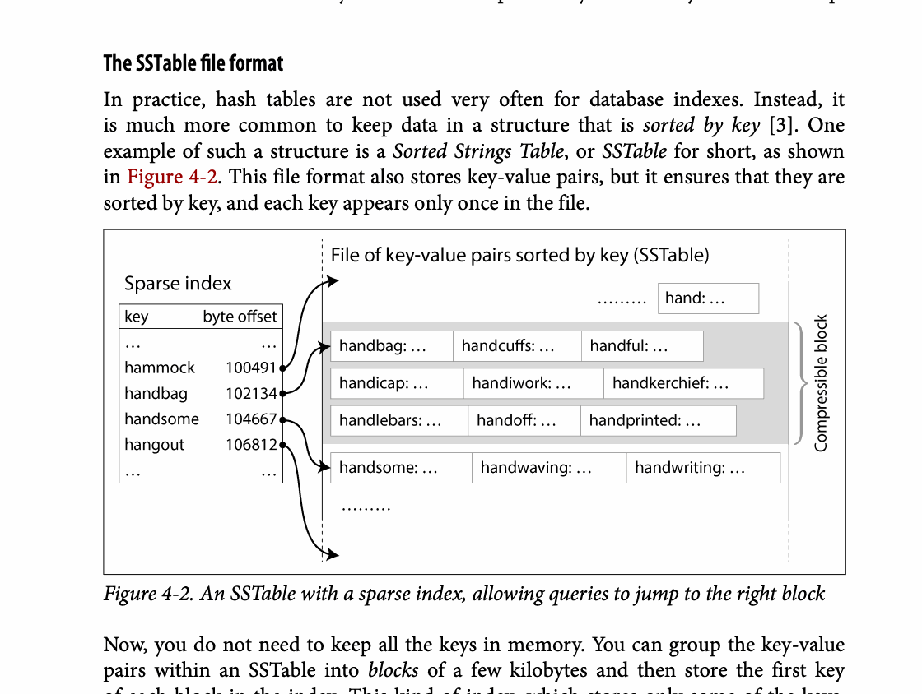
CHAPTER 04
Figure 4-2: mechanism explained
What it shows
The figure exposes the physical data structure used to accelerate reads or writes.
Why it matters
Performance comes from data layout and precomputation, with added write, space, or maintenance cost.
What to watch
Follow the arrows or timeline and test whether the conclusion still holds under failure, retry, and concurrency.
08 / 24
Notes:
Source: Martin Kleppmann and Chris Riccomini, Designing Data-Intensive Applications, 2nd ed., Chapter 4, book pages 115-150. Figure 4-2, PDF page 143. Original caption: Figure 4-2. An SSTable with a sparse index, allowing queries to jump to the right block
Explanation: The figure exposes the physical data structure used to accelerate reads or writes. Performance comes from data layout and precomputation, with added write, space, or maintenance cost. Follow the arrows or timeline and test whether the conclusion still holds under failure, retry, and concurrency.
Source file: /Users/eve/projects/Designing-Data-Intensive-Applications/Designing Data Intensive Applications 2nd.pdf

Slide 9
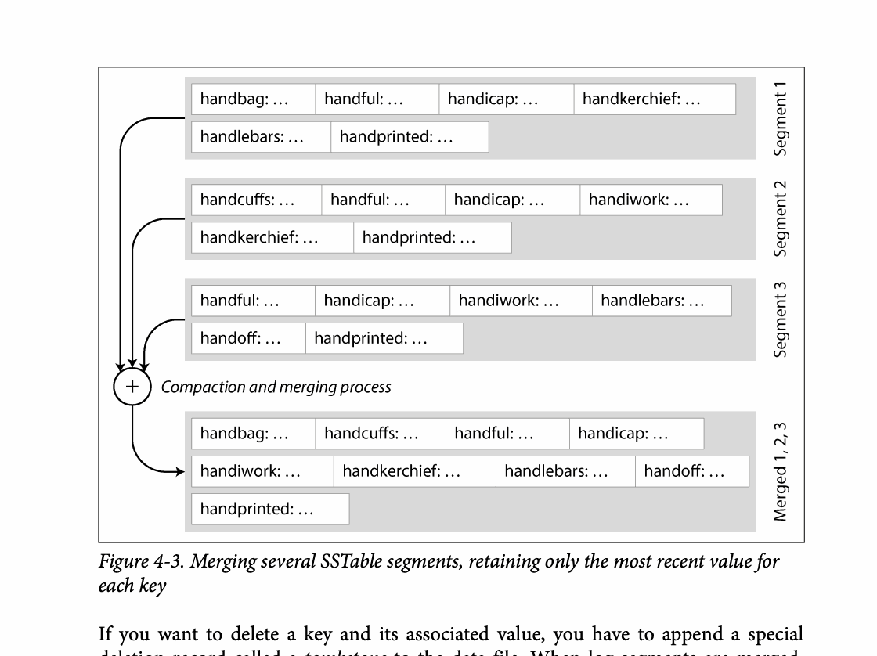
CHAPTER 04
Figure 4-3: mechanism explained
What it shows
The figure exposes the physical data structure used to accelerate reads or writes.
Why it matters
Performance comes from data layout and precomputation, with added write, space, or maintenance cost.
What to watch
Follow the arrows or timeline and test whether the conclusion still holds under failure, retry, and concurrency.
09 / 24
Notes:
Source: Martin Kleppmann and Chris Riccomini, Designing Data-Intensive Applications, 2nd ed., Chapter 4, book pages 115-150. Figure 4-3, PDF page 145. Original caption: Figure 4-3. Merging several SSTable segments, retaining only the most recent value for
Explanation: The figure exposes the physical data structure used to accelerate reads or writes. Performance comes from data layout and precomputation, with added write, space, or maintenance cost. Follow the arrows or timeline and test whether the conclusion still holds under failure, retry, and concurrency.
Source file: /Users/eve/projects/Designing-Data-Intensive-Applications/Designing Data Intensive Applications 2nd.pdf

Slide 10
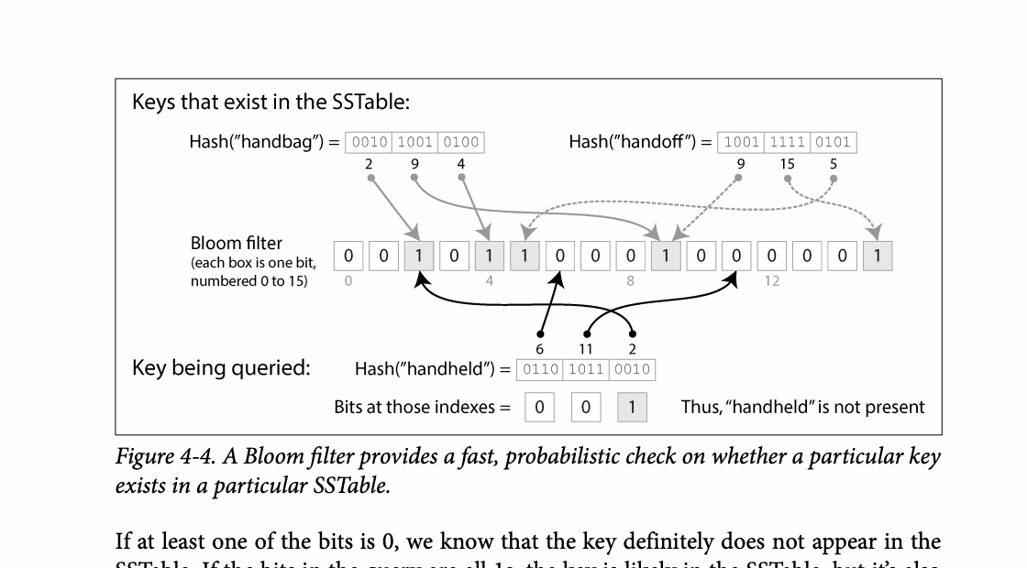
CHAPTER 04
Figure 4-4: mechanism explained
What it shows
The figure exposes the physical data structure used to accelerate reads or writes.
Why it matters
Performance comes from data layout and precomputation, with added write, space, or maintenance cost.
What to watch
Follow the arrows or timeline and test whether the conclusion still holds under failure, retry, and concurrency.
10 / 24
Notes:
Source: Martin Kleppmann and Chris Riccomini, Designing Data-Intensive Applications, 2nd ed., Chapter 4, book pages 115-150. Figure 4-4, PDF page 147. Original caption: Figure 4-4. A Bloom filter provides a fast, probabilistic check on whether a particular key
Explanation: The figure exposes the physical data structure used to accelerate reads or writes. Performance comes from data layout and precomputation, with added write, space, or maintenance cost. Follow the arrows or timeline and test whether the conclusion still holds under failure, retry, and concurrency.
Source file: /Users/eve/projects/Designing-Data-Intensive-Applications/Designing Data Intensive Applications 2nd.pdf

Slide 11
CHAPTER 04
B-trees and indexes
03
Page splits and write-ahead logging preserve recoverability.
Column order determines which queries a composite index can serve.
Covering indexes reduce table lookups while increasing write and storage cost.
Core question
What problem does it solve, and what does it cost under failure, growth, and change?
11 / 24
Notes:
Source: Martin Kleppmann and Chris Riccomini, Designing Data-Intensive Applications, 2nd ed., Chapter 4, book pages 115-150.
Source file: /Users/eve/projects/Designing-Data-Intensive-Applications/Designing Data Intensive Applications 2nd.pdf

Slide 12
CHAPTER 04
B-trees and indexes: design trade-offs
03
Fit: Page splits and write-ahead logging preserve recoverability.
Cost: evaluate latency, throughput, consistency, and operational complexity.
Failure check: what state becomes visible when a node, network path, or dependency fails?
Evolution check: can formats, interfaces, and topology change through rolling upgrades?
12 / 24
Notes:
Source: Martin Kleppmann and Chris Riccomini, Designing Data-Intensive Applications, 2nd ed., Chapter 4, book pages 115-150.
Source file: /Users/eve/projects/Designing-Data-Intensive-Applications/Designing Data Intensive Applications 2nd.pdf

Slide 13
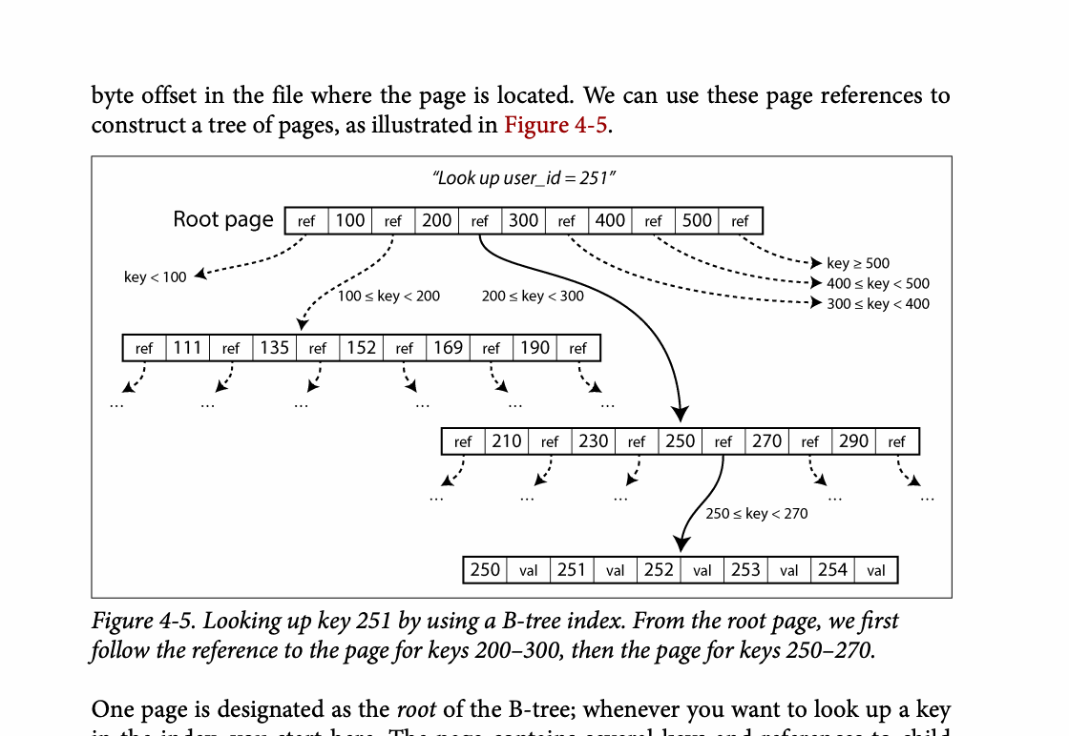
CHAPTER 04
Figure 4-5: mechanism explained
What it shows
The figure exposes the physical data structure used to accelerate reads or writes.
Why it matters
Performance comes from data layout and precomputation, with added write, space, or maintenance cost.
What to watch
Follow the arrows or timeline and test whether the conclusion still holds under failure, retry, and concurrency.
13 / 24
Notes:
Source: Martin Kleppmann and Chris Riccomini, Designing Data-Intensive Applications, 2nd ed., Chapter 4, book pages 115-150. Figure 4-5, PDF page 150. Original caption: Figure 4-5. Looking up key 251 by using a B-tree index. From the root page, we first
Explanation: The figure exposes the physical data structure used to accelerate reads or writes. Performance comes from data layout and precomputation, with added write, space, or maintenance cost. Follow the arrows or timeline and test whether the conclusion still holds under failure, retry, and concurrency.
Source file: /Users/eve/projects/Designing-Data-Intensive-Applications/Designing Data Intensive Applications 2nd.pdf

Slide 14
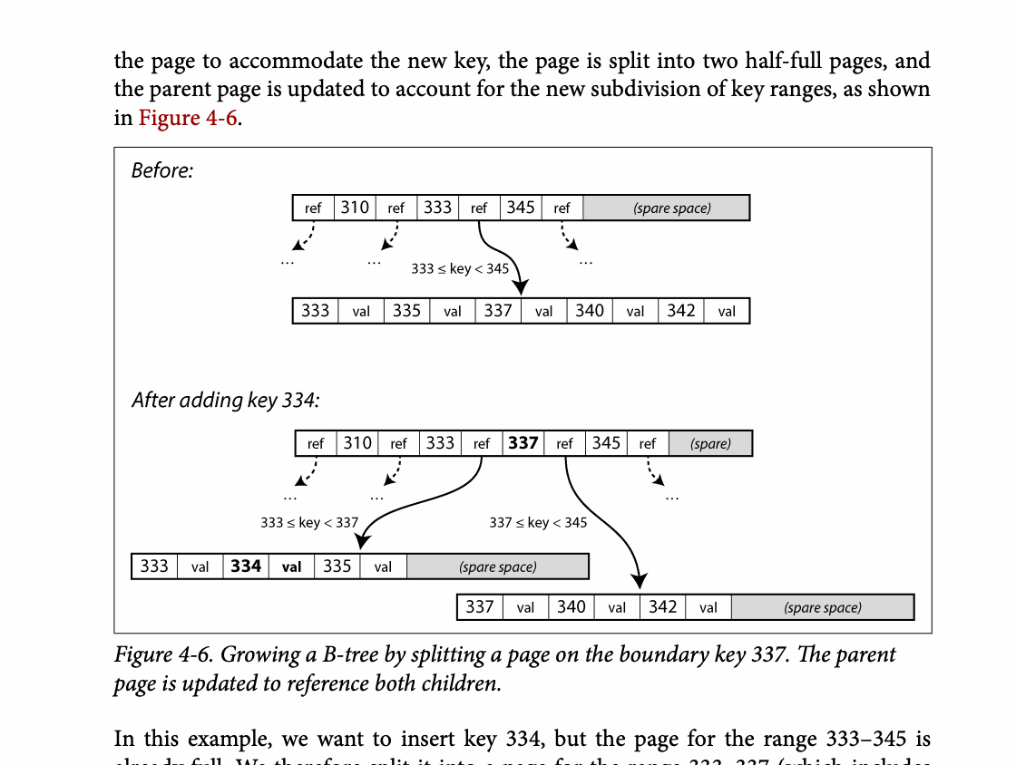
CHAPTER 04
Figure 4-6: mechanism explained
What it shows
The figure exposes the physical data structure used to accelerate reads or writes.
Why it matters
Performance comes from data layout and precomputation, with added write, space, or maintenance cost.
What to watch
Follow the arrows or timeline and test whether the conclusion still holds under failure, retry, and concurrency.
14 / 24
Notes:
Source: Martin Kleppmann and Chris Riccomini, Designing Data-Intensive Applications, 2nd ed., Chapter 4, book pages 115-150. Figure 4-6, PDF page 151. Original caption: Figure 4-6. Growing a B-tree by splitting a page on the boundary key 337. The parent
Explanation: The figure exposes the physical data structure used to accelerate reads or writes. Performance comes from data layout and precomputation, with added write, space, or maintenance cost. Follow the arrows or timeline and test whether the conclusion still holds under failure, retry, and concurrency.
Source file: /Users/eve/projects/Designing-Data-Intensive-Applications/Designing Data Intensive Applications 2nd.pdf

Slide 15
CHAPTER 04
Analytical storage
04
Columnar files read only requested columns and compress similar values.
Vectorized execution processes batches efficiently on modern CPUs.
Materialized views exchange refresh cost for faster queries.
Core question
What problem does it solve, and what does it cost under failure, growth, and change?
15 / 24
Notes:
Source: Martin Kleppmann and Chris Riccomini, Designing Data-Intensive Applications, 2nd ed., Chapter 4, book pages 115-150.
Source file: /Users/eve/projects/Designing-Data-Intensive-Applications/Designing Data Intensive Applications 2nd.pdf

Slide 16
CHAPTER 04
Analytical storage: design trade-offs
04
Fit: Columnar files read only requested columns and compress similar values.
Cost: evaluate latency, throughput, consistency, and operational complexity.
Failure check: what state becomes visible when a node, network path, or dependency fails?
Evolution check: can formats, interfaces, and topology change through rolling upgrades?
16 / 24
Notes:
Source: Martin Kleppmann and Chris Riccomini, Designing Data-Intensive Applications, 2nd ed., Chapter 4, book pages 115-150.
Source file: /Users/eve/projects/Designing-Data-Intensive-Applications/Designing Data Intensive Applications 2nd.pdf

Slide 17
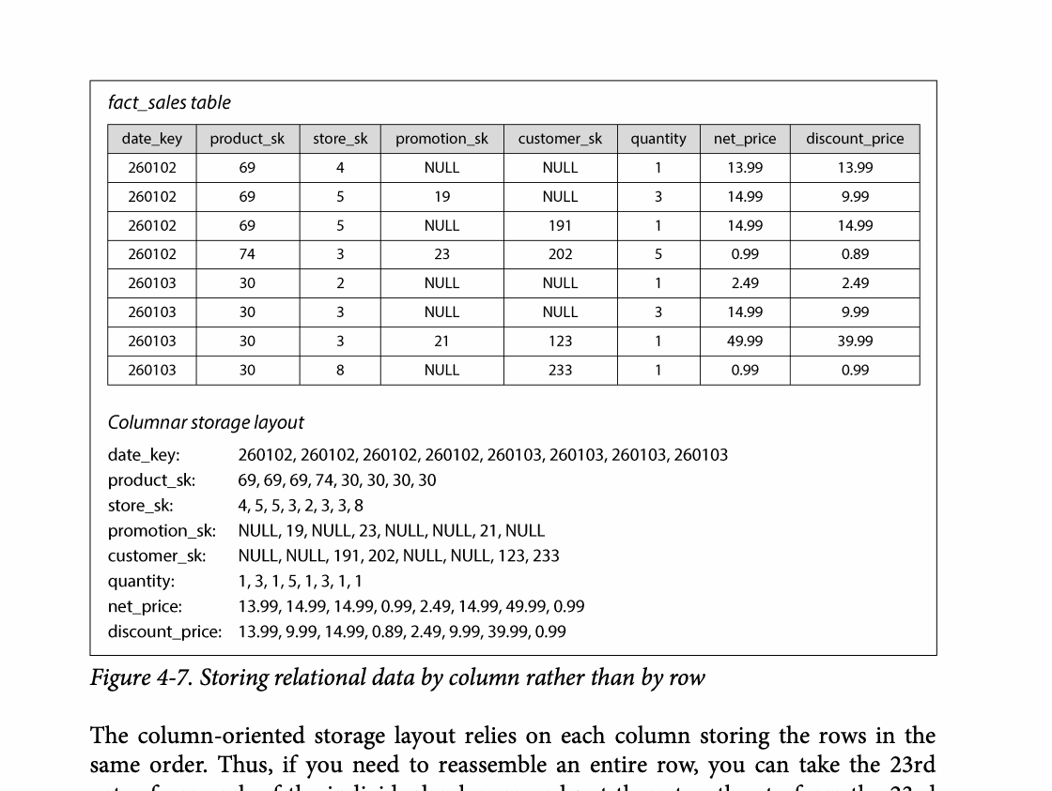
CHAPTER 04
Figure 4-7: mechanism explained
What it shows
The diagram shows how entities and relationships are represented by keys, nesting, or joins.
Why it matters
The model changes read locality, duplication, and update complexity.
What to watch
Follow the arrows or timeline and test whether the conclusion still holds under failure, retry, and concurrency.
17 / 24
Notes:
Source: Martin Kleppmann and Chris Riccomini, Designing Data-Intensive Applications, 2nd ed., Chapter 4, book pages 115-150. Figure 4-7, PDF page 162. Original caption: Figure 4-7. Storing relational data by column rather than by row
Explanation: The diagram shows how entities and relationships are represented by keys, nesting, or joins. The model changes read locality, duplication, and update complexity. Follow the arrows or timeline and test whether the conclusion still holds under failure, retry, and concurrency.
Source file: /Users/eve/projects/Designing-Data-Intensive-Applications/Designing Data Intensive Applications 2nd.pdf

Slide 18
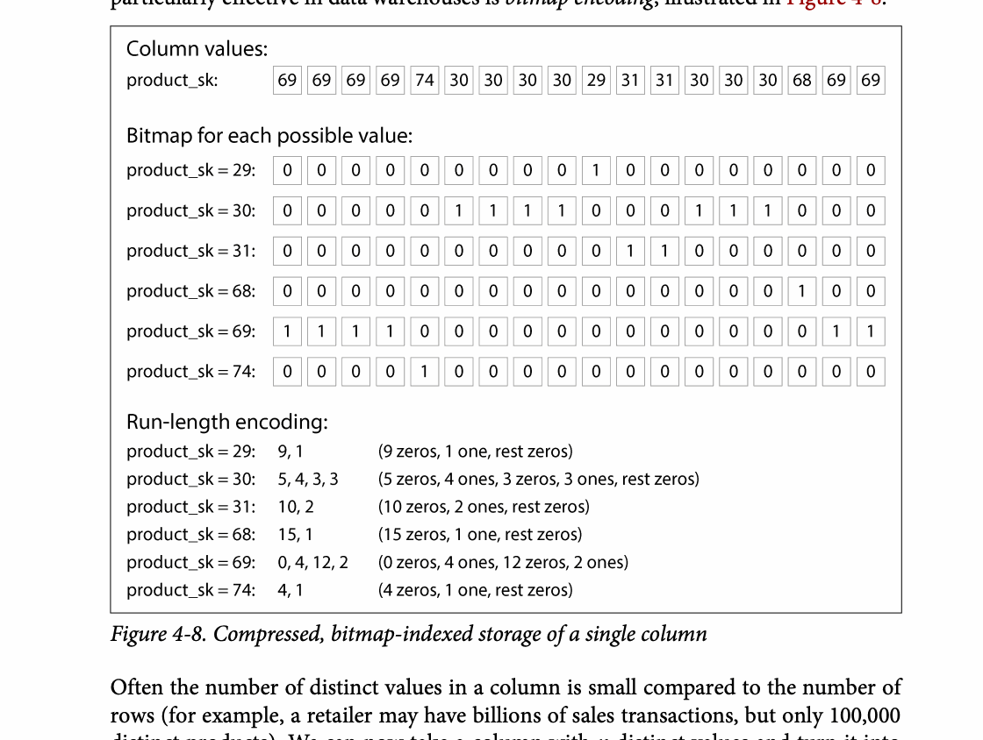
CHAPTER 04
Figure 4-8: mechanism explained
What it shows
The figure exposes the physical data structure used to accelerate reads or writes.
Why it matters
Performance comes from data layout and precomputation, with added write, space, or maintenance cost.
What to watch
Follow the arrows or timeline and test whether the conclusion still holds under failure, retry, and concurrency.
18 / 24
Notes:
Source: Martin Kleppmann and Chris Riccomini, Designing Data-Intensive Applications, 2nd ed., Chapter 4, book pages 115-150. Figure 4-8, PDF page 163. Original caption: Figure 4-8. Compressed, bitmap-indexed storage of a single column
Explanation: The figure exposes the physical data structure used to accelerate reads or writes. Performance comes from data layout and precomputation, with added write, space, or maintenance cost. Follow the arrows or timeline and test whether the conclusion still holds under failure, retry, and concurrency.
Source file: /Users/eve/projects/Designing-Data-Intensive-Applications/Designing Data Intensive Applications 2nd.pdf

Slide 19
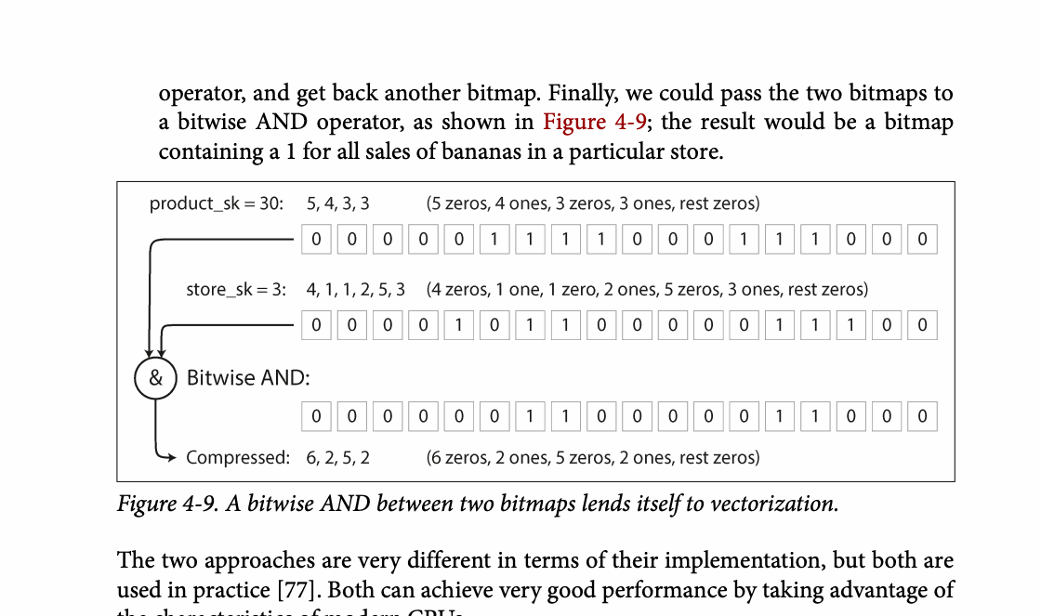
CHAPTER 04
Figure 4-9: mechanism explained
What it shows
The figure exposes the physical data structure used to accelerate reads or writes.
Why it matters
Performance comes from data layout and precomputation, with added write, space, or maintenance cost.
What to watch
Follow the arrows or timeline and test whether the conclusion still holds under failure, retry, and concurrency.
19 / 24
Notes:
Source: Martin Kleppmann and Chris Riccomini, Designing Data-Intensive Applications, 2nd ed., Chapter 4, book pages 115-150. Figure 4-9, PDF page 167. Original caption: Figure 4-9. A bitwise AND between two bitmaps lends itself to vectorization.
Explanation: The figure exposes the physical data structure used to accelerate reads or writes. Performance comes from data layout and precomputation, with added write, space, or maintenance cost. Follow the arrows or timeline and test whether the conclusion still holds under failure, retry, and concurrency.
Source file: /Users/eve/projects/Designing-Data-Intensive-Applications/Designing Data Intensive Applications 2nd.pdf

Slide 20
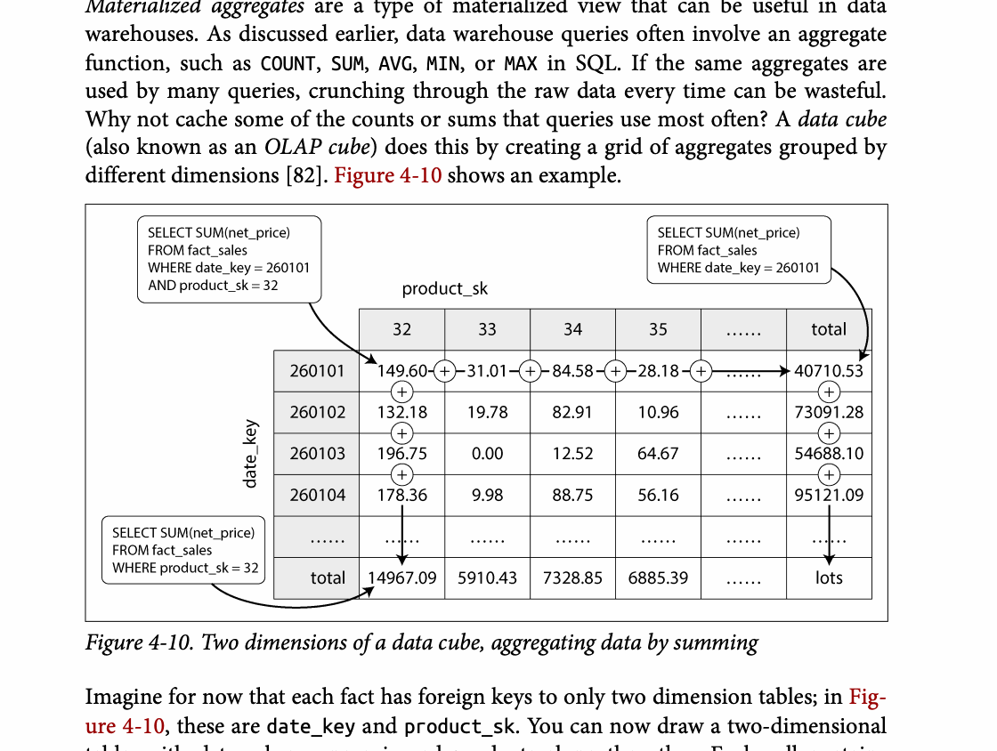
CHAPTER 04
Figure 4-10: mechanism explained
What it shows
The figure exposes the physical data structure used to accelerate reads or writes.
Why it matters
Performance comes from data layout and precomputation, with added write, space, or maintenance cost.
What to watch
Follow the arrows or timeline and test whether the conclusion still holds under failure, retry, and concurrency.
20 / 24
Notes:
Source: Martin Kleppmann and Chris Riccomini, Designing Data-Intensive Applications, 2nd ed., Chapter 4, book pages 115-150. Figure 4-10, PDF page 168. Original caption: Figure 4-10. Two dimensions of a data cube, aggregating data by summing
Explanation: The figure exposes the physical data structure used to accelerate reads or writes. Performance comes from data layout and precomputation, with added write, space, or maintenance cost. Follow the arrows or timeline and test whether the conclusion still holds under failure, retry, and concurrency.
Source file: /Users/eve/projects/Designing-Data-Intensive-Applications/Designing Data Intensive Applications 2nd.pdf

Slide 21
CHAPTER 04
Specialized indexes
05
Full-text indexes support term retrieval and ranking.
Multidimensional indexes serve spatial and compound predicates.
Vector indexes use approximate nearest-neighbor search for semantic similarity.
Core question
What problem does it solve, and what does it cost under failure, growth, and change?
21 / 24
Notes:
Source: Martin Kleppmann and Chris Riccomini, Designing Data-Intensive Applications, 2nd ed., Chapter 4, book pages 115-150.
Source file: /Users/eve/projects/Designing-Data-Intensive-Applications/Designing Data Intensive Applications 2nd.pdf

Slide 22
CHAPTER 04
Specialized indexes: design trade-offs
05
Fit: Full-text indexes support term retrieval and ranking.
Cost: evaluate latency, throughput, consistency, and operational complexity.
Failure check: what state becomes visible when a node, network path, or dependency fails?
Evolution check: can formats, interfaces, and topology change through rolling upgrades?
22 / 24
Notes:
Source: Martin Kleppmann and Chris Riccomini, Designing Data-Intensive Applications, 2nd ed., Chapter 4, book pages 115-150.
Source file: /Users/eve/projects/Designing-Data-Intensive-Applications/Designing Data Intensive Applications 2nd.pdf

Slide 23
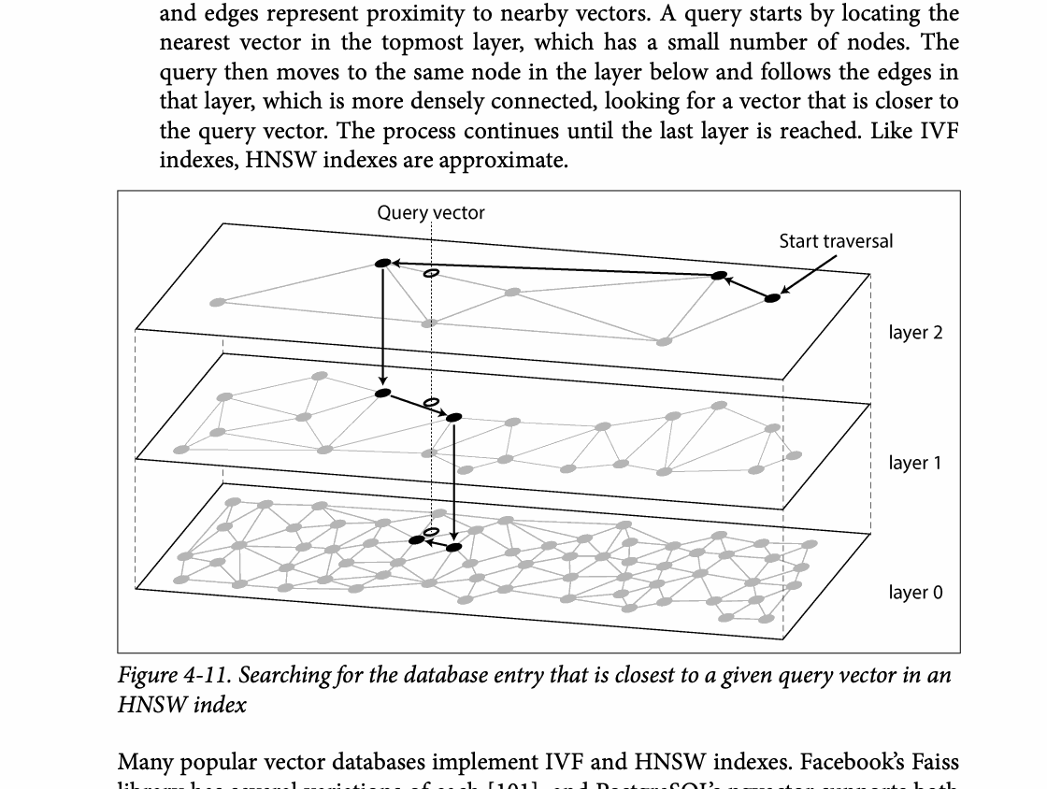
CHAPTER 04
Figure 4-11: mechanism explained
What it shows
The figure exposes the physical data structure used to accelerate reads or writes.
Why it matters
Performance comes from data layout and precomputation, with added write, space, or maintenance cost.
What to watch
Follow the arrows or timeline and test whether the conclusion still holds under failure, retry, and concurrency.
23 / 24
Notes:
Source: Martin Kleppmann and Chris Riccomini, Designing Data-Intensive Applications, 2nd ed., Chapter 4, book pages 115-150. Figure 4-11, PDF page 173. Original caption: Figure 4-11. Searching for the database entry that is closest to a given query vector in an
Explanation: The figure exposes the physical data structure used to accelerate reads or writes. Performance comes from data layout and precomputation, with added write, space, or maintenance cost. Follow the arrows or timeline and test whether the conclusion still holds under failure, retry, and concurrency.
Source file: /Users/eve/projects/Designing-Data-Intensive-Applications/Designing Data Intensive Applications 2nd.pdf

Slide 24
CHAPTER 04
Review and application
State the chapter’s central problem in one sentence.
Choose one mechanism and list the assumptions it relies on.
Describe a failure scenario and explain the recovery path.
Apply one trade-off from the chapter to a system you are designing.
24 / 24
Notes:
Source: Martin Kleppmann and Chris Riccomini, Designing Data-Intensive Applications, 2nd ed., Chapter 4, book pages 115-150.
Source file: /Users/eve/projects/Designing-Data-Intensive-Applications/Designing Data Intensive Applications 2nd.pdf

