Slide 1
CHAPTER 05
Encoding and Evolution
Designing Data-Intensive Applications, Second Edition
Detailed English Study Edition
01 / 20
Notes:
Source: Martin Kleppmann and Chris Riccomini, Designing Data-Intensive Applications, 2nd ed., Chapter 5, book pages 161-191.
Source file: /Users/eve/projects/Designing-Data-Intensive-Applications/Designing Data Intensive Applications 2nd.pdf

Slide 2
CHAPTER 05
Chapter map
01
Encoding formats
Text formats aid inspection but carry parsing and typing costs.
02
Compatibility
Backward compatibility lets new code read old data.
03
Database dataflow
Old records may retain earlier encodings for years.
04
Services and workflows
REST emphasizes resources and shared protocols while RPC emphasizes method calls.
05
Event-driven systems
Messages decouple producers and consumers in time and ownership.
02 / 20
Notes:
Source: Martin Kleppmann and Chris Riccomini, Designing Data-Intensive Applications, 2nd ed., Chapter 5, book pages 161-191.
Source file: /Users/eve/projects/Designing-Data-Intensive-Applications/Designing Data Intensive Applications 2nd.pdf

Slide 3
CHAPTER 05
Encoding formats
01
Text formats aid inspection but carry parsing and typing costs.
Binary formats often use field tags and schemas for compactness.
Schemas support validation, documentation, code generation, and compatibility checks.
Core question
What problem does it solve, and what does it cost under failure, growth, and change?
03 / 20
Notes:
Source: Martin Kleppmann and Chris Riccomini, Designing Data-Intensive Applications, 2nd ed., Chapter 5, book pages 161-191.
Source file: /Users/eve/projects/Designing-Data-Intensive-Applications/Designing Data Intensive Applications 2nd.pdf

Slide 4
CHAPTER 05
Encoding formats: design trade-offs
01
Fit: Text formats aid inspection but carry parsing and typing costs.
Cost: evaluate latency, throughput, consistency, and operational complexity.
Failure check: what state becomes visible when a node, network path, or dependency fails?
Evolution check: can formats, interfaces, and topology change through rolling upgrades?
04 / 20
Notes:
Source: Martin Kleppmann and Chris Riccomini, Designing Data-Intensive Applications, 2nd ed., Chapter 5, book pages 161-191.
Source file: /Users/eve/projects/Designing-Data-Intensive-Applications/Designing Data Intensive Applications 2nd.pdf

Slide 5
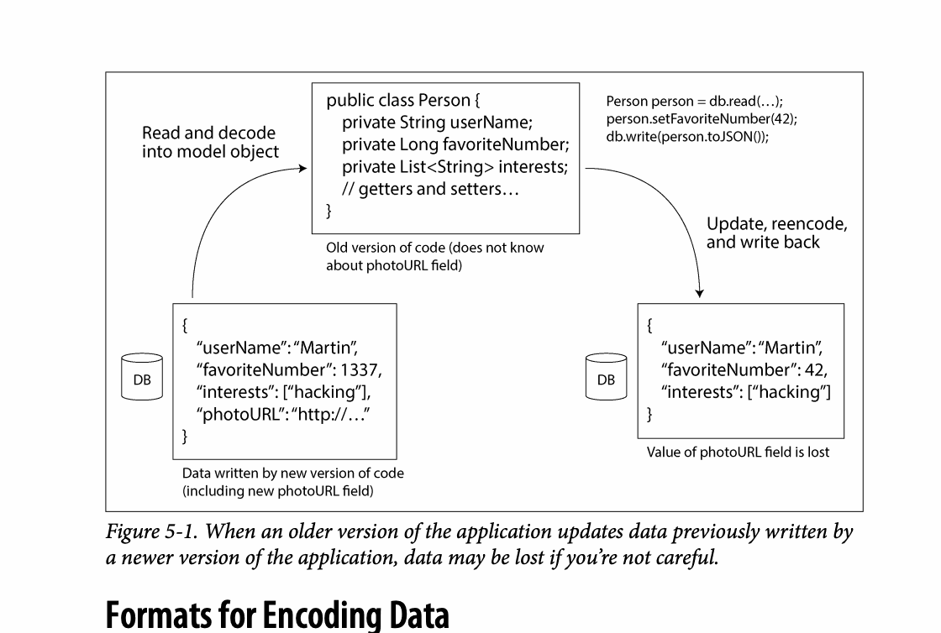
CHAPTER 05
Figure 5-1: mechanism explained
What it shows
When an older version of the application updates data previously written by
Why it matters
It turns the chapter concept into a concrete dataflow, timeline, or state transition.
What to watch
Check the actors, data direction, operation order, and hidden system assumptions.
05 / 20
Notes:
Source: Martin Kleppmann and Chris Riccomini, Designing Data-Intensive Applications, 2nd ed., Chapter 5, book pages 161-191. Figure 5-1, PDF page 187. Original caption: Figure 5-1. When an older version of the application updates data previously written by
Explanation: When an older version of the application updates data previously written by It turns the chapter concept into a concrete dataflow, timeline, or state transition. Check the actors, data direction, operation order, and hidden system assumptions.
Source file: /Users/eve/projects/Designing-Data-Intensive-Applications/Designing Data Intensive Applications 2nd.pdf

Slide 6
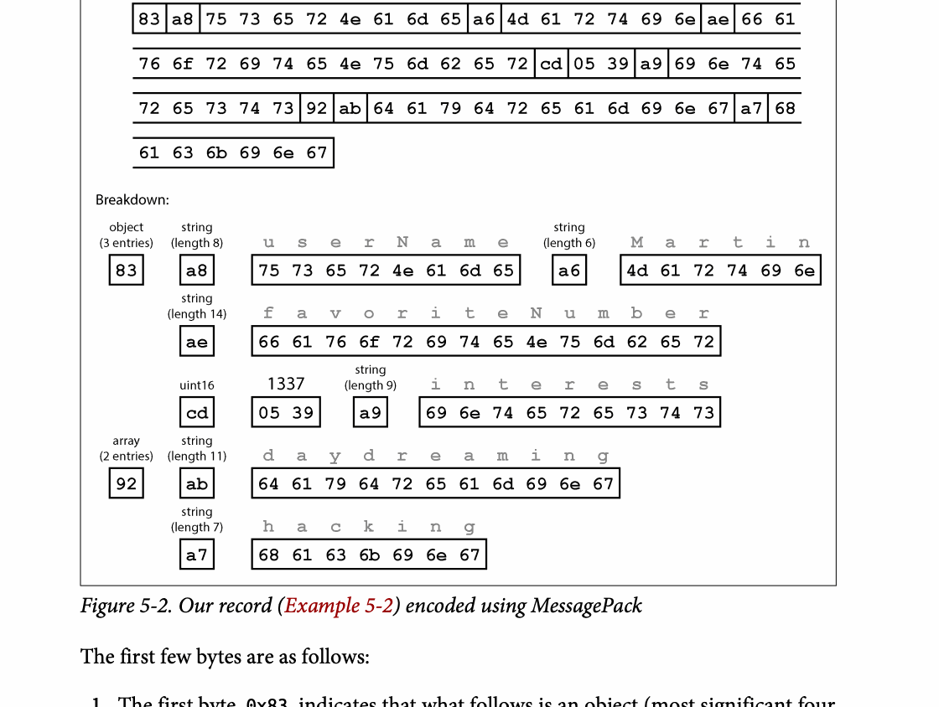
CHAPTER 05
Figure 5-2: mechanism explained
What it shows
The bytes encode field identity, type, or schema information in different ways.
Why it matters
Compatibility depends on how readers handle fields written by other schema versions.
What to watch
Follow the arrows or timeline and test whether the conclusion still holds under failure, retry, and concurrency.
06 / 20
Notes:
Source: Martin Kleppmann and Chris Riccomini, Designing Data-Intensive Applications, 2nd ed., Chapter 5, book pages 161-191. Figure 5-2, PDF page 192. Original caption: Figure 5-2. Our record (Example 5-2) encoded using MessagePack
Explanation: The bytes encode field identity, type, or schema information in different ways. Compatibility depends on how readers handle fields written by other schema versions. Follow the arrows or timeline and test whether the conclusion still holds under failure, retry, and concurrency.
Source file: /Users/eve/projects/Designing-Data-Intensive-Applications/Designing Data Intensive Applications 2nd.pdf

Slide 7
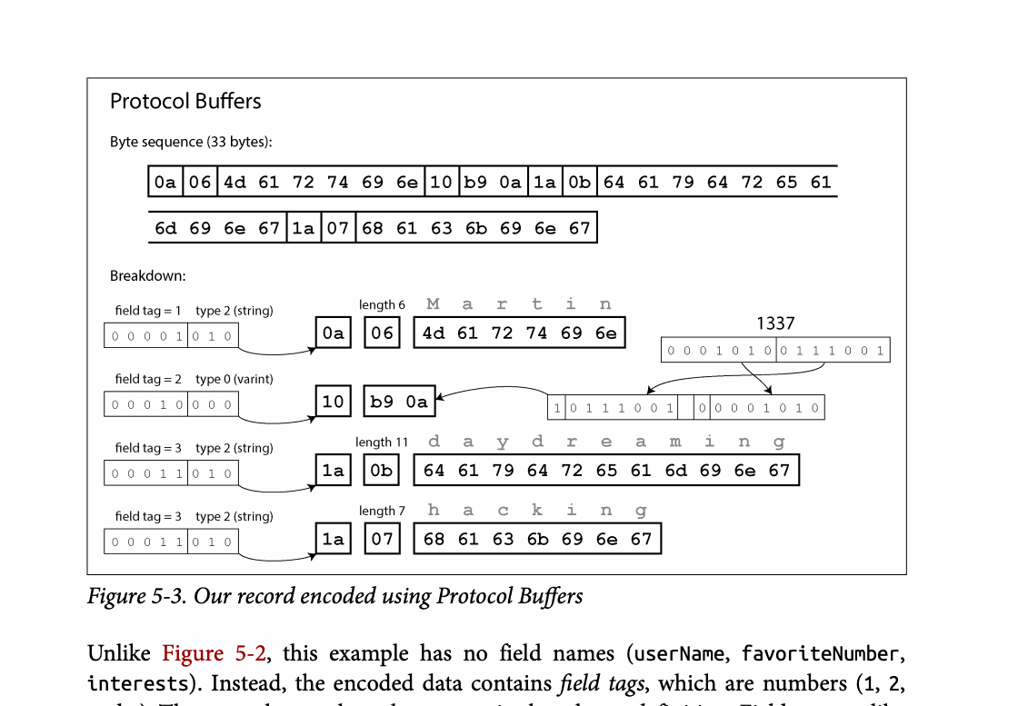
CHAPTER 05
Figure 5-3: mechanism explained
What it shows
The bytes encode field identity, type, or schema information in different ways.
Why it matters
Compatibility depends on how readers handle fields written by other schema versions.
What to watch
Follow the arrows or timeline and test whether the conclusion still holds under failure, retry, and concurrency.
07 / 20
Notes:
Source: Martin Kleppmann and Chris Riccomini, Designing Data-Intensive Applications, 2nd ed., Chapter 5, book pages 161-191. Figure 5-3, PDF page 194. Original caption: Figure 5-3. Our record encoded using Protocol Buffers
Explanation: The bytes encode field identity, type, or schema information in different ways. Compatibility depends on how readers handle fields written by other schema versions. Follow the arrows or timeline and test whether the conclusion still holds under failure, retry, and concurrency.
Source file: /Users/eve/projects/Designing-Data-Intensive-Applications/Designing Data Intensive Applications 2nd.pdf

Slide 8
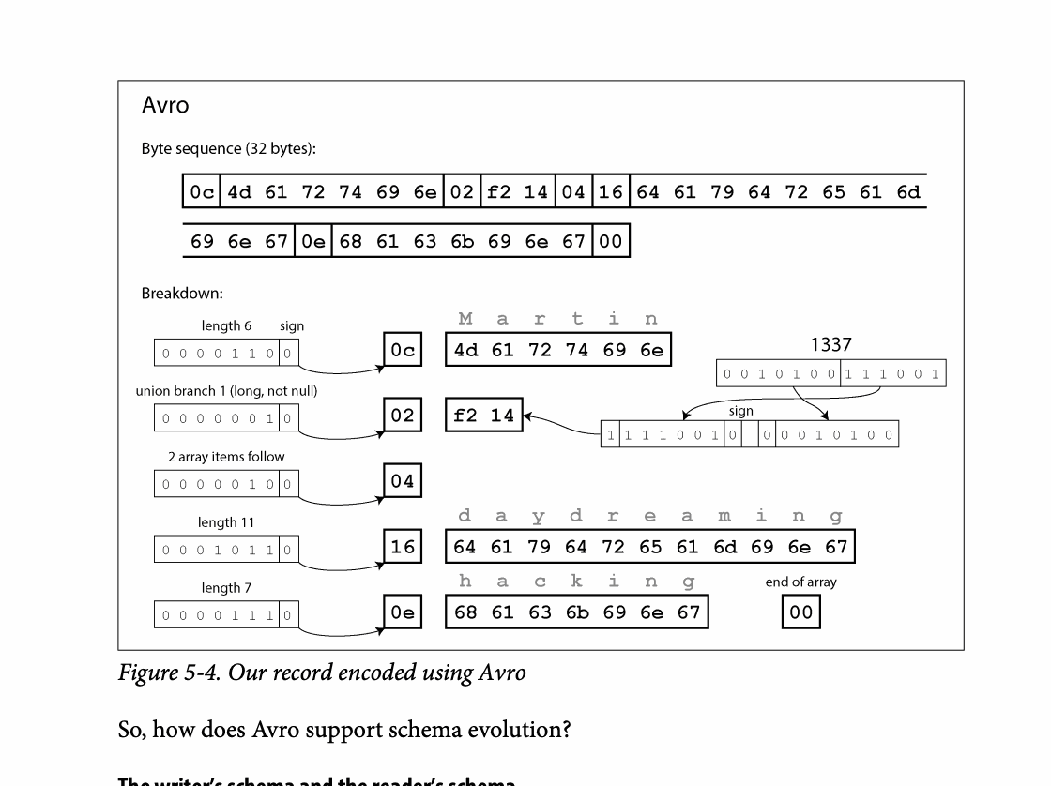
CHAPTER 05
Figure 5-4: mechanism explained
What it shows
The bytes encode field identity, type, or schema information in different ways.
Why it matters
Compatibility depends on how readers handle fields written by other schema versions.
What to watch
Follow the arrows or timeline and test whether the conclusion still holds under failure, retry, and concurrency.
08 / 20
Notes:
Source: Martin Kleppmann and Chris Riccomini, Designing Data-Intensive Applications, 2nd ed., Chapter 5, book pages 161-191. Figure 5-4, PDF page 197. Original caption: Figure 5-4. Our record encoded using Avro
Explanation: The bytes encode field identity, type, or schema information in different ways. Compatibility depends on how readers handle fields written by other schema versions. Follow the arrows or timeline and test whether the conclusion still holds under failure, retry, and concurrency.
Source file: /Users/eve/projects/Designing-Data-Intensive-Applications/Designing Data Intensive Applications 2nd.pdf

Slide 9
CHAPTER 05
Compatibility
02
Backward compatibility lets new code read old data.
Forward compatibility lets old code tolerate new data.
Rolling upgrades require old and new versions to coexist.
Core question
What problem does it solve, and what does it cost under failure, growth, and change?
09 / 20
Notes:
Source: Martin Kleppmann and Chris Riccomini, Designing Data-Intensive Applications, 2nd ed., Chapter 5, book pages 161-191.
Source file: /Users/eve/projects/Designing-Data-Intensive-Applications/Designing Data Intensive Applications 2nd.pdf

Slide 10
CHAPTER 05
Compatibility: design trade-offs
02
Fit: Backward compatibility lets new code read old data.
Cost: evaluate latency, throughput, consistency, and operational complexity.
Failure check: what state becomes visible when a node, network path, or dependency fails?
Evolution check: can formats, interfaces, and topology change through rolling upgrades?
10 / 20
Notes:
Source: Martin Kleppmann and Chris Riccomini, Designing Data-Intensive Applications, 2nd ed., Chapter 5, book pages 161-191.
Source file: /Users/eve/projects/Designing-Data-Intensive-Applications/Designing Data Intensive Applications 2nd.pdf

Slide 11
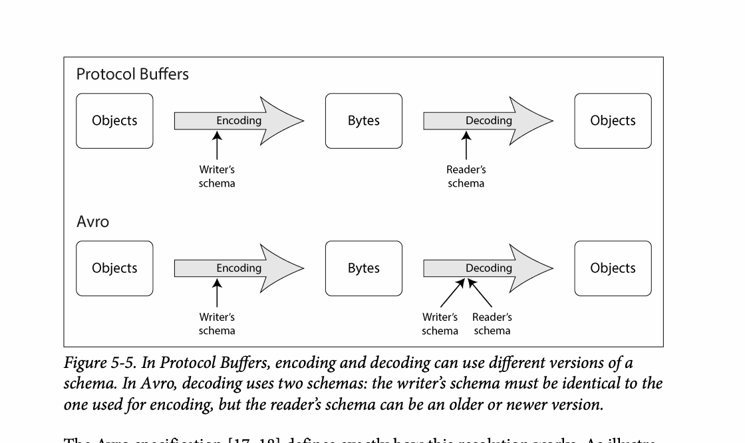
CHAPTER 05
Figure 5-5: mechanism explained
What it shows
The bytes encode field identity, type, or schema information in different ways.
Why it matters
Compatibility depends on how readers handle fields written by other schema versions.
What to watch
Follow the arrows or timeline and test whether the conclusion still holds under failure, retry, and concurrency.
11 / 20
Notes:
Source: Martin Kleppmann and Chris Riccomini, Designing Data-Intensive Applications, 2nd ed., Chapter 5, book pages 161-191. Figure 5-5, PDF page 198. Original caption: Figure 5-5. In Protocol Buffers, encoding and decoding can use different versions of a
Explanation: The bytes encode field identity, type, or schema information in different ways. Compatibility depends on how readers handle fields written by other schema versions. Follow the arrows or timeline and test whether the conclusion still holds under failure, retry, and concurrency.
Source file: /Users/eve/projects/Designing-Data-Intensive-Applications/Designing Data Intensive Applications 2nd.pdf

Slide 12
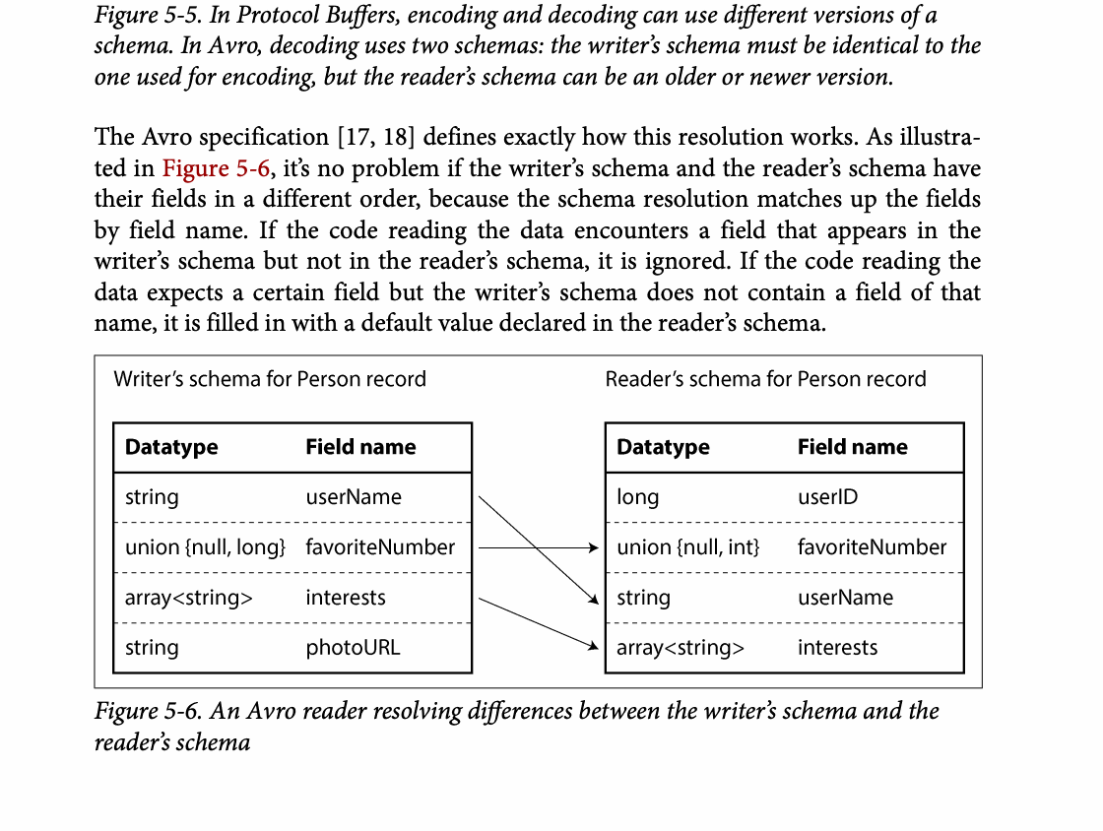
CHAPTER 05
Figure 5-6: mechanism explained
What it shows
The bytes encode field identity, type, or schema information in different ways.
Why it matters
Compatibility depends on how readers handle fields written by other schema versions.
What to watch
Follow the arrows or timeline and test whether the conclusion still holds under failure, retry, and concurrency.
12 / 20
Notes:
Source: Martin Kleppmann and Chris Riccomini, Designing Data-Intensive Applications, 2nd ed., Chapter 5, book pages 161-191. Figure 5-6, PDF page 198. Original caption: Figure 5-6. An Avro reader resolving differences between the writer’s schema and the
Explanation: The bytes encode field identity, type, or schema information in different ways. Compatibility depends on how readers handle fields written by other schema versions. Follow the arrows or timeline and test whether the conclusion still holds under failure, retry, and concurrency.
Source file: /Users/eve/projects/Designing-Data-Intensive-Applications/Designing Data Intensive Applications 2nd.pdf

Slide 13
CHAPTER 05
Database dataflow
03
Old records may retain earlier encodings for years.
Migration can happen on write, on read, or through background rewriting.
Schema evolution should avoid coupling a deployment to full data conversion.
Core question
What problem does it solve, and what does it cost under failure, growth, and change?
13 / 20
Notes:
Source: Martin Kleppmann and Chris Riccomini, Designing Data-Intensive Applications, 2nd ed., Chapter 5, book pages 161-191.
Source file: /Users/eve/projects/Designing-Data-Intensive-Applications/Designing Data Intensive Applications 2nd.pdf

Slide 14
CHAPTER 05
Database dataflow: design trade-offs
03
Fit: Old records may retain earlier encodings for years.
Cost: evaluate latency, throughput, consistency, and operational complexity.
Failure check: what state becomes visible when a node, network path, or dependency fails?
Evolution check: can formats, interfaces, and topology change through rolling upgrades?
14 / 20
Notes:
Source: Martin Kleppmann and Chris Riccomini, Designing Data-Intensive Applications, 2nd ed., Chapter 5, book pages 161-191.
Source file: /Users/eve/projects/Designing-Data-Intensive-Applications/Designing Data Intensive Applications 2nd.pdf

Slide 15
CHAPTER 05
Services and workflows
04
REST emphasizes resources and shared protocols while RPC emphasizes method calls.
Interface evolution must account for independently deployed clients.
Durable workflows persist execution state and resume across failures.
Core question
What problem does it solve, and what does it cost under failure, growth, and change?
15 / 20
Notes:
Source: Martin Kleppmann and Chris Riccomini, Designing Data-Intensive Applications, 2nd ed., Chapter 5, book pages 161-191.
Source file: /Users/eve/projects/Designing-Data-Intensive-Applications/Designing Data Intensive Applications 2nd.pdf

Slide 16
CHAPTER 05
Services and workflows: design trade-offs
04
Fit: REST emphasizes resources and shared protocols while RPC emphasizes method calls.
Cost: evaluate latency, throughput, consistency, and operational complexity.
Failure check: what state becomes visible when a node, network path, or dependency fails?
Evolution check: can formats, interfaces, and topology change through rolling upgrades?
16 / 20
Notes:
Source: Martin Kleppmann and Chris Riccomini, Designing Data-Intensive Applications, 2nd ed., Chapter 5, book pages 161-191.
Source file: /Users/eve/projects/Designing-Data-Intensive-Applications/Designing Data Intensive Applications 2nd.pdf

Slide 17
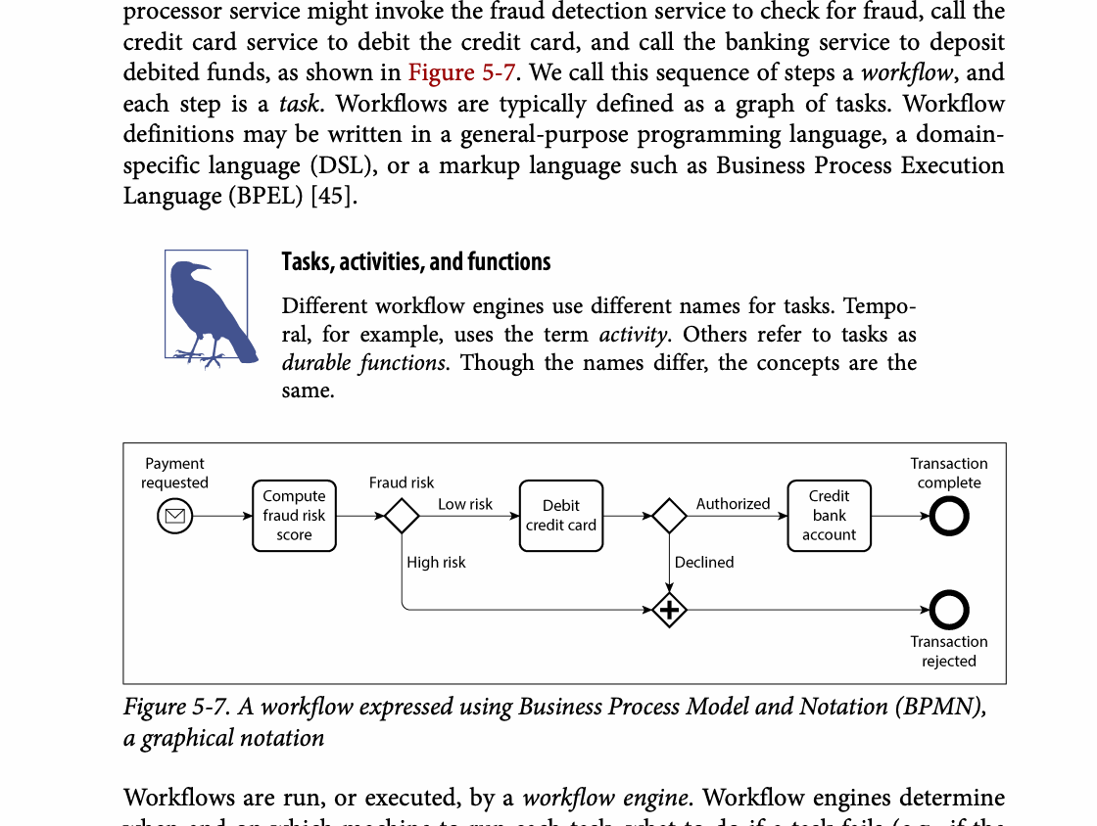
CHAPTER 05
Figure 5-7: mechanism explained
What it shows
A durable workflow records progress across service calls, waits, and retries.
Why it matters
Persisted state lets execution resume after process or machine failure.
What to watch
Follow the arrows or timeline and test whether the conclusion still holds under failure, retry, and concurrency.
17 / 20
Notes:
Source: Martin Kleppmann and Chris Riccomini, Designing Data-Intensive Applications, 2nd ed., Chapter 5, book pages 161-191. Figure 5-7, PDF page 211. Original caption: Figure 5-7. A workflow expressed using Business Process Model and Notation (BPMN),
Explanation: A durable workflow records progress across service calls, waits, and retries. Persisted state lets execution resume after process or machine failure. Follow the arrows or timeline and test whether the conclusion still holds under failure, retry, and concurrency.
Source file: /Users/eve/projects/Designing-Data-Intensive-Applications/Designing Data Intensive Applications 2nd.pdf

Slide 18
CHAPTER 05
Event-driven systems
05
Messages decouple producers and consumers in time and ownership.
Event schemas need the same compatibility discipline as stored data.
Replay requires idempotent processing and controlled side effects.
Core question
What problem does it solve, and what does it cost under failure, growth, and change?
18 / 20
Notes:
Source: Martin Kleppmann and Chris Riccomini, Designing Data-Intensive Applications, 2nd ed., Chapter 5, book pages 161-191.
Source file: /Users/eve/projects/Designing-Data-Intensive-Applications/Designing Data Intensive Applications 2nd.pdf

Slide 19
CHAPTER 05
Event-driven systems: design trade-offs
05
Fit: Messages decouple producers and consumers in time and ownership.
Cost: evaluate latency, throughput, consistency, and operational complexity.
Failure check: what state becomes visible when a node, network path, or dependency fails?
Evolution check: can formats, interfaces, and topology change through rolling upgrades?
19 / 20
Notes:
Source: Martin Kleppmann and Chris Riccomini, Designing Data-Intensive Applications, 2nd ed., Chapter 5, book pages 161-191.
Source file: /Users/eve/projects/Designing-Data-Intensive-Applications/Designing Data Intensive Applications 2nd.pdf

Slide 20
CHAPTER 05
Review and application
State the chapter’s central problem in one sentence.
Choose one mechanism and list the assumptions it relies on.
Describe a failure scenario and explain the recovery path.
Apply one trade-off from the chapter to a system you are designing.
20 / 20
Notes:
Source: Martin Kleppmann and Chris Riccomini, Designing Data-Intensive Applications, 2nd ed., Chapter 5, book pages 161-191.
Source file: /Users/eve/projects/Designing-Data-Intensive-Applications/Designing Data Intensive Applications 2nd.pdf

