Slide 1
CHAPTER 06
Replication
Designing Data-Intensive Applications, Second Edition
Detailed English Study Edition
01 / 29
Notes:
Source: Martin Kleppmann and Chris Riccomini, Designing Data-Intensive Applications, 2nd ed., Chapter 6, book pages 197-243.
Source file: /Users/eve/projects/Designing-Data-Intensive-Applications/Designing Data Intensive Applications 2nd.pdf

Slide 2
CHAPTER 06
Chapter map
01
Why replicate data
Replication improves availability, read capacity, and geographic proximity.
02
Single-leader replication
The leader orders writes and followers replay its log.
03
Replication lag guarantees
Read-your-writes keeps a user’s own updates visible.
04
Multi-leader replication
Local leaders reduce write latency across regions and support offline work.
05
Leaderless replication
Clients read and write several replicas and compare versions.
02 / 29
Notes:
Source: Martin Kleppmann and Chris Riccomini, Designing Data-Intensive Applications, 2nd ed., Chapter 6, book pages 197-243.
Source file: /Users/eve/projects/Designing-Data-Intensive-Applications/Designing Data Intensive Applications 2nd.pdf

Slide 3
CHAPTER 06
Why replicate data
01
Replication improves availability, read capacity, and geographic proximity.
A design must define write order, failover, and consistency semantics.
Replication lag makes different replicas expose different states.
Core question
What problem does it solve, and what does it cost under failure, growth, and change?
03 / 29
Notes:
Source: Martin Kleppmann and Chris Riccomini, Designing Data-Intensive Applications, 2nd ed., Chapter 6, book pages 197-243.
Source file: /Users/eve/projects/Designing-Data-Intensive-Applications/Designing Data Intensive Applications 2nd.pdf

Slide 4
CHAPTER 06
Why replicate data: design trade-offs
01
Fit: Replication improves availability, read capacity, and geographic proximity.
Cost: evaluate latency, throughput, consistency, and operational complexity.
Failure check: what state becomes visible when a node, network path, or dependency fails?
Evolution check: can formats, interfaces, and topology change through rolling upgrades?
04 / 29
Notes:
Source: Martin Kleppmann and Chris Riccomini, Designing Data-Intensive Applications, 2nd ed., Chapter 6, book pages 197-243.
Source file: /Users/eve/projects/Designing-Data-Intensive-Applications/Designing Data Intensive Applications 2nd.pdf

Slide 5
CHAPTER 06
Single-leader replication
02
The leader orders writes and followers replay its log.
Synchronous followers improve durability but add latency and availability risk.
Asynchronous followers respond quickly but may lose recent writes on failover.
Core question
What problem does it solve, and what does it cost under failure, growth, and change?
05 / 29
Notes:
Source: Martin Kleppmann and Chris Riccomini, Designing Data-Intensive Applications, 2nd ed., Chapter 6, book pages 197-243.
Source file: /Users/eve/projects/Designing-Data-Intensive-Applications/Designing Data Intensive Applications 2nd.pdf

Slide 6
CHAPTER 06
Single-leader replication: design trade-offs
02
Fit: The leader orders writes and followers replay its log.
Cost: evaluate latency, throughput, consistency, and operational complexity.
Failure check: what state becomes visible when a node, network path, or dependency fails?
Evolution check: can formats, interfaces, and topology change through rolling upgrades?
06 / 29
Notes:
Source: Martin Kleppmann and Chris Riccomini, Designing Data-Intensive Applications, 2nd ed., Chapter 6, book pages 197-243.
Source file: /Users/eve/projects/Designing-Data-Intensive-Applications/Designing Data Intensive Applications 2nd.pdf

Slide 7
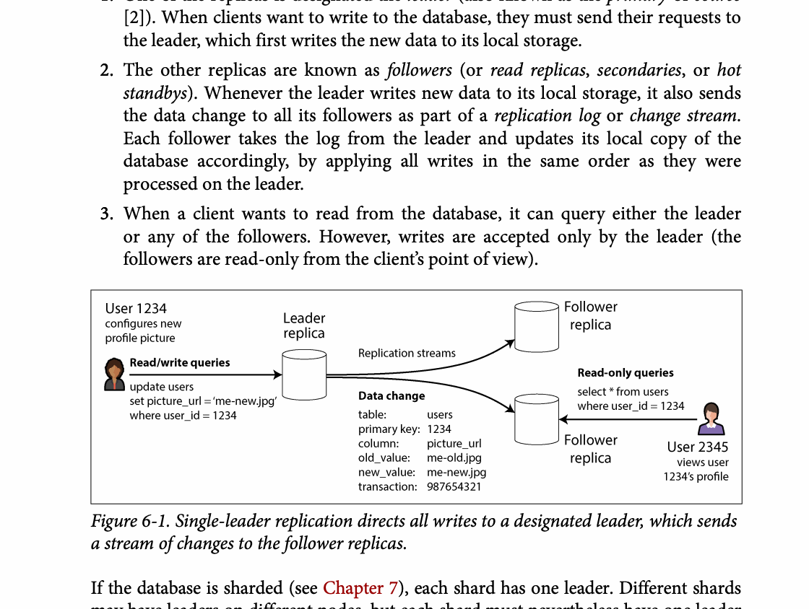
CHAPTER 06
Figure 6-1: mechanism explained
What it shows
Writes flow through one leader and followers replay the ordered log.
Why it matters
Acknowledgment policy trades write latency and availability against durability.
What to watch
Follow the arrows or timeline and test whether the conclusion still holds under failure, retry, and concurrency.
07 / 29
Notes:
Source: Martin Kleppmann and Chris Riccomini, Designing Data-Intensive Applications, 2nd ed., Chapter 6, book pages 197-243. Figure 6-1, PDF page 223. Original caption: Figure 6-1. Single-leader replication directs all writes to a designated leader, which sends
Explanation: Writes flow through one leader and followers replay the ordered log. Acknowledgment policy trades write latency and availability against durability. Follow the arrows or timeline and test whether the conclusion still holds under failure, retry, and concurrency.
Source file: /Users/eve/projects/Designing-Data-Intensive-Applications/Designing Data Intensive Applications 2nd.pdf

Slide 8
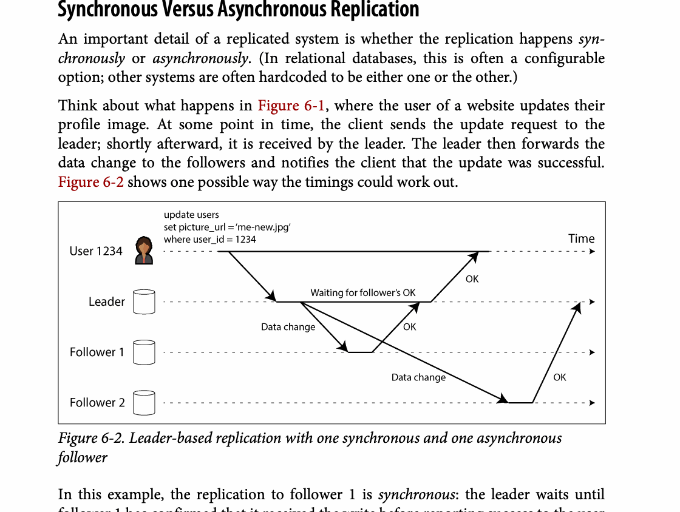
CHAPTER 06
Figure 6-2: mechanism explained
What it shows
Writes flow through one leader and followers replay the ordered log.
Why it matters
Acknowledgment policy trades write latency and availability against durability.
What to watch
Follow the arrows or timeline and test whether the conclusion still holds under failure, retry, and concurrency.
08 / 29
Notes:
Source: Martin Kleppmann and Chris Riccomini, Designing Data-Intensive Applications, 2nd ed., Chapter 6, book pages 197-243. Figure 6-2, PDF page 224. Original caption: Figure 6-2. Leader-based replication with one synchronous and one asynchronous
Explanation: Writes flow through one leader and followers replay the ordered log. Acknowledgment policy trades write latency and availability against durability. Follow the arrows or timeline and test whether the conclusion still holds under failure, retry, and concurrency.
Source file: /Users/eve/projects/Designing-Data-Intensive-Applications/Designing Data Intensive Applications 2nd.pdf

Slide 9
CHAPTER 06
Replication lag guarantees
03
Read-your-writes keeps a user’s own updates visible.
Monotonic reads prevent a session from moving backward in time.
Consistent-prefix reads preserve causal ordering.
Core question
What problem does it solve, and what does it cost under failure, growth, and change?
09 / 29
Notes:
Source: Martin Kleppmann and Chris Riccomini, Designing Data-Intensive Applications, 2nd ed., Chapter 6, book pages 197-243.
Source file: /Users/eve/projects/Designing-Data-Intensive-Applications/Designing Data Intensive Applications 2nd.pdf

Slide 10
CHAPTER 06
Replication lag guarantees: design trade-offs
03
Fit: Read-your-writes keeps a user’s own updates visible.
Cost: evaluate latency, throughput, consistency, and operational complexity.
Failure check: what state becomes visible when a node, network path, or dependency fails?
Evolution check: can formats, interfaces, and topology change through rolling upgrades?
10 / 29
Notes:
Source: Martin Kleppmann and Chris Riccomini, Designing Data-Intensive Applications, 2nd ed., Chapter 6, book pages 197-243.
Source file: /Users/eve/projects/Designing-Data-Intensive-Applications/Designing Data Intensive Applications 2nd.pdf

Slide 11
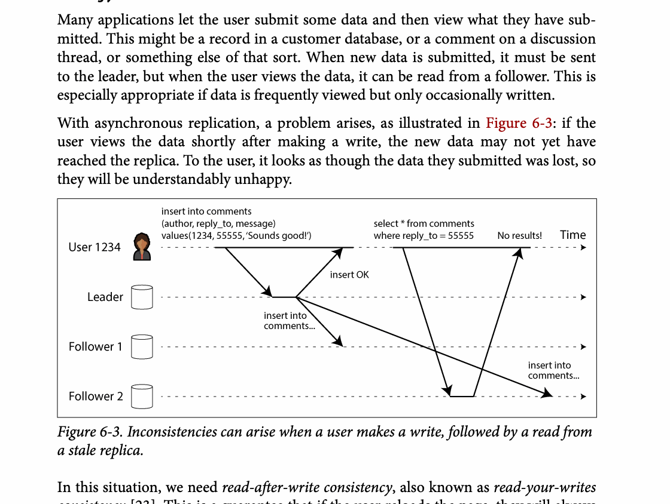
CHAPTER 06
Figure 6-3: mechanism explained
What it shows
Inconsistencies can arise when a user makes a write, followed by a read from
Why it matters
It turns the chapter concept into a concrete dataflow, timeline, or state transition.
What to watch
Check the actors, data direction, operation order, and hidden system assumptions.
11 / 29
Notes:
Source: Martin Kleppmann and Chris Riccomini, Designing Data-Intensive Applications, 2nd ed., Chapter 6, book pages 197-243. Figure 6-3, PDF page 234. Original caption: Figure 6-3. Inconsistencies can arise when a user makes a write, followed by a read from
Explanation: Inconsistencies can arise when a user makes a write, followed by a read from It turns the chapter concept into a concrete dataflow, timeline, or state transition. Check the actors, data direction, operation order, and hidden system assumptions.
Source file: /Users/eve/projects/Designing-Data-Intensive-Applications/Designing Data Intensive Applications 2nd.pdf

Slide 12
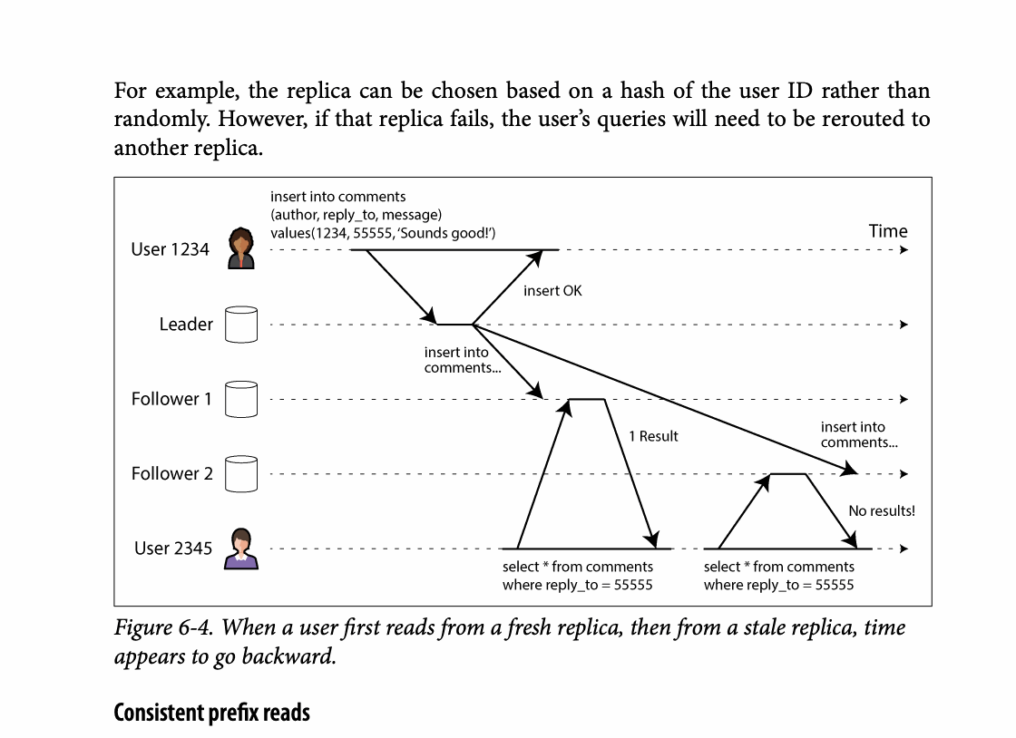
CHAPTER 06
Figure 6-4: mechanism explained
What it shows
Followers can expose older state while replication catches up.
Why it matters
Read-your-writes, monotonic reads, or leader reads protect freshness-sensitive paths.
What to watch
Follow the arrows or timeline and test whether the conclusion still holds under failure, retry, and concurrency.
12 / 29
Notes:
Source: Martin Kleppmann and Chris Riccomini, Designing Data-Intensive Applications, 2nd ed., Chapter 6, book pages 197-243. Figure 6-4, PDF page 237. Original caption: Figure 6-4. When a user first reads from a fresh replica, then from a stale replica, time
Explanation: Followers can expose older state while replication catches up. Read-your-writes, monotonic reads, or leader reads protect freshness-sensitive paths. Follow the arrows or timeline and test whether the conclusion still holds under failure, retry, and concurrency.
Source file: /Users/eve/projects/Designing-Data-Intensive-Applications/Designing Data Intensive Applications 2nd.pdf

Slide 13
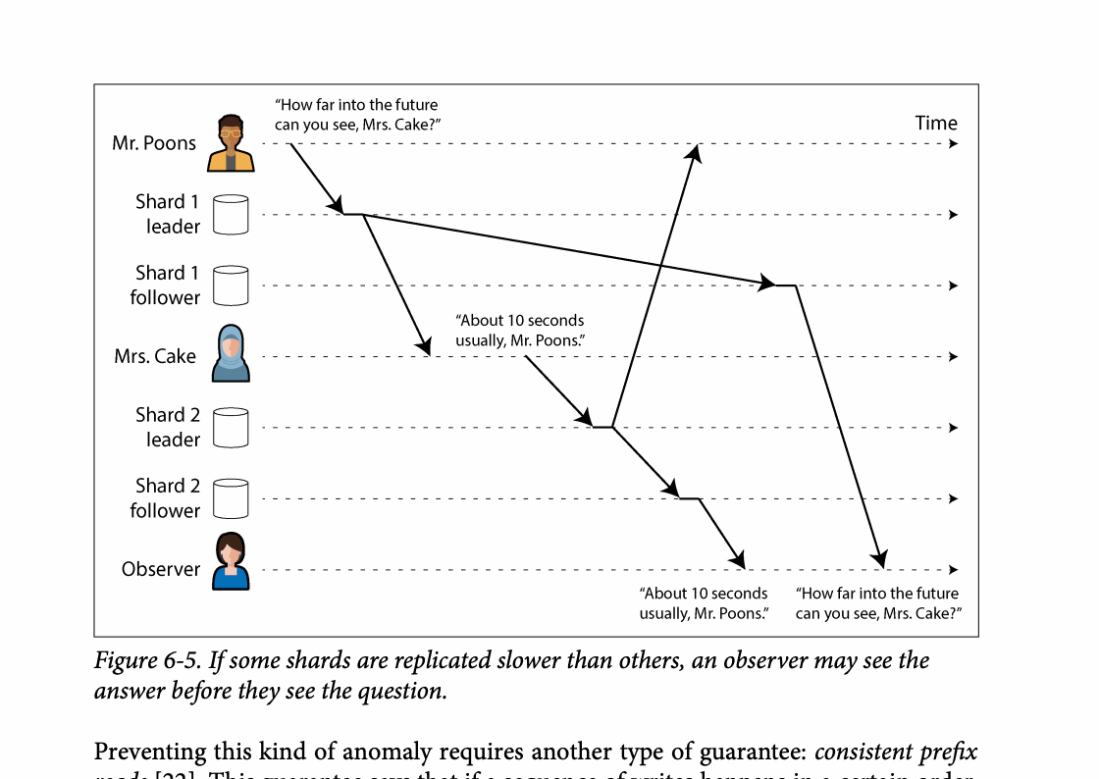
CHAPTER 06
Figure 6-5: mechanism explained
What it shows
Followers can expose older state while replication catches up.
Why it matters
Read-your-writes, monotonic reads, or leader reads protect freshness-sensitive paths.
What to watch
Follow the arrows or timeline and test whether the conclusion still holds under failure, retry, and concurrency.
13 / 29
Notes:
Source: Martin Kleppmann and Chris Riccomini, Designing Data-Intensive Applications, 2nd ed., Chapter 6, book pages 197-243. Figure 6-5, PDF page 238. Original caption: Figure 6-5. If some shards are replicated slower than others, an observer may see the
Explanation: Followers can expose older state while replication catches up. Read-your-writes, monotonic reads, or leader reads protect freshness-sensitive paths. Follow the arrows or timeline and test whether the conclusion still holds under failure, retry, and concurrency.
Source file: /Users/eve/projects/Designing-Data-Intensive-Applications/Designing Data Intensive Applications 2nd.pdf

Slide 14
CHAPTER 06
Multi-leader replication
04
Local leaders reduce write latency across regions and support offline work.
Concurrent writes create conflicts that require explicit resolution.
Conflict handling should preserve intent rather than rely only on last-write-wins.
Core question
What problem does it solve, and what does it cost under failure, growth, and change?
14 / 29
Notes:
Source: Martin Kleppmann and Chris Riccomini, Designing Data-Intensive Applications, 2nd ed., Chapter 6, book pages 197-243.
Source file: /Users/eve/projects/Designing-Data-Intensive-Applications/Designing Data Intensive Applications 2nd.pdf

Slide 15
CHAPTER 06
Multi-leader replication: design trade-offs
04
Fit: Local leaders reduce write latency across regions and support offline work.
Cost: evaluate latency, throughput, consistency, and operational complexity.
Failure check: what state becomes visible when a node, network path, or dependency fails?
Evolution check: can formats, interfaces, and topology change through rolling upgrades?
15 / 29
Notes:
Source: Martin Kleppmann and Chris Riccomini, Designing Data-Intensive Applications, 2nd ed., Chapter 6, book pages 197-243.
Source file: /Users/eve/projects/Designing-Data-Intensive-Applications/Designing Data Intensive Applications 2nd.pdf

Slide 16
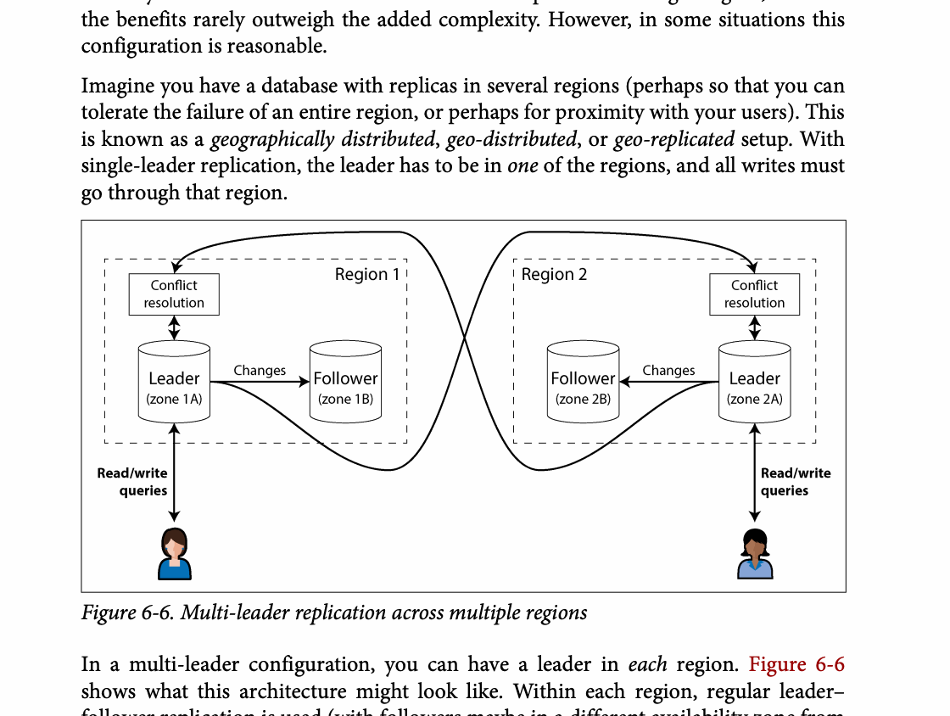
CHAPTER 06
Figure 6-6: mechanism explained
What it shows
Several writers create concurrent versions that may arrive in different orders.
Why it matters
Resolution must preserve intent; last-write-wins can silently discard valid work.
What to watch
Follow the arrows or timeline and test whether the conclusion still holds under failure, retry, and concurrency.
16 / 29
Notes:
Source: Martin Kleppmann and Chris Riccomini, Designing Data-Intensive Applications, 2nd ed., Chapter 6, book pages 197-243. Figure 6-6, PDF page 240. Original caption: Figure 6-6. Multi-leader replication across multiple regions
Explanation: Several writers create concurrent versions that may arrive in different orders. Resolution must preserve intent; last-write-wins can silently discard valid work. Follow the arrows or timeline and test whether the conclusion still holds under failure, retry, and concurrency.
Source file: /Users/eve/projects/Designing-Data-Intensive-Applications/Designing Data Intensive Applications 2nd.pdf

Slide 17
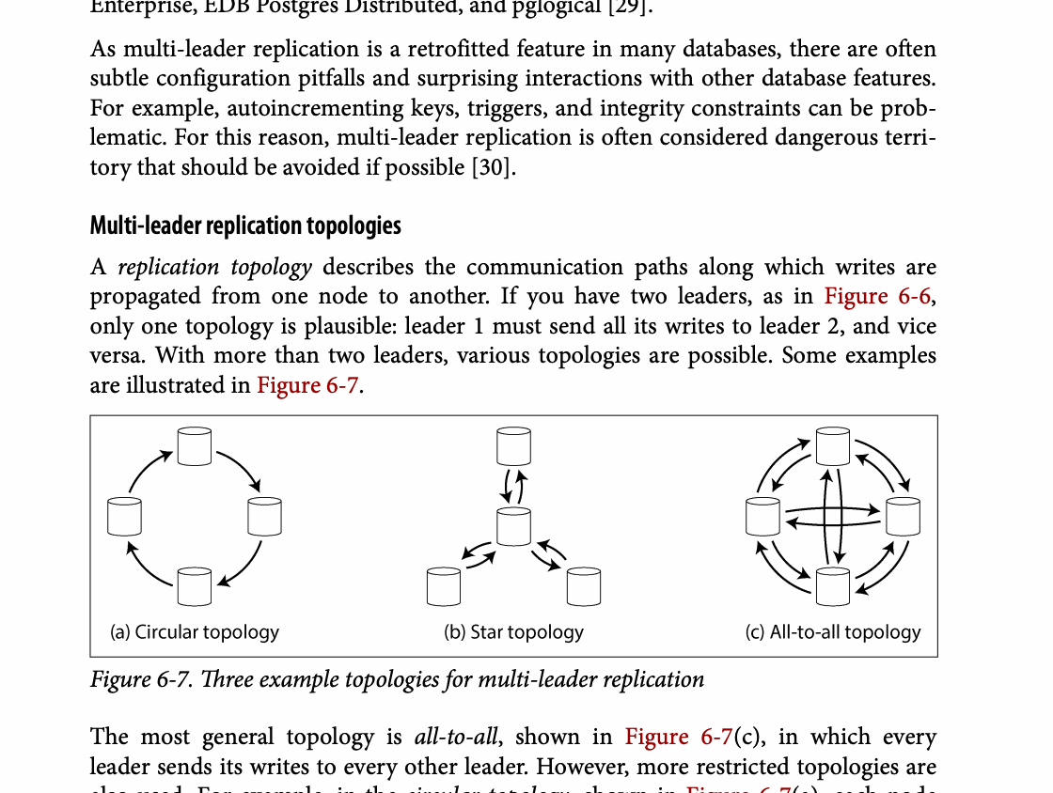
CHAPTER 06
Figure 6-7: mechanism explained
What it shows
Several writers create concurrent versions that may arrive in different orders.
Why it matters
Resolution must preserve intent; last-write-wins can silently discard valid work.
What to watch
Follow the arrows or timeline and test whether the conclusion still holds under failure, retry, and concurrency.
17 / 29
Notes:
Source: Martin Kleppmann and Chris Riccomini, Designing Data-Intensive Applications, 2nd ed., Chapter 6, book pages 197-243. Figure 6-7, PDF page 242. Original caption: Figure 6-7. Three example topologies for multi-leader replication
Explanation: Several writers create concurrent versions that may arrive in different orders. Resolution must preserve intent; last-write-wins can silently discard valid work. Follow the arrows or timeline and test whether the conclusion still holds under failure, retry, and concurrency.
Source file: /Users/eve/projects/Designing-Data-Intensive-Applications/Designing Data Intensive Applications 2nd.pdf

Slide 18
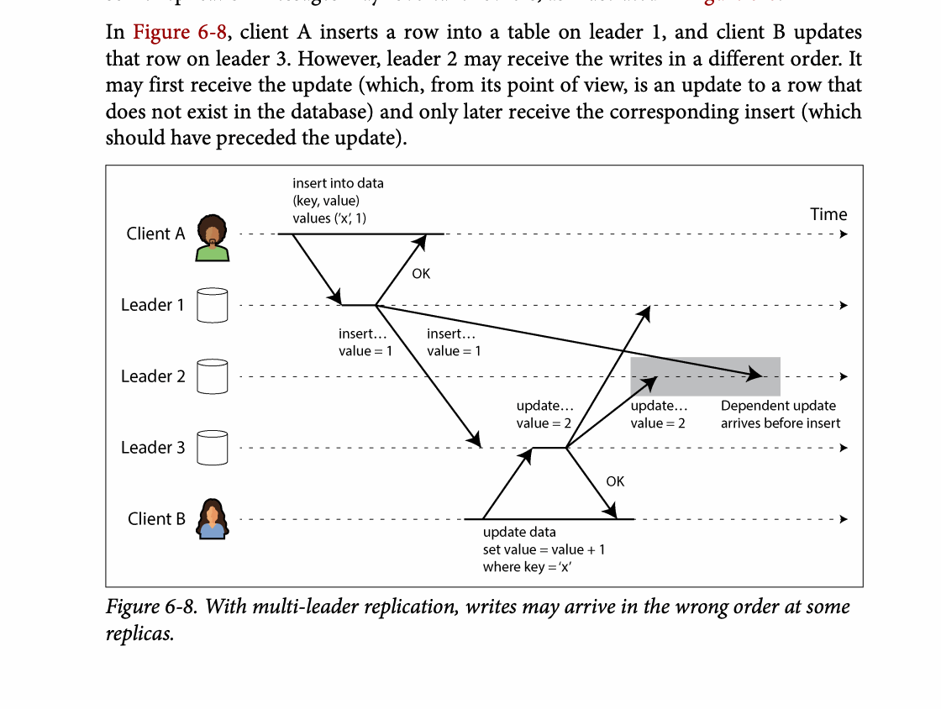
CHAPTER 06
Figure 6-8: mechanism explained
What it shows
Several writers create concurrent versions that may arrive in different orders.
Why it matters
Resolution must preserve intent; last-write-wins can silently discard valid work.
What to watch
Follow the arrows or timeline and test whether the conclusion still holds under failure, retry, and concurrency.
18 / 29
Notes:
Source: Martin Kleppmann and Chris Riccomini, Designing Data-Intensive Applications, 2nd ed., Chapter 6, book pages 197-243. Figure 6-8, PDF page 243. Original caption: Figure 6-8. With multi-leader replication, writes may arrive in the wrong order at some
Explanation: Several writers create concurrent versions that may arrive in different orders. Resolution must preserve intent; last-write-wins can silently discard valid work. Follow the arrows or timeline and test whether the conclusion still holds under failure, retry, and concurrency.
Source file: /Users/eve/projects/Designing-Data-Intensive-Applications/Designing Data Intensive Applications 2nd.pdf

Slide 19
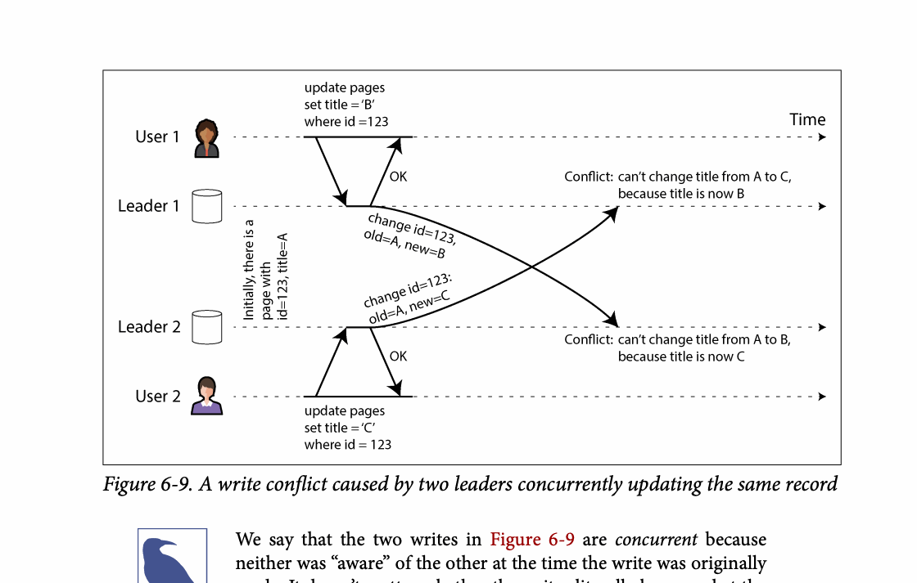
CHAPTER 06
Figure 6-9: mechanism explained
What it shows
Several writers create concurrent versions that may arrive in different orders.
Why it matters
Resolution must preserve intent; last-write-wins can silently discard valid work.
What to watch
Follow the arrows or timeline and test whether the conclusion still holds under failure, retry, and concurrency.
19 / 29
Notes:
Source: Martin Kleppmann and Chris Riccomini, Designing Data-Intensive Applications, 2nd ed., Chapter 6, book pages 197-243. Figure 6-9, PDF page 247. Original caption: Figure 6-9. A write conflict caused by two leaders concurrently updating the same record
Explanation: Several writers create concurrent versions that may arrive in different orders. Resolution must preserve intent; last-write-wins can silently discard valid work. Follow the arrows or timeline and test whether the conclusion still holds under failure, retry, and concurrency.
Source file: /Users/eve/projects/Designing-Data-Intensive-Applications/Designing Data Intensive Applications 2nd.pdf

Slide 20
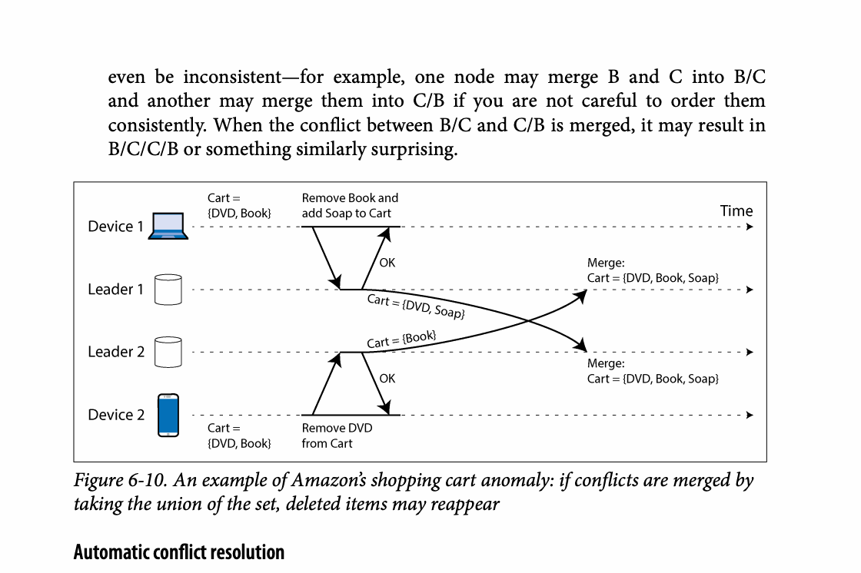
CHAPTER 06
Figure 6-10: mechanism explained
What it shows
Several writers create concurrent versions that may arrive in different orders.
Why it matters
Resolution must preserve intent; last-write-wins can silently discard valid work.
What to watch
Follow the arrows or timeline and test whether the conclusion still holds under failure, retry, and concurrency.
20 / 29
Notes:
Source: Martin Kleppmann and Chris Riccomini, Designing Data-Intensive Applications, 2nd ed., Chapter 6, book pages 197-243. Figure 6-10, PDF page 250. Original caption: Figure 6-10. An example of Amazon’s shopping cart anomaly: if conflicts are merged by
Explanation: Several writers create concurrent versions that may arrive in different orders. Resolution must preserve intent; last-write-wins can silently discard valid work. Follow the arrows or timeline and test whether the conclusion still holds under failure, retry, and concurrency.
Source file: /Users/eve/projects/Designing-Data-Intensive-Applications/Designing Data Intensive Applications 2nd.pdf

Slide 21
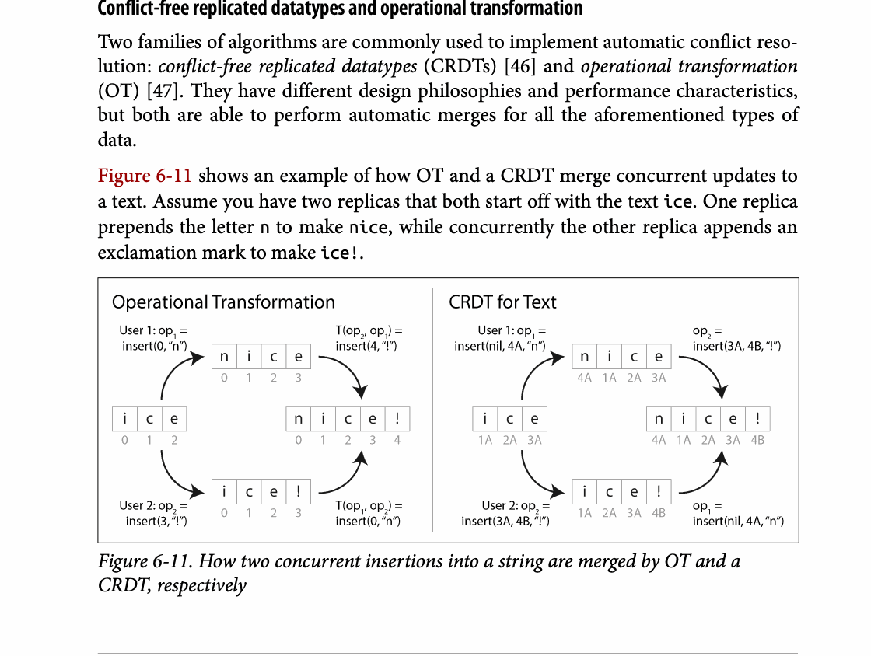
CHAPTER 06
Figure 6-11: mechanism explained
What it shows
Several writers create concurrent versions that may arrive in different orders.
Why it matters
Resolution must preserve intent; last-write-wins can silently discard valid work.
What to watch
Follow the arrows or timeline and test whether the conclusion still holds under failure, retry, and concurrency.
21 / 29
Notes:
Source: Martin Kleppmann and Chris Riccomini, Designing Data-Intensive Applications, 2nd ed., Chapter 6, book pages 197-243. Figure 6-11, PDF page 251. Original caption: Figure 6-11. How two concurrent insertions into a string are merged by OT and a
Explanation: Several writers create concurrent versions that may arrive in different orders. Resolution must preserve intent; last-write-wins can silently discard valid work. Follow the arrows or timeline and test whether the conclusion still holds under failure, retry, and concurrency.
Source file: /Users/eve/projects/Designing-Data-Intensive-Applications/Designing Data Intensive Applications 2nd.pdf

Slide 22
CHAPTER 06
Leaderless replication
05
Clients read and write several replicas and compare versions.
Read repair and anti-entropy repair missed updates.
Quorum arithmetic alone does not guarantee strong consistency.
Core question
What problem does it solve, and what does it cost under failure, growth, and change?
22 / 29
Notes:
Source: Martin Kleppmann and Chris Riccomini, Designing Data-Intensive Applications, 2nd ed., Chapter 6, book pages 197-243.
Source file: /Users/eve/projects/Designing-Data-Intensive-Applications/Designing Data Intensive Applications 2nd.pdf

Slide 23
CHAPTER 06
Leaderless replication: design trade-offs
05
Fit: Clients read and write several replicas and compare versions.
Cost: evaluate latency, throughput, consistency, and operational complexity.
Failure check: what state becomes visible when a node, network path, or dependency fails?
Evolution check: can formats, interfaces, and topology change through rolling upgrades?
23 / 29
Notes:
Source: Martin Kleppmann and Chris Riccomini, Designing Data-Intensive Applications, 2nd ed., Chapter 6, book pages 197-243.
Source file: /Users/eve/projects/Designing-Data-Intensive-Applications/Designing Data Intensive Applications 2nd.pdf

Slide 24
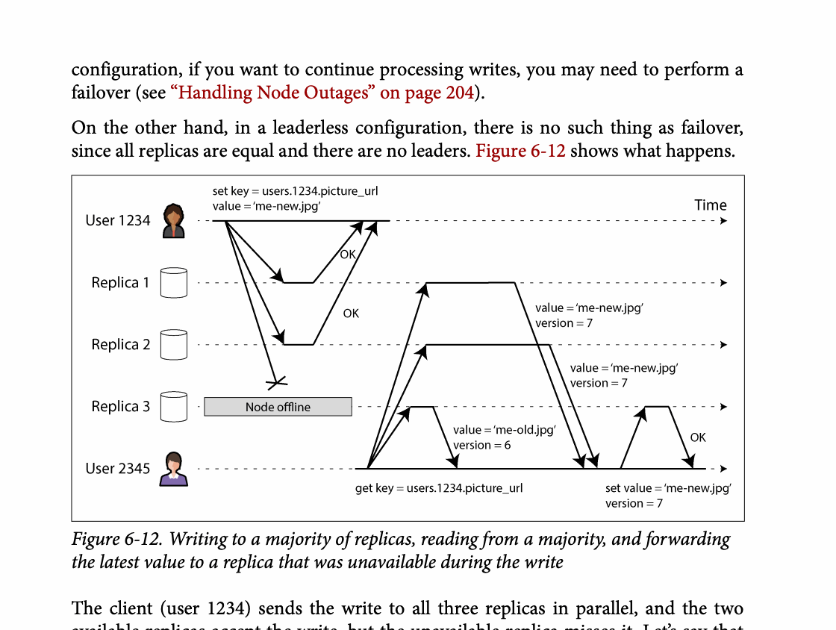
CHAPTER 06
Figure 6-12: mechanism explained
What it shows
Replica responses and version metadata are used to reason about freshness and causality.
Why it matters
Quorum overlap helps, but concurrent writes still require explicit version handling.
What to watch
Follow the arrows or timeline and test whether the conclusion still holds under failure, retry, and concurrency.
24 / 29
Notes:
Source: Martin Kleppmann and Chris Riccomini, Designing Data-Intensive Applications, 2nd ed., Chapter 6, book pages 197-243. Figure 6-12, PDF page 254. Original caption: Figure 6-12. Writing to a majority of replicas, reading from a majority, and forwarding
Explanation: Replica responses and version metadata are used to reason about freshness and causality. Quorum overlap helps, but concurrent writes still require explicit version handling. Follow the arrows or timeline and test whether the conclusion still holds under failure, retry, and concurrency.
Source file: /Users/eve/projects/Designing-Data-Intensive-Applications/Designing Data Intensive Applications 2nd.pdf

Slide 25
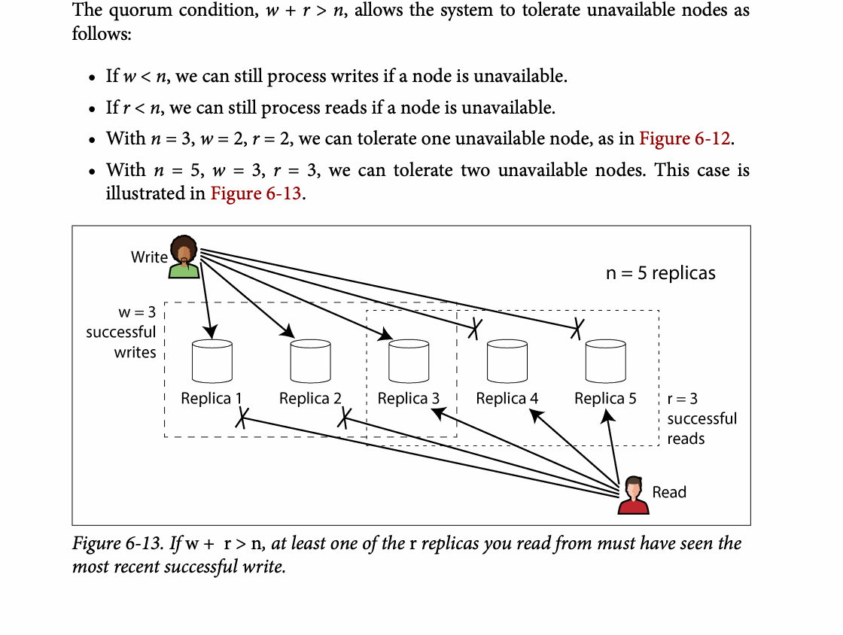
CHAPTER 06
Figure 6-13: mechanism explained
What it shows
If w + r > n, at least one of the r replicas you read from must have seen the
Why it matters
It turns the chapter concept into a concrete dataflow, timeline, or state transition.
What to watch
Check the actors, data direction, operation order, and hidden system assumptions.
25 / 29
Notes:
Source: Martin Kleppmann and Chris Riccomini, Designing Data-Intensive Applications, 2nd ed., Chapter 6, book pages 197-243. Figure 6-13, PDF page 256. Original caption: Figure 6-13. If w + r > n, at least one of the r replicas you read from must have seen the
Explanation: If w + r > n, at least one of the r replicas you read from must have seen the It turns the chapter concept into a concrete dataflow, timeline, or state transition. Check the actors, data direction, operation order, and hidden system assumptions.
Source file: /Users/eve/projects/Designing-Data-Intensive-Applications/Designing Data Intensive Applications 2nd.pdf

Slide 26
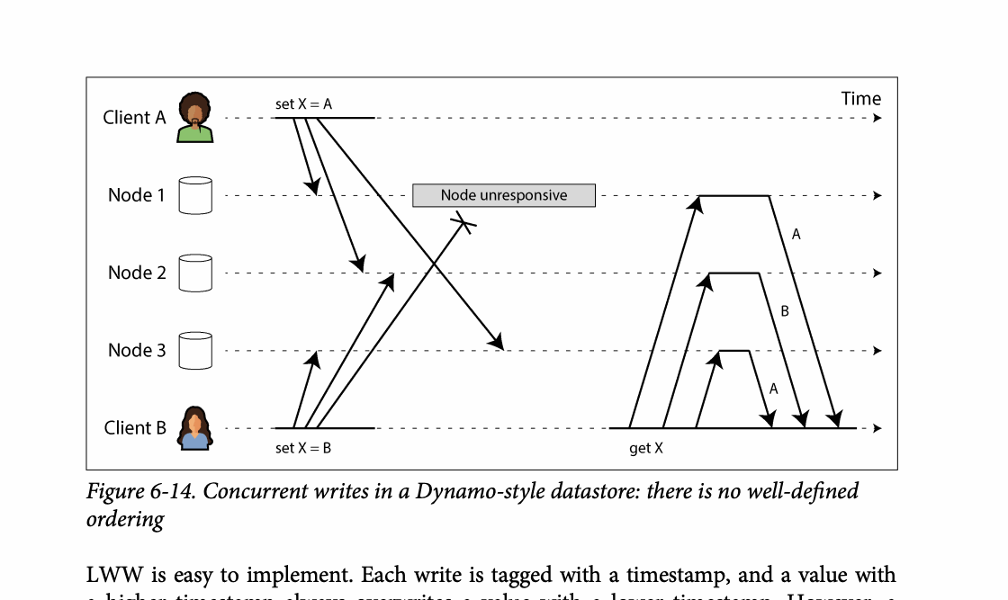
CHAPTER 06
Figure 6-14: mechanism explained
What it shows
Concurrent writes in a Dynamo-style datastore: there is no well-defined
Why it matters
It turns the chapter concept into a concrete dataflow, timeline, or state transition.
What to watch
Check the actors, data direction, operation order, and hidden system assumptions.
26 / 29
Notes:
Source: Martin Kleppmann and Chris Riccomini, Designing Data-Intensive Applications, 2nd ed., Chapter 6, book pages 197-243. Figure 6-14, PDF page 262. Original caption: Figure 6-14. Concurrent writes in a Dynamo-style datastore: there is no well-defined
Explanation: Concurrent writes in a Dynamo-style datastore: there is no well-defined It turns the chapter concept into a concrete dataflow, timeline, or state transition. Check the actors, data direction, operation order, and hidden system assumptions.
Source file: /Users/eve/projects/Designing-Data-Intensive-Applications/Designing Data Intensive Applications 2nd.pdf

Slide 27
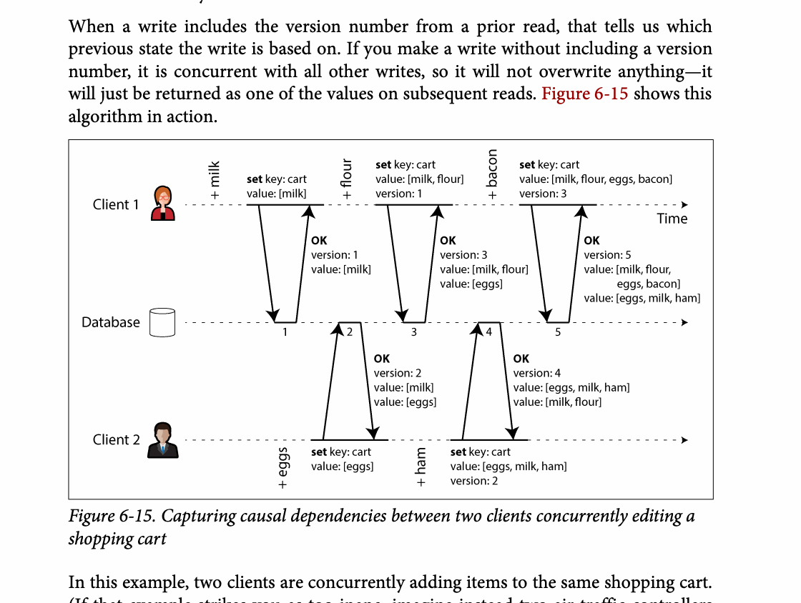
CHAPTER 06
Figure 6-15: mechanism explained
What it shows
Replica responses and version metadata are used to reason about freshness and causality.
Why it matters
Quorum overlap helps, but concurrent writes still require explicit version handling.
What to watch
Follow the arrows or timeline and test whether the conclusion still holds under failure, retry, and concurrency.
27 / 29
Notes:
Source: Martin Kleppmann and Chris Riccomini, Designing Data-Intensive Applications, 2nd ed., Chapter 6, book pages 197-243. Figure 6-15, PDF page 264. Original caption: Figure 6-15. Capturing causal dependencies between two clients concurrently editing a
Explanation: Replica responses and version metadata are used to reason about freshness and causality. Quorum overlap helps, but concurrent writes still require explicit version handling. Follow the arrows or timeline and test whether the conclusion still holds under failure, retry, and concurrency.
Source file: /Users/eve/projects/Designing-Data-Intensive-Applications/Designing Data Intensive Applications 2nd.pdf

Slide 28
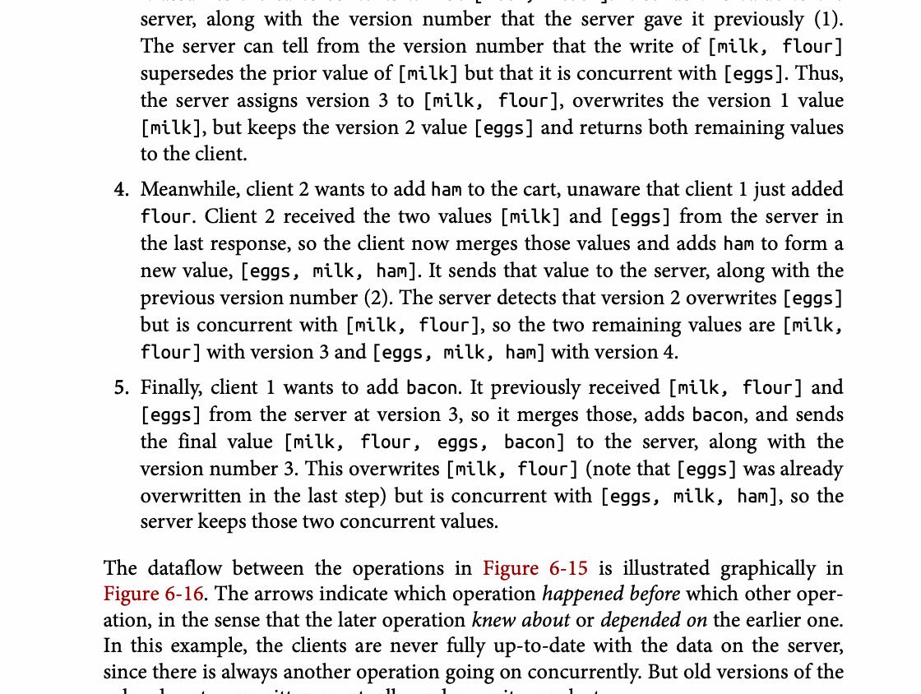
CHAPTER 06
Figure 6-16: mechanism explained
What it shows
Replica responses and version metadata are used to reason about freshness and causality.
Why it matters
Quorum overlap helps, but concurrent writes still require explicit version handling.
What to watch
Follow the arrows or timeline and test whether the conclusion still holds under failure, retry, and concurrency.
28 / 29
Notes:
Source: Martin Kleppmann and Chris Riccomini, Designing Data-Intensive Applications, 2nd ed., Chapter 6, book pages 197-243. Figure 6-16, PDF page 265. Original caption: Figure 6-16. The arrows indicate which operation happened before which other oper‐
Explanation: Replica responses and version metadata are used to reason about freshness and causality. Quorum overlap helps, but concurrent writes still require explicit version handling. Follow the arrows or timeline and test whether the conclusion still holds under failure, retry, and concurrency.
Source file: /Users/eve/projects/Designing-Data-Intensive-Applications/Designing Data Intensive Applications 2nd.pdf

Slide 29
CHAPTER 06
Review and application
State the chapter’s central problem in one sentence.
Choose one mechanism and list the assumptions it relies on.
Describe a failure scenario and explain the recovery path.
Apply one trade-off from the chapter to a system you are designing.
29 / 29
Notes:
Source: Martin Kleppmann and Chris Riccomini, Designing Data-Intensive Applications, 2nd ed., Chapter 6, book pages 197-243.
Source file: /Users/eve/projects/Designing-Data-Intensive-Applications/Designing Data Intensive Applications 2nd.pdf

