Slide 1
CHAPTER 07
Sharding
Designing Data-Intensive Applications, Second Edition
Detailed English Study Edition
01 / 23
Notes:
Source: Martin Kleppmann and Chris Riccomini, Designing Data-Intensive Applications, 2nd ed., Chapter 7, book pages 251-271.
Source file: /Users/eve/projects/Designing-Data-Intensive-Applications/Designing Data Intensive Applications 2nd.pdf

Slide 2
CHAPTER 07
Chapter map
01
Why shard data
Sharding spreads storage and throughput across nodes.
02
Range sharding
Adjacent keys share shards, enabling efficient range scans.
03
Hash sharding
Hashing distributes keys more evenly.
04
Hot spots and rebalancing
Hot keys, tenants, and time-correlated writes create skew.
05
Indexes and routing
Local indexes simplify writes but require scatter-gather queries.
02 / 23
Notes:
Source: Martin Kleppmann and Chris Riccomini, Designing Data-Intensive Applications, 2nd ed., Chapter 7, book pages 251-271.
Source file: /Users/eve/projects/Designing-Data-Intensive-Applications/Designing Data Intensive Applications 2nd.pdf

Slide 3
CHAPTER 07
Why shard data
01
Sharding spreads storage and throughput across nodes.
The hard problems are balance, hot spots, and cross-shard work.
Routing and rebalancing become part of normal operations.
Core question
What problem does it solve, and what does it cost under failure, growth, and change?
03 / 23
Notes:
Source: Martin Kleppmann and Chris Riccomini, Designing Data-Intensive Applications, 2nd ed., Chapter 7, book pages 251-271.
Source file: /Users/eve/projects/Designing-Data-Intensive-Applications/Designing Data Intensive Applications 2nd.pdf

Slide 4
CHAPTER 07
Why shard data: design trade-offs
01
Fit: Sharding spreads storage and throughput across nodes.
Cost: evaluate latency, throughput, consistency, and operational complexity.
Failure check: what state becomes visible when a node, network path, or dependency fails?
Evolution check: can formats, interfaces, and topology change through rolling upgrades?
04 / 23
Notes:
Source: Martin Kleppmann and Chris Riccomini, Designing Data-Intensive Applications, 2nd ed., Chapter 7, book pages 251-271.
Source file: /Users/eve/projects/Designing-Data-Intensive-Applications/Designing Data Intensive Applications 2nd.pdf

Slide 5
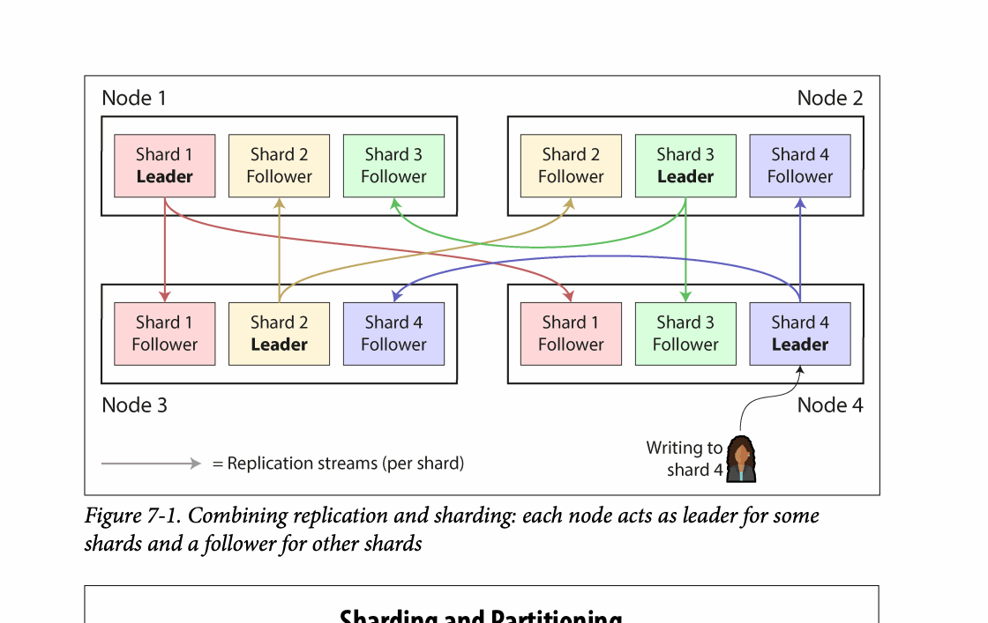
CHAPTER 07
Figure 7-1: mechanism explained
What it shows
Keys, requests, or index entries are assigned across partitions.
Why it matters
The assignment controls balance, range locality, routing work, and rebalancing cost.
What to watch
Follow the arrows or timeline and test whether the conclusion still holds under failure, retry, and concurrency.
05 / 23
Notes:
Source: Martin Kleppmann and Chris Riccomini, Designing Data-Intensive Applications, 2nd ed., Chapter 7, book pages 251-271. Figure 7-1, PDF page 276. Original caption: Figure 7-1. Combining replication and sharding: each node acts as leader for some
Explanation: Keys, requests, or index entries are assigned across partitions. The assignment controls balance, range locality, routing work, and rebalancing cost. Follow the arrows or timeline and test whether the conclusion still holds under failure, retry, and concurrency.
Source file: /Users/eve/projects/Designing-Data-Intensive-Applications/Designing Data Intensive Applications 2nd.pdf

Slide 6
CHAPTER 07
Range sharding
02
Adjacent keys share shards, enabling efficient range scans.
Sequential inserts can concentrate load on one shard.
Dynamic boundaries adapt shard size to the observed distribution.
Core question
What problem does it solve, and what does it cost under failure, growth, and change?
06 / 23
Notes:
Source: Martin Kleppmann and Chris Riccomini, Designing Data-Intensive Applications, 2nd ed., Chapter 7, book pages 251-271.
Source file: /Users/eve/projects/Designing-Data-Intensive-Applications/Designing Data Intensive Applications 2nd.pdf

Slide 7
CHAPTER 07
Range sharding: design trade-offs
02
Fit: Adjacent keys share shards, enabling efficient range scans.
Cost: evaluate latency, throughput, consistency, and operational complexity.
Failure check: what state becomes visible when a node, network path, or dependency fails?
Evolution check: can formats, interfaces, and topology change through rolling upgrades?
07 / 23
Notes:
Source: Martin Kleppmann and Chris Riccomini, Designing Data-Intensive Applications, 2nd ed., Chapter 7, book pages 251-271.
Source file: /Users/eve/projects/Designing-Data-Intensive-Applications/Designing Data Intensive Applications 2nd.pdf

Slide 8
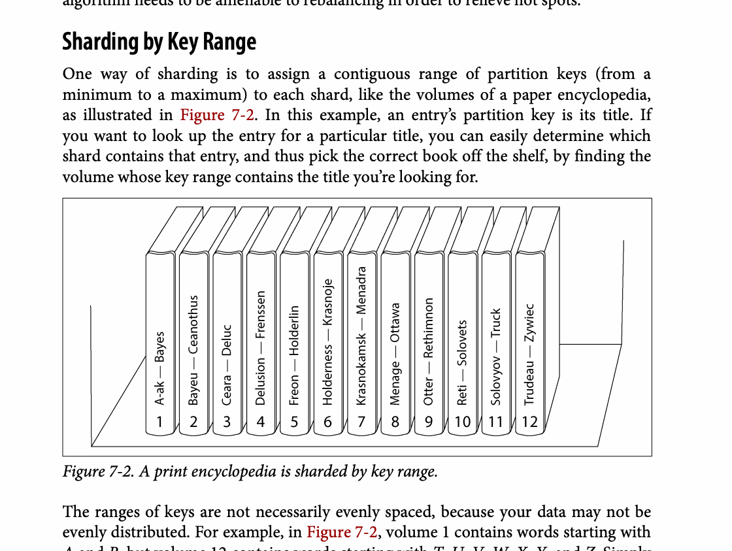
CHAPTER 07
Figure 7-2: mechanism explained
What it shows
Keys, requests, or index entries are assigned across partitions.
Why it matters
The assignment controls balance, range locality, routing work, and rebalancing cost.
What to watch
Follow the arrows or timeline and test whether the conclusion still holds under failure, retry, and concurrency.
08 / 23
Notes:
Source: Martin Kleppmann and Chris Riccomini, Designing Data-Intensive Applications, 2nd ed., Chapter 7, book pages 251-271. Figure 7-2, PDF page 280. Original caption: Figure 7-2. A print encyclopedia is sharded by key range.
Explanation: Keys, requests, or index entries are assigned across partitions. The assignment controls balance, range locality, routing work, and rebalancing cost. Follow the arrows or timeline and test whether the conclusion still holds under failure, retry, and concurrency.
Source file: /Users/eve/projects/Designing-Data-Intensive-Applications/Designing Data Intensive Applications 2nd.pdf

Slide 9
CHAPTER 07
Hash sharding
03
Hashing distributes keys more evenly.
Range scans usually contact several shards.
Fixed slots or consistent hashing reduce movement during rebalancing.
Core question
What problem does it solve, and what does it cost under failure, growth, and change?
09 / 23
Notes:
Source: Martin Kleppmann and Chris Riccomini, Designing Data-Intensive Applications, 2nd ed., Chapter 7, book pages 251-271.
Source file: /Users/eve/projects/Designing-Data-Intensive-Applications/Designing Data Intensive Applications 2nd.pdf

Slide 10
CHAPTER 07
Hash sharding: design trade-offs
03
Fit: Hashing distributes keys more evenly.
Cost: evaluate latency, throughput, consistency, and operational complexity.
Failure check: what state becomes visible when a node, network path, or dependency fails?
Evolution check: can formats, interfaces, and topology change through rolling upgrades?
10 / 23
Notes:
Source: Martin Kleppmann and Chris Riccomini, Designing Data-Intensive Applications, 2nd ed., Chapter 7, book pages 251-271.
Source file: /Users/eve/projects/Designing-Data-Intensive-Applications/Designing Data Intensive Applications 2nd.pdf

Slide 11
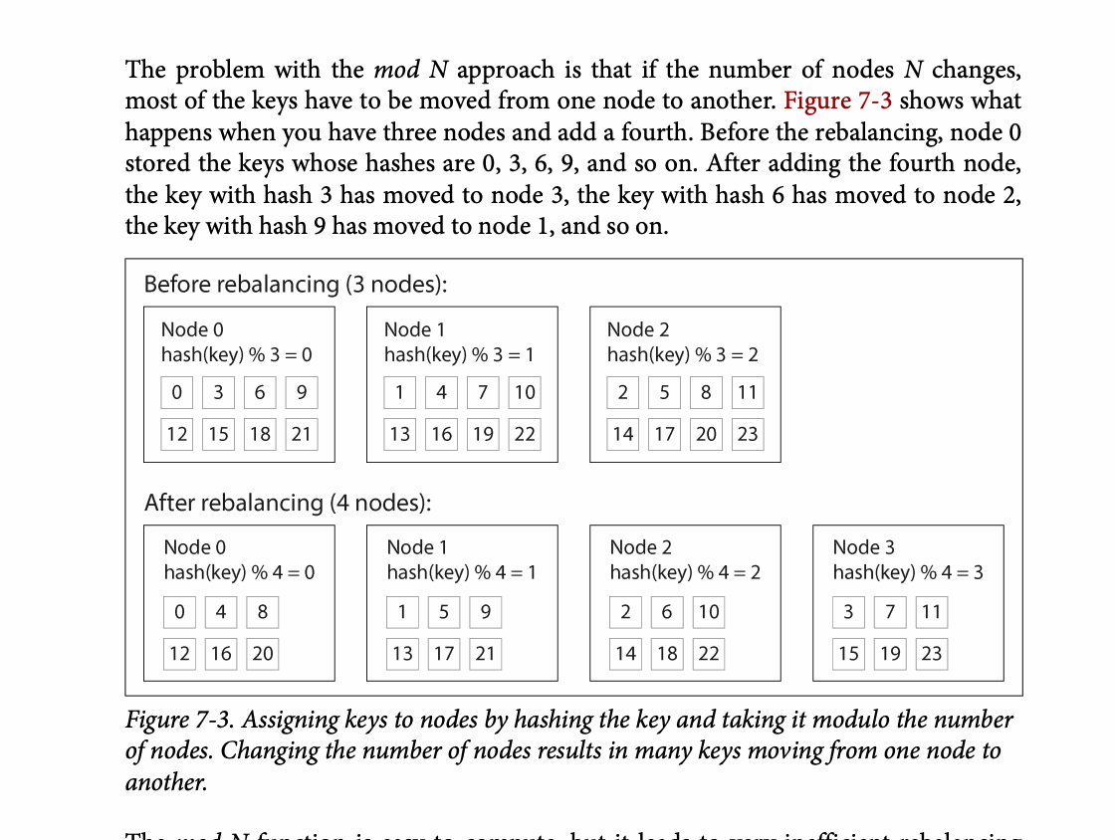
CHAPTER 07
Figure 7-3: mechanism explained
What it shows
Assigning keys to nodes by hashing the key and taking it modulo the number
Why it matters
It turns the chapter concept into a concrete dataflow, timeline, or state transition.
What to watch
Check the actors, data direction, operation order, and hidden system assumptions.
11 / 23
Notes:
Source: Martin Kleppmann and Chris Riccomini, Designing Data-Intensive Applications, 2nd ed., Chapter 7, book pages 251-271. Figure 7-3, PDF page 283. Original caption: Figure 7-3. Assigning keys to nodes by hashing the key and taking it modulo the number
Explanation: Assigning keys to nodes by hashing the key and taking it modulo the number It turns the chapter concept into a concrete dataflow, timeline, or state transition. Check the actors, data direction, operation order, and hidden system assumptions.
Source file: /Users/eve/projects/Designing-Data-Intensive-Applications/Designing Data Intensive Applications 2nd.pdf

Slide 12
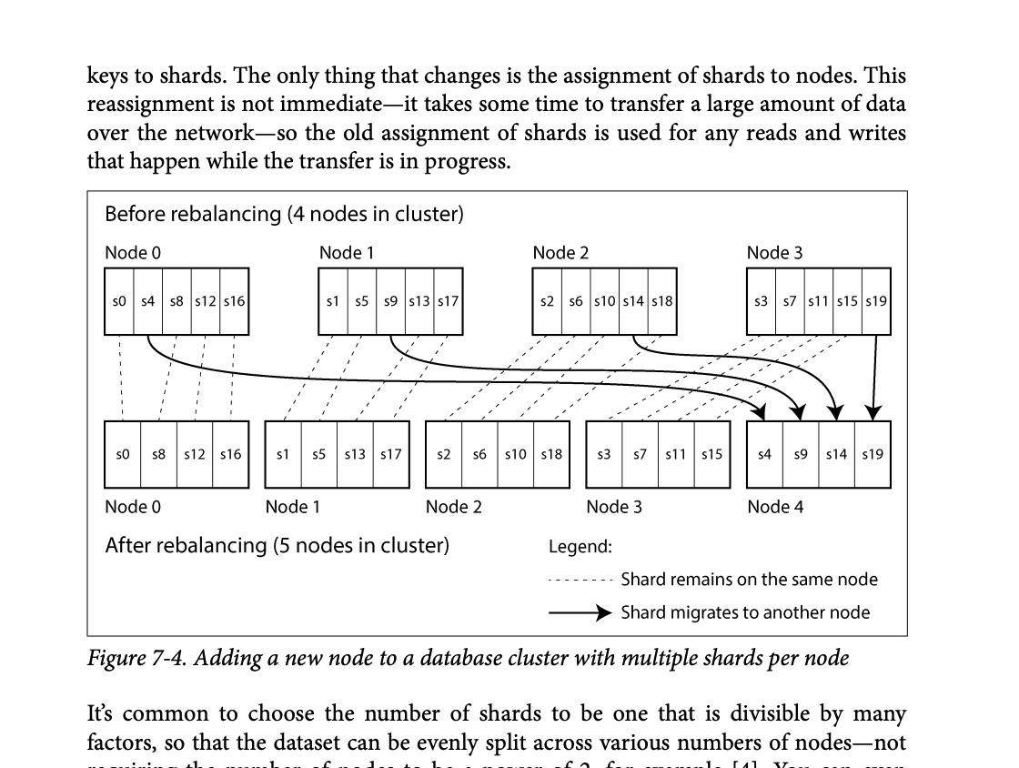
CHAPTER 07
Figure 7-4: mechanism explained
What it shows
Keys, requests, or index entries are assigned across partitions.
Why it matters
The assignment controls balance, range locality, routing work, and rebalancing cost.
What to watch
Follow the arrows or timeline and test whether the conclusion still holds under failure, retry, and concurrency.
12 / 23
Notes:
Source: Martin Kleppmann and Chris Riccomini, Designing Data-Intensive Applications, 2nd ed., Chapter 7, book pages 251-271. Figure 7-4, PDF page 284. Original caption: Figure 7-4. Adding a new node to a database cluster with multiple shards per node
Explanation: Keys, requests, or index entries are assigned across partitions. The assignment controls balance, range locality, routing work, and rebalancing cost. Follow the arrows or timeline and test whether the conclusion still holds under failure, retry, and concurrency.
Source file: /Users/eve/projects/Designing-Data-Intensive-Applications/Designing Data Intensive Applications 2nd.pdf

Slide 13
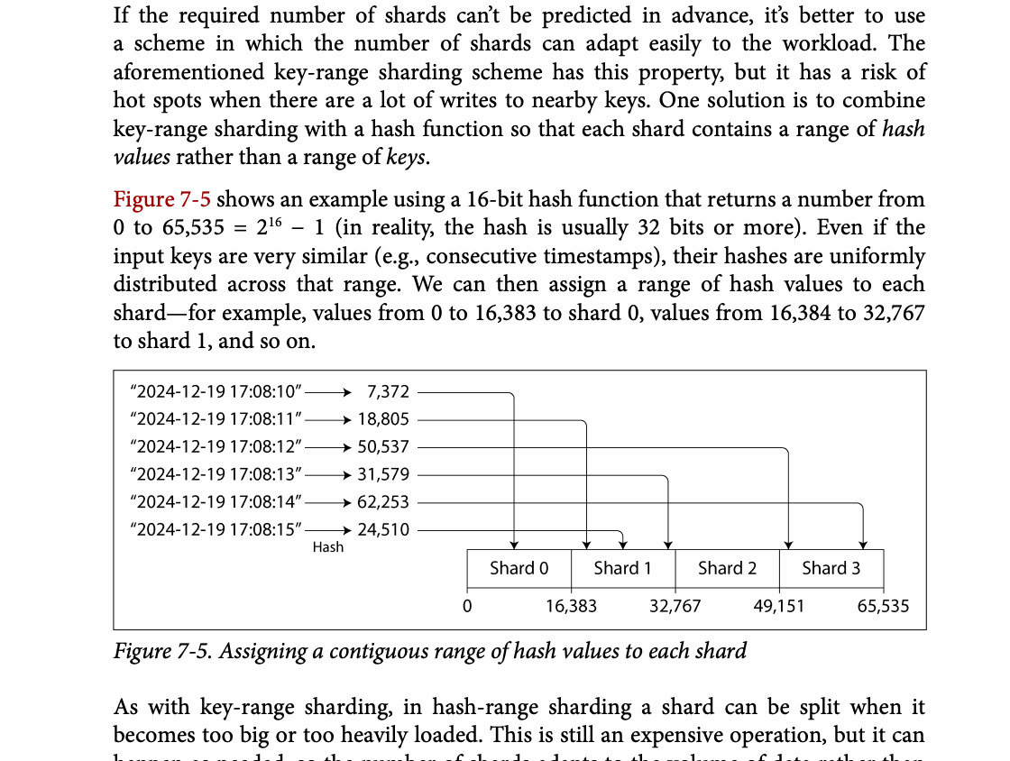
CHAPTER 07
Figure 7-5: mechanism explained
What it shows
Keys, requests, or index entries are assigned across partitions.
Why it matters
The assignment controls balance, range locality, routing work, and rebalancing cost.
What to watch
Follow the arrows or timeline and test whether the conclusion still holds under failure, retry, and concurrency.
13 / 23
Notes:
Source: Martin Kleppmann and Chris Riccomini, Designing Data-Intensive Applications, 2nd ed., Chapter 7, book pages 251-271. Figure 7-5, PDF page 285. Original caption: Figure 7-5. Assigning a contiguous range of hash values to each shard
Explanation: Keys, requests, or index entries are assigned across partitions. The assignment controls balance, range locality, routing work, and rebalancing cost. Follow the arrows or timeline and test whether the conclusion still holds under failure, retry, and concurrency.
Source file: /Users/eve/projects/Designing-Data-Intensive-Applications/Designing Data Intensive Applications 2nd.pdf

Slide 14
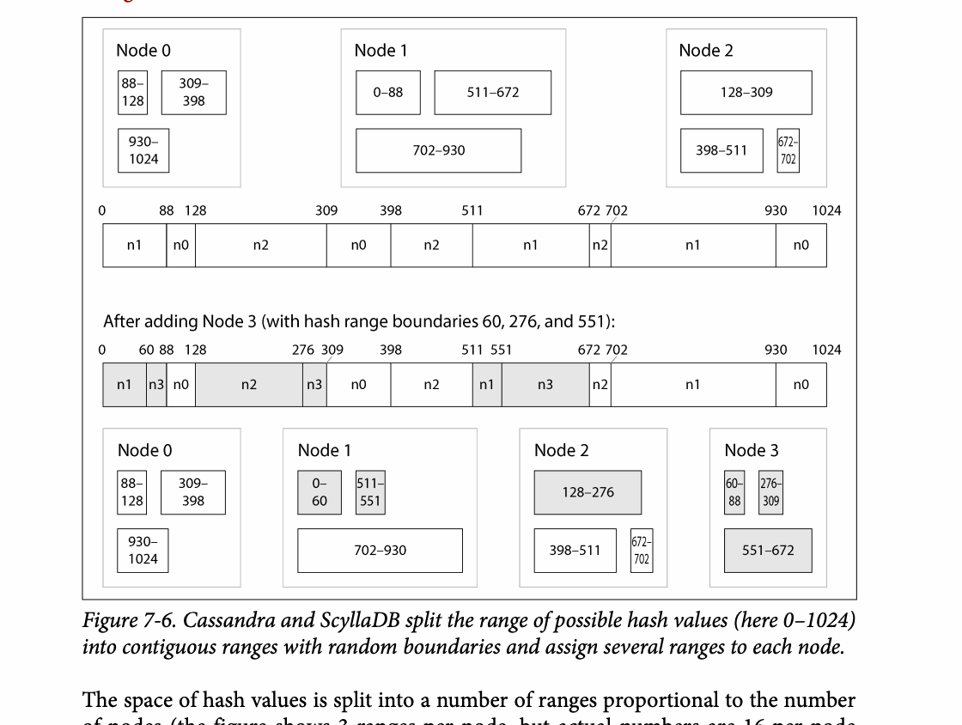
CHAPTER 07
Figure 7-6: mechanism explained
What it shows
Keys, requests, or index entries are assigned across partitions.
Why it matters
The assignment controls balance, range locality, routing work, and rebalancing cost.
What to watch
Follow the arrows or timeline and test whether the conclusion still holds under failure, retry, and concurrency.
14 / 23
Notes:
Source: Martin Kleppmann and Chris Riccomini, Designing Data-Intensive Applications, 2nd ed., Chapter 7, book pages 251-271. Figure 7-6, PDF page 286. Original caption: Figure 7-6. Cassandra and ScyllaDB split the range of possible hash values (here 0–1024)
Explanation: Keys, requests, or index entries are assigned across partitions. The assignment controls balance, range locality, routing work, and rebalancing cost. Follow the arrows or timeline and test whether the conclusion still holds under failure, retry, and concurrency.
Source file: /Users/eve/projects/Designing-Data-Intensive-Applications/Designing Data Intensive Applications 2nd.pdf

Slide 15
CHAPTER 07
Hot spots and rebalancing
04
Hot keys, tenants, and time-correlated writes create skew.
Splitting a hot key complicates aggregation and consistency.
Automated movement needs rate limits and stability controls.
Core question
What problem does it solve, and what does it cost under failure, growth, and change?
15 / 23
Notes:
Source: Martin Kleppmann and Chris Riccomini, Designing Data-Intensive Applications, 2nd ed., Chapter 7, book pages 251-271.
Source file: /Users/eve/projects/Designing-Data-Intensive-Applications/Designing Data Intensive Applications 2nd.pdf

Slide 16
CHAPTER 07
Hot spots and rebalancing: design trade-offs
04
Fit: Hot keys, tenants, and time-correlated writes create skew.
Cost: evaluate latency, throughput, consistency, and operational complexity.
Failure check: what state becomes visible when a node, network path, or dependency fails?
Evolution check: can formats, interfaces, and topology change through rolling upgrades?
16 / 23
Notes:
Source: Martin Kleppmann and Chris Riccomini, Designing Data-Intensive Applications, 2nd ed., Chapter 7, book pages 251-271.
Source file: /Users/eve/projects/Designing-Data-Intensive-Applications/Designing Data Intensive Applications 2nd.pdf

Slide 17
CHAPTER 07
Indexes and routing
05
Local indexes simplify writes but require scatter-gather queries.
Global indexes speed reads but complicate updates.
Routers must track ownership while topology changes.
Core question
What problem does it solve, and what does it cost under failure, growth, and change?
17 / 23
Notes:
Source: Martin Kleppmann and Chris Riccomini, Designing Data-Intensive Applications, 2nd ed., Chapter 7, book pages 251-271.
Source file: /Users/eve/projects/Designing-Data-Intensive-Applications/Designing Data Intensive Applications 2nd.pdf

Slide 18
CHAPTER 07
Indexes and routing: design trade-offs
05
Fit: Local indexes simplify writes but require scatter-gather queries.
Cost: evaluate latency, throughput, consistency, and operational complexity.
Failure check: what state becomes visible when a node, network path, or dependency fails?
Evolution check: can formats, interfaces, and topology change through rolling upgrades?
18 / 23
Notes:
Source: Martin Kleppmann and Chris Riccomini, Designing Data-Intensive Applications, 2nd ed., Chapter 7, book pages 251-271.
Source file: /Users/eve/projects/Designing-Data-Intensive-Applications/Designing Data Intensive Applications 2nd.pdf

Slide 19
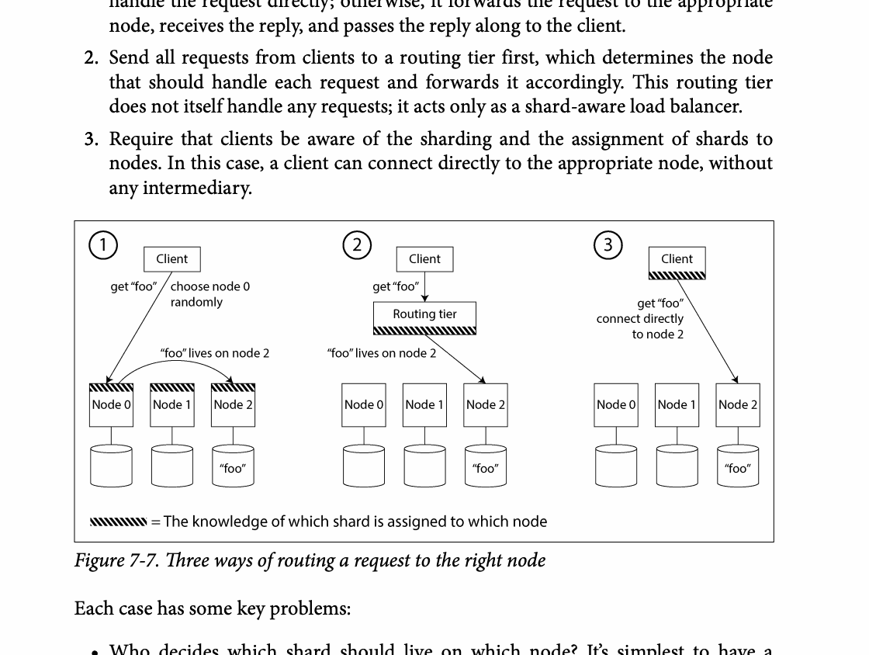
CHAPTER 07
Figure 7-7: mechanism explained
What it shows
Keys, requests, or index entries are assigned across partitions.
Why it matters
The assignment controls balance, range locality, routing work, and rebalancing cost.
What to watch
Follow the arrows or timeline and test whether the conclusion still holds under failure, retry, and concurrency.
19 / 23
Notes:
Source: Martin Kleppmann and Chris Riccomini, Designing Data-Intensive Applications, 2nd ed., Chapter 7, book pages 251-271. Figure 7-7, PDF page 290. Original caption: Figure 7-7. Three ways of routing a request to the right node
Explanation: Keys, requests, or index entries are assigned across partitions. The assignment controls balance, range locality, routing work, and rebalancing cost. Follow the arrows or timeline and test whether the conclusion still holds under failure, retry, and concurrency.
Source file: /Users/eve/projects/Designing-Data-Intensive-Applications/Designing Data Intensive Applications 2nd.pdf

Slide 20
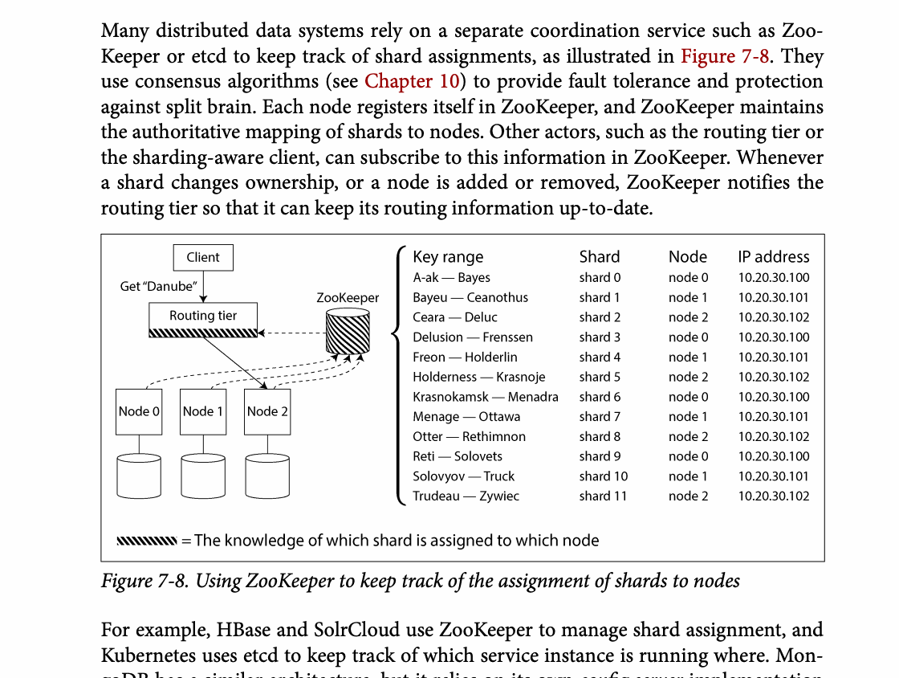
CHAPTER 07
Figure 7-8: mechanism explained
What it shows
Keys, requests, or index entries are assigned across partitions.
Why it matters
The assignment controls balance, range locality, routing work, and rebalancing cost.
What to watch
Follow the arrows or timeline and test whether the conclusion still holds under failure, retry, and concurrency.
20 / 23
Notes:
Source: Martin Kleppmann and Chris Riccomini, Designing Data-Intensive Applications, 2nd ed., Chapter 7, book pages 251-271. Figure 7-8, PDF page 291. Original caption: Figure 7-8. Using ZooKeeper to keep track of the assignment of shards to nodes
Explanation: Keys, requests, or index entries are assigned across partitions. The assignment controls balance, range locality, routing work, and rebalancing cost. Follow the arrows or timeline and test whether the conclusion still holds under failure, retry, and concurrency.
Source file: /Users/eve/projects/Designing-Data-Intensive-Applications/Designing Data Intensive Applications 2nd.pdf

Slide 21
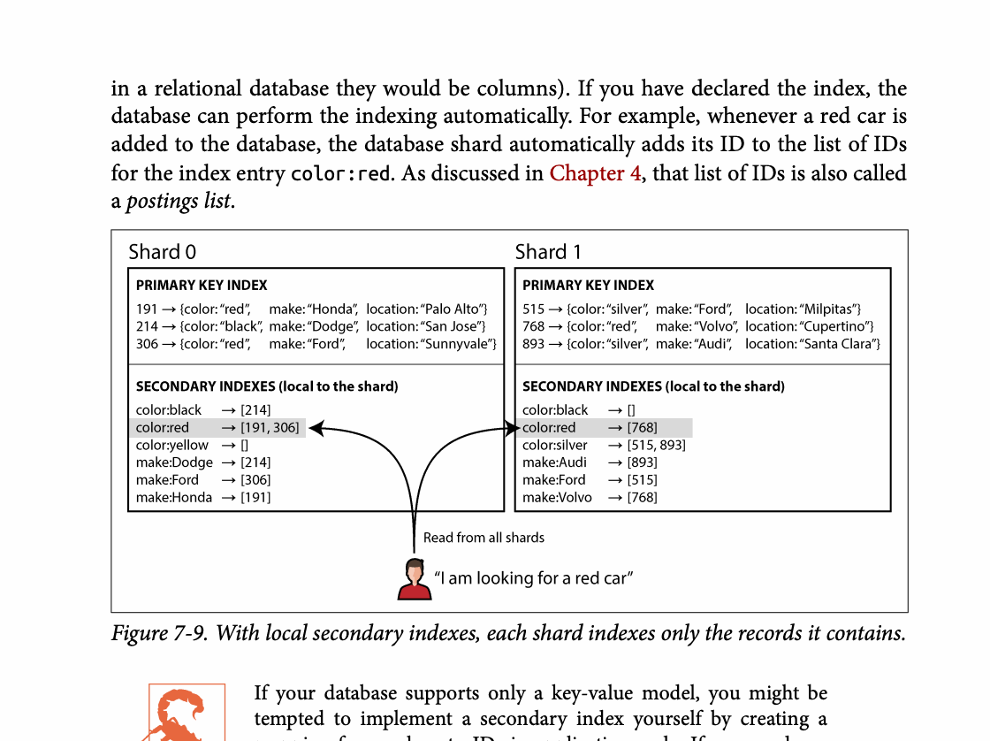
CHAPTER 07
Figure 7-9: mechanism explained
What it shows
Keys, requests, or index entries are assigned across partitions.
Why it matters
The assignment controls balance, range locality, routing work, and rebalancing cost.
What to watch
Follow the arrows or timeline and test whether the conclusion still holds under failure, retry, and concurrency.
21 / 23
Notes:
Source: Martin Kleppmann and Chris Riccomini, Designing Data-Intensive Applications, 2nd ed., Chapter 7, book pages 251-271. Figure 7-9, PDF page 293. Original caption: Figure 7-9. With local secondary indexes, each shard indexes only the records it contains.
Explanation: Keys, requests, or index entries are assigned across partitions. The assignment controls balance, range locality, routing work, and rebalancing cost. Follow the arrows or timeline and test whether the conclusion still holds under failure, retry, and concurrency.
Source file: /Users/eve/projects/Designing-Data-Intensive-Applications/Designing Data Intensive Applications 2nd.pdf

Slide 22
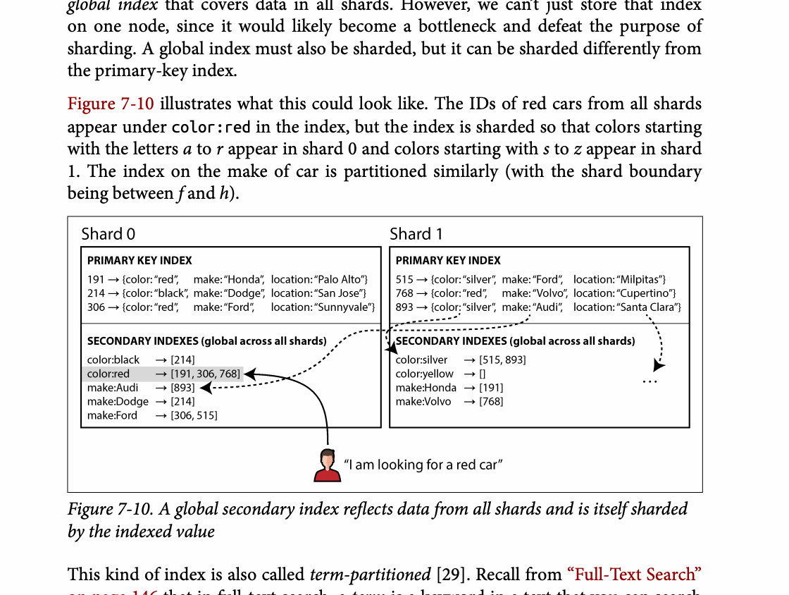
CHAPTER 07
Figure 7-10: mechanism explained
What it shows
Keys, requests, or index entries are assigned across partitions.
Why it matters
The assignment controls balance, range locality, routing work, and rebalancing cost.
What to watch
Follow the arrows or timeline and test whether the conclusion still holds under failure, retry, and concurrency.
22 / 23
Notes:
Source: Martin Kleppmann and Chris Riccomini, Designing Data-Intensive Applications, 2nd ed., Chapter 7, book pages 251-271. Figure 7-10, PDF page 294. Original caption: Figure 7-10. A global secondary index reflects data from all shards and is itself sharded
Explanation: Keys, requests, or index entries are assigned across partitions. The assignment controls balance, range locality, routing work, and rebalancing cost. Follow the arrows or timeline and test whether the conclusion still holds under failure, retry, and concurrency.
Source file: /Users/eve/projects/Designing-Data-Intensive-Applications/Designing Data Intensive Applications 2nd.pdf

Slide 23
CHAPTER 07
Review and application
State the chapter’s central problem in one sentence.
Choose one mechanism and list the assumptions it relies on.
Describe a failure scenario and explain the recovery path.
Apply one trade-off from the chapter to a system you are designing.
23 / 23
Notes:
Source: Martin Kleppmann and Chris Riccomini, Designing Data-Intensive Applications, 2nd ed., Chapter 7, book pages 251-271.
Source file: /Users/eve/projects/Designing-Data-Intensive-Applications/Designing Data Intensive Applications 2nd.pdf

