Slide 1
CHAPTER 08
Transactions
Designing Data-Intensive Applications, Second Edition
Detailed English Study Edition
01 / 27
Notes:
Source: Martin Kleppmann and Chris Riccomini, Designing Data-Intensive Applications, 2nd ed., Chapter 8, book pages 277-335.
Source file: /Users/eve/projects/Designing-Data-Intensive-Applications/Designing Data Intensive Applications 2nd.pdf

Slide 2
CHAPTER 08
Chapter map
01
Transaction boundaries
A transaction groups reads and writes into one logical operation.
02
Weak isolation
Read committed prevents dirty reads and dirty writes.
03
Serializability
Serializability matches the outcome of some serial execution.
04
Two-phase commit
The coordinator gathers prepare votes before deciding commit or abort.
05
Choosing transaction semantics
Identify invariants and the concurrency anomalies that can violate them.
02 / 27
Notes:
Source: Martin Kleppmann and Chris Riccomini, Designing Data-Intensive Applications, 2nd ed., Chapter 8, book pages 277-335.
Source file: /Users/eve/projects/Designing-Data-Intensive-Applications/Designing Data Intensive Applications 2nd.pdf

Slide 3
CHAPTER 08
Transaction boundaries
01
A transaction groups reads and writes into one logical operation.
ACID covers atomicity, consistency, isolation, and durability.
Single-object atomicity does not replace multi-object transactions.
Core question
What problem does it solve, and what does it cost under failure, growth, and change?
03 / 27
Notes:
Source: Martin Kleppmann and Chris Riccomini, Designing Data-Intensive Applications, 2nd ed., Chapter 8, book pages 277-335.
Source file: /Users/eve/projects/Designing-Data-Intensive-Applications/Designing Data Intensive Applications 2nd.pdf

Slide 4
CHAPTER 08
Transaction boundaries: design trade-offs
01
Fit: A transaction groups reads and writes into one logical operation.
Cost: evaluate latency, throughput, consistency, and operational complexity.
Failure check: what state becomes visible when a node, network path, or dependency fails?
Evolution check: can formats, interfaces, and topology change through rolling upgrades?
04 / 27
Notes:
Source: Martin Kleppmann and Chris Riccomini, Designing Data-Intensive Applications, 2nd ed., Chapter 8, book pages 277-335.
Source file: /Users/eve/projects/Designing-Data-Intensive-Applications/Designing Data Intensive Applications 2nd.pdf

Slide 5
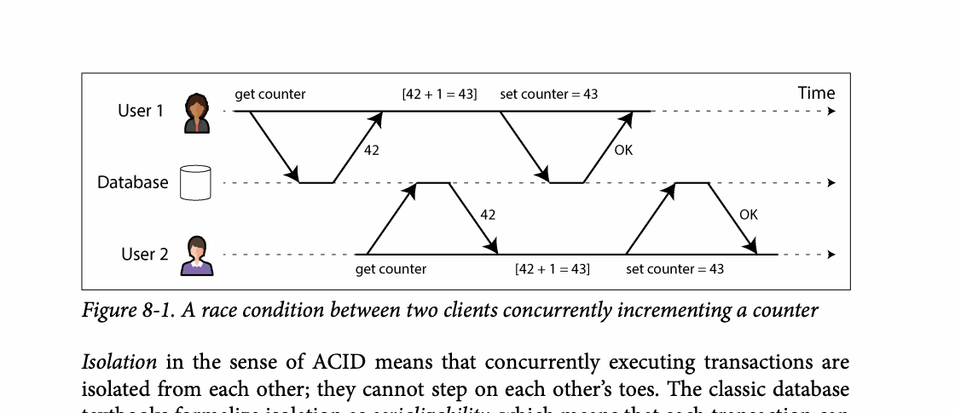
CHAPTER 08
Figure 8-1: mechanism explained
What it shows
A race condition between two clients concurrently incrementing a counter
Why it matters
It turns the chapter concept into a concrete dataflow, timeline, or state transition.
What to watch
Check the actors, data direction, operation order, and hidden system assumptions.
05 / 27
Notes:
Source: Martin Kleppmann and Chris Riccomini, Designing Data-Intensive Applications, 2nd ed., Chapter 8, book pages 277-335. Figure 8-1, PDF page 306. Original caption: Figure 8-1. A race condition between two clients concurrently incrementing a counter
Explanation: A race condition between two clients concurrently incrementing a counter It turns the chapter concept into a concrete dataflow, timeline, or state transition. Check the actors, data direction, operation order, and hidden system assumptions.
Source file: /Users/eve/projects/Designing-Data-Intensive-Applications/Designing Data Intensive Applications 2nd.pdf

Slide 6
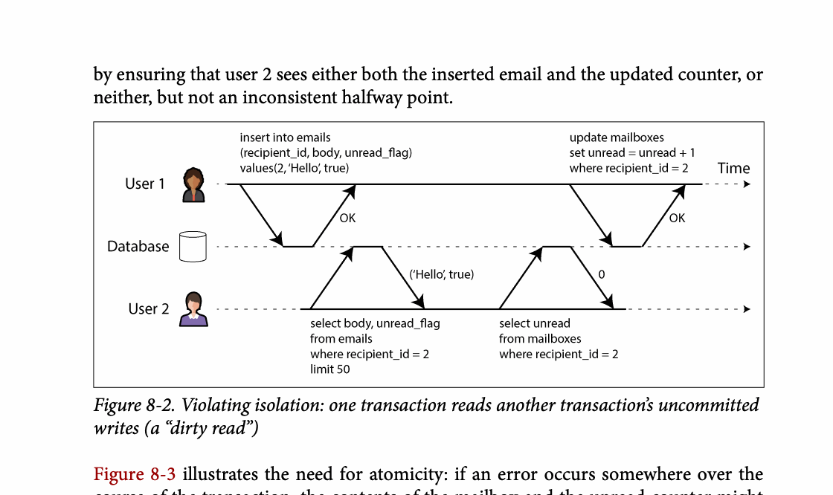
CHAPTER 08
Figure 8-2: mechanism explained
What it shows
Violating isolation: one transaction reads another transaction’s uncommitted
Why it matters
It turns the chapter concept into a concrete dataflow, timeline, or state transition.
What to watch
Check the actors, data direction, operation order, and hidden system assumptions.
06 / 27
Notes:
Source: Martin Kleppmann and Chris Riccomini, Designing Data-Intensive Applications, 2nd ed., Chapter 8, book pages 277-335. Figure 8-2, PDF page 309. Original caption: Figure 8-2. Violating isolation: one transaction reads another transaction’s uncommitted
Explanation: Violating isolation: one transaction reads another transaction’s uncommitted It turns the chapter concept into a concrete dataflow, timeline, or state transition. Check the actors, data direction, operation order, and hidden system assumptions.
Source file: /Users/eve/projects/Designing-Data-Intensive-Applications/Designing Data Intensive Applications 2nd.pdf

Slide 7
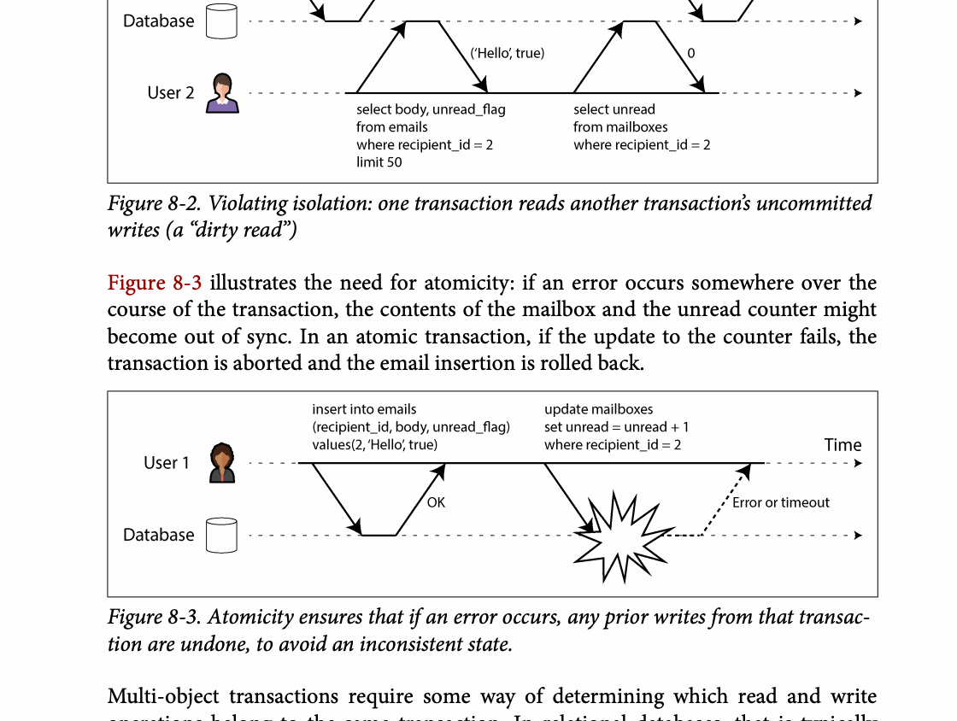
CHAPTER 08
Figure 8-3: mechanism explained
What it shows
Atomicity ensures that if an error occurs, any prior writes from that transac‐
Why it matters
It turns the chapter concept into a concrete dataflow, timeline, or state transition.
What to watch
Check the actors, data direction, operation order, and hidden system assumptions.
07 / 27
Notes:
Source: Martin Kleppmann and Chris Riccomini, Designing Data-Intensive Applications, 2nd ed., Chapter 8, book pages 277-335. Figure 8-3, PDF page 309. Original caption: Figure 8-3. Atomicity ensures that if an error occurs, any prior writes from that transac‐
Explanation: Atomicity ensures that if an error occurs, any prior writes from that transac‐ It turns the chapter concept into a concrete dataflow, timeline, or state transition. Check the actors, data direction, operation order, and hidden system assumptions.
Source file: /Users/eve/projects/Designing-Data-Intensive-Applications/Designing Data Intensive Applications 2nd.pdf

Slide 8
CHAPTER 08
Weak isolation
02
Read committed prevents dirty reads and dirty writes.
Snapshot isolation provides a stable view but still permits write skew.
Atomic updates, locks, or conflict detection prevent lost updates.
Core question
What problem does it solve, and what does it cost under failure, growth, and change?
08 / 27
Notes:
Source: Martin Kleppmann and Chris Riccomini, Designing Data-Intensive Applications, 2nd ed., Chapter 8, book pages 277-335.
Source file: /Users/eve/projects/Designing-Data-Intensive-Applications/Designing Data Intensive Applications 2nd.pdf

Slide 9
CHAPTER 08
Weak isolation: design trade-offs
02
Fit: Read committed prevents dirty reads and dirty writes.
Cost: evaluate latency, throughput, consistency, and operational complexity.
Failure check: what state becomes visible when a node, network path, or dependency fails?
Evolution check: can formats, interfaces, and topology change through rolling upgrades?
09 / 27
Notes:
Source: Martin Kleppmann and Chris Riccomini, Designing Data-Intensive Applications, 2nd ed., Chapter 8, book pages 277-335.
Source file: /Users/eve/projects/Designing-Data-Intensive-Applications/Designing Data Intensive Applications 2nd.pdf

Slide 10
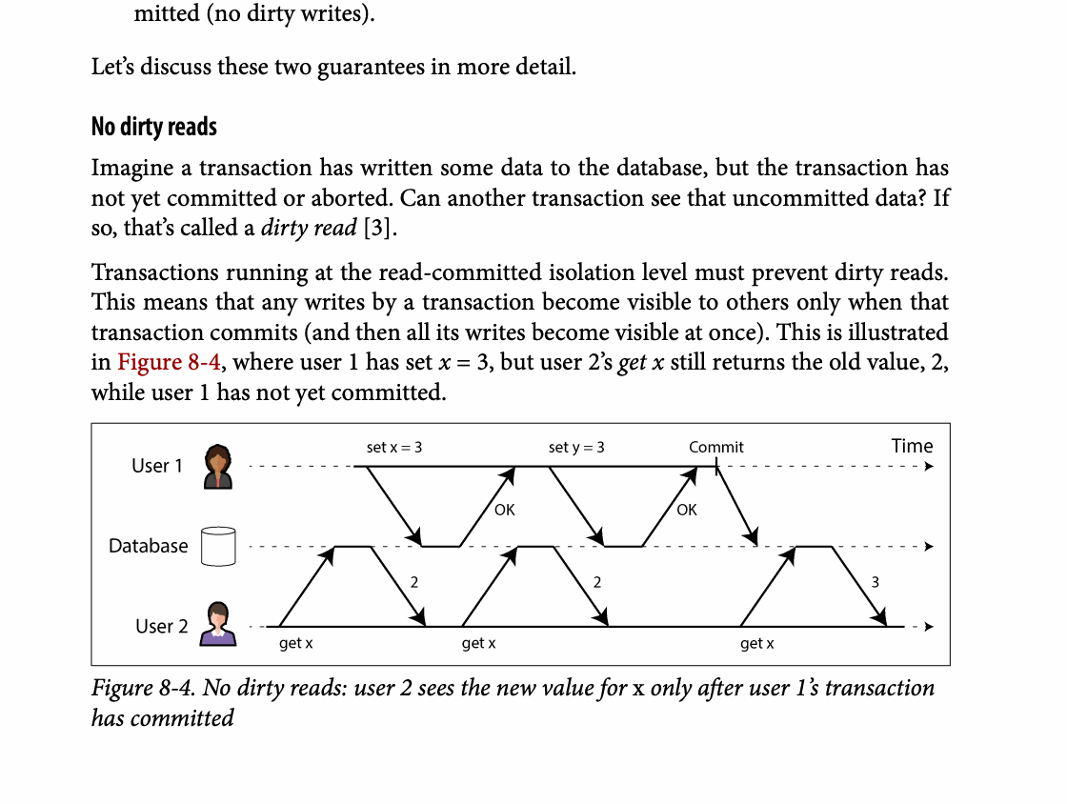
CHAPTER 08
Figure 8-4: mechanism explained
What it shows
The timeline shows one transaction observing an intermediate or inconsistent state.
Why it matters
Isolation rules must prevent states that no valid serial execution could expose.
What to watch
Follow the arrows or timeline and test whether the conclusion still holds under failure, retry, and concurrency.
10 / 27
Notes:
Source: Martin Kleppmann and Chris Riccomini, Designing Data-Intensive Applications, 2nd ed., Chapter 8, book pages 277-335. Figure 8-4, PDF page 314. Original caption: Figure 8-4. No dirty reads: user 2 sees the new value for x only after user 1’s transaction
Explanation: The timeline shows one transaction observing an intermediate or inconsistent state. Isolation rules must prevent states that no valid serial execution could expose. Follow the arrows or timeline and test whether the conclusion still holds under failure, retry, and concurrency.
Source file: /Users/eve/projects/Designing-Data-Intensive-Applications/Designing Data Intensive Applications 2nd.pdf

Slide 11
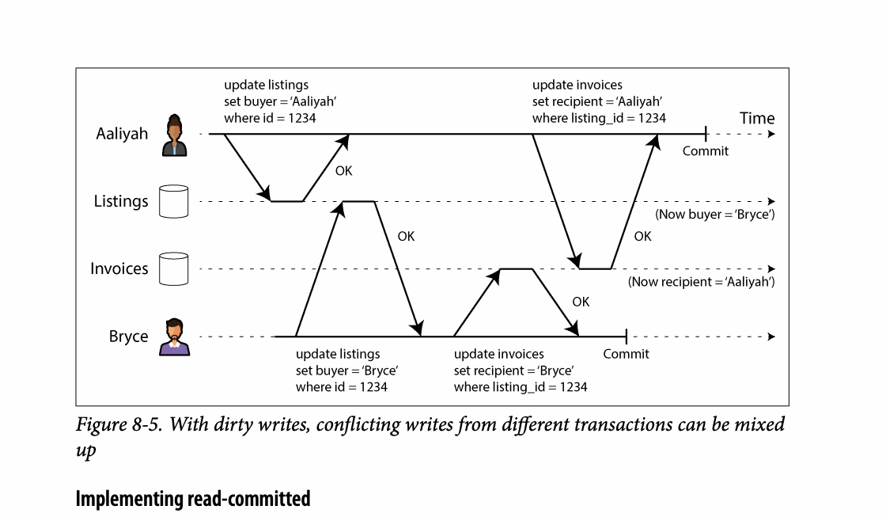
CHAPTER 08
Figure 8-5: mechanism explained
What it shows
Several writers create concurrent versions that may arrive in different orders.
Why it matters
Resolution must preserve intent; last-write-wins can silently discard valid work.
What to watch
Follow the arrows or timeline and test whether the conclusion still holds under failure, retry, and concurrency.
11 / 27
Notes:
Source: Martin Kleppmann and Chris Riccomini, Designing Data-Intensive Applications, 2nd ed., Chapter 8, book pages 277-335. Figure 8-5, PDF page 316. Original caption: Figure 8-5. With dirty writes, conflicting writes from different transactions can be mixed
Explanation: Several writers create concurrent versions that may arrive in different orders. Resolution must preserve intent; last-write-wins can silently discard valid work. Follow the arrows or timeline and test whether the conclusion still holds under failure, retry, and concurrency.
Source file: /Users/eve/projects/Designing-Data-Intensive-Applications/Designing Data Intensive Applications 2nd.pdf

Slide 12
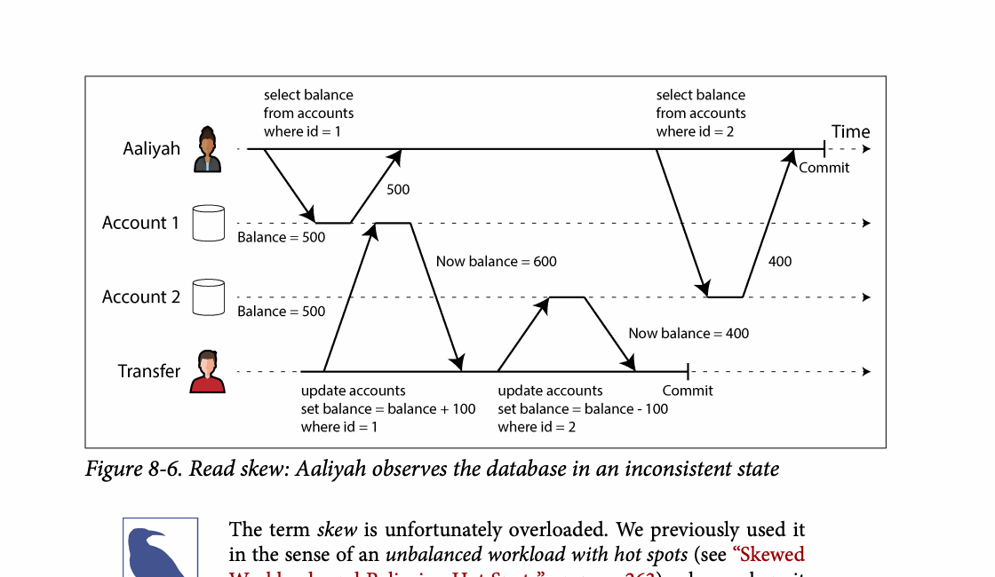
CHAPTER 08
Figure 8-6: mechanism explained
What it shows
The timeline shows one transaction observing an intermediate or inconsistent state.
Why it matters
Isolation rules must prevent states that no valid serial execution could expose.
What to watch
Follow the arrows or timeline and test whether the conclusion still holds under failure, retry, and concurrency.
12 / 27
Notes:
Source: Martin Kleppmann and Chris Riccomini, Designing Data-Intensive Applications, 2nd ed., Chapter 8, book pages 277-335. Figure 8-6, PDF page 318. Original caption: Figure 8-6. Read skew: Aaliyah observes the database in an inconsistent state
Explanation: The timeline shows one transaction observing an intermediate or inconsistent state. Isolation rules must prevent states that no valid serial execution could expose. Follow the arrows or timeline and test whether the conclusion still holds under failure, retry, and concurrency.
Source file: /Users/eve/projects/Designing-Data-Intensive-Applications/Designing Data Intensive Applications 2nd.pdf

Slide 13
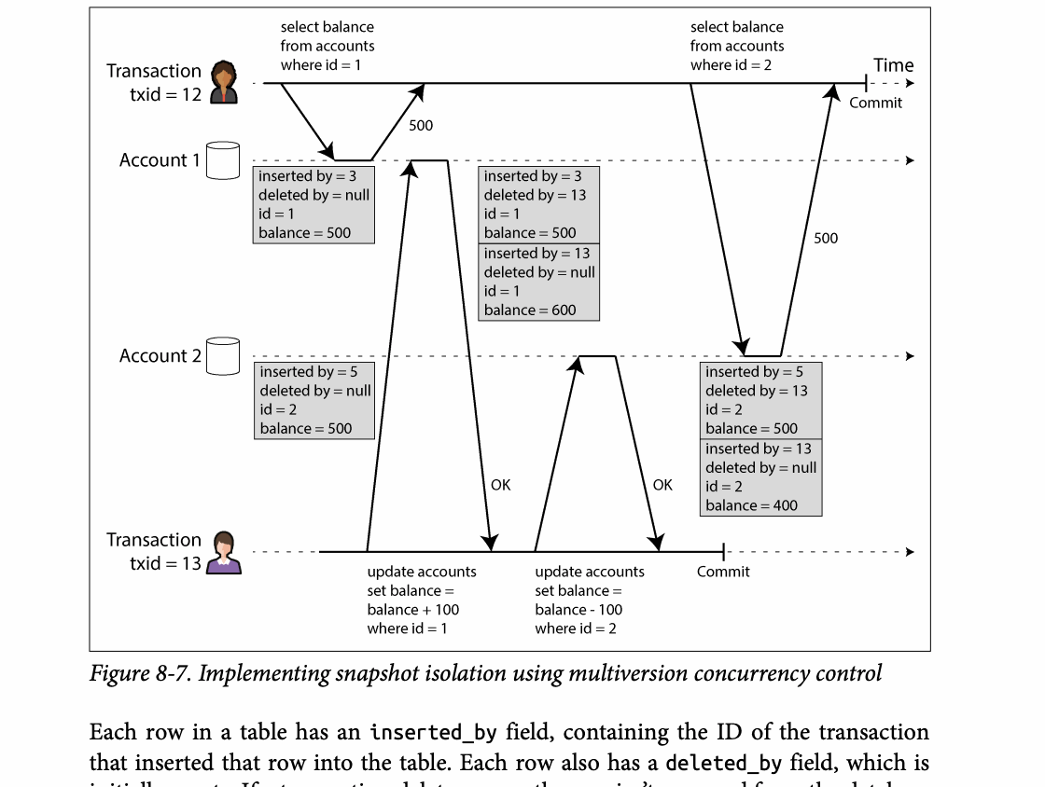
CHAPTER 08
Figure 8-7: mechanism explained
What it shows
Concurrent transactions read snapshots and create dependencies that may form an anomaly.
Why it matters
MVCC improves concurrency, while conflict detection or serialization protects invariants.
What to watch
Follow the arrows or timeline and test whether the conclusion still holds under failure, retry, and concurrency.
13 / 27
Notes:
Source: Martin Kleppmann and Chris Riccomini, Designing Data-Intensive Applications, 2nd ed., Chapter 8, book pages 277-335. Figure 8-7, PDF page 320. Original caption: Figure 8-7. Implementing snapshot isolation using multiversion concurrency control
Explanation: Concurrent transactions read snapshots and create dependencies that may form an anomaly. MVCC improves concurrency, while conflict detection or serialization protects invariants. Follow the arrows or timeline and test whether the conclusion still holds under failure, retry, and concurrency.
Source file: /Users/eve/projects/Designing-Data-Intensive-Applications/Designing Data Intensive Applications 2nd.pdf

Slide 14
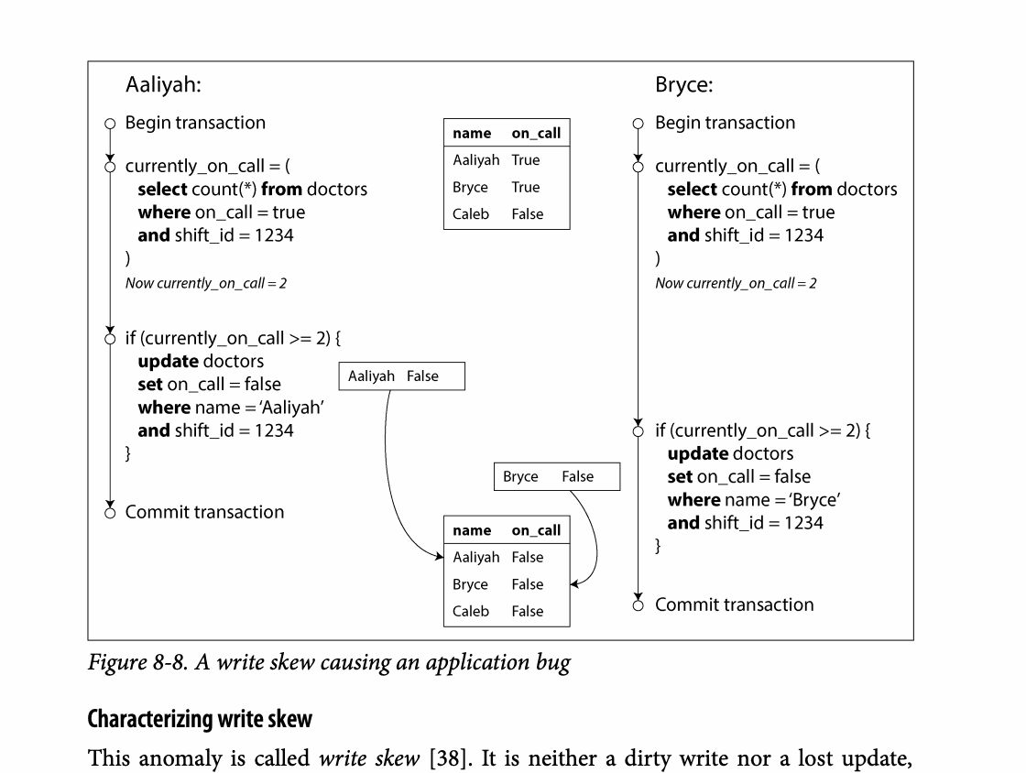
CHAPTER 08
Figure 8-8: mechanism explained
What it shows
Concurrent transactions read snapshots and create dependencies that may form an anomaly.
Why it matters
MVCC improves concurrency, while conflict detection or serialization protects invariants.
What to watch
Follow the arrows or timeline and test whether the conclusion still holds under failure, retry, and concurrency.
14 / 27
Notes:
Source: Martin Kleppmann and Chris Riccomini, Designing Data-Intensive Applications, 2nd ed., Chapter 8, book pages 277-335. Figure 8-8, PDF page 328. Original caption: Figure 8-8. A write skew causing an application bug
Explanation: Concurrent transactions read snapshots and create dependencies that may form an anomaly. MVCC improves concurrency, while conflict detection or serialization protects invariants. Follow the arrows or timeline and test whether the conclusion still holds under failure, retry, and concurrency.
Source file: /Users/eve/projects/Designing-Data-Intensive-Applications/Designing Data Intensive Applications 2nd.pdf

Slide 15
CHAPTER 08
Serializability
03
Serializability matches the outcome of some serial execution.
Actual serial execution is simple but constrained by transaction length and throughput.
Two-phase locking and SSI block anomalies with different costs.
Core question
What problem does it solve, and what does it cost under failure, growth, and change?
15 / 27
Notes:
Source: Martin Kleppmann and Chris Riccomini, Designing Data-Intensive Applications, 2nd ed., Chapter 8, book pages 277-335.
Source file: /Users/eve/projects/Designing-Data-Intensive-Applications/Designing Data Intensive Applications 2nd.pdf

Slide 16
CHAPTER 08
Serializability: design trade-offs
03
Fit: Serializability matches the outcome of some serial execution.
Cost: evaluate latency, throughput, consistency, and operational complexity.
Failure check: what state becomes visible when a node, network path, or dependency fails?
Evolution check: can formats, interfaces, and topology change through rolling upgrades?
16 / 27
Notes:
Source: Martin Kleppmann and Chris Riccomini, Designing Data-Intensive Applications, 2nd ed., Chapter 8, book pages 277-335.
Source file: /Users/eve/projects/Designing-Data-Intensive-Applications/Designing Data Intensive Applications 2nd.pdf

Slide 17
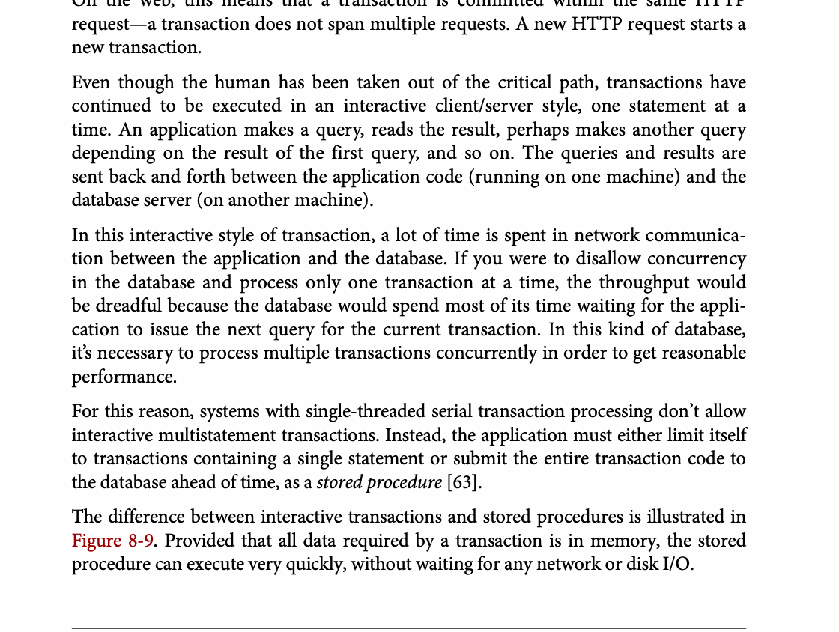
CHAPTER 08
Figure 8-9: mechanism explained
What it shows
Provided that all data required by a transaction is in memory, the stored
Why it matters
It turns the chapter concept into a concrete dataflow, timeline, or state transition.
What to watch
Check the actors, data direction, operation order, and hidden system assumptions.
17 / 27
Notes:
Source: Martin Kleppmann and Chris Riccomini, Designing Data-Intensive Applications, 2nd ed., Chapter 8, book pages 277-335. Figure 8-9, PDF page 334. Original caption: Figure 8-9. Provided that all data required by a transaction is in memory, the stored
Explanation: Provided that all data required by a transaction is in memory, the stored It turns the chapter concept into a concrete dataflow, timeline, or state transition. Check the actors, data direction, operation order, and hidden system assumptions.
Source file: /Users/eve/projects/Designing-Data-Intensive-Applications/Designing Data Intensive Applications 2nd.pdf

Slide 18
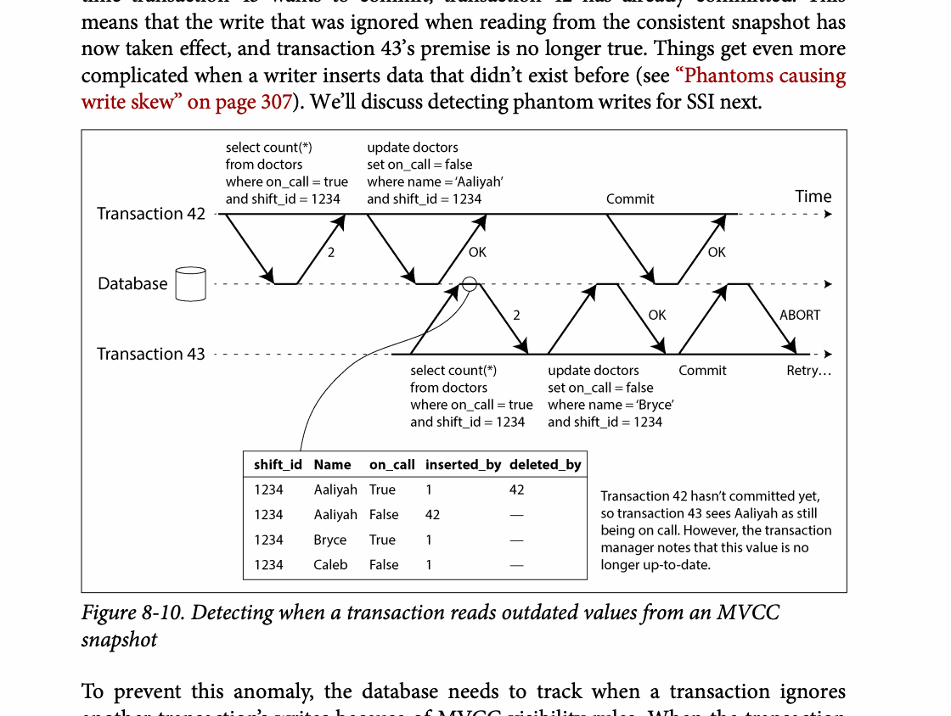
CHAPTER 08
Figure 8-10: mechanism explained
What it shows
Concurrent transactions read snapshots and create dependencies that may form an anomaly.
Why it matters
MVCC improves concurrency, while conflict detection or serialization protects invariants.
What to watch
Follow the arrows or timeline and test whether the conclusion still holds under failure, retry, and concurrency.
18 / 27
Notes:
Source: Martin Kleppmann and Chris Riccomini, Designing Data-Intensive Applications, 2nd ed., Chapter 8, book pages 277-335. Figure 8-10, PDF page 344. Original caption: Figure 8-10. Detecting when a transaction reads outdated values from an MVCC
Explanation: Concurrent transactions read snapshots and create dependencies that may form an anomaly. MVCC improves concurrency, while conflict detection or serialization protects invariants. Follow the arrows or timeline and test whether the conclusion still holds under failure, retry, and concurrency.
Source file: /Users/eve/projects/Designing-Data-Intensive-Applications/Designing Data Intensive Applications 2nd.pdf

Slide 19
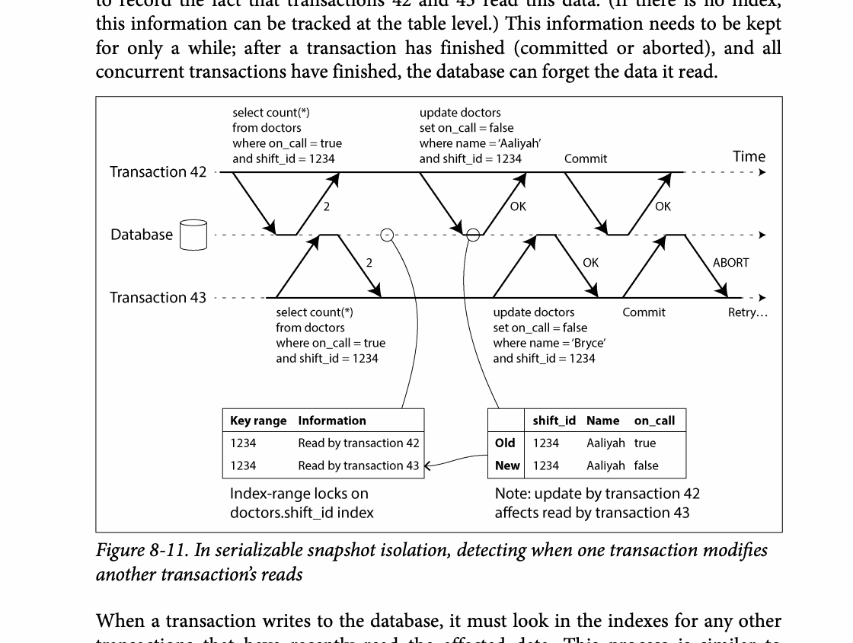
CHAPTER 08
Figure 8-11: mechanism explained
What it shows
Concurrent transactions read snapshots and create dependencies that may form an anomaly.
Why it matters
MVCC improves concurrency, while conflict detection or serialization protects invariants.
What to watch
Follow the arrows or timeline and test whether the conclusion still holds under failure, retry, and concurrency.
19 / 27
Notes:
Source: Martin Kleppmann and Chris Riccomini, Designing Data-Intensive Applications, 2nd ed., Chapter 8, book pages 277-335. Figure 8-11, PDF page 345. Original caption: Figure 8-11. In serializable snapshot isolation, detecting when one transaction modifies
Explanation: Concurrent transactions read snapshots and create dependencies that may form an anomaly. MVCC improves concurrency, while conflict detection or serialization protects invariants. Follow the arrows or timeline and test whether the conclusion still holds under failure, retry, and concurrency.
Source file: /Users/eve/projects/Designing-Data-Intensive-Applications/Designing Data Intensive Applications 2nd.pdf

Slide 20
CHAPTER 08
Two-phase commit
04
The coordinator gathers prepare votes before deciding commit or abort.
Failures can leave participants blocked and dependent on the coordinator log.
Cross-system transactions expand the failure domain.
Core question
What problem does it solve, and what does it cost under failure, growth, and change?
20 / 27
Notes:
Source: Martin Kleppmann and Chris Riccomini, Designing Data-Intensive Applications, 2nd ed., Chapter 8, book pages 277-335.
Source file: /Users/eve/projects/Designing-Data-Intensive-Applications/Designing Data Intensive Applications 2nd.pdf

Slide 21
CHAPTER 08
Two-phase commit: design trade-offs
04
Fit: The coordinator gathers prepare votes before deciding commit or abort.
Cost: evaluate latency, throughput, consistency, and operational complexity.
Failure check: what state becomes visible when a node, network path, or dependency fails?
Evolution check: can formats, interfaces, and topology change through rolling upgrades?
21 / 27
Notes:
Source: Martin Kleppmann and Chris Riccomini, Designing Data-Intensive Applications, 2nd ed., Chapter 8, book pages 277-335.
Source file: /Users/eve/projects/Designing-Data-Intensive-Applications/Designing Data Intensive Applications 2nd.pdf

Slide 22
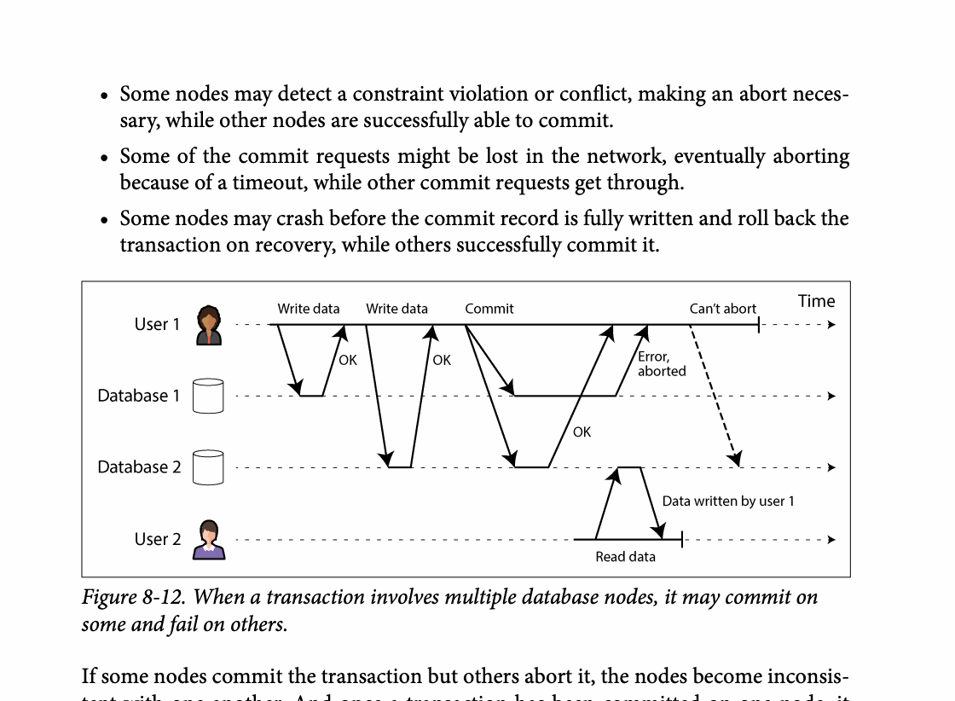
CHAPTER 08
Figure 8-12: mechanism explained
What it shows
When a transaction involves multiple database nodes, it may commit on
Why it matters
It turns the chapter concept into a concrete dataflow, timeline, or state transition.
What to watch
Check the actors, data direction, operation order, and hidden system assumptions.
22 / 27
Notes:
Source: Martin Kleppmann and Chris Riccomini, Designing Data-Intensive Applications, 2nd ed., Chapter 8, book pages 277-335. Figure 8-12, PDF page 348. Original caption: Figure 8-12. When a transaction involves multiple database nodes, it may commit on
Explanation: When a transaction involves multiple database nodes, it may commit on It turns the chapter concept into a concrete dataflow, timeline, or state transition. Check the actors, data direction, operation order, and hidden system assumptions.
Source file: /Users/eve/projects/Designing-Data-Intensive-Applications/Designing Data Intensive Applications 2nd.pdf

Slide 23
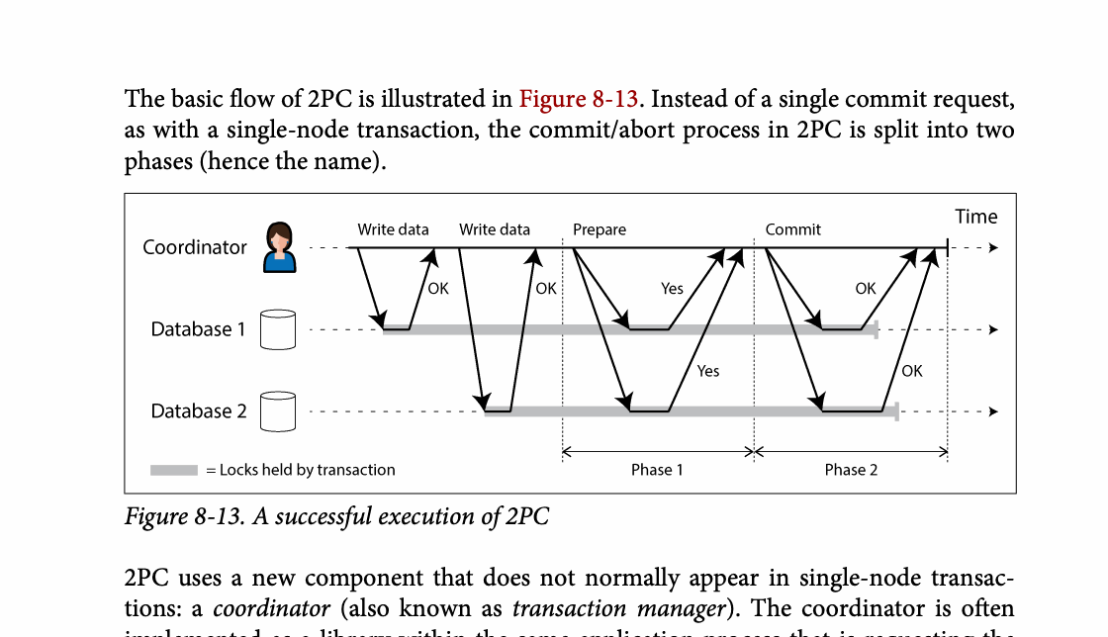
CHAPTER 08
Figure 8-13: mechanism explained
What it shows
Participants prepare first, then follow one final commit or abort decision.
Why it matters
A coordinator failure after prepare can leave participants blocked and holding resources.
What to watch
Follow the arrows or timeline and test whether the conclusion still holds under failure, retry, and concurrency.
23 / 27
Notes:
Source: Martin Kleppmann and Chris Riccomini, Designing Data-Intensive Applications, 2nd ed., Chapter 8, book pages 277-335. Figure 8-13, PDF page 349. Original caption: Figure 8-13. A successful execution of 2PC
Explanation: Participants prepare first, then follow one final commit or abort decision. A coordinator failure after prepare can leave participants blocked and holding resources. Follow the arrows or timeline and test whether the conclusion still holds under failure, retry, and concurrency.
Source file: /Users/eve/projects/Designing-Data-Intensive-Applications/Designing Data Intensive Applications 2nd.pdf

Slide 24
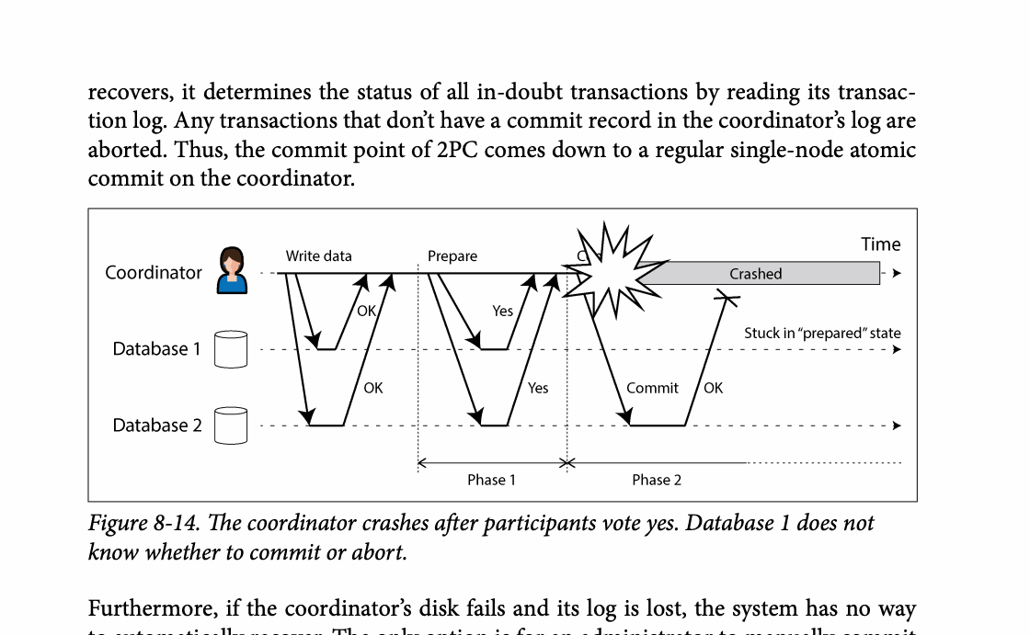
CHAPTER 08
Figure 8-14: mechanism explained
What it shows
Participants prepare first, then follow one final commit or abort decision.
Why it matters
A coordinator failure after prepare can leave participants blocked and holding resources.
What to watch
Follow the arrows or timeline and test whether the conclusion still holds under failure, retry, and concurrency.
24 / 27
Notes:
Source: Martin Kleppmann and Chris Riccomini, Designing Data-Intensive Applications, 2nd ed., Chapter 8, book pages 277-335. Figure 8-14, PDF page 352. Original caption: Figure 8-14. The coordinator crashes after participants vote yes. Database 1 does not
Explanation: Participants prepare first, then follow one final commit or abort decision. A coordinator failure after prepare can leave participants blocked and holding resources. Follow the arrows or timeline and test whether the conclusion still holds under failure, retry, and concurrency.
Source file: /Users/eve/projects/Designing-Data-Intensive-Applications/Designing Data Intensive Applications 2nd.pdf

Slide 25
CHAPTER 08
Choosing transaction semantics
05
Identify invariants and the concurrency anomalies that can violate them.
Select isolation from business risk, then test the assumptions.
Exactly-once processing usually combines transactional state with idempotent effects.
Core question
What problem does it solve, and what does it cost under failure, growth, and change?
25 / 27
Notes:
Source: Martin Kleppmann and Chris Riccomini, Designing Data-Intensive Applications, 2nd ed., Chapter 8, book pages 277-335.
Source file: /Users/eve/projects/Designing-Data-Intensive-Applications/Designing Data Intensive Applications 2nd.pdf

Slide 26
CHAPTER 08
Choosing transaction semantics: design trade-offs
05
Fit: Identify invariants and the concurrency anomalies that can violate them.
Cost: evaluate latency, throughput, consistency, and operational complexity.
Failure check: what state becomes visible when a node, network path, or dependency fails?
Evolution check: can formats, interfaces, and topology change through rolling upgrades?
26 / 27
Notes:
Source: Martin Kleppmann and Chris Riccomini, Designing Data-Intensive Applications, 2nd ed., Chapter 8, book pages 277-335.
Source file: /Users/eve/projects/Designing-Data-Intensive-Applications/Designing Data Intensive Applications 2nd.pdf

Slide 27
CHAPTER 08
Review and application
State the chapter’s central problem in one sentence.
Choose one mechanism and list the assumptions it relies on.
Describe a failure scenario and explain the recovery path.
Apply one trade-off from the chapter to a system you are designing.
27 / 27
Notes:
Source: Martin Kleppmann and Chris Riccomini, Designing Data-Intensive Applications, 2nd ed., Chapter 8, book pages 277-335.
Source file: /Users/eve/projects/Designing-Data-Intensive-Applications/Designing Data Intensive Applications 2nd.pdf

