Slide 1
CHAPTER 09
The Trouble with Distributed Systems
Designing Data-Intensive Applications, Second Edition
Detailed English Study Edition
01 / 20
Notes:
Source: Martin Kleppmann and Chris Riccomini, Designing Data-Intensive Applications, 2nd ed., Chapter 9, book pages 345-388.
Source file: /Users/eve/projects/Designing-Data-Intensive-Applications/Designing Data Intensive Applications 2nd.pdf

Slide 2
CHAPTER 09
Chapter map
01
Partial failures
Some components can fail while the rest of the system continues.
02
Unreliable networks
Packets can be lost, delayed, duplicated, or reordered.
03
Unreliable clocks
Monotonic clocks measure durations while wall clocks can jump.
04
Knowledge and majorities
A node infers world state only from messages it has received.
05
System models
A model states assumptions about delay, pauses, and failure types.
02 / 20
Notes:
Source: Martin Kleppmann and Chris Riccomini, Designing Data-Intensive Applications, 2nd ed., Chapter 9, book pages 345-388.
Source file: /Users/eve/projects/Designing-Data-Intensive-Applications/Designing Data Intensive Applications 2nd.pdf

Slide 3
CHAPTER 09
Partial failures
01
Some components can fail while the rest of the system continues.
A timeout cannot prove whether the remote operation ran.
Retries can duplicate work, so APIs need idempotency or deduplication.
Core question
What problem does it solve, and what does it cost under failure, growth, and change?
03 / 20
Notes:
Source: Martin Kleppmann and Chris Riccomini, Designing Data-Intensive Applications, 2nd ed., Chapter 9, book pages 345-388.
Source file: /Users/eve/projects/Designing-Data-Intensive-Applications/Designing Data Intensive Applications 2nd.pdf

Slide 4
CHAPTER 09
Partial failures: design trade-offs
01
Fit: Some components can fail while the rest of the system continues.
Cost: evaluate latency, throughput, consistency, and operational complexity.
Failure check: what state becomes visible when a node, network path, or dependency fails?
Evolution check: can formats, interfaces, and topology change through rolling upgrades?
04 / 20
Notes:
Source: Martin Kleppmann and Chris Riccomini, Designing Data-Intensive Applications, 2nd ed., Chapter 9, book pages 345-388.
Source file: /Users/eve/projects/Designing-Data-Intensive-Applications/Designing Data Intensive Applications 2nd.pdf

Slide 5
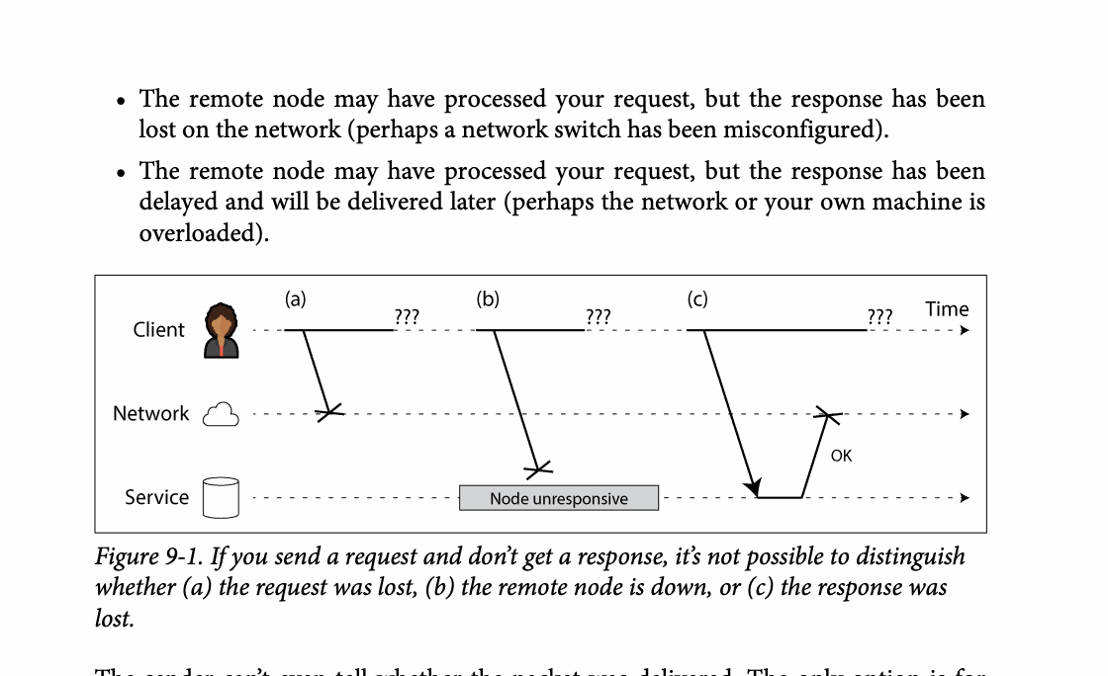
CHAPTER 09
Figure 9-1: mechanism explained
What it shows
Network silence cannot reveal whether a request, execution, or response failed.
Why it matters
Retries need idempotency because the original operation may already have completed.
What to watch
Follow the arrows or timeline and test whether the conclusion still holds under failure, retry, and concurrency.
05 / 20
Notes:
Source: Martin Kleppmann and Chris Riccomini, Designing Data-Intensive Applications, 2nd ed., Chapter 9, book pages 345-388. Figure 9-1, PDF page 372. Original caption: Figure 9-1. If you send a request and don’t get a response, it’s not possible to distinguish
Explanation: Network silence cannot reveal whether a request, execution, or response failed. Retries need idempotency because the original operation may already have completed. Follow the arrows or timeline and test whether the conclusion still holds under failure, retry, and concurrency.
Source file: /Users/eve/projects/Designing-Data-Intensive-Applications/Designing Data Intensive Applications 2nd.pdf

Slide 6
CHAPTER 09
Unreliable networks
02
Packets can be lost, delayed, duplicated, or reordered.
TCP supplies a byte stream, not proof that a business action completed.
Failure detection depends on timing assumptions and accepted false positives.
Core question
What problem does it solve, and what does it cost under failure, growth, and change?
06 / 20
Notes:
Source: Martin Kleppmann and Chris Riccomini, Designing Data-Intensive Applications, 2nd ed., Chapter 9, book pages 345-388.
Source file: /Users/eve/projects/Designing-Data-Intensive-Applications/Designing Data Intensive Applications 2nd.pdf

Slide 7
CHAPTER 09
Unreliable networks: design trade-offs
02
Fit: Packets can be lost, delayed, duplicated, or reordered.
Cost: evaluate latency, throughput, consistency, and operational complexity.
Failure check: what state becomes visible when a node, network path, or dependency fails?
Evolution check: can formats, interfaces, and topology change through rolling upgrades?
07 / 20
Notes:
Source: Martin Kleppmann and Chris Riccomini, Designing Data-Intensive Applications, 2nd ed., Chapter 9, book pages 345-388.
Source file: /Users/eve/projects/Designing-Data-Intensive-Applications/Designing Data Intensive Applications 2nd.pdf

Slide 8
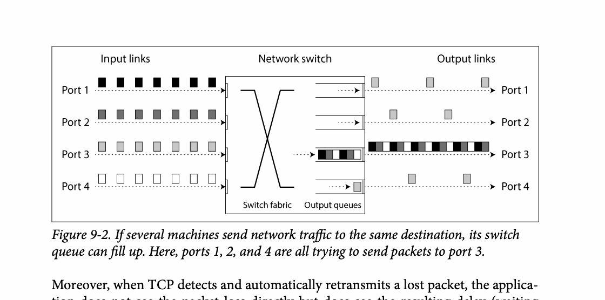
CHAPTER 09
Figure 9-2: mechanism explained
What it shows
Network silence cannot reveal whether a request, execution, or response failed.
Why it matters
Retries need idempotency because the original operation may already have completed.
What to watch
Follow the arrows or timeline and test whether the conclusion still holds under failure, retry, and concurrency.
08 / 20
Notes:
Source: Martin Kleppmann and Chris Riccomini, Designing Data-Intensive Applications, 2nd ed., Chapter 9, book pages 345-388. Figure 9-2, PDF page 378. Original caption: Figure 9-2. If several machines send network traffic to the same destination, its switch
Explanation: Network silence cannot reveal whether a request, execution, or response failed. Retries need idempotency because the original operation may already have completed. Follow the arrows or timeline and test whether the conclusion still holds under failure, retry, and concurrency.
Source file: /Users/eve/projects/Designing-Data-Intensive-Applications/Designing Data Intensive Applications 2nd.pdf

Slide 9
CHAPTER 09
Unreliable clocks
03
Monotonic clocks measure durations while wall clocks can jump.
Clock synchronization has uncertainty, so timestamps are not absolute order.
Process pauses can make an expired lease holder act on stale authority.
Core question
What problem does it solve, and what does it cost under failure, growth, and change?
09 / 20
Notes:
Source: Martin Kleppmann and Chris Riccomini, Designing Data-Intensive Applications, 2nd ed., Chapter 9, book pages 345-388.
Source file: /Users/eve/projects/Designing-Data-Intensive-Applications/Designing Data Intensive Applications 2nd.pdf

Slide 10
CHAPTER 09
Unreliable clocks: design trade-offs
03
Fit: Monotonic clocks measure durations while wall clocks can jump.
Cost: evaluate latency, throughput, consistency, and operational complexity.
Failure check: what state becomes visible when a node, network path, or dependency fails?
Evolution check: can formats, interfaces, and topology change through rolling upgrades?
10 / 20
Notes:
Source: Martin Kleppmann and Chris Riccomini, Designing Data-Intensive Applications, 2nd ed., Chapter 9, book pages 345-388.
Source file: /Users/eve/projects/Designing-Data-Intensive-Applications/Designing Data Intensive Applications 2nd.pdf

Slide 11
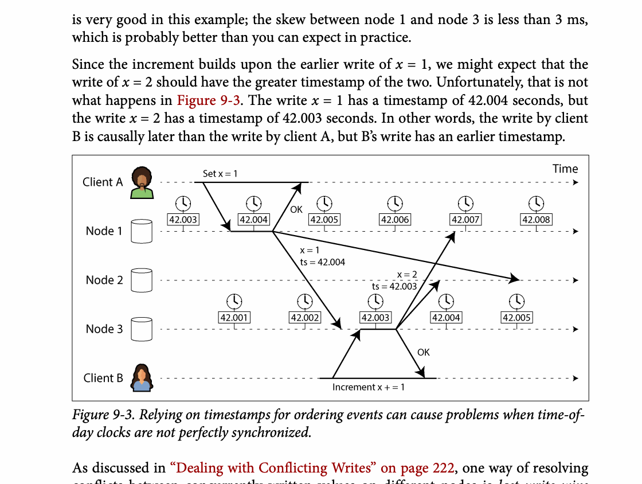
CHAPTER 09
Figure 9-3: mechanism explained
What it shows
Time or lease assumptions can become stale during clock error, delay, or process pause.
Why it matters
Fencing tokens let the resource reject operations from an expired owner.
What to watch
Follow the arrows or timeline and test whether the conclusion still holds under failure, retry, and concurrency.
11 / 20
Notes:
Source: Martin Kleppmann and Chris Riccomini, Designing Data-Intensive Applications, 2nd ed., Chapter 9, book pages 345-388. Figure 9-3, PDF page 387. Original caption: Figure 9-3. Relying on timestamps for ordering events can cause problems when time-of-
Explanation: Time or lease assumptions can become stale during clock error, delay, or process pause. Fencing tokens let the resource reject operations from an expired owner. Follow the arrows or timeline and test whether the conclusion still holds under failure, retry, and concurrency.
Source file: /Users/eve/projects/Designing-Data-Intensive-Applications/Designing Data Intensive Applications 2nd.pdf

Slide 12
CHAPTER 09
Knowledge and majorities
04
A node infers world state only from messages it has received.
Majorities form decisions while minority nodes may retain stale knowledge.
Fencing tokens prevent expired lease holders from writing.
Core question
What problem does it solve, and what does it cost under failure, growth, and change?
12 / 20
Notes:
Source: Martin Kleppmann and Chris Riccomini, Designing Data-Intensive Applications, 2nd ed., Chapter 9, book pages 345-388.
Source file: /Users/eve/projects/Designing-Data-Intensive-Applications/Designing Data Intensive Applications 2nd.pdf

Slide 13
CHAPTER 09
Knowledge and majorities: design trade-offs
04
Fit: A node infers world state only from messages it has received.
Cost: evaluate latency, throughput, consistency, and operational complexity.
Failure check: what state becomes visible when a node, network path, or dependency fails?
Evolution check: can formats, interfaces, and topology change through rolling upgrades?
13 / 20
Notes:
Source: Martin Kleppmann and Chris Riccomini, Designing Data-Intensive Applications, 2nd ed., Chapter 9, book pages 345-388.
Source file: /Users/eve/projects/Designing-Data-Intensive-Applications/Designing Data Intensive Applications 2nd.pdf

Slide 14
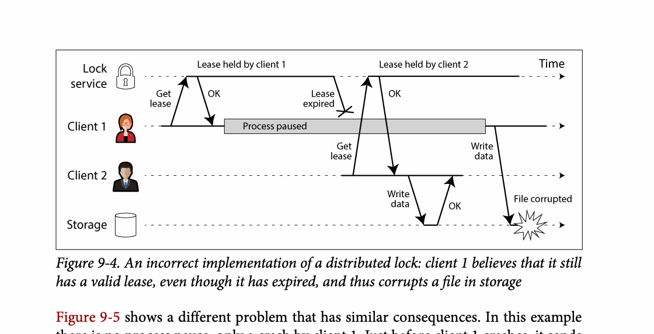
CHAPTER 09
Figure 9-4: mechanism explained
What it shows
Time or lease assumptions can become stale during clock error, delay, or process pause.
Why it matters
Fencing tokens let the resource reject operations from an expired owner.
What to watch
Follow the arrows or timeline and test whether the conclusion still holds under failure, retry, and concurrency.
14 / 20
Notes:
Source: Martin Kleppmann and Chris Riccomini, Designing Data-Intensive Applications, 2nd ed., Chapter 9, book pages 345-388. Figure 9-4, PDF page 398. Original caption: Figure 9-4. An incorrect implementation of a distributed lock: client 1 believes that it still
Explanation: Time or lease assumptions can become stale during clock error, delay, or process pause. Fencing tokens let the resource reject operations from an expired owner. Follow the arrows or timeline and test whether the conclusion still holds under failure, retry, and concurrency.
Source file: /Users/eve/projects/Designing-Data-Intensive-Applications/Designing Data Intensive Applications 2nd.pdf

Slide 15
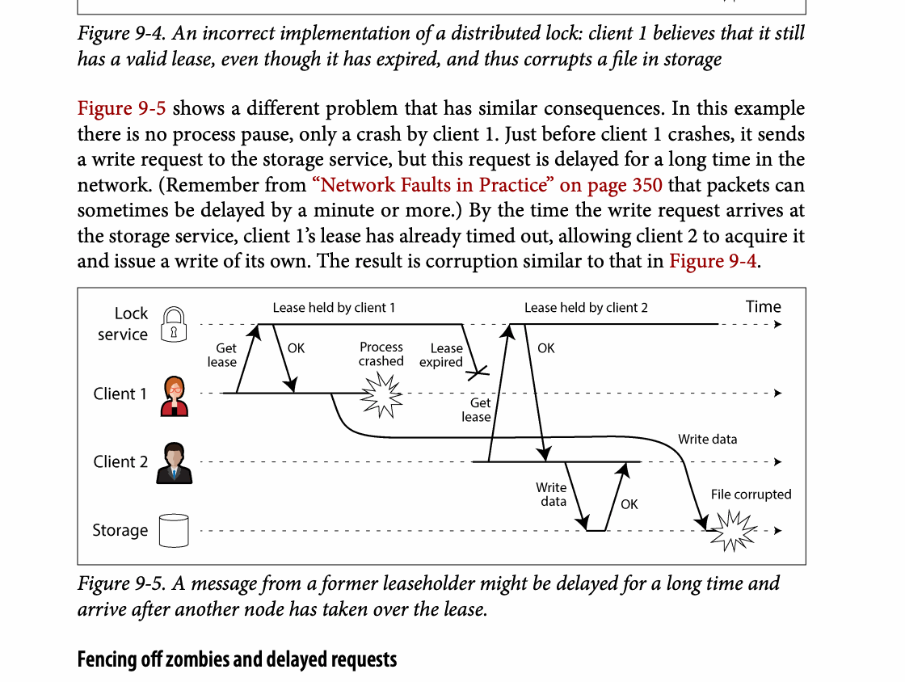
CHAPTER 09
Figure 9-5: mechanism explained
What it shows
Time or lease assumptions can become stale during clock error, delay, or process pause.
Why it matters
Fencing tokens let the resource reject operations from an expired owner.
What to watch
Follow the arrows or timeline and test whether the conclusion still holds under failure, retry, and concurrency.
15 / 20
Notes:
Source: Martin Kleppmann and Chris Riccomini, Designing Data-Intensive Applications, 2nd ed., Chapter 9, book pages 345-388. Figure 9-5, PDF page 398. Original caption: Figure 9-5. A message from a former leaseholder might be delayed for a long time and
Explanation: Time or lease assumptions can become stale during clock error, delay, or process pause. Fencing tokens let the resource reject operations from an expired owner. Follow the arrows or timeline and test whether the conclusion still holds under failure, retry, and concurrency.
Source file: /Users/eve/projects/Designing-Data-Intensive-Applications/Designing Data Intensive Applications 2nd.pdf

Slide 16
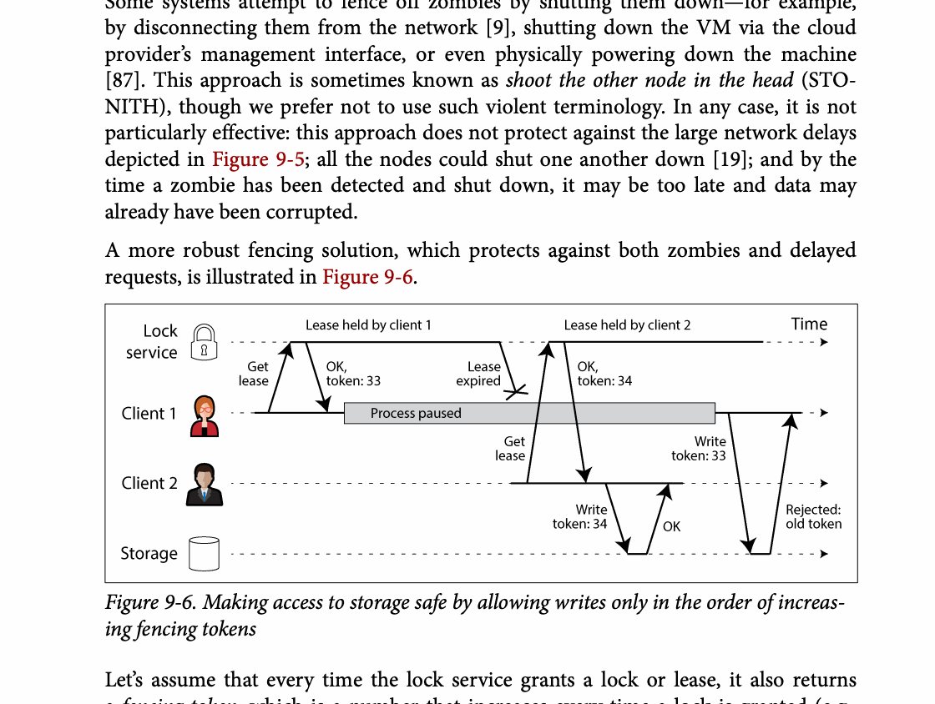
CHAPTER 09
Figure 9-6: mechanism explained
What it shows
Making access to storage safe by allowing writes only in the order of increas‐
Why it matters
It turns the chapter concept into a concrete dataflow, timeline, or state transition.
What to watch
Check the actors, data direction, operation order, and hidden system assumptions.
16 / 20
Notes:
Source: Martin Kleppmann and Chris Riccomini, Designing Data-Intensive Applications, 2nd ed., Chapter 9, book pages 345-388. Figure 9-6, PDF page 399. Original caption: Figure 9-6. Making access to storage safe by allowing writes only in the order of increas‐
Explanation: Making access to storage safe by allowing writes only in the order of increas‐ It turns the chapter concept into a concrete dataflow, timeline, or state transition. Check the actors, data direction, operation order, and hidden system assumptions.
Source file: /Users/eve/projects/Designing-Data-Intensive-Applications/Designing Data Intensive Applications 2nd.pdf

Slide 17
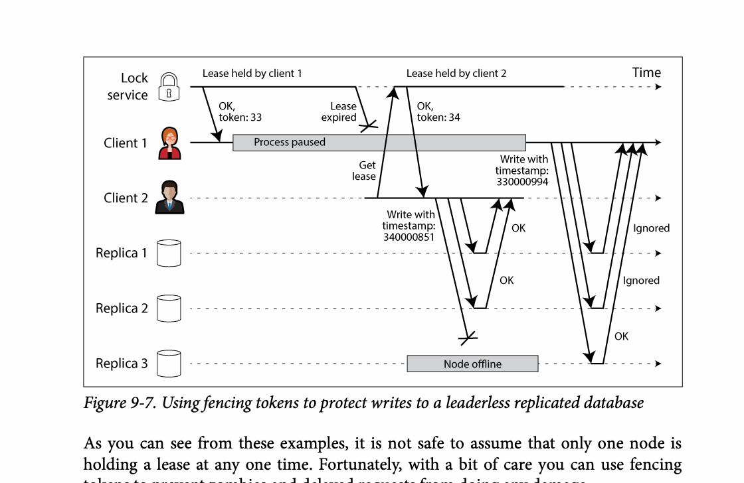
CHAPTER 09
Figure 9-7: mechanism explained
What it shows
Time or lease assumptions can become stale during clock error, delay, or process pause.
Why it matters
Fencing tokens let the resource reject operations from an expired owner.
What to watch
Follow the arrows or timeline and test whether the conclusion still holds under failure, retry, and concurrency.
17 / 20
Notes:
Source: Martin Kleppmann and Chris Riccomini, Designing Data-Intensive Applications, 2nd ed., Chapter 9, book pages 345-388. Figure 9-7, PDF page 401. Original caption: Figure 9-7. Using fencing tokens to protect writes to a leaderless replicated database
Explanation: Time or lease assumptions can become stale during clock error, delay, or process pause. Fencing tokens let the resource reject operations from an expired owner. Follow the arrows or timeline and test whether the conclusion still holds under failure, retry, and concurrency.
Source file: /Users/eve/projects/Designing-Data-Intensive-Applications/Designing Data Intensive Applications 2nd.pdf

Slide 18
CHAPTER 09
System models
05
A model states assumptions about delay, pauses, and failure types.
Byzantine faults allow arbitrary or malicious behavior.
Formal methods and randomized testing expose rare concurrency errors.
Core question
What problem does it solve, and what does it cost under failure, growth, and change?
18 / 20
Notes:
Source: Martin Kleppmann and Chris Riccomini, Designing Data-Intensive Applications, 2nd ed., Chapter 9, book pages 345-388.
Source file: /Users/eve/projects/Designing-Data-Intensive-Applications/Designing Data Intensive Applications 2nd.pdf

Slide 19
CHAPTER 09
System models: design trade-offs
05
Fit: A model states assumptions about delay, pauses, and failure types.
Cost: evaluate latency, throughput, consistency, and operational complexity.
Failure check: what state becomes visible when a node, network path, or dependency fails?
Evolution check: can formats, interfaces, and topology change through rolling upgrades?
19 / 20
Notes:
Source: Martin Kleppmann and Chris Riccomini, Designing Data-Intensive Applications, 2nd ed., Chapter 9, book pages 345-388.
Source file: /Users/eve/projects/Designing-Data-Intensive-Applications/Designing Data Intensive Applications 2nd.pdf

Slide 20
CHAPTER 09
Review and application
State the chapter’s central problem in one sentence.
Choose one mechanism and list the assumptions it relies on.
Describe a failure scenario and explain the recovery path.
Apply one trade-off from the chapter to a system you are designing.
20 / 20
Notes:
Source: Martin Kleppmann and Chris Riccomini, Designing Data-Intensive Applications, 2nd ed., Chapter 9, book pages 345-388.
Source file: /Users/eve/projects/Designing-Data-Intensive-Applications/Designing Data Intensive Applications 2nd.pdf

