Slide 1
CHAPTER 10
Consistency and Consensus
Designing Data-Intensive Applications, Second Edition
Detailed English Study Edition
01 / 23
Notes:
Source: Martin Kleppmann and Chris Riccomini, Designing Data-Intensive Applications, 2nd ed., Chapter 10, book pages 401-440.
Source file: /Users/eve/projects/Designing-Data-Intensive-Applications/Designing Data Intensive Applications 2nd.pdf

Slide 2
CHAPTER 10
Chapter map
01
Linearizability
Each operation appears to take effect atomically between invocation and response.
02
Where linearizability matters
Uniqueness constraints and leader election require agreement on current state.
03
Logical clocks and IDs
Logical clocks express ordering without precise physical time.
04
Consensus
Consensus lets nodes decide one value or an ordered log.
05
Coordination in practice
Consensus commonly powers replicated logs and metadata services.
02 / 23
Notes:
Source: Martin Kleppmann and Chris Riccomini, Designing Data-Intensive Applications, 2nd ed., Chapter 10, book pages 401-440.
Source file: /Users/eve/projects/Designing-Data-Intensive-Applications/Designing Data Intensive Applications 2nd.pdf

Slide 3
CHAPTER 10
Linearizability
01
Each operation appears to take effect atomically between invocation and response.
The system behaves as if it had one up-to-date copy.
Coordination raises latency and limits availability during partitions.
Core question
What problem does it solve, and what does it cost under failure, growth, and change?
03 / 23
Notes:
Source: Martin Kleppmann and Chris Riccomini, Designing Data-Intensive Applications, 2nd ed., Chapter 10, book pages 401-440.
Source file: /Users/eve/projects/Designing-Data-Intensive-Applications/Designing Data Intensive Applications 2nd.pdf

Slide 4
CHAPTER 10
Linearizability: design trade-offs
01
Fit: Each operation appears to take effect atomically between invocation and response.
Cost: evaluate latency, throughput, consistency, and operational complexity.
Failure check: what state becomes visible when a node, network path, or dependency fails?
Evolution check: can formats, interfaces, and topology change through rolling upgrades?
04 / 23
Notes:
Source: Martin Kleppmann and Chris Riccomini, Designing Data-Intensive Applications, 2nd ed., Chapter 10, book pages 401-440.
Source file: /Users/eve/projects/Designing-Data-Intensive-Applications/Designing Data Intensive Applications 2nd.pdf

Slide 5
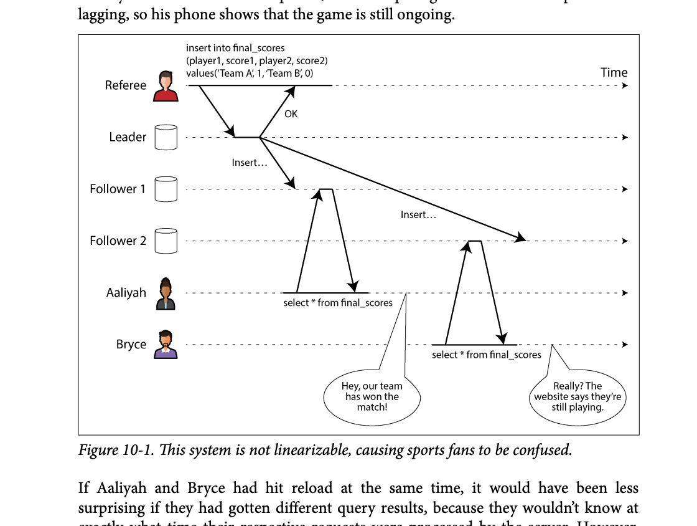
CHAPTER 10
Figure 10-1: mechanism explained
What it shows
The timeline compares real-time order with the order visible to clients.
Why it matters
Stronger ordering simplifies correctness but requires coordination or logical metadata.
What to watch
Follow the arrows or timeline and test whether the conclusion still holds under failure, retry, and concurrency.
05 / 23
Notes:
Source: Martin Kleppmann and Chris Riccomini, Designing Data-Intensive Applications, 2nd ed., Chapter 10, book pages 401-440. Figure 10-1, PDF page 427. Original caption: Figure 10-1. This system is not linearizable, causing sports fans to be confused.
Explanation: The timeline compares real-time order with the order visible to clients. Stronger ordering simplifies correctness but requires coordination or logical metadata. Follow the arrows or timeline and test whether the conclusion still holds under failure, retry, and concurrency.
Source file: /Users/eve/projects/Designing-Data-Intensive-Applications/Designing Data Intensive Applications 2nd.pdf

Slide 6
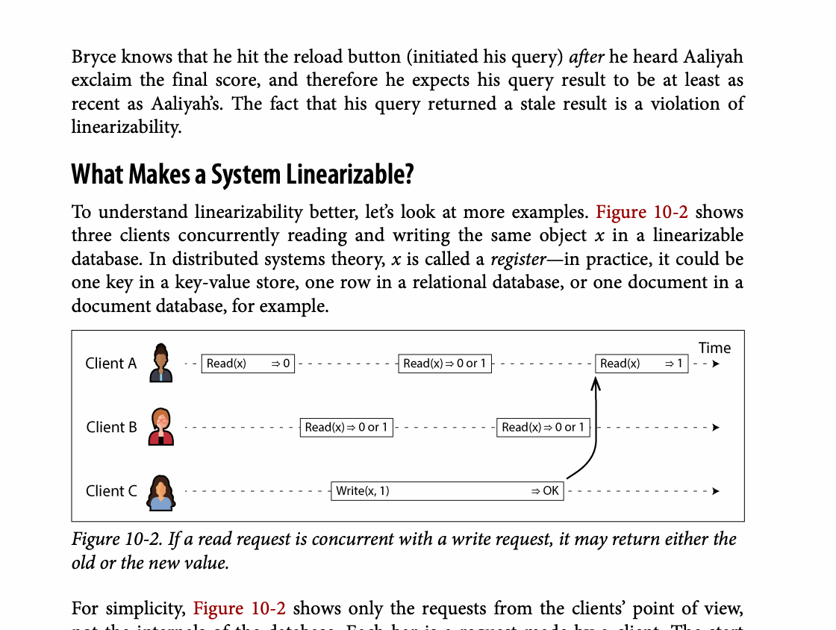
CHAPTER 10
Figure 10-2: mechanism explained
What it shows
If a read request is concurrent with a write request, it may return either the
Why it matters
It turns the chapter concept into a concrete dataflow, timeline, or state transition.
What to watch
Check the actors, data direction, operation order, and hidden system assumptions.
06 / 23
Notes:
Source: Martin Kleppmann and Chris Riccomini, Designing Data-Intensive Applications, 2nd ed., Chapter 10, book pages 401-440. Figure 10-2, PDF page 428. Original caption: Figure 10-2. If a read request is concurrent with a write request, it may return either the
Explanation: If a read request is concurrent with a write request, it may return either the It turns the chapter concept into a concrete dataflow, timeline, or state transition. Check the actors, data direction, operation order, and hidden system assumptions.
Source file: /Users/eve/projects/Designing-Data-Intensive-Applications/Designing Data Intensive Applications 2nd.pdf

Slide 7
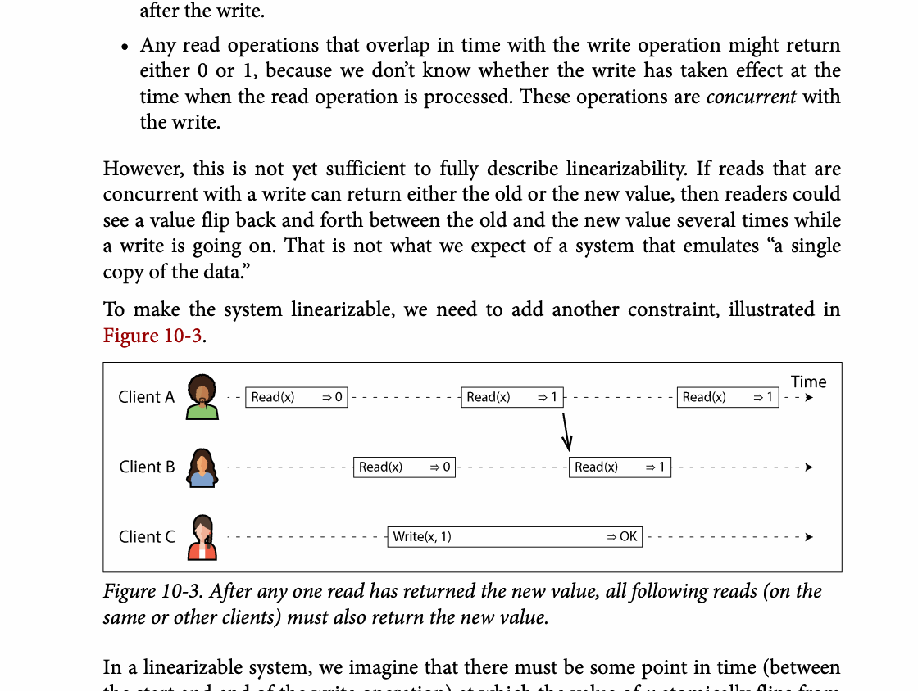
CHAPTER 10
Figure 10-3: mechanism explained
What it shows
After any one read has returned the new value, all following reads (on the
Why it matters
It turns the chapter concept into a concrete dataflow, timeline, or state transition.
What to watch
Check the actors, data direction, operation order, and hidden system assumptions.
07 / 23
Notes:
Source: Martin Kleppmann and Chris Riccomini, Designing Data-Intensive Applications, 2nd ed., Chapter 10, book pages 401-440. Figure 10-3, PDF page 429. Original caption: Figure 10-3. After any one read has returned the new value, all following reads (on the
Explanation: After any one read has returned the new value, all following reads (on the It turns the chapter concept into a concrete dataflow, timeline, or state transition. Check the actors, data direction, operation order, and hidden system assumptions.
Source file: /Users/eve/projects/Designing-Data-Intensive-Applications/Designing Data Intensive Applications 2nd.pdf

Slide 8
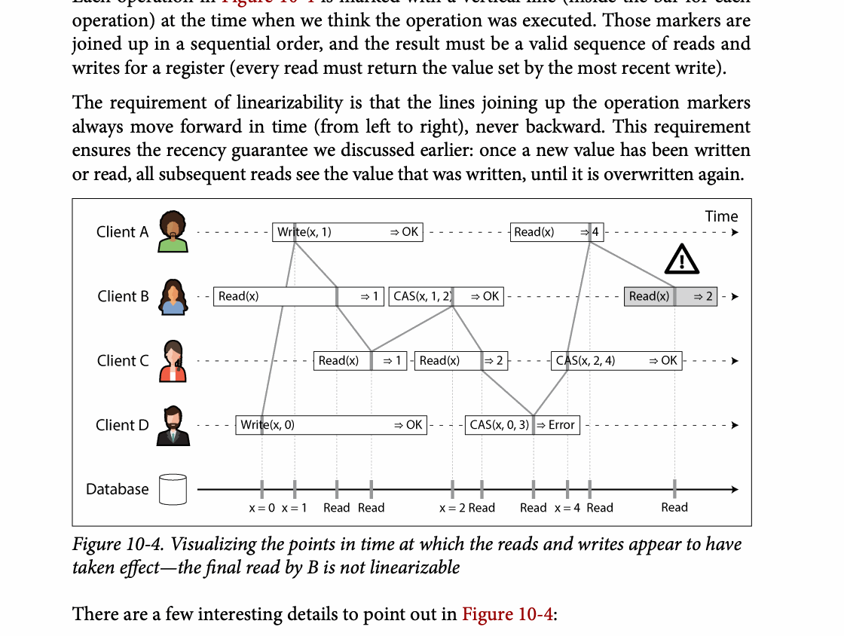
CHAPTER 10
Figure 10-4: mechanism explained
What it shows
Visualizing the points in time at which the reads and writes appear to have
Why it matters
It turns the chapter concept into a concrete dataflow, timeline, or state transition.
What to watch
Check the actors, data direction, operation order, and hidden system assumptions.
08 / 23
Notes:
Source: Martin Kleppmann and Chris Riccomini, Designing Data-Intensive Applications, 2nd ed., Chapter 10, book pages 401-440. Figure 10-4, PDF page 430. Original caption: Figure 10-4. Visualizing the points in time at which the reads and writes appear to have
Explanation: Visualizing the points in time at which the reads and writes appear to have It turns the chapter concept into a concrete dataflow, timeline, or state transition. Check the actors, data direction, operation order, and hidden system assumptions.
Source file: /Users/eve/projects/Designing-Data-Intensive-Applications/Designing Data Intensive Applications 2nd.pdf

Slide 9
CHAPTER 10
Where linearizability matters
02
Uniqueness constraints and leader election require agreement on current state.
Locks and leases need fencing tokens to protect external resources.
Many reads can use weaker semantics when business risk permits.
Core question
What problem does it solve, and what does it cost under failure, growth, and change?
09 / 23
Notes:
Source: Martin Kleppmann and Chris Riccomini, Designing Data-Intensive Applications, 2nd ed., Chapter 10, book pages 401-440.
Source file: /Users/eve/projects/Designing-Data-Intensive-Applications/Designing Data Intensive Applications 2nd.pdf

Slide 10
CHAPTER 10
Where linearizability matters: design trade-offs
02
Fit: Uniqueness constraints and leader election require agreement on current state.
Cost: evaluate latency, throughput, consistency, and operational complexity.
Failure check: what state becomes visible when a node, network path, or dependency fails?
Evolution check: can formats, interfaces, and topology change through rolling upgrades?
10 / 23
Notes:
Source: Martin Kleppmann and Chris Riccomini, Designing Data-Intensive Applications, 2nd ed., Chapter 10, book pages 401-440.
Source file: /Users/eve/projects/Designing-Data-Intensive-Applications/Designing Data Intensive Applications 2nd.pdf

Slide 11
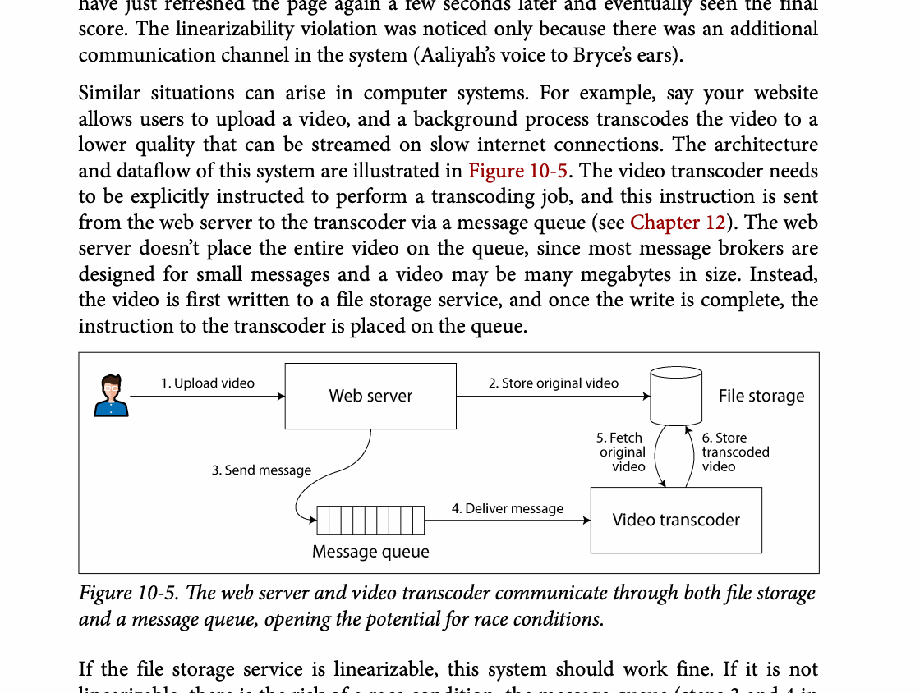
CHAPTER 10
Figure 10-5: mechanism explained
What it shows
The web server and video transcoder communicate through both file storage
Why it matters
It turns the chapter concept into a concrete dataflow, timeline, or state transition.
What to watch
Check the actors, data direction, operation order, and hidden system assumptions.
11 / 23
Notes:
Source: Martin Kleppmann and Chris Riccomini, Designing Data-Intensive Applications, 2nd ed., Chapter 10, book pages 401-440. Figure 10-5, PDF page 434. Original caption: Figure 10-5. The web server and video transcoder communicate through both file storage
Explanation: The web server and video transcoder communicate through both file storage It turns the chapter concept into a concrete dataflow, timeline, or state transition. Check the actors, data direction, operation order, and hidden system assumptions.
Source file: /Users/eve/projects/Designing-Data-Intensive-Applications/Designing Data Intensive Applications 2nd.pdf

Slide 12
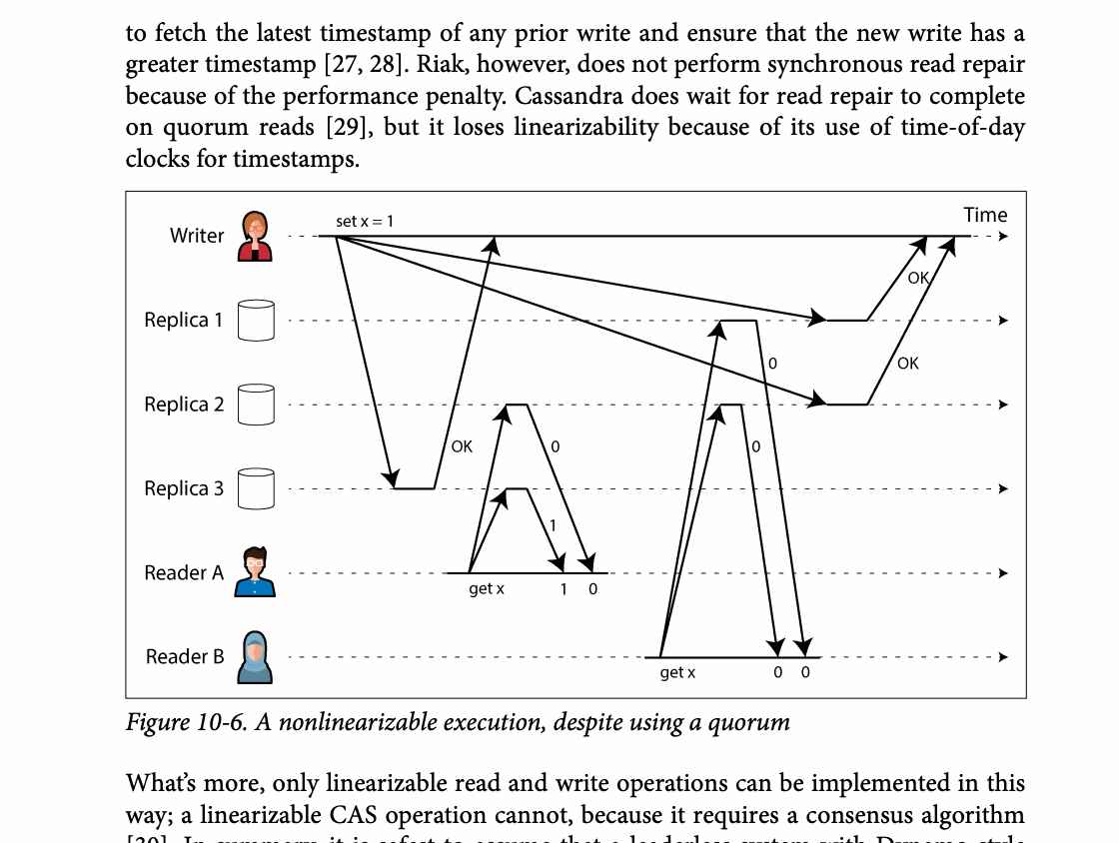
CHAPTER 10
Figure 10-6: mechanism explained
What it shows
Replica responses and version metadata are used to reason about freshness and causality.
Why it matters
Quorum overlap helps, but concurrent writes still require explicit version handling.
What to watch
Follow the arrows or timeline and test whether the conclusion still holds under failure, retry, and concurrency.
12 / 23
Notes:
Source: Martin Kleppmann and Chris Riccomini, Designing Data-Intensive Applications, 2nd ed., Chapter 10, book pages 401-440. Figure 10-6, PDF page 437. Original caption: Figure 10-6. A nonlinearizable execution, despite using a quorum
Explanation: Replica responses and version metadata are used to reason about freshness and causality. Quorum overlap helps, but concurrent writes still require explicit version handling. Follow the arrows or timeline and test whether the conclusion still holds under failure, retry, and concurrency.
Source file: /Users/eve/projects/Designing-Data-Intensive-Applications/Designing Data Intensive Applications 2nd.pdf

Slide 13
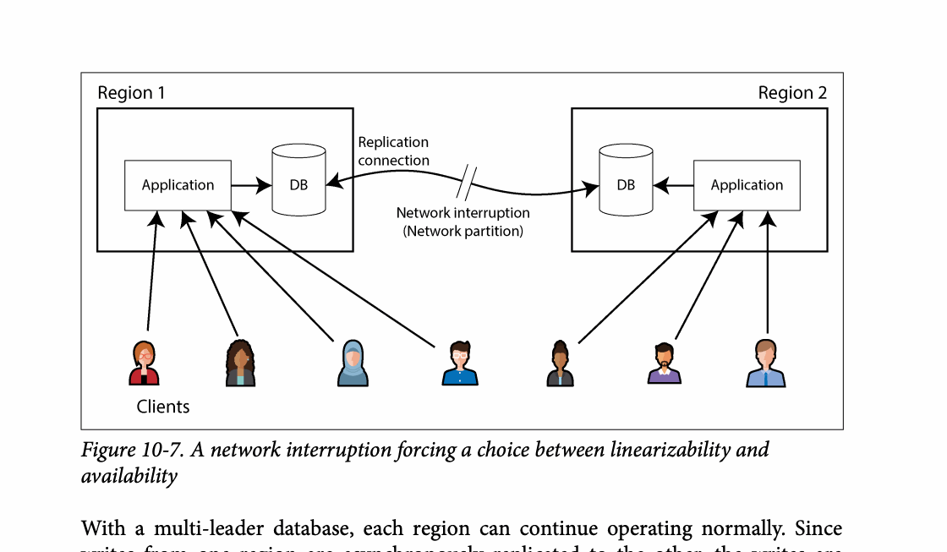
CHAPTER 10
Figure 10-7: mechanism explained
What it shows
The timeline compares real-time order with the order visible to clients.
Why it matters
Stronger ordering simplifies correctness but requires coordination or logical metadata.
What to watch
Follow the arrows or timeline and test whether the conclusion still holds under failure, retry, and concurrency.
13 / 23
Notes:
Source: Martin Kleppmann and Chris Riccomini, Designing Data-Intensive Applications, 2nd ed., Chapter 10, book pages 401-440. Figure 10-7, PDF page 438. Original caption: Figure 10-7. A network interruption forcing a choice between linearizability and
Explanation: The timeline compares real-time order with the order visible to clients. Stronger ordering simplifies correctness but requires coordination or logical metadata. Follow the arrows or timeline and test whether the conclusion still holds under failure, retry, and concurrency.
Source file: /Users/eve/projects/Designing-Data-Intensive-Applications/Designing Data Intensive Applications 2nd.pdf

Slide 14
CHAPTER 10
Logical clocks and IDs
03
Logical clocks express ordering without precise physical time.
Lamport timestamps provide a total order but do not identify concurrency.
Sortable ID generators trade throughput, order, and central dependency.
Core question
What problem does it solve, and what does it cost under failure, growth, and change?
14 / 23
Notes:
Source: Martin Kleppmann and Chris Riccomini, Designing Data-Intensive Applications, 2nd ed., Chapter 10, book pages 401-440.
Source file: /Users/eve/projects/Designing-Data-Intensive-Applications/Designing Data Intensive Applications 2nd.pdf

Slide 15
CHAPTER 10
Logical clocks and IDs: design trade-offs
03
Fit: Logical clocks express ordering without precise physical time.
Cost: evaluate latency, throughput, consistency, and operational complexity.
Failure check: what state becomes visible when a node, network path, or dependency fails?
Evolution check: can formats, interfaces, and topology change through rolling upgrades?
15 / 23
Notes:
Source: Martin Kleppmann and Chris Riccomini, Designing Data-Intensive Applications, 2nd ed., Chapter 10, book pages 401-440.
Source file: /Users/eve/projects/Designing-Data-Intensive-Applications/Designing Data Intensive Applications 2nd.pdf

Slide 16
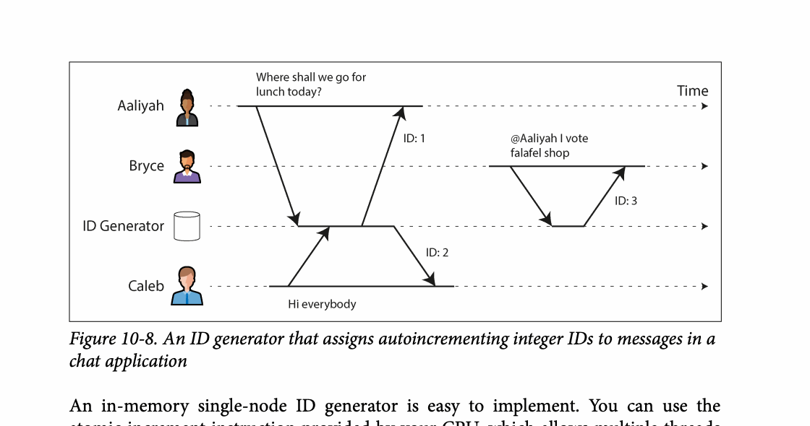
CHAPTER 10
Figure 10-8: mechanism explained
What it shows
The timeline compares real-time order with the order visible to clients.
Why it matters
Stronger ordering simplifies correctness but requires coordination or logical metadata.
What to watch
Follow the arrows or timeline and test whether the conclusion still holds under failure, retry, and concurrency.
16 / 23
Notes:
Source: Martin Kleppmann and Chris Riccomini, Designing Data-Intensive Applications, 2nd ed., Chapter 10, book pages 401-440. Figure 10-8, PDF page 442. Original caption: Figure 10-8. An ID generator that assigns autoincrementing integer IDs to messages in a
Explanation: The timeline compares real-time order with the order visible to clients. Stronger ordering simplifies correctness but requires coordination or logical metadata. Follow the arrows or timeline and test whether the conclusion still holds under failure, retry, and concurrency.
Source file: /Users/eve/projects/Designing-Data-Intensive-Applications/Designing Data Intensive Applications 2nd.pdf

Slide 17
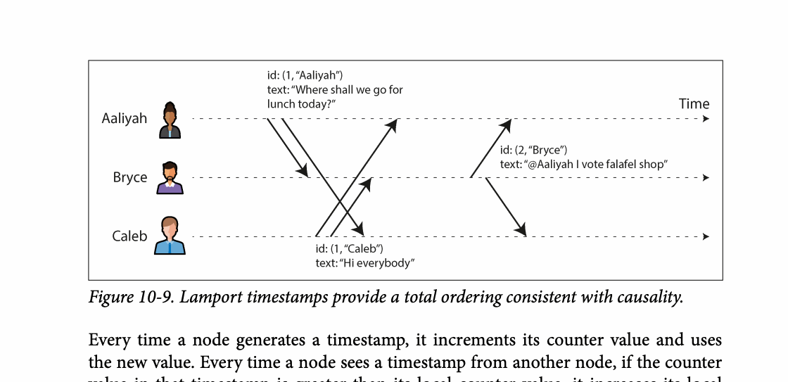
CHAPTER 10
Figure 10-9: mechanism explained
What it shows
Time or lease assumptions can become stale during clock error, delay, or process pause.
Why it matters
Fencing tokens let the resource reject operations from an expired owner.
What to watch
Follow the arrows or timeline and test whether the conclusion still holds under failure, retry, and concurrency.
17 / 23
Notes:
Source: Martin Kleppmann and Chris Riccomini, Designing Data-Intensive Applications, 2nd ed., Chapter 10, book pages 401-440. Figure 10-9, PDF page 445. Original caption: Figure 10-9. Lamport timestamps provide a total ordering consistent with causality.
Explanation: Time or lease assumptions can become stale during clock error, delay, or process pause. Fencing tokens let the resource reject operations from an expired owner. Follow the arrows or timeline and test whether the conclusion still holds under failure, retry, and concurrency.
Source file: /Users/eve/projects/Designing-Data-Intensive-Applications/Designing Data Intensive Applications 2nd.pdf

Slide 18
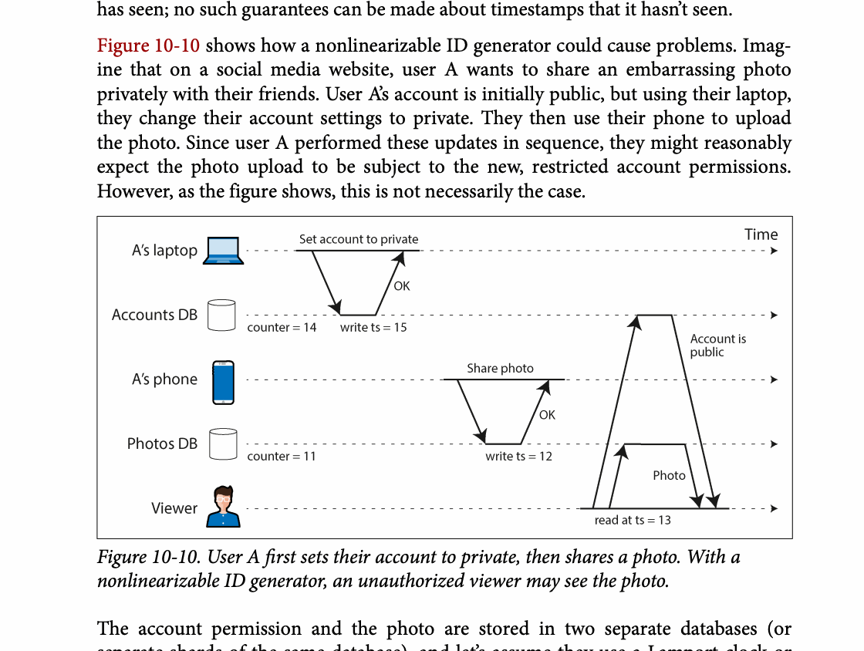
CHAPTER 10
Figure 10-10: mechanism explained
What it shows
User A first sets their account to private, then shares a photo. With a
Why it matters
It turns the chapter concept into a concrete dataflow, timeline, or state transition.
What to watch
Check the actors, data direction, operation order, and hidden system assumptions.
18 / 23
Notes:
Source: Martin Kleppmann and Chris Riccomini, Designing Data-Intensive Applications, 2nd ed., Chapter 10, book pages 401-440. Figure 10-10, PDF page 447. Original caption: Figure 10-10. User A first sets their account to private, then shares a photo. With a
Explanation: User A first sets their account to private, then shares a photo. With a It turns the chapter concept into a concrete dataflow, timeline, or state transition. Check the actors, data direction, operation order, and hidden system assumptions.
Source file: /Users/eve/projects/Designing-Data-Intensive-Applications/Designing Data Intensive Applications 2nd.pdf

Slide 19
CHAPTER 10
Consensus
04
Consensus lets nodes decide one value or an ordered log.
Raft and Paxos use quorums and terms to prevent conflicting leaders.
Safety prevents contradictory decisions while liveness enables progress.
Core question
What problem does it solve, and what does it cost under failure, growth, and change?
19 / 23
Notes:
Source: Martin Kleppmann and Chris Riccomini, Designing Data-Intensive Applications, 2nd ed., Chapter 10, book pages 401-440.
Source file: /Users/eve/projects/Designing-Data-Intensive-Applications/Designing Data Intensive Applications 2nd.pdf

Slide 20
CHAPTER 10
Consensus: design trade-offs
04
Fit: Consensus lets nodes decide one value or an ordered log.
Cost: evaluate latency, throughput, consistency, and operational complexity.
Failure check: what state becomes visible when a node, network path, or dependency fails?
Evolution check: can formats, interfaces, and topology change through rolling upgrades?
20 / 23
Notes:
Source: Martin Kleppmann and Chris Riccomini, Designing Data-Intensive Applications, 2nd ed., Chapter 10, book pages 401-440.
Source file: /Users/eve/projects/Designing-Data-Intensive-Applications/Designing Data Intensive Applications 2nd.pdf

Slide 21
CHAPTER 10
Coordination in practice
05
Consensus commonly powers replicated logs and metadata services.
Membership changes and snapshots are essential production concerns.
Use coordination services for small authoritative metadata, not bulk application data.
Core question
What problem does it solve, and what does it cost under failure, growth, and change?
21 / 23
Notes:
Source: Martin Kleppmann and Chris Riccomini, Designing Data-Intensive Applications, 2nd ed., Chapter 10, book pages 401-440.
Source file: /Users/eve/projects/Designing-Data-Intensive-Applications/Designing Data Intensive Applications 2nd.pdf

Slide 22
CHAPTER 10
Coordination in practice: design trade-offs
05
Fit: Consensus commonly powers replicated logs and metadata services.
Cost: evaluate latency, throughput, consistency, and operational complexity.
Failure check: what state becomes visible when a node, network path, or dependency fails?
Evolution check: can formats, interfaces, and topology change through rolling upgrades?
22 / 23
Notes:
Source: Martin Kleppmann and Chris Riccomini, Designing Data-Intensive Applications, 2nd ed., Chapter 10, book pages 401-440.
Source file: /Users/eve/projects/Designing-Data-Intensive-Applications/Designing Data Intensive Applications 2nd.pdf

Slide 23
CHAPTER 10
Review and application
State the chapter’s central problem in one sentence.
Choose one mechanism and list the assumptions it relies on.
Describe a failure scenario and explain the recovery path.
Apply one trade-off from the chapter to a system you are designing.
23 / 23
Notes:
Source: Martin Kleppmann and Chris Riccomini, Designing Data-Intensive Applications, 2nd ed., Chapter 10, book pages 401-440.
Source file: /Users/eve/projects/Designing-Data-Intensive-Applications/Designing Data Intensive Applications 2nd.pdf

