Slide 1
CHAPTER 11
Batch Processing
Designing Data-Intensive Applications, Second Edition
Detailed English Study Edition
01 / 16
Notes:
Source: Martin Kleppmann and Chris Riccomini, Designing Data-Intensive Applications, 2nd ed., Chapter 11, book pages 451-481.
Source file: /Users/eve/projects/Designing-Data-Intensive-Applications/Designing Data Intensive Applications 2nd.pdf

Slide 2
CHAPTER 11
Chapter map
01
Batch processing model
Batch jobs read bounded input and produce derived output.
02
Unix tools
Pipelines compose small tools through stream interfaces.
03
Distributed execution
Distributed filesystems and object stores provide shared inputs and outputs.
04
Execution models
MapReduce organizes map, shuffle, and reduce stages.
05
Batch use cases
ETL cleans and reshapes data for downstream systems.
02 / 16
Notes:
Source: Martin Kleppmann and Chris Riccomini, Designing Data-Intensive Applications, 2nd ed., Chapter 11, book pages 451-481.
Source file: /Users/eve/projects/Designing-Data-Intensive-Applications/Designing Data Intensive Applications 2nd.pdf

Slide 3
CHAPTER 11
Batch processing model
01
Batch jobs read bounded input and produce derived output.
Immutable input and rerunnable jobs simplify recovery.
Throughput usually matters more than per-record latency.
Core question
What problem does it solve, and what does it cost under failure, growth, and change?
03 / 16
Notes:
Source: Martin Kleppmann and Chris Riccomini, Designing Data-Intensive Applications, 2nd ed., Chapter 11, book pages 451-481.
Source file: /Users/eve/projects/Designing-Data-Intensive-Applications/Designing Data Intensive Applications 2nd.pdf

Slide 4
CHAPTER 11
Batch processing model: design trade-offs
01
Fit: Batch jobs read bounded input and produce derived output.
Cost: evaluate latency, throughput, consistency, and operational complexity.
Failure check: what state becomes visible when a node, network path, or dependency fails?
Evolution check: can formats, interfaces, and topology change through rolling upgrades?
04 / 16
Notes:
Source: Martin Kleppmann and Chris Riccomini, Designing Data-Intensive Applications, 2nd ed., Chapter 11, book pages 451-481.
Source file: /Users/eve/projects/Designing-Data-Intensive-Applications/Designing Data Intensive Applications 2nd.pdf

Slide 5
CHAPTER 11
Unix tools
02
Pipelines compose small tools through stream interfaces.
Sorting enables grouping and joins beyond memory size.
Text streams are simple but lack rich types and distributed scheduling.
Core question
What problem does it solve, and what does it cost under failure, growth, and change?
05 / 16
Notes:
Source: Martin Kleppmann and Chris Riccomini, Designing Data-Intensive Applications, 2nd ed., Chapter 11, book pages 451-481.
Source file: /Users/eve/projects/Designing-Data-Intensive-Applications/Designing Data Intensive Applications 2nd.pdf

Slide 6
CHAPTER 11
Unix tools: design trade-offs
02
Fit: Pipelines compose small tools through stream interfaces.
Cost: evaluate latency, throughput, consistency, and operational complexity.
Failure check: what state becomes visible when a node, network path, or dependency fails?
Evolution check: can formats, interfaces, and topology change through rolling upgrades?
06 / 16
Notes:
Source: Martin Kleppmann and Chris Riccomini, Designing Data-Intensive Applications, 2nd ed., Chapter 11, book pages 451-481.
Source file: /Users/eve/projects/Designing-Data-Intensive-Applications/Designing Data Intensive Applications 2nd.pdf

Slide 7
CHAPTER 11
Distributed execution
03
Distributed filesystems and object stores provide shared inputs and outputs.
Schedulers place tasks, monitor them, and retry failures.
Object storage shifts optimization from disk locality toward network and compute elasticity.
Core question
What problem does it solve, and what does it cost under failure, growth, and change?
07 / 16
Notes:
Source: Martin Kleppmann and Chris Riccomini, Designing Data-Intensive Applications, 2nd ed., Chapter 11, book pages 451-481.
Source file: /Users/eve/projects/Designing-Data-Intensive-Applications/Designing Data Intensive Applications 2nd.pdf

Slide 8
CHAPTER 11
Distributed execution: design trade-offs
03
Fit: Distributed filesystems and object stores provide shared inputs and outputs.
Cost: evaluate latency, throughput, consistency, and operational complexity.
Failure check: what state becomes visible when a node, network path, or dependency fails?
Evolution check: can formats, interfaces, and topology change through rolling upgrades?
08 / 16
Notes:
Source: Martin Kleppmann and Chris Riccomini, Designing Data-Intensive Applications, 2nd ed., Chapter 11, book pages 451-481.
Source file: /Users/eve/projects/Designing-Data-Intensive-Applications/Designing Data Intensive Applications 2nd.pdf

Slide 9
CHAPTER 11
Execution models
04
MapReduce organizes map, shuffle, and reduce stages.
Dataflow engines fuse several operations into an execution graph.
Shuffle boundaries dominate network, disk, and latency cost.
Core question
What problem does it solve, and what does it cost under failure, growth, and change?
09 / 16
Notes:
Source: Martin Kleppmann and Chris Riccomini, Designing Data-Intensive Applications, 2nd ed., Chapter 11, book pages 451-481.
Source file: /Users/eve/projects/Designing-Data-Intensive-Applications/Designing Data Intensive Applications 2nd.pdf

Slide 10
CHAPTER 11
Execution models: design trade-offs
04
Fit: MapReduce organizes map, shuffle, and reduce stages.
Cost: evaluate latency, throughput, consistency, and operational complexity.
Failure check: what state becomes visible when a node, network path, or dependency fails?
Evolution check: can formats, interfaces, and topology change through rolling upgrades?
10 / 16
Notes:
Source: Martin Kleppmann and Chris Riccomini, Designing Data-Intensive Applications, 2nd ed., Chapter 11, book pages 451-481.
Source file: /Users/eve/projects/Designing-Data-Intensive-Applications/Designing Data Intensive Applications 2nd.pdf

Slide 11
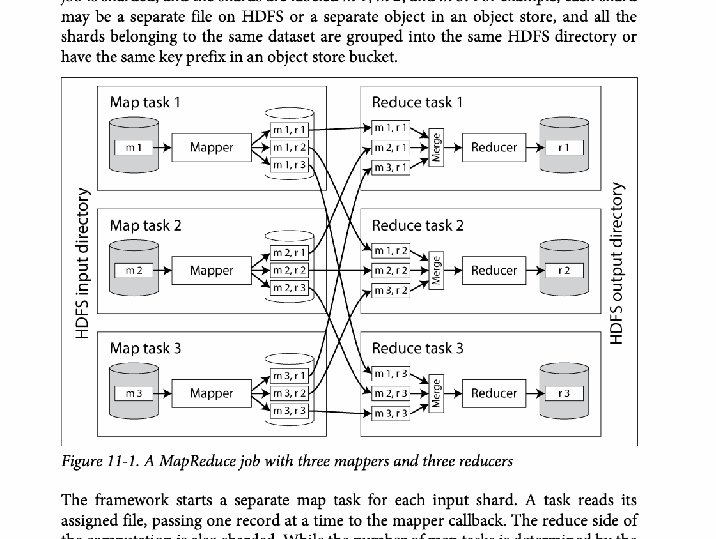
CHAPTER 11
Figure 11-1: mechanism explained
What it shows
Data is partitioned, shuffled by key, and combined in parallel.
Why it matters
Shuffle and sorting are the major network and disk cost boundaries.
What to watch
Follow the arrows or timeline and test whether the conclusion still holds under failure, retry, and concurrency.
11 / 16
Notes:
Source: Martin Kleppmann and Chris Riccomini, Designing Data-Intensive Applications, 2nd ed., Chapter 11, book pages 451-481. Figure 11-1, PDF page 494. Original caption: Figure 11-1. A MapReduce job with three mappers and three reducers
Explanation: Data is partitioned, shuffled by key, and combined in parallel. Shuffle and sorting are the major network and disk cost boundaries. Follow the arrows or timeline and test whether the conclusion still holds under failure, retry, and concurrency.
Source file: /Users/eve/projects/Designing-Data-Intensive-Applications/Designing Data Intensive Applications 2nd.pdf

Slide 12
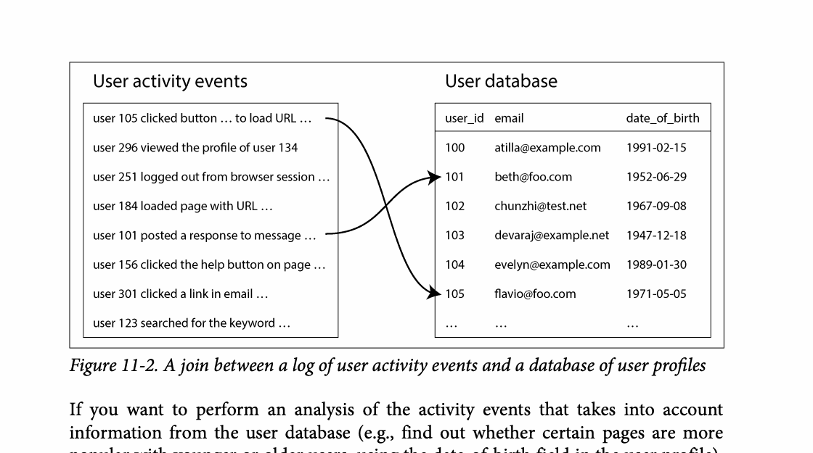
CHAPTER 11
Figure 11-2: mechanism explained
What it shows
Data is partitioned, shuffled by key, and combined in parallel.
Why it matters
Shuffle and sorting are the major network and disk cost boundaries.
What to watch
Follow the arrows or timeline and test whether the conclusion still holds under failure, retry, and concurrency.
12 / 16
Notes:
Source: Martin Kleppmann and Chris Riccomini, Designing Data-Intensive Applications, 2nd ed., Chapter 11, book pages 451-481. Figure 11-2, PDF page 496. Original caption: Figure 11-2. A join between a log of user activity events and a database of user profiles
Explanation: Data is partitioned, shuffled by key, and combined in parallel. Shuffle and sorting are the major network and disk cost boundaries. Follow the arrows or timeline and test whether the conclusion still holds under failure, retry, and concurrency.
Source file: /Users/eve/projects/Designing-Data-Intensive-Applications/Designing Data Intensive Applications 2nd.pdf

Slide 13
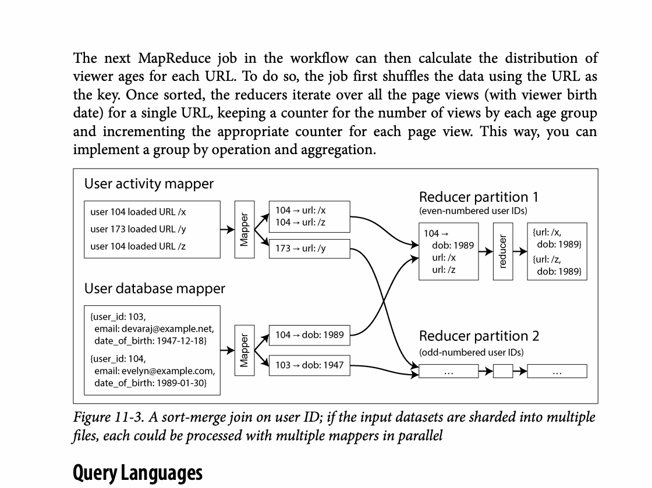
CHAPTER 11
Figure 11-3: mechanism explained
What it shows
Keys, requests, or index entries are assigned across partitions.
Why it matters
The assignment controls balance, range locality, routing work, and rebalancing cost.
What to watch
Follow the arrows or timeline and test whether the conclusion still holds under failure, retry, and concurrency.
13 / 16
Notes:
Source: Martin Kleppmann and Chris Riccomini, Designing Data-Intensive Applications, 2nd ed., Chapter 11, book pages 451-481. Figure 11-3, PDF page 497. Original caption: Figure 11-3. A sort-merge join on user ID; if the input datasets are sharded into multiple
Explanation: Keys, requests, or index entries are assigned across partitions. The assignment controls balance, range locality, routing work, and rebalancing cost. Follow the arrows or timeline and test whether the conclusion still holds under failure, retry, and concurrency.
Source file: /Users/eve/projects/Designing-Data-Intensive-Applications/Designing Data Intensive Applications 2nd.pdf

Slide 14
CHAPTER 11
Batch use cases
05
ETL cleans and reshapes data for downstream systems.
Analytics and machine learning derive metrics and models from history.
Serving layers load batch results into low-latency stores.
Core question
What problem does it solve, and what does it cost under failure, growth, and change?
14 / 16
Notes:
Source: Martin Kleppmann and Chris Riccomini, Designing Data-Intensive Applications, 2nd ed., Chapter 11, book pages 451-481.
Source file: /Users/eve/projects/Designing-Data-Intensive-Applications/Designing Data Intensive Applications 2nd.pdf

Slide 15
CHAPTER 11
Batch use cases: design trade-offs
05
Fit: ETL cleans and reshapes data for downstream systems.
Cost: evaluate latency, throughput, consistency, and operational complexity.
Failure check: what state becomes visible when a node, network path, or dependency fails?
Evolution check: can formats, interfaces, and topology change through rolling upgrades?
15 / 16
Notes:
Source: Martin Kleppmann and Chris Riccomini, Designing Data-Intensive Applications, 2nd ed., Chapter 11, book pages 451-481.
Source file: /Users/eve/projects/Designing-Data-Intensive-Applications/Designing Data Intensive Applications 2nd.pdf

Slide 16
CHAPTER 11
Review and application
State the chapter’s central problem in one sentence.
Choose one mechanism and list the assumptions it relies on.
Describe a failure scenario and explain the recovery path.
Apply one trade-off from the chapter to a system you are designing.
16 / 16
Notes:
Source: Martin Kleppmann and Chris Riccomini, Designing Data-Intensive Applications, 2nd ed., Chapter 11, book pages 451-481.
Source file: /Users/eve/projects/Designing-Data-Intensive-Applications/Designing Data Intensive Applications 2nd.pdf

