Slide 1
CHAPTER 12
Stream Processing
Designing Data-Intensive Applications, Second Edition
Detailed English Study Edition
01 / 21
Notes:
Source: Martin Kleppmann and Chris Riccomini, Designing Data-Intensive Applications, 2nd ed., Chapter 12, book pages 487-529.
Source file: /Users/eve/projects/Designing-Data-Intensive-Applications/Designing Data Intensive Applications 2nd.pdf

Slide 2
CHAPTER 12
Chapter map
01
Event streams
An event is an immutable fact recorded at a point in time.
02
Message brokers
Direct delivery minimizes delay but provides weaker recovery.
03
Databases and streams
Dual writes diverge when one side fails.
04
Time semantics
Event time records when business activity happened.
05
State and fault tolerance
Stream joins and aggregates maintain durable state.
02 / 21
Notes:
Source: Martin Kleppmann and Chris Riccomini, Designing Data-Intensive Applications, 2nd ed., Chapter 12, book pages 487-529.
Source file: /Users/eve/projects/Designing-Data-Intensive-Applications/Designing Data Intensive Applications 2nd.pdf

Slide 3
CHAPTER 12
Event streams
01
An event is an immutable fact recorded at a point in time.
Messaging systems move events between producers and consumers.
Durable logs retain partition order and support independent replay.
Core question
What problem does it solve, and what does it cost under failure, growth, and change?
03 / 21
Notes:
Source: Martin Kleppmann and Chris Riccomini, Designing Data-Intensive Applications, 2nd ed., Chapter 12, book pages 487-529.
Source file: /Users/eve/projects/Designing-Data-Intensive-Applications/Designing Data Intensive Applications 2nd.pdf

Slide 4
CHAPTER 12
Event streams: design trade-offs
01
Fit: An event is an immutable fact recorded at a point in time.
Cost: evaluate latency, throughput, consistency, and operational complexity.
Failure check: what state becomes visible when a node, network path, or dependency fails?
Evolution check: can formats, interfaces, and topology change through rolling upgrades?
04 / 21
Notes:
Source: Martin Kleppmann and Chris Riccomini, Designing Data-Intensive Applications, 2nd ed., Chapter 12, book pages 487-529.
Source file: /Users/eve/projects/Designing-Data-Intensive-Applications/Designing Data Intensive Applications 2nd.pdf

Slide 5
CHAPTER 12
Message brokers
02
Direct delivery minimizes delay but provides weaker recovery.
Log brokers separate retention from consumer position.
Partitions provide parallelism and define the scope of ordering.
Core question
What problem does it solve, and what does it cost under failure, growth, and change?
05 / 21
Notes:
Source: Martin Kleppmann and Chris Riccomini, Designing Data-Intensive Applications, 2nd ed., Chapter 12, book pages 487-529.
Source file: /Users/eve/projects/Designing-Data-Intensive-Applications/Designing Data Intensive Applications 2nd.pdf

Slide 6
CHAPTER 12
Message brokers: design trade-offs
02
Fit: Direct delivery minimizes delay but provides weaker recovery.
Cost: evaluate latency, throughput, consistency, and operational complexity.
Failure check: what state becomes visible when a node, network path, or dependency fails?
Evolution check: can formats, interfaces, and topology change through rolling upgrades?
06 / 21
Notes:
Source: Martin Kleppmann and Chris Riccomini, Designing Data-Intensive Applications, 2nd ed., Chapter 12, book pages 487-529.
Source file: /Users/eve/projects/Designing-Data-Intensive-Applications/Designing Data Intensive Applications 2nd.pdf

Slide 7
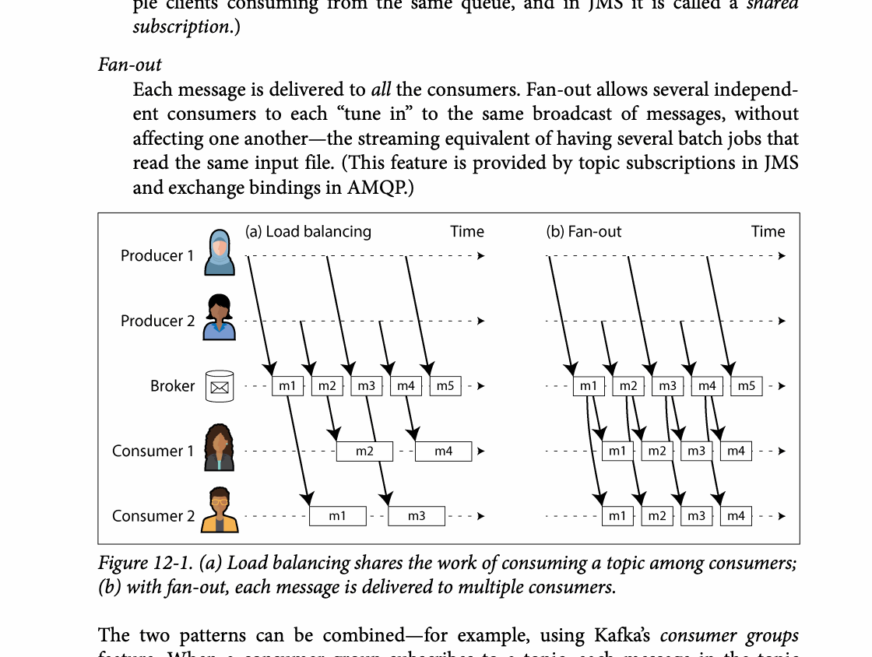
CHAPTER 12
Figure 12-1: mechanism explained
What it shows
Partitions define ordering while consumer assignment defines parallelism and delivery.
Why it matters
Crashes can cause redelivery, so handlers must tolerate duplicates.
What to watch
Follow the arrows or timeline and test whether the conclusion still holds under failure, retry, and concurrency.
07 / 21
Notes:
Source: Martin Kleppmann and Chris Riccomini, Designing Data-Intensive Applications, 2nd ed., Chapter 12, book pages 487-529. Figure 12-1, PDF page 517. Original caption: Figure 12-1. (a) Load balancing shares the work of consuming a topic among consumers;
Explanation: Partitions define ordering while consumer assignment defines parallelism and delivery. Crashes can cause redelivery, so handlers must tolerate duplicates. Follow the arrows or timeline and test whether the conclusion still holds under failure, retry, and concurrency.
Source file: /Users/eve/projects/Designing-Data-Intensive-Applications/Designing Data Intensive Applications 2nd.pdf

Slide 8
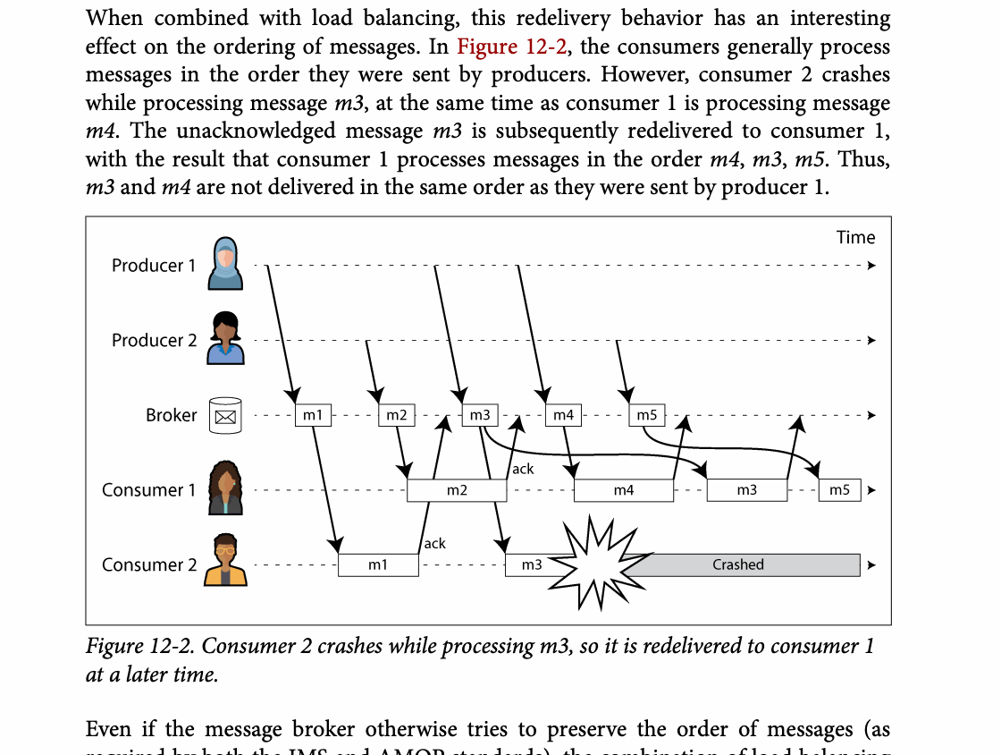
CHAPTER 12
Figure 12-2: mechanism explained
What it shows
Partitions define ordering while consumer assignment defines parallelism and delivery.
Why it matters
Crashes can cause redelivery, so handlers must tolerate duplicates.
What to watch
Follow the arrows or timeline and test whether the conclusion still holds under failure, retry, and concurrency.
08 / 21
Notes:
Source: Martin Kleppmann and Chris Riccomini, Designing Data-Intensive Applications, 2nd ed., Chapter 12, book pages 487-529. Figure 12-2, PDF page 518. Original caption: Figure 12-2. Consumer 2 crashes while processing m3, so it is redelivered to consumer 1
Explanation: Partitions define ordering while consumer assignment defines parallelism and delivery. Crashes can cause redelivery, so handlers must tolerate duplicates. Follow the arrows or timeline and test whether the conclusion still holds under failure, retry, and concurrency.
Source file: /Users/eve/projects/Designing-Data-Intensive-Applications/Designing Data Intensive Applications 2nd.pdf

Slide 9
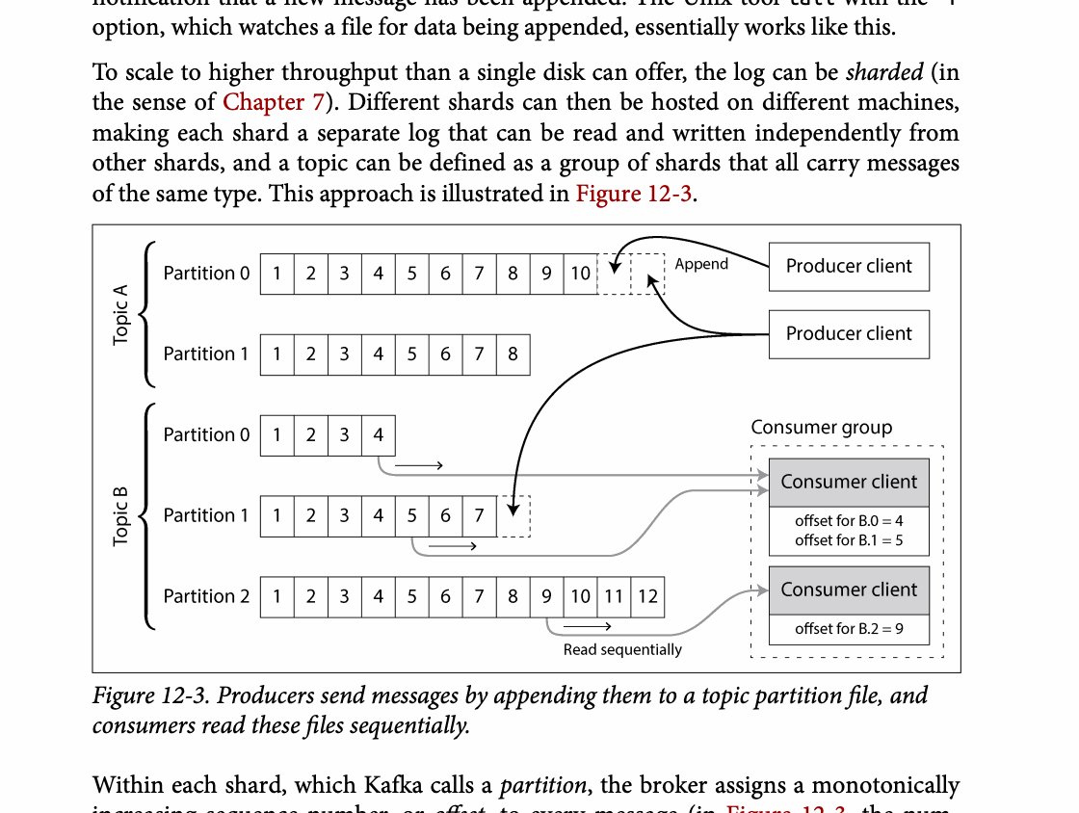
CHAPTER 12
Figure 12-3: mechanism explained
What it shows
Partitions define ordering while consumer assignment defines parallelism and delivery.
Why it matters
Crashes can cause redelivery, so handlers must tolerate duplicates.
What to watch
Follow the arrows or timeline and test whether the conclusion still holds under failure, retry, and concurrency.
09 / 21
Notes:
Source: Martin Kleppmann and Chris Riccomini, Designing Data-Intensive Applications, 2nd ed., Chapter 12, book pages 487-529. Figure 12-3, PDF page 520. Original caption: Figure 12-3. Producers send messages by appending them to a topic partition file, and
Explanation: Partitions define ordering while consumer assignment defines parallelism and delivery. Crashes can cause redelivery, so handlers must tolerate duplicates. Follow the arrows or timeline and test whether the conclusion still holds under failure, retry, and concurrency.
Source file: /Users/eve/projects/Designing-Data-Intensive-Applications/Designing Data Intensive Applications 2nd.pdf

Slide 10
CHAPTER 12
Databases and streams
03
Dual writes diverge when one side fails.
Change data capture converts database logs into a reliable change stream.
Event sourcing makes changes primary and state a derived view.
Core question
What problem does it solve, and what does it cost under failure, growth, and change?
10 / 21
Notes:
Source: Martin Kleppmann and Chris Riccomini, Designing Data-Intensive Applications, 2nd ed., Chapter 12, book pages 487-529.
Source file: /Users/eve/projects/Designing-Data-Intensive-Applications/Designing Data Intensive Applications 2nd.pdf

Slide 11
CHAPTER 12
Databases and streams: design trade-offs
03
Fit: Dual writes diverge when one side fails.
Cost: evaluate latency, throughput, consistency, and operational complexity.
Failure check: what state becomes visible when a node, network path, or dependency fails?
Evolution check: can formats, interfaces, and topology change through rolling upgrades?
11 / 21
Notes:
Source: Martin Kleppmann and Chris Riccomini, Designing Data-Intensive Applications, 2nd ed., Chapter 12, book pages 487-529.
Source file: /Users/eve/projects/Designing-Data-Intensive-Applications/Designing Data Intensive Applications 2nd.pdf

Slide 12
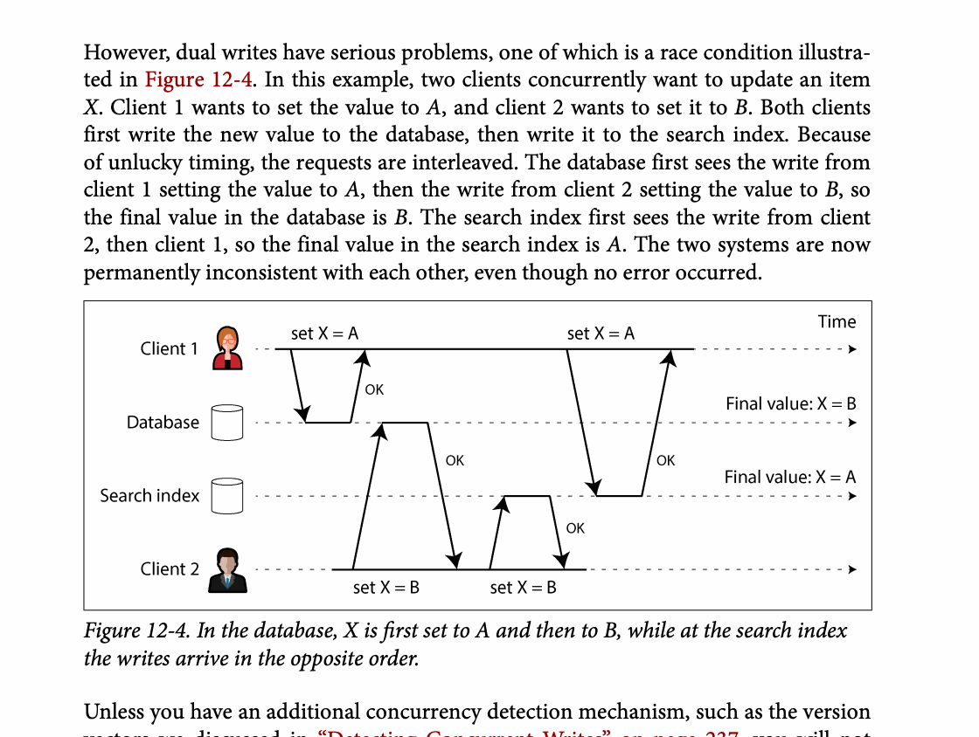
CHAPTER 12
Figure 12-4: mechanism explained
What it shows
Committed database changes are captured and propagated to a derived system.
Why it matters
CDC replaces fragile dual writes with an ordered, replayable change stream.
What to watch
Follow the arrows or timeline and test whether the conclusion still holds under failure, retry, and concurrency.
12 / 21
Notes:
Source: Martin Kleppmann and Chris Riccomini, Designing Data-Intensive Applications, 2nd ed., Chapter 12, book pages 487-529. Figure 12-4, PDF page 526. Original caption: Figure 12-4. In the database, X is first set to A and then to B, while at the search index
Explanation: Committed database changes are captured and propagated to a derived system. CDC replaces fragile dual writes with an ordered, replayable change stream. Follow the arrows or timeline and test whether the conclusion still holds under failure, retry, and concurrency.
Source file: /Users/eve/projects/Designing-Data-Intensive-Applications/Designing Data Intensive Applications 2nd.pdf

Slide 13
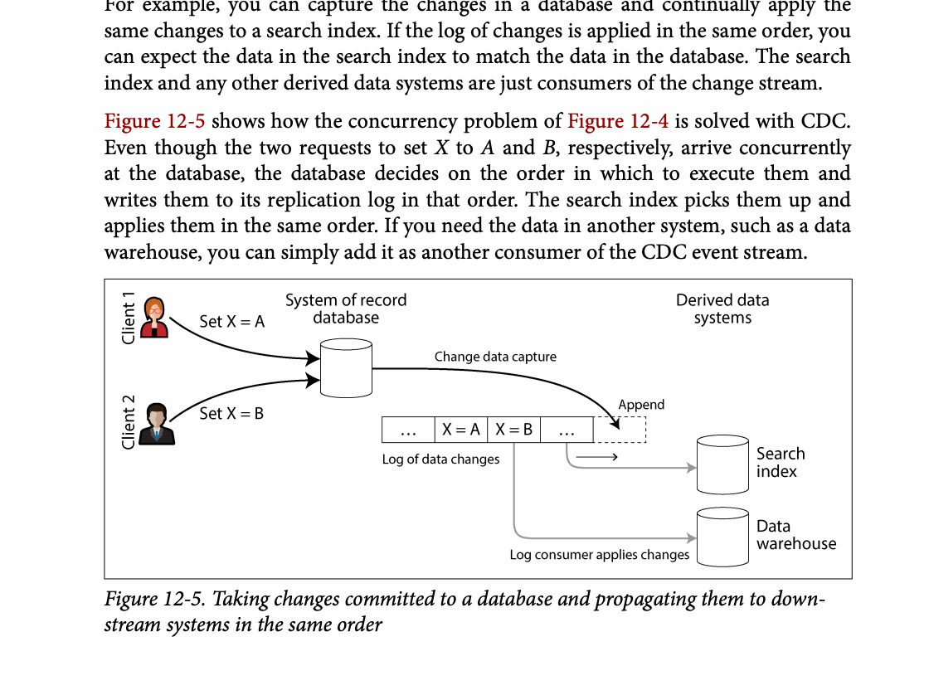
CHAPTER 12
Figure 12-5: mechanism explained
What it shows
Committed database changes are captured and propagated to a derived system.
Why it matters
CDC replaces fragile dual writes with an ordered, replayable change stream.
What to watch
Follow the arrows or timeline and test whether the conclusion still holds under failure, retry, and concurrency.
13 / 21
Notes:
Source: Martin Kleppmann and Chris Riccomini, Designing Data-Intensive Applications, 2nd ed., Chapter 12, book pages 487-529. Figure 12-5, PDF page 527. Original caption: Figure 12-5. Taking changes committed to a database and propagating them to down‐
Explanation: Committed database changes are captured and propagated to a derived system. CDC replaces fragile dual writes with an ordered, replayable change stream. Follow the arrows or timeline and test whether the conclusion still holds under failure, retry, and concurrency.
Source file: /Users/eve/projects/Designing-Data-Intensive-Applications/Designing Data Intensive Applications 2nd.pdf

Slide 14
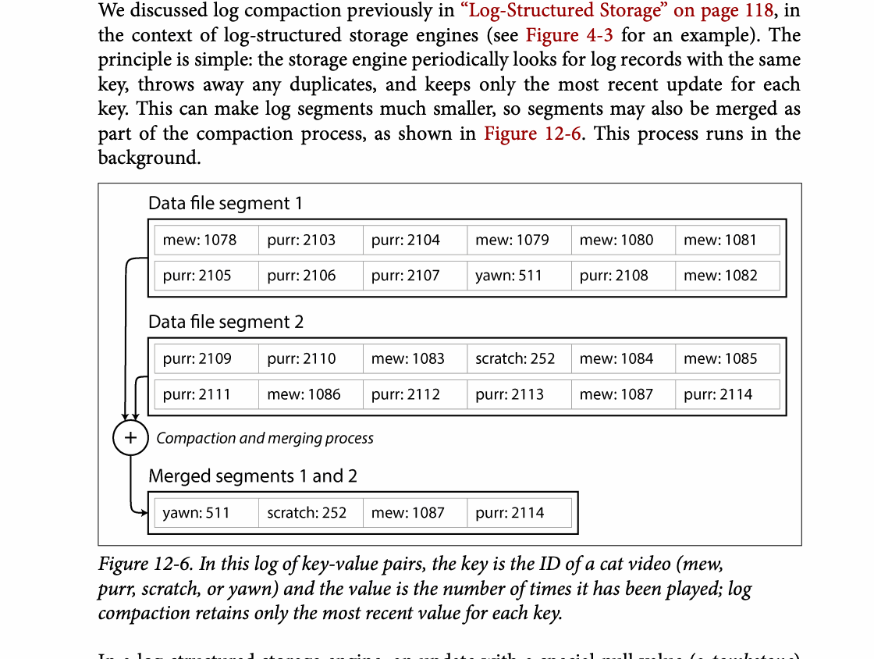
CHAPTER 12
Figure 12-6: mechanism explained
What it shows
In this log of key-value pairs, the key is the ID of a cat video (mew,
Why it matters
It turns the chapter concept into a concrete dataflow, timeline, or state transition.
What to watch
Check the actors, data direction, operation order, and hidden system assumptions.
14 / 21
Notes:
Source: Martin Kleppmann and Chris Riccomini, Designing Data-Intensive Applications, 2nd ed., Chapter 12, book pages 487-529. Figure 12-6, PDF page 529. Original caption: Figure 12-6. In this log of key-value pairs, the key is the ID of a cat video (mew,
Explanation: In this log of key-value pairs, the key is the ID of a cat video (mew, It turns the chapter concept into a concrete dataflow, timeline, or state transition. Check the actors, data direction, operation order, and hidden system assumptions.
Source file: /Users/eve/projects/Designing-Data-Intensive-Applications/Designing Data Intensive Applications 2nd.pdf

Slide 15
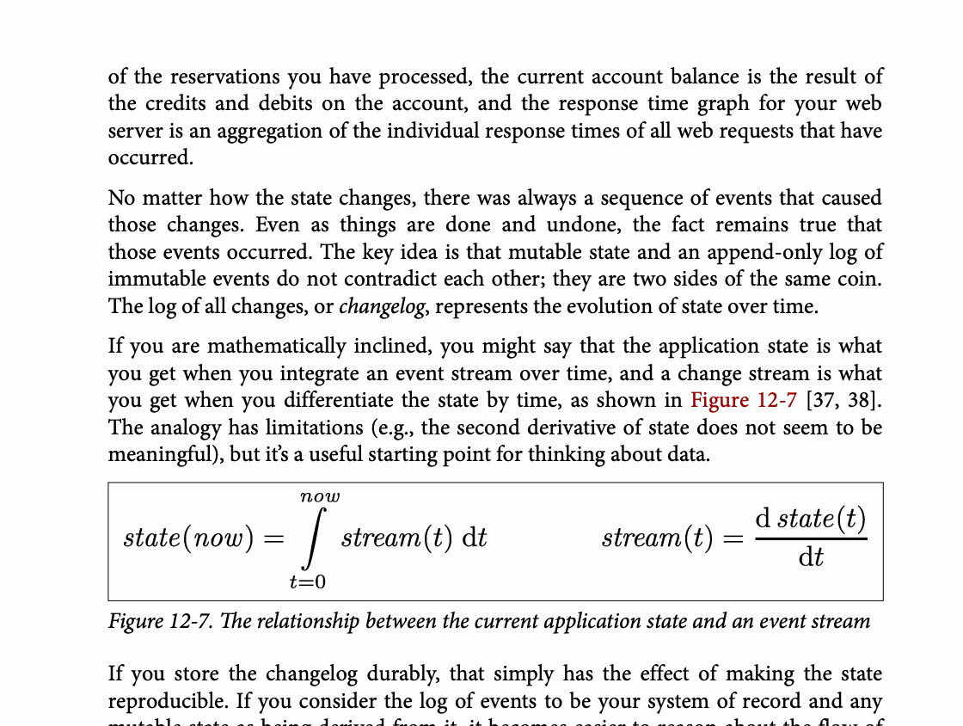
CHAPTER 12
Figure 12-7: mechanism explained
What it shows
The diagram relates an event log to maintained state or time windows.
Why it matters
Correctness depends on replay, event time, late data, and state recovery rules.
What to watch
Follow the arrows or timeline and test whether the conclusion still holds under failure, retry, and concurrency.
15 / 21
Notes:
Source: Martin Kleppmann and Chris Riccomini, Designing Data-Intensive Applications, 2nd ed., Chapter 12, book pages 487-529. Figure 12-7, PDF page 533. Original caption: Figure 12-7. The relationship between the current application state and an event stream
Explanation: The diagram relates an event log to maintained state or time windows. Correctness depends on replay, event time, late data, and state recovery rules. Follow the arrows or timeline and test whether the conclusion still holds under failure, retry, and concurrency.
Source file: /Users/eve/projects/Designing-Data-Intensive-Applications/Designing Data Intensive Applications 2nd.pdf

Slide 16
CHAPTER 12
Time semantics
04
Event time records when business activity happened.
Watermarks estimate progress and windows aggregate unbounded input.
Late events require explicit correction and completion policy.
Core question
What problem does it solve, and what does it cost under failure, growth, and change?
16 / 21
Notes:
Source: Martin Kleppmann and Chris Riccomini, Designing Data-Intensive Applications, 2nd ed., Chapter 12, book pages 487-529.
Source file: /Users/eve/projects/Designing-Data-Intensive-Applications/Designing Data Intensive Applications 2nd.pdf

Slide 17
CHAPTER 12
Time semantics: design trade-offs
04
Fit: Event time records when business activity happened.
Cost: evaluate latency, throughput, consistency, and operational complexity.
Failure check: what state becomes visible when a node, network path, or dependency fails?
Evolution check: can formats, interfaces, and topology change through rolling upgrades?
17 / 21
Notes:
Source: Martin Kleppmann and Chris Riccomini, Designing Data-Intensive Applications, 2nd ed., Chapter 12, book pages 487-529.
Source file: /Users/eve/projects/Designing-Data-Intensive-Applications/Designing Data Intensive Applications 2nd.pdf

Slide 18
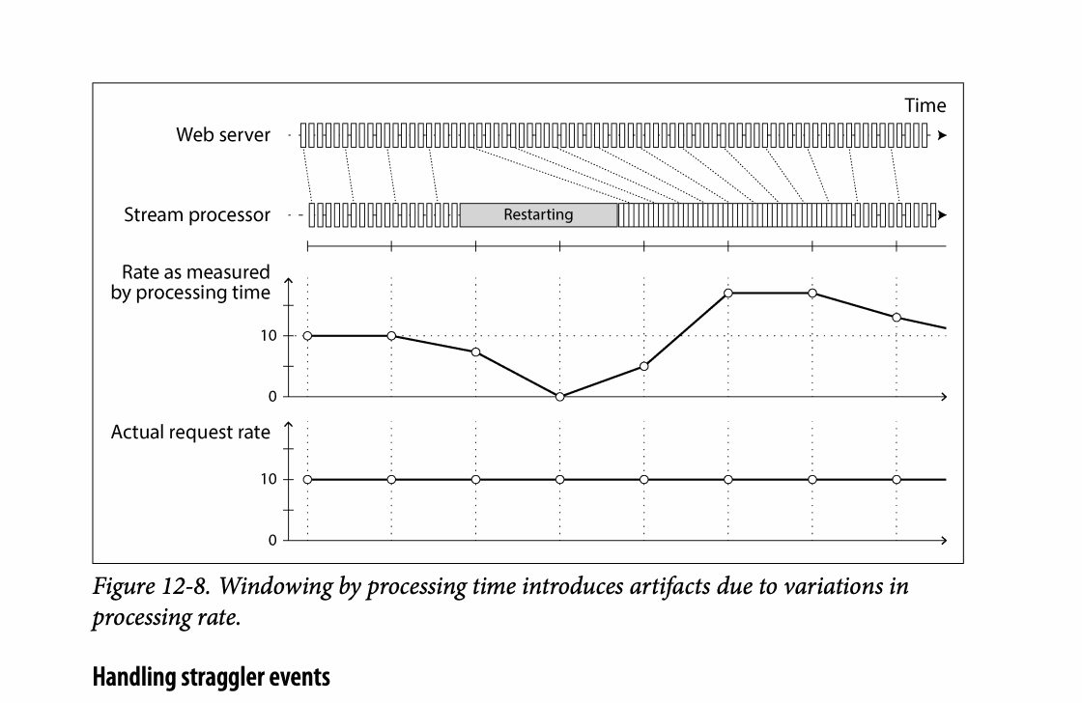
CHAPTER 12
Figure 12-8: mechanism explained
What it shows
The diagram relates an event log to maintained state or time windows.
Why it matters
Correctness depends on replay, event time, late data, and state recovery rules.
What to watch
Follow the arrows or timeline and test whether the conclusion still holds under failure, retry, and concurrency.
18 / 21
Notes:
Source: Martin Kleppmann and Chris Riccomini, Designing Data-Intensive Applications, 2nd ed., Chapter 12, book pages 487-529. Figure 12-8, PDF page 544. Original caption: Figure 12-8. Windowing by processing time introduces artifacts due to variations in
Explanation: The diagram relates an event log to maintained state or time windows. Correctness depends on replay, event time, late data, and state recovery rules. Follow the arrows or timeline and test whether the conclusion still holds under failure, retry, and concurrency.
Source file: /Users/eve/projects/Designing-Data-Intensive-Applications/Designing Data Intensive Applications 2nd.pdf

Slide 19
CHAPTER 12
State and fault tolerance
05
Stream joins and aggregates maintain durable state.
Checkpoints coordinate processing position with state snapshots.
End-to-end correctness needs transactional or idempotent sinks.
Core question
What problem does it solve, and what does it cost under failure, growth, and change?
19 / 21
Notes:
Source: Martin Kleppmann and Chris Riccomini, Designing Data-Intensive Applications, 2nd ed., Chapter 12, book pages 487-529.
Source file: /Users/eve/projects/Designing-Data-Intensive-Applications/Designing Data Intensive Applications 2nd.pdf

Slide 20
CHAPTER 12
State and fault tolerance: design trade-offs
05
Fit: Stream joins and aggregates maintain durable state.
Cost: evaluate latency, throughput, consistency, and operational complexity.
Failure check: what state becomes visible when a node, network path, or dependency fails?
Evolution check: can formats, interfaces, and topology change through rolling upgrades?
20 / 21
Notes:
Source: Martin Kleppmann and Chris Riccomini, Designing Data-Intensive Applications, 2nd ed., Chapter 12, book pages 487-529.
Source file: /Users/eve/projects/Designing-Data-Intensive-Applications/Designing Data Intensive Applications 2nd.pdf

Slide 21
CHAPTER 12
Review and application
State the chapter’s central problem in one sentence.
Choose one mechanism and list the assumptions it relies on.
Describe a failure scenario and explain the recovery path.
Apply one trade-off from the chapter to a system you are designing.
21 / 21
Notes:
Source: Martin Kleppmann and Chris Riccomini, Designing Data-Intensive Applications, 2nd ed., Chapter 12, book pages 487-529.
Source file: /Users/eve/projects/Designing-Data-Intensive-Applications/Designing Data Intensive Applications 2nd.pdf

