Slide 1
CHAPTER 13
A Philosophy of Streaming Systems
Designing Data-Intensive Applications, Second Edition
Detailed English Study Edition
01 / 15
Notes:
Source: Martin Kleppmann and Chris Riccomini, Designing Data-Intensive Applications, 2nd ed., Chapter 13, book pages 539-579.
Source file: /Users/eve/projects/Designing-Data-Intensive-Applications/Designing Data Intensive Applications 2nd.pdf

Slide 2
CHAPTER 13
Chapter map
01
Data integration
Organizations combine specialized systems rather than one universal database.
02
Batch and stream processing
Batch processes bounded data while streams process continuing changes.
03
Unbundling databases
Indexes, caches, search, and warehouses are maintained views.
04
Correctness
Low-level atomicity does not guarantee cross-system business correctness.
05
Trust but verify
Timeliness asks when an update becomes visible; integrity asks whether it is correct.
02 / 15
Notes:
Source: Martin Kleppmann and Chris Riccomini, Designing Data-Intensive Applications, 2nd ed., Chapter 13, book pages 539-579.
Source file: /Users/eve/projects/Designing-Data-Intensive-Applications/Designing Data Intensive Applications 2nd.pdf

Slide 3
CHAPTER 13
Data integration
01
Organizations combine specialized systems rather than one universal database.
Batch and stream jobs derive data from systems of record.
Dataflows need clear ownership, traceability, and rebuild paths.
Core question
What problem does it solve, and what does it cost under failure, growth, and change?
03 / 15
Notes:
Source: Martin Kleppmann and Chris Riccomini, Designing Data-Intensive Applications, 2nd ed., Chapter 13, book pages 539-579.
Source file: /Users/eve/projects/Designing-Data-Intensive-Applications/Designing Data Intensive Applications 2nd.pdf

Slide 4
CHAPTER 13
Data integration: design trade-offs
01
Fit: Organizations combine specialized systems rather than one universal database.
Cost: evaluate latency, throughput, consistency, and operational complexity.
Failure check: what state becomes visible when a node, network path, or dependency fails?
Evolution check: can formats, interfaces, and topology change through rolling upgrades?
04 / 15
Notes:
Source: Martin Kleppmann and Chris Riccomini, Designing Data-Intensive Applications, 2nd ed., Chapter 13, book pages 539-579.
Source file: /Users/eve/projects/Designing-Data-Intensive-Applications/Designing Data Intensive Applications 2nd.pdf

Slide 5
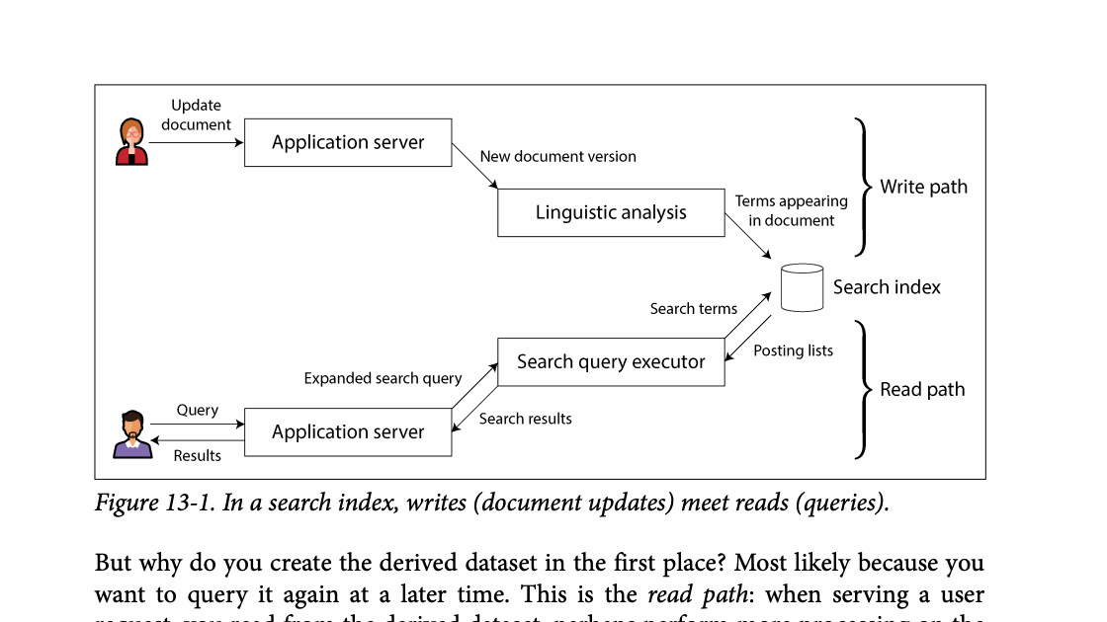
CHAPTER 13
Figure 13-1: mechanism explained
What it shows
Reads and writes meet at a derived-state or constraint boundary.
Why it matters
The system must coordinate updates or verify invariants end to end.
What to watch
Follow the arrows or timeline and test whether the conclusion still holds under failure, retry, and concurrency.
05 / 15
Notes:
Source: Martin Kleppmann and Chris Riccomini, Designing Data-Intensive Applications, 2nd ed., Chapter 13, book pages 539-579. Figure 13-1, PDF page 580. Original caption: Figure 13-1. In a search index, writes (document updates) meet reads (queries).
Explanation: Reads and writes meet at a derived-state or constraint boundary. The system must coordinate updates or verify invariants end to end. Follow the arrows or timeline and test whether the conclusion still holds under failure, retry, and concurrency.
Source file: /Users/eve/projects/Designing-Data-Intensive-Applications/Designing Data Intensive Applications 2nd.pdf

Slide 6
CHAPTER 13
Batch and stream processing
02
Batch processes bounded data while streams process continuing changes.
The two can share transformation logic and data models.
Unification does not require one engine for every workload.
Core question
What problem does it solve, and what does it cost under failure, growth, and change?
06 / 15
Notes:
Source: Martin Kleppmann and Chris Riccomini, Designing Data-Intensive Applications, 2nd ed., Chapter 13, book pages 539-579.
Source file: /Users/eve/projects/Designing-Data-Intensive-Applications/Designing Data Intensive Applications 2nd.pdf

Slide 7
CHAPTER 13
Batch and stream processing: design trade-offs
02
Fit: Batch processes bounded data while streams process continuing changes.
Cost: evaluate latency, throughput, consistency, and operational complexity.
Failure check: what state becomes visible when a node, network path, or dependency fails?
Evolution check: can formats, interfaces, and topology change through rolling upgrades?
07 / 15
Notes:
Source: Martin Kleppmann and Chris Riccomini, Designing Data-Intensive Applications, 2nd ed., Chapter 13, book pages 539-579.
Source file: /Users/eve/projects/Designing-Data-Intensive-Applications/Designing Data Intensive Applications 2nd.pdf

Slide 8
CHAPTER 13
Unbundling databases
03
Indexes, caches, search, and warehouses are maintained views.
Logs turn ordered writes into inputs for specialized stores.
Applications can compose storage around dataflow.
Core question
What problem does it solve, and what does it cost under failure, growth, and change?
08 / 15
Notes:
Source: Martin Kleppmann and Chris Riccomini, Designing Data-Intensive Applications, 2nd ed., Chapter 13, book pages 539-579.
Source file: /Users/eve/projects/Designing-Data-Intensive-Applications/Designing Data Intensive Applications 2nd.pdf

Slide 9
CHAPTER 13
Unbundling databases: design trade-offs
03
Fit: Indexes, caches, search, and warehouses are maintained views.
Cost: evaluate latency, throughput, consistency, and operational complexity.
Failure check: what state becomes visible when a node, network path, or dependency fails?
Evolution check: can formats, interfaces, and topology change through rolling upgrades?
09 / 15
Notes:
Source: Martin Kleppmann and Chris Riccomini, Designing Data-Intensive Applications, 2nd ed., Chapter 13, book pages 539-579.
Source file: /Users/eve/projects/Designing-Data-Intensive-Applications/Designing Data Intensive Applications 2nd.pdf

Slide 10
CHAPTER 13
Correctness
04
Low-level atomicity does not guarantee cross-system business correctness.
End-to-end checks belong at the layer that understands intent.
Constraints may use coordination, ownership, or compensation.
Core question
What problem does it solve, and what does it cost under failure, growth, and change?
10 / 15
Notes:
Source: Martin Kleppmann and Chris Riccomini, Designing Data-Intensive Applications, 2nd ed., Chapter 13, book pages 539-579.
Source file: /Users/eve/projects/Designing-Data-Intensive-Applications/Designing Data Intensive Applications 2nd.pdf

Slide 11
CHAPTER 13
Correctness: design trade-offs
04
Fit: Low-level atomicity does not guarantee cross-system business correctness.
Cost: evaluate latency, throughput, consistency, and operational complexity.
Failure check: what state becomes visible when a node, network path, or dependency fails?
Evolution check: can formats, interfaces, and topology change through rolling upgrades?
11 / 15
Notes:
Source: Martin Kleppmann and Chris Riccomini, Designing Data-Intensive Applications, 2nd ed., Chapter 13, book pages 539-579.
Source file: /Users/eve/projects/Designing-Data-Intensive-Applications/Designing Data Intensive Applications 2nd.pdf

Slide 12
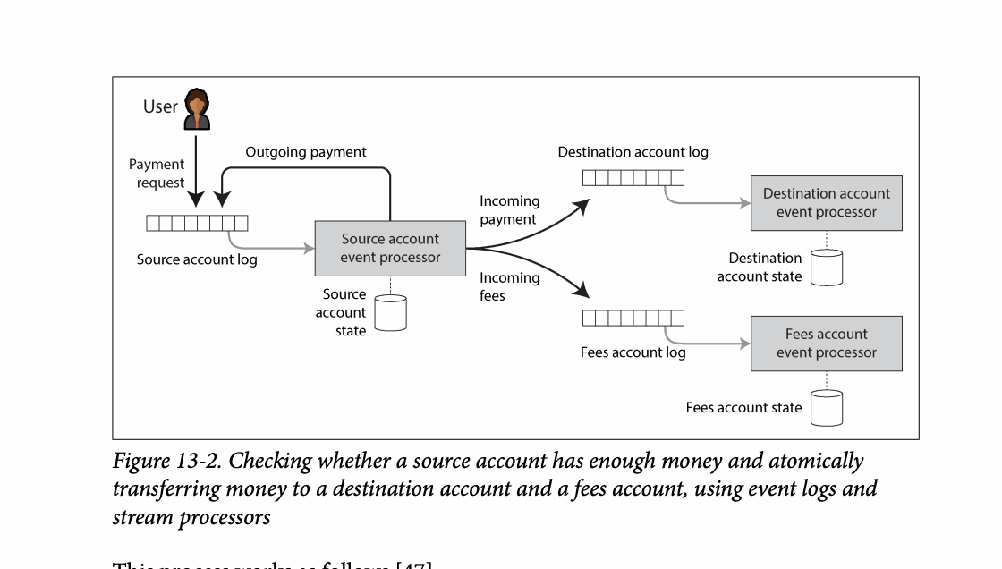
CHAPTER 13
Figure 13-2: mechanism explained
What it shows
Reads and writes meet at a derived-state or constraint boundary.
Why it matters
The system must coordinate updates or verify invariants end to end.
What to watch
Follow the arrows or timeline and test whether the conclusion still holds under failure, retry, and concurrency.
12 / 15
Notes:
Source: Martin Kleppmann and Chris Riccomini, Designing Data-Intensive Applications, 2nd ed., Chapter 13, book pages 539-579. Figure 13-2, PDF page 593. Original caption: Figure 13-2. Checking whether a source account has enough money and atomically
Explanation: Reads and writes meet at a derived-state or constraint boundary. The system must coordinate updates or verify invariants end to end. Follow the arrows or timeline and test whether the conclusion still holds under failure, retry, and concurrency.
Source file: /Users/eve/projects/Designing-Data-Intensive-Applications/Designing Data Intensive Applications 2nd.pdf

Slide 13
CHAPTER 13
Trust but verify
05
Timeliness asks when an update becomes visible; integrity asks whether it is correct.
Audit logs, reconciliation, and invariant checks expose silent corruption.
Critical systems need both prevention and independent repair paths.
Core question
What problem does it solve, and what does it cost under failure, growth, and change?
13 / 15
Notes:
Source: Martin Kleppmann and Chris Riccomini, Designing Data-Intensive Applications, 2nd ed., Chapter 13, book pages 539-579.
Source file: /Users/eve/projects/Designing-Data-Intensive-Applications/Designing Data Intensive Applications 2nd.pdf

Slide 14
CHAPTER 13
Trust but verify: design trade-offs
05
Fit: Timeliness asks when an update becomes visible; integrity asks whether it is correct.
Cost: evaluate latency, throughput, consistency, and operational complexity.
Failure check: what state becomes visible when a node, network path, or dependency fails?
Evolution check: can formats, interfaces, and topology change through rolling upgrades?
14 / 15
Notes:
Source: Martin Kleppmann and Chris Riccomini, Designing Data-Intensive Applications, 2nd ed., Chapter 13, book pages 539-579.
Source file: /Users/eve/projects/Designing-Data-Intensive-Applications/Designing Data Intensive Applications 2nd.pdf

Slide 15
CHAPTER 13
Review and application
State the chapter’s central problem in one sentence.
Choose one mechanism and list the assumptions it relies on.
Describe a failure scenario and explain the recovery path.
Apply one trade-off from the chapter to a system you are designing.
15 / 15
Notes:
Source: Martin Kleppmann and Chris Riccomini, Designing Data-Intensive Applications, 2nd ed., Chapter 13, book pages 539-579.
Source file: /Users/eve/projects/Designing-Data-Intensive-Applications/Designing Data Intensive Applications 2nd.pdf

