Slide 1
THE WALKTHROUGH
hands on
deck
How an AI agent built its own PowerPoint — in six days.
github.com/EveryInc/hands-on-deck
hands-on-deck · slide 01/18 · built by deck.py — 9 ops

Slide 2
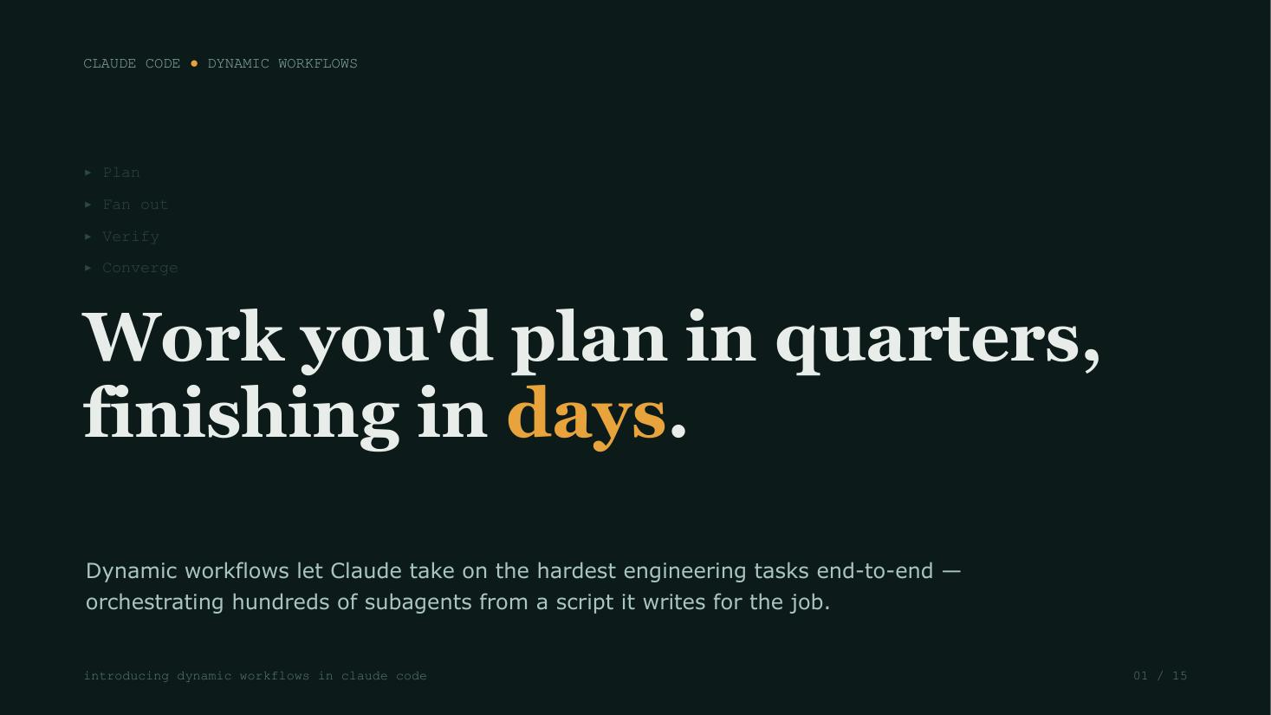
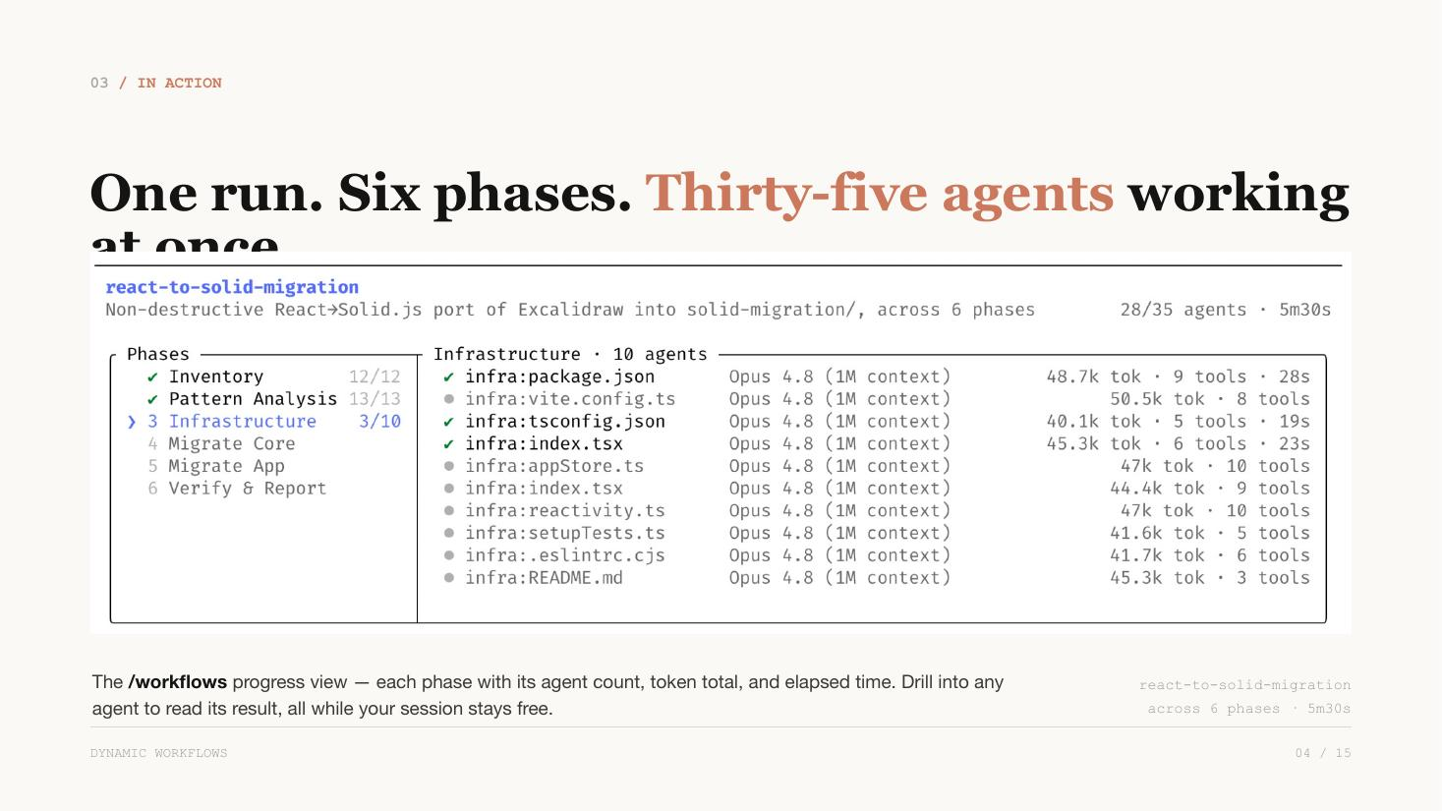
I
ACT I — THE PROBLEM
You've watched my decks for months.
THE GOOD DAYS
THE BAD DAYS
title x: 0.43" → 0.51" → 0.47" (drifts across slides)
given template: ignored — rebuilt from scratch
× 23 more slides to review by hand
footer: missing on 7 slides
The failure mode wasn't ugliness. It was unreviewable tedium.
hands-on-deck · slide 02/18 · built by deck.py — 28 ops

Slide 3
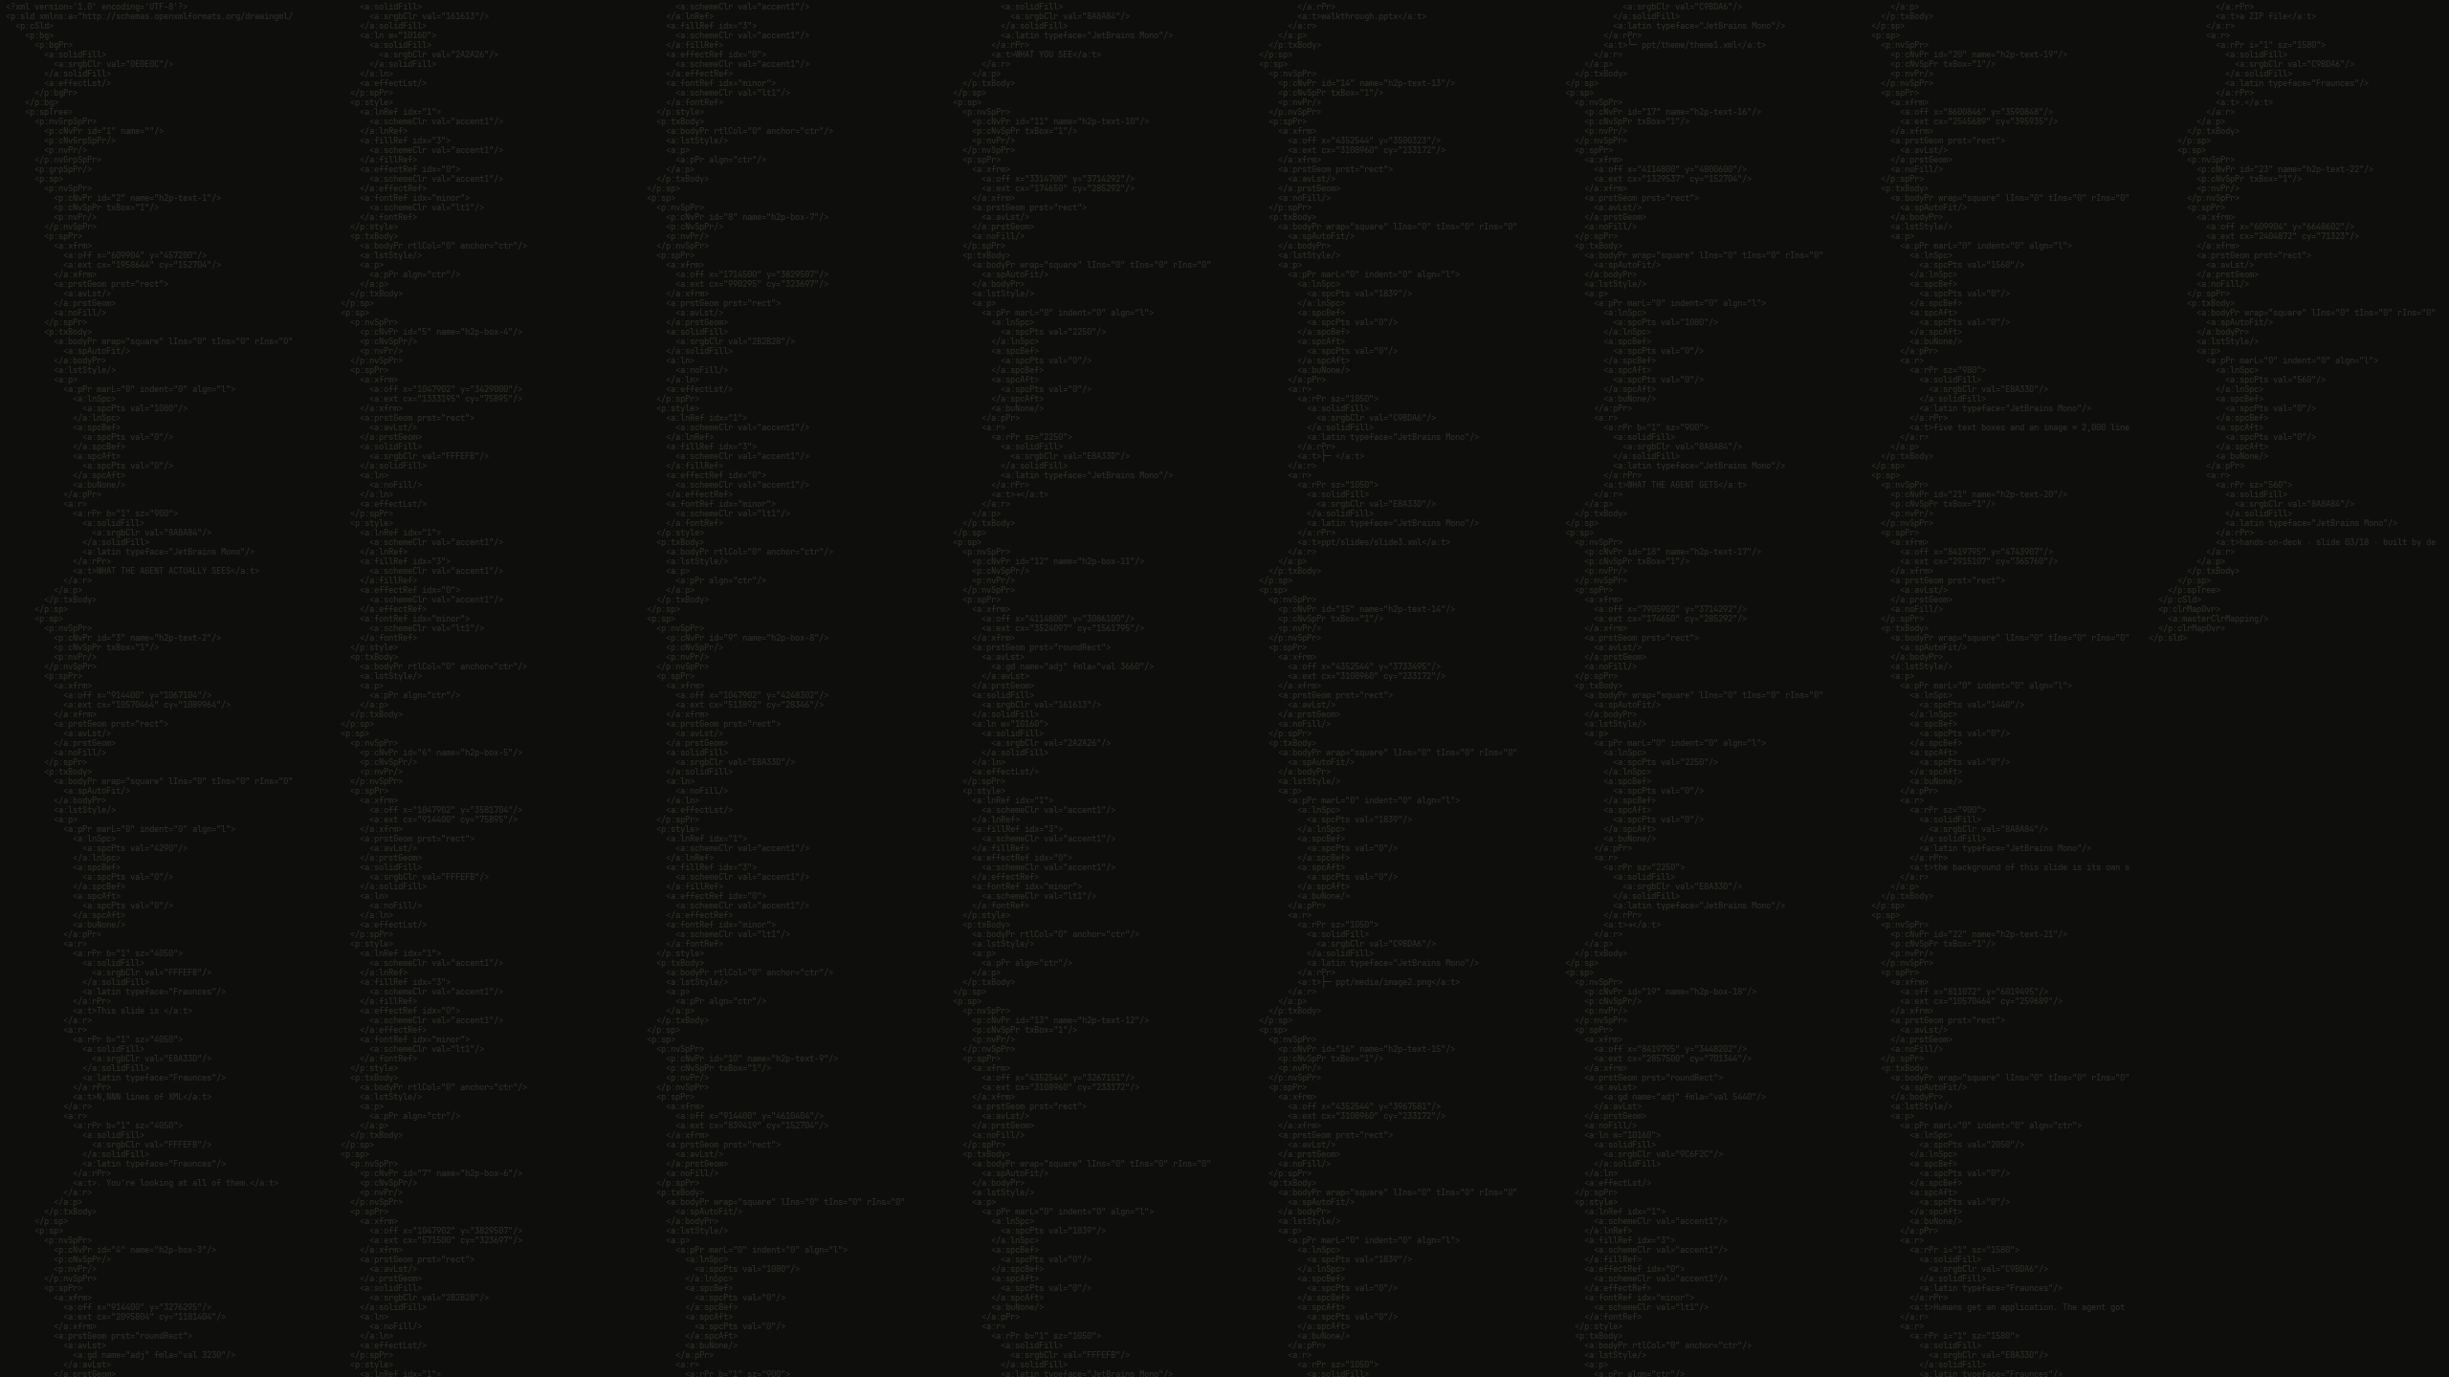
WHAT THE AGENT ACTUALLY SEES
This slide is 1,183 lines of XML. You're looking at all of them.
walkthrough.pptx
├─ ppt/slides/slide3.xml
five text boxes and an image ≈ 2,000 lines of markup
→
├─ ppt/media/image2.png
→
└─ ppt/theme/theme1.xml
WHAT YOU SEE
the background of this slide is its own slide3.xml — every line of it
WHAT THE AGENT GETS
Humans get an application. The agent got a ZIP file.
hands-on-deck · slide 03/18 · built by deck.py — 31 ops

Slide 4
THE ROOT CAUSE
The old skill makes the agent a CODER.
LANE A — THE GOOD DAYS
write one big build script
→
run
→
ship
when its mental picture is right, it's right everywhere
LANE B — THE BAD DAYS
anything needs FIXING
→
open 2,000 lines of XML
→
edit blind
→
re-read to verify
×50 turns
cost ≈ context × turns. It cannot SEE the slide it's fixing — so it breaks alignment it never knew was there.
It was never bad at design. It was blind while editing.
hands-on-deck · slide 04/18 · built by deck.py — 38 ops

Slide 5
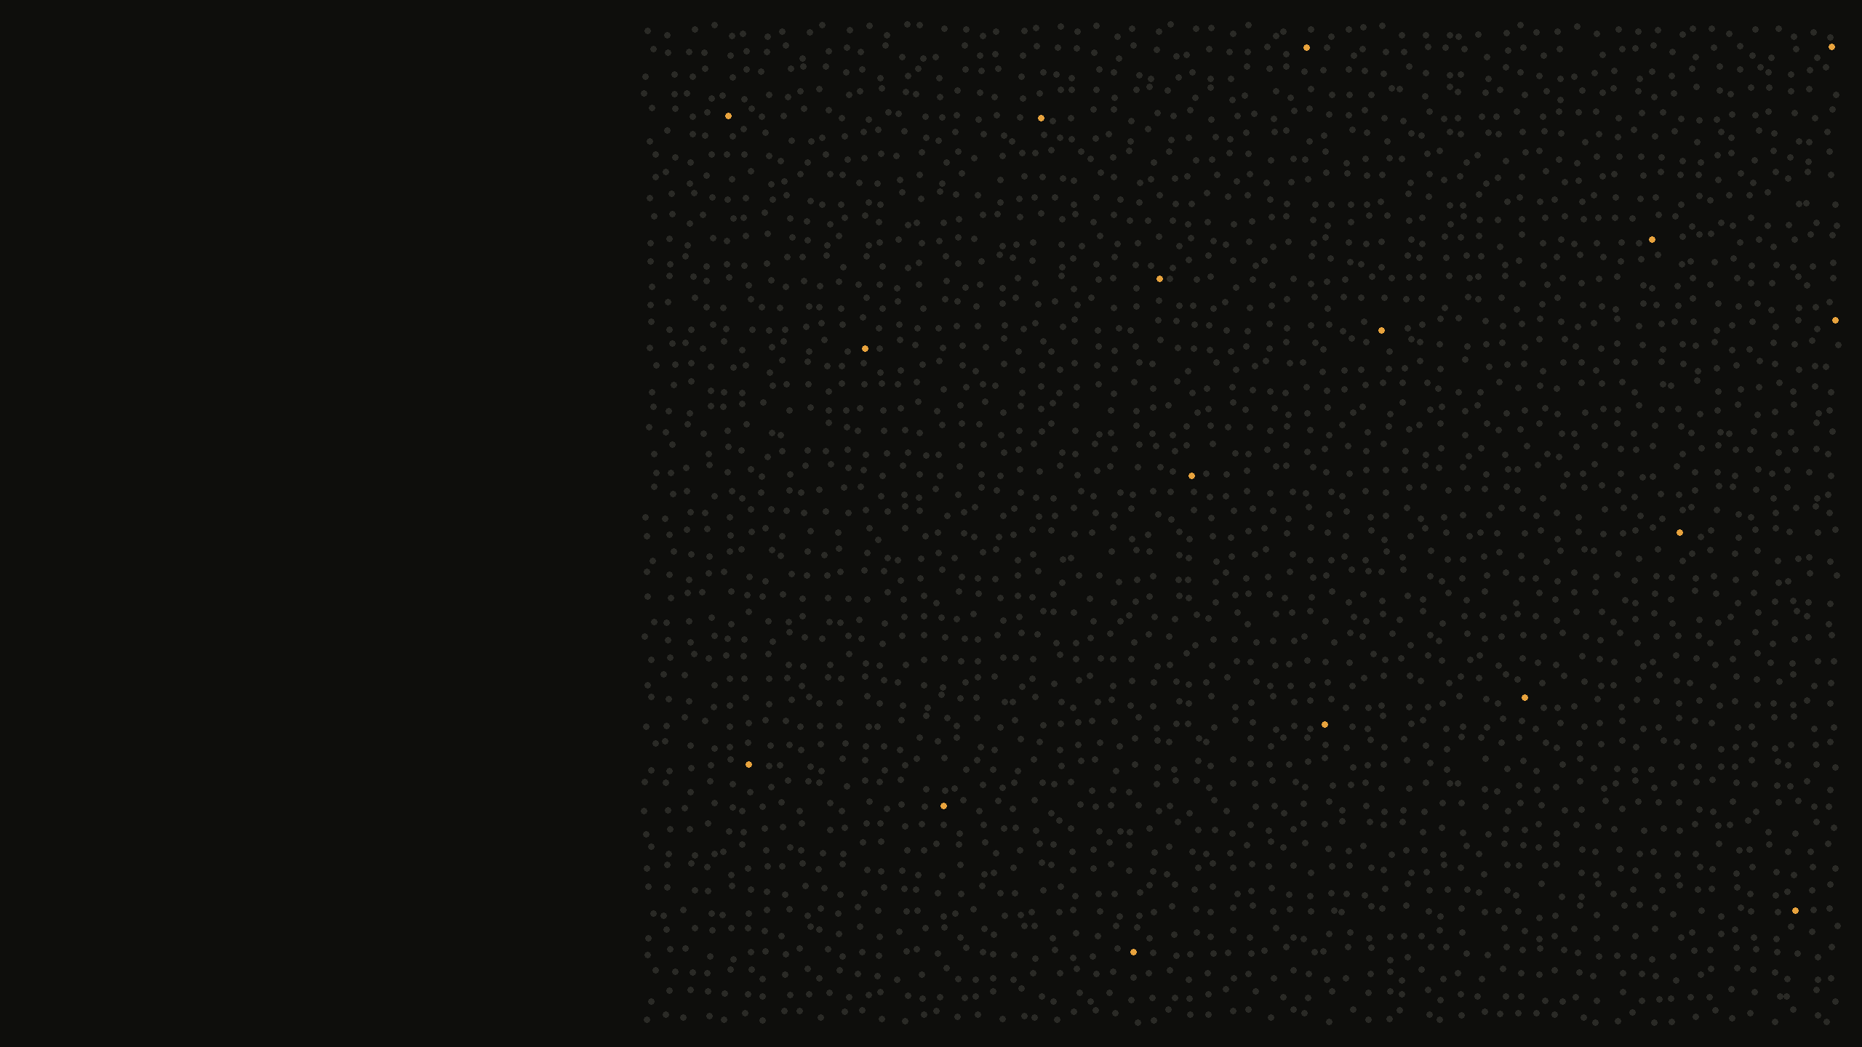
THE BILL
STEP 01 —
the $130
six-slide deck
fixing slides in raw XML = 50% of the entire bill
166K
GENERATED
29.6M
MOVED
$130
The gap is the story. Each dot is 10,000 tokens.
hands-on-deck · slide 05/18 · built by deck.py — 21 ops

Slide 6
II
ACT II — THE BIRTH
I didn’t ask for a better deck.
THE PROMPT — IN FULL
> look at all the steps and look at where we consume the most tokens, or where does it drift the most from how a human would do it? And try to think of whether there is something, a tool, a NEW TOOL that we can give to the agent to make it more efficient.
one prompt, pointed inward — June 5
Point the model at its own transcripts, not at the task.
hands-on-deck · slide 06/18 · built by deck.py — 17 ops

Slide 7
THE DIAGNOSIS
The diagnosis — with receipts
4–10×
FABLE'S OUTPUT — VERBATIM
STEP
METHOD
TOKENS / AGENT
write the build script
scripted
~0.6M
the raw-XML tax, per step
run · render · ship
scripted
~0.7M
edit slide XML, blind
raw XML
2.7M
“the cost isn’t the editing, it’s the XML entering the model’s context”
re-read to verify, ×50 turns
raw XML
6M
“markup archaeology”
Keep bytes out of the context window.
hands-on-deck · slide 07/18 · built by deck.py — 43 ops

Slide 8
THE GAP
It found the missing middle
FABLE'S OUTPUT — VERBATIM
DECK LEVEL
blueprint.json
→
rearrange / merge_decks
✓ exists
SLIDE LEVEL
patch.json
→
???
✗ the gap
PIXEL LEVEL
judgment
→
LLM looks at rendered JPGs
✓ exists
The LLM compiles intent; scripts execute.
The LLM never edits.
June 5. Forty minutes later, deck.py existed.
hands-on-deck · slide 08/18 · built by deck.py — 39 ops

Slide 9
THE FRAMING
We built PowerPoint. As a CLI.
YOUR GESTURE
ITS GESTURE
click a box and type
→
apply {"op":"set-text", …}
drag a shape
→
apply {"op":"move", …}
bold one word
→
set-text "runs":[…]
look at the slide
→
render --slide 9 --crop
undo
→
patches are atomic; diff to verify
spot something’s off
→
inspect --issues (it lints itself)
every gesture you have, it now has.
Not a converter. Not a script. The application itself.
hands-on-deck · slide 09/18 · built by deck.py — 41 ops

Slide 10
THE MAP
The whole application, on one slide.
WHAT YOU DO IN POWERPOINT
THE COMMAND
WHAT IT COSTS
type in a box
→
set-text
~40 tokens
bold one word mid-sentence
→
set-text runs:[…]
~60 tokens
insert text / image / table
→
add-shape · add-picture · add-table
one op each
drag, resize, align
→
move · resize
one op each
swap the logo deck-wide
→
swap-image media:"logo.png"
1 op, every slide
rebrand a 95-slide deck
→
replace-text scope:"master"
2 ops, total
re-theme the whole palette
→
replace-color per mapping
1 op per color
proof-read the geometry
→
inspect --issues (the linter)
deterministic
fix what’s off
→
fix — re-measures, demotes lies
0 LLM tokens
look at your work
→
render --slide N --crop
looks, never reads
the old way to fix one misaligned title: ~50 blind turns through 2,000 lines of XML ≈ millions of tokens
the new way: one 40-token op.
The ribbon, rebuilt as a vocabulary.
hands-on-deck · slide 10/18 · built by deck.py — 68 ops

Slide 11
THE TWIST
Cheaper edits didn’t save money.
MECHANICAL EDIT COST
−76%
“
It collapsed the cost of caring. When acting is cheap, validated, and reversible, agents act on everything they notice.
TOTAL SPEND
−6%
Parkinson’s law for agents — they spent the savings on ambition.
hands-on-deck · slide 11/18 · built by deck.py — 30 ops

Slide 12


III
ACT III — THE PROOF
95 slides. One human gate.
BEFORE
AFTER
THE PROMPT — IN FULL
> direction is right but i wanna make it even more hardcore ... to make it absolutely insane.
The human gate fired — in the opposite direction everyone expects.
hands-on-deck · slide 12/18 · built by deck.py — 28 ops

Slide 13
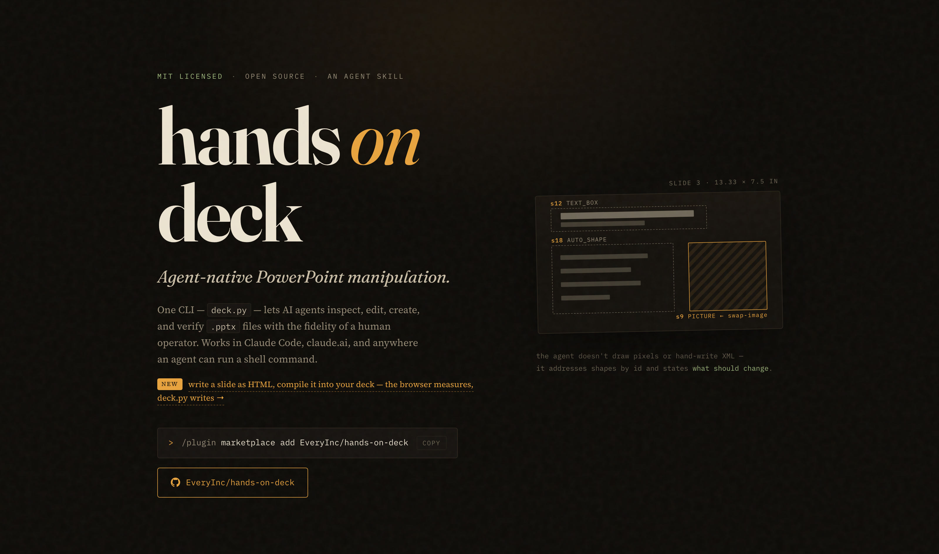
THE AUDIT
Before publishing, I asked it to audit my claim
THE PROMPT — CONDENSED
> tell me if the framing … is a fair claim … I’m planning to move this into an open source repository
FABLE’S OUTPUT — VERBATIM
“Yes, fair — and honestly understated: the interesting part isn’t that it’s a CLI, it’s that it’s an agent-native CLI.”
docs/index.html — live the same night
but — “say edit, not create” → gaps closed same evening → 11:47 PM: v1.0.0 public.
Every design choice targets an LLM failure mode.
hands-on-deck · slide 13/18 · built by deck.py — 28 ops

Slide 14
THE CLEAN ROOM
The license bombshell
html2pptx.js — proprietary
RELEASE NOTE — V2.0.0
CANNOT SHIP
“1.x edited decks.
2.0 designs them.”
HTML slide
→
Chromium measures
→
deck.py patch
→
.pptx
the slide you are reading went through this exact pipeline.
The constraint forced the better invention: compile to a patch, not a file.
hands-on-deck · slide 14/18 · built by deck.py — 42 ops

Slide 15
THE BENCHMARK
So we made them race
same model · same brief
THE PERSONALITY SPLIT
↓
↓
WITH HANDS-ON-DECK
arm 1 — hands-on-deck
arm 2 — the old skill
a DESIGNER
↓
neutral re-render
87 tool calls
looked at its own render 27 times
↓
blind.py → Deck A / Deck B
WITH THE OLD SKILL
↓
3 judges, rotated order
a CODER
↓
one 40KB build script
looked 0 times
unblind last
Same model. Different tool. Different species of worker.
hands-on-deck · slide 15/18 · built by deck.py — 49 ops

Slide 16
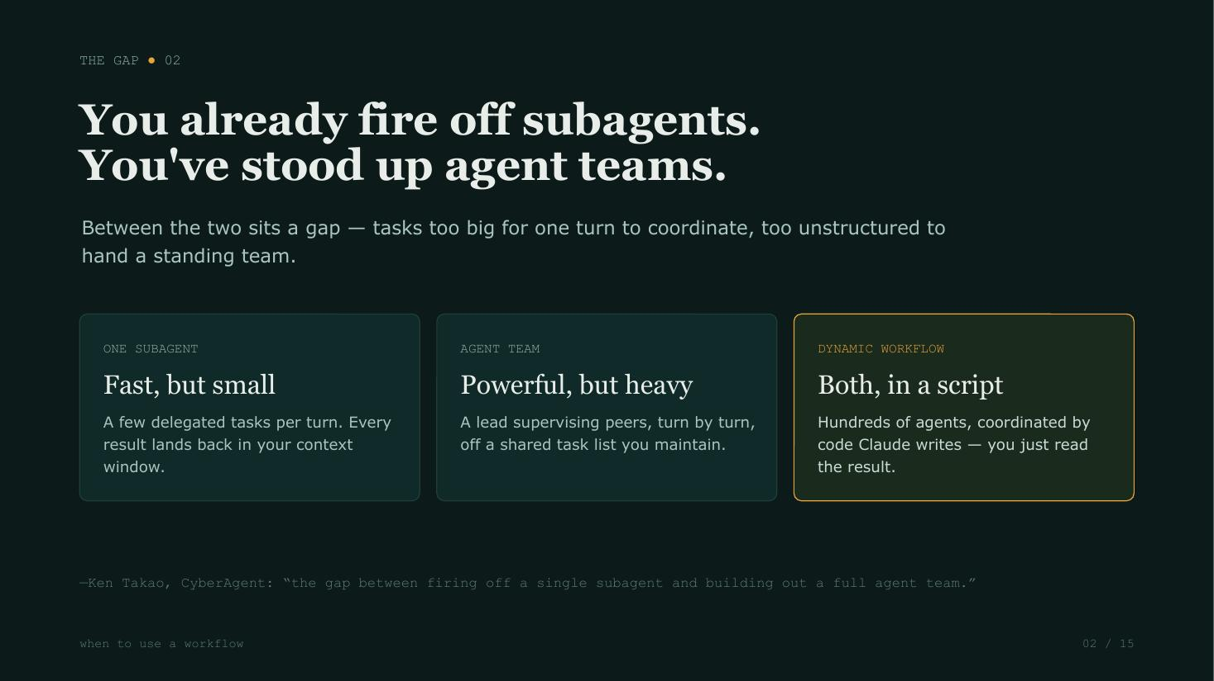
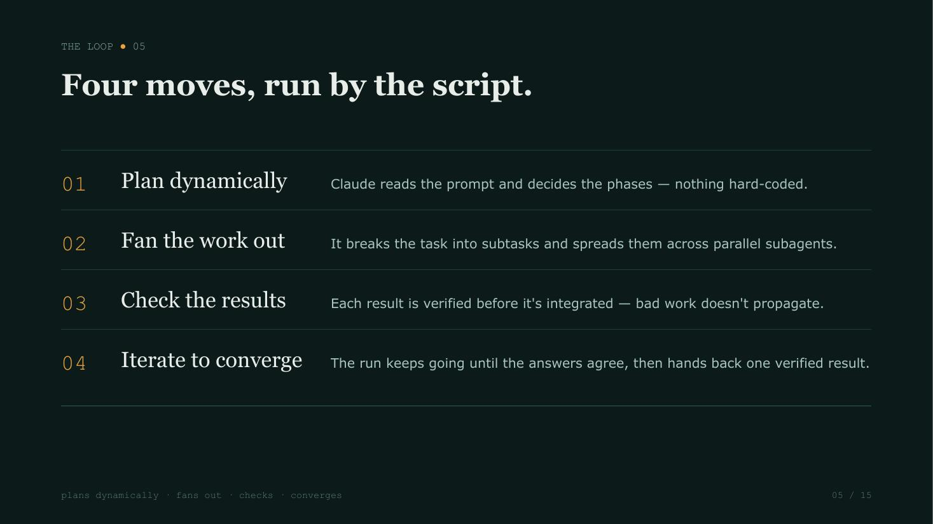
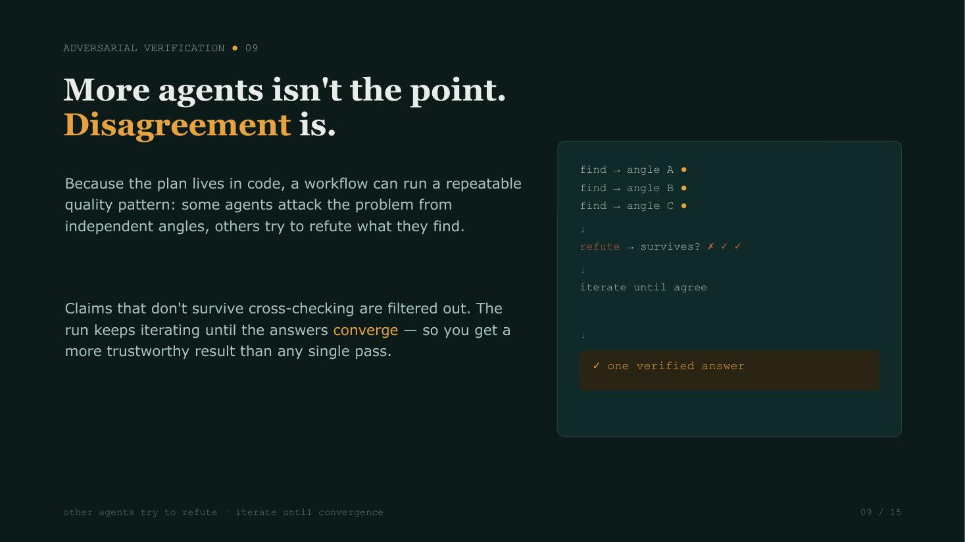
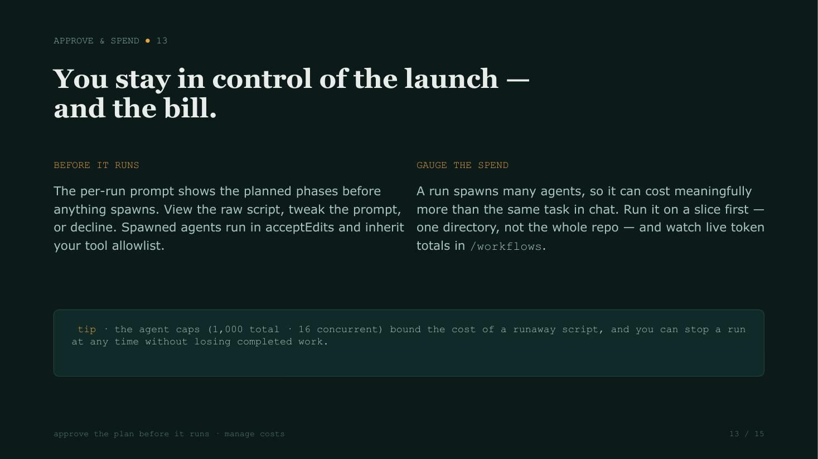
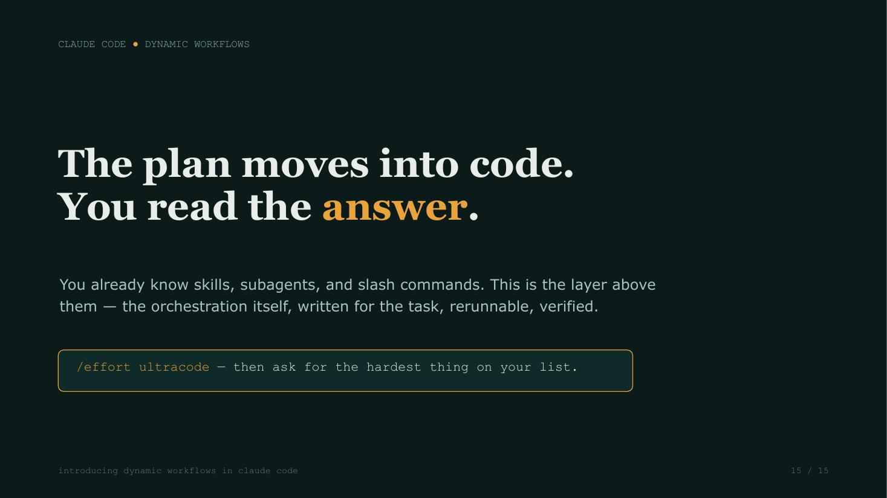
THE SCOREBOARD
R1 ✗ lint was right → fix shipped
Tools learn. Prompts don’t.
R2 ✗ one <br> tag → fix shipped
“airtight” · “flawless” · “rock-steady”
WIN 2–1 · TWO CLEAR
every defect became a tool upgrade with a regression test — the old skill made the same mistakes in round 3 as round 1.
Every loss became machinery. The benchmark ships inside the repo.
hands-on-deck · slide 16/18 · built by deck.py — 27 ops

Slide 17
IV
ACT IV — THE TOOL
hands-on-deck, v3
EDIT
CREATE
VERIFY
patches, lint, fix
html2patch
render, diff
EVALS
TRANSITIONS
CI
blind by design, in the repo
opt-in only
43 tests, LibreOffice + Chromium
INSTALL — TWO COMMANDS
/plugin marketplace add EveryInc/hands-on-deck
/plugin install hands-on-deck@hands-on-deck
Named by the CEO’s nautical pun — one hand became all hands.
hands-on-deck · slide 17/18 · built by deck.py — 39 ops

Slide 18
THE CLOSE
Go make your agent
its own PowerPoint.
github.com/EveryInc/hands-on-deck
this deck: 597 patch ops · 23,178 lines of XML written · 31 render-lint-fix cycles · 0 lines written by a human
hands-on-deck · slide 18/18 · built by deck.py — 19 ops

