Slide 1

RENDER · JUNE 18, 2026
THE ERA OF
Compound Engineering
“I haven't written a line of code this year.”
Kieran Klaassen
GM of Cora at Every
Notes:
• Haven't written a line of code this year — barely looked at it • Yet I ship: thousands pay, trust it with their inbox • Not hype, not fear — just how I actually work • Two halves: why now / how I got here, then live demos

Slide 2
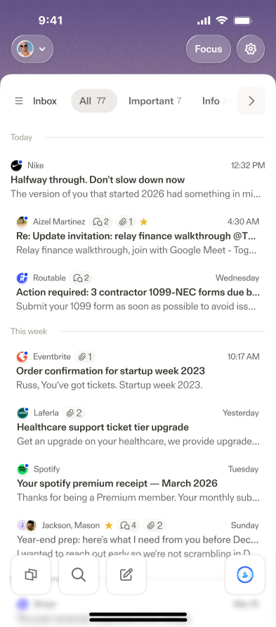
ACT 1 · WHO I AM
Cora
Every
A COMPLETE AI EMAIL INBOX
Handles your email so you focus elsewhere.
AN AI LAB FOR THE FUTURE OF WORK
We write it, teach it, and build it.
Agent-native — anything you can do, the agent can do.
A studio of mostly single-engineer teams.
One engineer, one problem.
Desktop, iOS, Android, CLI, inside Codex.
V2 in alpha — DM me on X
COMPOUND ENGINEERING
02 / 15
Notes:
• Every = an AI lab for the future of work • Studio model: one engineer, one problem (repeatable, not me being fast) • Cora: agent-native email inbox — where I found compound engineering • V2 in alpha — DM me on X to get in

Slide 3
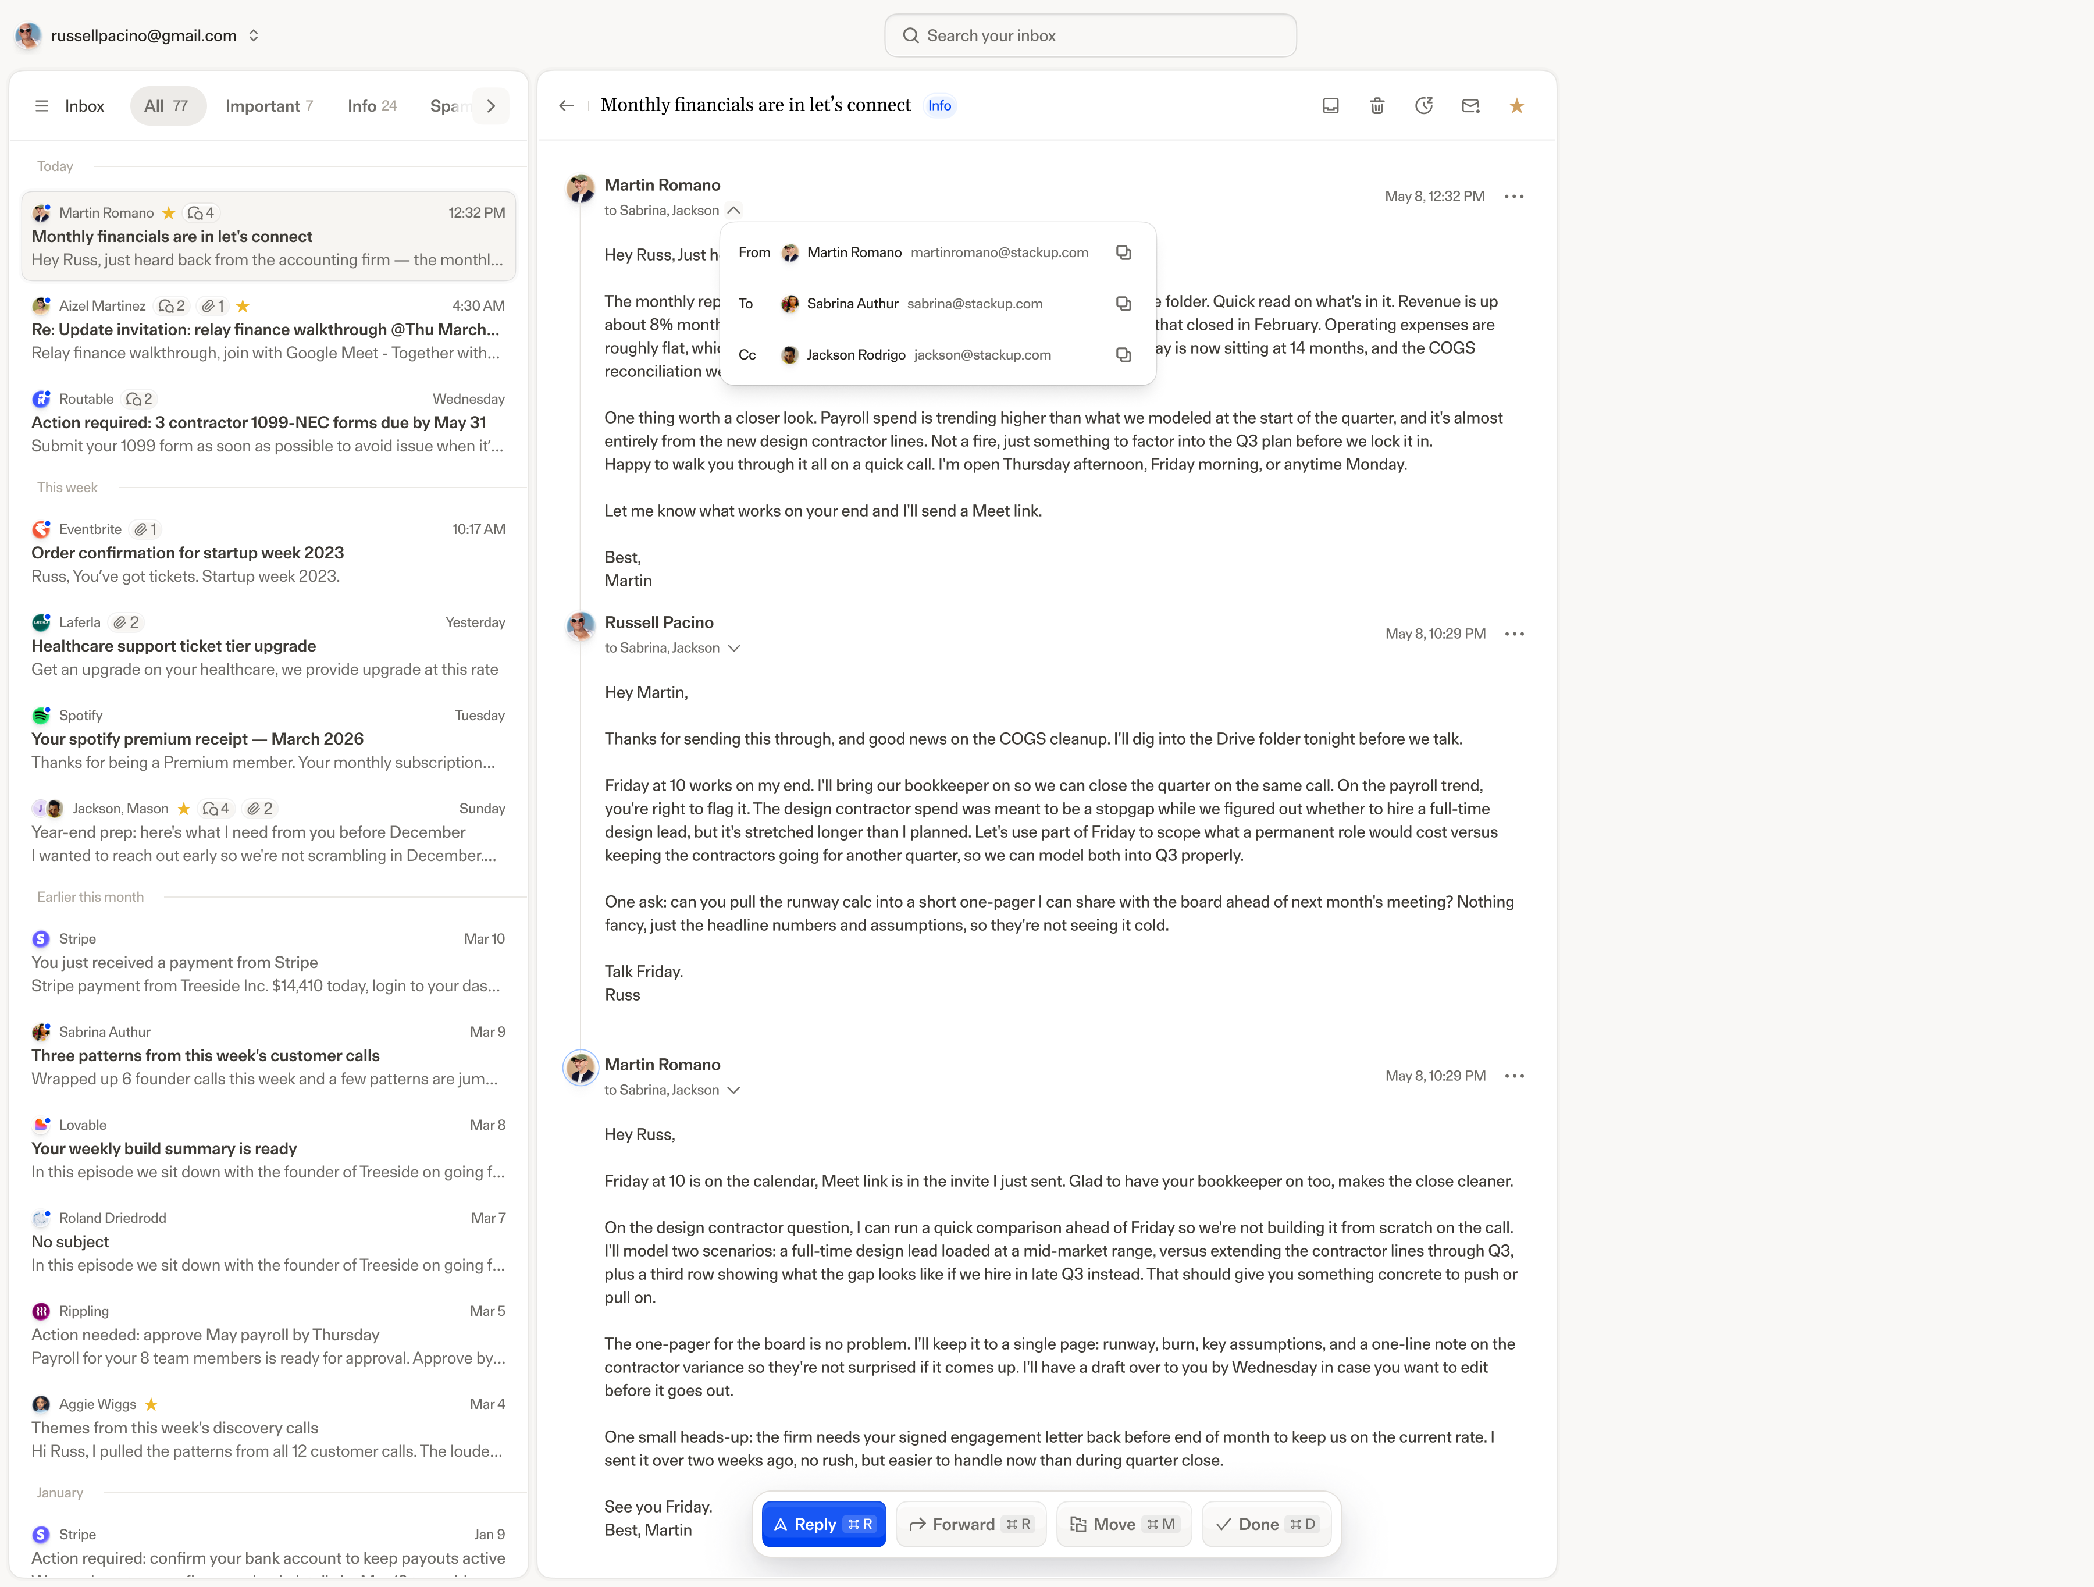
ACT 1 · THE CONSTRAINT
One engineer. A full email client.
Rails
React
Render
Set up on purpose: how far can one engineer push AI before hiring?
COMPOUND ENGINEERING · 03 / 15
Notes:
• Full email client: Rails + React, on Render • Only full-time engineer — I own product + engineering • When it breaks, it's my problem • Set up on purpose: how far can one engineer push AI before hiring?

Slide 4
The bottleneck kept moving
ACT 1 · MY EVOLUTION
CODE
One prompt became two, then six agents.
PLANS
Then the plan was the bottleneck.
PRODUCT
Then deciding what to build was.
MEMORY
So I built a system that remembers.
Away from typing, toward judgment.
COMPOUND ENGINEERING
04 / 15
Notes:
• Happened gradually over ~2 years • Code → plans → product → memory • Each time I solved one, the bottleneck (and my job) moved • Always the same direction: away from typing, toward judgment

Slide 5
ACT 1 · WHY NOW
01 — THE MODELS
03 — THE REAL WHY
Finally good enough to hand real work to.
Implementation is solved. Judgment isn't.
02 — IT COMPOUNDS
A system that remembers gets better every time — and the gap widens.
The job moves from typing the code to choosing the problem and owning the outcome.
Not less engineering — one laptop now competes with companies worth billions.
COMPOUND ENGINEERING
05 / 15
Notes:
• Models are finally good enough to hand real work to • Codify anything and it compounds — gap widens as models improve • The real why: implementation is solved, judgment isn't • Not less engineering — the most leverage we've ever had

Slide 6
One loop, run again and again
ACT 1 · HOW I RUN IT
You lead — judgment
Agents run — execution
Ideate
OPTIONAL
→
Brainstorm
→
Plan
→
Work
→
Review
→
Polish
→
Compound
↻
repeat
Vision at the start, taste at the end. The agents run the middle — it got boring, in the best way.
THE 50/50 RULE
50
Review the output — was the work good?
50
Teach the system — codify the mistake once.
COMPOUND ENGINEERING
06 / 15
Notes:
• One loop: brainstorm → plan → work → review → polish → compound • I'm the bread: vision at the start, taste at the end. Agents run the middle • 50/50 rule: half reviewing, half teaching the system • Codify the mistake once → never hit it again (also saves tokens)

Slide 7

ACT 2
Let me just show you.
First, install the plugin — Codex, Claude Code, Cursor, wherever you work. Then: the command, what it does, the output.
$
install github.com/EveryInc/compound-engineering-plugin
SCAN TO INSTALL
COMPOUND ENGINEERING
07 / 15
Notes:
• Now the practical half — examples you can run yourself • Step one: install the plugin (Codex, Claude Code, Cursor, anywhere) • For each: the command, what it does, the output • Useful for engineers, PMs, and business leaders

Slide 8
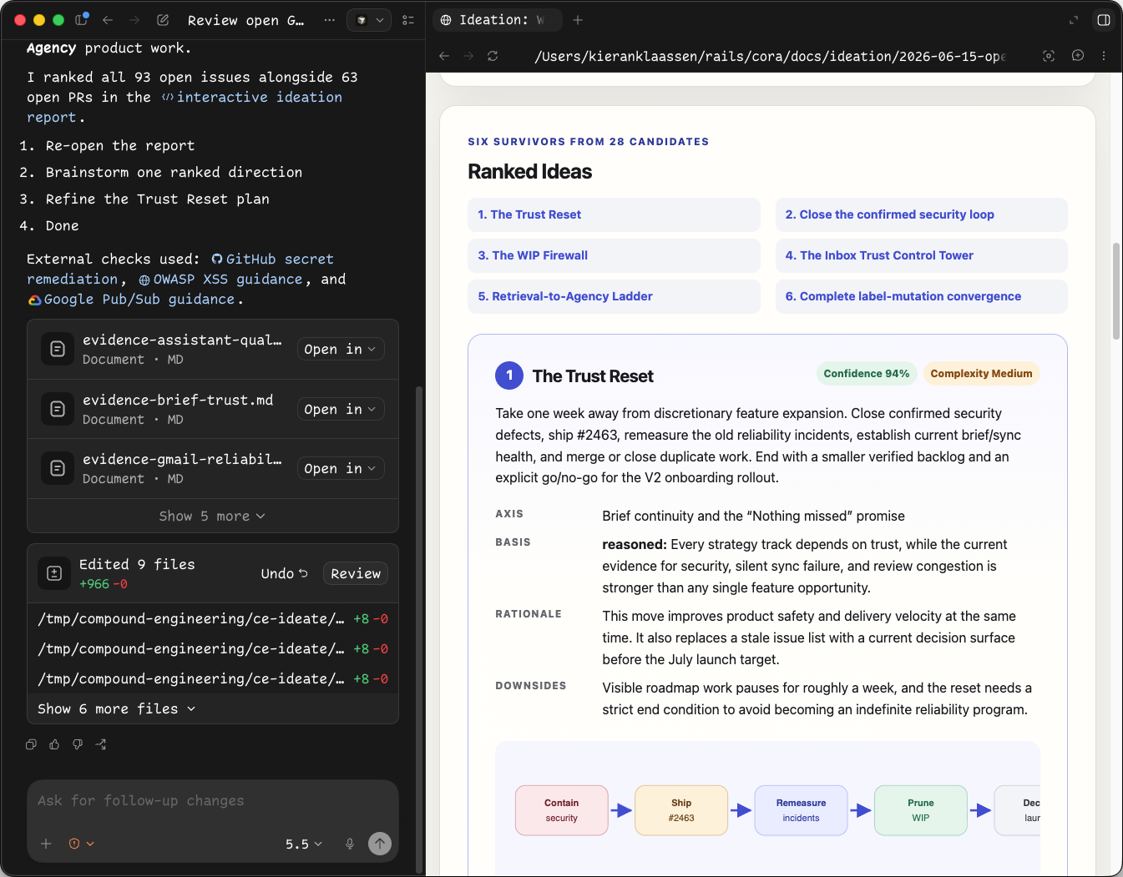
ACT 2 · COMMAND 01
/ce-ideate — what should I do next?
YOU RUN
YOU GET — the ideation page
› /ce-ideate
“look at all my open GitHub
tickets — what do I do next?”
point it at →
tickets
Slack
Intercom
email
your OKRs
COMPOUND ENGINEERING
08 / 15
Notes:
• Point it at tickets, Slack, feedback, Intercom, email — or your OKRs • Generates ideas, structures them, argues good vs bad • Hands back a clean HTML page • Favorite: aimed at OKRs, so ideation matches strategy

Slide 9
ACT 2 · COMMAND 02
/ce-doc-review — sharp questions on any PRD
YOU RUN
YOU GET — questions back
› /ce-doc-review
Q1
What happens to legacy accounts that fail validation?
notion.so/prd-inbox-v2
Q2
Is the v2 switch reversible once a user opts in?
↻ then /ce-compound
Q3
Which metric tells us onboarding actually worked?
Feed the answers back — the doc learns the reasoning, so it won't ask again.
answer inline · or push back to the author
COMPOUND ENGINEERING
09 / 15
Notes:
• Someone hands you a PRD — run review on the link instead of just reading • It returns the sharp questions • Answer them, or push them back to the author • Then /ce-compound the answers → the doc learns, won't ask again

Slide 10
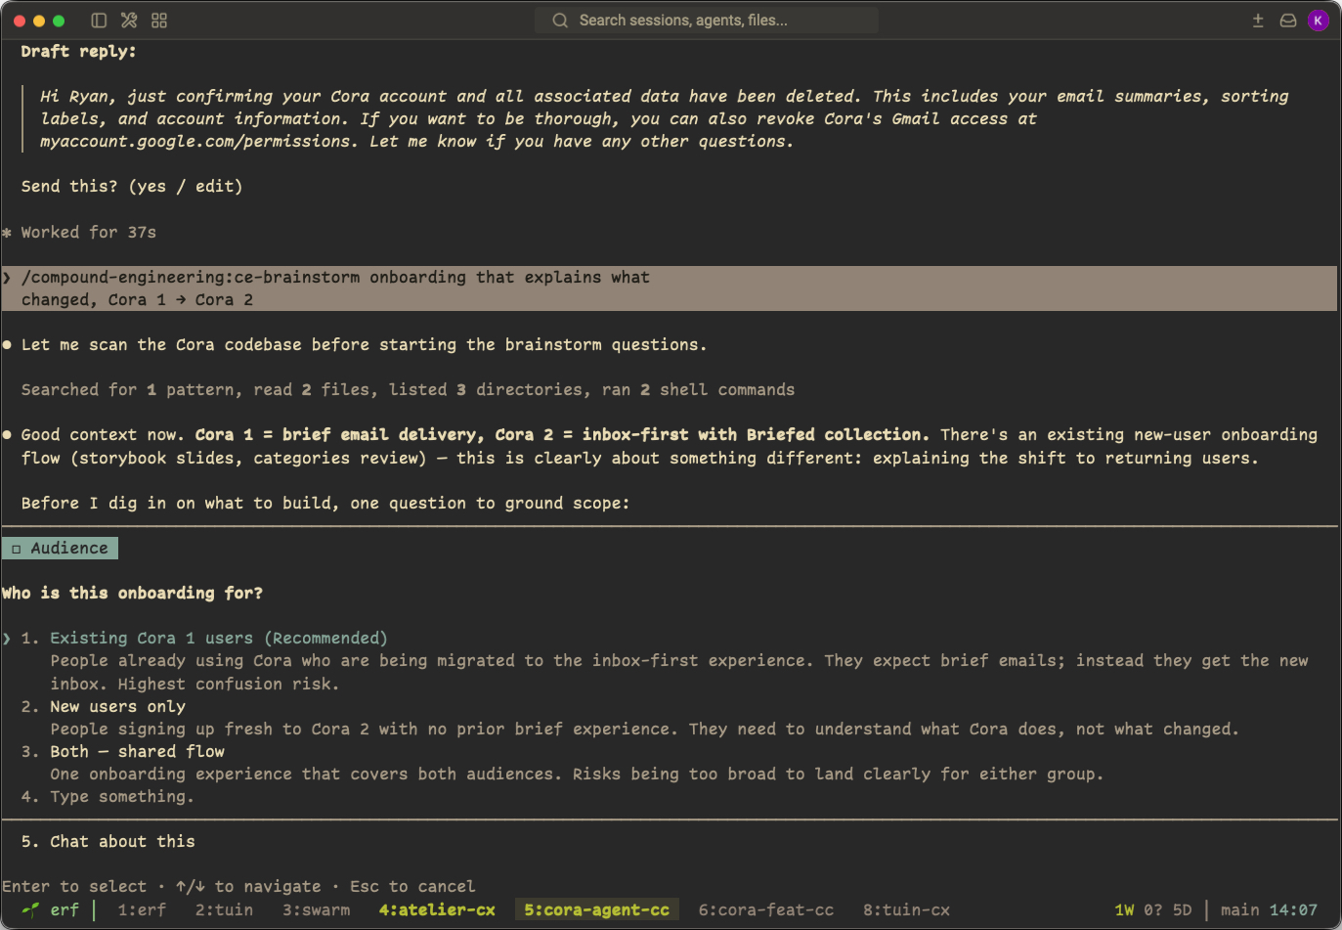
ACT 2 · COMMAND 03
my most used
/ce-brainstorm → /lfg
YOU RUN
YOU GET — it interviews you
› /ce-brainstorm
“onboarding that explains what
changed, Cora 1 → Cora 2”
THEN /lfg RUNS THE MIDDLE
plan
→
work
→
review
→
tests
→
PR
COMPOUND ENGINEERING
10 / 15
Notes:
• My most used — for an idea too big to just describe • ce-brainstorm pulls in compound knowledge, personas, diffs • It interviews you: asks questions back → a stored brainstorm doc • Then /lfg runs the middle: plan → work → review → tests → PR

Slide 11
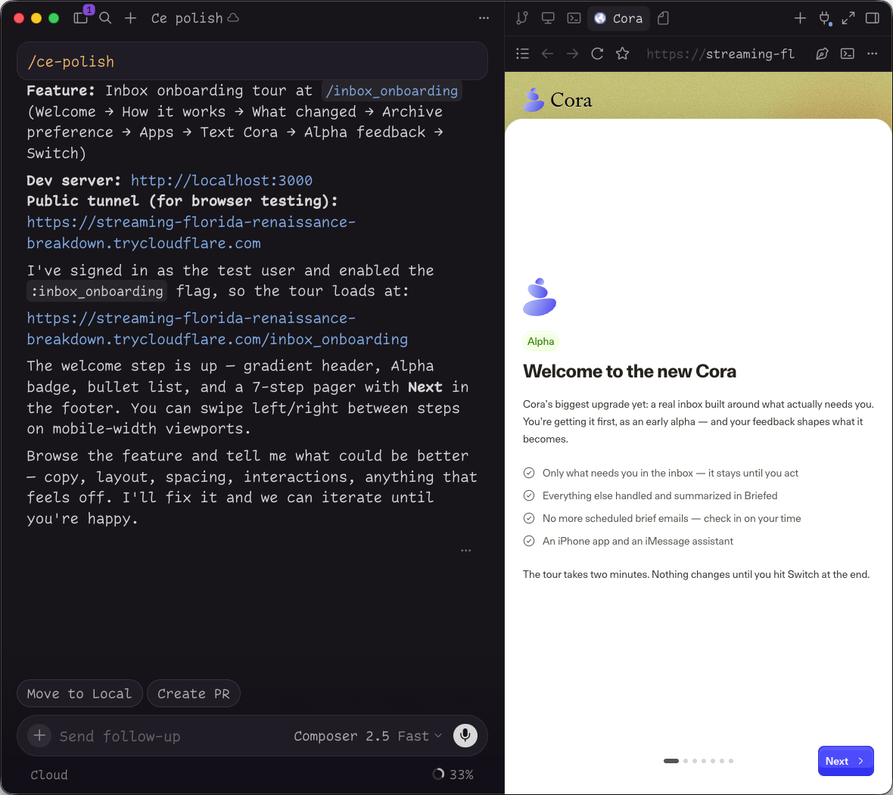
ACT 2 · COMMAND 04
/ce-polish — raise the bar on a PR
›
/ce-polish PR #2715
LEFT — THE AGENT
What changed, and how to test it — live tunnel and all.
RIGHT — YOU
Open the real thing and raise the bar.
Not “is it broken.” Does it feel good? Can it be better? Then merge — you're live.
COMPOUND ENGINEERING
11 / 15
Notes:
• Run polish on any open PR — yours or someone else's (I use Cursor) • Left: what changed + how to test it • Right: you check it and raise the bar • Not 'is it broken' — does it feel good? then merge, you're live

Slide 12
ACT 2 · COMMAND 05
/ce-debug
+
RENDER
render logs — cora-web
“Something's wrong with this deploy.”
$ /ce-debug render.com/deploy/dep-x9
ERROR worker boot failed (exit 1)
The Render CLI exposes the logs, the agent debugs it — then you hand the fix to /lfg.
↓ Redis connection refused :6379
→ agent diagnosing…
→ fix ready · handing to /lfg
COMPOUND ENGINEERING
12 / 15
Notes:
• A deploy went wrong — run /ce-debug with a link to the Render deploy • The Render CLI exposes the logs and state • The agent debugs it right there • Hand the fix to /lfg — the loop reaches into production

Slide 13
ACT 2 · THE LESSON
Give your agent access to where things happen.
INSTALL THE RENDER CLI · THE SKILLS · THE MCP — THEN HOOK UP EVERYTHING ELSE
Your deploys
As much data as possible
Your logs
Production jobs
Customer support
Slack
Intercom
Your email — all of it
It can even run jobs on production — and /lfg alone runs 10–20 of these skills in one flow.
COMPOUND ENGINEERING
13 / 15
Notes:
• The real lesson: give your agent access to where things happen • Install the Render CLI, the skills, the MCP • It reaches deploys, production data, logs — can even run jobs • /lfg alone runs 10–20 of these skills in one flow

Slide 14
THE BET
Implementation is getting cheap. Judgment isn't.
Choose the problem.
Remove yourself from what the AI can do.
Codify your judgment so it compounds.
Kieran Klaassen · @kieranklaassen
The next feature should be easier because you built this one.
github.com/EveryInc/compound-engineering-plugin
Open source. PRs welcome. Or build your own.
Notes:
• The bet: implementation is getting cheap, judgment isn't • Choose the problem; remove yourself from what AI can do • Codify your judgment into the system so it compounds • Standard: the next feature should be easier because you built this one

Slide 15


THE SEND-OFF
Go compound today.
Install the compound engineering plugin in Codex, Claude Code, or Cursor — and start where I left off.
I'm here at Render today — come say hi.
@kieranklaassen on X & GitHub.
github.com/EveryInc/compound-engineering-plugin
SCAN TO INSTALL
Open source · PRs welcome · or build your own
COMPOUND ENGINEERING
15 / 15
Notes:
• Install the plugin in your tool — Codex, Claude Code, Cursor • Scan the QR to grab it right now • I'm here at Render today — come say hi • @kieranklaassen on X & GitHub — open source, PRs welcome, or build your own

