Slide 1







Rates of developer tools
Evgenii Sokolov
April 2023

Slide 2



OUTLINE
Executive Summary
Introduction
Methodology
Results
Visualization – Charts
Dashboard
Discussion
Findings & Implications
Conclusion
Appendix

Slide 3

EXECUTIVE SUMMARY
Current investigation encompasses an evaluation of a variety of tools, including programming languages, databases, platforms, and tool frameworks. Additionally, we aim to detect and analyze emerging trends, providing insight into which tools are likely to be in high demand in the future.

Slide 4

INTRODUCTION
The inquiry of identifying the most sought-after tool in the developer community is a complex task. Establishing objective criteria that can accurately determine the most demanded tool remains a challenge. In the current investigation, we endeavor to scrutinize the demand for tools by relying on empirical data obtained from a study conducted by the reputable web forum, stackoverflow.com.

Slide 5

METHODOLOGY
Data collection:
The data utilized for this research was collected using the API and webscraping techniques, in addition to incorporating the following dataset: https://www.kaggle.com/promptcloud/jobs-on-naukricom.
Data wrangling:
The data was subjected to preprocessing measures, including the removal of duplicated, missing values and normalization utilizing Python, Pandas and NumPy libraries.
Exploratory data analysis:
Data was explored and visualized through the implementation of various graphical techniques, including the identification of data distribution, outliers, correlation, composition and comparisons within the data using Python libraries such as Matplotlib, Seaborn, Plotly, and Dash.
Building dashboards:
Following the analysis, dashboards were constructed to provide an accessible means for stakeholders to review the study's findings and potentially unearth novel insights.

Slide 6
RESULTS
TOP demand tools:
PROGRAMMING LANGUAGE: JavaScript.
DATABASE: MySQL.
PLATFORM: Windows.
FRAMEWORK: jQery.

Slide 7
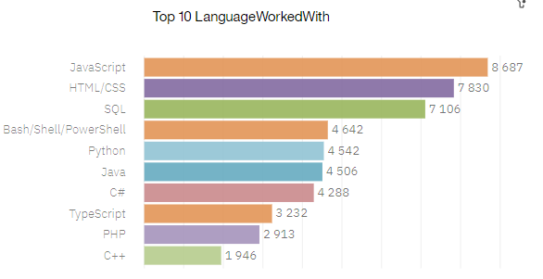
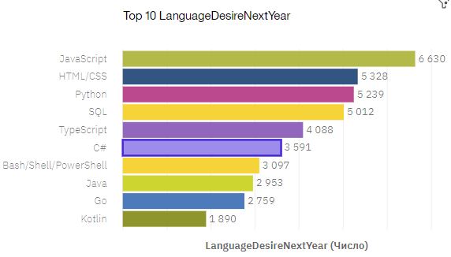
PROGRAMMING LANGUAGE TRENDS
Current Year
Next Year

Slide 8
PROGRAMMING LANGUAGE TRENDS - FINDINGS & IMPLICATIONS
Findings
Leaders stay the same
Kotlin, Go appeared in the top
PHP and C++ are not planed to learn

Slide 9
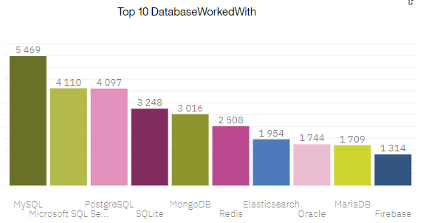
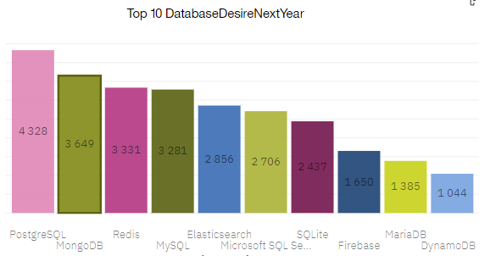
DATABASE TRENDS
Current Year
Next Year

Slide 10
DATABASE TRENDS - FINDINGS & IMPLICATIONS
Findings
PostgreSQL popularity increases
MongoDB popularity increases
Leaders stay the same in general

Slide 11

DASHBOARD
The permanent link of the read-only view of the Cognos dashboard goes here:
https://eu-gb.dataplatform.cloud.ibm.com/dashboards/5ca5d194-8cd9-48a7-8f1f-ec1c0d64e9de/view/5b18c2391b8b22f21fc5f2e407cf2c007837225ee3bbd00180d67b4907672597f33c46c2c82942088c405631f0ee1a5d9c

Slide 12
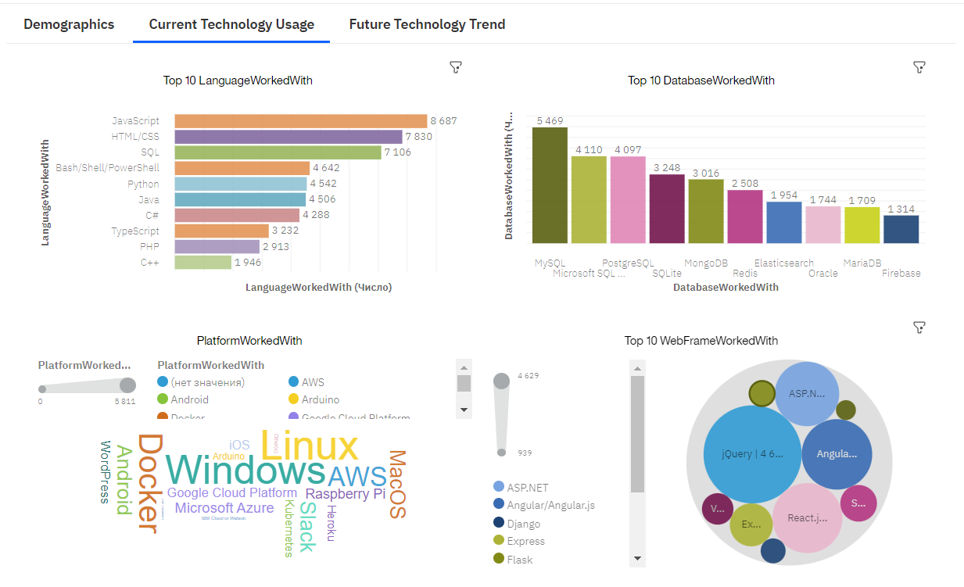
DASHBOARD TAB 1

Slide 13
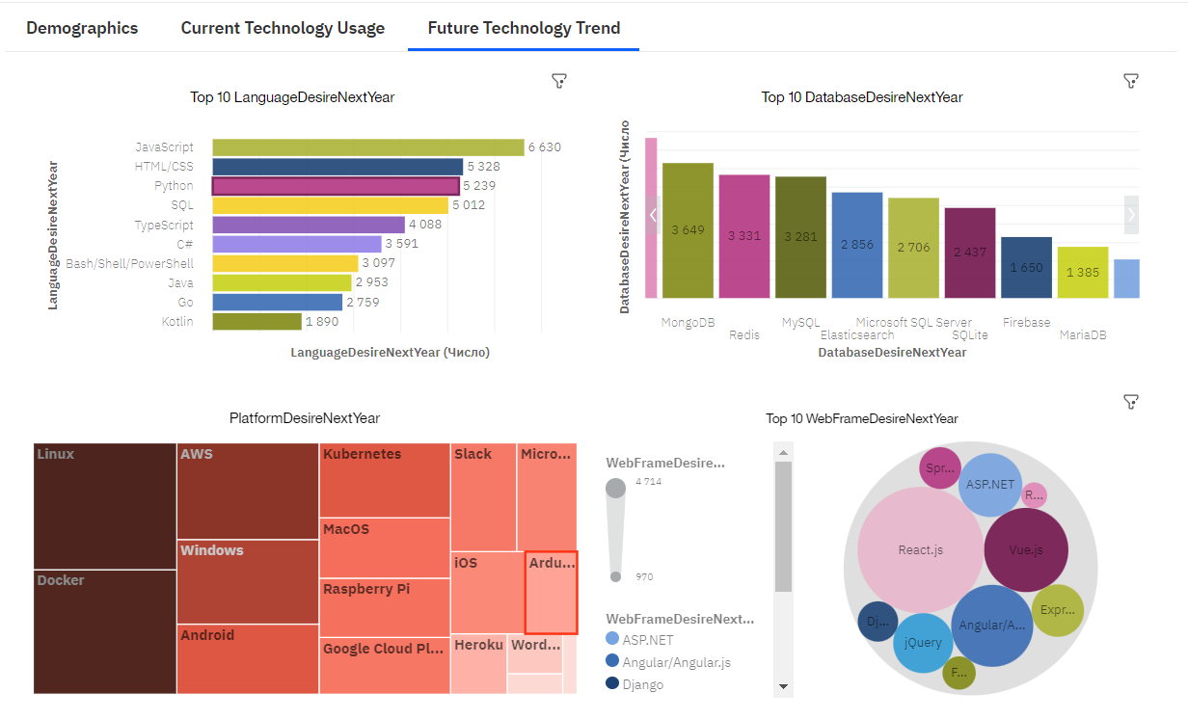
DASHBOARD TAB 2

Slide 14
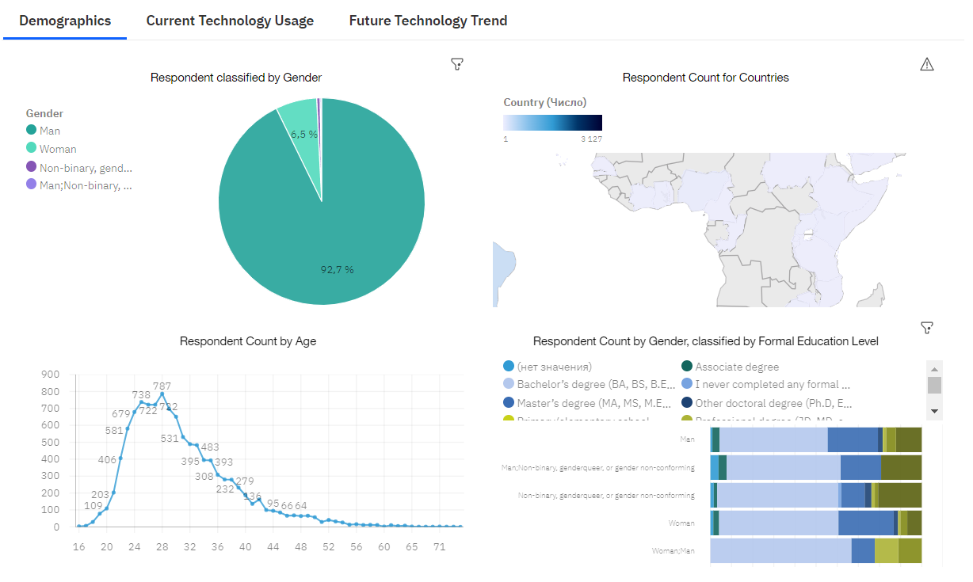
DASHBOARD TAB 3

Slide 15
DISCUSSION
Will Docker get a top as a platform?

Slide 16
OVERALL FINDINGS & IMPLICATIONS
TOP demand tools:
PROGRAMMING LANGUAGE: JavaScript.
DATABASE: MySQL.
PLATFORM: Windows.
FRAMEWORK: jQery.
Tools could get a TOP in the future:
PROGRAMMING LANGUAGE: Python.
DATABASE: PostgreSQL.
PLATFORM: Linux/Docker.
FRAMEWORK: React.js.

Slide 17

CONCLUSION
This research has been highly enlightening, allowing for a comprehensive analysis of numerous technologies and identification of several intriguing trends.
While there were no surprising results concerning the most in-demand developer tools, we did discover some promising tools that have the potential to take the lead in the future of development.
Overall, this study provides valuable insight for stakeholders seeking to stay current with industry trends and emerging technologies.

Slide 18
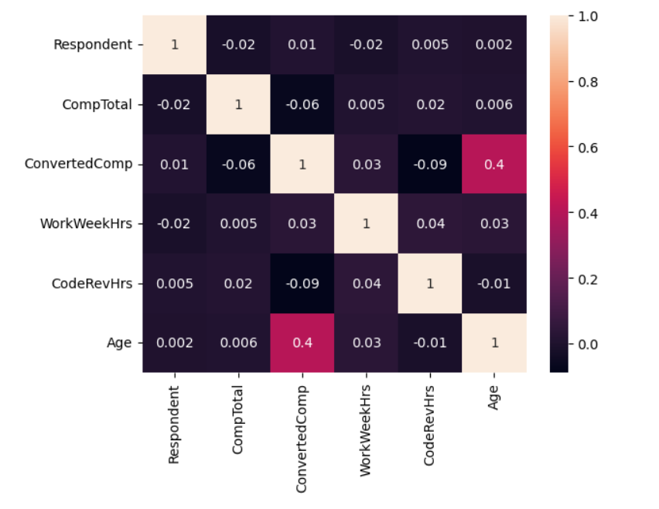
APPENDIX
Dataset shows that only age has correlation with salary.

Slide 19
JOB POSTINGS

Slide 20
POPULAR LANGUAGES

