Slide 1

Guarantee Assurance Initiative for Project Portfolio Execution
Evgenii Sokolov
May 2023

Slide 2

OUTLINE
EXECUTIVE SUMMARY………………...…………………(3)
METHODOLOGY………………………………………..……….(4)
RESULTS……………………………………………………...……….....(5)
FINDINGS………………………………………………………...…(6-9)
DASHBOARD...……………………………………………………(10)
CONCLUSION & VALUE………………………………(11)

Slide 3

EXECUTIVE SUMMARY
This project aims to address the observed discrepancy between the guarantee provision and the target level of project portfolio execution.
Through an in-depth analysis of statistical data on guarantee provision from 2018 to 2020, the project seeks to investigate the current state of guarantee provision and propose effective strategies to improve performance indicators to meet the desired targets.
In 2021, the proposed changes was implemented, and the results and effectiveness of the implemented changes was thoroughly examined and evaluated.
All project information can be found in the GitHub repository.

Slide 4

METHODOLOGY
Data Collection: Data for the project is based on the data structure the author worked with at ASE Rosatom. The dataset was formed from data pertaining to 4 projects, 99 contractors, 5000 contracts, and 15000 guarantees. However, due to the non-disclosure agreement, all data was randomly generated using the Python library Numpy. For more detailed information, please refer to the Jupyter notebook provided at the following link: ___.
Data Wrangling: The data has been prepared for analysis, sorted, filtered, and additional necessary parameters have been created and computed.
Data Visualization and Analysis: The data has been analyzed for project purposes using grouping, calculating means, medians, modes, creating pivot tables and pivot charts.
Building Dashboard: Dashboard was created to ensure regular monitoring of the project portfolio execution.
Tools: Excel: pivot tables, pivot charts, charts, Excel Formula Syntax. Power BI: charts, buttons, slicers, sliders, bookmarks, measures, DAX. Jupiter Notebook. Python: Pandas, Numpy.

Slide 5
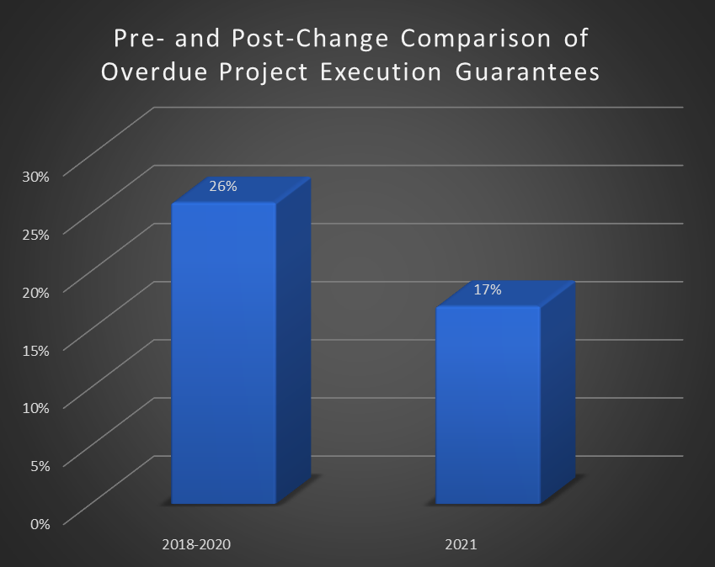

RESULTS
During the statistical analysis of the project portfolio data, it was revealed that when the responsibility for non-provision of guarantees is established in the form of a forfeit of 0.05% per day, the percentage of overdue guarantees significantly decreases and remains at a level of 15%. This specific form of responsibility was implemented in all contracts starting from 2021. As a result, the percentage of overdue guarantees for project execution has decreased by 9 precents, from 26% to 17%, aligning with the target indicator.

Slide 6
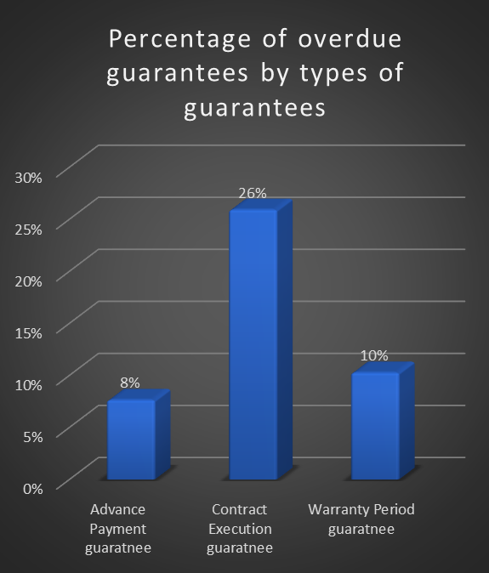
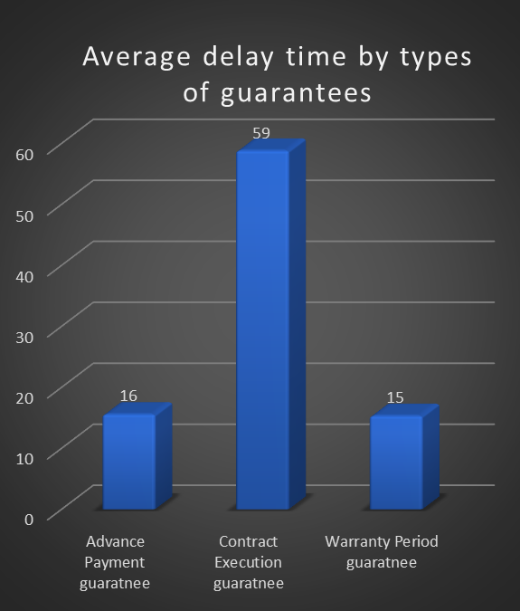
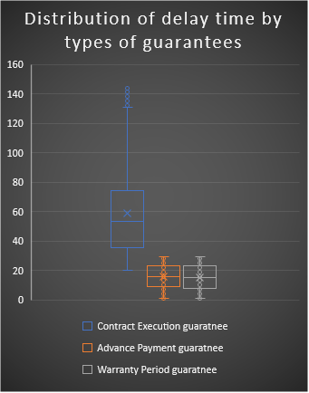
FINDINGS
It was identified that the main issue lies in the Contract Execution guarantee.

Slide 7
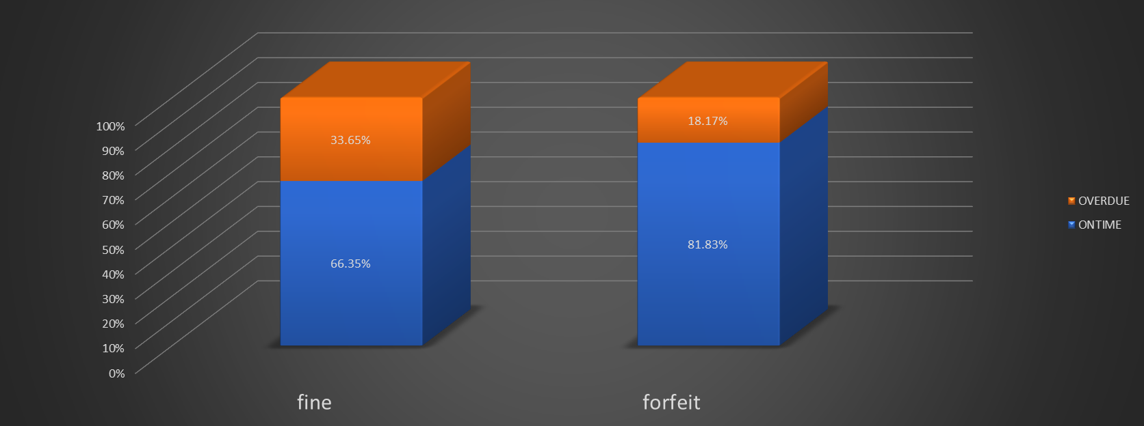
FINDINGS
It has been determined that when the responsibility for non-provision of guarantees is established in the form of forfeit rather than fines, the percentage of overdue guarantees is nearly halved, with 18% compared to 34%.

Slide 8
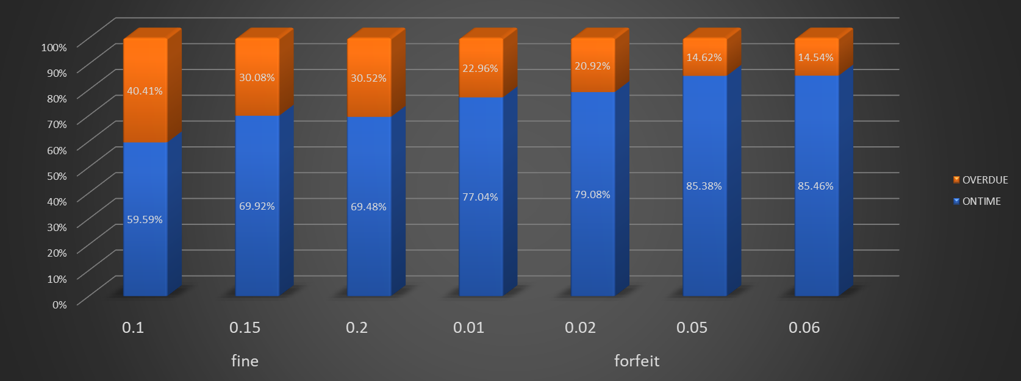
FINDINGS
The most effective forfeit rate is found to be 0.05% (per day), considering the percentage of overdue guarantees at 15%. Further increasing it to 0.06% does not significantly impact the outcomes.

Slide 9
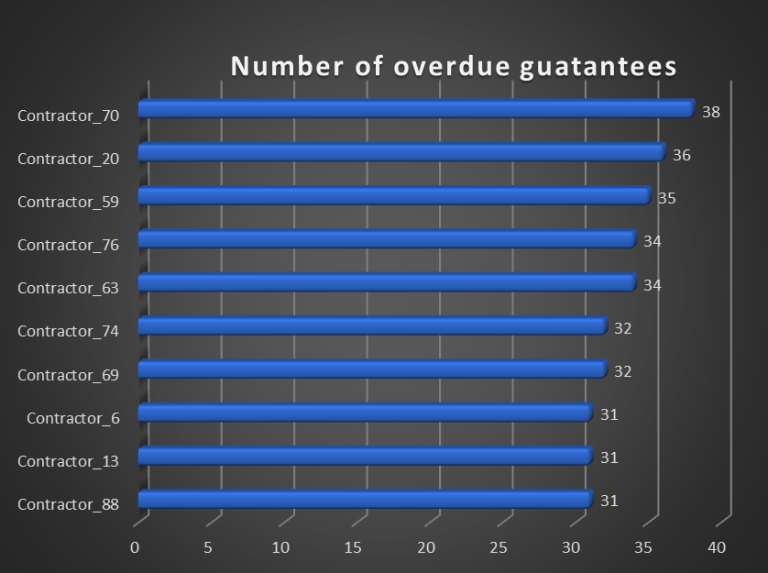
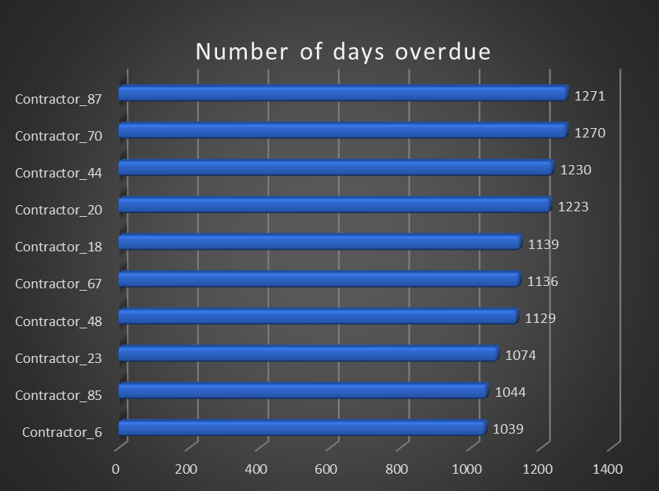
FINDINGS
Additionally, for the purpose of contractor management, the most frequent offenders among contractors have been identified.

Slide 10
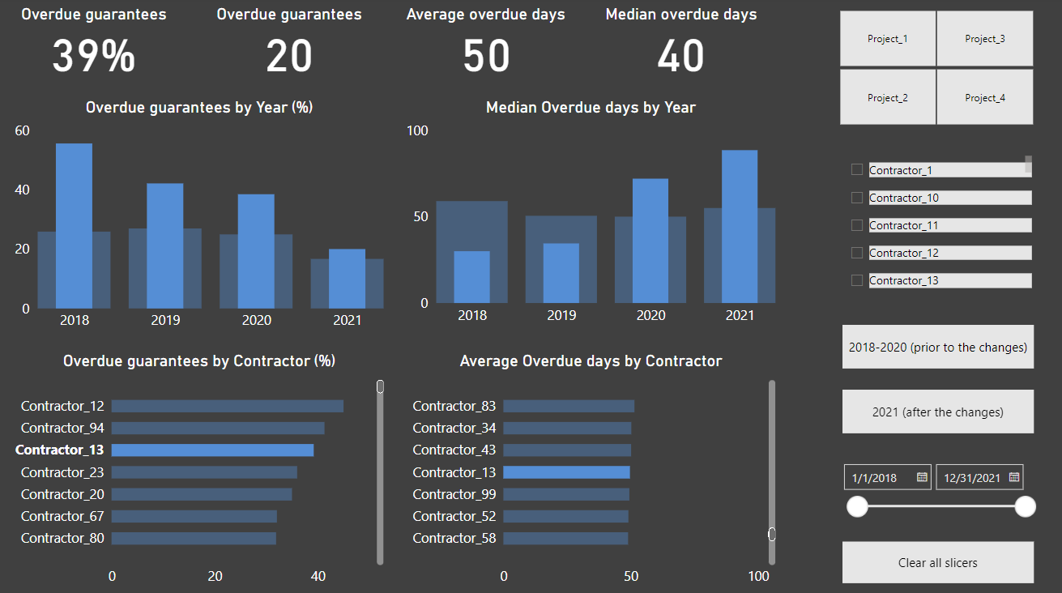
DASHBOARD
To ensure regular monitoring of the project portfolio's guarantee provision, a dashboard was created in Microsoft Power BI. The dashboard enables tracking of the desired parameters based on specific projects, contractors, and time periods.
Available on this webpage or within the this PowerBI file.

Slide 11

CONCLUSION & VALUE
In this study, we conducted an analysis of project portfolio execution data to identify patterns in guarantee provision. Based on the insights gained during the project, changes were implemented in 2021, resulting in a 9% reduction in overdue guarantees for project execution across the project portfolio.
Additionally, the created dashboard enables tracking of relevant indicators based on projects, contractors, and timeframes.

