Slide 1
Кострюков Евгений
М8О-407Б-22

Slide 2
Тема: Музей - Театр
Тип контраста: Контраст тёплого и холодного
Тип композиции: Диагональная композиция

Slide 3
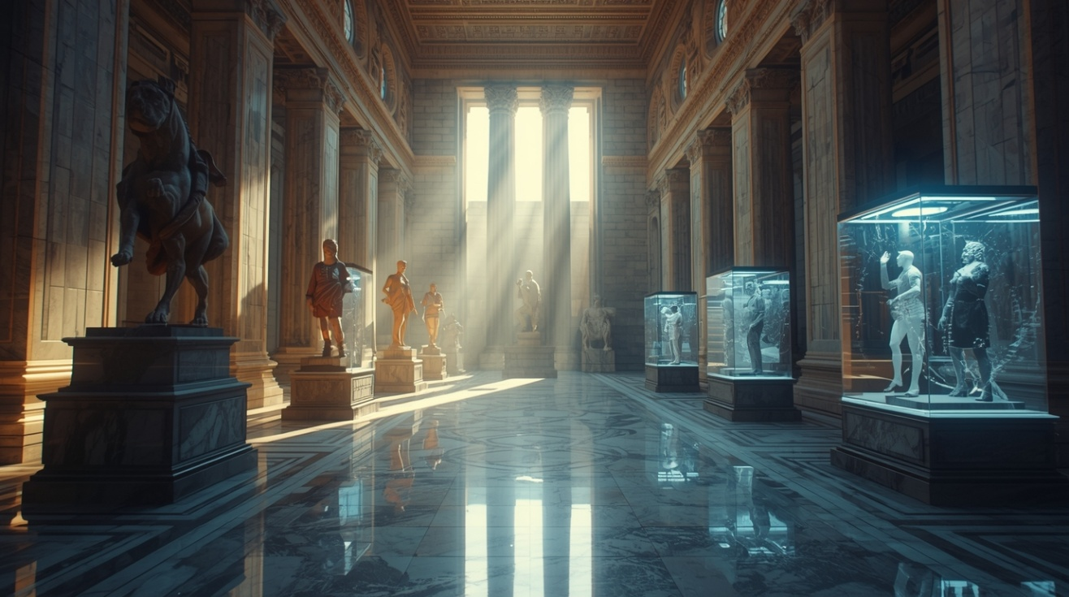
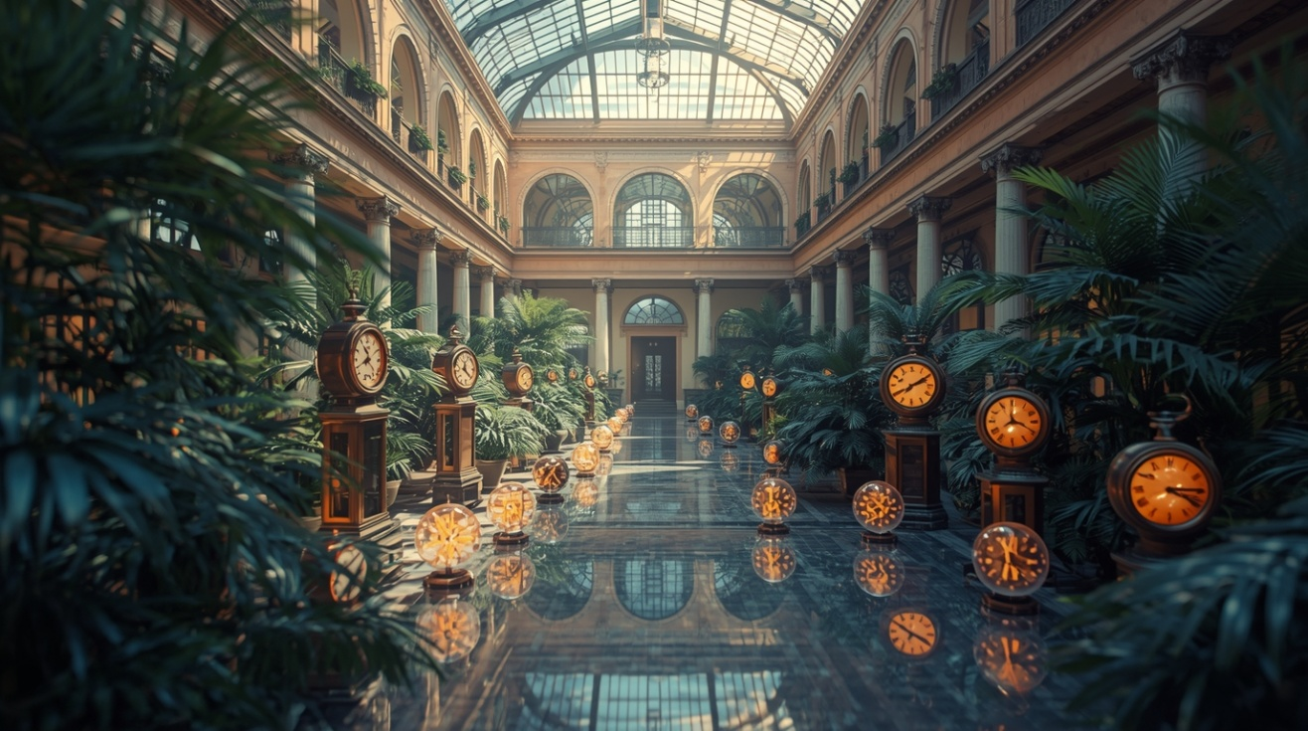
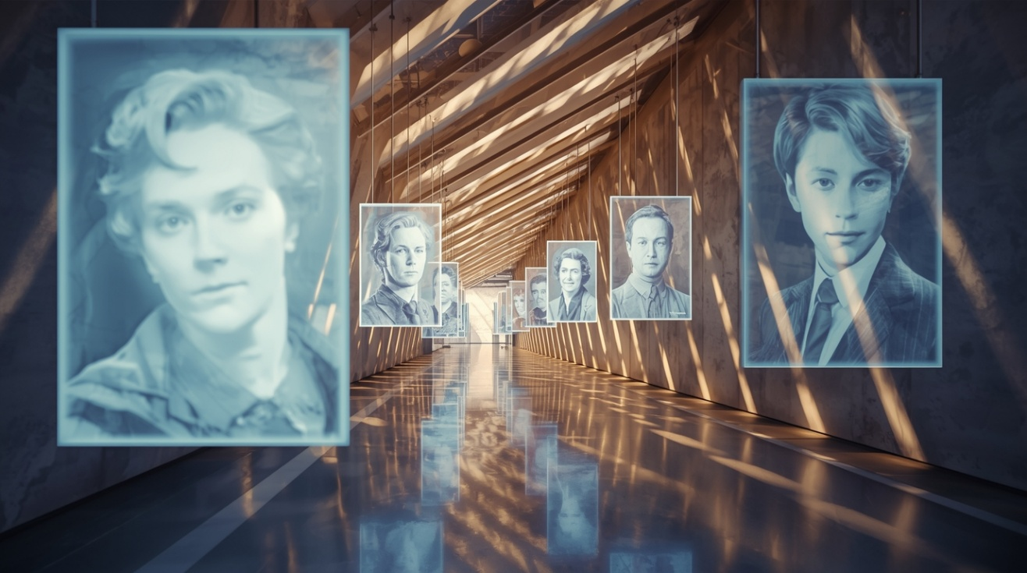

Slide 4

futuristic museum interior with glass time capsules containing frozen moments of people in motion, diagonal composition, warm orange and cool blue lighting, cinematic atmosphere, 3D render, high detail, soft light

Slide 5

modern museum corridor with suspended holographic portraits slowly fading in the air, perspective lines in diagonal composition, warm golden lights contrasting with icy blue reflections, cinematic 3D render, detailed, soft shadows

Slide 6

open museum atrium with scattered antique clocks and glowing digital time spheres among plants, warm sunlight mixing with cold bluish reflections, diagonal composition, cinematic atmosphere, detailed 3D render

