Slide 1
Dog And Cat CNN Classifier

Slide 2
Objective:
Creating a classifier which will efficiently classify between dog and cat images taken from Kaggle “Cat and Dog” data set [https://www.kaggle.com/tongpython/cat-and-dog]
Humans classify dog and cats images successfully about 99.6% of the time [https://www.microsoft.com/en-us/research/publication/asirra-a-captcha-that-exploits-interest-aligned-manual-image-categorization/]
So our main objective is to tend to this efficiency

Slide 3
Data Set:
Taken from Kaggle - [https://www.kaggle.com/tongpython/cat-and-dog]
All images resolution edited to be 200X200 (3 channels - RGB)
Train set contains 6003 images (2999 cats and 3004 dogs)
Validation set contains 2002 images (roughly 30% of train)
Test set is 2023 images

Slide 4
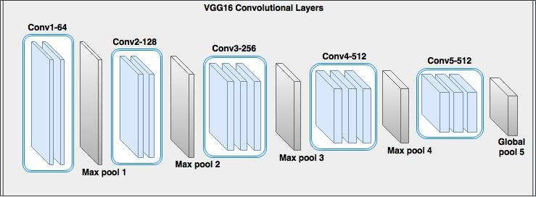
Architectural Decisions:
We’ll use the VGG blocks model [https://arxiv.org/abs/1409.1556] which is known for being capable of classifying images with large accuracy
VGG blocks are Convolutional Layers followed – connected to a Max Pooling layer, while both kernels are usually small matrix 3X3 with random numbers and 2X2 respectively, and the amount of filters start usually from 32 and grows by powers of 2 –16,32,64,128,etc..

Slide 5
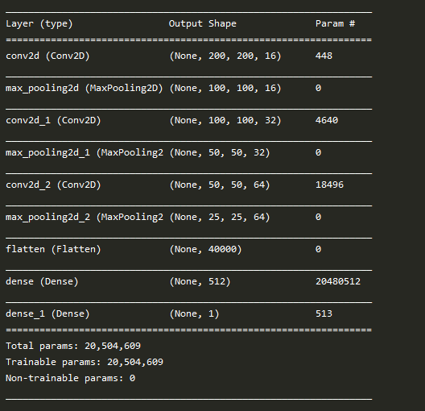
First Attempt:
Our first try is the next architecture:
We’re using ADAM optimizer with 0.001 learning rate (default rate), binary cross entropy loss function, ReLU activation function between all layers except for the logistic – final layer in which we use sigmoid function to output predicated class

Slide 6
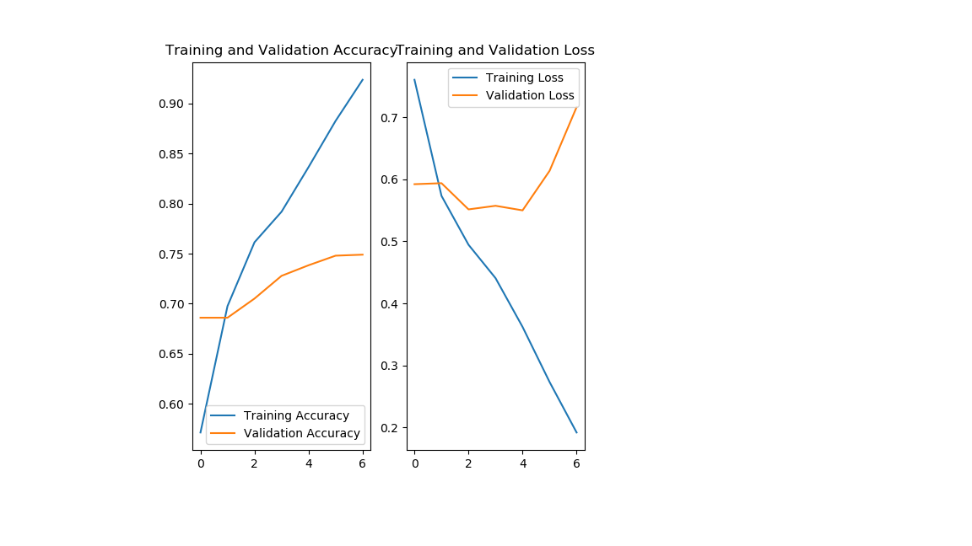
Results:
We ran the model for 7 epochs
Seems we got tendency to overfit the train set – even after small amount of epochs, notice how validation loss is starting to raise from the 4th epoch, in addition, our train acc is 94.83% while test is much lower
Test accuracy: 72.66%
F-Measure: 0.7050

Slide 7
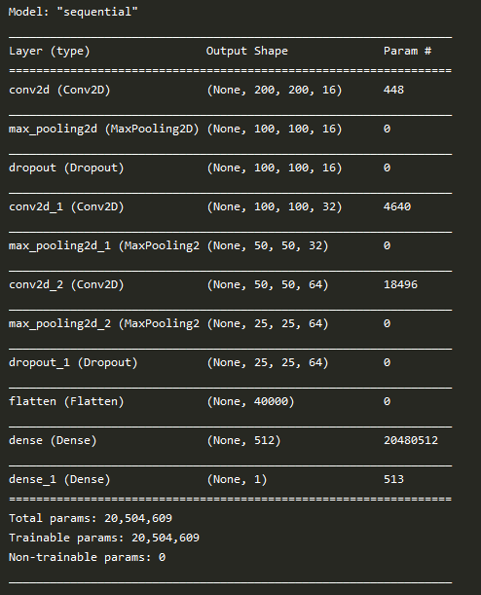
Second Attempt:
We’ll use the same architecture, but now with Dropout regularization – as we try to reduce overfitting to the train set, dropout layers inserted between 1st and 3rd VGG block
With all the same settings as before we now run the training for 10 epochs

Slide 8
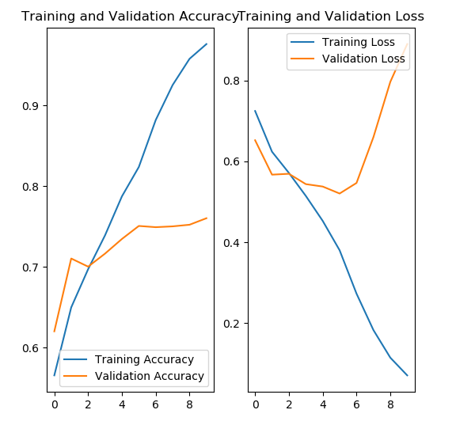
Results:
We got 97.58% acc in train, much less in test, quite easy to see we’re still overfitting the train data, in addition notice how validation and train losses are splitting after certain amount of epochs
Train acc – 75.43%, which is slightly better but still pretty low,
F-measure: 0.76589,
Overall better results but still not good enough

Slide 9
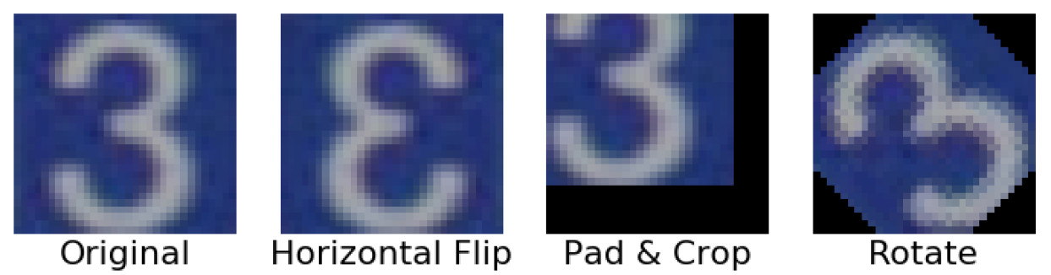
Data augmentation:
Data augmentation is a strategy that enables practitioners to significantly increase the diversity of data available for training models, without actually collecting new data. Data augmentation techniques such as cropping, padding, and horizontal flipping are commonly used to train large neural networks. However, most approaches used in training neural networks only use basic types of augmentation. While neural network architectures have been investigated in depth, less focus has been put into discovering strong types of data augmentation and data augmentation policies that capture data invariances.[https://bair.berkeley.edu/blog/2019/06/07/data_aug/]

Slide 10
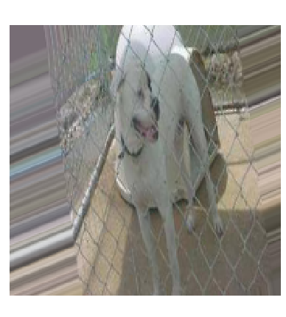
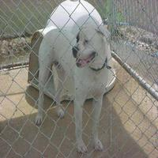
Third Attempt:
We’ll now use data augmentation for whole train set, and run it for 50 epochs with the same dropout:

Slide 11
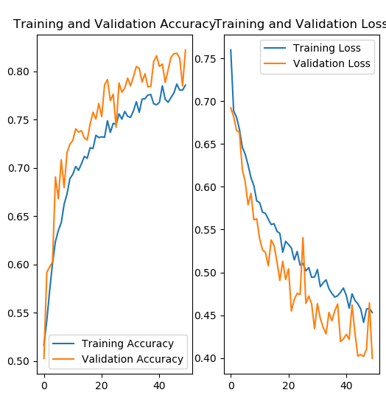
Results:
Easy to see that even after relatively big amount of epochs – validation and train loss are still not splitting – we can see that they are both decreasing together
we got the next measures for test set:
Test acc: 81.018%
F-measure: 0.80041
This is quite good in comparison to previous attempts.
But we notice that its quite hard for the model to fit data – we did 50 epochs and as you can see train acc is only around 80%, it means we have to make our model more complex – i.e. add more layers, in addition, at the right corner of the graph – you can see that train loss is still decreasing – which means we need more epochs

Slide 12
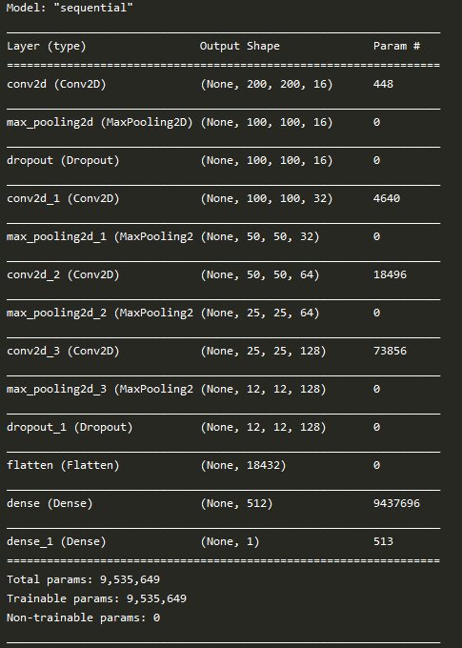
Fourth Attempt:
We’ll now add one VGG block to our model, VGG blocks are good way to make the model richer without adding too much additional weights, our architecture now:
We’re not afraid of overfitting this time because we already seen that validation and train losses won’t split, so we now can train our model until train loss is zero – we’ll run the model for 250 epochs
Notice that we moved the dropout layer to our new last VGG block

Slide 13
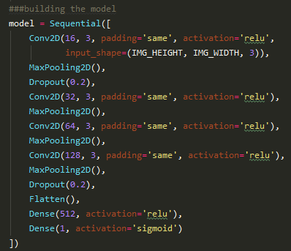
In TF.Keras:

Slide 14
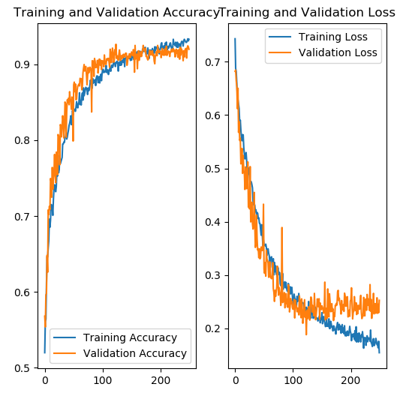
Results:
We got 92.14% test acc,
F-measure:0.92
This is much better, we will stop here.
But we could do better - Notice that we got only to around ~93% in train acc, with more epochs we could get to 100%, and while we use data augmentation combined with dropout reg – we shouldn’t overfit

Slide 15
EXAMPLE ON 100 RANDOM IMAGES

Slide 16
What's Next?
We could train the model for some additional amount of epochs – its hard to say which amount because the rate of loss improvement is changing, it takes more epochs to improve the loss value as the loss gets smaller
We could add more VGG blocks to our model to make it more complex, which should make it “stronger” – fitting to train data will happen faster
We could work with bigger dataset, 6K images is pretty small

Slide 17
Q&A

