Slide 1
Randomized SVD for Hilbert-Schmidt operators low-rank approximation
Team:
Aleksandr Tolmachev
Arkadiy Vladimirov
Emil Alkin
Eugeny Gurov

Slide 2


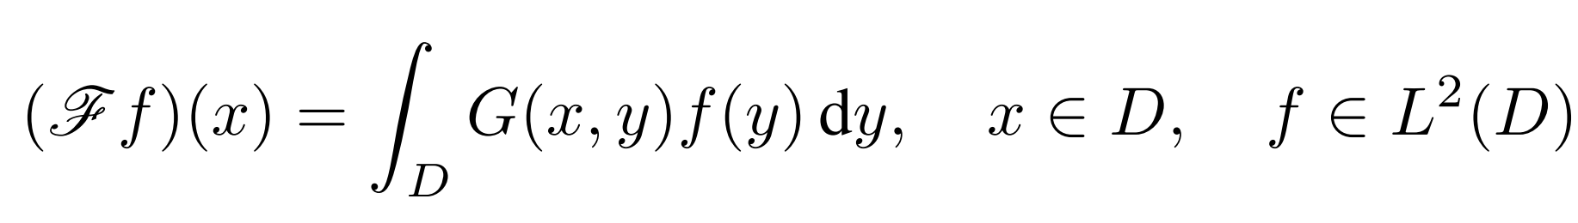
The problem:
Low rank approximation for the kernel function of an integral Hilbert-Schmidt operator :

Slide 3
Applications:
Learning integral kernels such as Green functions associated with linear partial differential equations
2. Compressed storage of Integral operators
3. Fast Integral operators evaluation

Slide 4
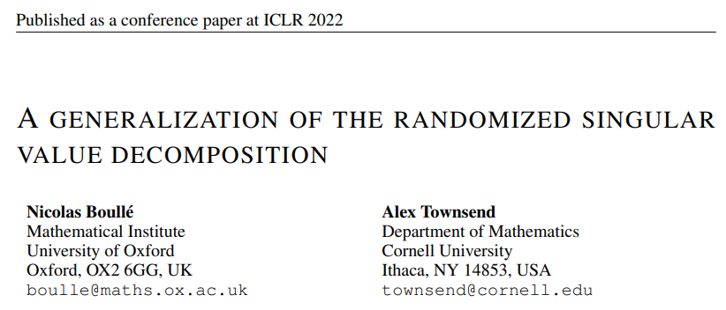
Recently proposed solution
The article proposes an algorithm for the generalization of randomized SVD for Hilbert-Schmidt operators with non-standard covariance kernels.

Slide 5
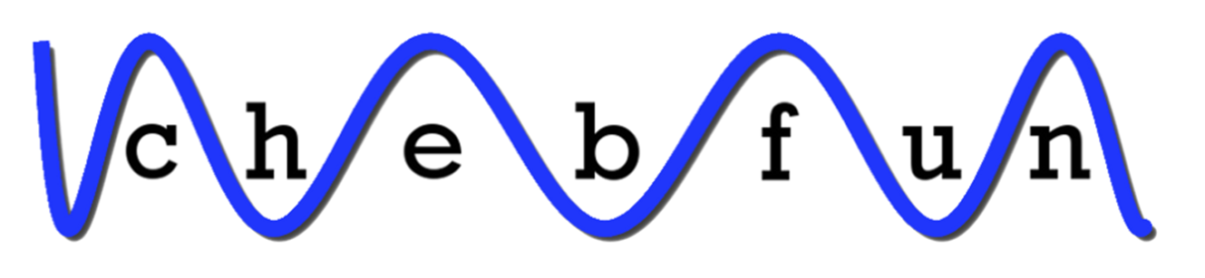
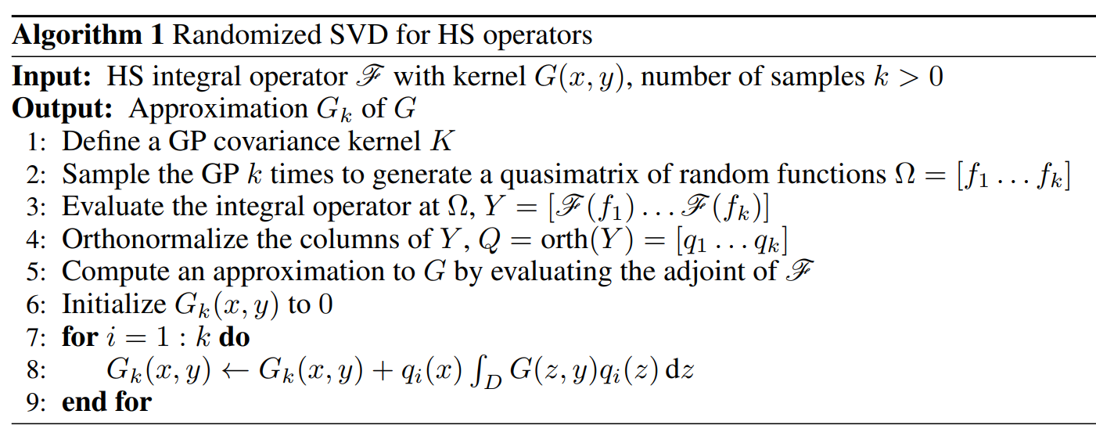
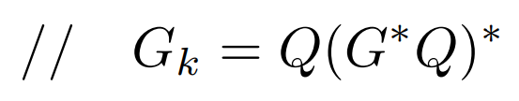
The algorithm

Slide 6
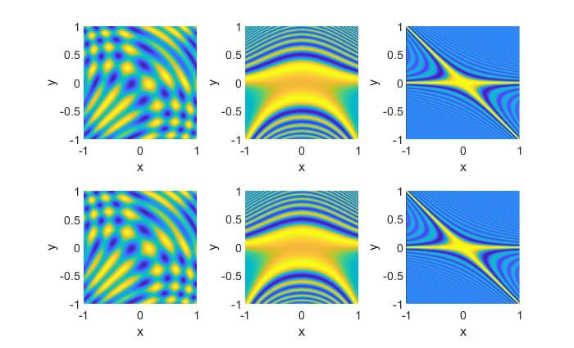
Experiments: original kernels vs obtained approximations
Kernel
Trigonometric
Airy
Bessel
Approx. rank
k = 5
k = 50
k = 100
Original
Learned

Slide 7
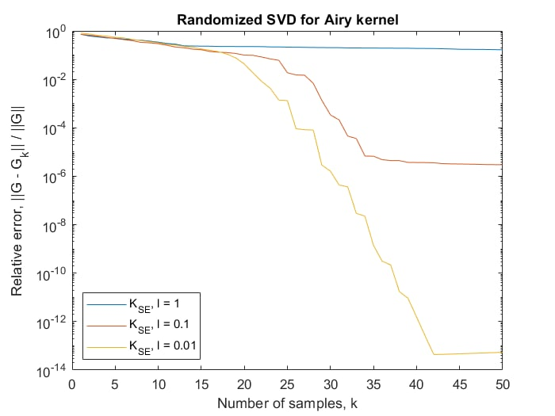


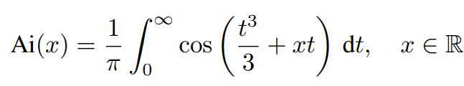
Experiments: accuracy of approximation for Airy kernel
Airy kernel:

Slide 8
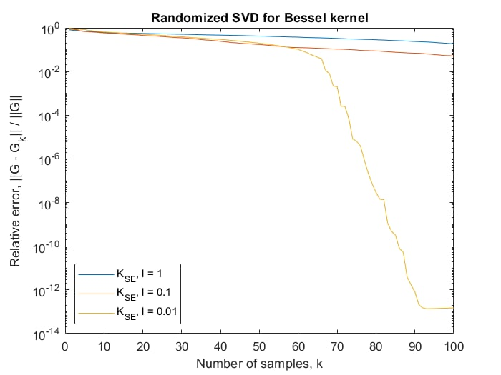

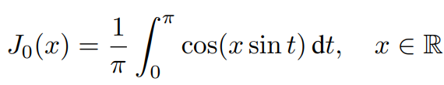
Experiments: accuracy of approximation for Bessel kernel
Bessel kernel:

Slide 9
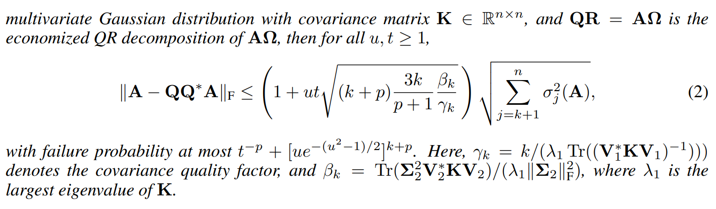
Approximation of matrices using non-standard covariance functions
Highlight that, the more prior knowledge of the matrix A that
can be incorporated into the covariance matrix, the better

Slide 10
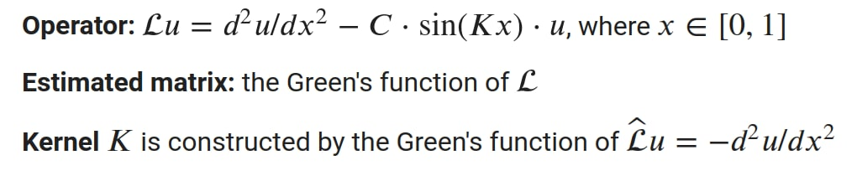
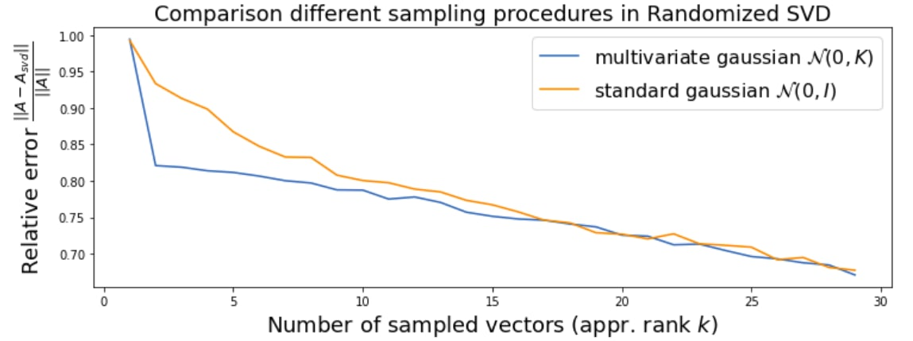
Approximation of matrices using non-standard covariance functions

Slide 11
Team:
Emil Alkin – performing experiments, presentation;
Arkadiy Vladimirov – the idea, article analysis, algorithm realization;
Evgeny Gurov – article analysis, algorithm realization, organization, github handling;
Aleksandr Tolmachev – finite case algorithm realization.

