Slide 1
Validating Credit Scoring Models
9/18/2023
The views expressed in the presentation are those of the presenter and do not represent the views of Wells Fargo.

Slide 2
Outline
What are credit scoring models and related regulations
Types of credit scoring models
Source of model risk
Validating credit scoring ML models with AARC
Appendices
Q&A

Slide 3
What are credit scoring models and related regulations
Credit Scoring models are statistical models developed to predict the likelihood of certain credit behaviors (eg, default), and used by lenders to evaluate consumer’s credit worthiness for credit decision.
“To qualify as an empirically derived, demonstrably and statistically sound, credit scoring system, the system must be: (i) Based on data that are derived from an empirical comparison of sample groups or the population of creditworthy and noncreditworthy applicants who applied for credit within a reasonable preceding period of time;” [ECOA, RegB §202.2] ➔ RI (Reject Inference)
“Disclosure of Credit Scores …all of the key factors that adversely affected the credit score of the consumer in the model used, the total number of which shall not exceed 4, subject to paragraph (9);… Key factors means all relevant elements or reasons adversely affecting the credit score for the particular individual, listed in the order of their importance based on their effect on the credit score.” [FCRA, 15 U.S.C. § 1681] ➔ AARC (Adverse Action Reason Code)
Notes:
Default, Number cycles delinquent, charge-off, bankruptcy
FL regulation in ECOA, Reg B
CS models developed based on model objectives defined by the business, while complying relevant regulations.

Slide 4
Types of credit scoring models – by business (Auto/HL/Card/PLL/SBL)
Origination credit score (with reject inference)
Account Management credit score
Card Origination Line Usage Propensity models (Line assignment)
Revolving balance
Purchase volume
Card Account Management CLI Balance-Purchase models (Line management)
Revolving balance
Purchase volume
Auto/HL Credit Cost Model
Collections model
Notes:
PLL: personal line and loan SBL: small business lending
Models for specific credit decisions
Approval decision -> line assignment (predict revolving balance and purchase volume ). Line assignment is a part of the origination strategy, and revolving balance and purchase volume is needed for line assignment, may need to be predicted. E.g. If revolving balance and purchase volume is low, no need for line increase
CLI: credit line increase. Increase credit line after obtaining credit. Customer requested or automatically initiated by bank. Not much AM for HL, HE, may decrease CL by using AM model to support decisions. CC AM may give lower interest based on credit score, or other risk factors such as revolving balance Credit cost models for general portfolio pricing strategy Collections model predict change in delinquency status for collection strategies at the account level (e.g. who to call). Contact customers who are more likely to pay back, prioritize strategy. Allocate senior collectors contact customers who are less likely to pay back.

Slide 5
Types of credit scoring models – by modeling technique
Logistic Regression
FICO Scorecard Pro (Xeno)
Binning/classing
Performance Inference using parceling
Predicting ratio target variable using parceling (fractional logistic regression)
Generalized Additive Model (GAM)
GBM, XGBoost (with/without monotonicity constraints)
EBM, GAMI-Tree, GAMI-Net, ReLU DNN
Light GBM (with monotonicity constraint, controlled depth in interaction tree)
Why main effects only, why no interactions in logistic regression?
Why monotonicity constraints in Xeno scorecard models?
Why interpretability/explainability in ML models?
Notes:
Harder to interpret interaction in logistic regression. Harder to impose monotonicity constraint
In credit scoring models, monotonicity is essential to interpretability and palatability. It ensures that as risk factors increase, the estimated risk rises and the model score drops
Monotonicity and interpretability: AARC sensitivity analysis, performance monitoring, etc.

Slide 6
Source of model risk – Model risk can occur at any point from design to implementation and use
Model Use Scope
- Use scope
- Environment
Model Framework
- Approach
- Structure
Model Data/Inputs
- Quality
- Limitations
- Availability
- Treatment
Model Use and Monitoring
- Plan coverage
- Metrics/KPI
- Early warning
- Escalation
Model Development
- Theory
- Techniques
- Assumptions
- Sampling
- Hyper-parameter tuning
Model Testing/ Performance
- Accuracy
- Rank ordering
- Explainability
- Benchmarking
- Sensitivity
- Bias
Model Implementation
- Incorrect impl
- Readiness for ML
- Control
OCC has defined eight categories of risk for bank supervision purposes:
Credit, Interest rate, Liquidity, Price, Operational, Compliance, Strategic, Reputation
The risks associated with model use can occur at any point during a model’s development, implementation, use, and validation.
Untimely or missing validations can result in inaccurate or misrepresented risk measurements and business decisions that are based on inaccurate or irrelevant model outputs.
Notes:
Examples:
Environment: covid
Model use on additional population

Slide 7
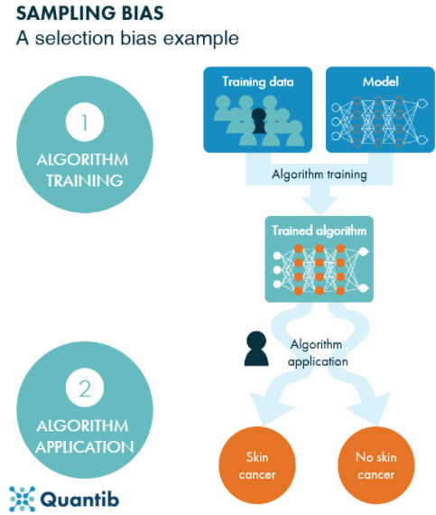
Validating credit scoring ML models – Focus/Challenges
Reproducibility/replicability
Alternative data: available in production with the same quality?
Sampling bias, algorithm bias
- Amazon’s recruiting ML model
- Missing category in training data (appeared in test data)
Reject inference for origination models
ML model building process
Hyper-parameter tuning: expert judgement and latest industry practices
Variable reduction and best model selection process
Overfitting (large # of inputs, performance drop across samples?)
Interpretability/explainability
Variable importance (importance metrics: gain, coverage, weight in XGBoost)
PDP, ALE, SHAP, LIME, etc.
Sensitivity analysis, benchmarking, challenger model
Alternative algorithms
XGBoost for regression / NN vs. Fractional logistic regression
Identify model weakness (via residual analysis)
ML model AARC method (PDP, SHAP, etc.) and Reasonableness
Notes:
Amazon recruiting model bias toward women

Slide 8
Validating credit scoring ML models with AARC
Regulatory Requirements
‘Credit scoring - method for selecting reasons. The regulation does not require that any one method be used for selecting reasons for a credit denial or other adverse action that is based on a credit scoring system. Various methods will meet the requirements of the regulation.
One method is to identify the factors for which the applicant's score fell furthest below the average score for each of those factors achieved by applicants whose total score was at or slightly above the minimum passing score.
Another method is to identify the factors for which the applicant's score fell furthest below the average score for each of those factors achieved by all applicants. These average scores could be calculated during the development or use of the system. Any other method that produces results substantially similar to either of these methods is also acceptable under the regulation.’ [§ 1002.9 Notifications. | CFPB (consumerfinance.gov)]
‘… Providing one or more adverse action reasons from the credit scoring system will help educate consumers about why their credit score did not pass the credit scoring component.’ [ECOA]
‘Description of reasons. A creditor need not describe how or why a factor adversely affected an applicant. For example, the notice may say "length of residence" rather than "too short a period of residence.” ’ [ECOA]
Length of residence (too short)
Length of employment (too short)
Number of recent inquiries on credit bureau report (too many)
DDA account age (time since DDA opened) (too short)
John opened a DDA account 6 years ago.
Key factor: Too little time passed since DDA was opened.
??
Key factor: # inquiries on credit bureau report
John reduced # inquiries from 5 to 2, but the score gets worse.
??
Notes:
Need to provide reason for rejection
Method 1: find the average factors of the applicants whose score is the minimum pass score or slightly higher, then identified the 4 worse factors based on the average
Method 2: find the average factors of all applicants, then identified the 4 worse factors based on the average

Slide 9
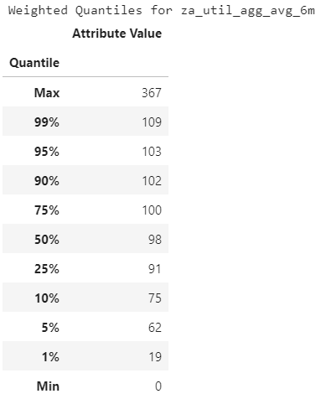
Validating credit scoring ML models with AARC – Case Study
AARC Reasonableness: Focus on the high risk population (eg, worst 10%) and examine the distribution of the key factor.
If the reason is due to low values, what are the low values?
If the reason is due to high values, what are the high values?
Example:
Key factor za_util_agg_6m (6-month average utilization)
90% of the high risk population has utilization ≥ 75
1% of the high risk population has utilization ≤ 19
What if the key factor is “length of residence”?
- Should expect max or 99th percentile is reasonably small.
Utilization too high (≥ 62)?
AARC: Amounts owed relative to the credit limit are too high
Utilization too low (≤ 19)? Or insufficient credit use?
AARC reasonability can be evaluated for all variables selected as top 4 key factors on potential high risk population.
Notes:
This quantile summary is based on the worst 10% population. In this population, most customers have high utilization, but a small percentage still have small utilization.
Need to verify that the AARCs are intuitive, and the customers can use to improve their credit

Slide 10
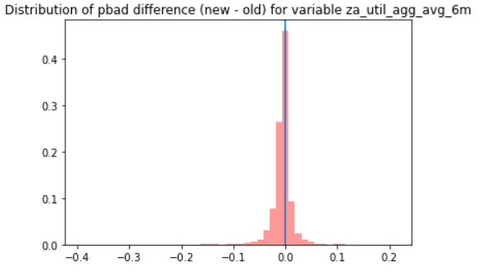
Validating credit scoring ML models with AARC – Case Study
AARC Reasonableness: Focus on the high risk population (eg, worst 10%) who will receive the key factor due to high/low value as AARC.
In case of high values, what happens to the score if the customers reduce the value? Will the score get better?
In case of low values, what happens to the score if the customers increase the value? Will the score get better?
Example: Focus on the high risk population (worst 10%) who will receive za_util_agg_6m (6-month average utilization) due to high value (>90%) as AARC.
What happens to the score if the customers reduce avg util by 5 percentage points? Will the score get improved?
Not all customers will have better score.
What percent of customers will get worse score after reducing avg util?
30.8%. Is this reasonable/acceptable?
30.8% pbad(new-old)> 0
Monotonicity Constraint may need to be considered when building ML models for credit decision with AARC.

Slide 11
Appendix 1.1
FORM C-1—SAMPLE NOTICE OF ACTION TAKEN AND STATEMENT OF REASONS [ECOA]
Statement of Credit Denial, Termination or Change
Date:
Applicant’s Name:
Applicant’s Address:
Description of Account, Transaction, or Requested Credit:
Description of Action Taken:
Part I – PRINCIPAL REASON(S) FOR CREDIT DENIAL, TERMINATION, OR OTHER ACTION TAKEN CONCERNING CREDIT.
This section must be completed in all instances.
Credit application incomplete
Insufficient number of credit references provided
Unacceptable type of credit references provided
Unable to verify credit references
Temporary or irregular employment
Unable to verify employment
Length of employment
Income insufficient for amount of credit requested
Excessive obligations in relation to income
Unable to verify income
Length of residence
Temporary residence
Unable to verify residence
No credit file
Limited credit experience
Poor credit performance with us
Delinquent past or present credit obligations with others
Collection action or judgment
Garnishment or attachment
Foreclosure or repossession
Bankruptcy
Number of recent inquiries on credit bureau report
Value or type of collateral not sufficient
Other, specify:
…
Notes:
Purple font reason: too much info
Blue font reason: enough info

Slide 12
Appendix 1.2
FORM C-2—SAMPLE NOTICE OF ACTION TAKEN AND STATEMENT OF REASONS [ECOA]
Date
Dear Applicant:
Thank you for your recent application. Your request for [a loan/a credit card/an increase in your credit limit] was carefully considered, and we regret that we are unable to approve your application at this time, for the following reason(s):
Your Income:
______is below our minimum requirement.
______is insufficient to sustain payments on the amount of credit requested.
______could not be verified.
Your Employment:
______is not of sufficient length to qualify.
______could not be verified.
Your Credit History:
______of making payments on time was not satisfactory.
______could not be verified.
Your Application:
______lacks a sufficient number of credit references.
______lacks acceptable types of credit references.
______reveals that current obligations are excessive in relation to income.
Other: _______________________________________
…

Slide 13
Appendix 1.3
FORM C-3—SAMPLE NOTICE OF ACTION TAKEN AND STATEMENT OF REASONS (CREDIT SCORING) [ECOA]
Date
Dear Applicant:
Thank you for your recent application for _________________. We regret that we are unable to approve your request.
Your application was processed by a credit scoring system that assigns a numerical value to the various items of information we consider in evaluating an application. These numerical values are based upon the results of analyses of repayment histories of large numbers of customers.
The information you provided in your application did not score a sufficient number of points for approval of the application. The reasons you did not score well compared with other applicants were:
• Insufficient bank references
• Type of occupation
• Insufficient credit experience
• Number of recent inquiries on credit bureau report
…

Slide 14
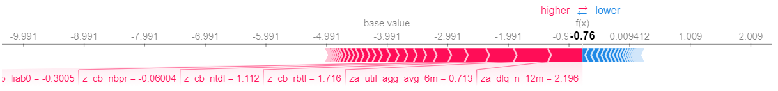
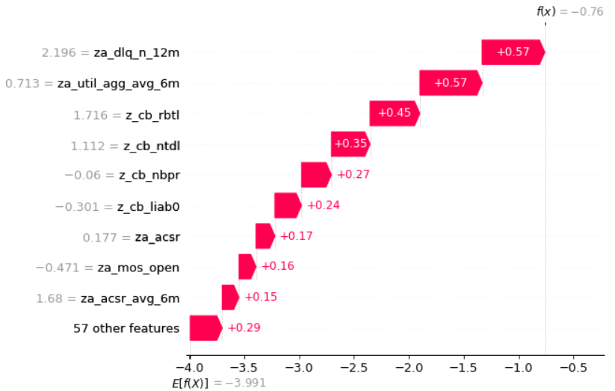
Appendix 2.1 CMoR ML Model – Model Explainability by SHAP
Shapley additive explanations (SHAP): Given an observation of interest, the SHAP value measures the average marginal contribution of a feature value across all possible combinations of inputs.
Top 4 variables to be selected as key factors for AARC for this applicant
za_dlq_n_12m: # months with 30+ dpd last 12 months
za_util_agg_avg_6m: Average utilization last 6 months
z_cb_rbtl: Overall balance/line ratio on all open revolving trade
z_cb_ntdl: # trades 30+ days delinquent or derogatory last 12 months
Notes:
Add a summary slide.

Slide 15
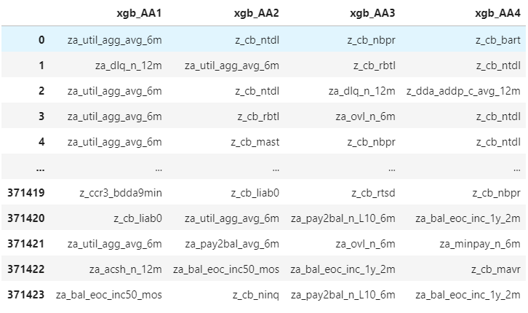
Appendix 2.2 CMoR ML Model AARC Generation
List of application level AARC (top 4 key factors) generated by SHAP method

Slide 16
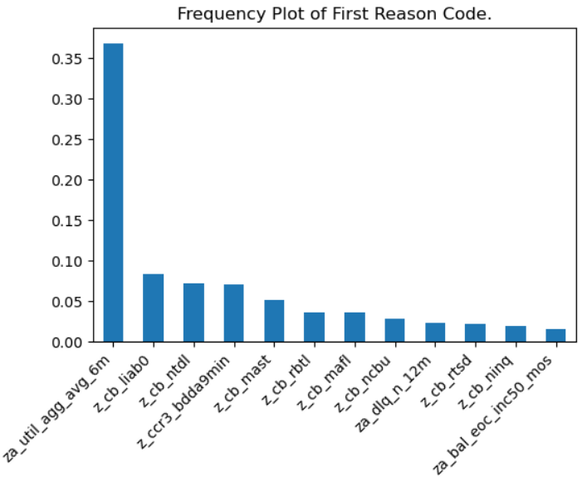
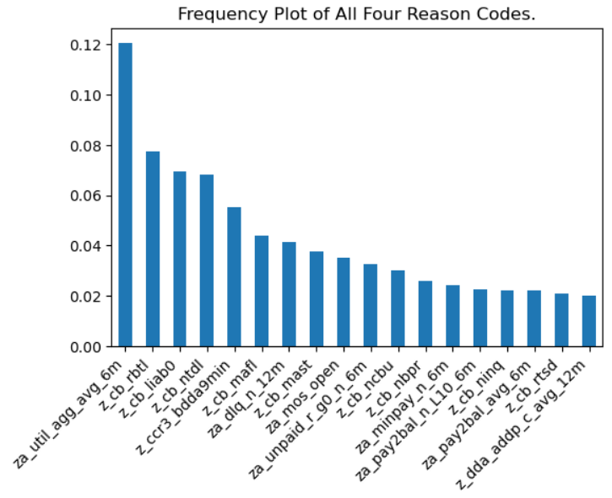
Appendix 2.3 CMoR ML Model AARC Evaluation - General
Examine the frequency distribution of the first reason code and the distribution of top four factors
37% of population receive 1st reason code corresponding to za_util_agg_avg_6m
Top four factors spread out over a diverse set of model input attributes
Expectation: No single feature is overly impactful to the model. A broader set of key factors materially impact the model.
Notes:
Since independent variables all have some contribution to the prediction

Slide 17


