Slide 1
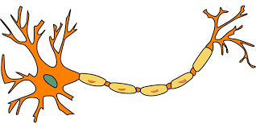





What is deep learning?
Linear algebra
Neural cell
$$y=W^{T}x+b$$
$$x_{1}$$
$$Σ/W^{T}$$
$$y$$
$$x_{2}$$

Slide 2
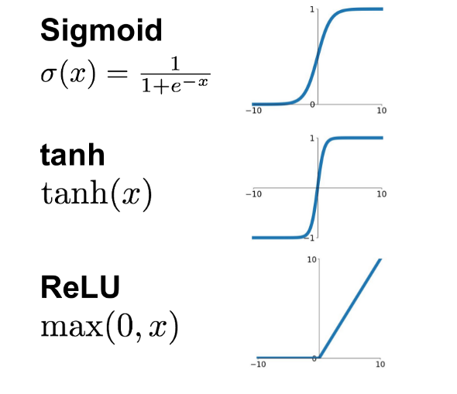






What is deep learning?
Activation function
$$x_{1}$$
Linear projection
$$Σ/W^{T}$$
$$φ$$
$$y$$
$$x_{2}$$
$$y=W^{T}x+b$$
Non-linear projection
Non-linear projection
$$y={φ(W}^{T}x+b)$$

Slide 3
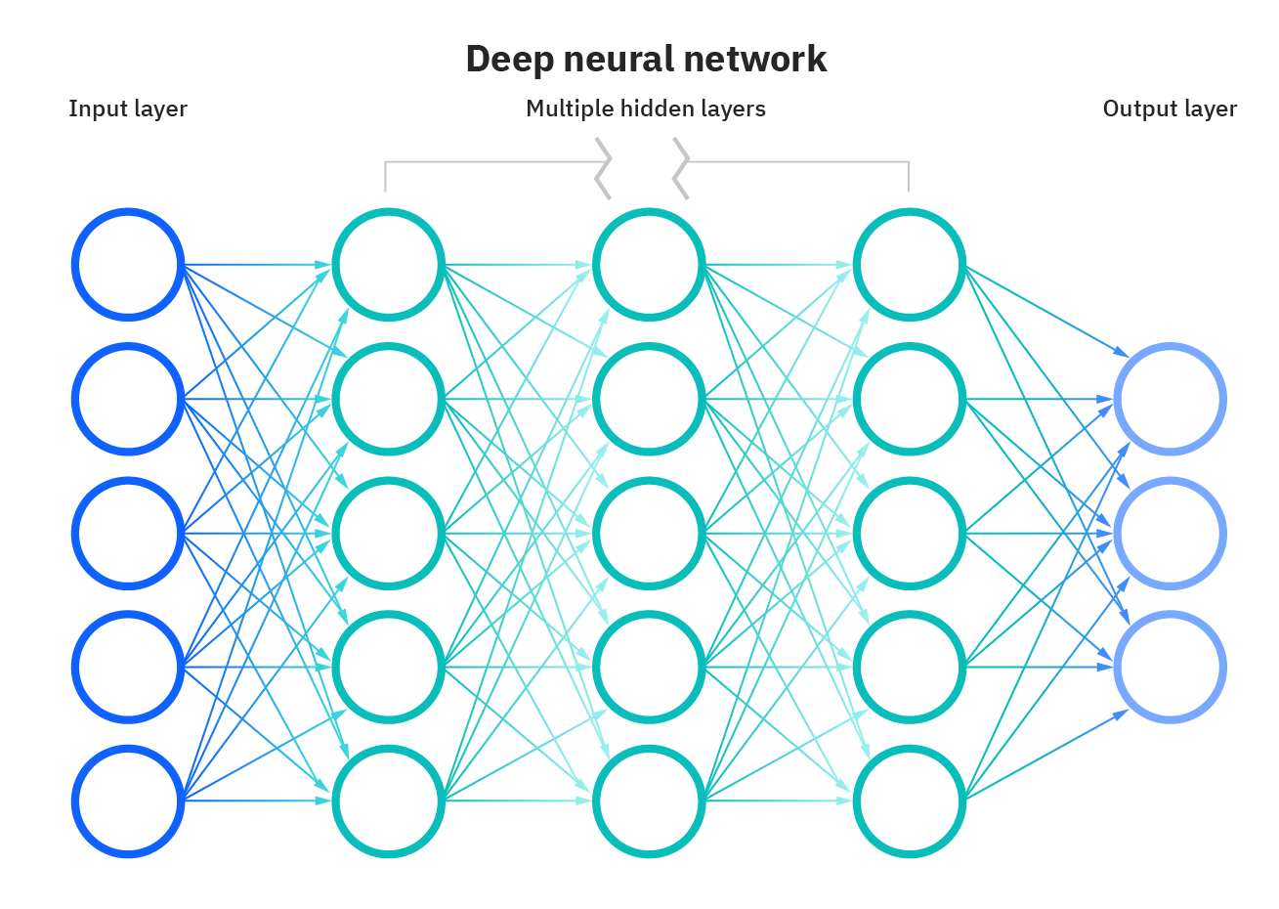
What is deep learning?
Deep learning
Deeper & Wider

Slide 4
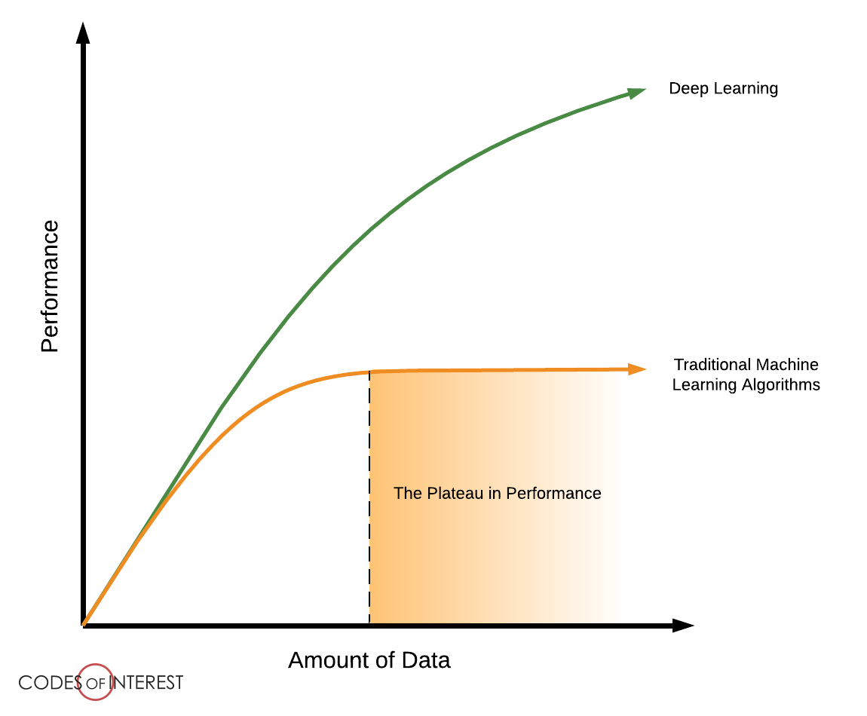
Why deep learning?
Much better performance compared with traditional machine learning

Slide 5

How does deep learning work?
②
①
Input
Model
Output
③
Optimize Loss
Ground truth
④

Slide 6
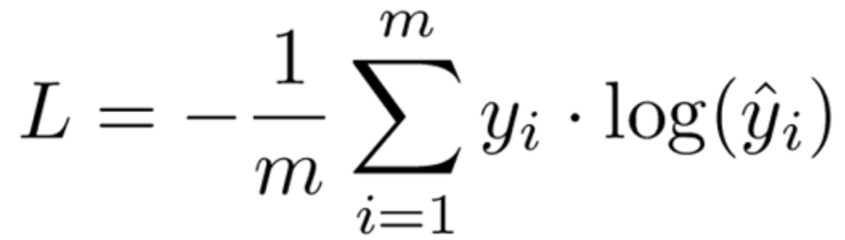
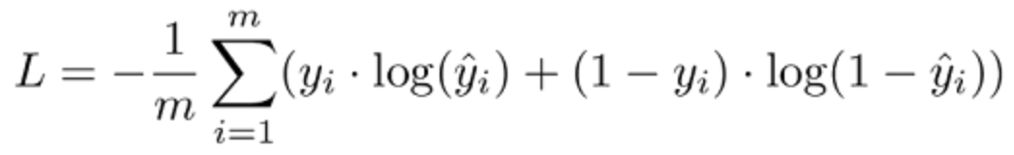
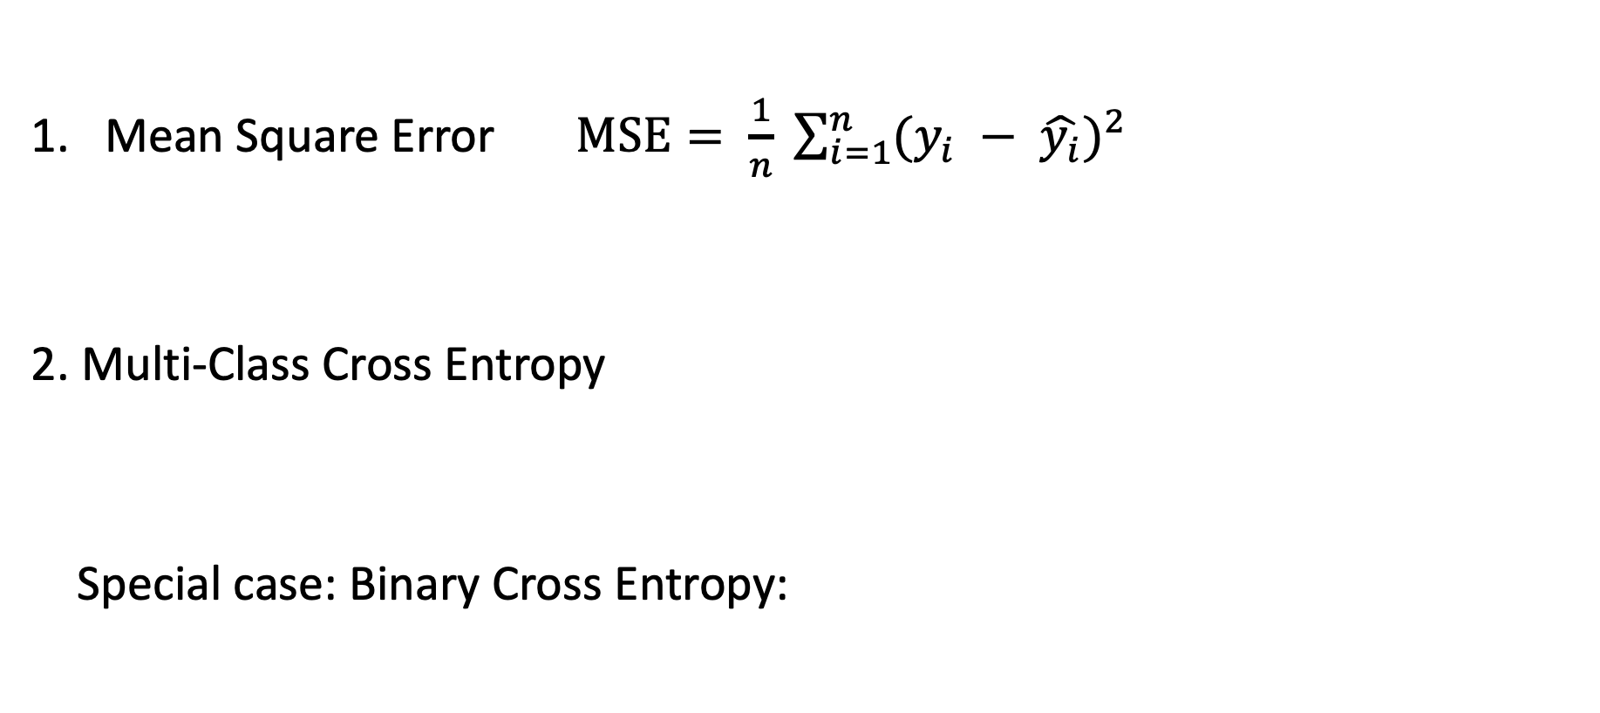
Two Common Loss Functions:
Mean Square Error $MSE= \frac{1}{n} \sum_{i=1}^{n}{{(y_{i} − \hat{y_{i}})}^{2}}$
2. Multi-Class Cross Entropy
Special case: Binary Cross Entropy:

Slide 7
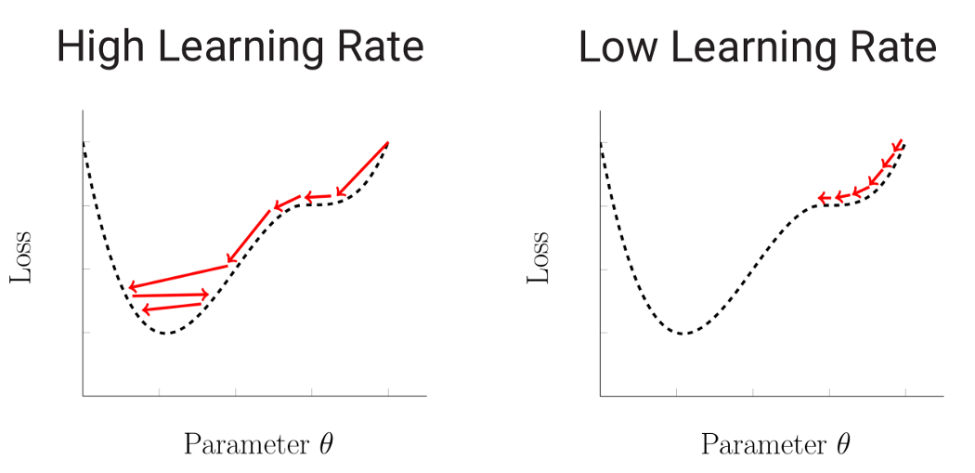

How does deep learning work? – Optimization
Optimizer: Strategy to update the weights in deep learning
Gradient Descent (GD)
Learning Rate
$$w^{′}=w−λ∙g(w)$$

Slide 8
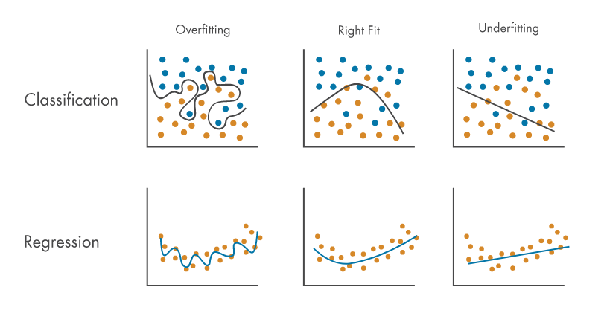
How does deep learning work? – Underfitting & Overfitting
Underfitting:
Model is unable to fit the training data
Perform badly on both training and testing data
More training time, More input features,
More complex model
Overfitting:
Model fits exactly against its training data
Perform well on training data but badly on testing data
Early stopping, Feature selection, Data augmentation
Regularization, Dropout

Slide 9
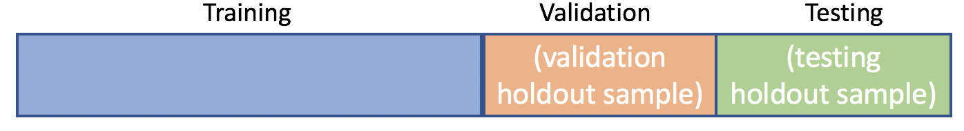
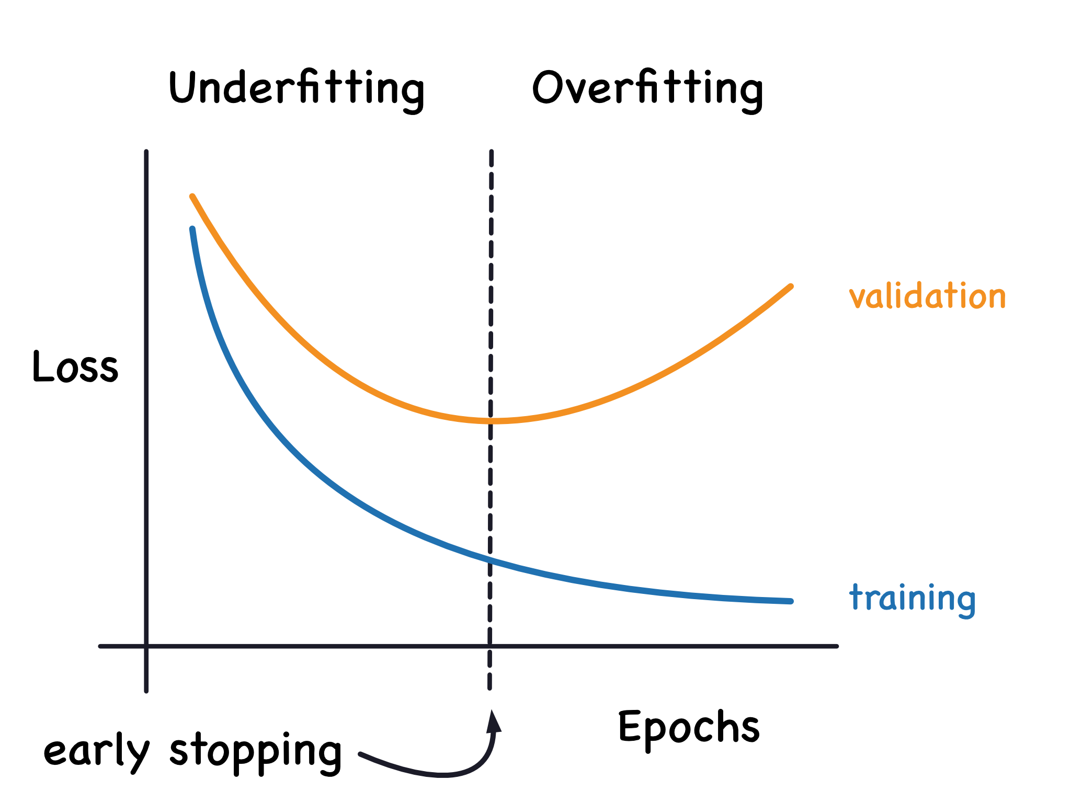
How does deep learning work? – Overfitting
Detect overfitting
Validation set
All data

Slide 10
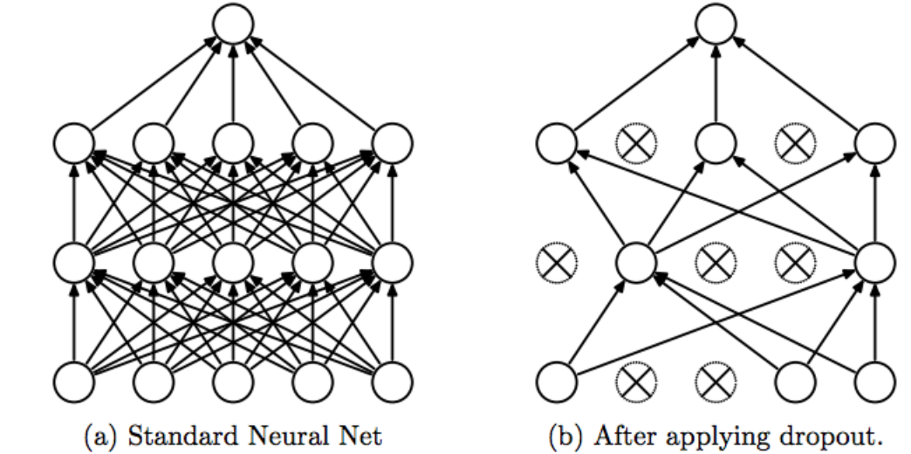
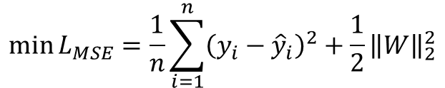
How does deep learning work? – Overfitting
Regularization
Add penalty to weights
Prevent too large weights
Dropout
Randomly "dropping out" some of the units of neural network
Prune the network and add some noise
$$\min{L_{MSE}=\frac{1}{n}\sum_{i=1}^{n}{{\left(y_{i}−{\hat{y}}_{i}\right)}^{2}+\frac{1}{2}{\left\|W\right\|}_{2}^{2}}}$$

Slide 11




How to implement deep learning?
Open-source library for deep learning
Keras – Friendly to the beginners
Tensorflow – More flexible
PyTorch - GNN
Hugging Face – Pretrained models
Scikit-learn – Evaluation metrics
Numpy – Confident in your ability
Hugging Face

Slide 12
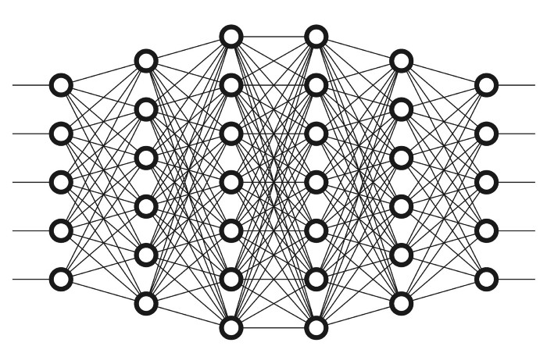



Deep learning models - MLP
Activation function
Multi-Layer Perceptron (MLP)
Stacked fully connected layers
$$x_{1}$$
$$Σ/W^{T}$$
$$φ$$
$$y$$
$$x_{2}$$

