Slide 1
DSBA/HCIP/ ITIS 6162 Knowledge Discovery in Databases Spring 2024 Getting to Know Your Data
Professor Xi (Sunshine) Niu, Ph.D.
University of North Carolina at Charlotte
Notes:
1

Slide 2
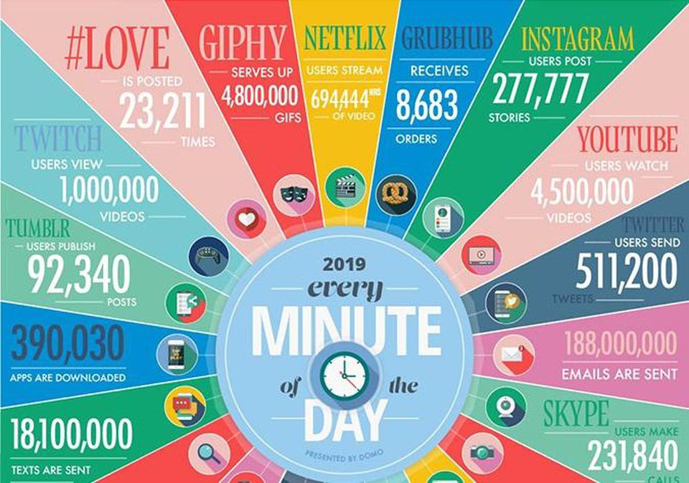

Slide 3
Why Data Mining?
The Explosive Growth of Data: from terabytes to petabytes
Data mining—Automated analysis of massive data sets
Major sources of abundant data
Business: Web, e-commerce, transactions, stocks, …
Science: Remote sensing, bioinformatics, scientific simulation, …
Society and everyone: news, digital cameras, YouTube
We are drowning in data, but starving for knowledge!
“Necessity is the mother of invention”

Slide 4
What Is Data Mining?
Data mining (knowledge discovery from data)
Extraction of interesting patterns or knowledge from huge amount of data
What is interesting pattern?
Alternative names
Data analytics, knowledge discovery (mining) in databases (KDD), knowledge extraction, data/pattern analysis, data archeology, data dredging, information harvesting, business intelligence, etc.
Notes:
Data mining: a misnomer?
What is an interesting patten? (previously unknown, non-trivial, implicit, and potentially useful)

Slide 5
Data Mining in Database Systems
Knowledge
This is a view from typical database systems and data warehousing communities
Data mining plays an essential role in the knowledge discovery process
Pattern Evaluation
Data Mining
Task-relevant Data
Data Warehouse
Selection
Data Cleaning
Data Integration
Databases

Slide 6
Data Mining in Business Intelligence
Increasing potential
to support
business decisions
End User
Decision Making
Data Presentation
Business
Analyst
Visualization Techniques
Data Mining
Data
Analyst
Information Discovery
Data Exploration
Statistical Summary, Querying, and Reporting
Data Preprocessing/Integration, Data Warehouses
Data Sources
DBA
Paper, Files, Web documents, Scientific experiments, Database Systems

Slide 7
Data Mining in Machine Learning and Statistics
Pattern
Information
Knowledge
Input Data
Data Pre-Processing
Data Mining
Post-Processing
Data integration
Normalization
Feature selection
Dimension reduction
Pattern discovery
Association & correlation
Classification
Clustering
Outlier analysis
… … … …
Pattern evaluation
Pattern selection
Pattern interpretation
Pattern visualization
This is a view from typical machine learning and statistics communities

Slide 8
Time and Ordering: Sequential Pattern, Trend and Evolution Analysis
Sequence, trend and evolution analysis
Trend, time-series, and deviation analysis: e.g., regression and value prediction
Sequential pattern mining
Periodicity analysis
Motifs and biological sequence analysis
Similarity-based analysis
Mining data streams
Ordered, time-varying, potentially infinite, data streams

Slide 9
Structure and Network Analysis
Graph mining
Finding frequent subgraphs (e.g., chemical compounds), trees (XML), substructures (web fragments)
Information network analysis
Social networks: actors (objects, nodes) and relationships (edges)
Multiple heterogeneous networks
Links carry a lot of semantic information: Link mining
Web mining
Web is a big information network: from PageRank to Google
Analysis of Web information networks
Web community discovery, opinion mining, usage mining, …

Slide 10
Text Data
Text mining ≈ Text analytics
Turn text data into high-quality information or actionable
knowledge
Minimizes human effort (on consuming text data)
Supplies knowledge for optimal decision making

Slide 11
Data Objects
Data sets are made up of data objects.
A data object represents an entity.
Examples:
sales database: customers, store items, sales
Also called samples , examples, instances, data points, objects, tuples.
Data objects are described by attributes.
Notes:
Database rows -> data objects; columns ->attributes.

Slide 12
Attributes
Attribute (or dimensions, features, variables): a data field, representing a characteristic or feature of a data object.

Slide 13
Types of Attributes
Types:
Categorical
Binary
Nominal
Ordinal
Numeric (Continous)
Interval
Ratio

Slide 14
Numeric Attribute
Interval
Measured on a scale of equal-sized units
Values have order
E.g., temperature in C˚or F˚, calendar dates
No true zero-point
Ratio
Measured on a scale of equal-sized units
Values have order
Inherent zero-point
Ratio makes sense
($100,000 is twice as high as $50,000).
e.g., temperature in Kelvin, length, counts, monetary quantities

Slide 16
Similarity and Dissimilarity
Similarity
Numerical measure of how alike two data objects are
Value is higher when objects are more alike
Often falls in the range [0,1]
Dissimilarity (e.g., distance)
Numerical measure of how different two data objects are
Lower when objects are more alike
Minimum dissimilarity is often 0

Slide 17
Data Matrix
Data matrix
n data points with p dimensions

Slide 18
Distance on Numeric Data: Minkowski Distance
Minkowski distance: A popular distance measure
where i = (x_{i1}, x_{i2}, …, x_{ip}) and j = (x_{j1}, x_{j2}, …, x_{jp}) are two p-dimensional data objects, and h is the order (the distance so defined is also called L-h norm)

Slide 19
Special Cases of Minkowski Distance
h = 1: Manhattan (city block, L₁ norm) distance
h = 2: (L₂ norm) Euclidean distance
h → ∞. “supremum” (L_{max} norm, L∞ norm) distance.
This is the minimum difference between any component (attribute) of the vectors

Slide 20
Example: Minkowski Distance
Dissimilarity Matrices
Manhattan (L₁)
Euclidean (L₂)
Supremum

Slide 21
Distance Measure for Categorical Attributes
Binary
Nominal
Ordinal

Slide 22
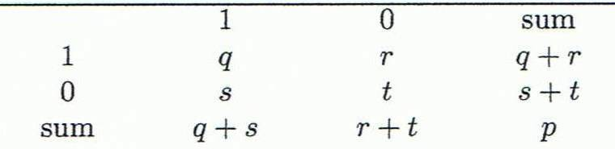
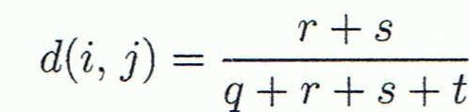
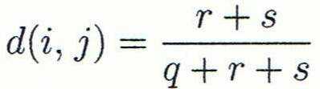

Distance Measure for Binary Attributes
Object j
A contingency table for binary data
Distance measure for symmetric binary variables:
Distance measure for asymmetric binary variables:
Jaccard coefficient (similarity measure for asymmetric binary variables):
Object i
1 – d(i,j) =

Slide 23
Dissimilarity between Binary Variables
Example
Gender is a symmetric attribute (excluding gender from calculation)
The remaining attributes are asymmetric binary
Let the values Y and P be 1, and the value N 0

Slide 24
Distance Measure for Nominal Attributes
Can take 2 or more states, e.g., red, yellow, blue, green (generalization of a binary attribute)
Method 1: Simple matching
m: # of matches, p: total # of attributes
Method 2: Use a large number of binary attributes
creating a new binary attribute for each of the M nominal states

Slide 25
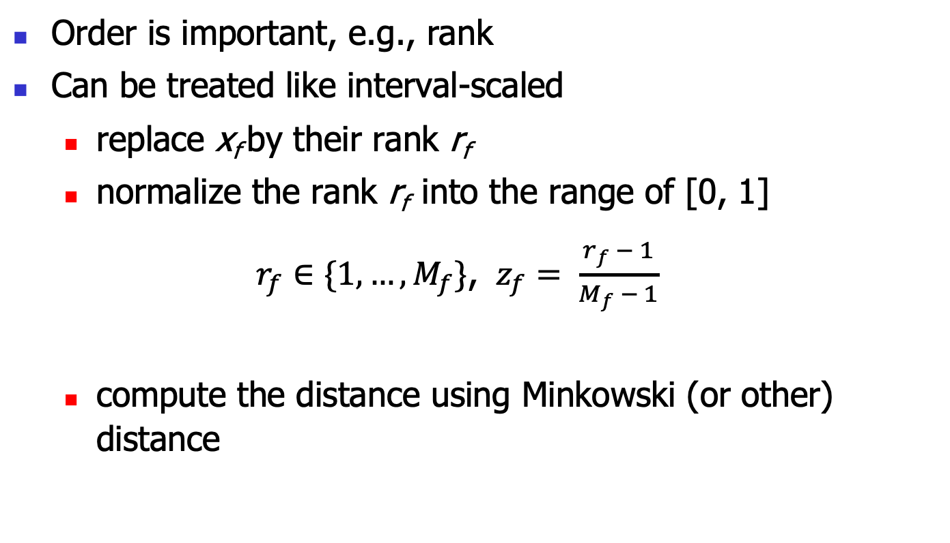
Ordinal Variables
Order is important, e.g., rank
Can be treated like interval-scaled
replace x_{f} by their rank r_{f}
normalize the rank r_{f} into the range of [0, 1]
$r_{f}∈\{1,…,M_{f}\}$, $z_{f}= \frac{{r_{f}}_{ }− 1}{M_{f} − 1}$
compute the distance using Minkowski (or other) distance
Notes:
Need to revise the formula

Slide 26
Attributes of Mixed Type
A database may contain all attribute types
Nominal, symmetric binary, asymmetric binary, numeric, ordinal
One may use a weighted formula to combine their effects
f is binary or nominal:
d_{ij}^{(f)} = 0 if x_{if} = x_{jf} , or d_{ij}^{(f)} = 1 otherwise
f is ordinal
Compute ranks r_{if} and the
Treat z_{if} as interval-scaled
f is numeric: normalize the variable to [0,1], then use Minkowski (or other) distance

Slide 27
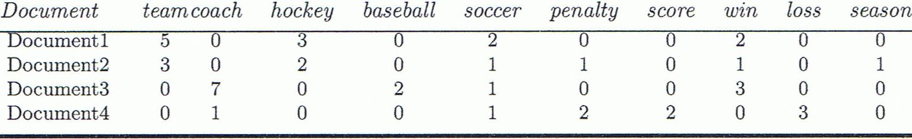
A Special Case
A document can be represented by thousands of attributes, each recording the frequency of a particular word (such as keywords) or phrase in the document.

Slide 28
Cosine Similarity
Cosine measure: If d₁ and d₂ are two vectors (e.g., term-frequency vectors), then
cos(d₁, d₂) = (d₁ • d₂) /||d₁|| ||d₂|| ,
where • indicates vector dot product, ||d|| is the length of vector d

Slide 29
Example: Cosine Similarity
cos(d₁, d₂) = (d₁ • d₂) /||d₁|| ||d₂|| ,
where • indicates vector dot product, ||d|: the length of vector d
Ex: Find the similarity between documents 1 and 2.
d₁ = (5, 0, 3, 0, 2, 0, 0, 2, 0, 0)
d₂ = (3, 0, 2, 0, 1, 1, 0, 1, 0, 1)
d₁•d₂ = 5*3+0*0+3*2+0*0+2*1+0*1+0*1+2*1+0*0+0*1 = 25
||d₁||= (5*5+0*0+3*3+0*0+2*2+0*0+0*0+2*2+0*0+0*0)^{0.5}=(42)^{0.5} = 6.481
||d₂||= (3*3+0*0+2*2+0*0+1*1+1*1+0*0+1*1+0*0+1*1)^{0.5}=(17)^{0.5} = 4.12
cos(d₁, d₂ ) = 0.94

Slide 30
Summary
Data attribute types: nominal （binary）, ordinal, interval-scaled, ratio-scaled
Measure data similarity
Above steps are the beginning of data preprocessing.
Many methods have been developed but still an active area of research.

