Slide 1
Matrix and Vector Algebra
Prof. Xi Niu
University of North Carolina at Charlotte
1
Notes:
1

Slide 2
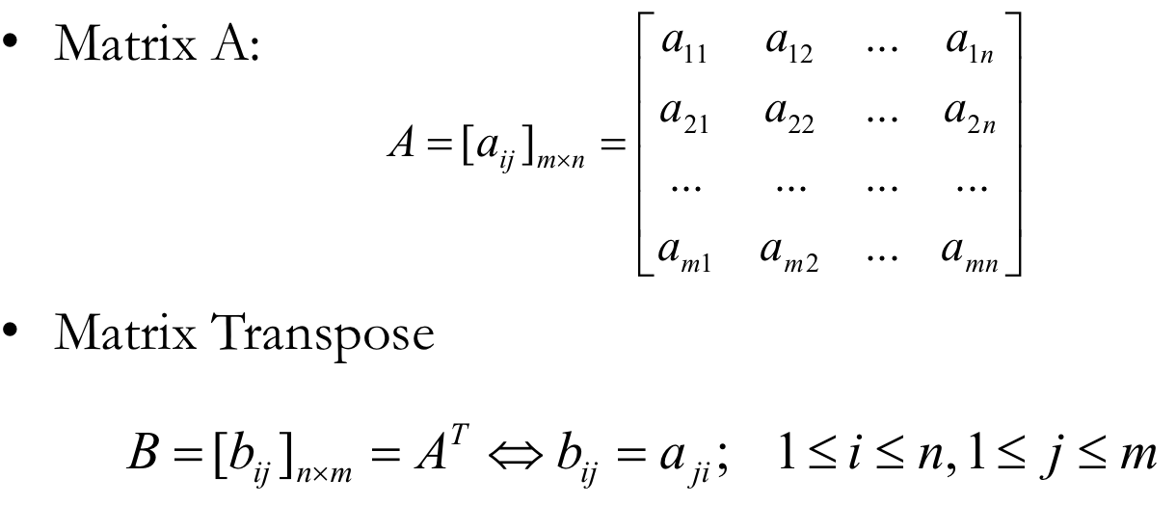
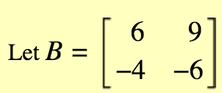
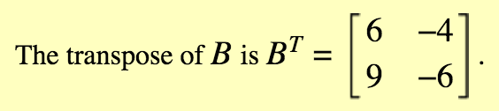
Matrix Transpose

Slide 3
Matrix Multiplication
Notes:
2 examples:

Slide 4
Identity Matrix and Inverse Matrix
Identity matrix I_{n}
Inverse matrix

Slide 5
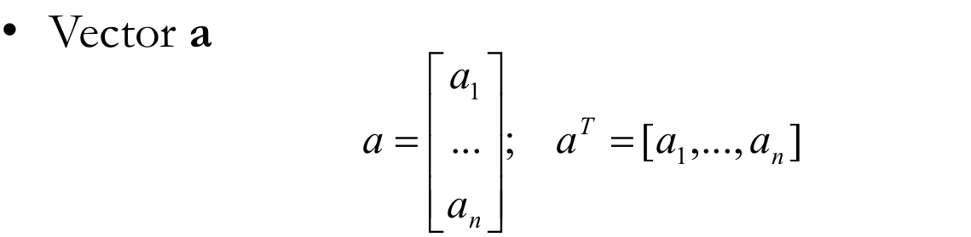
Vectors: Special Matrices

Slide 6
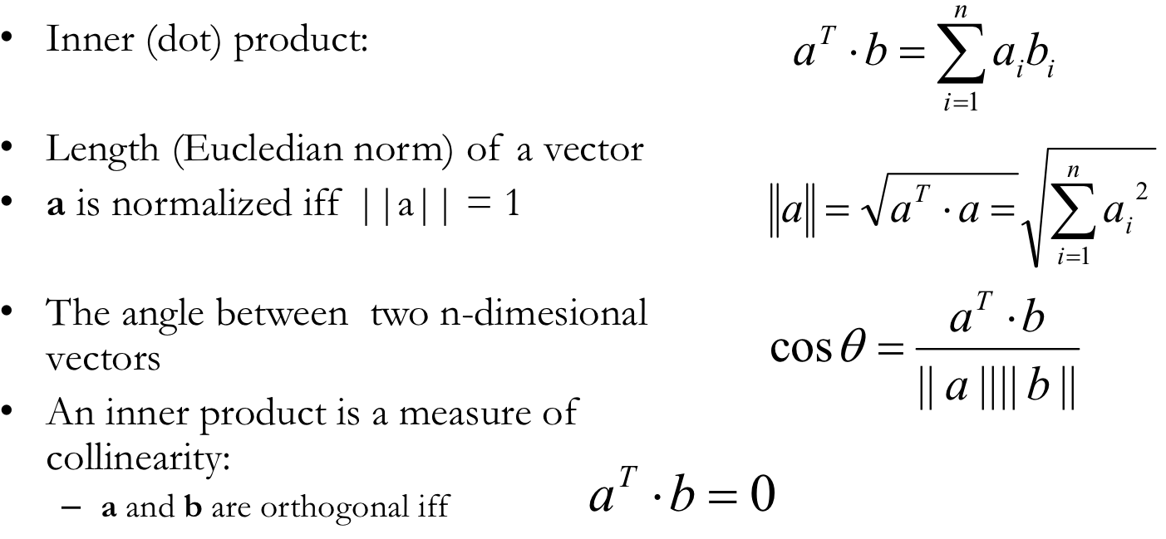
Vector Operations

Slide 7

Examples
a=(3,5,7), b=(1,4,6)
Inner product:3*1+5*4+7*6=65
Length of a: sqrt(3² + 5² + 7²) = 9.1
Length of b: sqrt(1² + 4² + 6² ⁾ ⁼
Angle between a and b:

Slide 8
Being Orthogonal
If two vectors’ dot product is 0, the two vectors are orthogonal.
example: (0.3,0,0) and (0,1,5)

Slide 9
Vector vs. Matrix
Matrix is a collection of vectors
X = [X₁,X₂,…,X_{n}]
In data analytics, a variable maps to the concept of vector, and a series of variables maps to the concept of matrix.

Slide 10
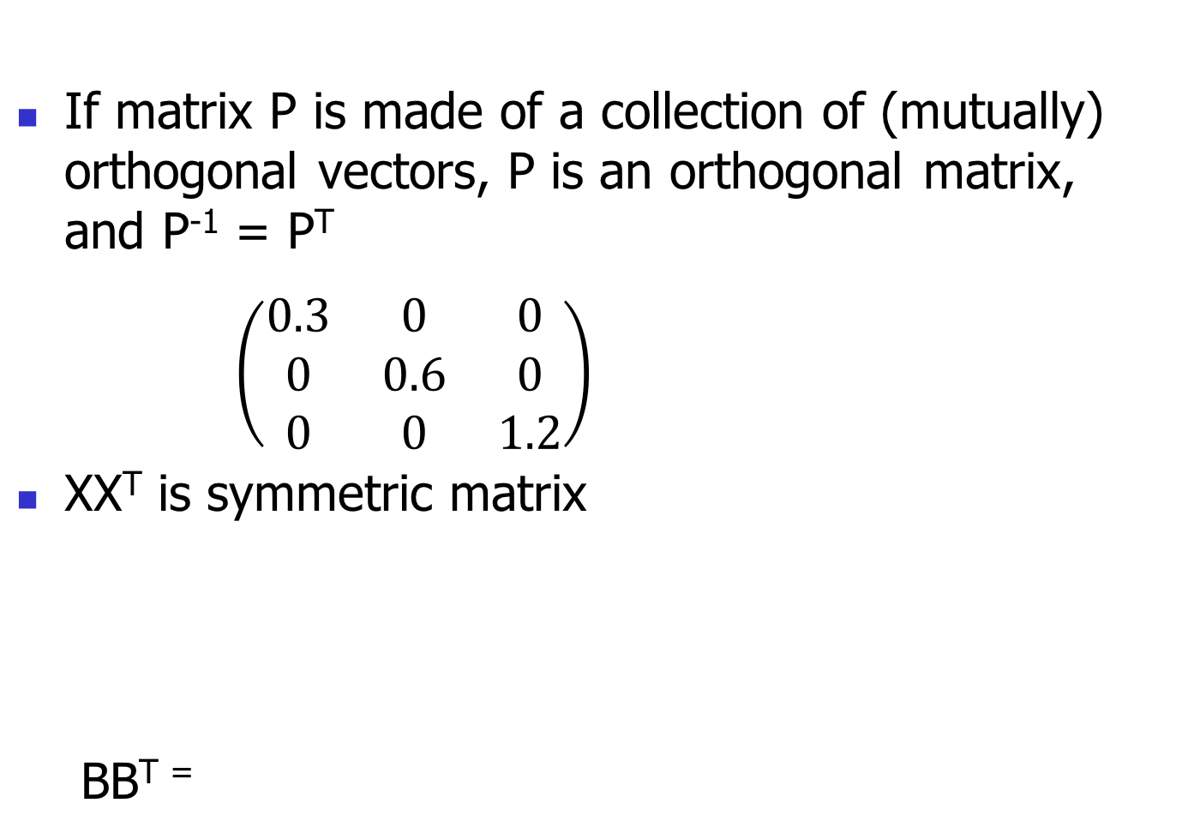
Two Important Properties to Remember
If matrix P is made of a collection of (mutually) orthogonal vectors, P is an orthogonal matrix, and P⁻¹ = P^{T}
$\left(\begin{matrix}0.3 & 0 & 0 \\ 0 & 0.6 & 0 \\ 0 & 0 & 1.2\end{matrix}\right)$
XX^{T} is symmetric matrix
BB^{T =}

Slide 11
Eigenvalue Problem

Slide 12
Example of Eigenvalues and Eigenvectors

Slide 13
Calculate Eigenvalues and Eigenvectors

Slide 14
Example

Slide 15
Example
Solution:

Slide 16
Example

Slide 17
Properties of Eigenvalues and Eigenvectors
Eigenvalues and eigenvectors can only be found for square matrices and not every square matrix has.
In practice eigenvectors are normalized to have the length of 1.
Very Important: all eigenvectors are (mutually) orthogonal. The matrix composed of a collection of eigenvectors is a orthogonal matrix.

Slide 18
Properties of Eigenvalues and Eigenvectors (cont’d)
A symmetric matrix has: real eigenvalues, eigenvectors corresponding to the eigenvalues that are orthogonal
Very Important: A symmetric matrix A could be written as EDE^{T}, where D is a diagonal matrix of eigen values, E is the matrix of eigenvectors of A (arranged as columns).
A = EDE^{T}

