Slide 1
ITIS 6162 Knowledge Discovery in Databases
Clustering
Prof. Xi Niu
University of North Carolina at Charlotte

Slide 2
Agenda
Clustering Analysis: Basic Concepts
Partitioning Methods
Hierarchical Methods
Evaluation of Clustering
Summary

Slide 3
Supervised vs. Unsupervised Learning
Supervised learning (classification or prediction)
  The training data (observations, measurements, etc.) are accompanied by labels indicating the class of the observations
  New data is classified based on the training set
Unsupervised learning (clustering)
  The class labels of training data is unknown
  Given a set of observations (cases) with the aim of establishing the existence of classes or clusters in the data

Slide 4
What is Cluster Analysis?
Cluster: A collection of data objects
  similar (or related) to one another within the same group
  dissimilar (or unrelated) to the objects in other groups
Typical applications
  As a stand-alone tool to get insight into data distribution
  As a preprocessing step for other algorithms

Slide 5
Clustering for Data Understanding and Applications
Biology: taxonomy of living things: kingdom, phylum, class, order, family, genus and species
Information retrieval: document clustering
Land use: Identification of areas of similar land use in an earth observation database
Marketing: Help marketers discover distinct groups in their customer bases, and then use this knowledge to develop targeted marketing programs
City-planning: Identifying groups of houses according to their house type, value, and geographical location
Earth-quake studies: Observed earth quake epicenters should be clustered along continent faults
Climate: understanding earth climate, find patterns of atmospheric and ocean

Slide 6
Quality: What Is Good Clustering?
A good clustering method will produce high quality clusters
  high intra-class similarity: cohesive within clusters
  low inter-class similarity: distinctive between clusters
The quality of a clustering method depends on
  the similarity measure used by the method
  its implementation, and
  Its ability to discover some or all of the hidden patterns

Slide 7
Measure the Quality of Clustering
Dissimilarity/Similarity metric
  Similarity is expressed in terms of a distance function, typically metric: d(i, j)
  The definitions of distance functions are usually rather different for numeric and categorical variables.
  Weights should be associated with different variables based on applications and data semantics

Slide 8

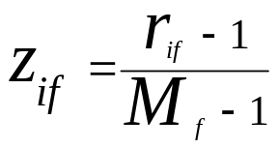
Attributes of Mixed Type
A database may contain all attribute types
  symmetric binary, asymmetric binary, nominal, ordinal, and numeric
One may use a weighted formula to combine their effects
  f is binary or nominal:
    d_{ij}^{(f)} = 0 if x_{if} = x_{jf} , or d_{ij}^{(f)} = 1 if x_{if} ≠ x_{jf}
  f is ordinal
    Compute ranks r_{if} and
    Treat z_{if} as interval-scaled
  f is numeric: use the normalized distance

Slide 9
Major Clustering Approaches
Partitioning approach:
  Construct various partitions and then evaluate them by some criterion,
  Typical methods: k-means, k-medoids
Hierarchical approach:
  Create a hierarchical decomposition of the set of data (or objects) using some criterion
  Typical methods: Diana, Agnes, BIRCH, CAMELEON
Density-based approach:
Grid-based approach:
Graph-based approach

Slide 10
Agenda
Cluster Analysis: Basic Concepts
Partitioning Methods
Hierarchical Methods
Evaluation of Clustering
Summary

Slide 11

Partitioning Algorithms: Basic Concept
Partitioning method: Partitioning a database D of n objects into a set of k clusters, such that the sum of squared distances is minimized (where c_{i} is the centroid or medoid of cluster C_{i})
objective function or cost function?

Slide 12
About the centroid and distance
Centroid: Mean value of the objects in a cluster
  X (1,1), Y(1.5,2), Z(3,4)
  C = ((1+1.5+3)/3, (1+2+4)/3) = (1.8,2.3)
Distance: Euclidean distance
  DX-C = [(1-1.8)² + (1-2.3)²]^{1/2} = 1.5
  DY-C = 0.4
  DZ-C = 2.1

Slide 13
Partitioning Algorithms: Basic Concept
Given k, find a partition of k clusters that minimize E
  k-means

Slide 14
The K-Means Clustering Method
Given k, the k-means algorithm is implemented in four steps:
  Arbitrarily partition objects into k nonempty subsets
  Compute seed points as the centroids of the clusters of the current partitioning
  Assign each object to the cluster with the nearest seed point
  Go back to Step 2, stop when the assignment does not change

Slide 15





An Example of K-Means Clustering
K=2
Arbitrarily partition objects into k groups
Calculate the cluster centroids
The initial data set
Reassign objects
Loop if needed
Partition objects into k nonempty subsets
Repeat
  Compute centroid (i.e., mean point) for each partition
  Assign each object to the cluster of its nearest centroid
Until no change
Update the cluster centroids

Slide 16
Comments on the K-Means Method
Strength: Efficient: O(tkn), where n is # of objects, k is # of clusters, and t is # of iterations. Normally, k, t << n.

Slide 17
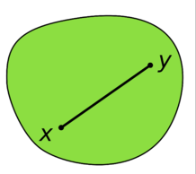
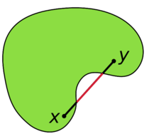
Weakness
Applicable only to objects in a continuous n-dimensional space
Need to specify k, the number of clusters, in advance
Sensitive to noisy data and outliers
Not suitable to discover clusters with non-convex shapes

Slide 18
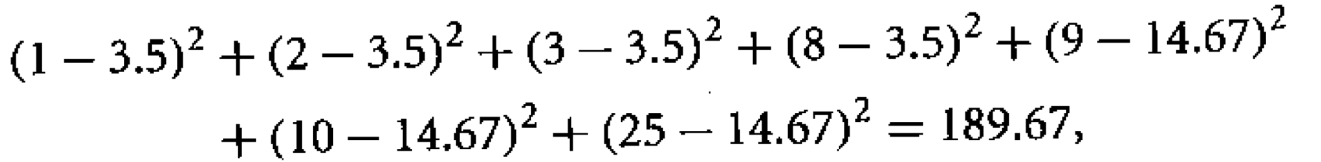
The k-means algorithm is sensitive to outliers !
  Since an object with an extremely large value may substantially distort the distribution of the data
  1,2,3,8,9,10,25
    K-means: k=2,
    {1,2,3} {8,9,10,25} or {1,2,3,8}{9,10,25}

Slide 19
K-Modes Method
Handling categorical data: k-modes
  Replacing means of clusters with modes
  Using categorical dissimilarity measures to do the object assignment
  Using a frequency-based method to update modes of clusters

Slide 20
K-Medoids Method
K-Medoids: Instead of taking the mean value of the object in a cluster as a reference point, medoids can be used, which is the most centrally located object in a cluster
10
10
9
9
8
8
7
7
6
6
5
5
4
4
3
3
2
2
1
1
0
0
1
2
3
4
5
6
7
8
9
10
0
0
1
2
3
4
5
6
7
8
9
10

Slide 21
The K-Medoid Clustering Method
K-Medoids Clustering: Find representative objects (medoids) in clusters
  PAM (Partitioning Around Medoids, Kaufmann & Rousseeuw 1987)
    Starts from an initial set of medoids and iteratively replaces one of the medoids by one of the non-medoids if it improves the total distance of the resulting clustering
  PAM works effectively for small data sets, but does not scale well for large data sets (due to the computational complexity)

Slide 22
Agenda
Cluster Analysis: Basic Concepts
Partitioning Methods
Hierarchical Methods
Evaluation of Clustering
Summary

Slide 23
Hierarchical Clustering
Use distance matrix as clustering criteria. This method does not require the number of clusters k as an input, but needs a termination condition
Step 0
Step 1
Step 2
Step 3
Step 4
agglomerative
(AGNES)
a
a b
b
a b c d e
c
c d e
d
d e
e
divisive
(DIANA)
Step 4
Step 3
Step 2
Step 1
Step 0

Slide 24
Dendrogram
  Decompose data objects into a several levels of nested partitioning (tree of clusters), called a dendrogram
  A clustering of the data objects is obtained by cutting the dendrogram at the desired level, then each connected component forms a cluster

Slide 25

AGNES (Agglomerative Nesting)
Introduced in Kaufmann and Rousseeuw (1990)
Merge nodes that have the largest similarity
Eventually all nodes belong to the same cluster

Slide 26
DIANA (Divisive Analysis)
Introduced in Kaufmann and Rousseeuw (1990)
Inverse order of AGNES
Eventually each node forms a cluster on its own

Slide 27
Distance (Dissimilarity) between Clusters
X
X
Single link: smallest distance between an element in one cluster and an element in the other, i.e., dist(K_{i}, K_{j}) = min(t_{ip}, t_{jq})
Complete link: largest distance between an element in one cluster and an element in the other, i.e., dist(K_{i}, K_{j}) = max(t_{ip}, t_{jq})
Average link: avg distance between an element in one cluster and an element in the other, i.e., dist(K_{i}, K_{j}) = avg(t_{ip}, t_{jq})
Centroid: distance between the centroids of two clusters, i.e., dist(K_{i}, K_{j}) = dist(C_{i}, C_{j})
Medoid: distance between the medoids of two clusters, i.e., dist(K_{i}, K_{j}) = dist(M_{i}, M_{j})
Ward link: difference between the two error values

Slide 28
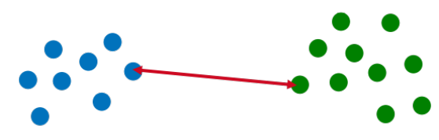
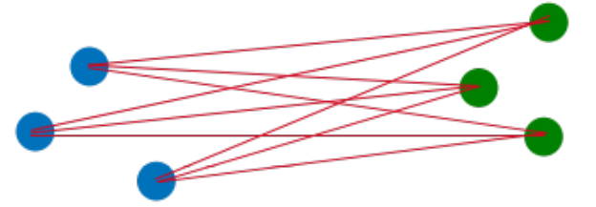
Distance (Dissimilarity) between Clusters

Slide 29
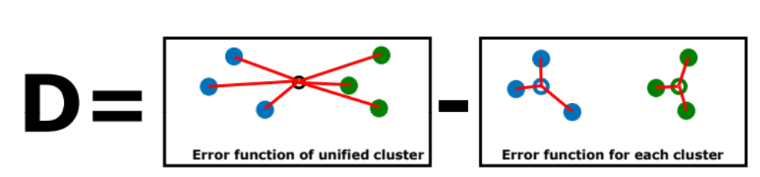
Ward link

Slide 30
Weakness of Hierarchical Clustering
Major weakness of hierarchical clustering methods
  Can never undo what was done previously
  Do not scale well: time complexity of at least O(n²), where n is the number of total objects

Slide 31
Agenda
Cluster Analysis: Basic Concepts
Partitioning Methods
Hierarchical Methods
Evaluation of Clustering
Summary

Slide 32

Determine the Number of Clusters
Empirical method
  # of clusters ≈ for a dataset of n points
Elbow method
  Use the turning point in the curve of sum of within cluster variance w.r.t the # of clusters
Cross validation method
  Divide a given data set into m parts
  Use m – 1 parts to obtain a clustering model
  Use the remaining part to test the quality of the clustering
    E.g., For each point in the test set, find the closest centroid, and use the sum of squared distance between all points in the test set and their closest centroids to measure how well the model fits the test set
  For any k > 0, repeat it m times, compare the overall quality measure w.r.t. different k’s, and find # of clusters that fits the data the best

Slide 33
Evaluation Criteria
Clustering is good if it satisfies the following 4 essential criteria
  Cluster homogeneity: the purer, the better
  Cluster completeness:
  Rag bag: putting a heterogeneous object into a pure cluster should be penalized more than putting it into a rag bag (i.e., “miscellaneous” or “other” category)
  Small cluster preservation: splitting a small category into pieces is more harmful than splitting a large category into pieces

Slide 34
Measuring Clustering Quality
Two methods: extrinsic vs. intrinsic
Extrinsic: supervised, i.e., the ground truth is available
  Compare a clustering against the ground truth (using accuracy)

Slide 35
Intrinsic Methods
Intrinsic: unsupervised, i.e., the ground truth is unavailable
  Evaluate the goodness of a clustering by considering how well the clusters are separated, and how compact the clusters are

Slide 36
Summary
Cluster analysis groups objects based on their similarity and has wide applications
Measure of similarity can be computed for various types of data
Clustering algorithms can be categorized into partitioning methods, hierarchical methods, density-based methods, and grid-based methods
K-means and K-medoids algorithms are popular partitioning-based clustering algorithms
Agglomerative and divisive are two ways for hierarchical clustering.
Quality of clustering results can be evaluated in various ways

