Slide 1
Pattern Mining
Professor Xi (Sunshine) Niu
University of North Carolina at Charlotte

Slide 2
What Is Frequent Pattern Analysis?
Frequent pattern: a pattern (a set of items, subsequences, substructures, etc.) that occurs frequently in a data set
Applications
  Basket data analysis, cross-marketing, catalog design, sale campaign analysis, Web log (click stream) analysis, and DNA sequence analysis.
Notes:
Motivation: Finding inherent regularities in data
What products were often purchased together?— Beer and diapers?!
What are the subsequent purchases after buying a PC?
What kinds of DNA are sensitive to this new drug?
Can we automatically classify web documents?

Slide 3
Basic Concepts: Support
Tid | Items bought
10 | Beer, Nuts, Diaper
20 | Beer, Coffee, Diaper
30 | Beer, Diaper, Eggs
40 | Nuts, Eggs, Milk
50 | Nuts, Coffee, Diaper, Eggs, Milk
itemset: A set of one or more items
k-itemset X = {x₁, …, x_{k}}
(absolute) support, or, support count of X: Frequency or occurrence of an itemset X
(relative) support, s, is the fraction of transactions that contains X (i.e., the probability that a transaction contains X)
support (X=>Y) = P(A and B)
support (Beer => Coffee) = ?

Slide 4
Basic Concepts: Confidence
Tid | Items bought
10 | Beer, Nuts, Diaper
20 | Beer, Coffee, Diaper
30 | Beer, Diaper, Eggs
40 | Nuts, Eggs, Milk
50 | Nuts, Coffee, Diaper, Eggs, Milk
confidence (X=>Y) = P (Y|X)
confidence (Beer => Diaper) = ?

Slide 5
Basic Concepts: Association Rules
Tid
Items bought
10
Beer, Nuts, Diaper
Find all the rules X=>Y with minimum support and minimum confidence
Let minsup = 50%, minconf = 80%
Association rules:
  Beer → Diaper (?)
  Diaper → Beer (?)
We call X=>Y is a frequent pattern
20
Beer, Coffee, Diaper
30
Beer, Diaper, Eggs
40
Nuts, Eggs, Milk
50
Nuts, Coffee, Diaper, Eggs, Milk

Slide 6
Scalable Frequent Itemset Mining Methods
Apriori: A Candidate Generation and Test Approach
Improving the Efficiency of Apriori
  FPGrowth: A Frequent Pattern-Growth Approach
  ECLAT: Frequent Pattern Mining with Vertical Data Format

Slide 7
The Downward Closure Property and Scalable Mining Methods
The downward closure property of frequent patterns
  Any subset of a frequent itemset must be frequent
  If {beer, diaper, nuts} is frequent, so is {beer, diaper}
  i.e., every transaction having {beer, diaper, nuts} also contains {beer, diaper}

Slide 8
Apriori: A Candidate Generation & Test Approach
Apriori pruning principle: If there is any itemset which is infrequent, its superset should not be generated/tested!
Method:
  Initially, scan DB once to get frequent 1-itemset
  Generate length (k+1) candidate itemsets from length k frequent itemsets
  Test the candidates against DB
  Terminate when no frequent or candidate set can be generated

Slide 9
The Apriori Algorithm—An Example
Sup_{min} = 2
Itemset | sup
{A} | 2
{B} | 3
{C} | 3
{D} | 1
{E} | 3
Database TDB
Itemset | sup
{A} | 2
{B} | 3
{C} | 3
{E} | 3
L₁
Tid | Items
10 | A, C, D
20 | B, C, E
30 | A, B, C, E
40 | B, E
C₁
1st scan
C₂
Itemset | sup
{A, B} | 1
{A, C} | 2
{A, E} | 1
{B, C} | 2
{B, E} | 3
{C, E} | 2
C₂
L₂
Itemset
{A, B}
{A, C}
{A, E}
{B, C}
{B, E}
{C, E}
Itemset | sup
{A, C} | 2
{B, C} | 2
{B, E} | 3
{C, E} | 2
2nd scan
self join
C₃
Itemset
{B, C, E}
3rd scan
L₃
Itemset | sup
{B, C, E} | 2

Slide 10
The Apriori Algorithm (Pseudo-Code)
C_{k}: Candidate itemset of size k
L_{k} : frequent itemset of size k
L₁ = {frequent items};
for (k = 1; L_{k} !=∅; k++) do begin
C_{k+1} = candidates generated from L_{k} through self-joining and pruning;
for each transaction t in C_{k+1} do
  increment the count of L_{k+1} if its sup is greater than
  min_support
  L_{k+1} = candidates in C_{k+1} with min_support
end
return ∪_{k} L_{k}

Slide 11
Implementation of Apriori
How to generate candidates?
  Step 1: self-joining L_{k}
  Step 2: pruning
Example of Candidate-generation
  L₃={abc, abd, acd, ace, bcd}
  Self-joining: L₃*L₃
    abcd from abc and abd
    acde from acd and ace
  Pruning:
    acde is removed because ade is not in L₃
  C₄ = {abcd}

Slide 12
Further Improvement of the Apriori Method
Major computational challenges
  Multiple scans of transaction database
  Huge number of candidates
  Tedious workload of support counting for candidates
Improving Apriori: general ideas
  Reduce passes of transaction database scans
  Shrink number of candidates
  Facilitate support counting of candidates

Slide 13
Scalable Frequent Itemset Mining Methods
Apriori: A Candidate Generation-and-Test Approach
Improving the Efficiency of Apriori
  FPGrowth: A Frequent Pattern-Growth Approach
  ECLAT: Frequent Pattern Mining with Vertical Data Format

Slide 14
Pattern-Growth Approach: Mining Frequent Patterns Without Candidate Generation
Bottlenecks of the Apriori approach
  Breadth-first (i.e., level-wise) search
  Candidate generation and test
    Often generates a huge number of candidates
The FPGrowth Approach
  Depth-first search
  Avoid explicit candidate generation
Major philosophy: Grow long patterns from short ones using local frequent items only
  “abc” is a frequent pattern
  Get all transactions having “abc”, i.e., project DB on abc: DB|abc
  “d” is a local frequent item in DB|abc → abcd is a frequent pattern

Slide 15
Construct FP-tree from a Transaction Database
TID Items bought (ordered) frequent items
100 {f, a, c, d, g, i, m, p} {f, c, a, m, p}
200 {a, b, c, f, l, m, o} {f, c, a, b, m}
300 {b, f, h, j, o, w} {f, b}
400 {b, c, k, s, p} {c, b, p}
500 {a, f, c, e, l, p, m, n} {f, c, a, m, p}
min_support = 3
{}
Header Table
Item frequency head
f 4
c 4
a 3
b 3
m 3
p 3
Scan DB once, find frequent 1-itemset (single item pattern)
Sort frequent items in frequency descending order, f-list
Scan DB again, construct FP-tree
f:4
c:1
c:3
b:1
b:1
a:3
p:1
F-list = f-c-a-b-m-p
m:2
b:1
p:2
m:1

Slide 16
Partition Patterns and Databases
Frequent patterns can be partitioned into subsets according to f-list
  F-list = f-c-a-b-m-p
  Patterns containing p
  Patterns having m but no p
  …
  Patterns having c but no a nor b, m, p
  Pattern f
Completeness and non-redundency

Slide 17
Find Patterns Having P From P-conditional Database
Starting at the frequent item header table in the FP-tree
Traverse the FP-tree by following the link of each frequent item
Accumulate all of transformed prefix paths of item to form the item’s conditional pattern base
{}
Header Table
Item frequency head
f 4
c 4
a 3
b 3
m 3
p 3
f:4
c:1
Conditional pattern bases
item cond. pattern base
c f:3
a fc:3
b fca:1, f:1, c:1
m fca:2, fcab:1
p fcam:2, cb:1
c:3
b:1
b:1
a:3
p:1
m:2
b:1
p:2
m:1

Slide 18
From Conditional Pattern-bases to Conditional FP-trees
For each pattern-base
  Accumulate the count for each item in the base
  Construct the FP-tree for the frequent items of the pattern base
m-conditional pattern base:
  fca:2, fcab:1
{}
Header Table
Item frequency head
f 4
c 4
a 3
b 3
m 3
p 3
f:4
c:1
{}
All frequent patterns relate to m
m,
fm, cm, am,
fcm, fam, cam,
fcam
c:3
b:1
b:1

f:3
a:3
p:1

m:2
b:1
c:3
p:2
m:1
a:3
m-conditional FP-tree

Slide 19
The Frequent Pattern Growth Mining Method
Idea: Frequent pattern growth
  Recursively grow frequent patterns by pattern and database partition
Method
  For each frequent item, construct its conditional pattern-base, and then its conditional FP-tree
  Repeat the process on each newly created conditional FP-tree

Slide 20
Benefits of the FP-tree Structure
Completeness
  Preserve complete information for frequent pattern mining
  Never break a long pattern of any transaction
Compactness
  Reduce irrelevant info—infrequent items are gone
  Items in frequency descending order: the more frequently occurring, the more likely to be shared
  Never be larger than the original database (not count node-links and the count field)

Slide 21

Performance of FPGrowth in Large Datasets
Data set T25I20D10K
FP-Growth vs. Apriori

Slide 22
Further Improvements of Mining Methods
AFOPT (Liu, et al. @ KDD’03)
  A “push-right” method for mining condensed frequent pattern (CFP) tree
Carpenter (Pan, et al. @ KDD’03)
  Mine data sets with small rows but numerous columns
  Construct a row-enumeration tree for efficient mining
FPgrowth+ (Grahne and Zhu, FIMI’03)
  Efficiently Using Prefix-Trees in Mining Frequent Itemsets, Proc. ICDM'03 Int. Workshop on Frequent Itemset Mining Implementations (FIMI'03), Melbourne, FL, Nov. 2003
TD-Close (Liu, et al, SDM’06)

Slide 23
Scalable Frequent Itemset Mining Methods
Apriori: A Candidate Generation-and-Test Approach
Improving the Efficiency of Apriori
FPGrowth: A Frequent Pattern-Growth Approach
ECLAT: Frequent Pattern Mining with Vertical Data Format

Slide 24
ECLAT: Mining by Exploring Vertical Data Format
Vertical format: t(AB) = {T₁₁, T₂₅, …}
  tid-list: list of trans.-ids containing an itemset

Slide 25
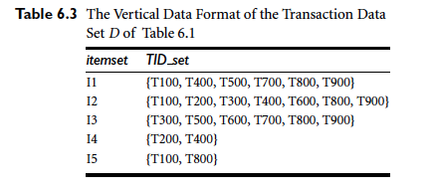

Slide 26
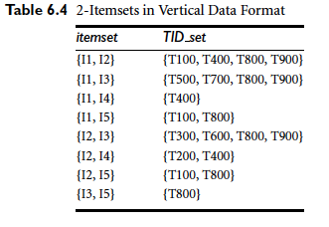

Slide 27
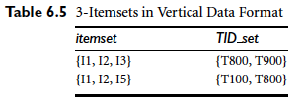

Slide 28
ECLAT: Mining by Exploring Vertical Data Format
Take advantage of the basic idea of Apriori algorithms
No need to scan the database
Not scale up very well

Slide 29
Which Patterns Are Interesting?
Which Patterns Are Interesting?

Slide 30
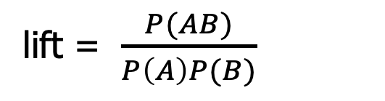


Interestingness Measure: Lift
play basketball ⇒ eat cereal [40%, 66.7%] is misleading
  The overall % of students eating cereal is 75% > 66.7%.
play basketball ⇒ not eat cereal [20%, 33.3%] is more accurate, although with lower support and confidence
Measure of dependent/correlated events: lift
 | Basketball | Not basketball | Sum (row)
Cereal | 2000 | 1750 | 3750
Not cereal | 1000 | 250 | 1250
Sum(col.) | 3000 | 2000 | 5000

Slide 31
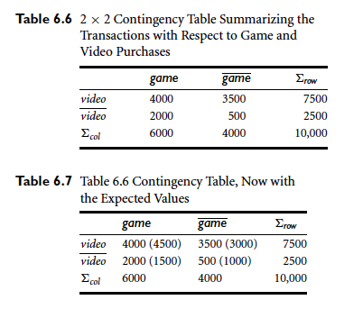
Interestingness Measure: χ²

Slide 32

χ²
χ²(1) = 555.6, p<.01

Slide 33

Are lift and χ² Good Measures of Correlation?
“Buy walnuts ⇒ buy milk [1%, 80%]” is misleading if 85% of customers buy milk
Support and confidence are not good to indicate correlations
Over 20 interestingness measures have been proposed (see Tan, Kumar, Sritastava @KDD’02)
Which are good ones?

Slide 34
Summary
Basic concepts: association rules, support-confidence framework, closed and max-patterns
Scalable frequent pattern mining methods
  Apriori (Candidate generation & test)
  FPgrowth,
  Vertical format approach (ECLAT)
Which patterns are interesting?
  Pattern evaluation methods

