Slide 1
Machine Learning 2
Professor Xi Niu
University of North Carolina at Charlotte
Notes:
ROC curves

Slide 2
Agenda
Some reflections
ROC
Naïve Bayesian Model
KNN

Slide 3
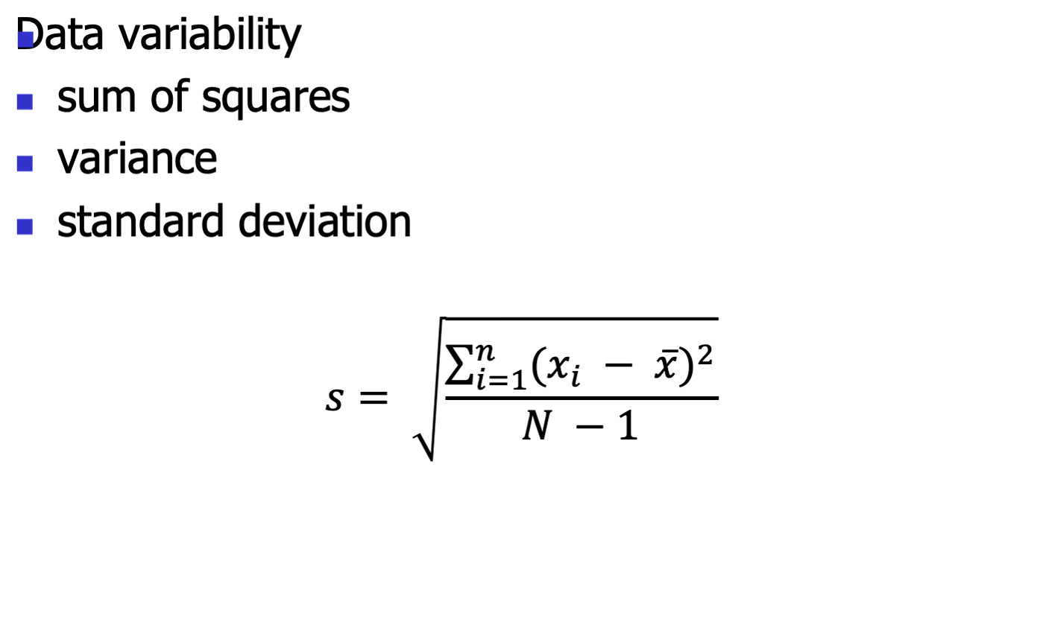
Reflections
Notes:
1. Why N-1 for standard deviation?
2. Euclidian distance vs. cosine distance

Slide 4
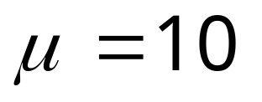

Degrees of Freedom
Population
Sample
11
7
8
8
12
15
?
9
Slide <number>

Slide 5
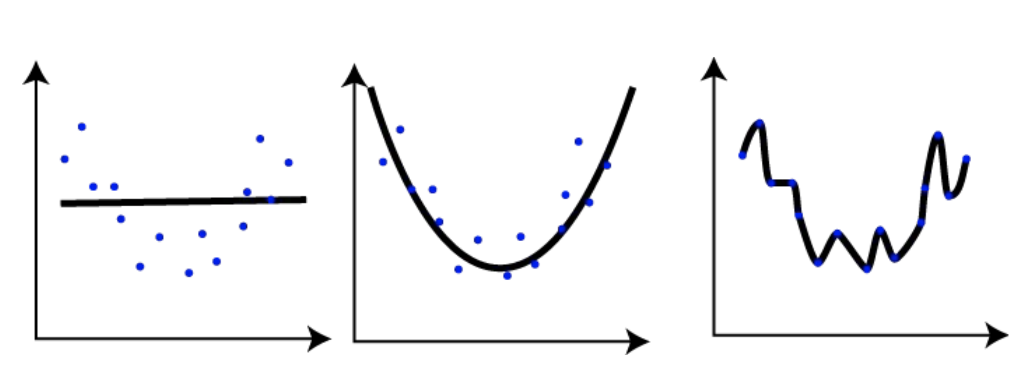
Underfiting and Overfiting

Slide 6
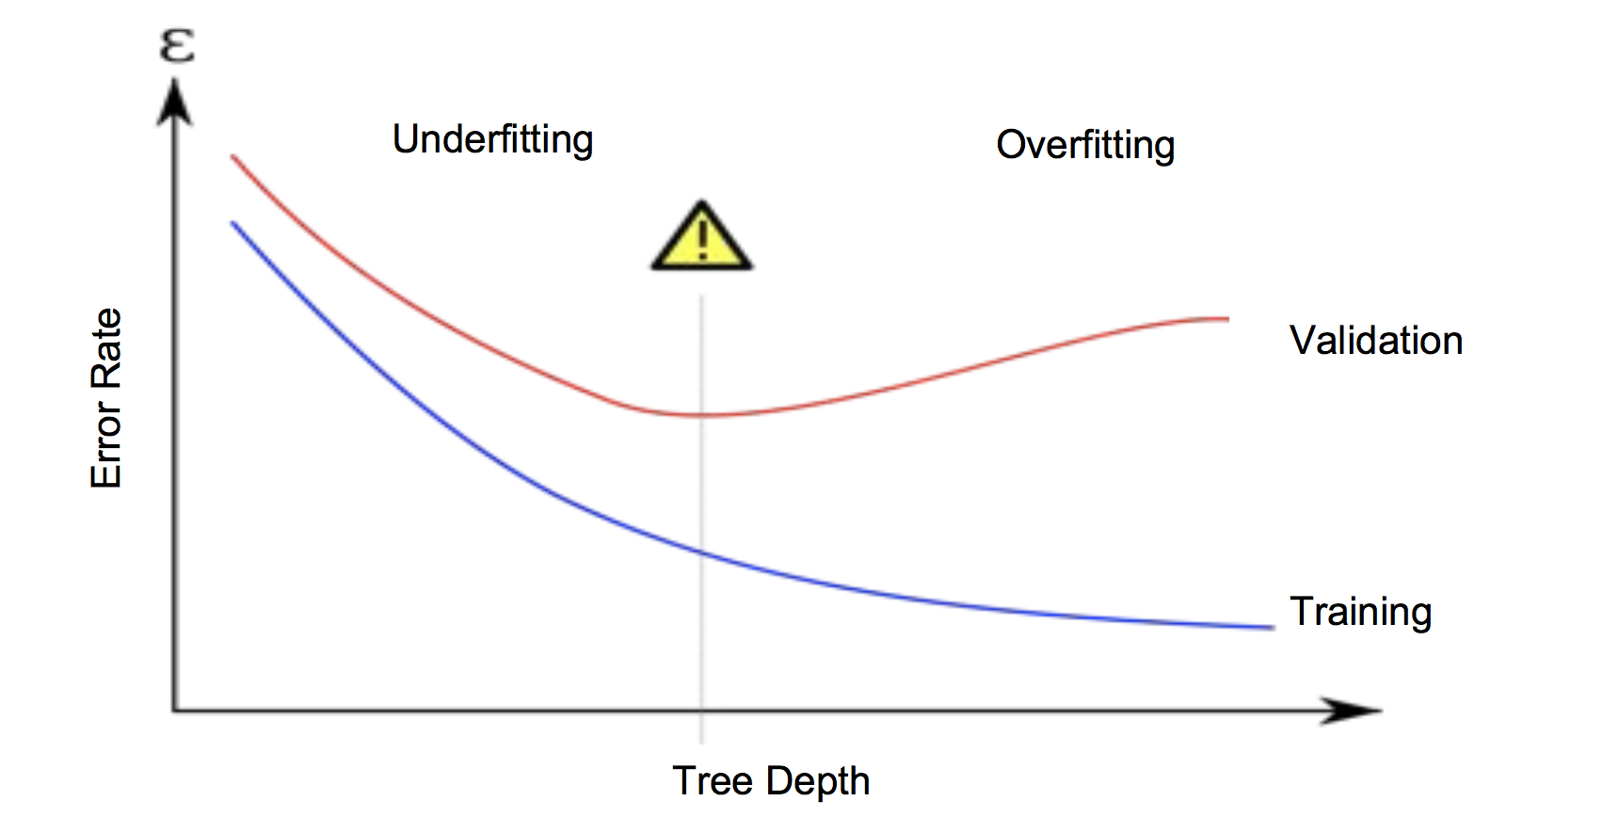
How to Discover Underfiting and Overfiting

Slide 7
Classification: A Mathematical Mapping
Classification:
  predicts categorical class labels
E.g., Personal homepage classification
  x_{i} = (x₁, x₂, x₃, …), y_{i} = +1 or –1
  x₁ : # of a word “homepage”
  x₂ : # of a word “welcome”
Mathematically
  x ∈ X = ℜ^{n}, y ∈ Y = {+1, –1}
  We want a function f: X → Y

Slide 8

Model Selection: ROC Curves
ROC (Receiver Operating Characteristics) curves: for visual comparison of classification models
Originated from signal detection theory
Shows the trade-off between the true positive rate and the false positive rate
The area under the ROC curve is a measure of the accuracy of the model
Rank the test tuples in decreasing order: the one that is most likely to belong to the positive class appears at the top of the list
The closer to the diagonal line (i.e., the closer the area is to 0.5), the less accurate is the model

Slide 9
Model Selection: ROC Curves
Vertical axis represents the true positive rate
Horizontal axis represents the false positive rate
The plot also shows a diagonal line
A model with perfect accuracy will have an area of 1.0

Slide 10
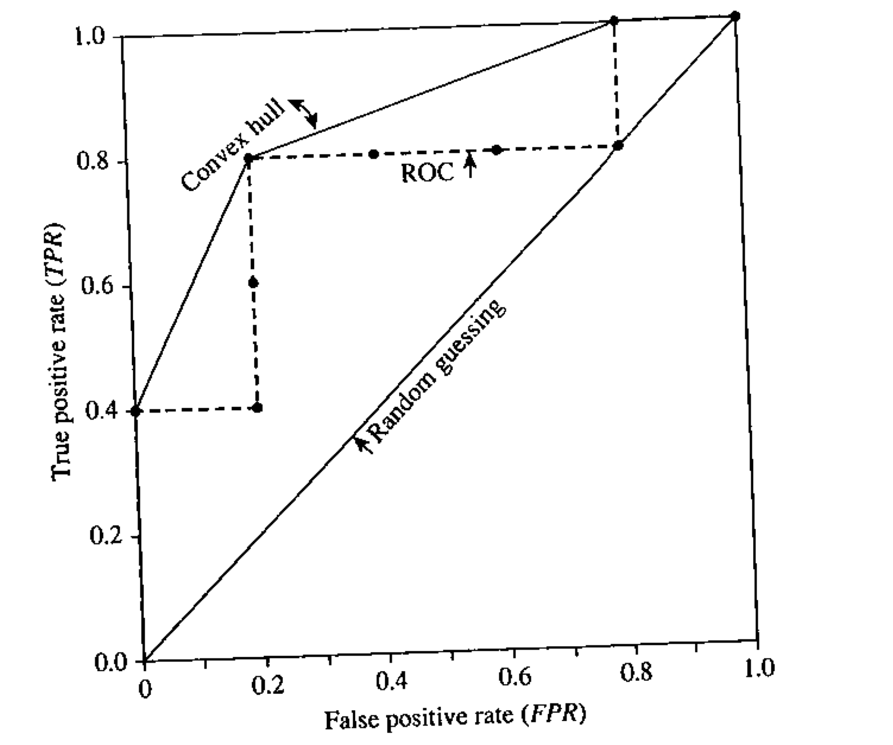
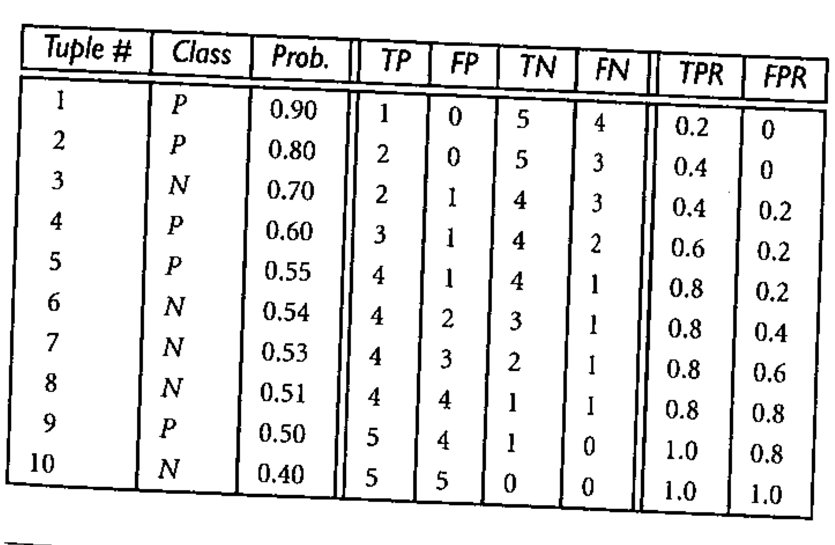
ROC Example

Slide 11
Naïve Bayesian Model

Slide 12
Bayes Theorem: Basics
Let X be a data sample (“evidence”): class label is unknown
Let H be a hypothesis that X belongs to class C
Classification is to determine P(H|X), the posterior probability that the hypothesis holds given the observed data sample X
P(H) (prior probability), the initial probability
  E.g., X will buy computer, regardless of age, income, …
P(X): (evidence) probability that sample data is observed
P(X|H) (likelihood), the probability of observing the sample X, given that the hypothesis holds
  E.g., Given that X will buy computer, the prob. that X is 31..40, medium income

Slide 13
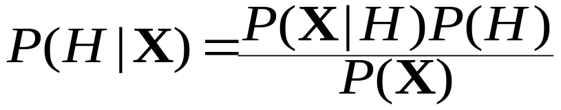
Bayes Theorem
P(X), P(H), P(X|H), and P(H|X) follows the Bayes theorem
Informally, this can be written as
  posterior likelihood = likelihood x prior/evidence
Predicts X belongs to C_{i} iff the probability P(C_{i}|X) is the highest among all the P(C_{k}|X) for all the k classes
Practical difficulty: require initial knowledge of many probabilities, significant computational cost

Slide 14


Towards Naïve Bayesian Classifier
Let D be a training set of tuples and their associated class labels, and each tuple is represented by an n-D attribute vector X = (x₁, x₂, …, x_{n})
Suppose there are m classes C₁, C₂, …, C_{m}.
Classification is to derive the maximum posteriori, i.e., the maximal P(C_{i}|X)
This can be derived from Bayes’ theorem
Since P(X) is constant for all classes, only
  needs to be maximized

Slide 15
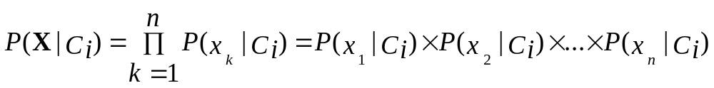
Derivation of Naïve Bayesian Classifier
A simplified assumption: attributes are independent (i.e., no dependence relation between attributes):
This greatly reduces the computation cost: Only counts the class distribution

Slide 16

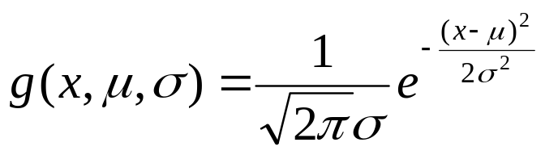
Derivation of Naïve Bayesian Classifier
If A_{k} is categorical, P(x_{k}|C_{i}) is the # of tuples in C_{i} having value x_{k} for A_{k}
If A_{k} is continous-valued, P(x_{k}|C_{i}) is usually computed based on Gaussian distribution (normal distribution) with a mean μ and standard deviation σ, and P(x_{k}|C_{i}) is:
where

Slide 17

Naïve Bayesian Classifier: Training Dataset
Class:
C1:buys_computer = ‘yes’
C2:buys_computer = ‘no’
Data sample
X = (age <=30,
Income = medium,
Student = yes
Credit_rating = Fair)
Data Mining: Concepts and Techniques

Slide 18
Naïve Bayesian Classifier: An Example
P(C_{i}): P(buys_computer = “yes”) = 9/14 = 0.643
P(buys_computer = “no”) = 5/14= 0.357
Compute P(X|C_{i}) for each class
P(age = “<=30” | buys_computer = “yes”) = 2/9 = 0.222
P(age = “<= 30” | buys_computer = “no”) = 3/5 = 0.6
P(income = “medium” | buys_computer = “yes”) = 4/9 = 0.444
P(income = “medium” | buys_computer = “no”) = 2/5 = 0.4
P(student = “yes” | buys_computer = “yes) = 6/9 = 0.667
P(student = “yes” | buys_computer = “no”) = 1/5 = 0.2
P(credit_rating = “fair” | buys_computer = “yes”) = 6/9 = 0.667
P(credit_rating = “fair” | buys_computer = “no”) = 2/5 = 0.4
X = (age <= 30 , income = medium, student = yes, credit_rating = fair)
P(X|C_{i}) : P(X|buys_computer = “yes”) = 0.222 x 0.444 x 0.667 x 0.667 = 0.044
P(X|buys_computer = “no”) = 0.6 x 0.4 x 0.2 x 0.4 = 0.019
P(X|C_{i})*P(C_{i}) : P(X|buys_computer = “yes”) * P(buys_computer = “yes”) = 0.028
P(X|buys_computer = “no”) * P(buys_computer = “no”) = 0.007
Therefore, X belongs to class (“buys_computer = yes”)
Data Mining: Concepts and Techniques

Slide 19
Naïve Bayesian Classifier: Comments
Advantages
  Easy to implement
  Good results obtained in most of the cases
Disadvantages
  Assumption: attributes independence, therefore loss of accuracy
  Practically, dependencies exist among variables
    E.g., age and income
    Dependencies among these cannot be modeled by Naïve Bayesian Classifier
How to deal with these dependencies?
  Bayesian Belief Networks

Slide 20
Example
Naïve Bayesian model on the iris dataset.

Slide 21
Bayesian Classification:
A statistical classifier: performs probabilistic prediction, i.e., predicts class membership probabilities
Foundation: Based on Bayes’ Theorem.
Performance: A simple Bayesian classifier, naïve Bayesian classifier, has comparable performance with decision tree and selected neural network classifiers
Incremental: Each training example can incrementally increase/decrease the probability that a hypothesis is correct — prior knowledge can be combined with observed data
Bayesian methods are computationally intractable

Slide 22
KNN

Slide 23
Lazy Learning
  Lazy learning (e.g., instance-based learning): simply stores training data (or only minor processing) and waits until it is given a test tuple
  Lazy: Less time in training but more time in predicting

Slide 24
Lazy Learner: Instance-Based Methods
Typical approaches
  k-nearest neighbor approach
    Instances represented as points in a n-D space.
  Locally weighted regression
    Constructs local approximation
  Case-based reasoning
    Uses symbolic representations and knowledge-based inference

Slide 25
The k-Nearest Neighbor Algorithm
All instances correspond to points in the n-D space
The nearest neighbor are defined in terms distance, dist(X₁, X₂)
k-NN returns the most common class among the k training examples nearest to x_{q}
_
_
_
.
+
_
+
_
x_{q}
+
_
+

Slide 26
Discussion on the k-NN Algorithm
Distance-weighted nearest neighbor algorithm
  Weight the contribution of each of the k neighbors according to their distance to the query x_{q}
    Give greater weight to closer neighbors
Robust to noisy data by taking consideration of the k-nearest neighbors
Curse of dimensionality: distance between neighbors could be dominated by irrelevant attributes
  To overcome it, axes stretch (PCA) or elimination of the least relevant attributes

Slide 27
Example
KNN on the iris dataset.

Slide 28
Other Methods
Deep Learning (Neural Network)
Bayesian Belief Network
SVM
Genetic Algorithms (GA)
Rough Set Approach
Fuzzy Set Approach

Slide 29
Summary (I)
Classification and prediction are two forms of machine learning that can be used to extract models describing important data classes or to predict future data trends.
k-fold cross-validation is a recommended method for accuracy estimation. Bagging and boosting can be used to increase overall accuracy by learning and combining a series of individual models.

Slide 30
Summary (II)
There have been numerous comparisons of the different classification and prediction methods, and the matter remains a research topic
No single method has been found to be superior over all others for all data sets
Issues such as accuracy, training time, robustness, interpretability, and scalability must be considered and can involve trade-offs, further complicating the quest for an overall superior method

