Slide 1
Machine Learning I
Prof. Xi (Sunshine) Niu
University of North Carolina at Charlotte

Slide 2
Agenda
Introduction to the basic concepts of machine learning
Tree-based machine learning models
  Decision trees
  Random forests
Evaluation Method
Implementation Examples with Python

Slide 3
Classification vs. Prediction
Classification
  predicts categorical class labels (binary, nominal)
  Constructs a model to classify data based on the current set and uses it in classifying future data
Prediction
  models continuous-valued functions, i.e., predicts unknown or missing values
Typical applications
  Credit card approval
  Economic growth next year
  Guess your age using face recognition
  Medical diagnosis
  Fraud detection

Slide 4
Supervised vs. Unsupervised Learning
Supervised learning (classification, prediction)
  Supervision: The training and the test data (observations, measurements, etc.) are accompanied by labels indicating the class of the observations
Unsupervised learning (pattern mining, clustering)
  The class labels of training and test data is unknown
  Given a set of measurements, observations, etc. with the aim of establishing the existence of classes or clusters in the data

Slide 5
Machine Learning—A Three-Step Process
Step I: Model Construction: describing a set of predetermined classes
  Each tuple/sample is assumed to belong to one predefined class
  The set of tuples used for model construction is training set
  The model is represented as classification rules, decision trees, or mathematical formulae

Slide 6
Machine Learning—A Three-Step Process
Step II: Model Evaluation: for classifying testing objects
  Estimate accuracy of the model
    The classified result is compared with the known label of the test set
    Accuracy rate is the percentage of test set samples that are correctly classified by the model
    Test set is independent of training set

Slide 7
Machine Learning—A Three-Step Process
Step III: Model Usage: for classifying future or unknown objects
    If the accuracy is acceptable, use the model to classify future data tuples whose class labels are not known

Slide 8



Process (1): Constructing Model
Classification
Algorithms
Training
Data
Classifier
(Model)
IF rank = ‘professor’
OR years > 6
THEN tenured = ‘yes’

Slide 9

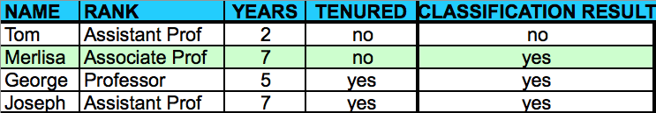
Process (2): Evaluating Model
Classifier
Testing
Data

Slide 10


Process (3): Using the Model in Prediction
Classifier
Unseen Data
(Jeff, Professor, 4)
Tenured?

Slide 11
Classification Models
Decision trees
Random forest
Bayesian models
K-nearest neighbors
Neural network (Deep learning)
SVM
…

Slide 12
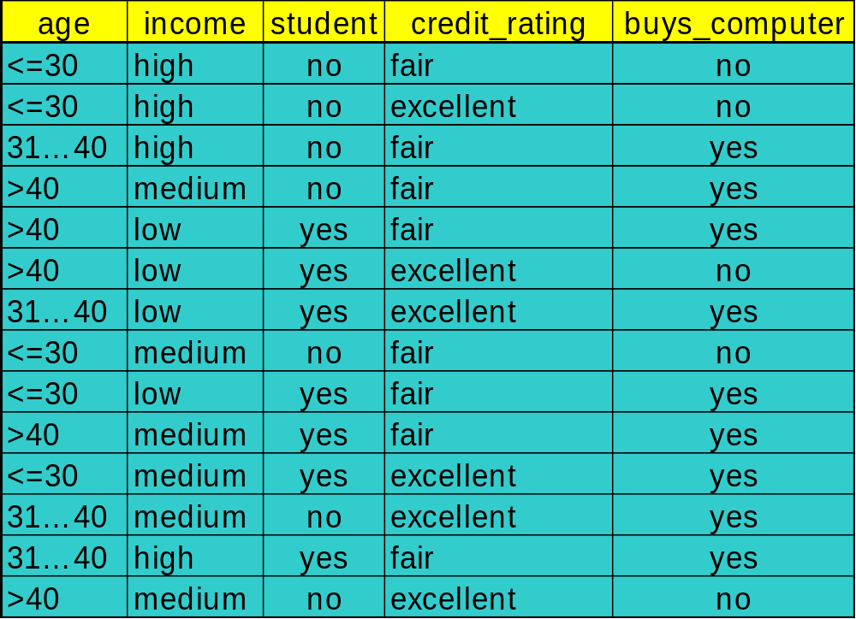
Decision Tree Induction: Training Dataset

Slide 13
A Decision Tree for “buys_computer”
age?
<=30
31..40
>40
student?
yes
credit rating?
no
yes
excellent
fair
no
yes
no
yes

Slide 14

Attribute Selection Measure: Information Gain
Select the attribute with the highest information gain
Expected information (entropy) needed to classify tuples in D:
p_{i} be the probability that an arbitrary tuple in D belongs to class C_{i}, estimated by |C_{i, D}|/|D|

Slide 15
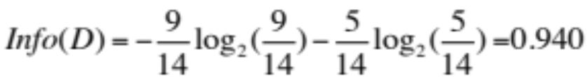
Example
Class P: buys_computer = “yes”
Class N: buys_computer = “no”

Slide 16
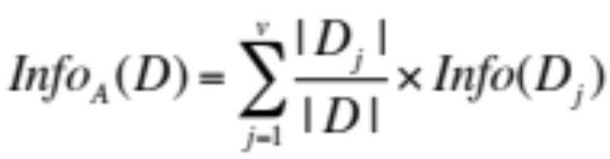
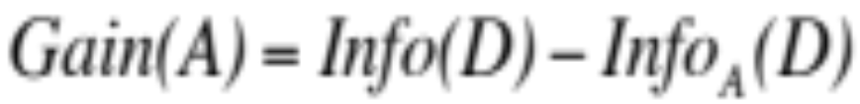
Attribute Selection Measure: Information Gain
Information needed after using an attribute A
Information gained by branching on attribute A
Notes:
Info (D): the expected information needed to classify a given sample
info_{A}(D): expected information needed to classify a given sample after partitioning into subsets by the attribute A

Slide 17
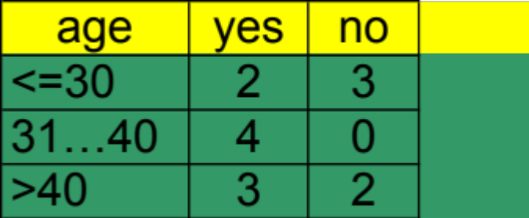
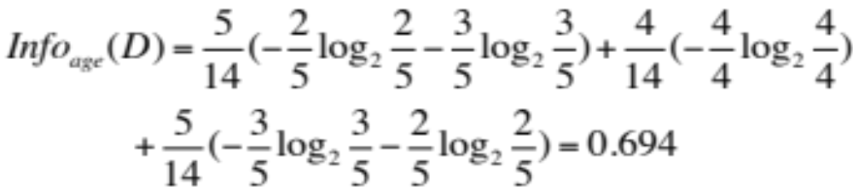
Example

Slide 18

Example
Similarly,

Slide 19

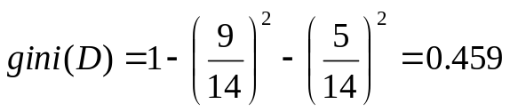


Gini index
If a data set D contains examples from n classes, gini index, gini(D) is defined as
If a data set D is split on A into two subsets D₁ and D₂, the gini index is defined as
Reduction in Impurity:
The attribute provides the smallest gini_{split}(D) (or the largest gain, meaning the largest reduction in impurity) is chosen to split the node

Slide 20
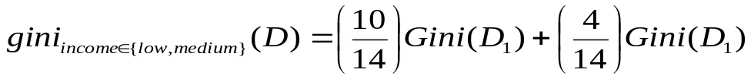
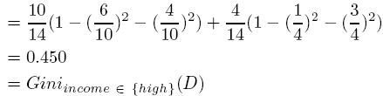
Gini index (cont’d)
All attributes are assumed categorical with two values: binary
Ginin index could be used for both selecting attributes and selecting a split values if the variable is numeric or categorical with more than two values
Suppose the attribute income partitions D into 10 cases in D₁: {low, medium} and 4 cases in D_{2:}{high}
  gini_{{medium,high}} is 0.30

Slide 21
Comparing Attribute Selection Measures
The two measures, in general, return good results but
  Information gain through entropy
    biased towards multivalued attributes
  Gini index (CART):
    biased toward multivalued attributes
    has difficulty when # of categorical values is large
    tends to favor variables that result in equal-sized partitions and purity in both partitions

Slide 22
Algorithm for Decision Tree Induction
Tree is constructed in a top-down recursive manner
At start, all the training examples are at the root
Attributes are categorical
Examples are partitioned recursively based on selected attributes
Test attributes are selected on the basis of statistical measure (e.g., information gain, Gini index)
Conditions for stopping partitioning
  All samples for a given node belong to the same class
  There are no remaining attributes for further partitioning – majority voting is employed for classifying the leaf
Notes:
if continuous-valued attributes, they are discretized in advance

Slide 23
Demo
A decision tree model on the Iris dataset

Slide 24
Classifier Accuracy Measures
Accuracy of a classifier M, acc(M): percentage of test set tuples that are correctly classified by the model M
Error rate (misclassification rate) of M = 1 – acc(M)

Slide 25
Classifier Accuracy Measures
 | pred C₁ | pred C₂
true C₁ | True positive | False negative
true C₂ | False positive | True negative
classes | buy_computer = yes | buy_computer = no | total
buy_computer = yes | 6954 | 46 | 7000
buy_computer = no | 412 | 2588 | 3000
total | 7366 | 2634 | 10000
    Given m classes, CM_{i,j}, an entry in a confusion matrix, indicates # of tuples in class i that are labeled by the classifier as class j
Alternative accuracy measures
  accuracy = (t-pos + t-neg)/total
  sensitivity = t-pos/pos /* true positive recognition rate */
  Specificity = t-neg/neg /* true negative recognition rate */
  In cancer diagnosis, is sensitivity or specificity more important?

Slide 26
Evaluating the Accuracy of a Classifier or Predictor
Holdout method
  Given data is randomly partitioned into two independent sets
    Training set (e.g., 2/3) for model construction
    Test set (e.g., 1/3) for accuracy estimation
  Random sampling: a variation of holdout
    Repeat holdout k times, accuracy = avg. of the accuracies obtained
Cross-validation (k-fold, where k = 10 is most popular)
  Randomly partition the data into k mutually exclusive subsets, each approximately equal size
  At i-th iteration, use D_{i} as test set and others as training set

Slide 27
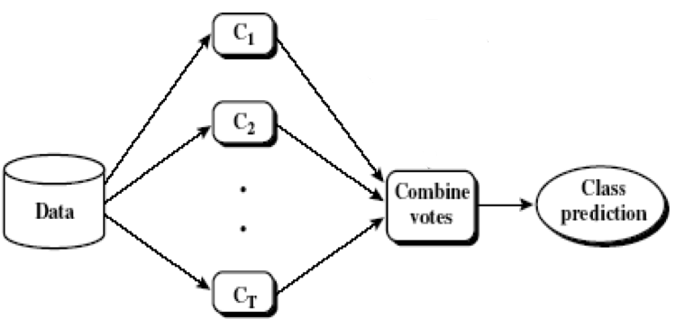
Ensemble Methods: Increasing the Accuracy
Ensemble methods
  Use a combination of models to increase accuracy
  Combine a series of k learned models, M₁, M₂, …, M_{k}, with the aim of creating an improved model M*
Popular ensemble methods
  Bagging: averaging the prediction over a collection of classifiers
  Boosting: weighted vote with a collection of classifiers

Slide 28
Evaluating Beyond Accuracy
Accuracy
  classifier accuracy: predicting class label
Speed
  time to construct the model (training time)
  time to use the model (classification/prediction time)
Robustness: handling noise and missing values
Scalability: efficiency in dealing with a large amount of data
Interpretability (Explainable AI)
  understanding and insight provided by the model
Other measures, e.g., goodness of rules, such as decision tree size or compactness of classification rules

Slide 29
Random Forest

Slide 30
Sampling with Replacement
    Each time an item is sampled (selected), it will be re-added to pool for reselection
    It is equally likely to be selected again and re-added to the pool again

Slide 31
Bootstrap Sampling
  Sample the given dataset (with d tuples) uniformly with replacement.
  Sample d times.

Slide 32
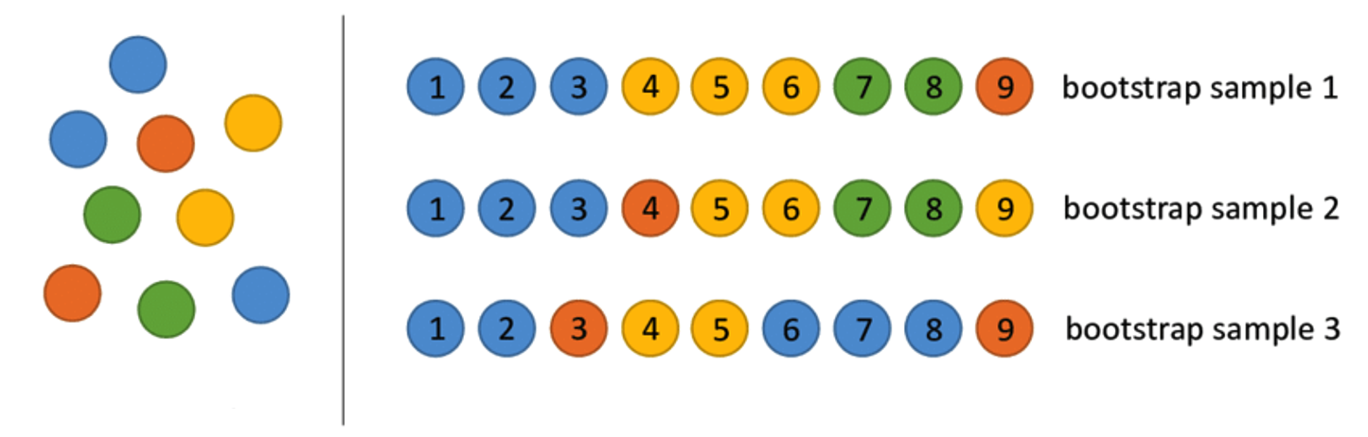
Bootstrap Sampling
original dataset

Slide 33
Bootstrap Sampling
  Works well with small data sets
  Suppose we are given a dataset of d tuples. The dataset is sampled d times, with replacement, resulting in a sample having d sample items.
  Statistically, about 63.2% of the original items (tuples) will end up in the bootstrap sample, and the remaining 36.8% ((1 – 1/d)^{d} ≈ e⁻¹ = 0.368) will be left out.
  For machine learning, we could use each bootstrap sample as a training dataset. For each bootstrap sample, the (items) tuples that did not make it into the bootstrap sample could be used as the test set.

Slide 34
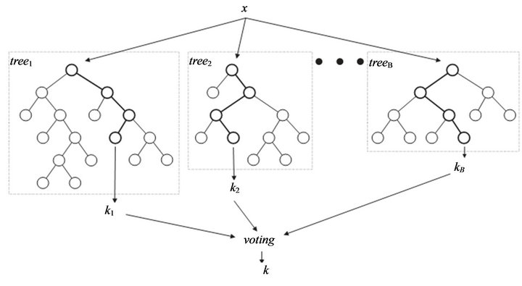
Random Forest
Random forest grows many decision trees.

Slide 35
Random Forest
Each tree is grown:
  On a bootstrap sample
  Binary split at each level (using Gini Index)
  If there are M input variables, a number m<<M is specified such that at each node, m variables are selected at random out of the M, and the best split on these m variables is used to split the node. The value of m is held constant during the forest growing.
  Each tree is grown to the largest extent possible. There is no pruning.

Slide 36
OOB in Random Forest
OOB
  OOB (out-of-bag) data (about 36.8% (1/3) of cases are left out for each bootstrap sample)
OOB Error Estimate
  Put each case left out during the construction of the k^{th} tree down the k^{th} tree to get a classification. In this way, a test set classification is obtained for each case in about 1/3 of the trees. The proportion of times that the case j is not equal to the true class averaged over all cases is the OOB error estimate. This has proven to be unbiased in many tests.
OOB Variable Importance Estimate
  Every time a split of a node is made on variable v, the Gini impurity criterion for the two children nodes is less than the parent node. Adding up the Gini decreases for each individual variable over all trees in the forest gives a variable importance.

Slide 37
Demo
Several random forest models on the iris dataset.

Slide 38
Features of Random Forest
It makes uses the idea of randomization and repetition.
It usually has a good accuracy level.
It runs efficiently on large databases.
It can handle thousands of input variables without variable deletion.
It gives estimates of what variables are important in the classification.

Slide 39
Supervised vs. Unsupervised Learning
Supervised learning (classification, prediction)
  Supervision: The training and the test data (observations, measurements, etc.) are accompanied by labels indicating the class of the observations
Unsupervised learning (pattern mining, clustering)
  The class labels of training and test data is unknown
  Given a set of measurements, observations, etc. with the aim of establishing the existence of classes or clusters in the data

