Slide 1
tAROT READINGS
BY EVI NIKOLAIDOU

Slide 2
PRESENTATION OVERVIEW
About this Project
Microservice Architecture
Project Tracking
Risk Assessment
Deployment
Demonstration
Future Updates
Wrap Up

Slide 3
About this Project
PROJECT BRIEF
“At its core you are creating an application that generates “Objects” upon a set of predefined rules. These “Objects” can be from whatever domain you wish.”
MY SOLUTION
“I created an app which randomly choose a crystal from a list and a randomly choose a card from the Tarot Deck. Therefore, depending on the crystal you get the the meaning of the card or the reverse meaning of the card.”

Slide 4
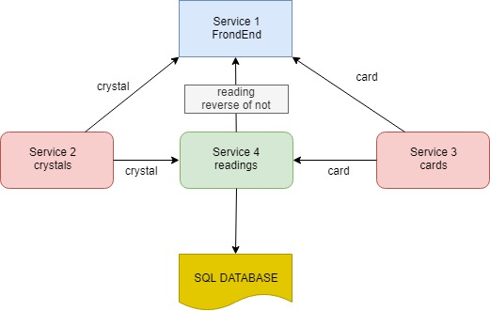
Microservice Architecture

Slide 5
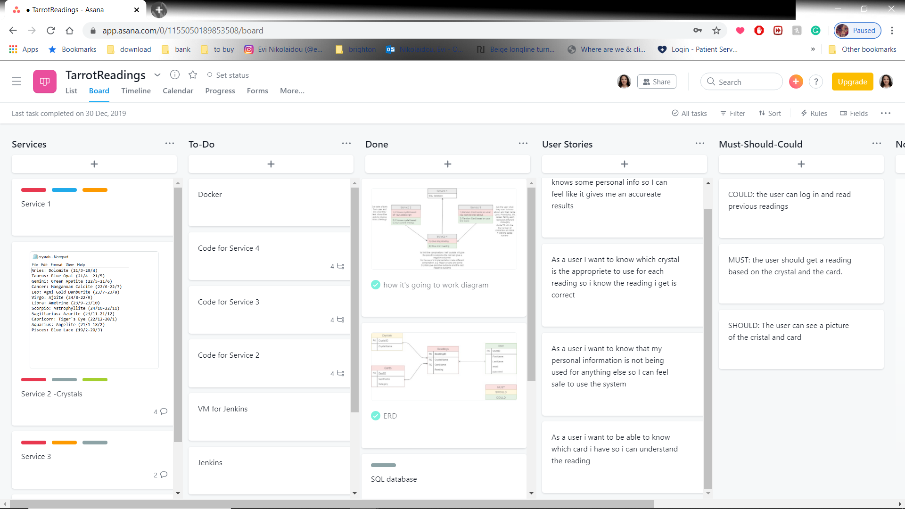
Project Tracking

Slide 6
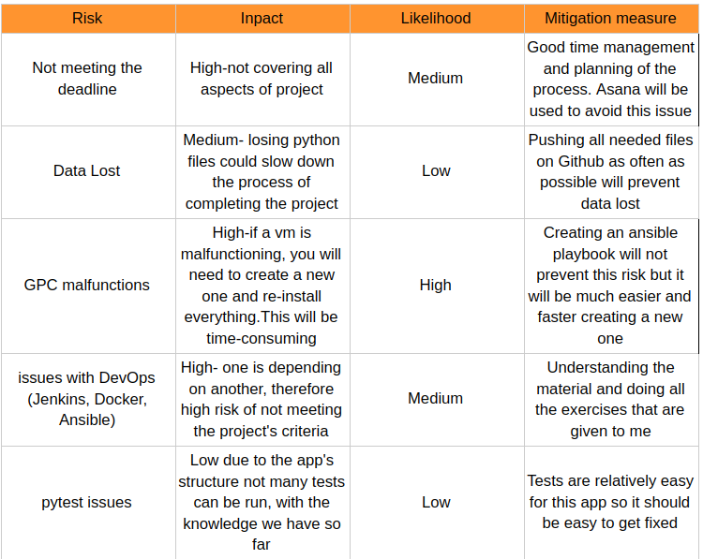
Risk Assessment

Slide 7
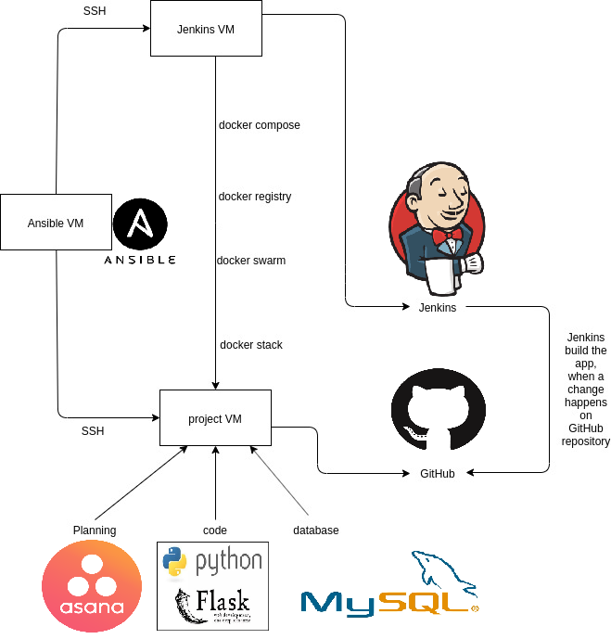
Deployment

Slide 8
Future Updates
Add all 78 cards of the tarrot deck (currently only 22 cards)
Debug Jenkins
Automate testing
Create all the tables of the EDR

Slide 9
Wrap Up
About this Project
Microservice Architecture
Project Tracking
Risk Assessment
Deployment
Demonstration
Future Updates
Wrap Up

