Slide 1
tAROT READINGS
BY EVI NIKOLAIDOU

Slide 2
PRESENTATION OVERVIEW
About this Project
Microservice Architecture
ERD
Project Tracking
Risk Assessment
Deployment
Demonstration
Future Updates
Wrap Up

Slide 3
About this Project
PROJECT BRIEF
“At its core you are creating an application that generates “Objects” upon a set of predefined rules. These “Objects” can be from whatever domain you wish.”
MY SOLUTION
“I created an app which randomly choose a crystal from a list and a randomly choose a card from the Tarot Deck. Therefore, depending on the crystal you get the the meaning of the card or the reverse meaning of the card.”

Slide 4
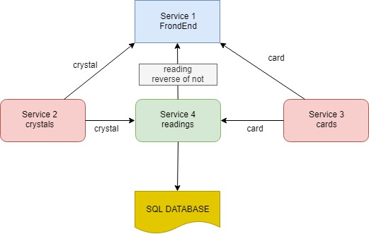
Microservice Architecture

Slide 5
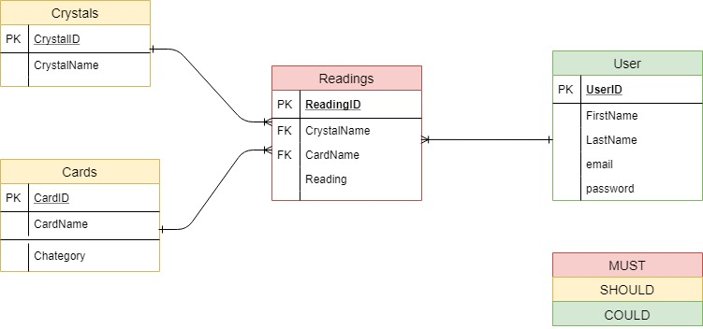
ERD

Slide 6
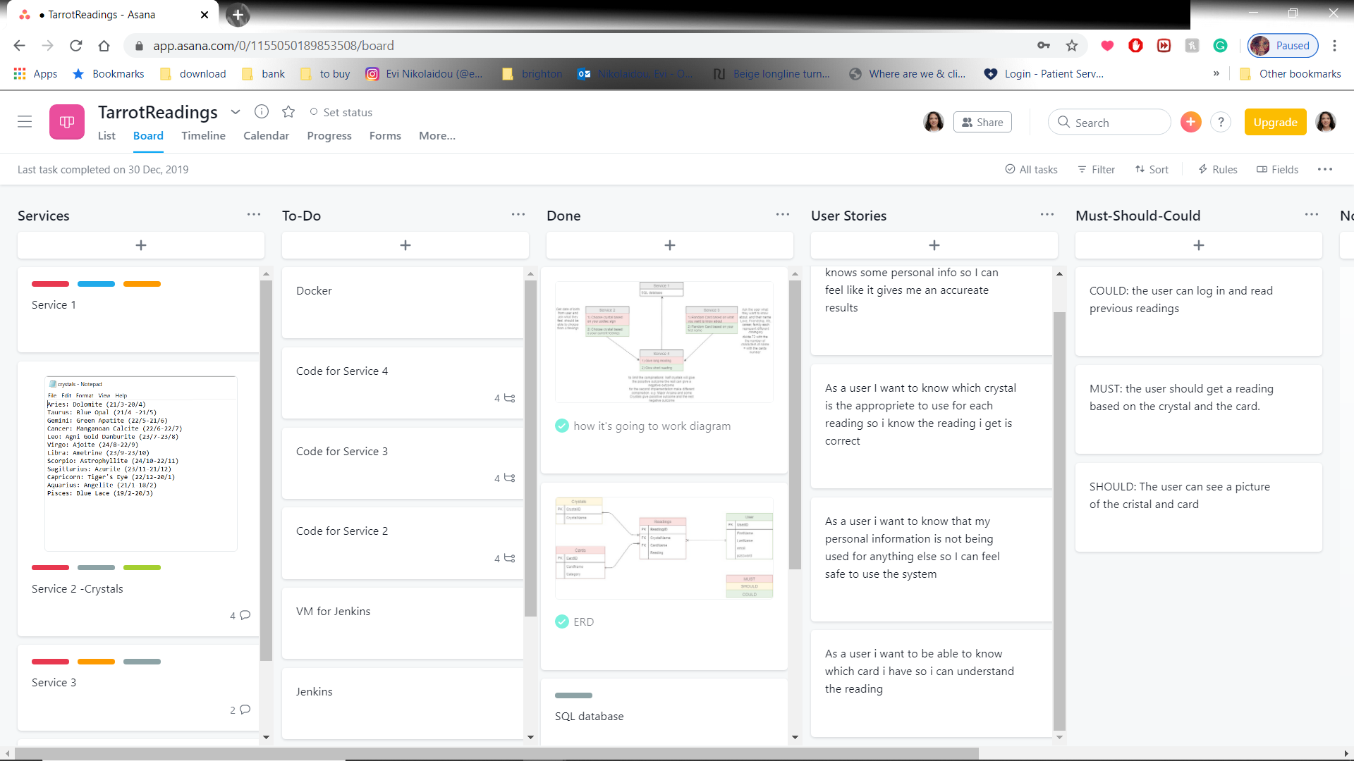
Project Tracking

Slide 7
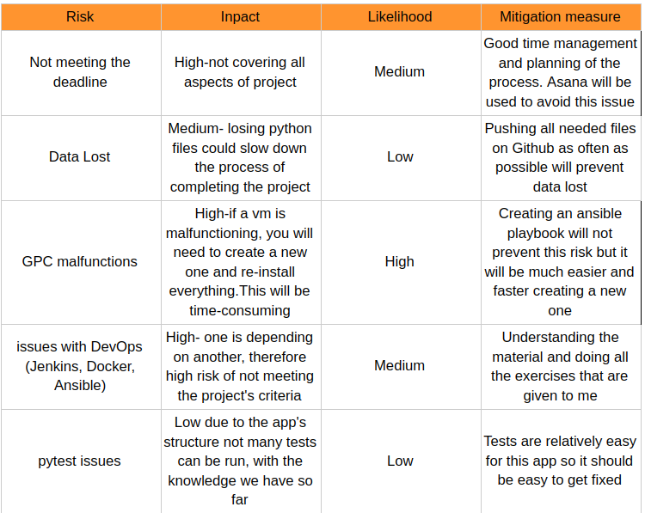
Risk Assessment

Slide 8
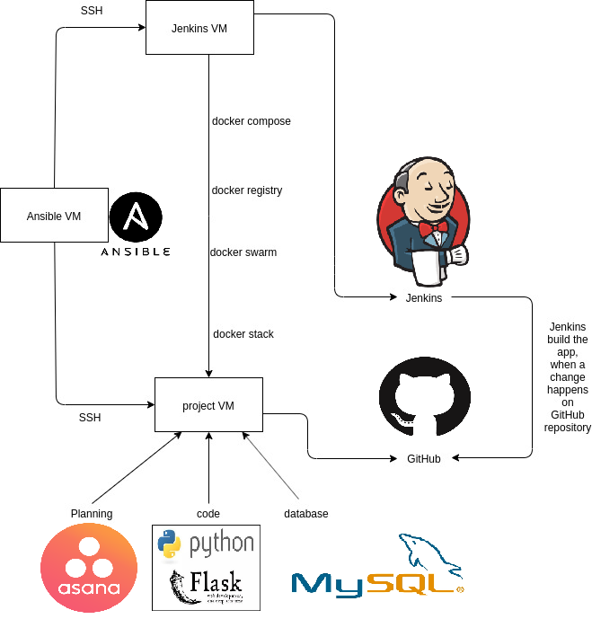
Deployment

Slide 9
Future Updates
Add all 78 cards of the tarot deck (currently only 22 cards)
Debug Jenkins
Automate testing
Create all the tables of the EDR

Slide 10
Wrap Up
About this Project
Microservice Architecture
Project Tracking
Risk Assessment
Deployment
Demonstration
Future Updates
Wrap Up

