Slide 1
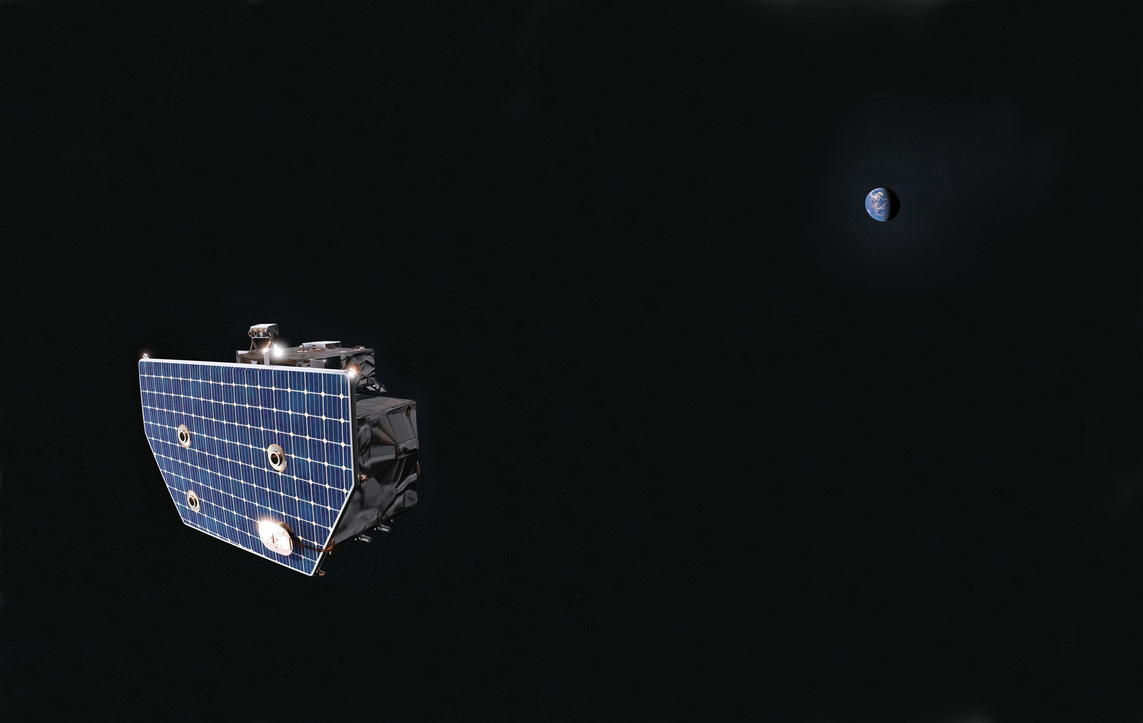
Preliminary Optically Thin
Storm Retrievals
Science Team Meeting
Evan Widloski
2026

Slide 2
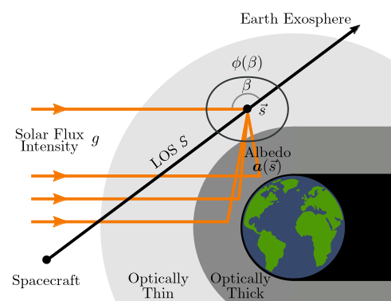
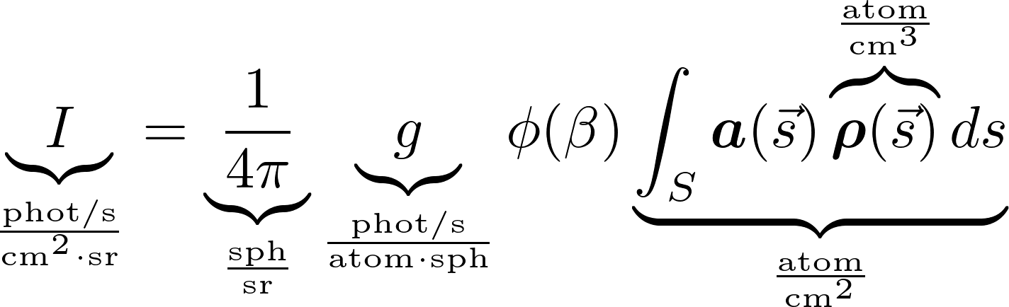
Optically Thin Emission Model
Exospheric H scatters solar Lyman-α photons
Emission model relates H density (ρ) to measurable photon radiance (I )
Single scattering through optically thin atmosphere - line integral (column density)
Angle-dependent scattering distribution - ϕ
Enhancement due to contributions from scattering in optically-thick region - a
Solar g-factor converts column density to photon radiance

Slide 3
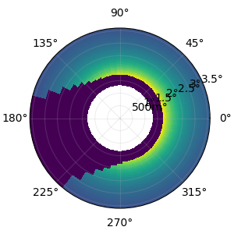
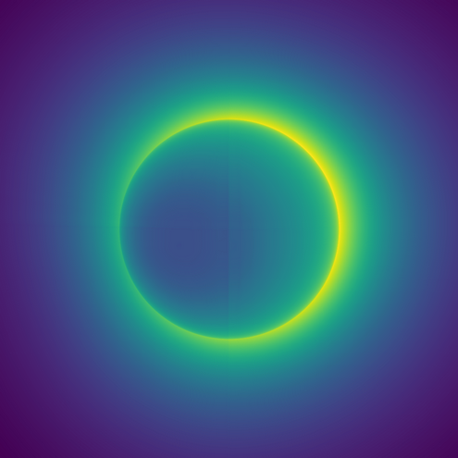

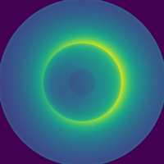
Calibration and Binning
Raw sensor images from spacecraft need significant post-processing to be usable
Instrument effects removed: ADC bias, radiation backgrounds, optical distortion
Scene effects removed: interplanetary hydrogen (IPH), g-factor
Science pixel binning:
  Reduces 1024×1024 (NFI) and 512×512 (WFI) rectilinear images to 100×50 polar images
  Substantial reduction in compute burden without loss of information
Final calibrated image is column density y (atoms/cm²)
→ tomographic retrieval of H density distribution (atoms/cm³)
Optically-thick mask and Earth shadow mask
Noiseless image
Raw sensor reading
Calibrated image
Binned and Masked image

Slide 4
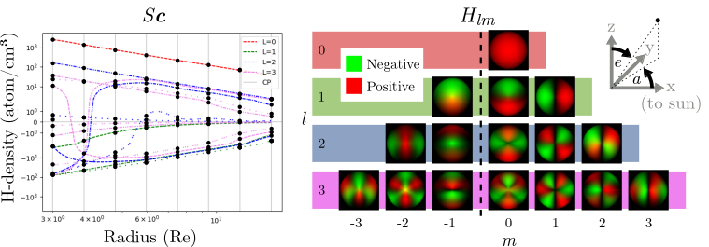
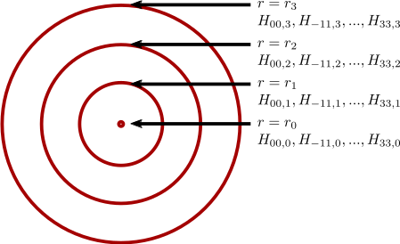
Spherical Harmonic Spline Model
Assume each radial shell of ground truth is well approximated by low-order linear combination of spherical harmonics → smooth elevational/azimuthal variation
Assume coefficients are defined by spline between shells → smooth radial variation
Example: 4 control shells with 16 harmonic functions each: 64 free parameters
Spherical harmonic functions up to third order
Additional model expectations: non-negative density

Slide 5

Inverse Problem Formulation
y - noisy measurements
F:R^{T×N³}→R^{100×50} - Forward tomographic operator
H:R^{X×N}→R^{T×N³} - Spherical harmonic basis functions
S:R^{X×K}→R^{X×N} - Cubic b-spline
c ∈ R^{X×K} - Model coefficients (at spline control points)
Fidelity
Coeff.
Sparsity
Negative Density
Penalization

Slide 6
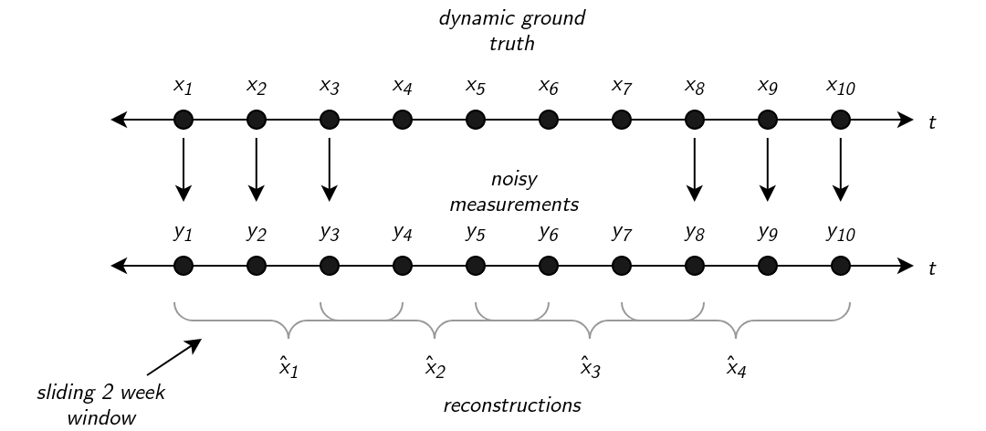
3D Retrieval (2 week sliding window)
1D Retrieval

Slide 7
Backup

Slide 8
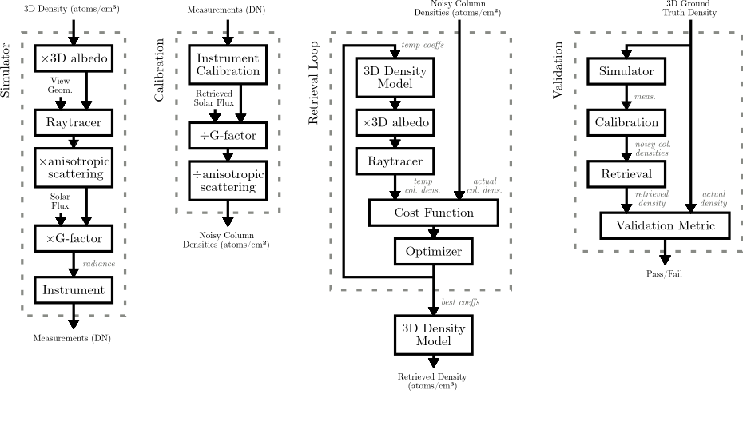
Carruthers Pipeline Summary
Used validation block to develop retrieval algorithm
Need access to synthetic ground truths

Slide 9
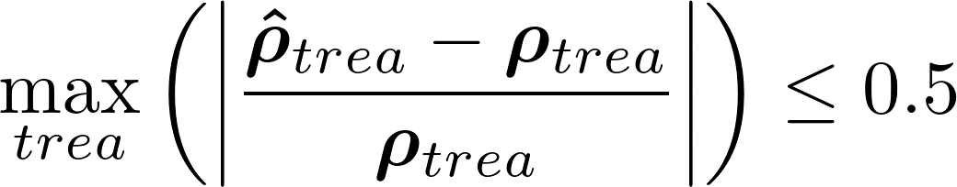
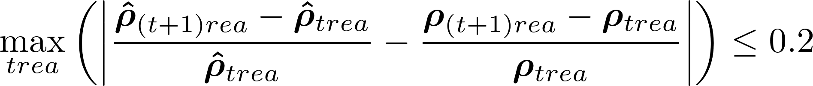
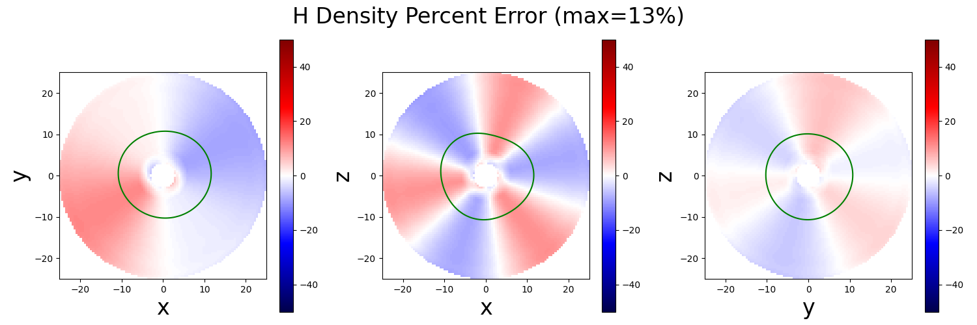
Retrieval Requirements and Validation Criterion
Mission defines minimum spatiotemporal resolution and maximum reconstruction error requirements for any voxel trea
ρ̂ - reconstruction
ρ - ground truth
Accuracy
Change
(future work)
Dimension | Criterion
Temporal | Storm: Δt = 1hr Quiet: Δt = 6hr
Radial | Δr ≤ 0.5 Re
Elevational | Δe ≤ 180°
Azimuthal | Δa ≤ 120°
Example accuracy plot showing relative accuracy errors in cardinal planes. Green line is 25 atoms/cm³ boundary
Reconstruction resolution requirements

Slide 10
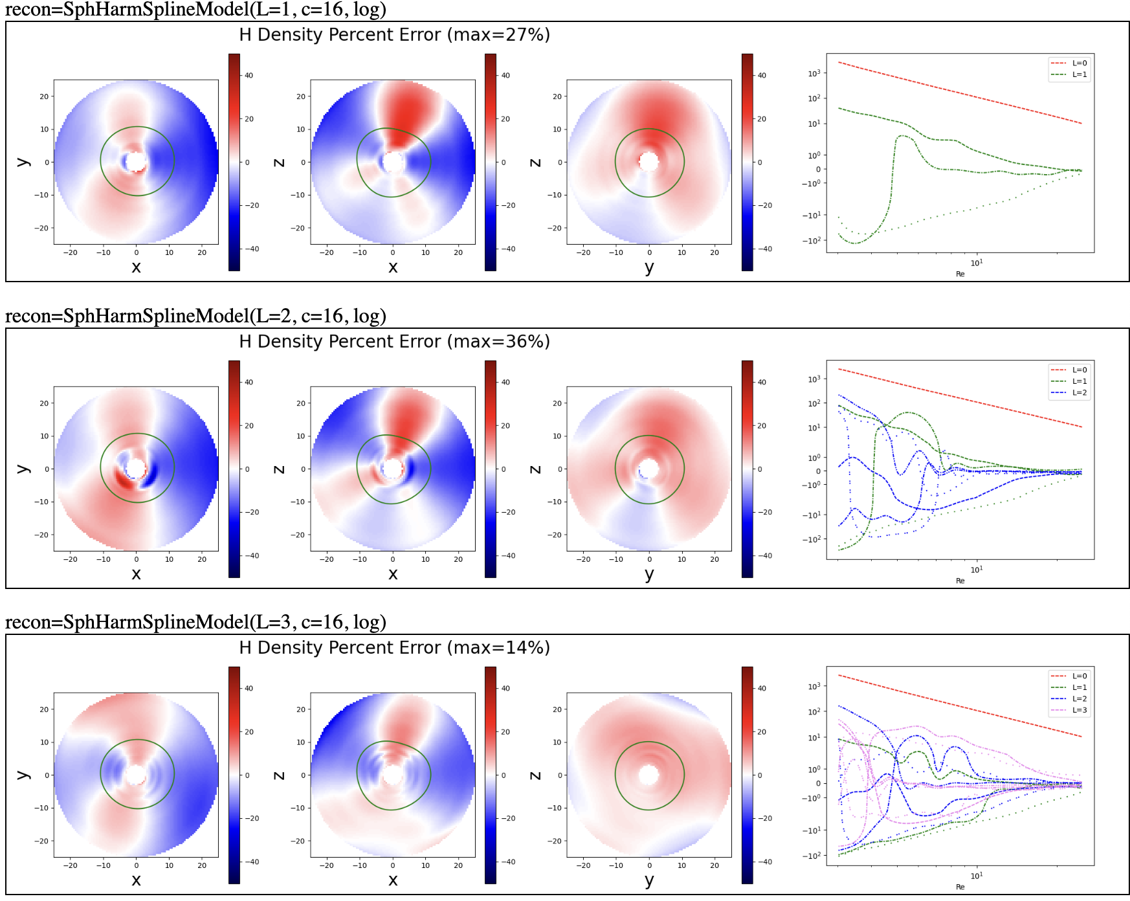
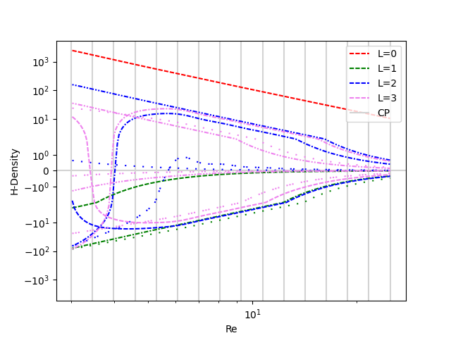
Static Reconstruction Results - TWINS SPH
Two week observation window
Six hour integration
Assumes no bias introduced in calibration
  Have tested sensitivity against various forms of bias
Static reconstructions meet accuracy requirement at high spatial resolution
L=1
Truncation Order
L=2
Ground Truth
Coeffs.
L=3

Slide 11
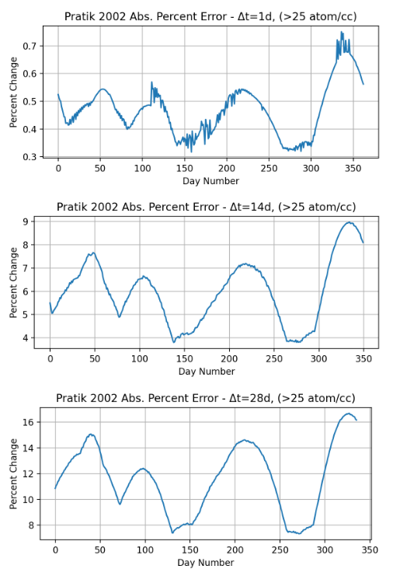
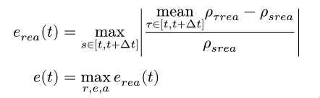

Slide 12

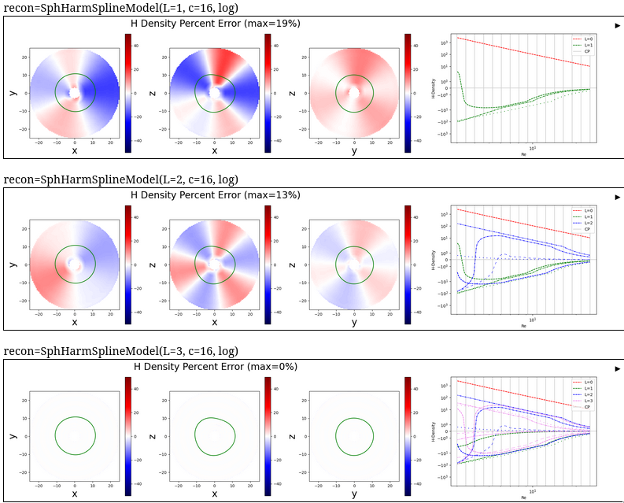
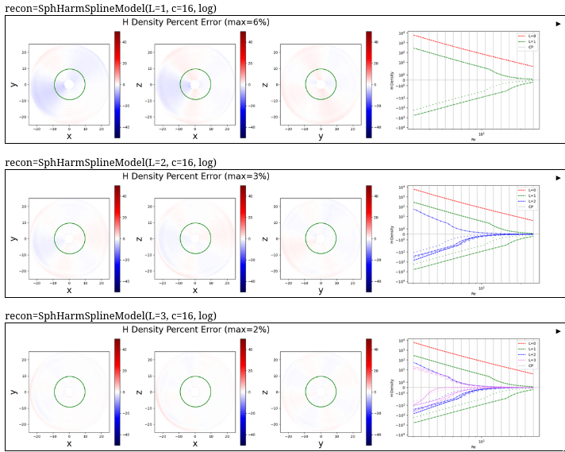
How well does assumed model fit the data?
Direct fit of model to data. Assumes knowledge of ground truth
TWINS SPH
VMB
L=1
L=2
L=3

Slide 13
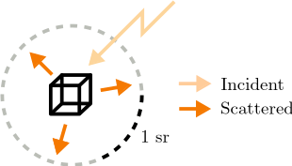
Dimensional Analysis
ϕ - Angle-dependent anisotropic scattering (unitless)
a - Apparent density enhancement due to Earth surface scattering (unitless)
ρ - H density (atom/cm²)
g - Solar g-factor - photon scattering rate (phot/s/atom/sph)

