Slide 1
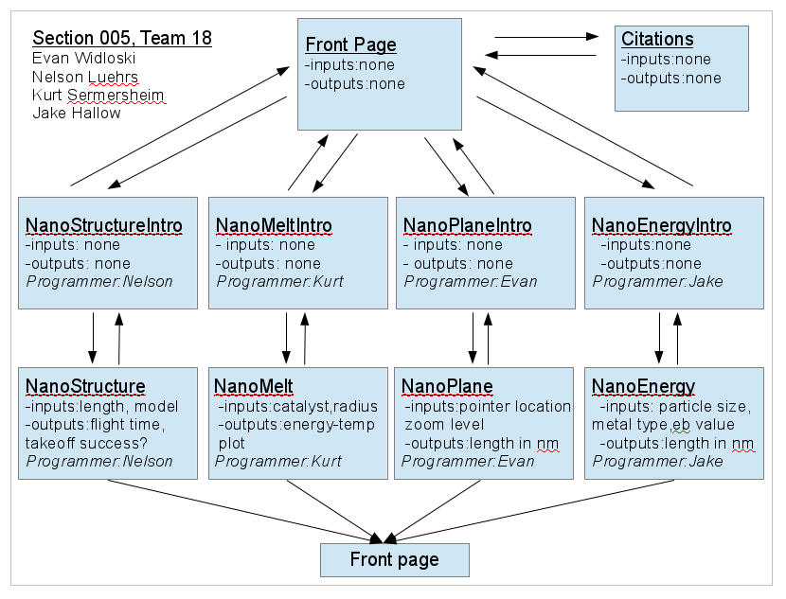

Slide 2
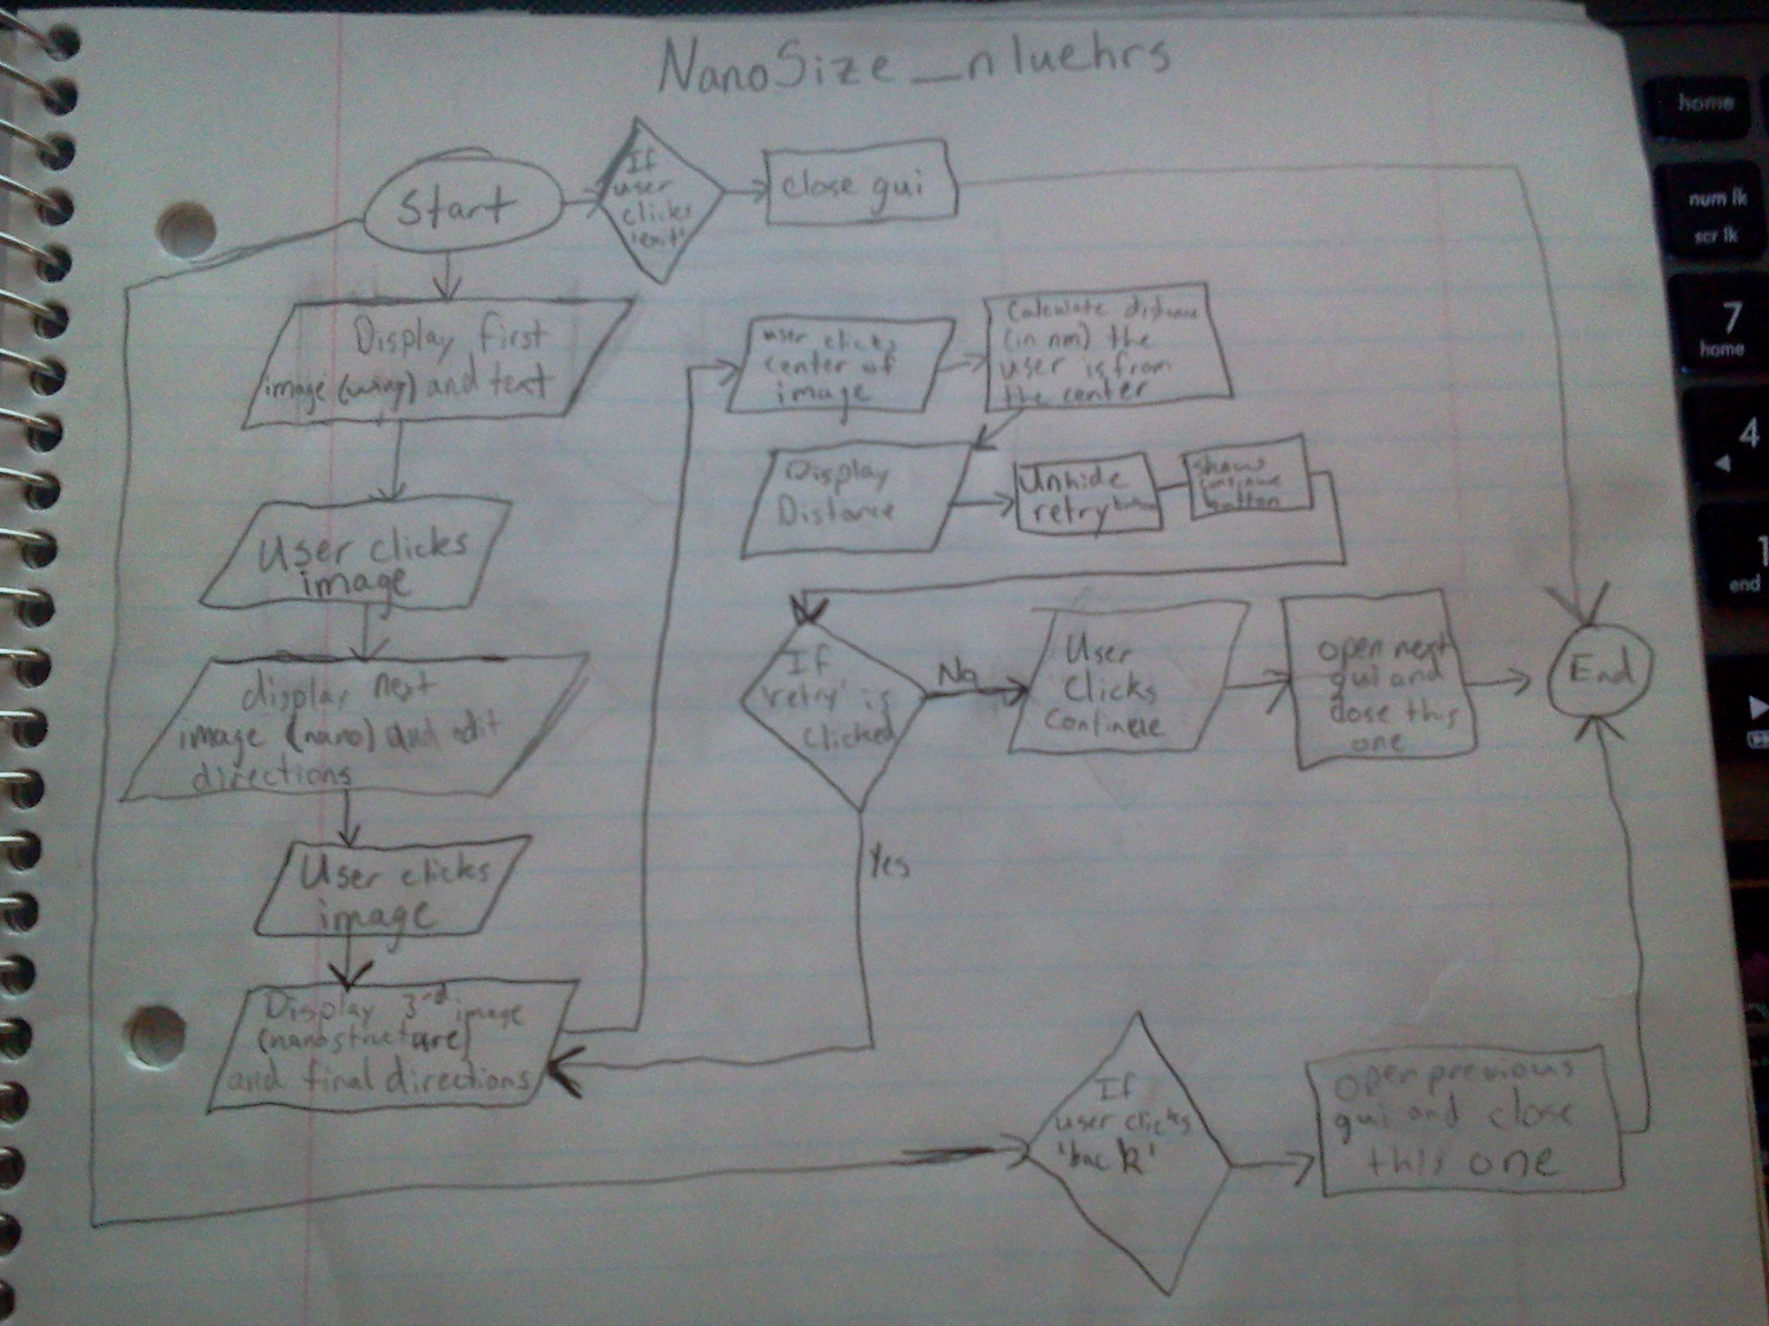

Slide 3
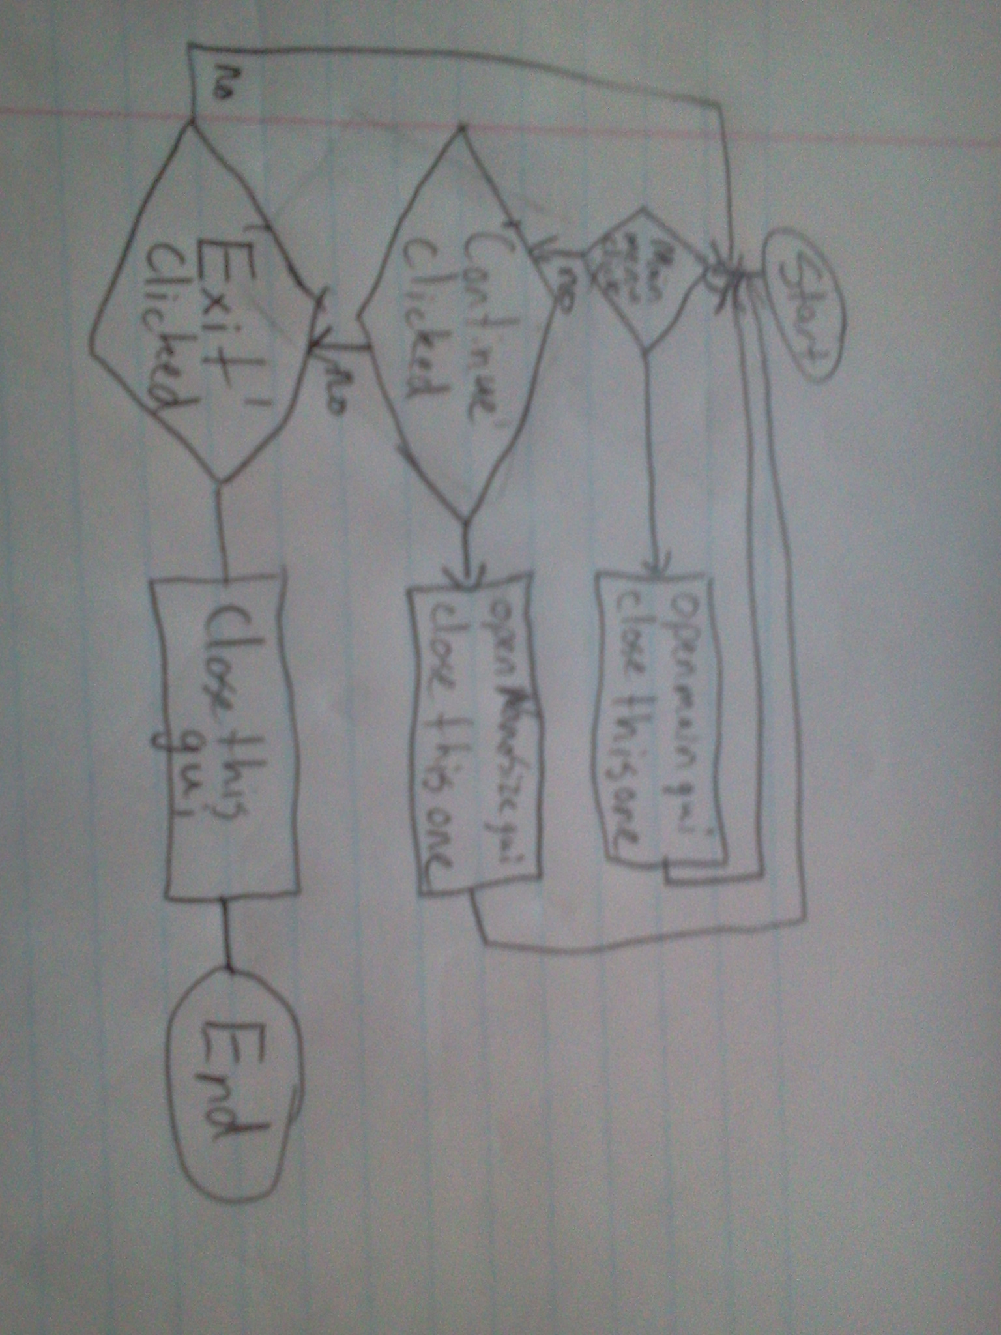
Intro_nluehrs

Slide 4
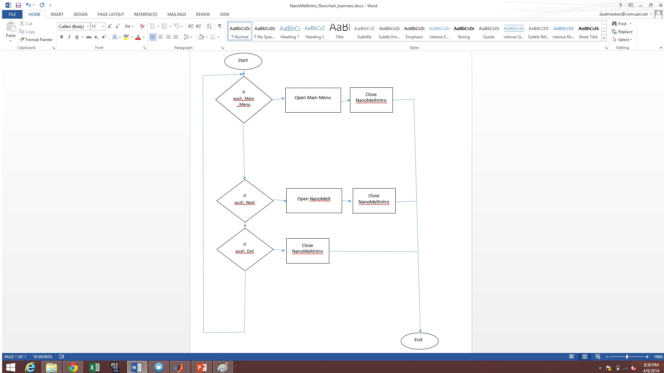
Kurt Sermersheim NanoMeltIntro

Slide 5
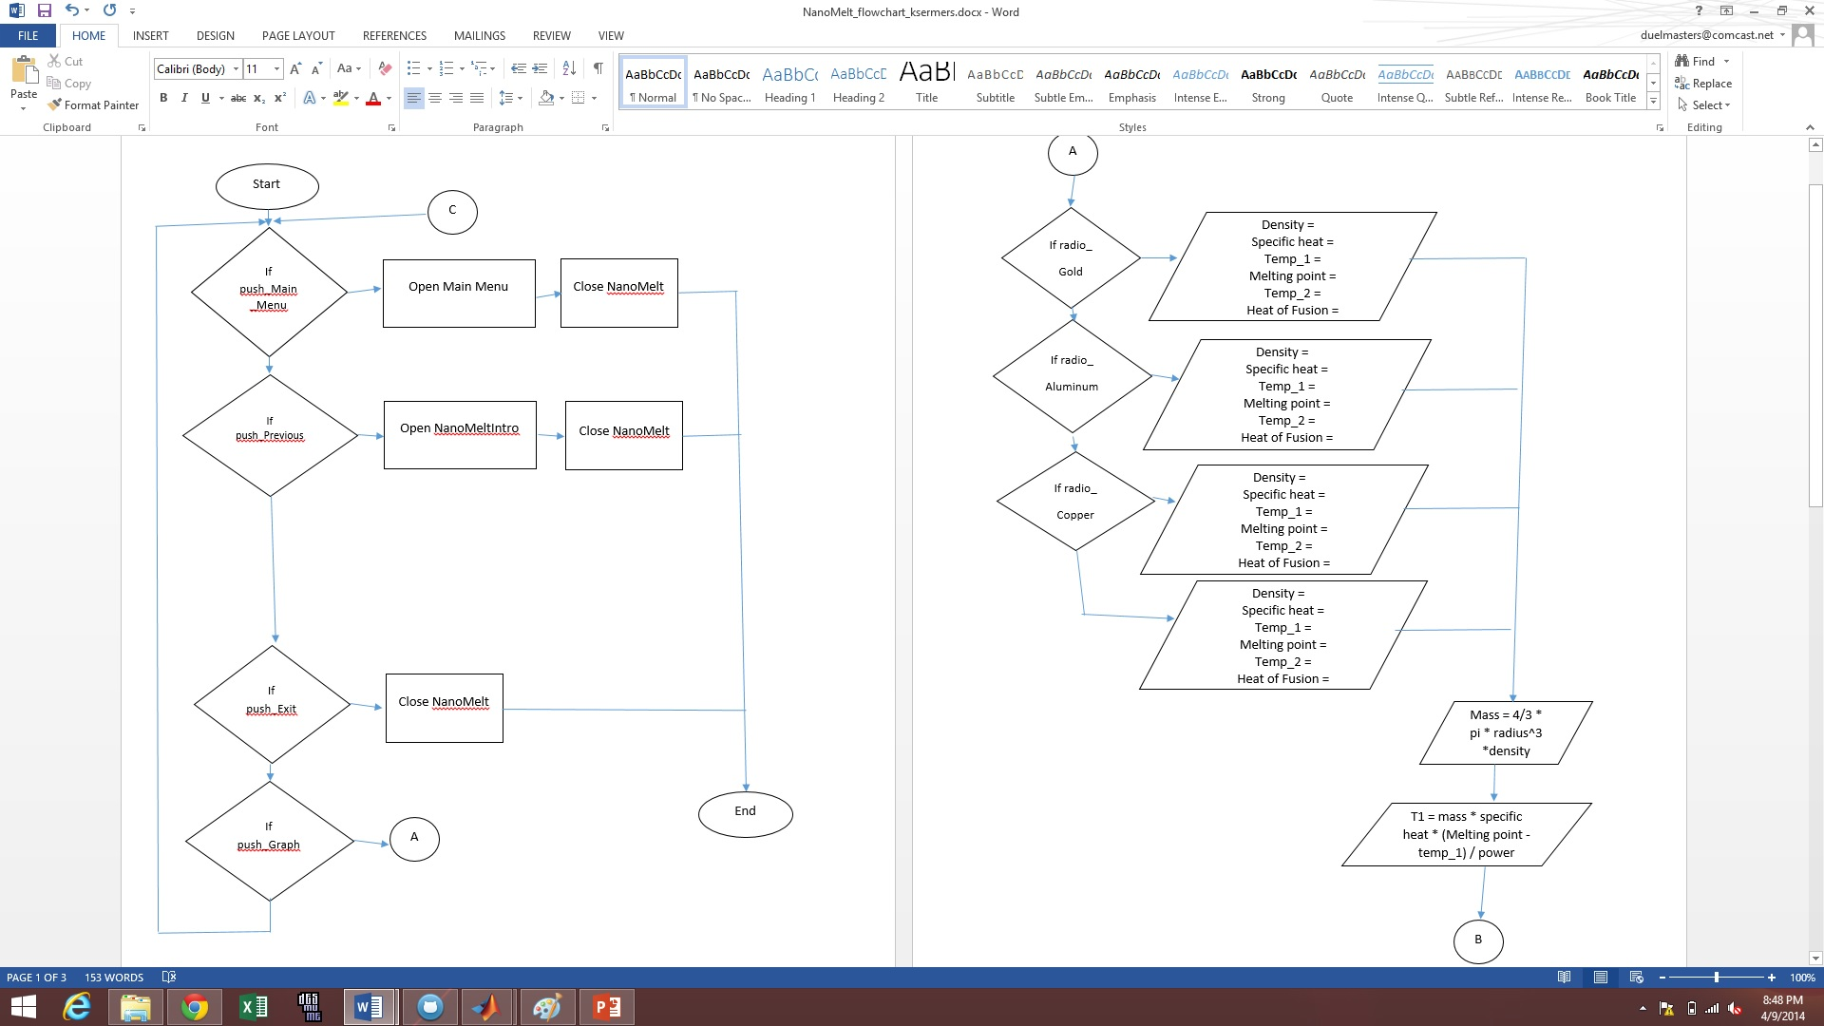
Kurt Sermersheim NanoMelt

Slide 6
Kurt Sermersheim NanoMelt

Slide 7
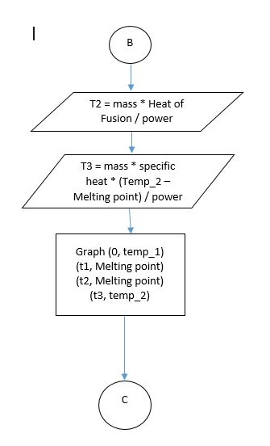
Kurt Sermersheim NanoMelt

