Slide 1
i3 Window Manager
Evan Widloski | 2014-02-09
Purdue GNU/Linux Users Group
Notes:
how many have used tiling wm?
how many know what a tiling wm is?

Slide 2
Tiling Window Managers
No overlap (tiles)
Keyboard shortcuts
Lightweight
Minimalistic
Notes:
a few key characteristics of a tiling wm

Slide 3




Popular Tiling WMs
awesome
xmonad
dwm
wmii
Dozens others...
Notes:
common tiling window managers
big list of others on wikipedia if you want to try them

Slide 4
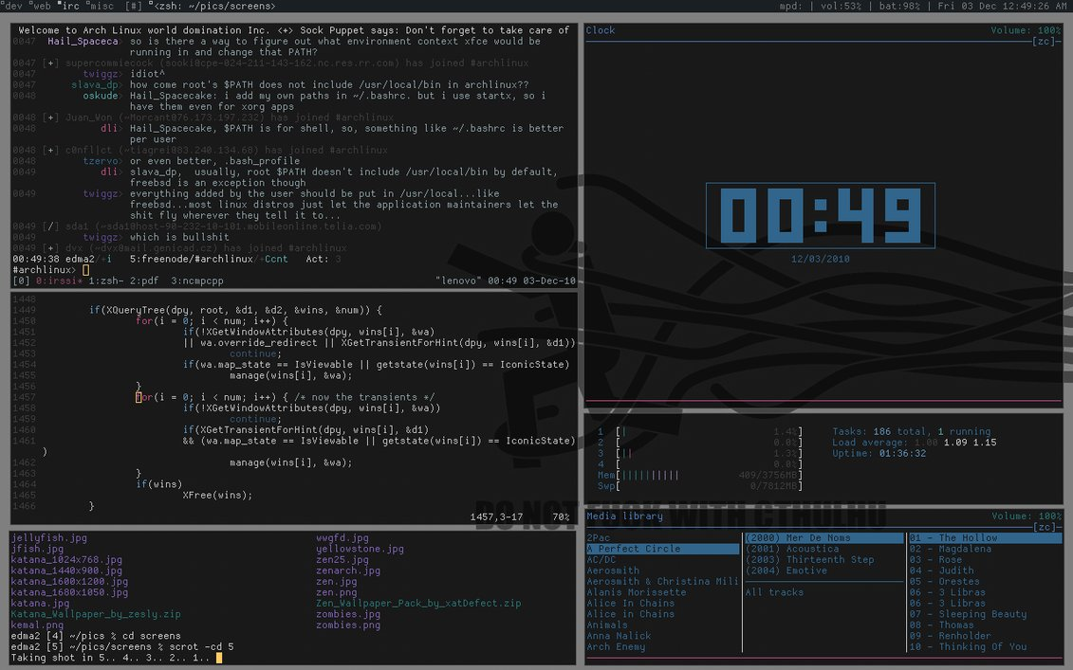
Notes:
dwm, written in C
~20KB
goal of creator: <2000
no configuration file, edit headers as configuration

Slide 5
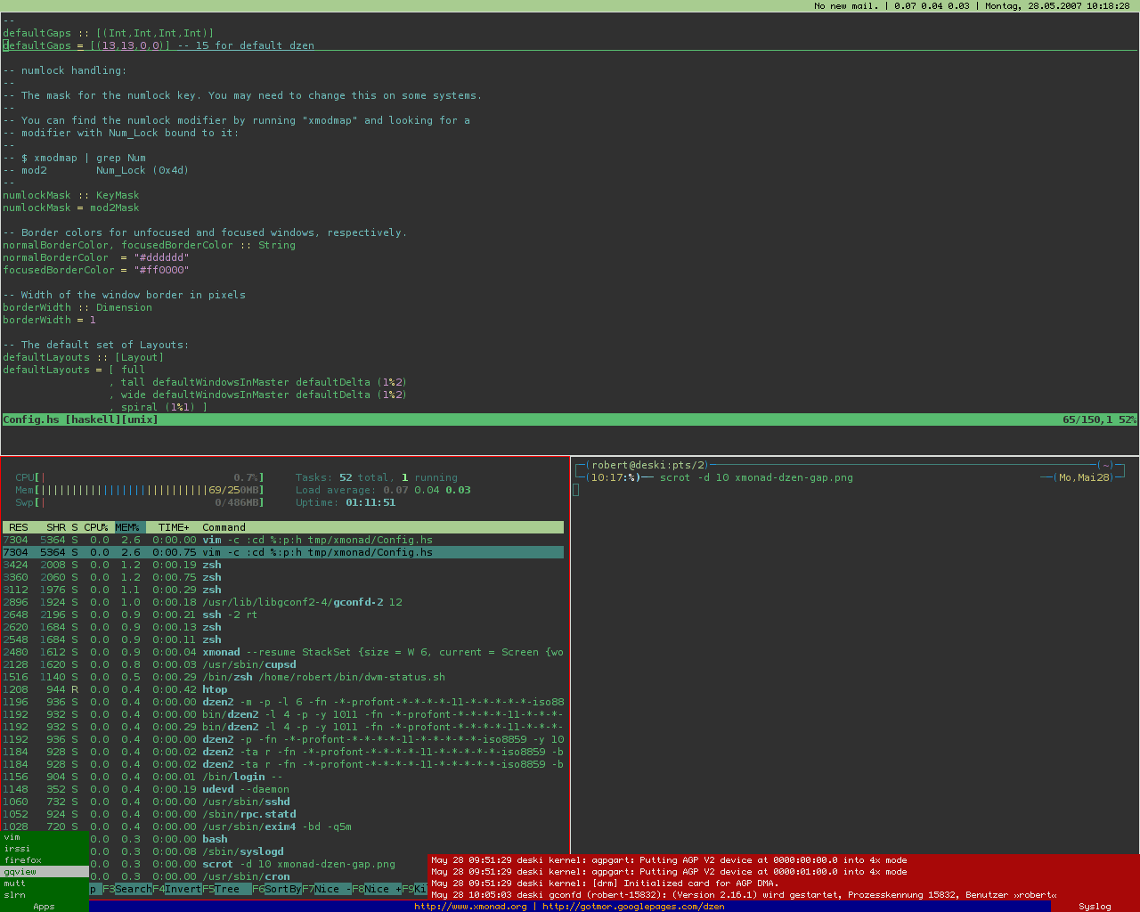
Notes:
xmonad - written in haskell
interesting fact: windows 1.0 had a tiling window manager

Slide 6
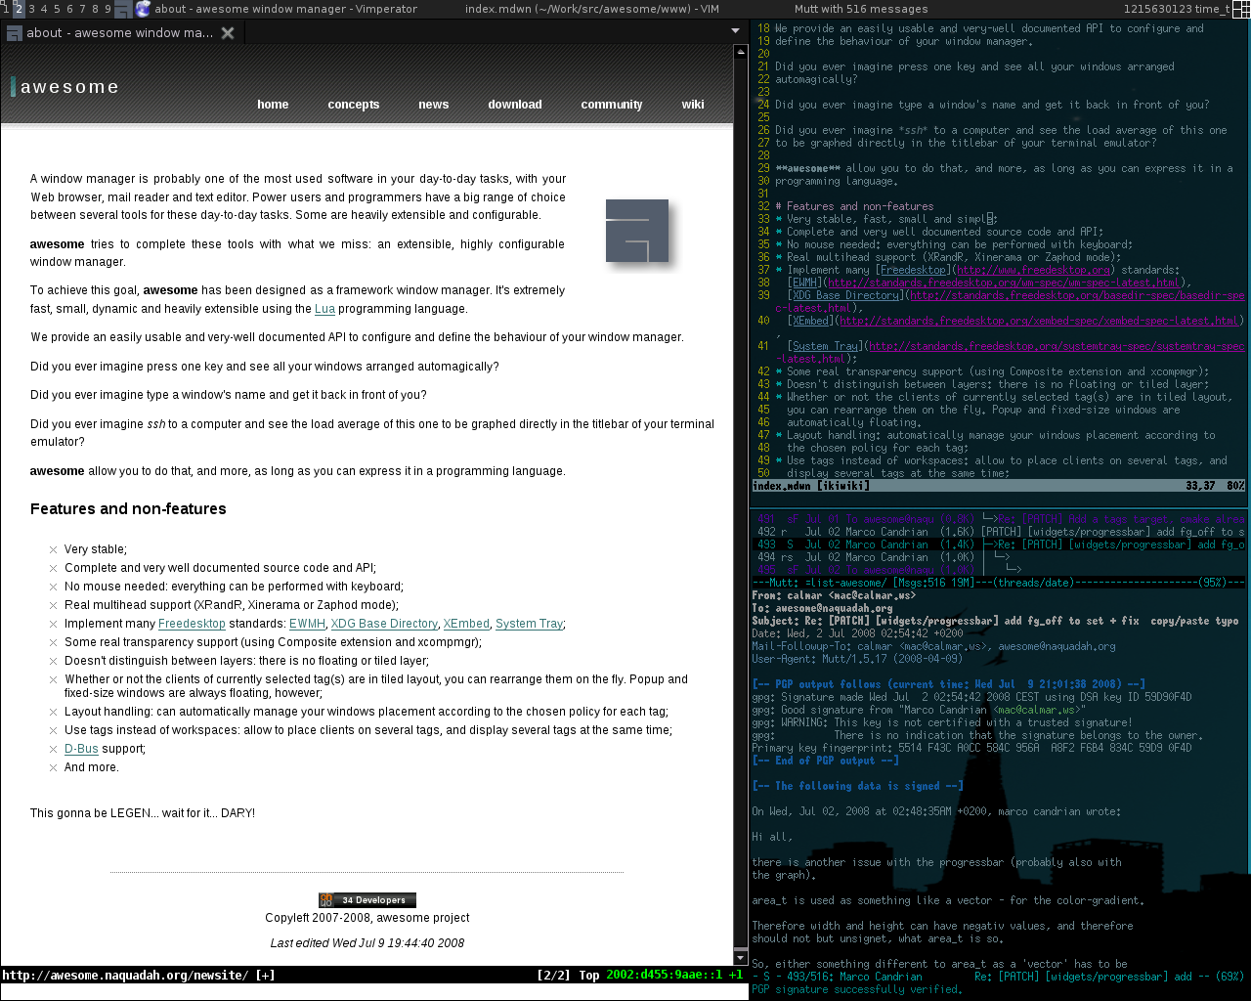
Notes:
awesome -
lots of tiling wm's are similar

Slide 7
Fact: Tiling WMs are better than Stacking WMs
Great increase in productivity
Highly customizable
Utilities from other WMs can still be used

Slide 8

Notes:
started in 2009, written in c, good documentation
differences:
uses text configuration file
split and move windows any way you want
###################
-open new workspace, create windows
-keyboard navigation much faster than swapping between mouse and keyboard
-vim like navigation,resizing
-move windows around/different workspace
-floating windows – calculator
-can still use xfce utilities
-config – change modkeys, set shortcuts, set colors

Slide 9
Characteristics of i3wm
Direct control of window tree
Settings stored in easily-read text file
vim-like window navigation and resizing
Floating window support (good for popups)

Slide 10

i3bar
Area to display system statistics
User configurable (accepts JSON input)
Uses 'i3status' by default
Supports click events

Slide 11
Check out my config and find
example i3bar scripts @
http://github.com/Evidlo/i3config/

