Slide 1
Linux 101: Introduction To Linux
Purdue Linux Users Group
Speaker:
Jack Cottom

Slide 2
What is Linux?
Linux is a kernel, the core of an operating system.
Linux Kernel released by Linus Torvalds in 1991.
It is based off the design of the UNIX operating system.
GNU/Linux vs. Linux

Slide 3
Linux Distributions
Linux is open source
Easy to redistribute and repurpose
Hundreds of independent versions of Linux, called distributions

Slide 4
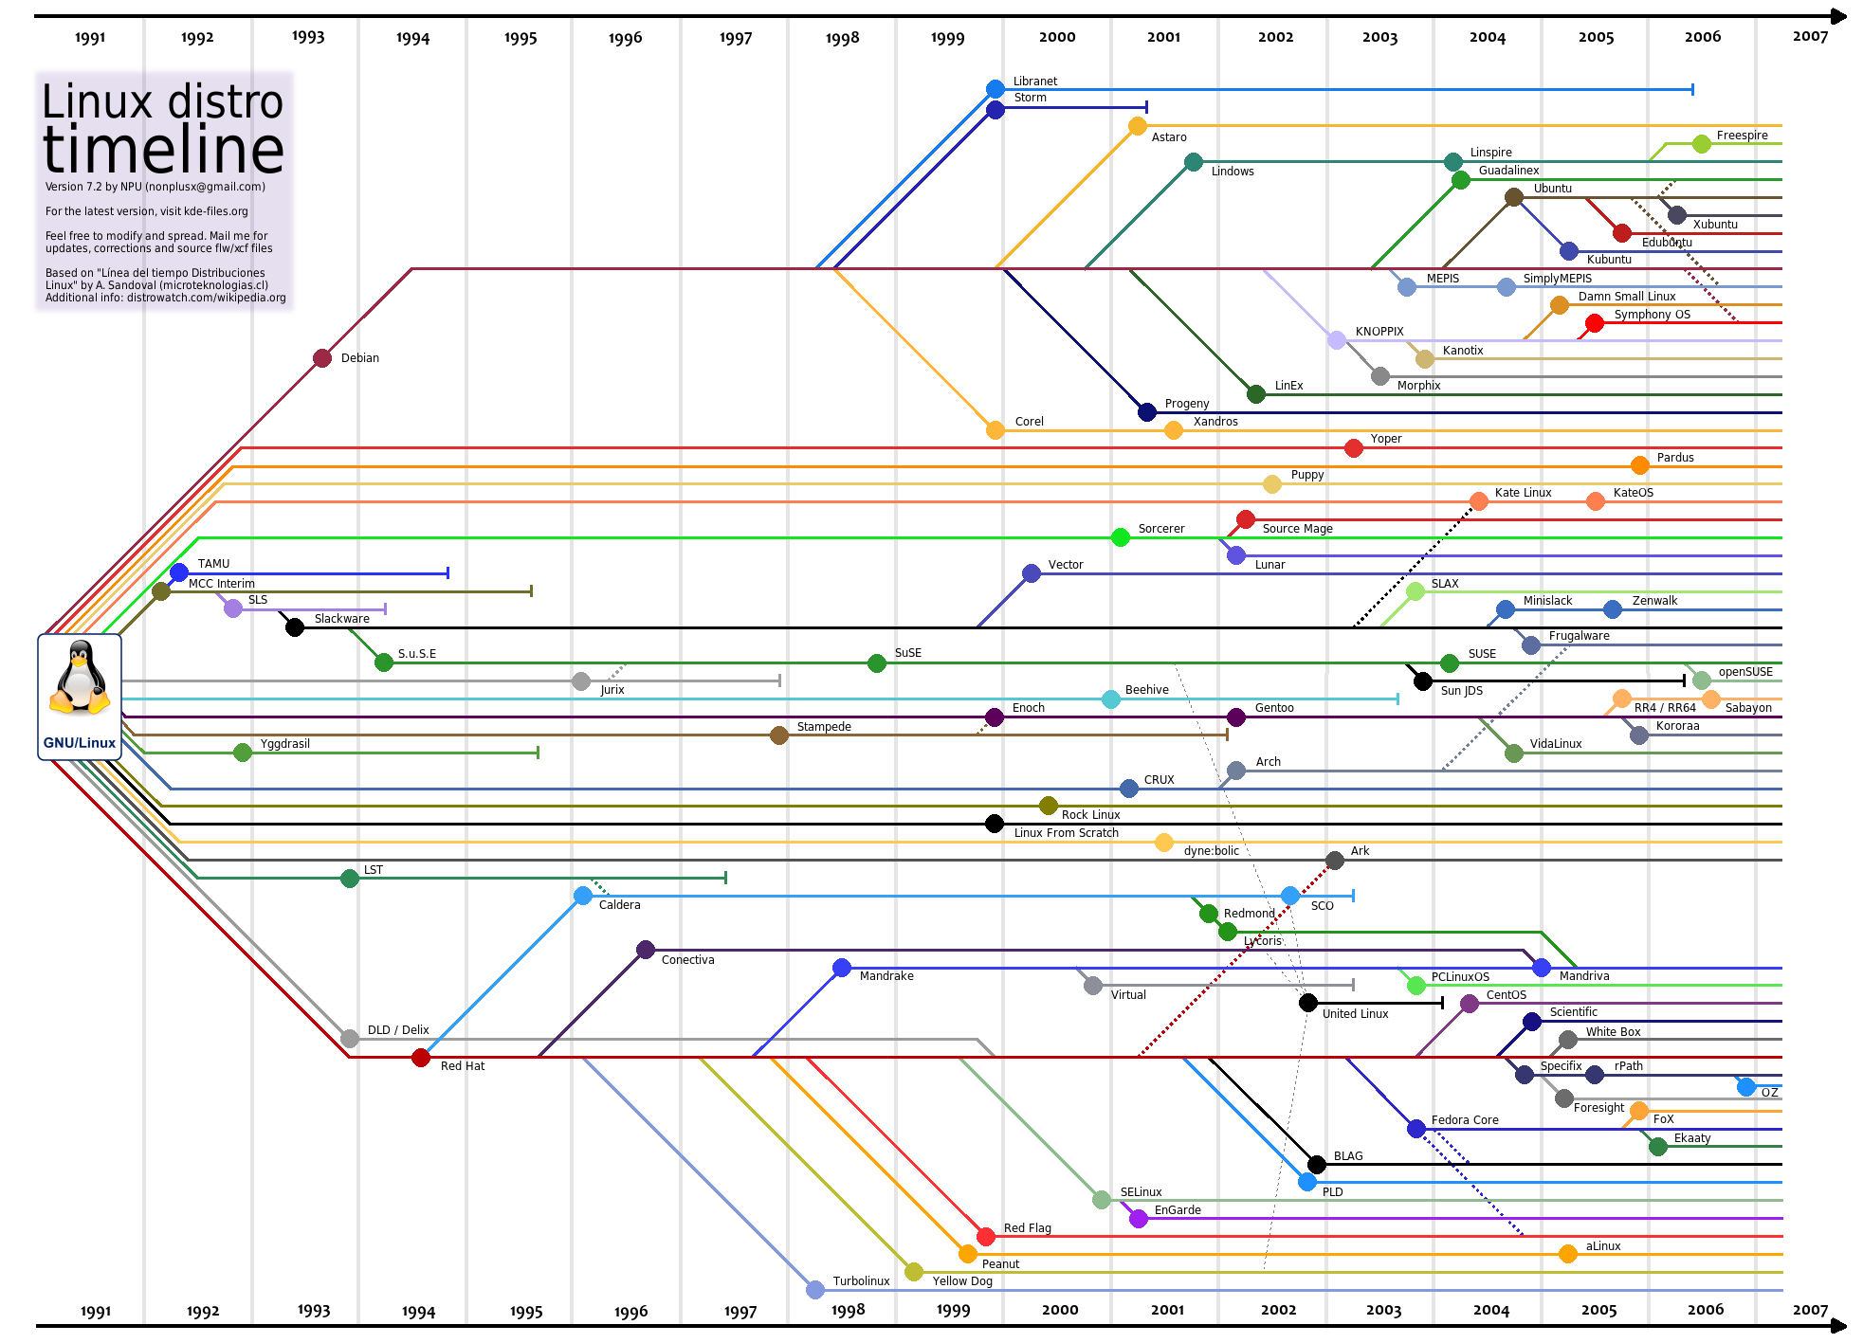
Distributions of Linux

Slide 5
Desktop Managers
Manager manages your desktop applications
Modular
Different design goals
Examples Include:
  KDE
  Gnome
  Xfce

Slide 6
Uses for Linux
Linux is nearly infinitely customizable. As such, it is an excellent choice for many different tasks:
  Programming
  Data collection
  Networking
  Office and academic work
  Saving money

Slide 7
The Root User
root user is the Linux equivalent of the administrator, aka, ”super user”
No need for authorization
Required to create new users, install new software, etc.

Slide 8
Use Caution!
Linux will not notify you if you are about to mess up something system-critical while you are running as root. As such, you must be very careful!
Use the sudo command to run a specific command as the root user:
  sudo command

Slide 9
Use Caution!
The su command allows a session to be run as root
  Su
Good practice to logout of root session ASAP

Slide 10
Navigating in the Terminal
The terminal is your window into the shell. Inside type ”echo $SHELL” to find out what you're using.
uname -a
  General Operating System info
ls ls -l ls -la
  List files and directories.
cd cd ~ cd .. cd .
  Change Directory
pwd
  Print the current working directory
whoami
  What is your user name

Slide 11
Creating, Deleting, and Editing
Create Directory
  mkdir newdir
Copy, Move/Rename
  cp orig/path cop/path
  mv orig/path new/path
Remove Files and Dir
  rm filename
  rm -r directory
Editing:
  vim, emacs, nano, etc.
  editor filename
Print file contents:
  cat filename
Output to a file
  echo ”this text” > myfile.txt
  echo ”append this text” >> myfile.txt

Slide 12
Finding Files
Search the entire computer
  locate filename
Find files in the current directory using ”find” (recursive)
  find -name filename
  find -name *keyword*
[grep description]
  grep ”keyword” file

Slide 13
Miscellaneous
View excessive output or long files (no editing)
  command | less
  ls -la | less
File Security: Permission and Ownership
  chmod +x file
  chown username file
Documentation in Linux
  man command/topic
  command --help

Slide 14
Miscellaneous
Exit the terminal
  exit
Shut down or reboot the system
  shutdown -h now
  reboot
Check if you have a program installed
  which program
Run a program in the background
  program &

Slide 15
No Graphics (TTYs)
Linux can be run without a Desktop.
  Press Ctr-Alt-F1
  Log in
  Press Ctr-Alt-F7 to go back.

Slide 16
The Coming Sessions
Package managers, Bash, and more.

Slide 17
Announcements
Session Two of Linux 101 on 9/16
The next PLUG member meeting is at 6:00 PM on September 9th, in REC 123
Keep an eye on the PLUG website – we will post updates for our events

Slide 18

Questions/Comments?
Feel free to join the IRC to ask questions:
  #purduelug @ Freenode.net
Library in PLUG office: LWSN B128
Plug-president@purduelug.org

