Slide 1
Spring Callout
Purdue Linux Users Group
2016-01-26

Slide 2
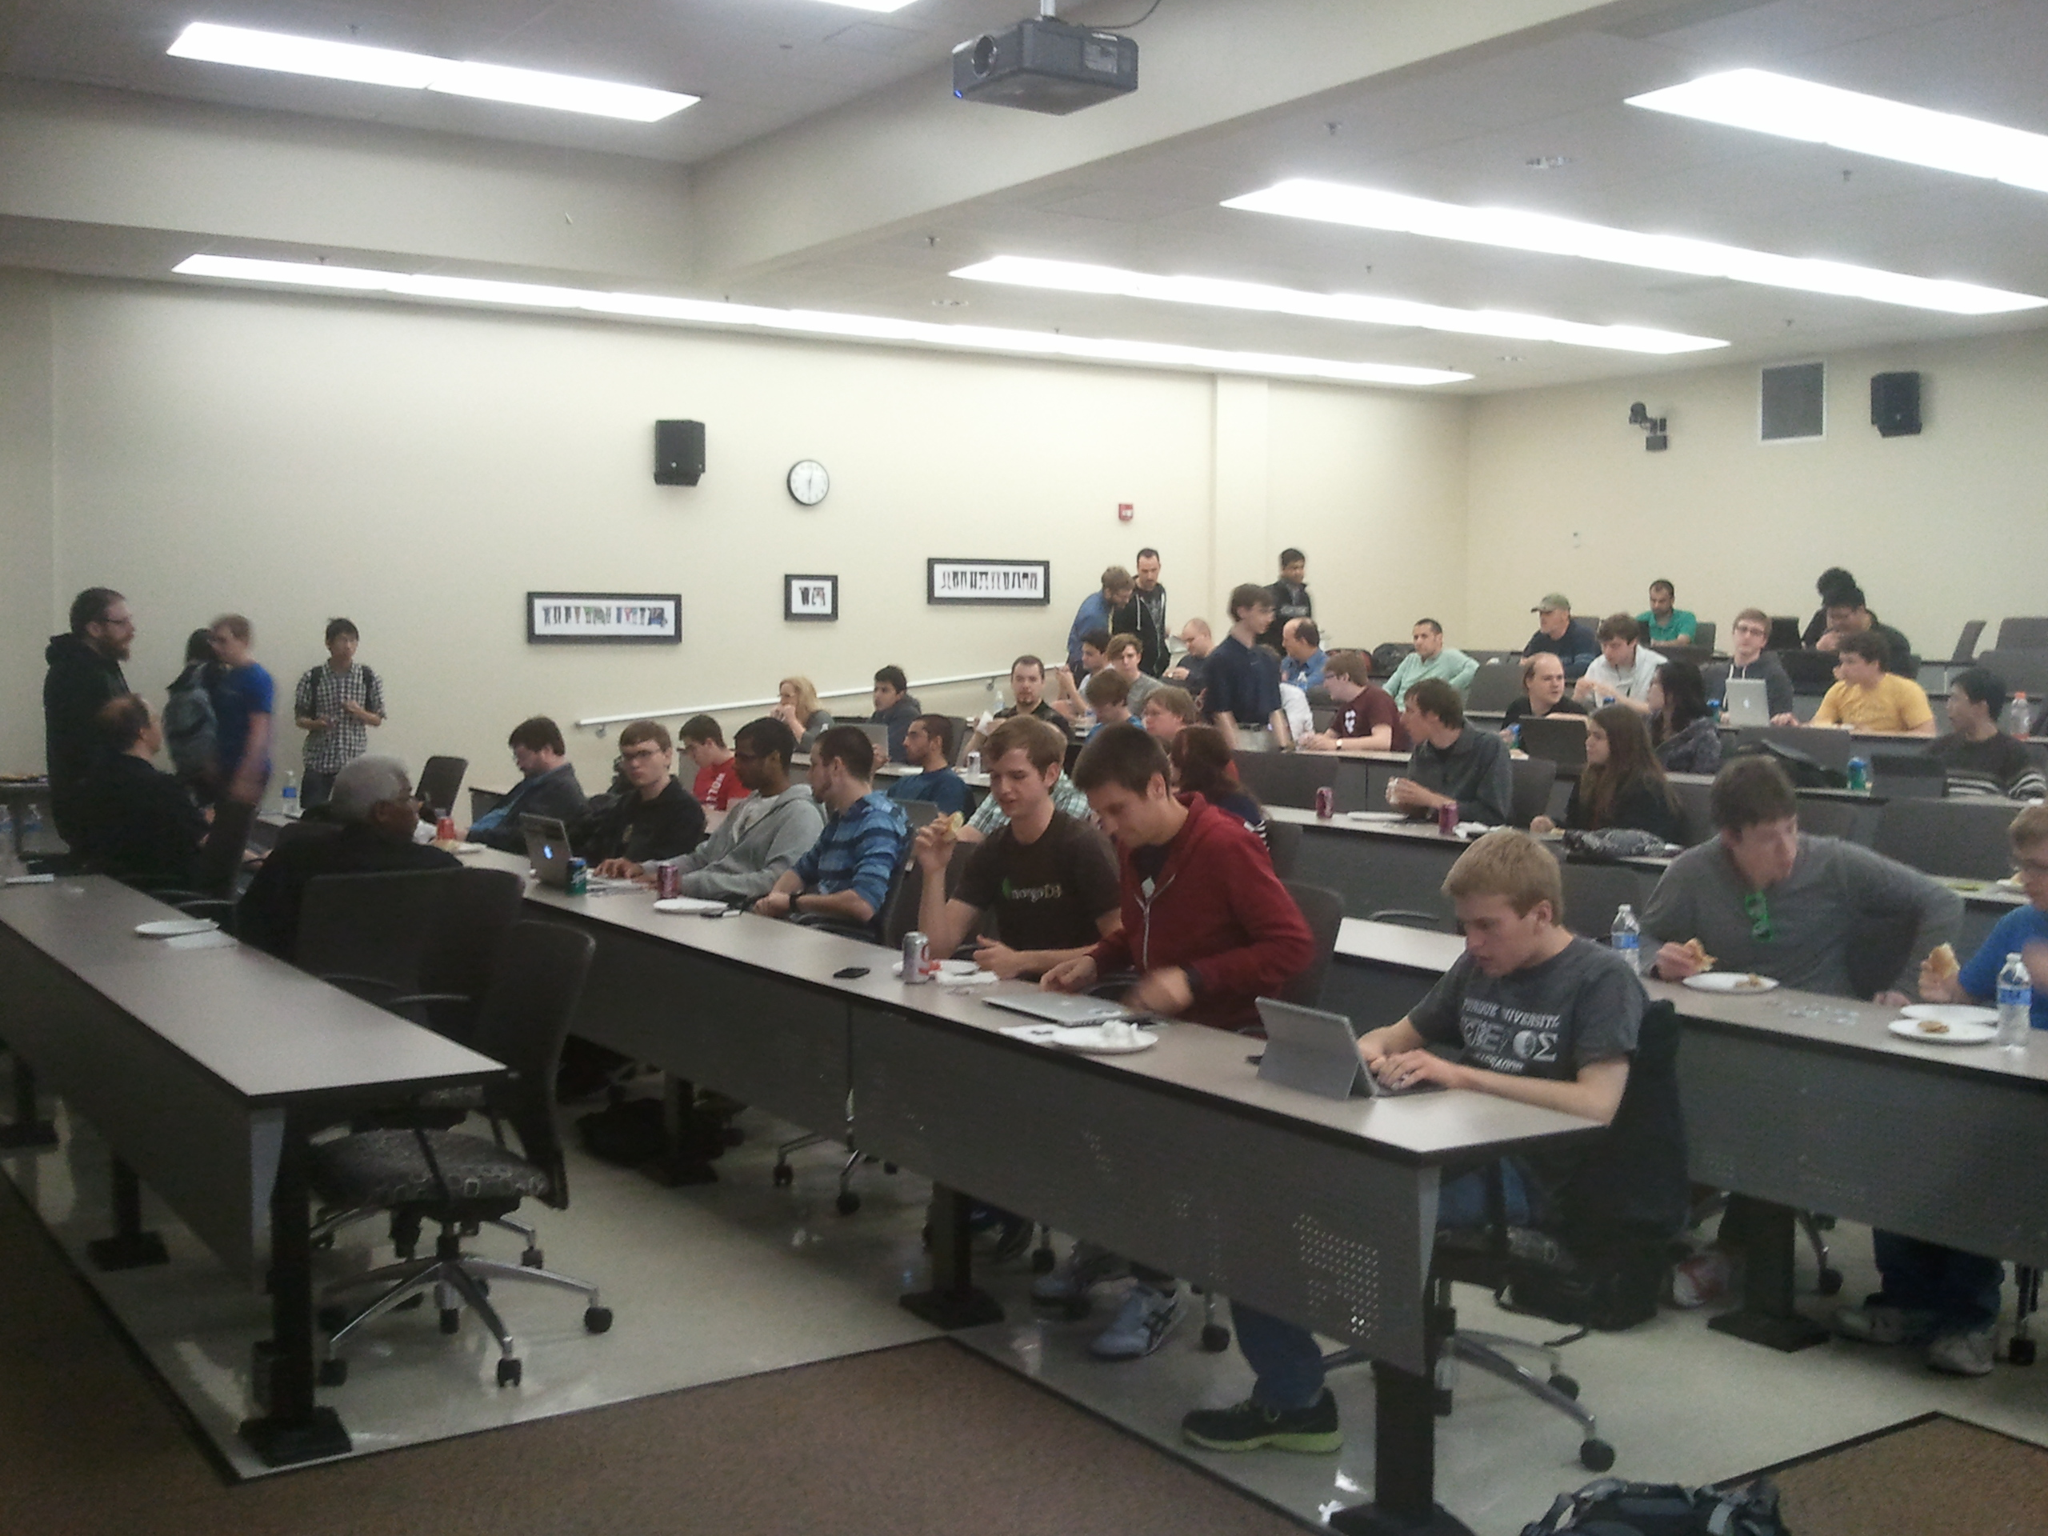



What PLUG does
Company tech-talks (free food)

Slide 3
Student Mini Tech Talks
Students talking about what they know.
android, tmux, web-dev, etc.
5 - 15min
Come talk to us afterwards

Slide 4
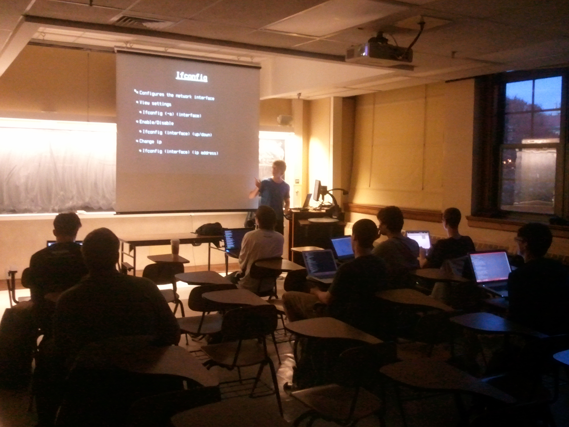
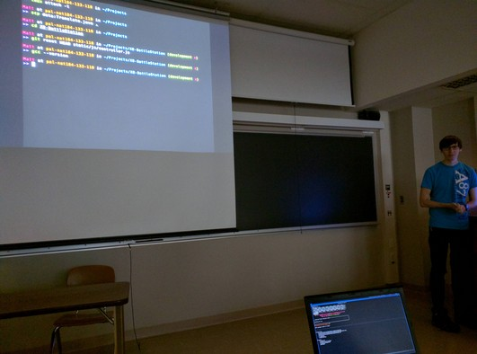
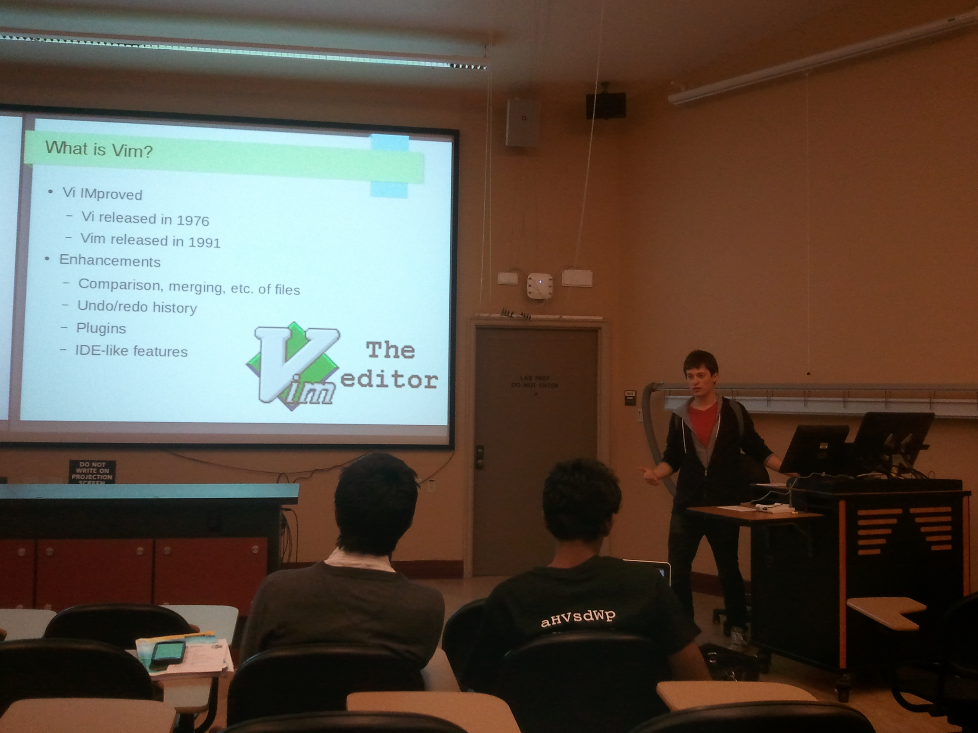
Linux 101 Topics
Intro to Linux 1 & 2
Vim Editor
systemd
Window Managers

Slide 5

Installfest

Slide 6
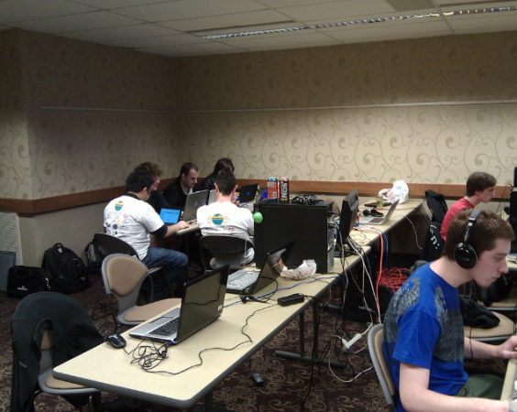
Open Source LAN and
Member Projects
Food
Fun
Frags

Slide 7
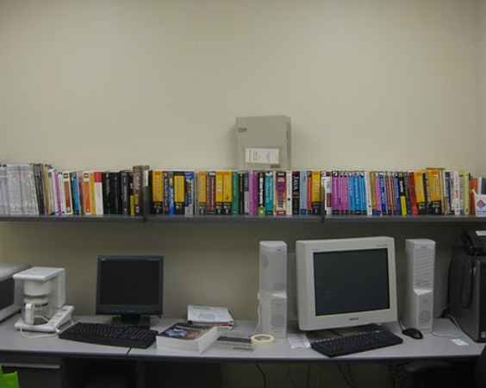

PLUG Library
Hundreds of titles, free to check out
Mathematica, Samba, Unix, Redhat, Networking
and much more!

Slide 8
More information
Google Calendar - purduelug.org/calendar
Mailing List - PurdueLUG @ googlegroups.com
Dates to look forward to:
Linux 101 #1 - Tuesday, Feb. 10th

Slide 9



