Slide 1
Spring Callout
Purdue Linux Users Group
2015-02-03

Slide 2
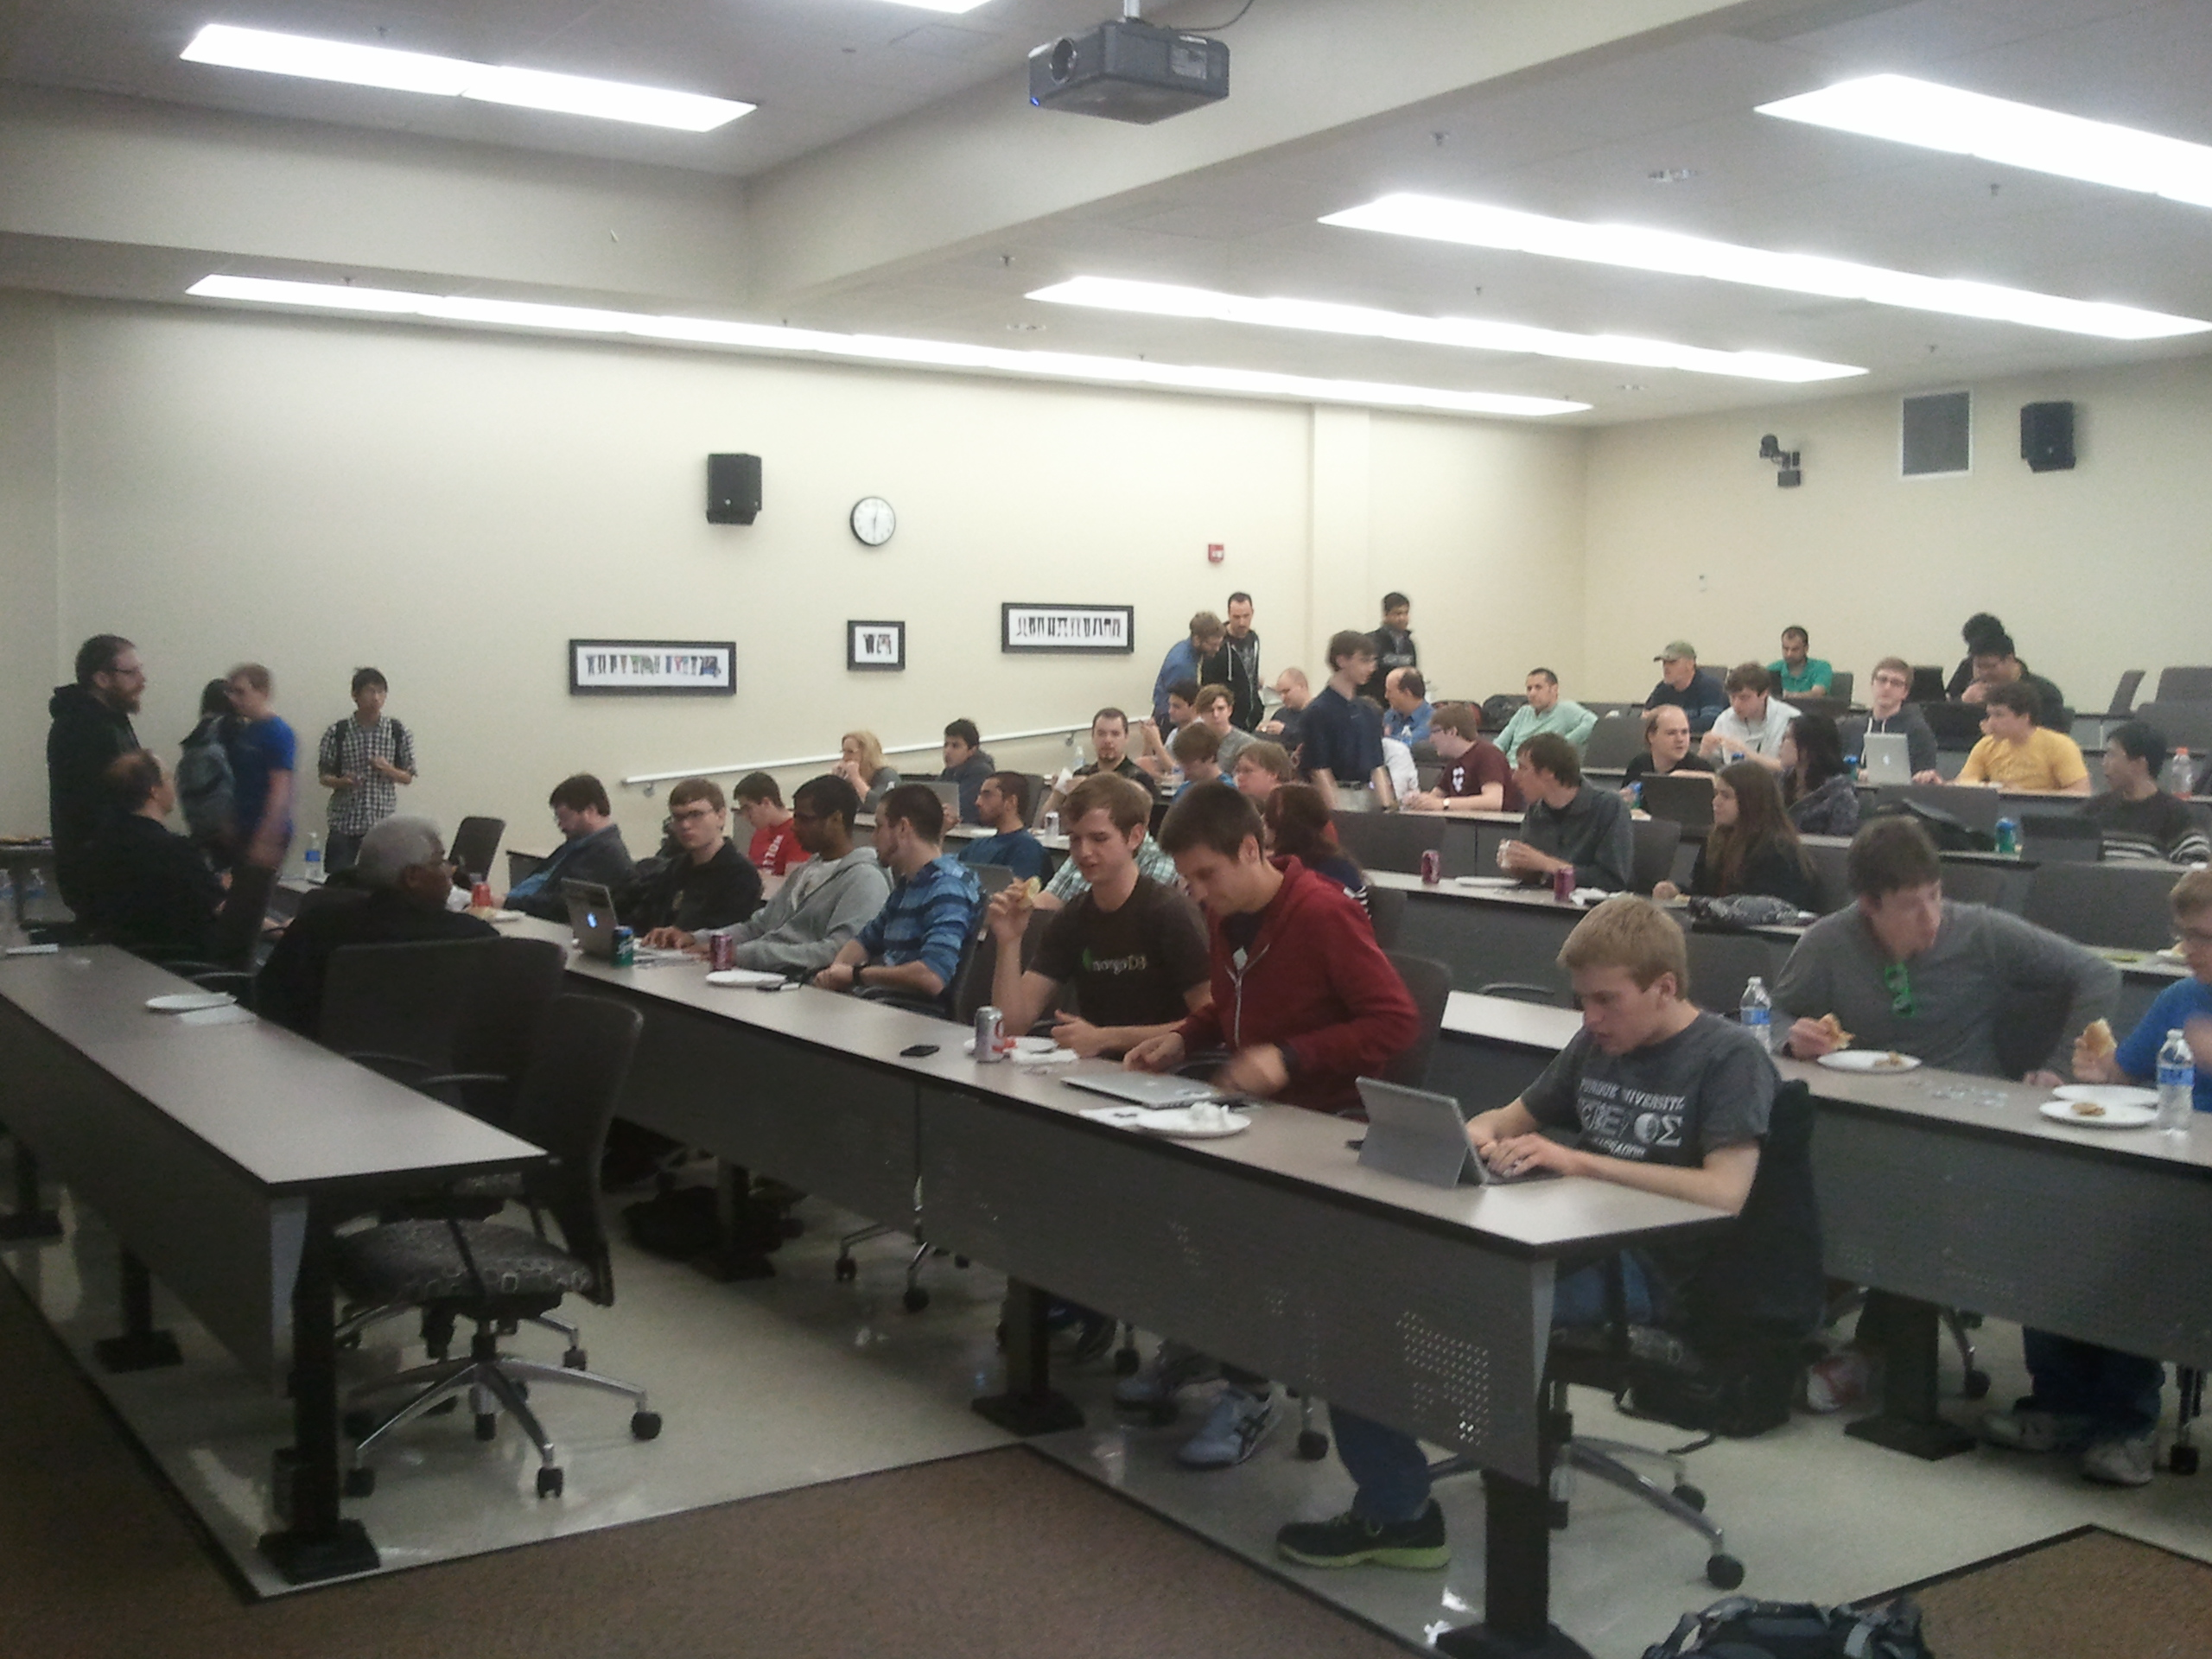



What PLUG does
Company tech-talks (free food)

Slide 3
Student Mini Tech Talks
Students talking about what they know.
android, arduino, web-dev, etc.
5 - 15min
Come talk to us afterwards

Slide 4
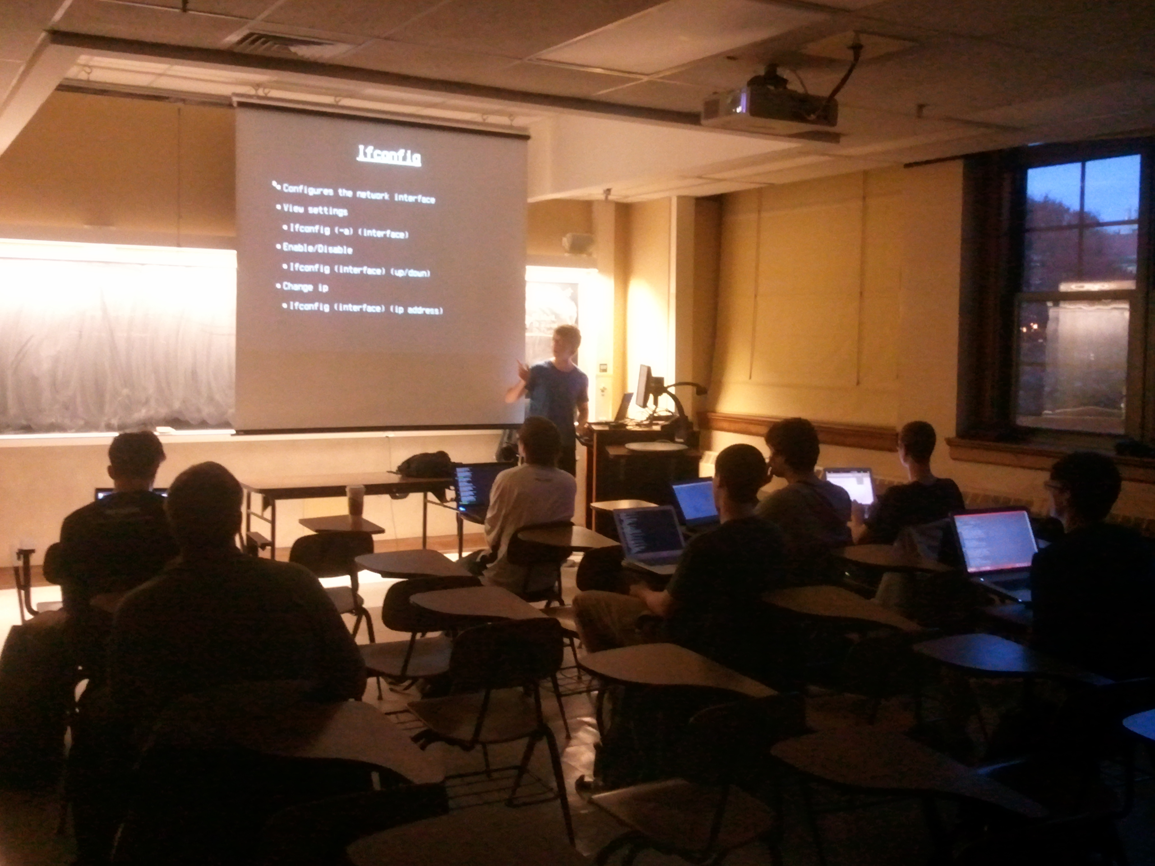
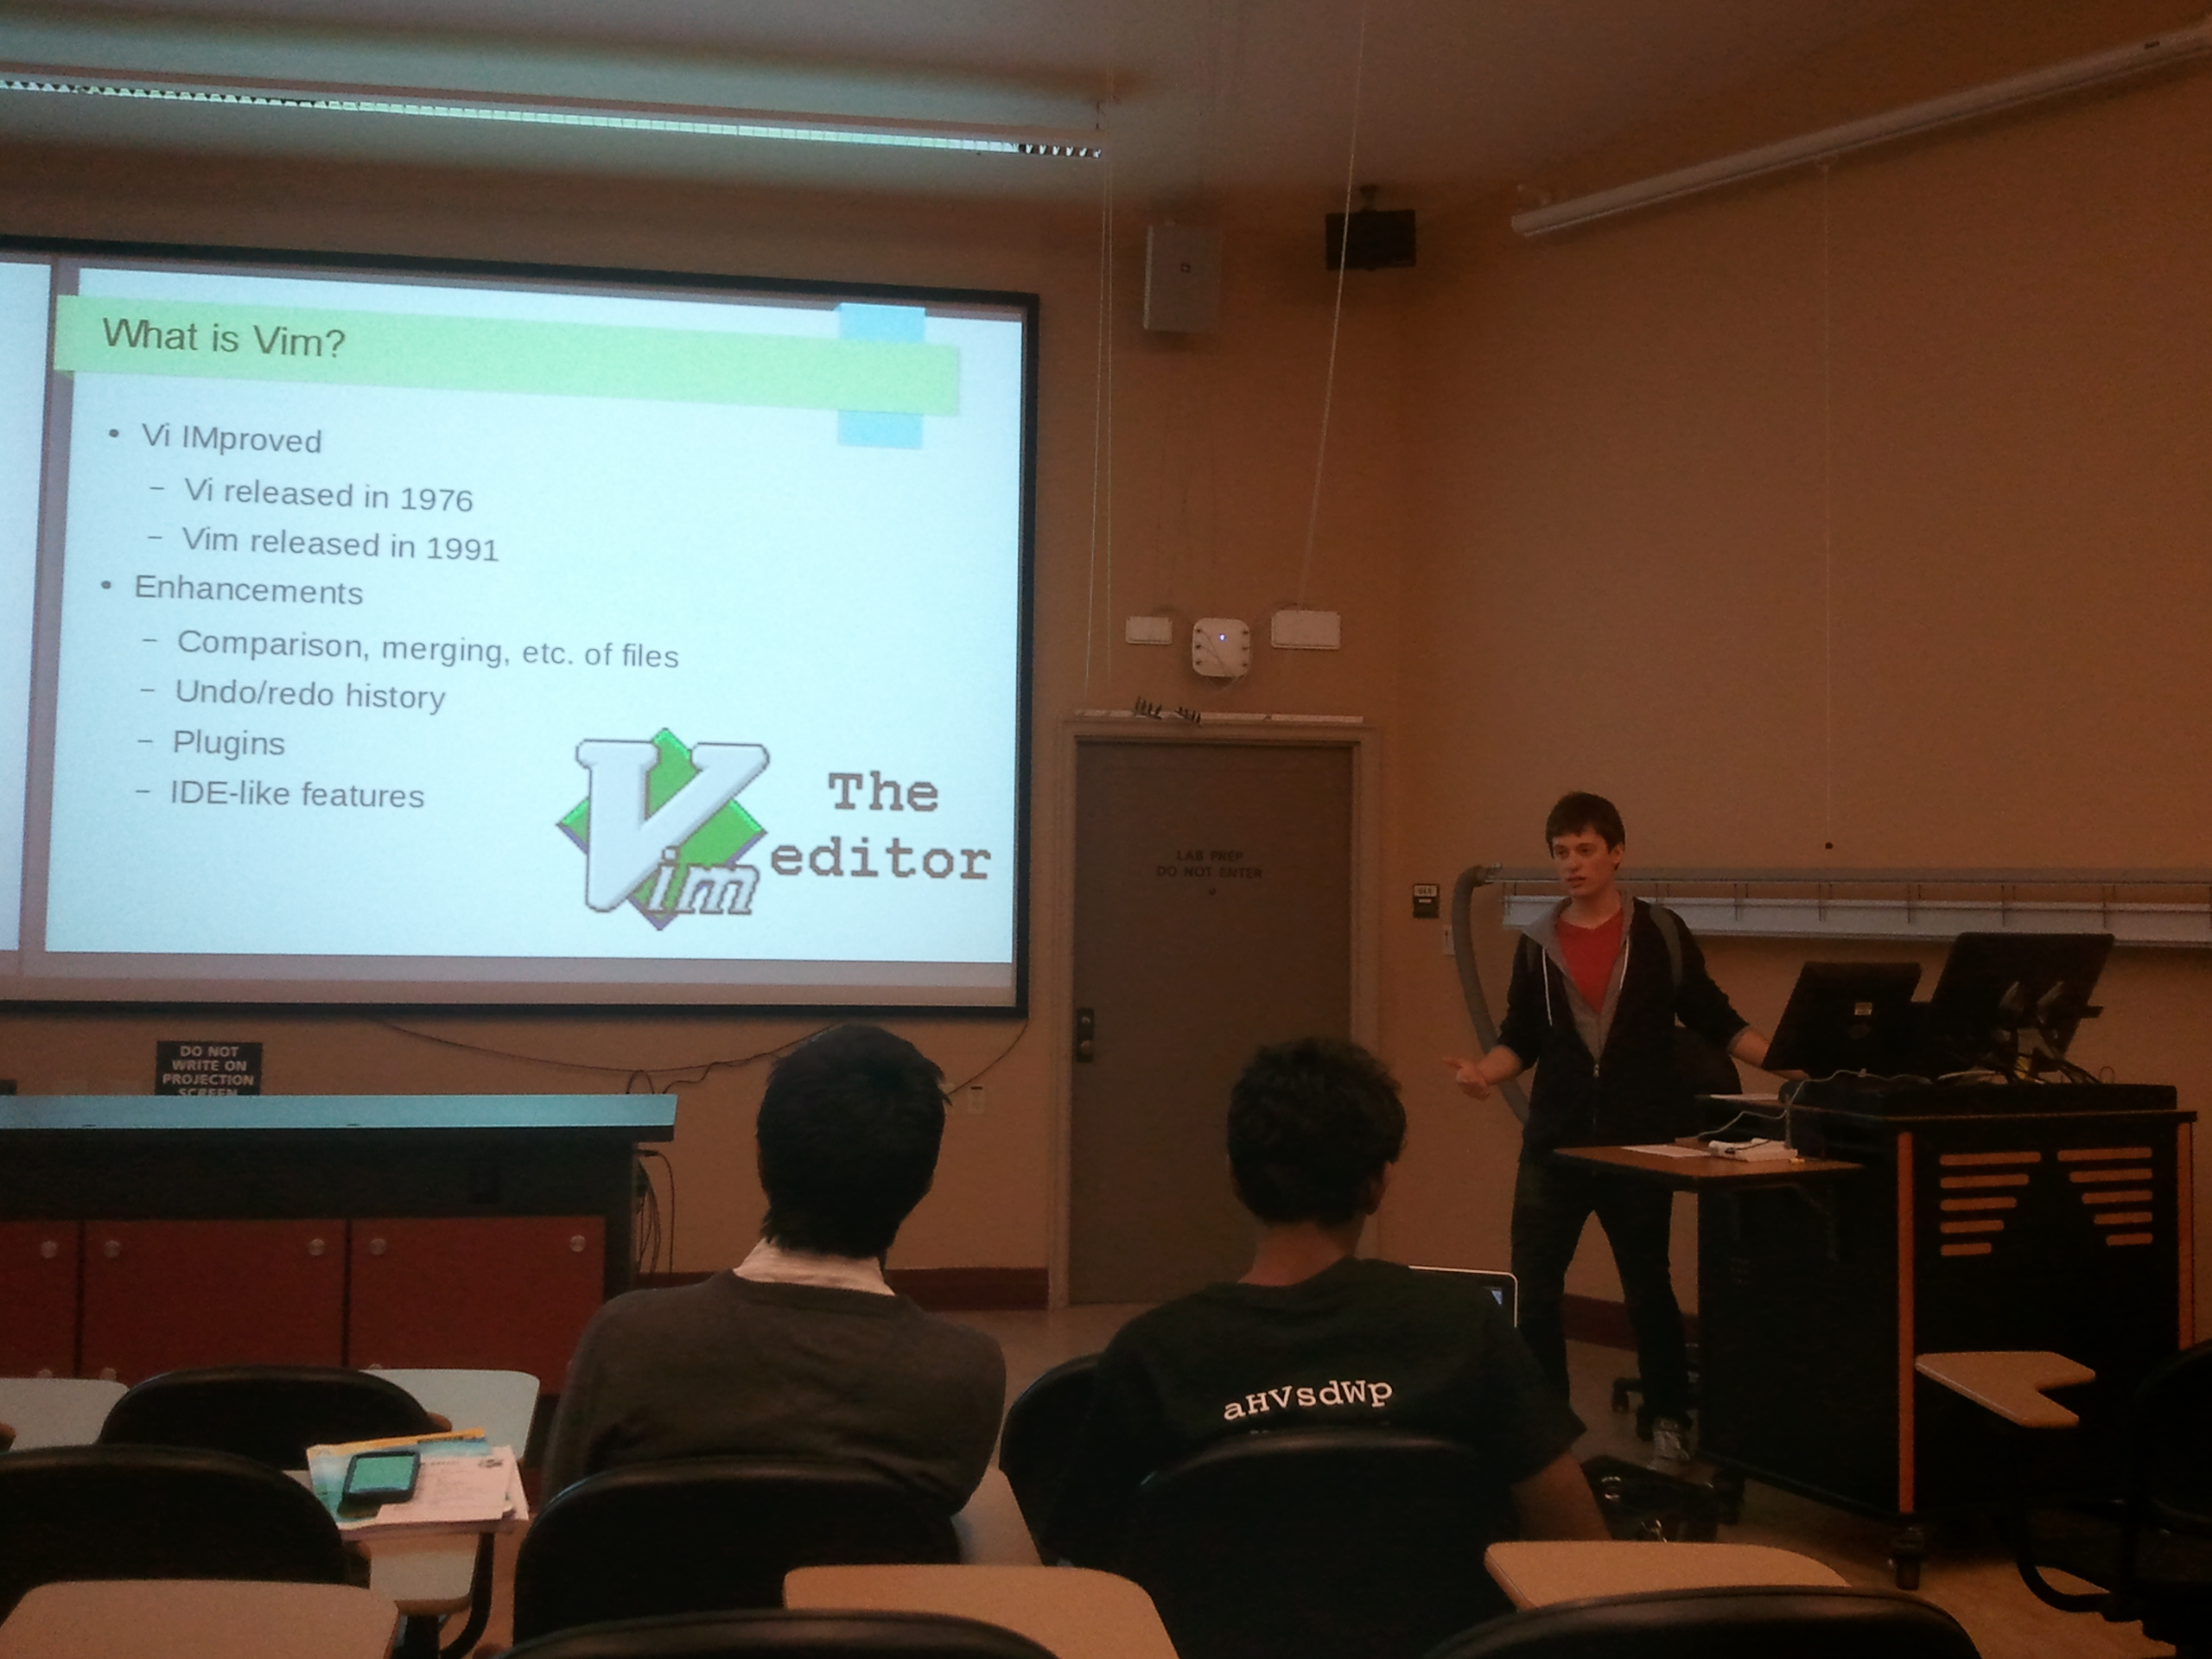
Linux 201 Topics
Introduction to Vim
Bash Scripting
Extended Linux topics
???

Slide 5
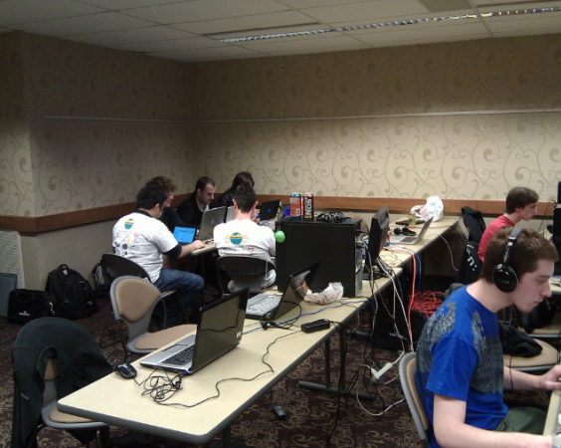
Open Source LAN and
Member Projects
Food
Fun
Frags

Slide 6
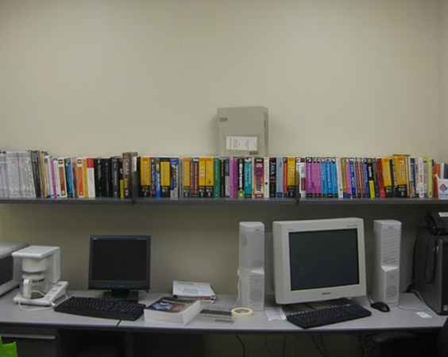

PLUG Library
Hundreds of titles, free to check out
Mathematica, Samba, Unix, Redhat, Networking
and much more!

Slide 7
More information
Google Calendar - purduelug.org/calendar
Mailing List - PurdueLUG @ googlegroups.com
Dates to look forward to:
Linux 201 #1 - Tuesday, Feb. 10th

Slide 8



