Slide 1
Purdue Linux Users Group
2014-09-24

Slide 2
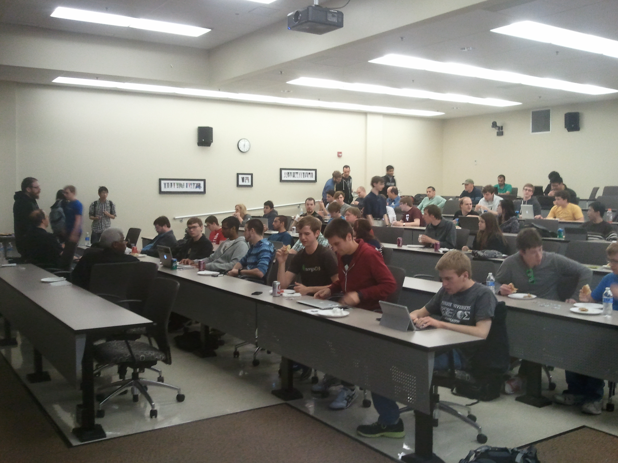



What PLUG does
Company tech-talks (free food)

Slide 3
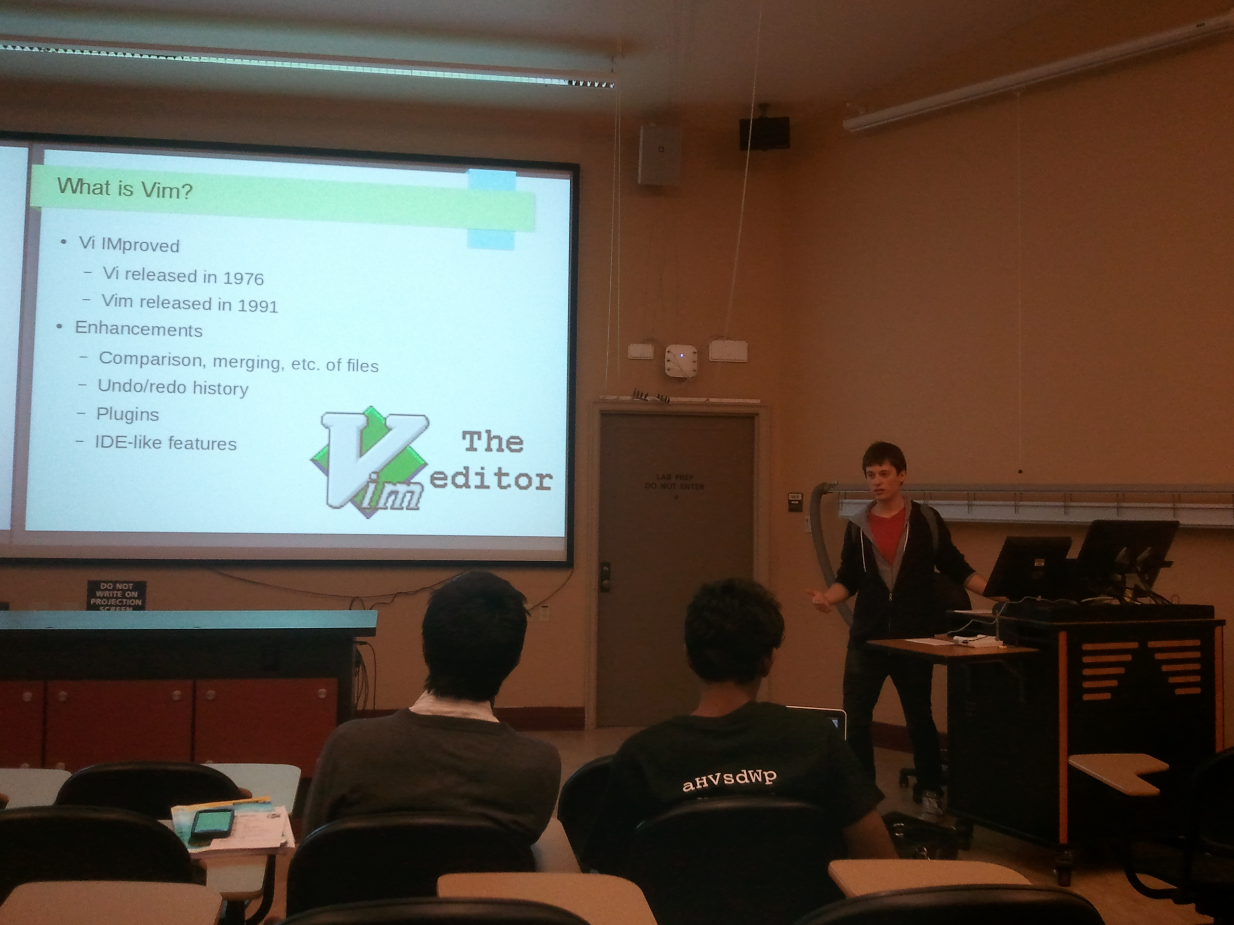
Student Tech Talks
Students talking about what they know.
android, arduino,
web-dev, etc

Slide 4
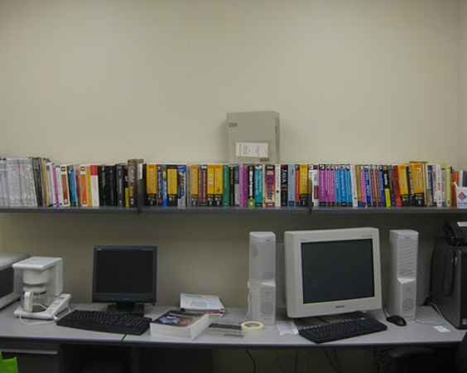

PLUG Library
Hundreds of titles, free to check out
Mathematica, Samba, Unix, Redhat, Networkingand much more!

Slide 5
PLUG 101 Topics
Introduction to Linux
Using package managers - apt-get, yum
Vim
Bash Scripting

Slide 6
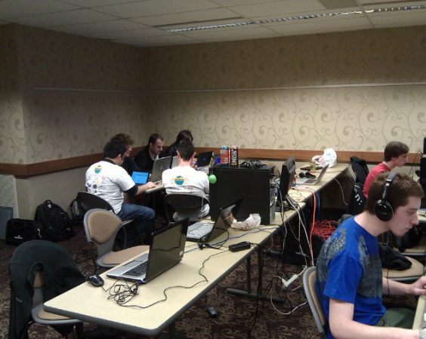
Open Source LAN and
Member Projects
Food
Fun
Frags

Slide 7
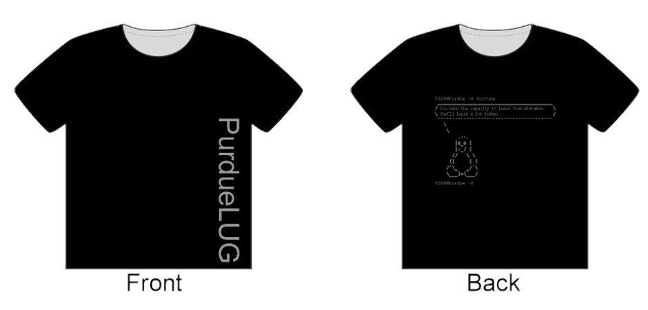
PLUG T-Shirts

Slide 8
More information
Google Calendar - purduelug.org/calendar
Mailing List - PurdueLUG @ googlegroups.com
Dates to look forward to:
Linux 101 #4 - Sep. 30th, REC123, 7pm
Mini Techtalks - Oct. 4th, ARMS1109, 11:30am

