Slide 1
PLUG Meeting #1
PurdueLUG - 2014-09-09

Slide 2
Overview
Linux 101
Openhatch
Boilerbuntu
Techtalks
Event Scheduling

Slide 3
Linux 101
Next event: September 16th, Lawson B131
  Package Managers - Nick
  Time?
Distribute fliers for #2
Open to suggestions for #4 and #5
Other presenters

Slide 4
Openhatch
'Open Source Comes to Campus' - campus.openhatch.org
Potential cooperation with Computer Science Women's Network (CSWN)
November 15th or 16th
Notes:
http://blog.openhatch.org/2013/teaching-open-source-at-purdue-university/

Slide 5
Boilerbuntu

Slide 6
Mini Techtalks
5-10m presentations on something that interests you
Don't have to be an expert
Fri. Sep. 26th - Sun. Sep. 28th ???
Notes:
http://blog.openhatch.org/2013/teaching-open-source-at-purdue-university/

Slide 7
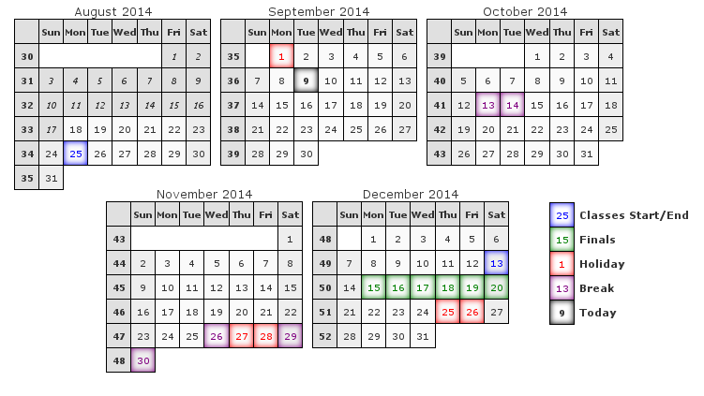
Mini Techtalks, Company Techtalk, OS LAN
Notes:
http://blog.openhatch.org/2013/teaching-open-source-at-purdue-university/

Slide 8
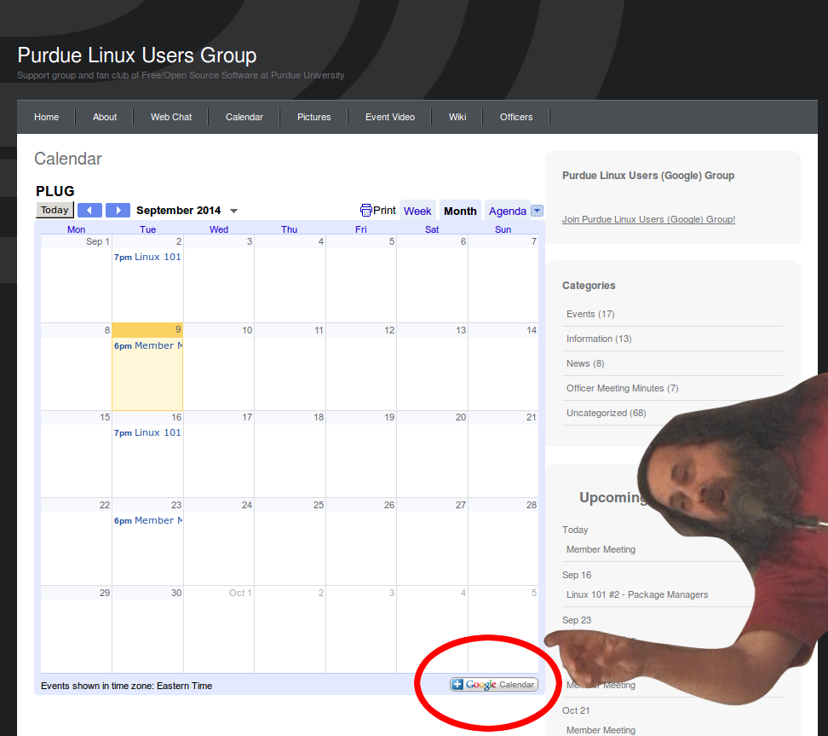
Notes:
http://blog.openhatch.org/2013/teaching-open-source-at-purdue-university/

Slide 9
Stay updated at
purduelug.org/calendar
freenode:#purduelug
Notes:
http://blog.openhatch.org/2013/teaching-open-source-at-purdue-university/

