Slide 1
PLUG Meeting #2
PurdueLUG - 2014-09-23

Slide 2
Overview
Office Hours
Linux 101
T-Shirts
Techtalks

Slide 3
Linux 101 #4
Next event: September 30th, REC123, 7pm
  Bash Scripting - Evan
  Automating tasks, command line
Distribute fliers for #4
Other presenters for #5?
  (iptables, SysV, systemd, compiling, etc.)

Slide 4
Office Hours
HKN Lounge - EE24
Jack - Monday, 2pm
Nick - Thursday, 2pm
Evan - Friday, 11am

Slide 5
Openhatch
'Open Source Comes to Campus' - campus.openhatch.org
Potential cooperation with Computer Science Women's Network (CSWN)
November 15th or 16th
Notes:
http://blog.openhatch.org/2013/teaching-open-source-at-purdue-university/

Slide 6
Boilerbuntu

Slide 7
T-Shirts
Mininum order: 12
approximately 13-15 dollars
Notes:
http://blog.openhatch.org/2013/teaching-open-source-at-purdue-university/

Slide 8
Mini Techtalks
Saturday, October 4th, ARMS1109, 12pm
5-10m presentations on something that interests you
Don't have to be an expert
topic ideas: Wine, Greasemonkey, Gimp
Notes:
http://blog.openhatch.org/2013/teaching-open-source-at-purdue-university/

Slide 9
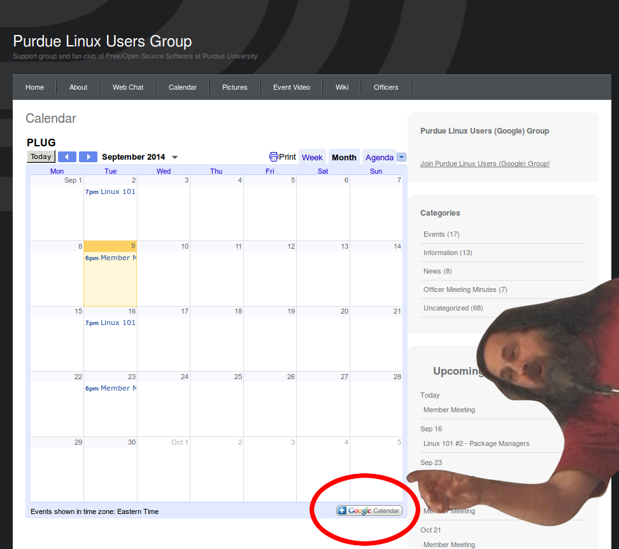
Notes:
http://blog.openhatch.org/2013/teaching-open-source-at-purdue-university/

Slide 10
Stay updated at
purduelug.org/calendar
irc.freenode.net #purduelug
Notes:
http://blog.openhatch.org/2013/teaching-open-source-at-purdue-university/

