Slide 1
PLUG Meeting #2
PurdueLUG - 2015-03-11

Slide 2
Office Hours
PLUG Office B128
Jack - Friday, 11:30am
Evan - Friday, 3:30pm

Slide 3
Semester Events
Using Git & Github Monday, Apr. 13th - 6pm
Perl Guest Presenter Monday, Mar. 30th - 6pm
  (tentative)
Open-Source LAN Friday, Apr. 17th - 6pm
Notes:
http://blog.openhatch.org/2013/teaching-open-source-at-purdue-university/

Slide 4
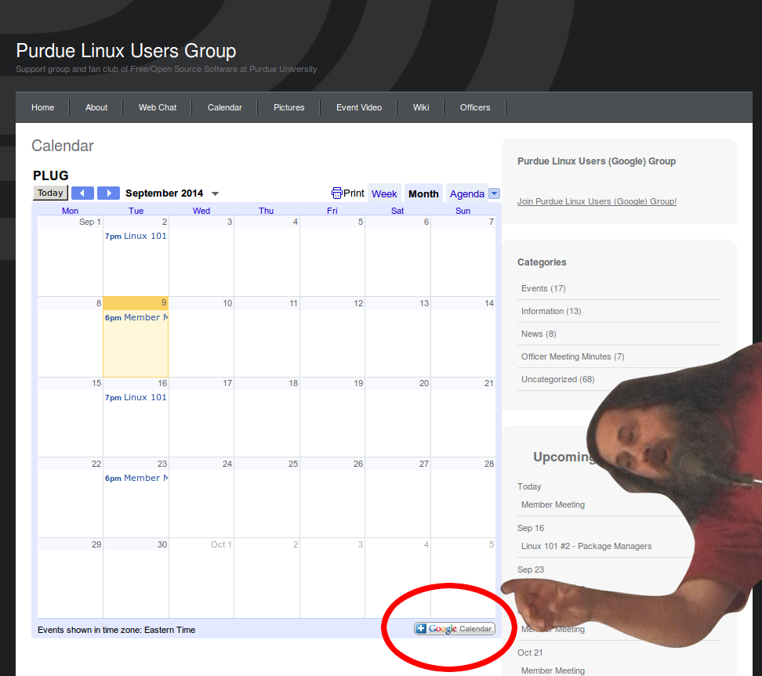
Notes:
http://blog.openhatch.org/2013/teaching-open-source-at-purdue-university/

Slide 5
Stay updated at
purduelug.org/calendar
irc.freenode.net #purduelug
Notes:
http://blog.openhatch.org/2013/teaching-open-source-at-purdue-university/

