Slide 1
PLUG Meeting #6
PurdueLUG - 2014-11-04

Slide 2
Overview
Office Hours
Linux 101
T-Shirts
Openhatch

Slide 3
Linux 101 #6
Next event: November 18th, REC123, 7pm
  systemd - Evan
  writing your own scripts, startup actions

Slide 4
Office Hours
PLUG Office B128
Jack - Monday, 2pm
Nick - Thursday, 2pm
Evan - Friday, 11am

Slide 5
Openhatch
'Open Source Comes to Campus' - campus.openhatch.org
Cooperation with Computer Science Women's Network (CSWN)
November 16th
Notes:
http://blog.openhatch.org/2013/teaching-open-source-at-purdue-university/

Slide 6
T-Shirts
Mininum order: 12
approximately 13-15 dollars
Notes:
http://blog.openhatch.org/2013/teaching-open-source-at-purdue-university/

Slide 7
Opensource LAN
Friday, Nov. 7th - 6pm
Pizza and candy and games
Notes:
http://blog.openhatch.org/2013/teaching-open-source-at-purdue-university/

Slide 8
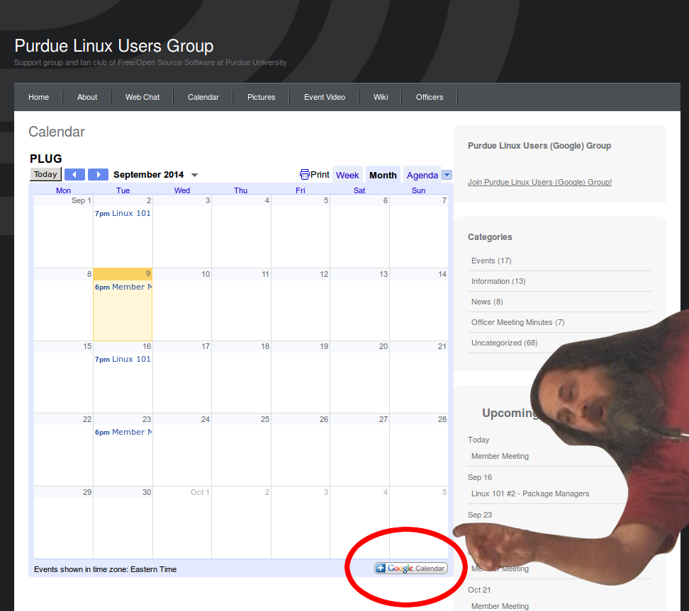
Notes:
http://blog.openhatch.org/2013/teaching-open-source-at-purdue-university/

Slide 9
Stay updated at
purduelug.org/calendar
irc.freenode.net #purduelug
Notes:
http://blog.openhatch.org/2013/teaching-open-source-at-purdue-university/

