Slide 1
Carruthers Research Summary
Evan Widloski
2023-12-21

Slide 2
Outline
Carruthers Mission Overview
Emission Model
Instrument Model and Post Processing
Tomography Problem Formulation
Retrieval Validation
Differentiable Tomographic Projector
Uncertainty Quantification
Kalman Filter

Slide 3
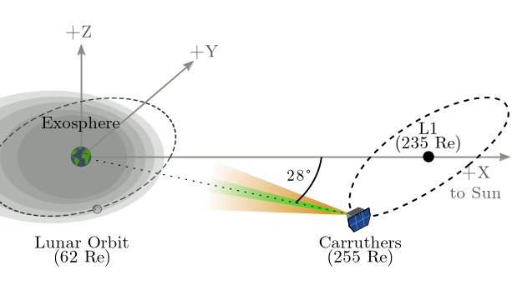
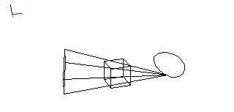
Viewing Geometry
Carruthers completes 1 orbit around L1 once every 6 months
Angle diversity in ecliptic plane: ±28°
Angle diversity in ecliptic pole: ±7°
Two instruments with different FOV
WFI Detector
18°, 512² pix
30 min cadence
NFI Detector
3.6°, 1024² pix
60 min cadence
6 mo. WFI view geometry
with 50 Re cube centered on Earth

Slide 4
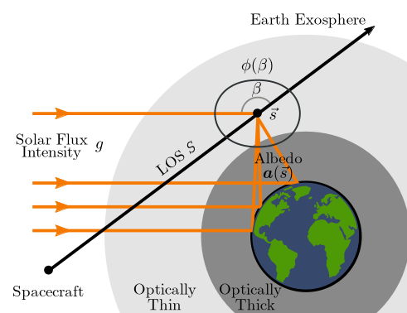
Emission Model
Emission model can be broken into 3 parts
Single scattering through optically thin atmosphere
Angle-dependent (anisotropic) scattering - ϕ
Enhancement due to contributions from optically thick atm. and Earth surface - a

Slide 5
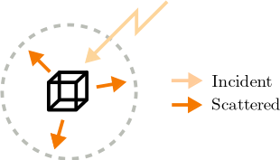
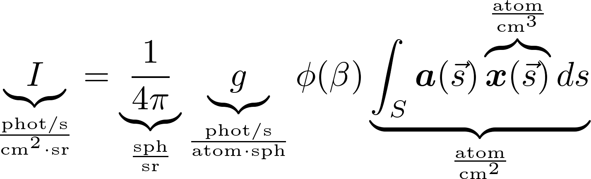
Dimensional Analysis
ϕ - Angle-dependent anisotropic scattering (unitless)
a - Apparent density enhancement due to Earth surface scattering (unitless)
g - Solar g-factor - photon scattering rate (phot/s/atom/sph)

Slide 6
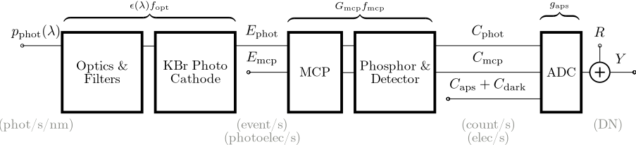
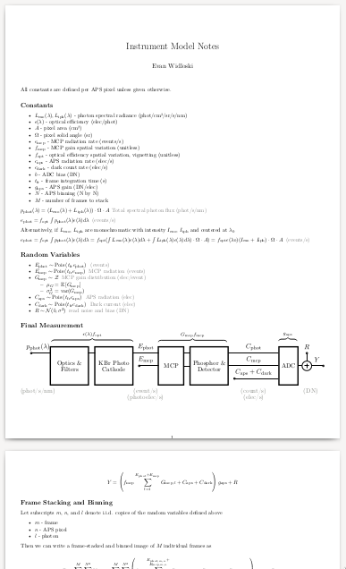
Instrument Model (Noise Model)
Complexity of instrument/noise models summarized in manuscript
Consists of sum of Poisson/Empirical RVs where summation bound is another RV
Showed numerically/analytically this is well-approximated by Gaussian given sufficient integration time (Ephot + Emcp →∞)

Slide 7
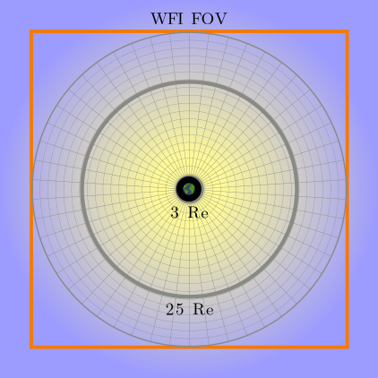
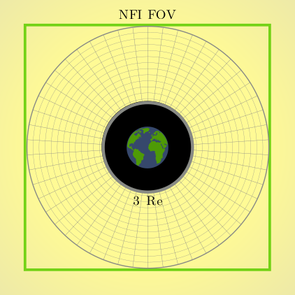

Slide 8


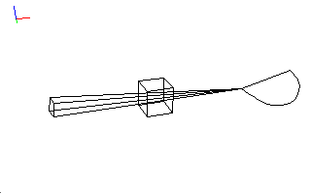


Sample Measurements (out of date)
Pratik data
Summer solstice 2022
Zoennchen data
2015 Solar max
3 month viewing geometry
with 50 uniform vantages, Summer 2025
Noiseless
Noisy

Slide 9
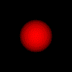
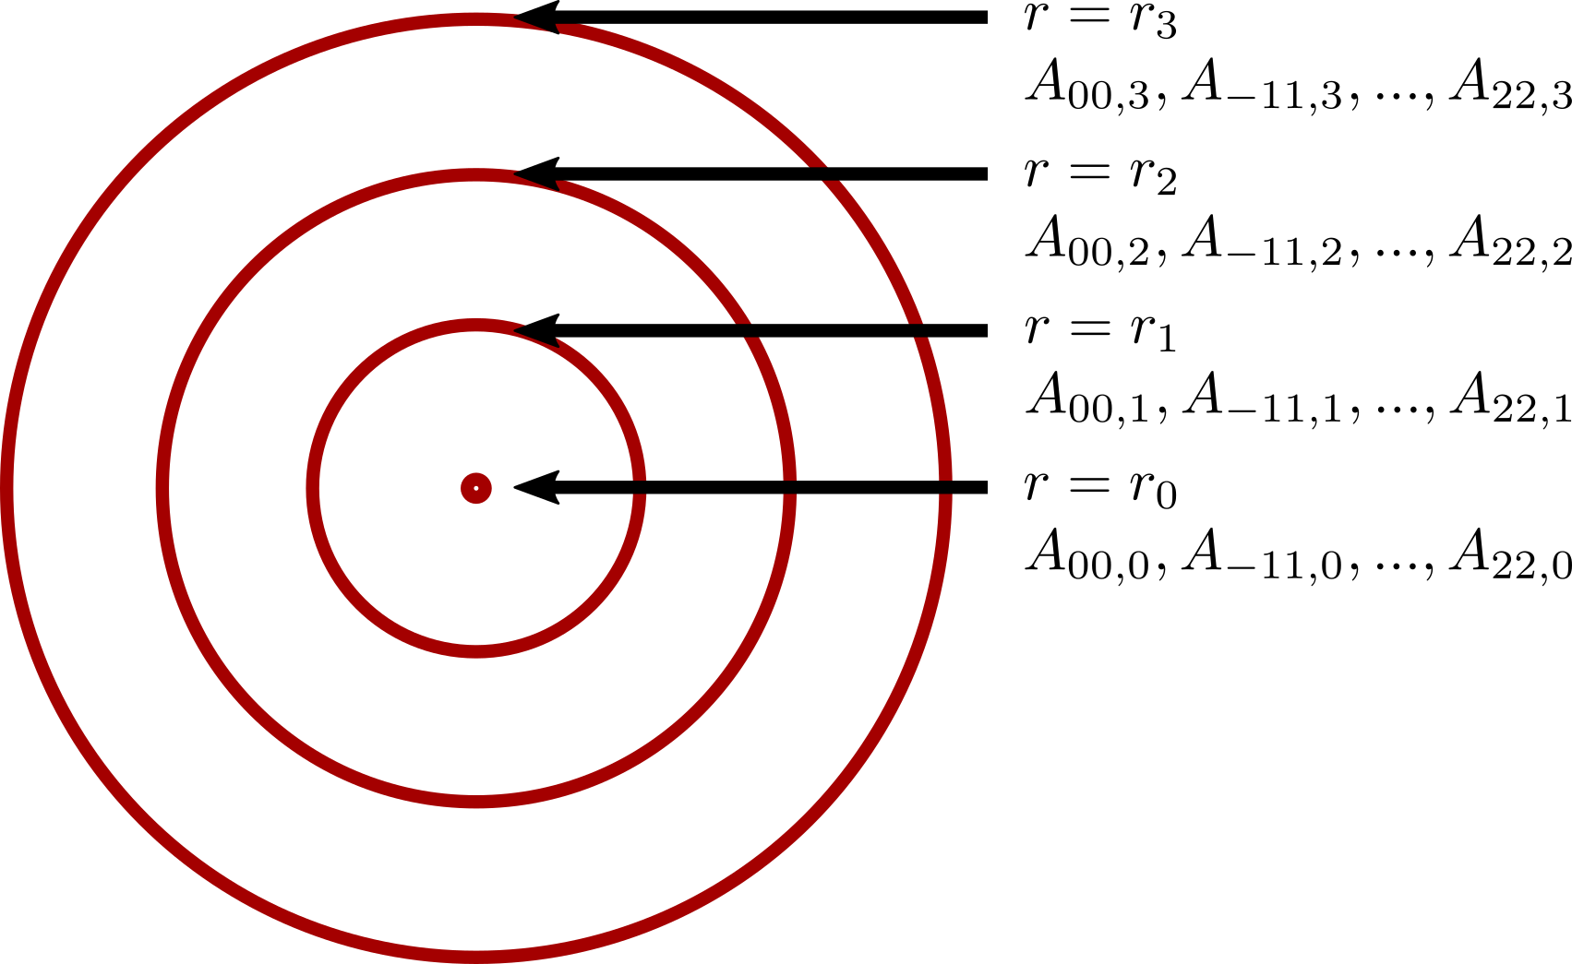
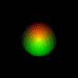
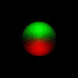
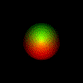
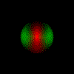
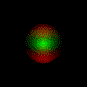
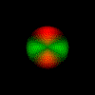
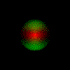
Static Reconstruction Model Assumptions
Assume every radial shell of ground truth is well approximated by low-order linear combination of spherical harmonic functions
Assume scaling coefficients vary smoothly in radial direction → spline interpolation
Example: 4 control shells with 9 harmonic functions each: 36 free parameters
Spherical harmonic functions up to second order

Slide 10
Additional Expectations of Static Model
Density should be non-negative (R1)
Density is smooth in the radial direction (R2)
Density is smooth in the azimuthal/elevational direction
  Implicit from the spherical harmonic bases
Density decays monotonically in the radial direction
  Regularizer not necessary from experimentation

Slide 11
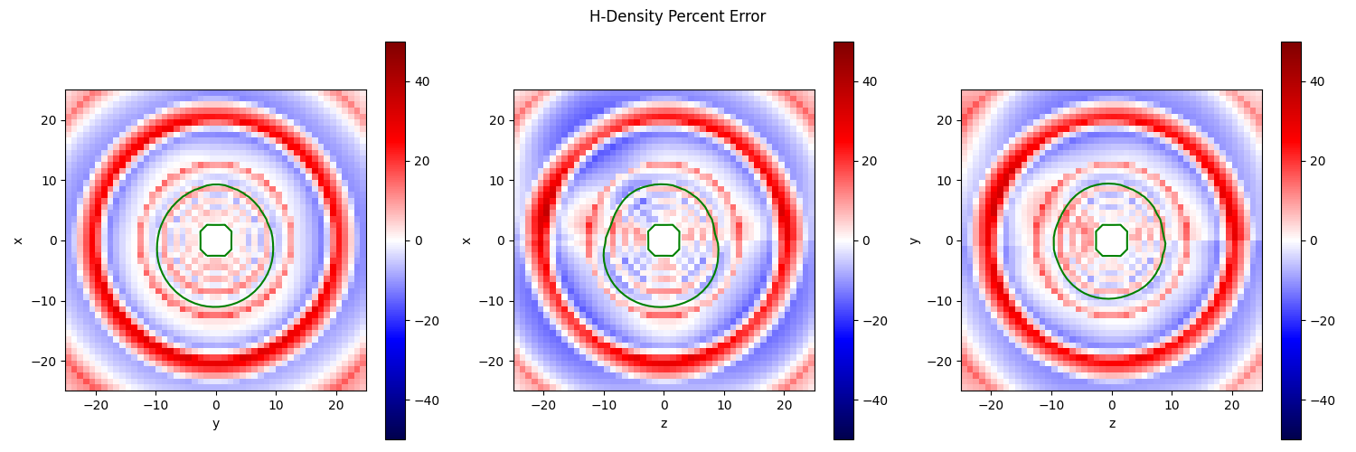
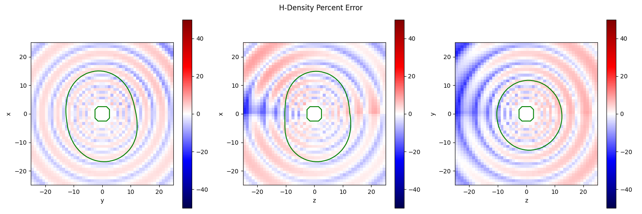
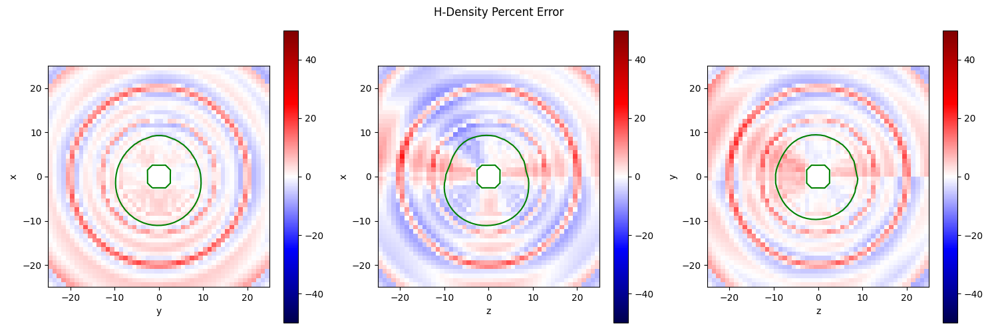
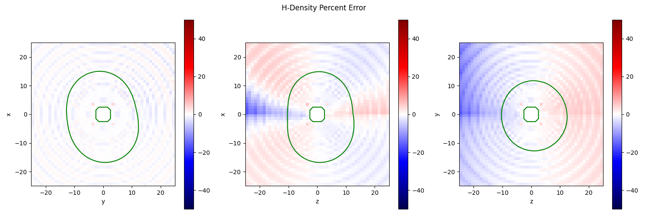
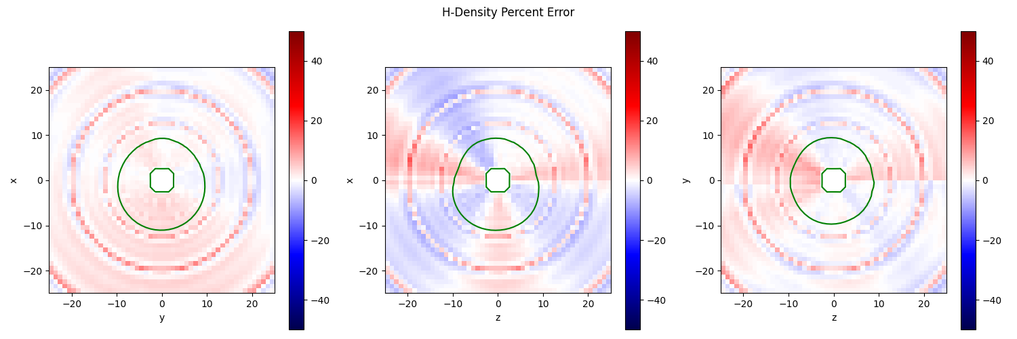
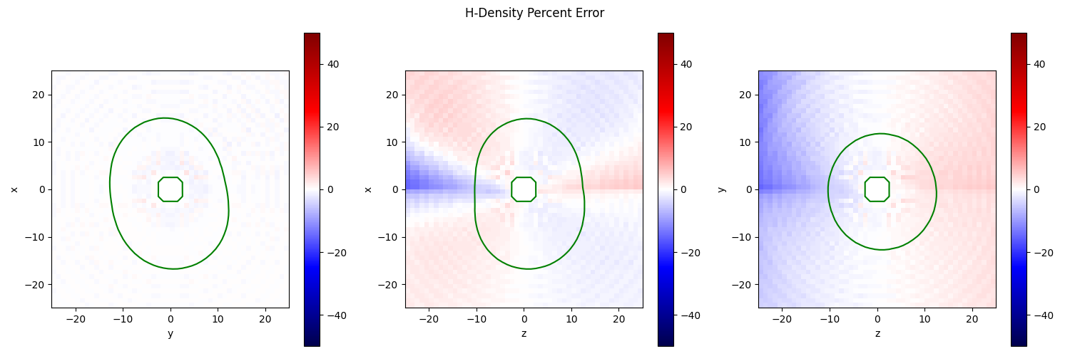
How well does assumed model fit the data?
Direct fit of model to data. Assumes knowledge of ground truth
Ripples indicate issue with linear interpolation
Pratik
Zoennchen
shells=10
order=2
shells=20
order=2
shells=30
order=2

Slide 12
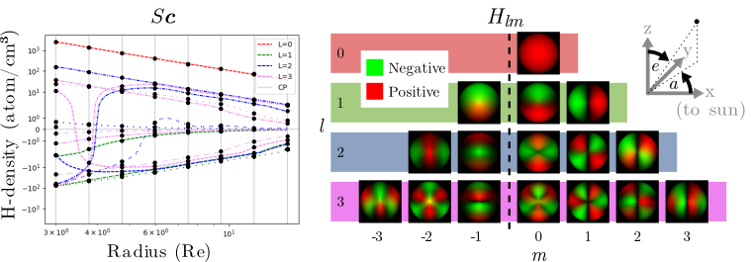

Inverse Problem Formulation
F:R^{T×N³}→R^{100×50} - Forward tomographic operator
H:R^{X×N}→R^{T×N³} - Spherical harmonic basis functions
S:R^{X×K}→R^{X×N} -
y - noisy measurements
c ∈ R^{X×K} - Model coefficients (at spline control points)
Fidelity
Sparsity
Positive Density

Slide 13
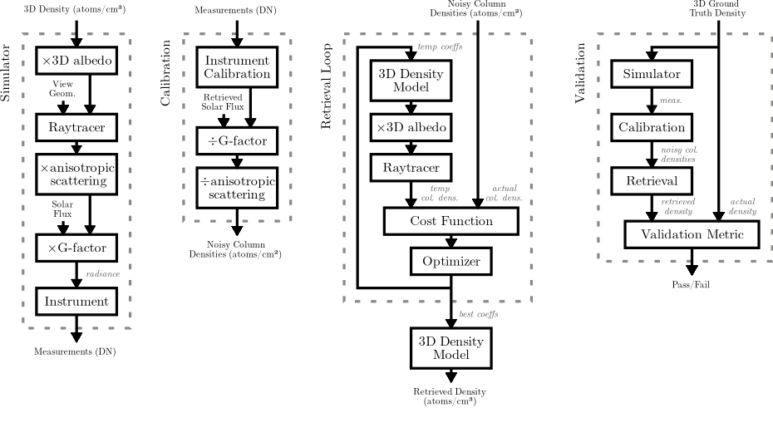
Carruthers Pipeline Summary

Slide 14
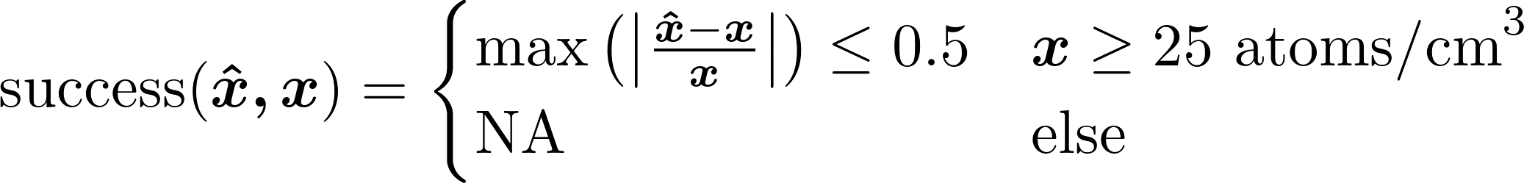
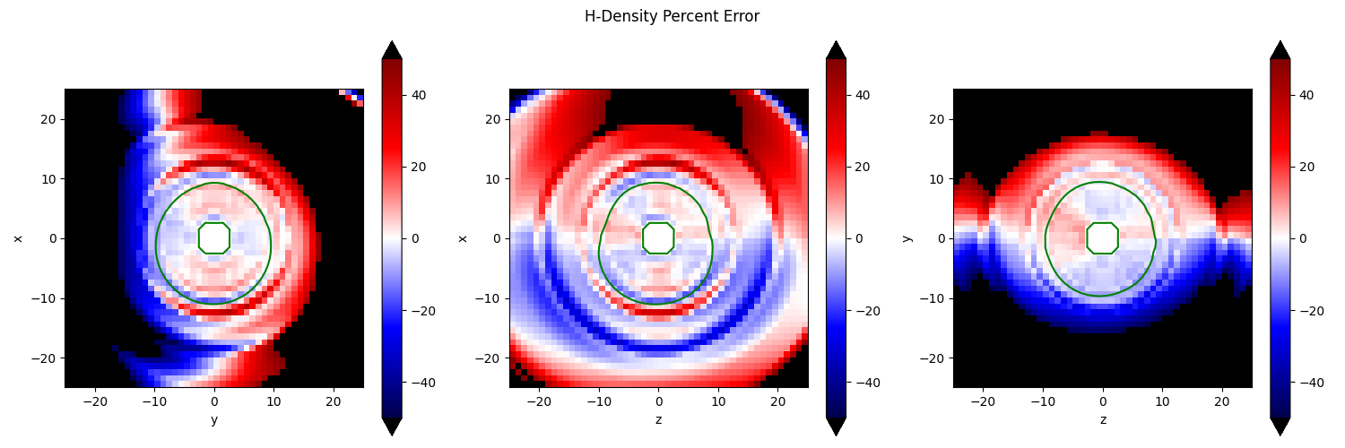
Simplified Validation Criterion
x̂ - reconstruction
x - ground truth
Example validation plot showing relative errors in cardinal planes. Green line is 25 atoms/cm³ boundary
Requirements given in PLRA document are more complicated, involving spatial/temporal resolution constraints.

Slide 15
Reconstruction Results

Slide 16
Inverse Problem Formulation
m:R^{k}→R^{T×N³} - Model. A Mapping from low-dimensional representation to density
f:R^{T×N³}→R⁵¹²² - forward tomographic operator
y - noisy measurements
c ∈ R^{C} - reconstructed model coefficients
Off-the-shelf line integrator inside f through Tomosipo package - GPU/autograd
My implementations of different m through Pytorch - GPU/autograd

Slide 17
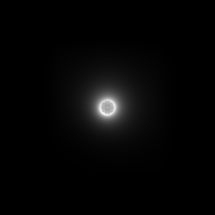
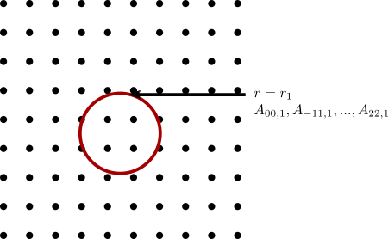
Static Validation Datasets - Ground Truth (out of date)
“Zoennchen” dataset
Spherical harmonics defined on single shell
Exponential decay outwards
Derived from 2015 solar max
“Pratik” dataset
Derived from NRLMSIS data
Plot of Zoennchen and Pratik datasets from 3Re to 25Re

Slide 18
















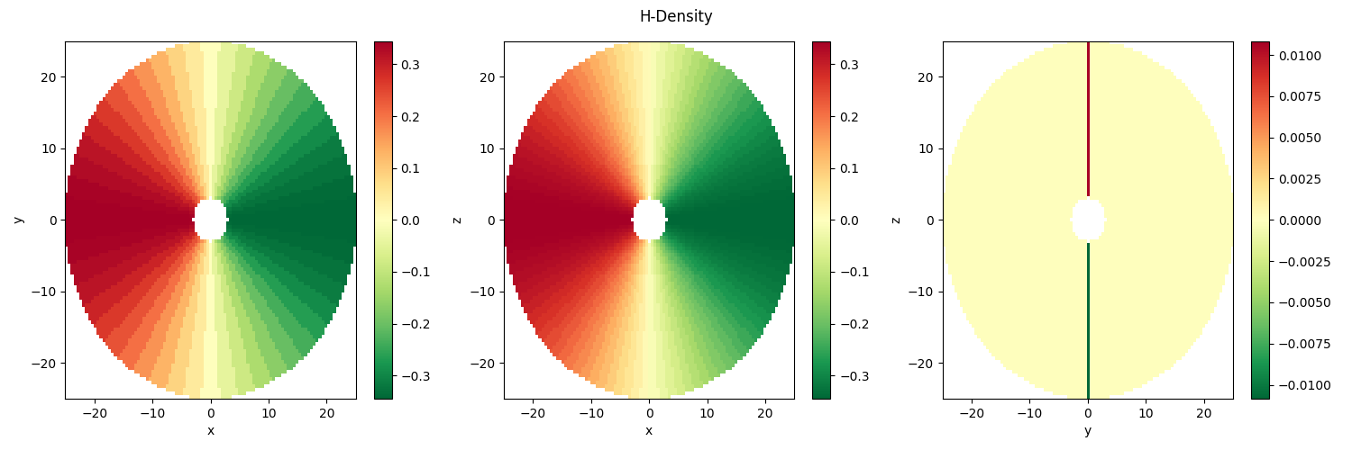
Real Spherical Harmonic Basis Slm(e, a)
+Z
0
Bl|m|
Alm
1
Positive
L
Negative
2
3
-3
-2
-1
0
1
2
3
M
S11 is negative towards +X
Notes:
aaa

Slide 19
Validation Dataset Overview
Name | Dynamic/Static | Derived from | Condition | Source
Zoennchen | Static | TWINS | Quiet | [Zoennchen 2024]
Gonzalo | Static | TWINS | Quiet | [Zoennchen 2024]
Pratik | Dynamic | NRLMSIS | Quiet | Pratik Joshi
Connor | Dynamic | Physics-based | Storm
Gonzalo Dynamic | Dynamic | TWINS

Slide 20
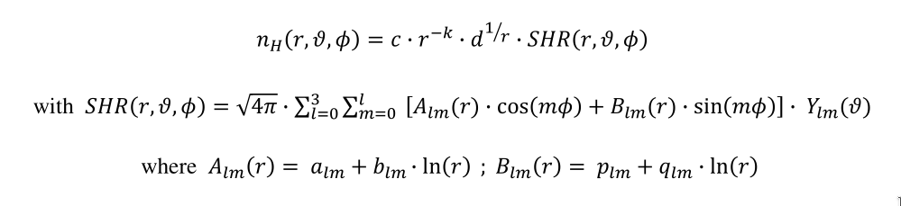
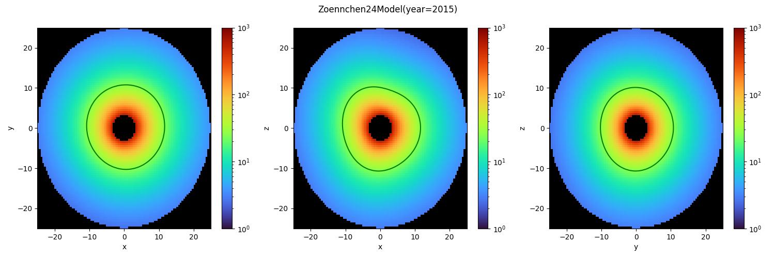
Zoennchen Validation Dataset
Spherical harmonic basis up to order L=3
Static
Separable - Spherical harmonic coefficients defined for single shell w/ radial decay

Slide 21

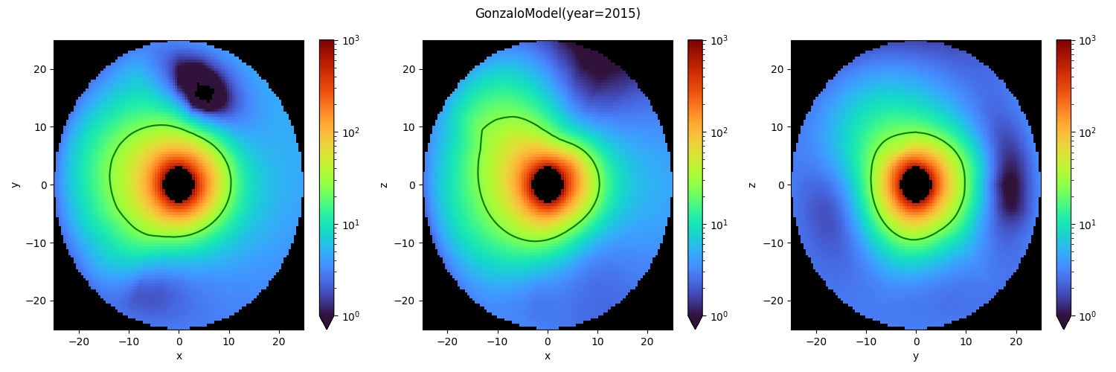
Gonzalo Validation Dataset
Referred to as “High degree-of-freedom (HDoF)” in paper
Static
MAP estimate
  xref - initial estimate of density derived spherically symmetric Chamberlain profile
  Q - precision matrix

Slide 22
GSE Coordinate System WIP
explain GSE
other coordinate systems - ECI

Slide 23
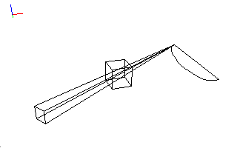

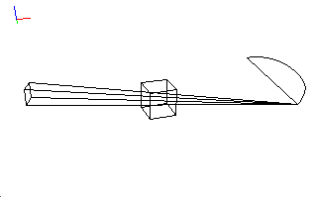
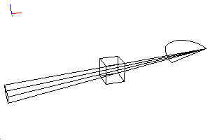
Season Dependent Static Retrieval Performance
Static retrieval algorithm performs worse during Summer/Winter when measurement diversity is limited
Spring
Summer
Fall
Winter

Slide 24
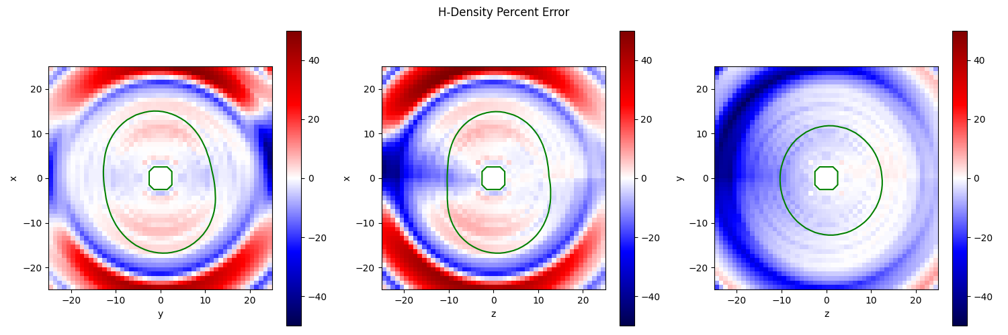
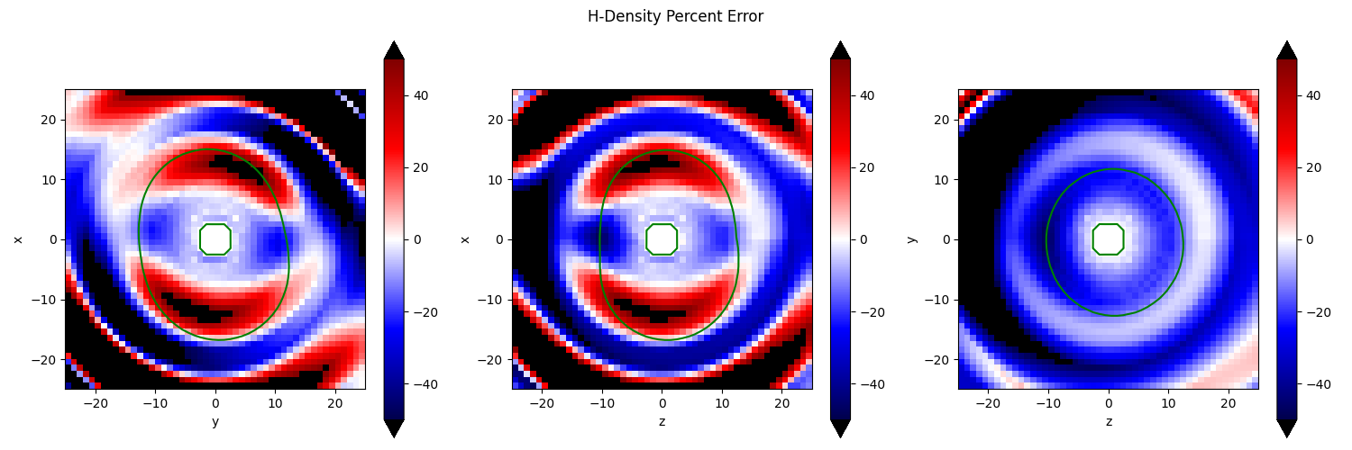
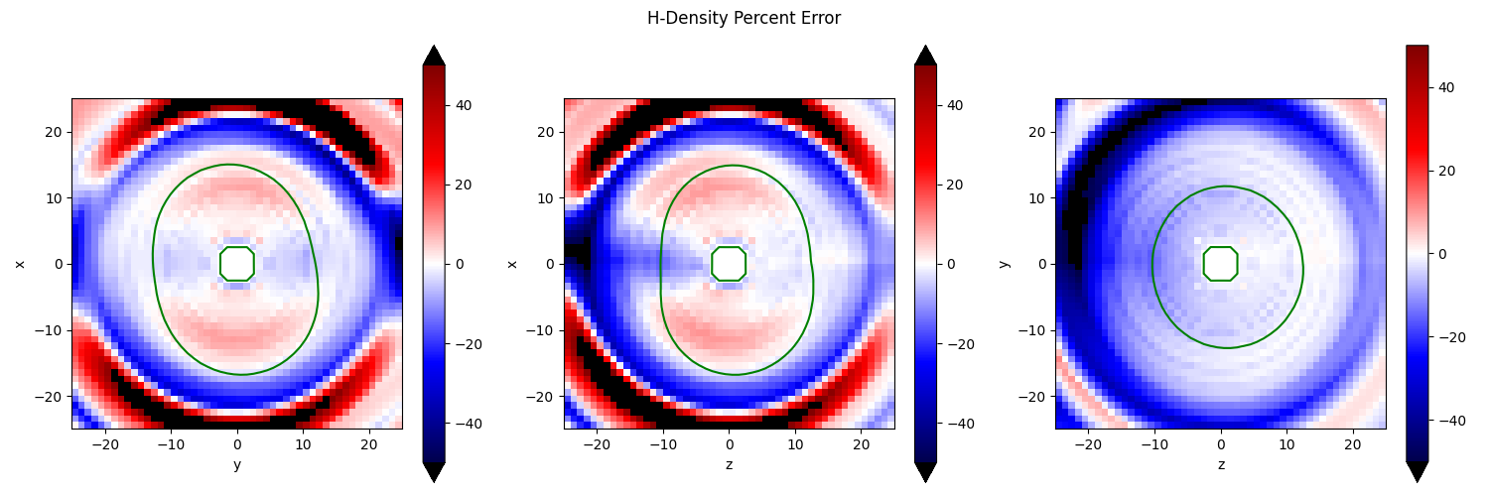
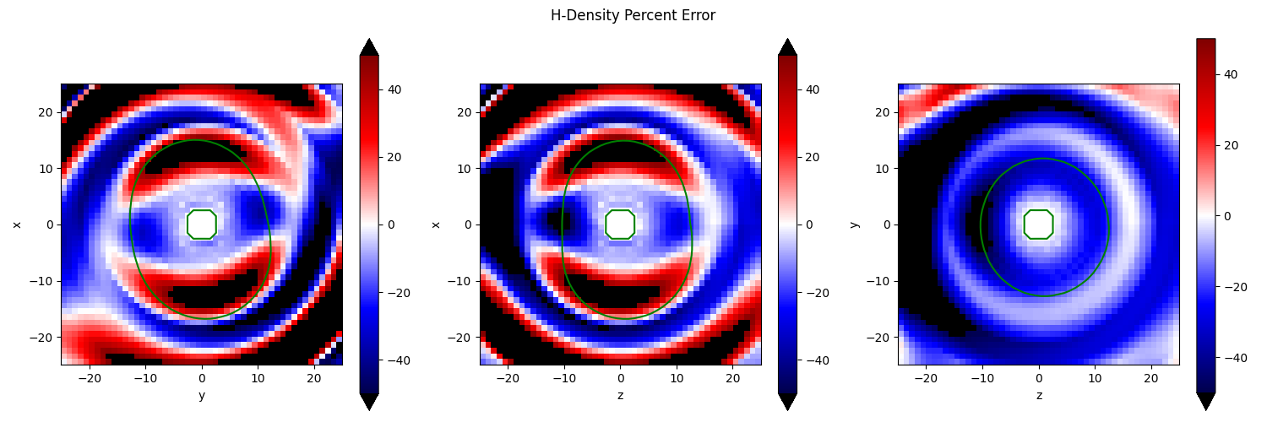
Season Dependent Retrieval Performance
50 vantages over 3 month window. Zoennchen ground truth.
Spring
Summer
Fall
Winter

Slide 25
Dynamic Inverse Problem Approaches
m:R^{k×T}→R^{N³×T} - Model. A Mapping from low-dimensional representation to density
f:R^{N³×T}→R^{512²×T} - forward tomographic operator
y ∈ R^{512²×T} - noisy measurements
c ∈ R^{k×T} - reconstructed model coefficients
Conventional formulation with additional temporal regularization
Kalman filter approach

Slide 26
References
[Zoennchen 2024] - Comparison of terrestrial exospheric hydrogen 3D distributions at solar minimum and maximum using TWINS Lyman-α observations

Slide 27
Backup

Slide 28
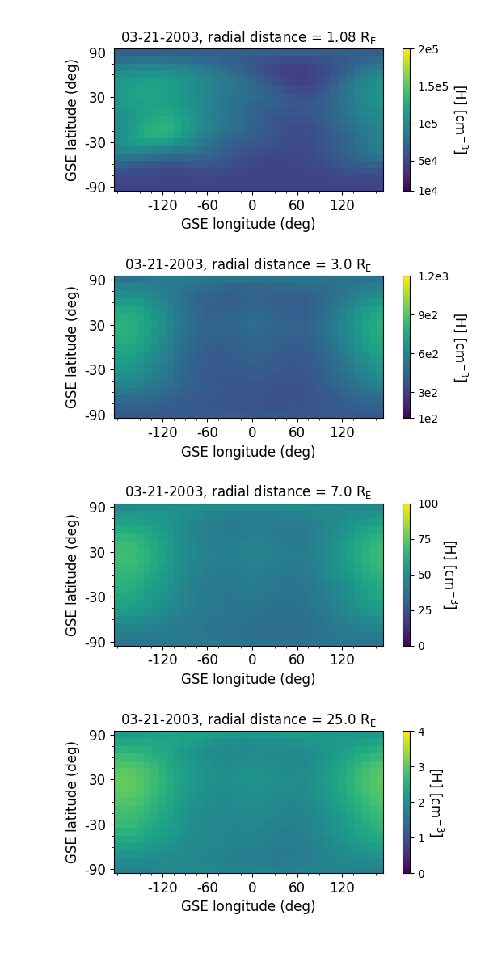
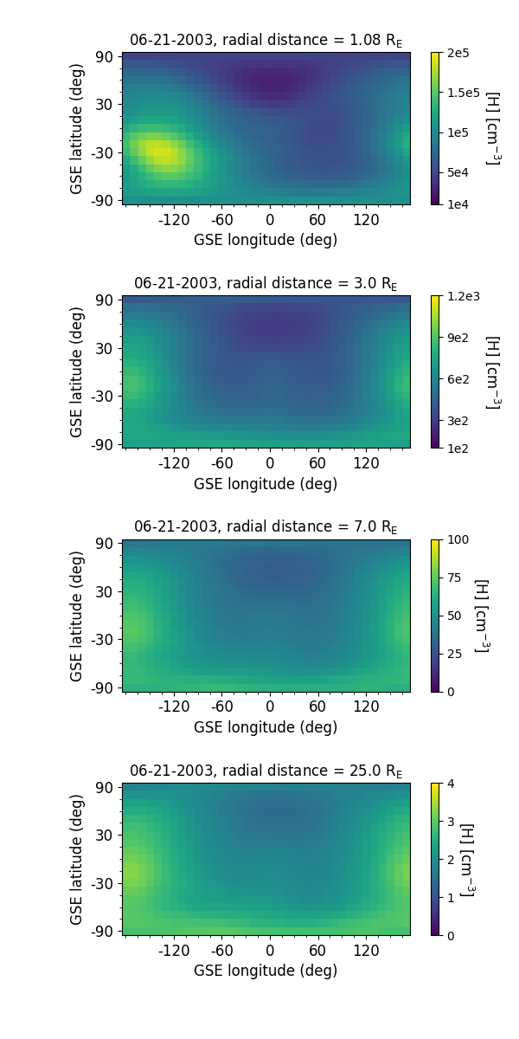
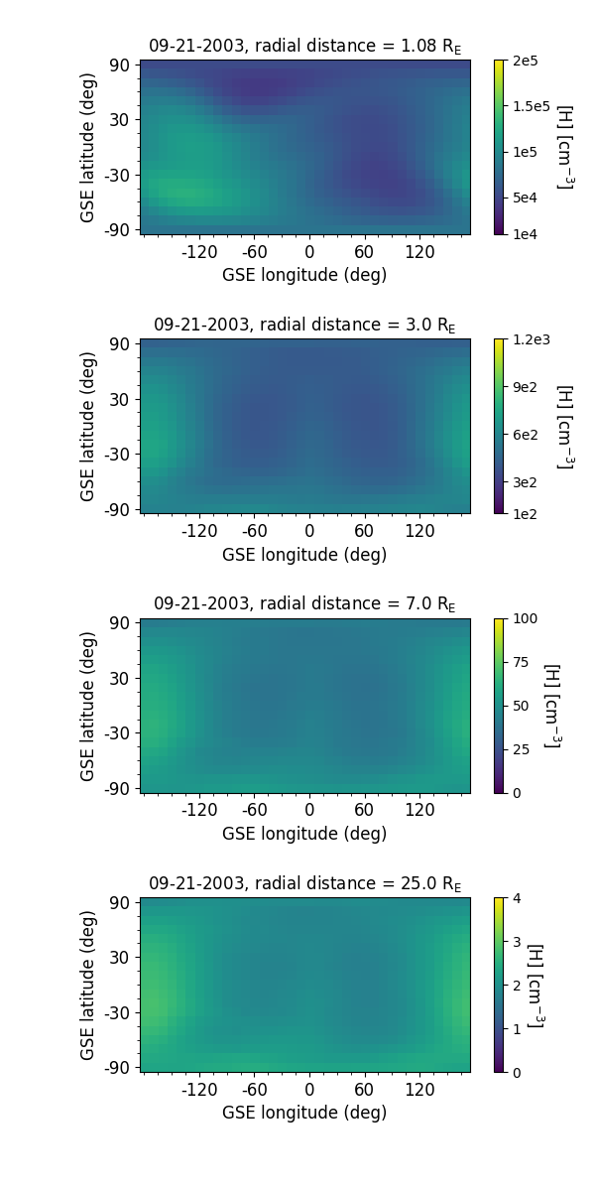

Seasonal variation in 3D H density distribution for a fixed Ap=3 and F10.7=150 sfu
3D H density code is developed based on the analytical exosphere formulation by Vidal-Madjar and Bertaux [1972]
Using exobase H density and temperature specification from MSIS2.1, the Figure below shows the radial variation in H density distribution with GSE latitude and GSE longitude for Spring Equinox, Summer Solstice, Fall Equinox, and Winter Solstice, respectively.
The underlying seasonal variation in H density will be used as prior knowledge (ground truth) for developing the retrieval algorithms in the optically thin exosphere.
21 March 2003
21 June 2003
21 September 2003
21 December 2003

Slide 29
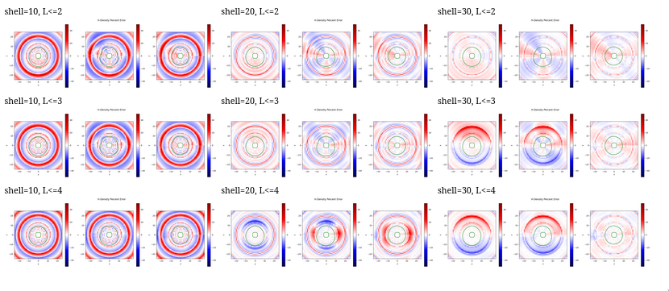
Direct fit of spherical model to Pratik data
(2002 Summer solstice)

Slide 30
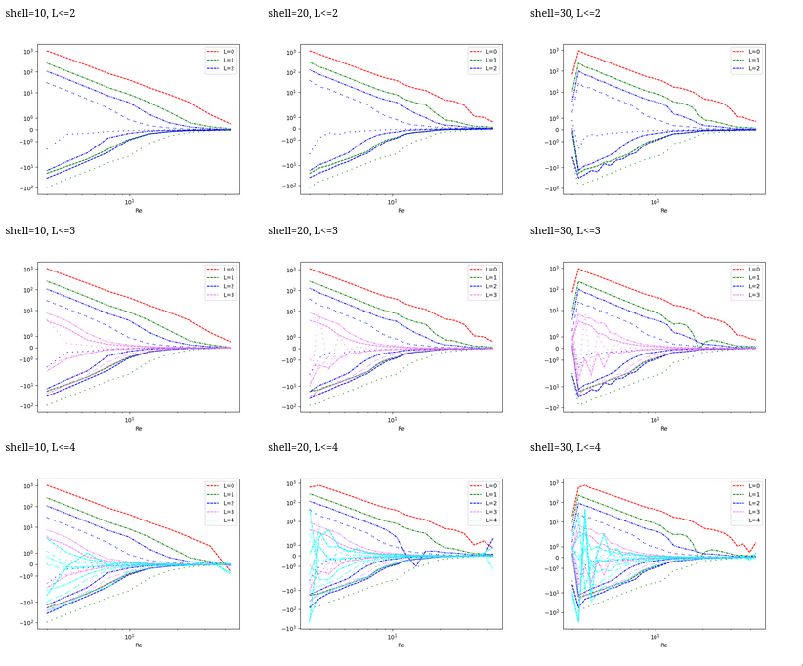
Direct fit of spherical model to Pratik data
(2002 Summer solstice)

