Slide 1
Postscript
Evan Widloski - 2023-04-05
Notes:
things to add
- arrays
- backticks
- wget text vs del file example script

Slide 2
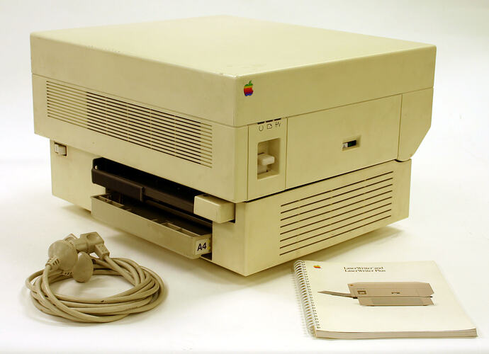
What is Postscript
Page description language (PDL)
  Describes how printed documents look in a vector format
  Allows documents to be typesetted in a printer-agnostic way
Developed at Adobe in ~1982 as one of their first offerings with a focus on document typesetting
Released Postscript spec in public domain
Apple LaserWriter one of the first
printers to ship with a Postscript
interpreter
Postscript began to dominate other
proprietary PDLs from e.g. HP and IBM
Apple LaserWriter, 1985

Slide 3
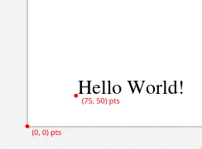
A Postscript Taster
%!
/Times 30 selectfont
75 50 moveto
(Hello World!) show
showpage
Required by Postscript
Set the document font
Move the cursor to position
Write the string to page
Render the page
Coordinates are given in points
1 inch = 72 points

Slide 4
Postscript Stack
Postscript uses postfix notation (aka reverse Polish notation)
  Arguments come before operator
Postscript stack is last-in, first-out
5 3 mul
Put 5 on the stack
Put 3 on the stack
Multiply top two items on the stack
Put result on the stack
Some operations put things back on the stack
(e.g. mul) but others do not (e.g. moveto)
5
15
3
mul

Slide 5
Functions and Variables
Variables are created like so
/x 123 def
And they are referenced without a slash
x x moveto
Functions (a.k.a procedures) are similar
/inch2pts {72 mul} def
5 inch2pts 5 inch2pts moveto
5
360
5
360
360
360
inch2pts
inch2pts
moveto

Slide 6
Postscript Data Types
Number
3 1e5 3.1 16#DEADBEEF
String
(Hello World) (New\nLine)
(New
Line)
Name (aka variable)
/Foo
Array
[1 2 3 4]
Dictionary
http://tid.uio.no/epf/postscript/language.html

Slide 7
Getting Started
Install ghostview (gv)
  `apt install gv`
  Enable file watching: State > Watch file
  Fit to Window: 1.000 > Fit to window
Or use handy webapp
  ehubsoft.herokuapp.com/psviewer
  Show PDF
“test.ps”
%!
/Times 30 selectfont
75 50 moveto
(Hello World!) show
showpage

Slide 8
Getting Started
Install ghostview (gv)
  `apt install gv`
  Enable file watching: State > Watch file
  Fit to Window: 1.000 > Fit to window
Or use handy webapp
  ehubsoft.herokuapp.com/psviewer
  Show PDF
“test.ps”
%!
/Times 30 selectfont
75 50 moveto
(Hello World!) show
showpage

Slide 9

Moving Cursor and Drawing Lines
%!
50 50 moveto
100 50 lineto
0 50 rlineto
closepath
gsave
20 setlinewidth
stroke
grestore
1 0 0 setrgbcolor
fill
Move cursor
First path segment
Another segment
Connect start to end
Save graphics state
Consume path and stroke
Restore graphics state
Consume path and fill

Slide 10

Let's Make Some Art
Save current position
Draw a long line
Return to position
Rotate page under cursor
%!
/longline {
gsave
0 1000 rlineto stroke
grestore
} def
300 400 moveto
longline
90 rotate
longline
90 rotate
longline
90 rotate
longline

Slide 11
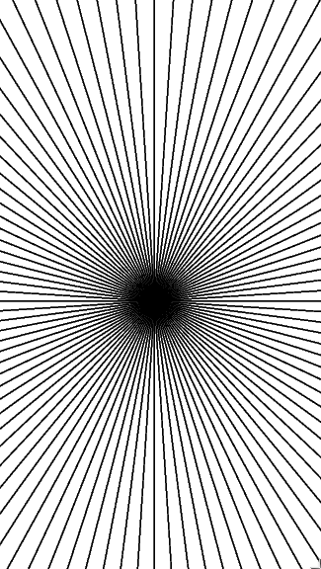
Let's Make Some Art
%!
/longline {
gsave
0 1000 rlineto stroke
grestore
} def
/numlines 100 def
/degrees {360 numlines div} def
300 400 moveto
numlines {
longline
degrees rotate
} repeat

Slide 12
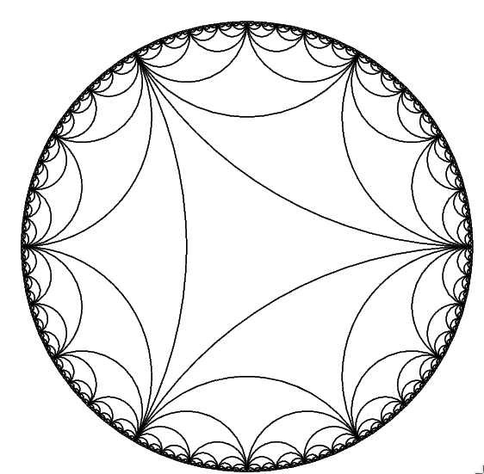
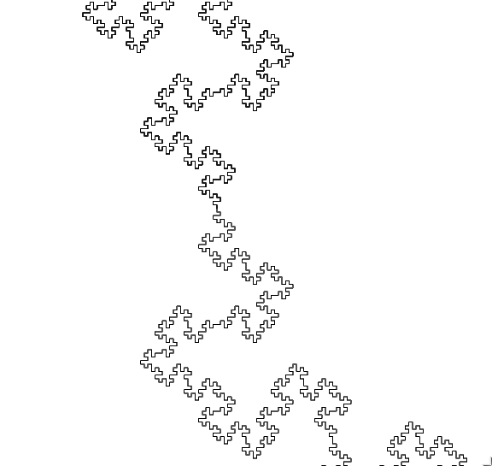
More Examples
hyperbolic_test.ps
snowflake.ps

Slide 13
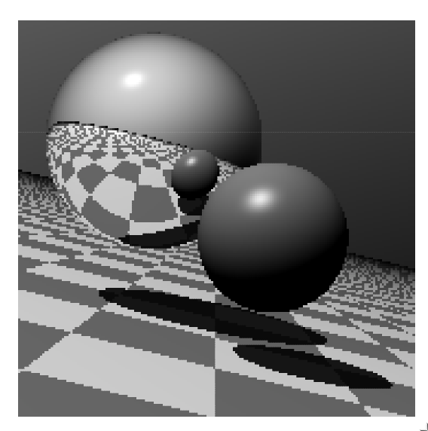
More Examples
raytracing

Slide 14
Postscript Stack Manipulation
Exchange top two stack items
exch
Duplicate top stack item
dup
Remove top stack item
pop
Run function on each array element
arr my_func forall
If/else
bool if_func else_func ifelse
And many more! https://personal.math.ubc.ca/~cass/courses/ps.html

Slide 15
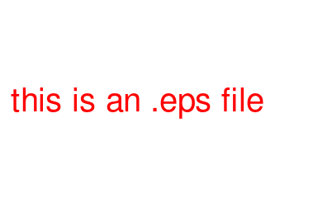
Other Postscript Facts
Many printers accept Postscript data (and PDF data) directly on TCP 9100
  Send a Postscript file with nc -N 192.168.1.133 9100 < test.ps
  https://github.com/evidlo/presentations
Postscript files can be directly embedded in Latex and Libreoffice slides (as .eps files).
%!PS-Adobe-3.0 EPSF-3.0
%%BoundingBox: 0 0 300 200
/Helvetica 30 selectfont
1 0 0 setrgbcolor
10 100 moveto
(this is a .eps file) show
showpage

