Slide 1


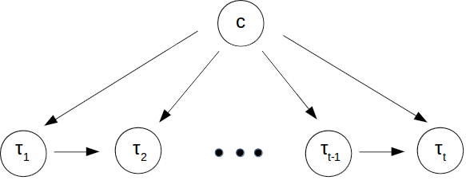
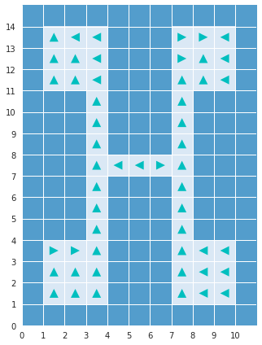
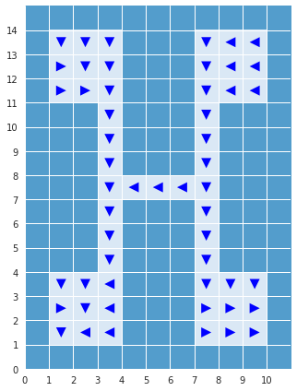
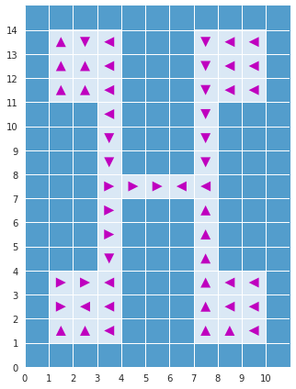
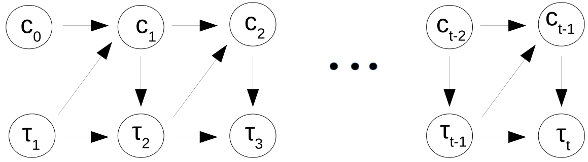
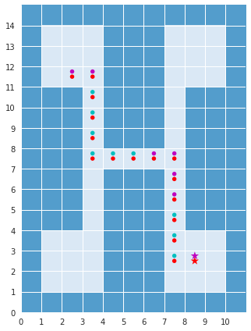
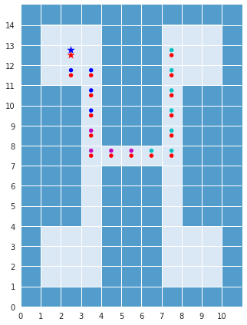
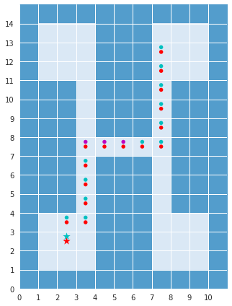

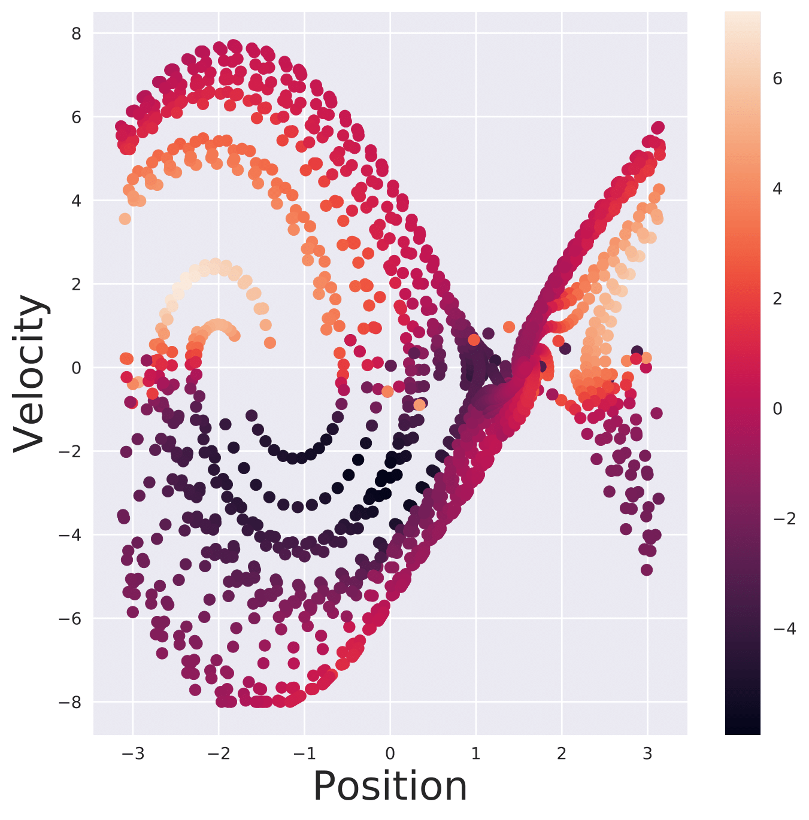
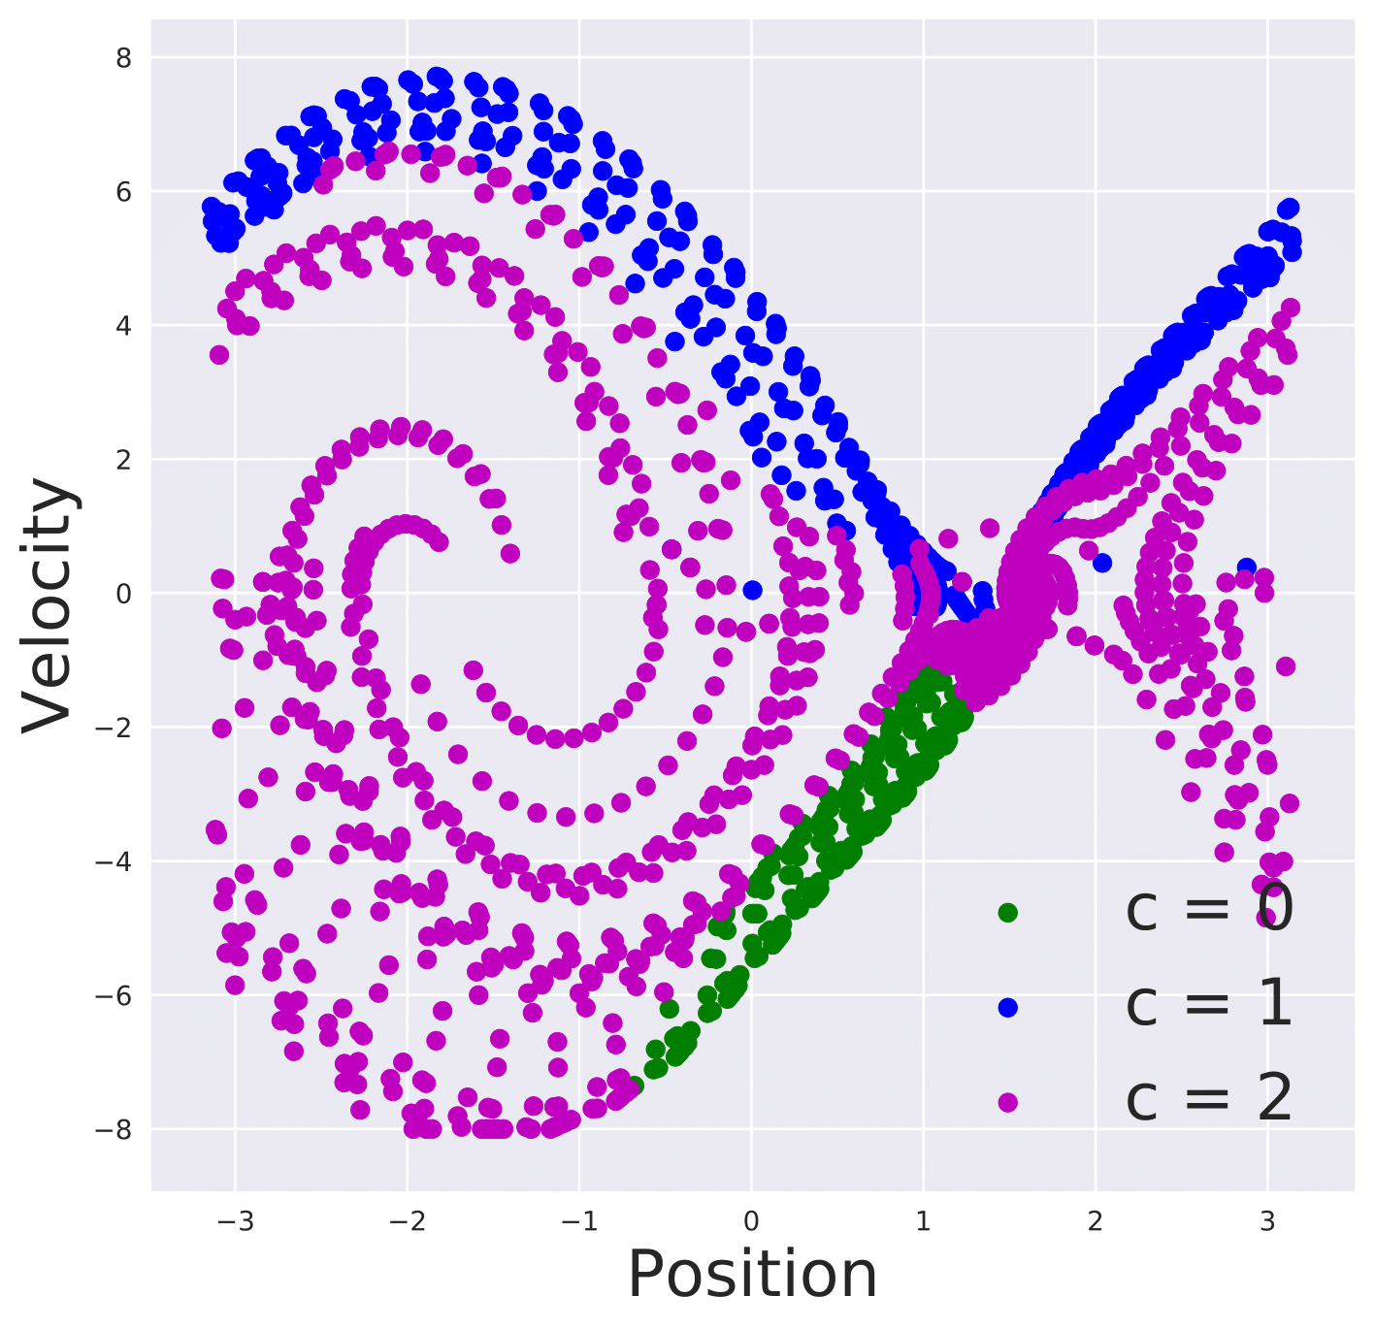
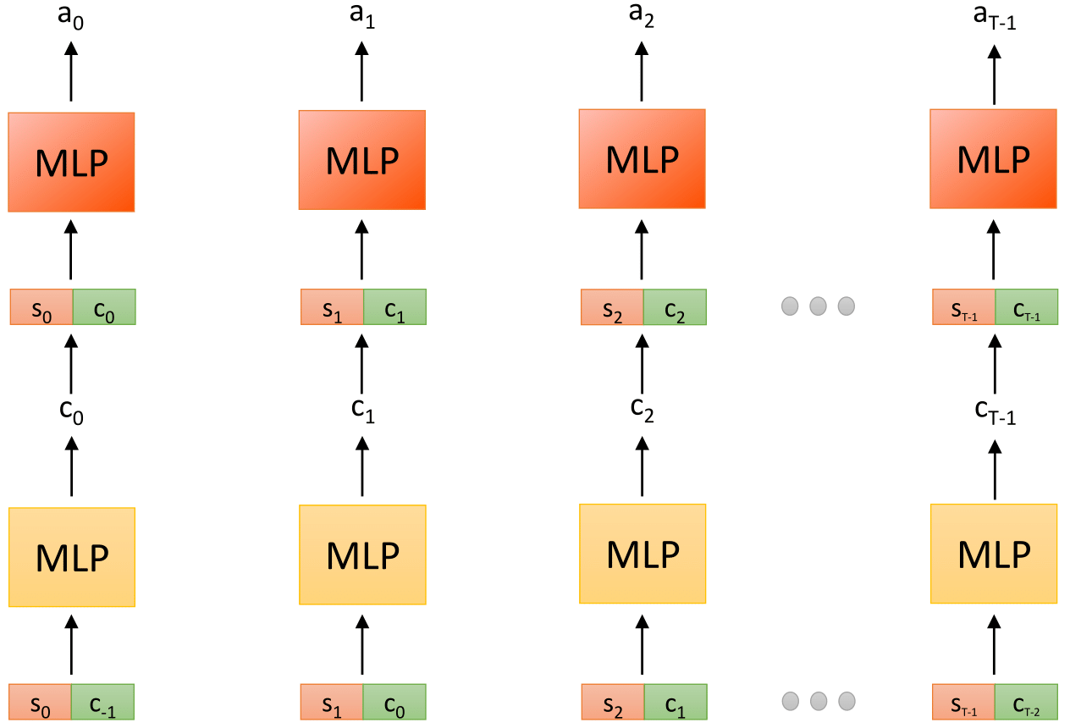
Learning Hierarchical Policies from Unsegmented Demonstrations using Causal Information
Experiments
Mohit Sharma*, Arjun Sharma*, Nicholas Rhinehart, Kris M. Kitani
Introduction
Learning complex tasks require learning sub-task specific policies. We use a directed graphical model to learn the interaction between such sub-tasks and resulting state-action trajectory sequences. Our algorithm, Causal-Info GAIL learns sub-task policies from unsegmented demonstrations by maximizing the causal information flow in the resulting graphical model.
Daniel et al. [6] provide a probabilistic perspective of options framework and maximize the following lower bound (collapsing and into single latent variable )
Our proposed Causal-Info GAIL can thus be considered as the general adversarial variant of imitation learning using the options framework.
Connection to Options framework
Option: Option activation policy:
Sub-policy: Termination policy:
Imitation Learning
Generative Adversarial Imitation Learning (GAIL) [1]
Objective,
GAIL for mixture of experts [2, 3]
c : Latent variable denoting expert
Maximize lower bound to mutual information,
Overall objective,
Experiments
Discrete environment
Figure 1: Graphical model in [2, 3]
15x11 grid with 4 rooms connected via corridors. An object is placed at the center of a random room at the beginning of the episode. The agent spawns at a random location in the grid.
Proposed Approach: Graphical Model
Figure 2: Graphical model used in this work
Limitation of using mutual information
Figure 3: Visualization of sub-policy actions (top) and macro-policy actions (bottom)
Dependence of q on the entire trajectory precludes its use at test time where only trajectory up to current time is known
Continuous environments
Proposed Approach: Causal Information
Causal Information
Using lower bound to causal information,
where L₁ is the lower bound to causal information.
Variational Autoencoder (VAE) pre-training
Figure 4: Visualization of sub-policy actions (left) and macro-policy actions (right) on Pendulum-v0
Environment | GAIL | VAE | Causal-Info GAIL
Pendulum | -121.4 ± 94.1 | -142.9 ± 95.6 | -125.4 ± 103.8
Inverted Pendulum | 1000.0 ± 15.2 | 218.8 ± 8.0 | 1000.0 ± 15.0
Using causal information removes dependence of q on future unobserved trajectory. Thus, q can now be used as a macro-policy to select the next sub-task latent variable.
Overall Causal-Info GAIL objective,
Table 1: Returns over 300 episodes on continuous environments
References
[1] J. Ho and S. Ermon. “Generative Adversarial Imitation Learning." NIPS, 2016.
[2] Y. Li, J. Song and S. Ermon. “InfoGAIL: Interpretable Imitation Learning from Visual Demonstrations." NIPS, 2017.
[3] K. Hausman, Y. Chebotar, S. Schaal, G. Sukhatme and J. J. Lim. ‘‘Multi-modal Imitation Learning from Unstructured Demonstrations using Generative Adversarial Nets.’’ NIPS, 2017.
[4] C. Daniel, H. V. Hoof, J. Peters and G. Neumann. “Probabilistic Inference for determining Options.” Machine Learning, 2016.
[5] R. Sutton, D. Precup and S. P. Singh. “Intra-option learning about temporally abstract actions.” ICML, 1998
[6] J. Massey. “Causality, Feedback and Directed Information.” ISITA, 1990
Learn approximate prior over latent variables using VAE
* - Equal contribution

