Slide 1
Causal-Information GAIL
Mohit Sharma*, Arjun Sharma*, Nicholas Rhinehart, Kris M. Kitani
Robotics Institute, Carnegie Mellon University
* - Equal contribution
Notes:
In this part of the presentation, I will discuss how a probabilistic graphical model can be used to integrate structure with imitation learning. We call our method Directed-Information GAIL. This ongoing work is in collaboration with another masters student at CMU, and was again done under the supervision of my advisor Prof. Kitani

Slide 2
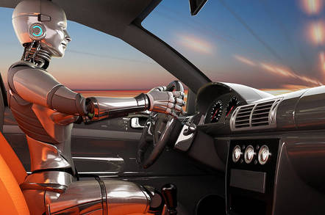
Motivation: Breaking down complex tasks
Complex task: drive a car
Task consists of simpler sub-tasks:
Drive straight
Change lanes
Execute a turn
Brake …
Can combine sub-tasks to achieve a variety of behavior
Notes:
Consider the case of an expert demonstrating a complex task such as driving a car. Complicated tasks can often be broken down into simpler tasks. For e.g., the task of driving can consist of sub-tasks like driving straight, changing lanes, braking and so on. And an agent can combine these sub-tasks in different orders and for different time periods to achieve different behaviours

Slide 3
Motivation: Breaking down complex tasks
Should we learn a policy conditioned on each task?
A monolithic policy for each task ignores the shared sub-structure between different tasks
Learning sub-task specific policies
Shared learning
Each sub-task is easier to learn
Need to learn how to combine sub-tasks
Notes:
When it comes to imitation learning, should we learn a separate policy for each task? A problem with learning such monolithic policies is that they do not take advantage of the shared sub-structure of the various tasks. Instead, we could learn sub-task specific policies. Doing so has the advantage of sharing learning. Also, each sub-task is arguably easier to learn since it involves learning over a subset of the state space. However, it has the added complexity of learning a new higher level policy that dictates how the lower level sub-task policies should be combined.

Slide 4
Goals
Given unsegmented expert demonstrations of a complex task
Notes:
The goal of this work is, given unsegmented expert trajectories or demonstrations, --- learn to segment then into sub-tasks --- learn sub-task specific policies --- learn a higher level policy that decides when to switch between different sub-tasks. As we’ll see our solution is to model imitation learning as a graphical model

Slide 5
Goals
Given unsegmented expert demonstrations of a complex task,
Learn to segment task demonstrations into sub-tasks
Notes:
The goal of this work is, given unsegmented expert trajectories or demonstrations, --- learn to segment then into sub-tasks --- learn sub-task specific policies --- learn a higher level policy that decides when to switch between different sub-tasks. As we’ll see our solution is to model imitation learning as a graphical model

Slide 6
Goals
Given unsegmented expert demonstrations of a complex task,
Learn to segment task demonstrations into sub-tasks
Learn a policy for each sub-task
Notes:
The goal of this work is, given unsegmented expert trajectories or demonstrations, --- learn to segment then into sub-tasks --- learn sub-task specific policies --- learn a higher level policy that decides when to switch between different sub-tasks. As we’ll see our solution is to model imitation learning as a graphical model

Slide 7
Goals
Given unsegmented expert demonstrations of a complex task,
Learn to segment task demonstrations into sub-tasks
Learn a policy for each sub-task
Learn a policy which switches between sub-tasks
Notes:
The goal of this work is, given unsegmented expert trajectories or demonstrations, --- learn to segment then into sub-tasks --- learn sub-task specific policies --- learn a higher level policy that decides when to switch between different sub-tasks. As we’ll see our solution is to model imitation learning as a graphical model

Slide 8
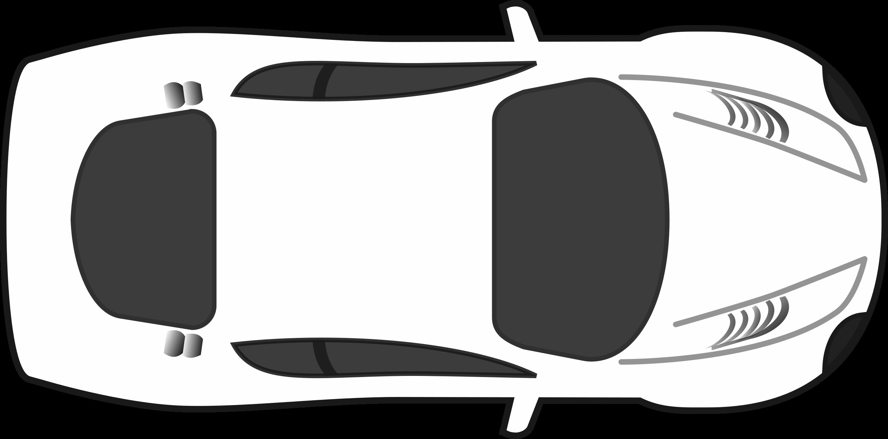
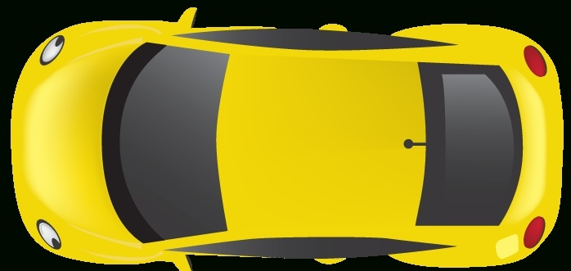
Related Work
Li et al. 2017, Hausman et al. 2017 model variations in expert behavior
Use a latent variable for type of behaviors
c
GAIL
InfoGAIL
z
z
Y. Li, J. Song and S. Ermon. InfoGAIL: Interpretable imitation learning from visual demonstrations. NIPS 2017
Hausman et al. Multi-modal imitation learning from unstructured demonstrations using generative adversarial nets. NIPS 2017
Notes:
More recent works have looked into the problem of trying to model the variations in expert behavior. One such work called InfoGAIL learns to assign a latent variable to different behaviors, and condition the policy (generator) on this latent variable, to produce different types of behaviors. For e.g. given expert demonstrations of a car overtaking another car from either its left or right, GAIL would only learn to generate a single type of behavior because of the common mode collapse problem in GANs. However, InfoGAIL learns to assign a different latent variable for each behavior and conditions the policy on this latent variable, thus producing both types of overtaking behaviors in this example.

Slide 9
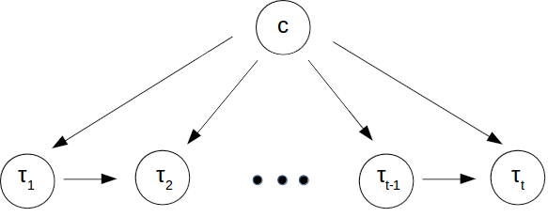
Related Work
Maximize lower bound of mutual information between latent variable c and generated trajectory
Notes:
To do so, InfoGAIL maximizes the mutual information between the latent variable c and the generated trajectory. We can represent the problem using the following directed graphical model. We first select a latent variable c and then conditioned on this latent variable generate a trajectory

Slide 10
Proposed approach
Goals
Given unsegmented expert demonstrations of a complex task,
Learn to segment task demonstrations into sub-tasks
Learn a policy for each sub-task
Learn a policy which switches between sub-tasks
We extend the graphical model so as to model sub-tasks in demonstrations
Notes:
Keeping the goals that we started out with in mind, we’ll extend the graphical model on the previous slide to model sub-tasks. We’ll derive the mutual information lower bound in this setting and show that it has a problem in our setting. Then, we’ll show how treating the graphical model as a sequentially revealing graph by using the notion of directed or causal information solves this problem. We’ll propose an approach that combines the benefits of behavior cloning and IRL, specifically GAIL. Lastly, we’ll see how the approach connects to a popular method for hierarchical RL called options. I have deliberately left the discussion of options for later and will discuss it when I discuss its connection to the proposed approach.

Slide 11
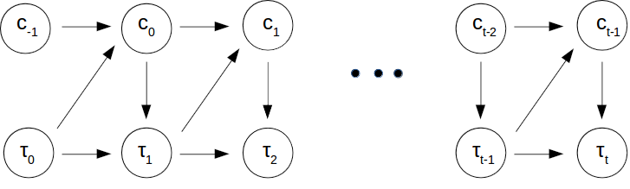


Directed Graphical Model
Aim - Learn a policy which imitates the expert and a policy which selects the sub-task at next time step
Notes:
Given expert demonstrations, each of which is represented as tau_1 to tau_T. Let each trajectory also have an associated latent sequence c_1 to c_T. Here c_t represents the sub-activity at time t. Then, we can model problem as the following directed graph. Given trajectory at time t and sub-task c_t-1, we get sub-task c_t. Then, depending on tau_t and sub-task c_t, we take action and get tau_t+1. The graph here is drawn with the Markov assumption, but the process in general have a dependence on the entire trajectory and latent sequence till the current time. The aim is then to learn a sub-task conditioned policy pi and a high level policy q which selects the sub-task for next time step.

Slide 12
Proposed approach
Goals
Given unsegmented expert demonstrations of a complex task,
Learn to segment task demonstrations into sub-tasks
Learn a policy for each sub-task
Learn a policy which switches between sub-tasks
We extend the graphical model so as to model sub-tasks in demonstrations
We show that using mutual information maximization in this new setting is problematic and that using directed information solves this problem
Notes:
Keeping the goals that we started out with in mind, we’ll extend the graphical model on the previous slide to model sub-tasks. We’ll derive the mutual information lower bound in this setting and show that it has a problem in our setting. Then, we’ll show how treating the graphical model as a sequentially revealing graph by using the notion of directed or causal information solves this problem. We’ll propose an approach that combines the benefits of behavior cloning and IRL, specifically GAIL. Lastly, we’ll see how the approach connects to a popular method for hierarchical RL called options. I have deliberately left the discussion of options for later and will discuss it when I discuss its connection to the proposed approach.

Slide 13
Limitations of Mutual Information
Notice depends on the complete trajectory
Hence, we cannot use at test time since the future is unknown.
Mutual Information Lower Bound
Distribution over the next sub-activity
Notes:
If we derive a lower bound to the mutual information then we get the following. q is the distribution over the next sub-task. Notice that the sub-task distribution q depends on the complete trajectory tau

Slide 14
Causal Information
Use a lower bound to causal information,
Notice now depends only
Thus, we can use at test time since it only depends on the past.
Distribution over the next sub-activity
Notes:
Using the notion of directed information and the idea in sequentially revealing graphs fact that future cannot influence the past, we get the following lower bound of the directed information. So now we have a form for our higher level policy q which only depends on the trajectory generated up to the current time, and we can thus use it at test time.

Slide 15
Proposed approach
Goals
Given unsegmented expert demonstrations of a complex task,
Learn to segment task demonstrations into sub-tasks
Learn a policy for each sub-task
Learn a policy which switches between sub-tasks
We extend the graphical model so as to model sub-tasks in demonstrations
We show that using mutual information maximization in this new setting is problematic and that using directed information solves this problem
We propose an approach that combines behavior cloning and GAIL
Notes:
Keeping the goals that we started out with in mind, we’ll extend the graphical model on the previous slide to model sub-tasks. We’ll derive the mutual information lower bound in this setting and show that it has a problem in our setting. Then, we’ll show how treating the graphical model as a sequentially revealing graph by using the notion of directed or causal information solves this problem. We’ll propose an approach that combines the benefits of behavior cloning and IRL, specifically GAIL. Lastly, we’ll see how the approach connects to a popular method for hierarchical RL called options. I have deliberately left the discussion of options for later and will discuss it when I discuss its connection to the proposed approach.

Slide 16
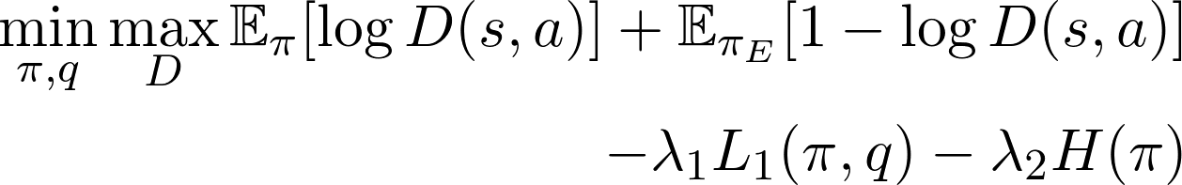
Causal-Information GAIL
Combining GAIL loss with causal information loss
where
Learn approx. by VAE behavior cloning.
Notes:
Combining it with the GAIL loss, we get the following optimization objective.

Slide 17
Proposed approach
Goals
Given unsegmented expert demonstrations of a complex task,
Learn to segment task demonstrations into sub-tasks
Learn a policy for each sub-task
Learn a policy which switches between sub-tasks
We extend the graphical model so as to model sub-tasks in demonstrations
We show that using mutual information maximization in this new setting is problematic and that using directed information solves this problem
We propose an approach that combines behavior cloning and GAIL
We connect this approach to an existing framework in RL called options
Notes:
Keeping the goals that we started out with in mind, we’ll extend the graphical model on the previous slide to model sub-tasks. We’ll derive the mutual information lower bound in this setting and show that it has a problem in our setting. Then, we’ll show how treating the graphical model as a sequentially revealing graph by using the notion of directed or causal information solves this problem. We’ll propose an approach that combines the benefits of behavior cloning and IRL, specifically GAIL. Lastly, we’ll see how the approach connects to a popular method for hierarchical RL called options. I have deliberately left the discussion of options for later and will discuss it when I discuss its connection to the proposed approach.

Slide 18
Thank you

