Slide 1
Seattle Airbnb Strategy recommendation for hosts
Nguyen Dang Minh, PhD
Email: dmnguyen92@gmail.com
Linkedin: https://www.linkedin.com/in/dmnguyen92/
Github: https://github.com/dmnguyen92

Slide 2
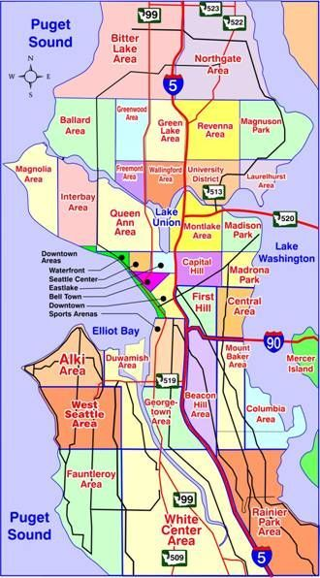
Airbnb Seattle – Problem Statement
Questions: A host is trying to enter the Airbnb business in Seattle, can you provide him/her with a housing and pricing strategy that can maximize the revenue?
How does this help Airbnb?
Maximizing hosts' return means maximizing Airbnb's commissions
Can be implemented as a strategy recommendation system for host
Suggest Airbnb potential hosts that bring maximum profit to aim for marketing.

Slide 3
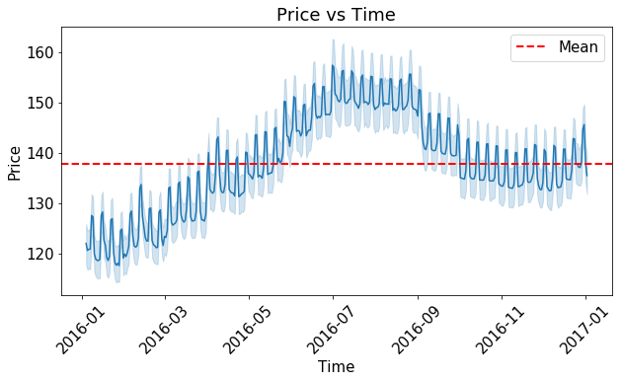
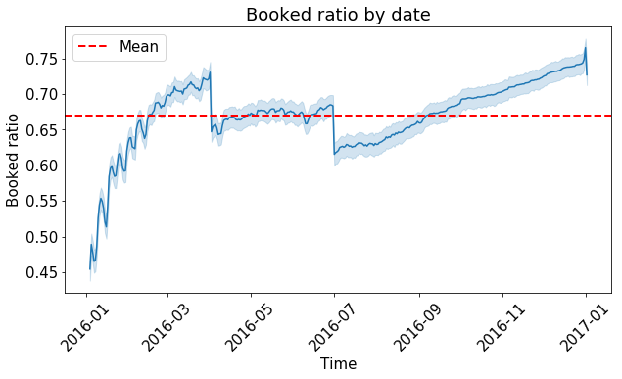
Seattle dataset - Overview
Price vs time
Small peaks: weekend
Seattle:
Big companies headquarters: Amazon, Microsoft, Starbucks, etc.
Big universities: Washington Uni., Uni. of Seattle
Busy city, travelers come on business travel rather than holiday
Dataset:
Exactly one year information: 2016-2017
All hosts have joined before 2016
Prices can be adjusted by the hosts, based on seasons
High price: Summer vacations
Incoming students
Booking probability vs time
Easter holliday
US independence day

Slide 4
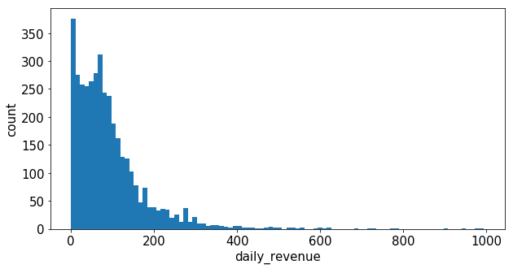
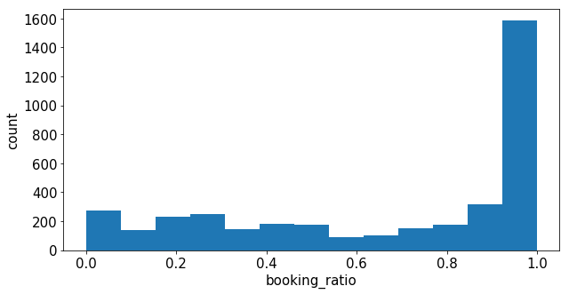
My approaches
Revenue distribution
Assumptions:
New host => ignore historical properties, reviews, etc
Ignore images, texts features
Steps:
Retrieves revenue from calendar set
From listings set, retrieves hosts info:
House properties: sizes, types, locations, etc.
Host policies: cancellation, verification, etc.
Pricing strategies: price, cleaning fee, surcharge, etc.
Builds Prediction model using lightgbm, using mean absolute error as loss.
Average daily avenue:
92.5 USD
Count distribution
High demand
Most hosts are fully booked

Slide 5
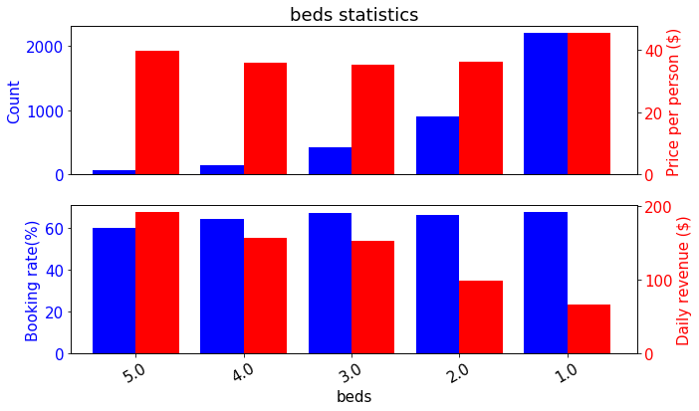
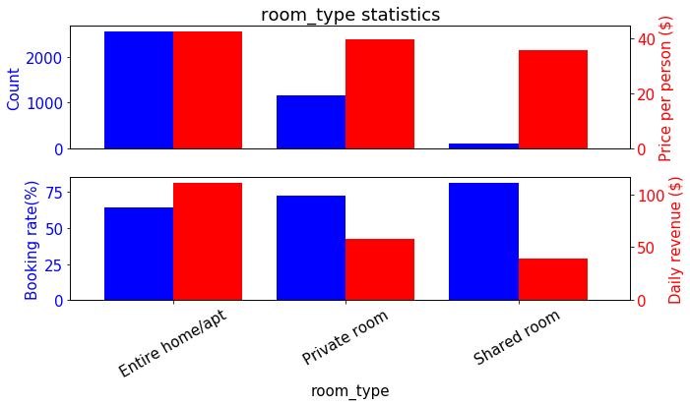
House properties
Count: number of hosts with that property
Booking rate: the probability of that host being booked
Price per person: booking price per accommodate
Daily revenue: day-averaged revenue
Majorities are small hosts
Market welcomes both big and small hosts. Booking probability not affected by host’s size
The higher the host’s size, the higher the return (trivial)
Shared rooms are cheaper and get higher booking ratio, but rent out the entire home/apartment gives better revenue

Slide 6
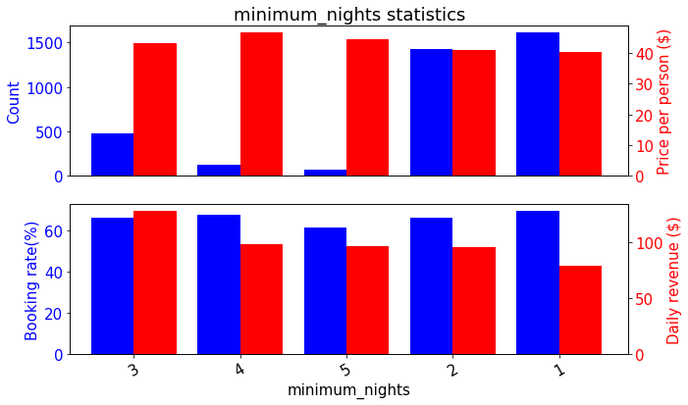
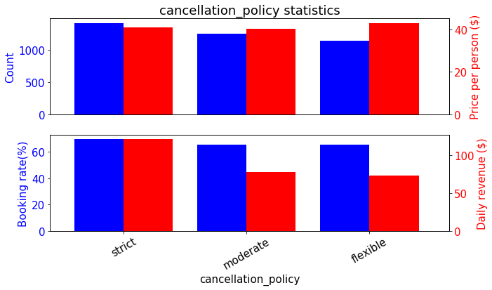
Host policies
Allowing guests to stay too short or forcing them staying too long hurts the business.
3 nights are optimum
The more “strict” the hosts are in term of cancellation policy, the better the revenue. This helps deal with bad customers and avoid scamming.

Slide 7
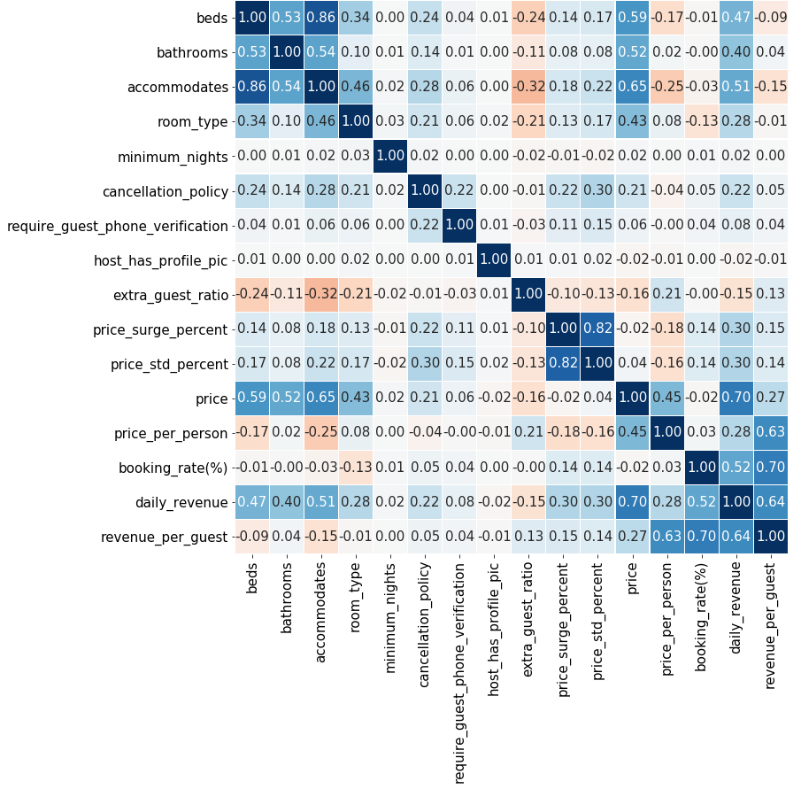
An increase in host’s size:
Does NOT affect booking rate
Increases overall revenue
Does NOT increase revenue per guest
Business size
Host policies:
Only cancellation policy impacts and revenue. Other policies do NOT.
Host policies
Pricing strategies:
Strongly impacts booking rate and revenue
Revenue per person are only high for properties with high booking rate and high price per person => likely high quality rooms
Pricing strategies
Correlation table

Slide 8
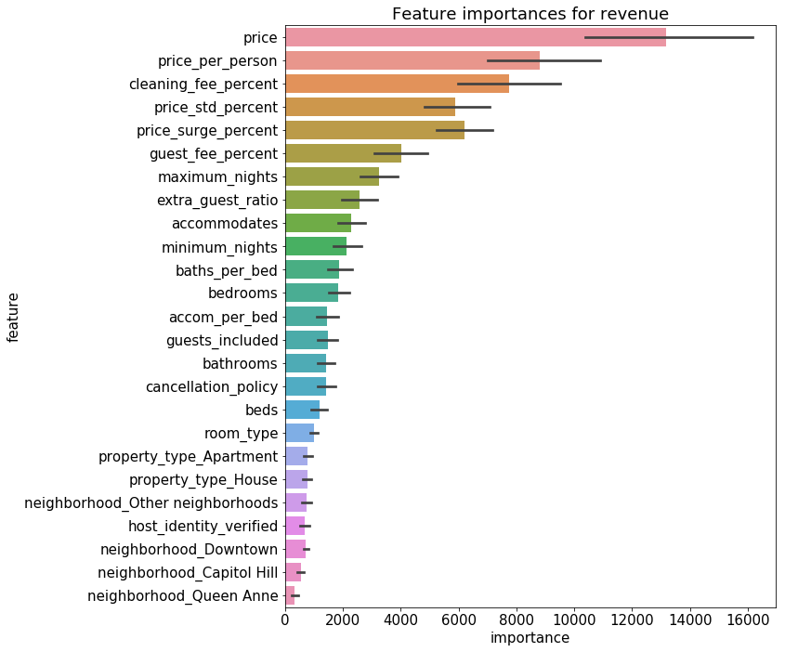
Modelling
Input:
Pricing strategy
House’s properties
Host’s policies
Output:
Expected booking probability
Expected daily revenue
Pricing strategies
5 folds cross validation
Mean absolute error: 20 USD

Slide 9


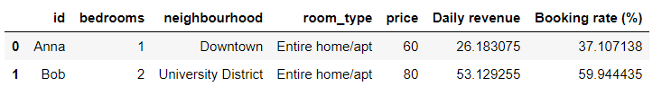
Case study
Anna
Bob
Scenario:
Anna and Bob wants to move in together into 1 apartment and rent out the other
Questions:
Which apartment to rent out?
1 bedroom apartment
Downtown district
2 accommodations
60$/night = 30$/person
40$ extra in peak seasons
2 bedroom house
University district
4 accommodations
80$/night = 20$/person
20$ extra in peak seasons
Should rent out Bob’s
Model’s prediction

Slide 10
Conclusions
About the data:
Pricing strategies has the biggest impact on overall revenue. The higher the price per person (maybe from better position, rooms quality), the higher the revenue
The majority of current hosts are small owner. However hosts of all kind of sizes have equal booking rate.
Being strict on cancellation policy anddoes help.
About the code
The model assists host estimate the potential booking rate and revenue to choose the right rental plan and pricing strategy.
The EDA part provide overview about Airbnb market in Seattle.
This analysis can be a recommendation tool for Airbnb and also helps them identify potential hosts that can maximize revenue.

