Slide 1
LPC2148 MICROCONTROLLER
Dr. Kavya B S
Dept. of ECE
MIT
Bengaluru

Slide 2
Introduction to LPC2148 Microcontroller
The LPC2141/42/44/46/48 microcontrollers are based on a 16-bit/32-bit ARM7TDMI-S
CPU
Has embedded high-speed flash memory
A 128-bit wide memory interface and a unique accelerator architecture
16-bit Thumb mode reduces code by more than 30 % with minimal performance penalty.
Ideal for applications where miniaturization is a key requirement, such as access control and point-of-sale.
Serial communications interfaces makes them well suited for:
communication gateways and protocol converters
soft modems
voice recognition and low end imaging
Presence of various peripheral devices make these microcontrollers suitable for industrial control and medical systems.

Slide 3
Features of LPC2148 Microcontroller
16-bit/32-bit ARM7TDMI-S microcontroller in a tiny LQFP64 package. (low profile quad flat pack)
8 kB to 40 kB of on-chip static RAM and 32 kB to 512 kB of on-chip flash memory.
128-bit wide interface/accelerator enables high-speed 60 MHz operation.
In-System Programming/In-Application Programming (ISP/IAP) via on-chip boot loader software.
EmbeddedICE RT and Embedded Trace interfaces offer real-time debugging with the on- chip RealMonitor software and high-speed tracing of instruction execution.
USB 2.0 Full-speed compliant device controller with 2 kB of endpoint RAM.
One or two (LPC2141/42 vs. LPC2144/46/48) 10-bit ADCs provide a total of 6/14 analog
inputs, with conversion times as low as 2.44 ms per channel.
Single 10-bit DAC provides variable analog output (LPC2142/44/46/48 only).
Two 32-bit timers/external event counters (with four capture and four compare channels each), PWM unit (six outputs) and watchdog.

Slide 4
Features of LPC2148 Microcontroller
Low power Real-Time Clock (RTC) with independent power and 32 kHz clock input.
Multiple serial interfaces
Two UARTs (16C550)
Two Fast I²C-bus (400 kbit/s)
SPI
SSP
Vectored Interrupt Controller (VIC) with configurable priorities and vector addresses.
Up to 45 of 5 V tolerant fast general purpose I/O pins in a tiny LQFP64 package.
Up to 21 external interrupt pins available.
60 MHz maximum CPU clock available from programmable on-chip PLL with settling time of 100 ms.
On-chip integrated oscillator operates with an external crystal from 1 MHz to 25 MHz.
Power saving modes: Idle and Power-down.
Individual enable/disable of peripheral functions as well as peripheral clock scaling for additional power optimization.
Processor wake-up from Power-down mode via external interrupt or BOD.
Single power supply chip with POR and BOD circuits:
CPU operating voltage range of 3.0 V to 3.6 V (3.3 V ± 10 %) with 5 V tolerant I/O pads.

Slide 5
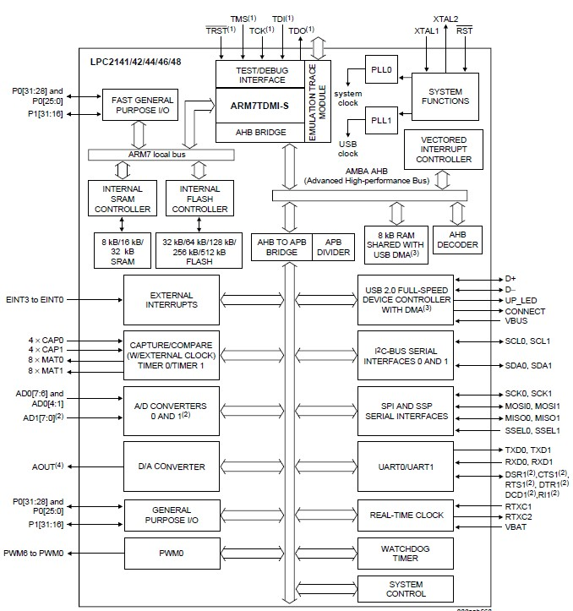
Block Diagram/Architecture of LPC2148 Microcontroller

Slide 6
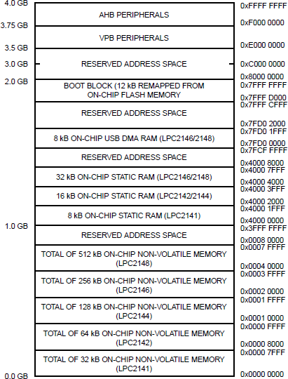

Slide 7
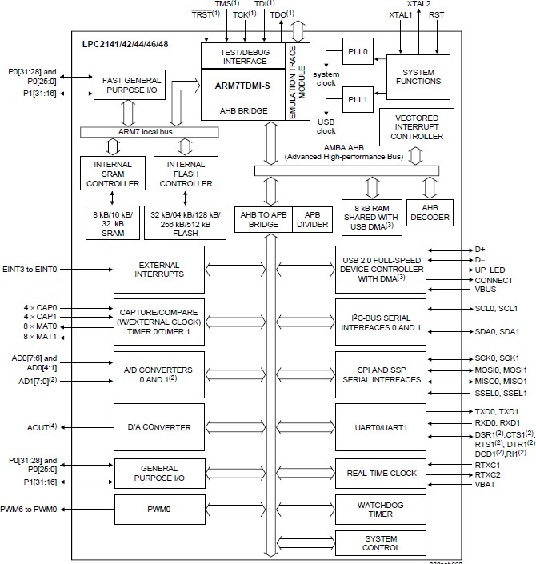
Introduction to LPC2148 Microcontroller
Interrupt controller
The Vectored Interrupt Controller (VIC) accepts all of the interrupt request inputs and categorizes them as:
‒ Fast Interrupt Request (FIQ)
‒ vectored Interrupt Request (IRQ)
‒ non-vectored IRQ as defined by programmable
settings.
Priorities of interrupts from the various peripherals can be dynamically assigned and adjusted.
‒ FIQ has the highest priority.
‒ Vectored IRQs have the middle priority.
‒ Non-vectored IRQs have the lowest priority.
The VIC combines the requests from all the vectored and non-vectored IRQs to produce the IRQ signal to the ARM processor.
Interrupt sources
Each peripheral device has one interrupt line connected to the VIC
May have several internal interrupt flags. Individual interrupt flags may also represent more than one interrupt source.

Slide 8
Introduction to LPC2148 Microcontroller
Pin connect block
Allows selected pins of the microcontroller to have more than one function
Configuration registers control the multiplexers to allow connection between the pin and the on chip peripherals.
Peripherals should be connected to the appropriate pins prior to being activated, and prior to any related interrupt(s) being enabled.
The Pin Control Module with its pin select registers defines the functionality of the microcontroller
The Pin Control Module contains 3 registers which enable read/write operations -
‒ PINSEL0
‒ PINSEL1
‒ PINSEL2

Slide 9
Introduction to LPC2148 Microcontroller
Fast general purpose parallel I/O (GPIO)
Pins may be dynamically configured as inputs or outputs.
Separate registers allow setting or clearing any number of outputs simultaneously.
LPC2141/42/44/46/48 introduce accelerated GPIO
functions:
‒ GPIO registers are relocated to the ARM local bus for the fastest possible I/O timing.
‒ Mask registers allow treating sets of port bits as a group, leaving other bits unchanged.
‒ All GPIO registers are byte addressable.
‒ Entire port value can be written in one instruction.
Features
‒ Bit-level set and clear registers allow a single instruction set or clear of any number of bits in one port.
‒ Direction control of individual bits.
‒ Separate control of output set and clear.
‒ All I/O default to inputs after reset.

Slide 10
Introduction to LPC2148 Microcontroller
10-bit ADC
‒ 10-bit successive approximation analog to digital converter.
‒ Measurement range of 0 V to VREF (2.0 V ≤ VREF ≤ VDDA).
‒ Each converter capable of performing more
than 400000 10-bit samples per second.
‒ Every analog input has a dedicated result register to reduce interrupt overhead.
‒ Burst conversion mode for single or multiple inputs.
‒ Optional conversion on transition on input pin or timer match signal.
‒ Global Start command for both converters

Slide 11
Introduction to LPC2148 Microcontroller
10-bit DAC
‒ 10-bit DAC.
‒ Buffered output.
‒ Power-down mode available.

Slide 12
Introduction to LPC2148 Microcontroller
USB 2.0 device controller
‒ Fully compliant with USB 2.0 Full-speed specification.
‒ Supports 32 physical (16 logical) endpoints.
‒ Supports control, bulk, interrupt and isochronous endpoints.
‒ Scalable realization of endpoints at run time.
‒ Endpoint maximum packet size selection (up to USB maximum specification) by software at run time.
‒ Supports DMA transfer on all non-control
endpoints
‒ One duplex DMA channel serves all endpoints

Slide 13
Introduction to LPC2148 Microcontroller
UARTs
16 bytes Receive and Transmit FIFOs.
Receiver FIFO trigger points at 1 B, 4 B, 8 B, and 14 B
Built-in fractional baud rate generator covering wide range of baud rates without a need for external crystals of particular values.
Transmission FIFO control enables implementation of software (XON/XOFF) flow control on both UARTs.
LPC2144/46/48 UART1 equipped with standard
modem interface signals.
Module also provides full support for hardware flow control (auto-CTS/RTS).

Slide 14
Introduction to LPC2148 Microcontroller
I2C-bus serial I/O controller
Easy to configure as master, slave, or master/slave.
Programmable clocks allow versatile rate control.
Bidirectional data transfer between masters and slaves.
Multi-master bus (no central master).
Arbitration between simultaneously transmitting masters without corruption of serial data on the bus.
Serial clock synchronization allows devices with different bit rates to communicate via one serial bus.
Serial clock synchronization can be used as a handshake mechanism to suspend and resume serial transfer.
The I2C-bus can be used for test and diagnostic purposes

Slide 15
Introduction to LPC2148 Microcontroller
SPI serial I/O controller
The LPC2148 contain one SPI controller.
Compliant with SPI specification.
Synchronous, Serial, Full Duplex, Communication.
Combined SPI master and slave.
Maximum data bit rate of one eighth of the input clock rate.
SSP serial I/O controller
Compatible with Motorola’s SPI, TI’s 4-wire SSI and
National Semiconductor’s Microwire buses.
Synchronous serial communication.
Master or slave operation.
8-frame FIFOs for both transmit and receive.
Four bits to 16 bits per frame.

Slide 16
Introduction to LPC2148 Microcontroller
General
counters
purpose
timers/external
event
A 32-bit timer/counter with a programmable 32-bit prescaler.
External event counter or timer operation.
Four 32-bit capture channels per timer/counter that can take a snapshot of the timer value when an input signal transitions. A capture event may also optionally generate an interrupt.
Four 32-bit match registers that allow:
Continuous operation with optional interrupt generation on match.
Stop timer on match with optional interrupt generation.
Reset timer on match with optional interrupt generation.
Four external outputs per timer/counter corresponding to match registers, with the following capabilities:
Set LOW on match.
Set HIGH on match.
Toggle on match.
Do nothing on match.

Slide 17
Introduction to LPC2148 Microcontroller
Watchdog timer
Internally resets chip if not periodically reloaded.
Debug mode.
Enabled by software but requires a hardware reset or a watchdog reset/interrupt to be disabled.
Incorrect/Incomplete feed sequence causes reset/interrupt if enabled.
Flag to indicate watchdog reset.
Programmable 32-bit timer with internal pre-
scaler.

Slide 18
Introduction to LPC2148 Microcontroller
Real-time clock
Measures the passage of time to maintain a calendar and clock.
Ultra-low power design to support battery powered systems.
Provides Seconds, Minutes, Hours, Day of Month,
Month, Year, Day of Week, and Day of Year.
Can use either the RTC dedicated 32 kHz oscillator input or clock derived from the external
Dedicated power supply pin can be connected to
a battery or the main 3.3 V

Slide 19
Introduction to LPC2148 Microcontroller
Pulse width modulator
Supports single edge controlled and/or double edge controlled PWM outputs.
Pulse period and width can be any number of timer counts.
All PWM outputs will occur at the same repetition
rate.
Double edge controlled PWM outputs can be programmed to be either positive going or negative going pulses.
Match register updates are synchronized with pulse outputs to prevent generation of erroneous pulses.
May be used as a standard timer if the PWM mode is not enabled.
A 32-bit Timer/Counter with a programmable 32- bit Prescaler

Slide 20
Introduction to LPC2148 Microcontroller
System control
Crystal oscillator
PLL
Reset and wake-up timer
Brownout detector
Code security
External interrupt inputs
Memory mapping control
Power control
Idle mode
Power-down mode
APB bus

Slide 21
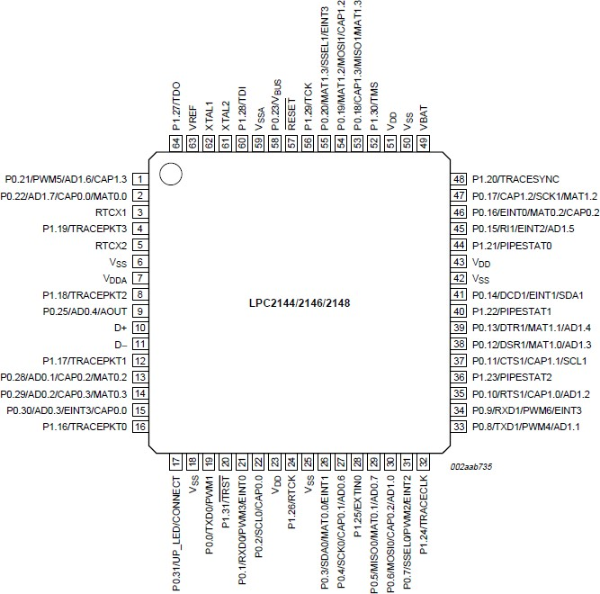
LPC2148 Pin diagram

Slide 22
LPC2148 GPIO Ports and Registers
Introduction
64 pins are attached to two 32-bit I/O ports: Port-0 & Port-1.
Port-0, Port-1 pins are designated as P0.0 – P0.31 & P1.0 - P1.31.
Pins P0.24, P0.26, P0.27, P1.0-P1.15 are unavailable.
Almost every pin of these two ports has some alternate function available. For example: P0.0 can be configured as the TXD pin for UART0 or as PWM1 pin as well
Pin functions are multiplexed, up to 4 functions assigned to each pin.
‒ Port-0 pins multiplex peripheral pin, & comm. interface pin functions
‒ Port-1 pins multiplex JTAG interface, Trace function
‒ Advantages: keeps size small, adds more functionalities to devices
‒ Disadvantages: if functions not carefully selected, some can’t be availed
The functionality of each pin can be selected using the Pin Function Select Registers.

Slide 23
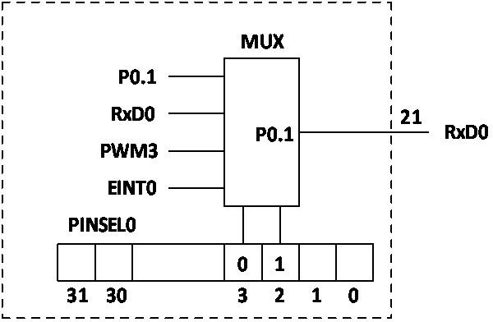
PIN connect block in LPC2148 microcontroller
Pin Function Select Registers
Pin Function Select Registers are 32-bit registers. These registers are used to select or configure specific pin functionality.
There are 3 Pin Function Select Registers in LPC2148:
PINSEL0 : - used to configure PORT0 pins P0.0 to P0.15.
PINSEL1 : - used to configure PORT0 pins P0.16 to P0.31.
PINSEL2 : - used to configure PORT1 pins P1.16 to P1.31.
Value | Function | Enumeration
00 | Primary (default) function, typically GPIO port | PINSEL_FUNC_0
01 | First alternate function | PINSEL_FUNC_1
10 | Second alternate function | PINSEL_FUNC_2
11 | Third alternate function | PINSEL_FUNC_3

Slide 24
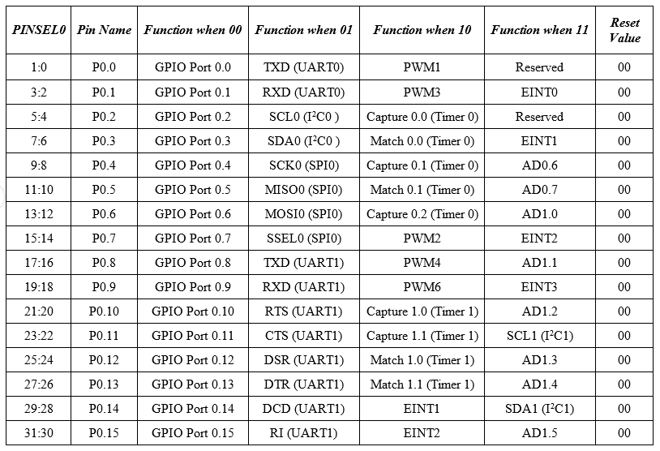
PIN connect block in LPC2148 microcontroller

Slide 25
PIN connect block in LPC2148 microcontroller
Pin Function Select Registers
Pin Function Select Registers are 32-bit registers. These registers are used to select or configure specific pin functionality.
There are 3 Pin Function Select Registers in LPC2148:
PINSEL0 : - used to configure PORT0 pins P0.0 to P0.15.
PINSEL1 : - used to configure PORT0 pins P0.16 to P0.31.
PINSEL2 : - sed to configure PORT1 pins P1.16 to P1.31.
Pin function selection: Examples
Configuring P0.0 and P0.1 of Port-0 as I/O pins for TxD0 and RxD0 functions of UART0 in ‘C’:
‒ PINSEL0=0x00000000;
//clear bits[3:2], [1:0] of PINSEL0 register, hence assign P0.0, P0.1 general purpose I/O function
‒ PINSEL0=0x00000005;
‒ /place 01 in bits[3:2], [1:0] of PINSEL0 register which selects TxD0 for P0.0 & RxD0 for P0.1 pins

Slide 26
LPC2148 microcontroller GPIO registers
GPIO ports
The Port 0 pins do not have built-in pull-up or pull-down resistors.
Programmer Responsibility to connect pull-up or pull-down resistors externally.
GPIO function is the most frequently used functionality of the microcontroller.
Fast and Slow GPIO Registers
‒ 5 Fast (also called Enhanced GPIO Features Registers) GPIO Registers
‒ 4 Slow (also called Legacy GPIO Registers) GPIO Registers available
The Slow Registers allow backward compatibility with earlier family devices using the existing codes.
The GPIO function in both the Ports are controlled by a set of 4 registers: IOPIN, IODIR, IOSET and IOCLR.

Slide 27
LPC2148 microcontroller GPIO registers
Slow GPIO Registers
The GPIO function in both the Ports are controlled by a set of 4 registers: IOxPIN, IOxDIR, IOxSET and IOxCLR.
IOxPIN (GPIO Port Pin value register):
This is a 32-bit wide register.
This register is used to read/write the value on Port (PORT0/PORT1).
But care should be taken while writing.
Masking should be used to ensure write to the desired pin.
Examples :
Writing 1 to P0.4 using IO0PIN
IO0PIN = IO0PIN | (1<<4) ;This method should be avoided, as all other pins are forced to be assigned ‘0’
Writing 0 to P0.4 using IO0PIN IO0PIN = IO0PIN | (~(1<<4) )
Writing F to P0.7-P0.4
IO0PIN = IO0PIN | (0x000000F0)

Slide 28
LPC2148 microcontroller GPIO registers
2. IOxDIR(GPIO port Direction Control register ):
Used to set the direction i.e. either input or output of individual pins.
When a bit in this register is set to ‘0’, the corresponding pin in the microcontroller is configured as Input.
Similarly, when a bit is set as ‘1’, the corresponding pin is configured as Output.
The syntax for this register is IOxDIR, where ‘x’ is the port number i.e. IO0DIR for PORT0 and IO1DIR for PORT1.

Slide 29
LPC2148 microcontroller GPIO registers
3. IOxSET(GPIO Port Output Set Register)
Used to set the value of a GPIO pin that is configured as output to High (Logic 1).
When a bit in the IOSET register is set to ‘1’, the corresponding pin is set to Logic 1.
Setting a bit ‘0’ in this register has no effect on the pin.
The syntax for this register is IOxSET, where ‘x’ is the port number i.e. IO0SET for PORT0 and IO1SET for PORT1.
4. IOxCLR(GPIO Port Output Clear Register)
Used to set the value of a GPIO pin that is configured as output to Low (Logic 0).
When a bit in the IOCLR register is set to ‘1’, the corresponding pin in the respective Port is set to Logic 0
At the same time clears the corresponding bit in the IOSET register.
Setting ‘0’ in the IOCLR has no effect on the pin.
The syntax for this register is IOxCLR, where ‘x’ is the port number i.e. IO0CLR for PORT0 and IO1CLR for PORT1.

Slide 30
LPC2148 microcontroller GPIO registers
Pin programming
Method 1: IO0DIR = (1<<3);
Direct assignment method where ‘1’ is set directly on the pin.
All the other pins are set to 0.
This method should be avoided as all the other pins are forced to be assigned ‘0’.
Method 2: IO0DIR | = 0x00000008;
Hexadecimal value of the register is assigned after ORing the register with itself.
Other pins are not affected.
This method is useful if we want to assign many pins without affecting the other pins.
Method 3: IO0DIR | = (1<<3);
This is similar to the above method except that only a single pin is affected.
Other registers can also be set using the same methods.

Slide 31
LPC2148 microcontroller GPIO registers
Example: set pin 15 of PORT0(i.e. P0.15) as output and drive the pin High.
‒ For this we need to use two registers: IODIR and IOSET.
‒ IO0DIR | = (1<<15); // Configuring P0.15 as output.
‒ IO0SET | = (1<<15); // Make the O/P pin P0.15 as High
Example: set pin 11 of PORT0 as output and the output logic ‘1’ on this pin and then to logic 0.
‒ For this we need to use three registers: IODIR, IOSET and IOCLR.
‒ IO0DIR | = (1<<11); // Configuring P0.11 as output.
‒ IO0SET | = (1<<11); // Make the O/P pin P0.11 as High.
‒ IO0CLR | = (1<<11); // Make the O/P pin P0.11 as Low.
Example: set more than one pin as output and the value of that pin must be HIGH. Consider pins 7 and 14 of PORT0 (P0.7 and P0.14).
‒ IO0DIR | = (1<<7) | (1<<14); // Configuring pins P0.7 and P0.14 as output.
‒ IO0SET | = (1<<7) | (1<<14); // Make the O/P of pins P0.7 and P0.14 as High.

Slide 32
LPC2148 microcontroller GPIO registers
Fast GPIO Registers
There are 5 fast GPIO registers :
FIOxDIR (Fast GPIO Port Direction control register) :
‒ This is a 32-bit wide register.
‒ This register individually controls the direction of each port pin.
‒ Setting a bit to ‘1’ configures the corresponding pin as an output pin.
‒ Setting a bit to ‘0’ configures the corresponding pin as an input pin.
FIOxMASK (Fast Mask register for port) :
‒ This is a 32-bit wide register.
‒ This register controls the effect of fast registers (FIOxPIN, FIOxSET, FIOxCLR) on port pins.
‒ Setting a bit to ‘0’ configures the corresponding pin access to the fast registers i.e. we can write/read the corresponding pin in fast mode using fast registers.
‒ Setting a bit to ‘1’ configures the corresponding pin unaffected by fast registers.

Slide 33
LPC2148 microcontroller GPIO registers
Fast GPIO Registers
FIOxPIN (Fast Port Pin value register using FIOMASK) :
‒ This is a 32-bit wide register.
‒ This register is used to read/write the value on port pins, only if that corresponding port pins have access to fast registers (Access to port pins using fast registers is enabled using Zeroes in FIOxMASK register).
FIOxSET (Fast Port Output Set register using FIOMASK) :
‒ This is a 32-bit wide register.
‒ This register is used to make pins of Port HIGH.
‒ Writing one to specific bit makes that pin HIGH.
‒ Writing zero has no effect.
‒ Reading this register returns the current contents of the port output register. Only bits enabled by ZEROES in FIOMASK can be altered.
FIOxCLR (Fast Port Output Clear register using FIOMASK) :
‒ This is a 32-bit wide register.
‒ This register is used to make pins of Port LOW. Writing one to specific bit makes that pin LOW. Writing
zeroes has no effect. Only bits enabled by ZEROES in FIOMASK can be altered.

Slide 34
LPC2148 Port Programming
LED blinking
Assume that 32 LEDS are connected to PORT1. Write a program to blink the LEDs

Slide 35
LPC2148 Port Programming
LED blinking
Assume that 32 LEDS are connected to PORT1. Write a program to blink the LEDs
Method 1: using IOxSET and IOxCLR registers
#include <lpc214x.h>
/* start the main program */ int main()
{
PINSEL2 = 0x000000; //Configure the P1 Pins for GPIO;
IODIR1 = 0xFFFFFFFF; //Configure the P1 pins as OUTPUT;
void delay_ms(unsigned int count)
{
unsigned int j=0,i=0; for(j=0; j<count; j++)
{
for(i=0; i<3000; i++);
}
}
while(1)
{
IO1SET = 0xFFFFFFFF;
delay_ms(1000);
IO1CLR = 0xFFFFFFFF;
delay_ms(1000);
}
// Make all the Port pins as high
// Make all the Port pins as low
}

Slide 36
LPC2148 Port Programming
LED blinking
Assume that 32 LEDS are connected to PORT1. Write a program to blonk the LEDs
Method 2: in which IOxPIN register is used for both setting and clearing the PORT pins.
#include <lpc214x.h>
/* start the main program */
int main()
{
void delay_ms(unsigned int count)
{
unsigned int j=0,i=0;
for(j=0;j<count;j++)
{
for(i=0;i<3000;i++);
}
}
PINSEL2 = 0x000000; IO1DIR = 0xFFFFFFFF;
while(1)
{
IO1PIN = 0xFFFFFFFF;
delay_ms(1000);
//Configure the P1 Pins for GPIO;
//Configure the P1 pins as OUTPUT;
// Make all the Port pins as high
IO1PIN = 0x00000000; // Make all the Port pins as low
delay_ms(1000);
}
}

Slide 37
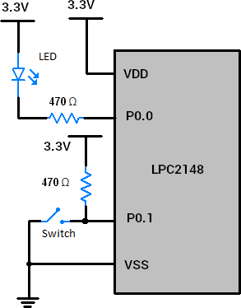
LPC2148 Port Programming
A LED is interfaced to P0.0 and a switch is interfaced to P0.1. Write a simple program for turning LED ON or OFF depending on the status of the pin.
#include <lpc214x.h> #include <stdint.h> int main(void)
{
PINSEL0 = 0x00000000;
/* Configuring P0.0 to P0.15 as GPIO */
/* Make P0.0 bit as output bit, P0.1 bit as an input pin */
IO0DIR =
while(1)
{
0x00000001;
if ( IO0PIN & (1<<1) ) /* If switch is open, pin is HIGH */
{
IO0SET = 0x00000001; /* Turn off LED */
}
else
{
/* If switch is closed, pin is LOW */
IO0CLR = 0x00000001; /* Turn on LED */
}
}
}

Slide 38
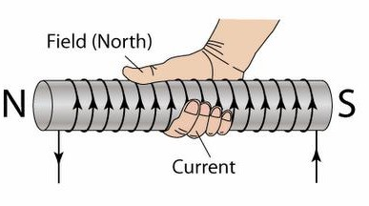
Stepper Motor Interfacing with LPC2148
Introduction
It is a brushless DC Motor
Control signals are applied to stepper motor to rotate it in steps.
Its speed of rotation depends upon rate at which control signals are applied.
There are various stepper motors available with minimum required step angle.
Stepper motor is made up of mainly two parts: a stator and rotor
Stator is of coil winding
Rotor is mostly permanent magnet or ferromagnetic material.
Working Principle of Stepper Motor
Current flowing through winding creates magnetic North and South pole on coil.
If we wrap our right-hand fingers around coil in the direction of current flowing through the coil, then the thumb direction indicates the magnetic North Pole.

Slide 39
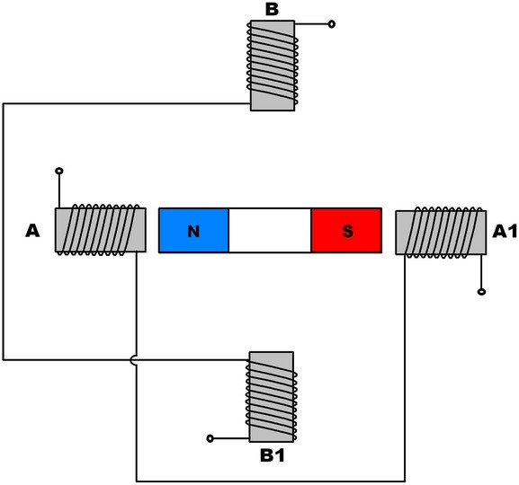
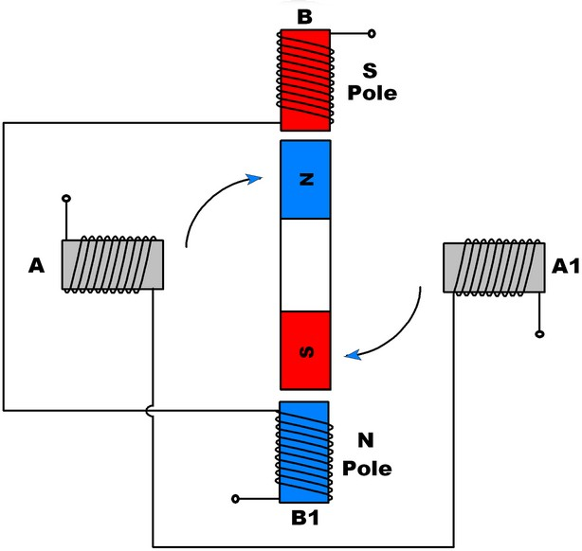
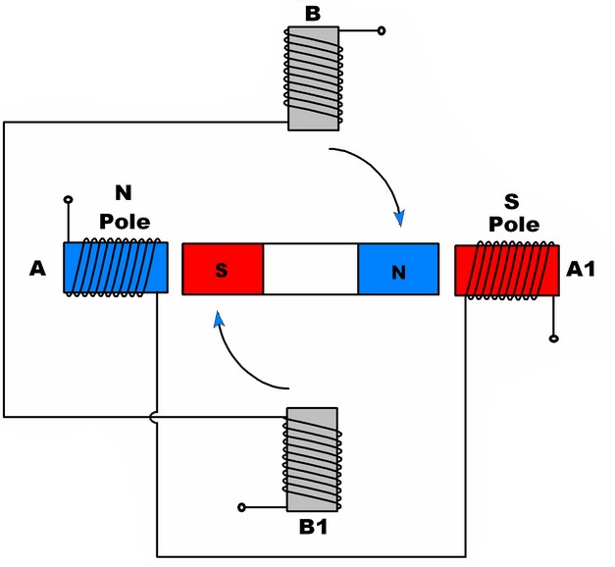
Stepper Motor Interfacing with LPC2148
Working Principle
Stepper motor rotates in steps
Two winding, A and B are the stator of motor.
Permanent magnet having North and South poles is rotor of the motor.

Slide 40
Stepper Motor Interfacing with LPC2148
Step Angle
Minimum angle that stepper motor will cover within one move/step.
Number of steps required to complete one rotation depends upon step angle.
Example: If step angle is of 45° then 8 steps are required to complete one rotation
Depending upon stepper motor configuration, step angle varies e.g. 0.72°, 1.8°, 3.75°,
7.5°, 15° etc.
Classification of Stepper motors:
Depending upon winding arrangement
Unipolar Stepper Motor
Bipolar Stepper Motor
Depending upon construction
Permanent Magnet Stepper Motor
Variable Reluctance Stepper Motor
Hybrid Stepper Motor

Slide 41
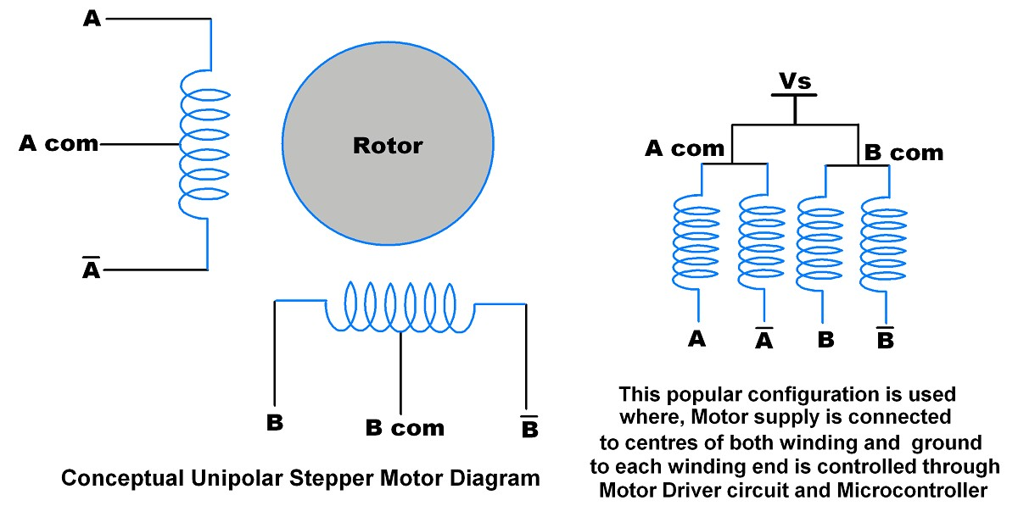
Stepper Motor Interfacing with LPC2148
Unipolar Stepper Motor
Unipolar Stepper Motor has centre tapped winding with 5 (If both centres are connected internally) or 6 wires.
Generally, these centre tapped connections are connected to the power supply.
By providing ground path to the winding leads we can allow the flow of current through each half of coil
which create magnetic poles.
By altering poles sequentially, we can rotate rotor accordingly.
The current is unidirectional in unipolar motor.
Due to centre tap, each winding is divided i.e. current flows through half of winding.
Due to its centre tap arrangement, we do not need to change current direction to change magnetic pole on
winding. Here we just need to alter ground connection at winding ends.

Slide 42
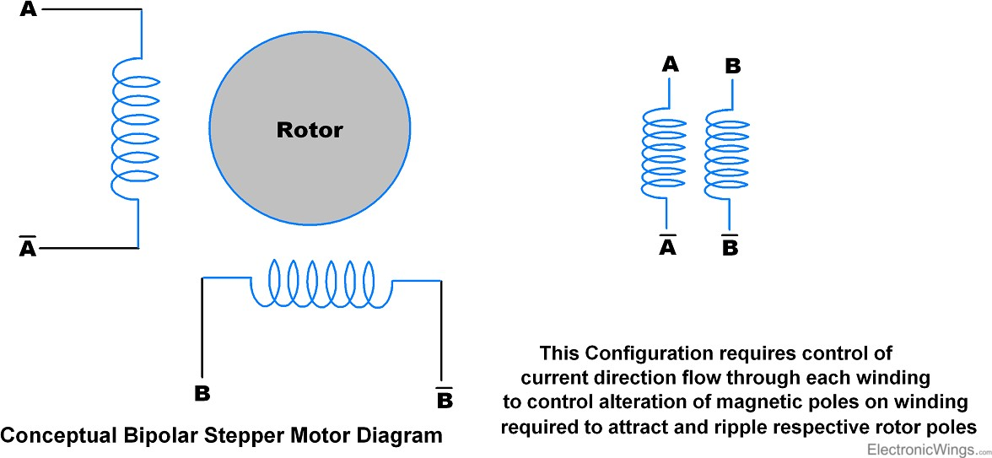
Stepper Motor Interfacing with LPC2148
Bipolar Stepper Motor
Bipolar stepper Motor has no centre tap connection.
Normally it is of two windings i.e. 4 wire end
Current flows through full winding of stator.
The current is Bidirectional in Bipolar stepper motor i.e. we need to alter current direction through winding to alter magnetic pole of that winding.

Slide 43
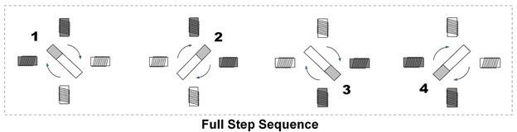
Stepper Motor Interfacing with LPC2148
How to Rotate Stepper Motor
Stepper motor rotates in steps and for continuous or limited angle rotation we need to provide sequential steps.
There are two step sequences used to rotate Stepper Motor
Full Step Sequence
Half Step Sequence
Full Step Sequence
Here motor moves through its basic step angle.
At a time two coils are excited.
Step | A | B | C | D
1 | 1 | 0 | 0 | 1
2 | 1 | 1 | 0 | 0
3 | 0 | 1 | 1 | 0
4 | 0 | 0 | 1 | 1

Slide 44
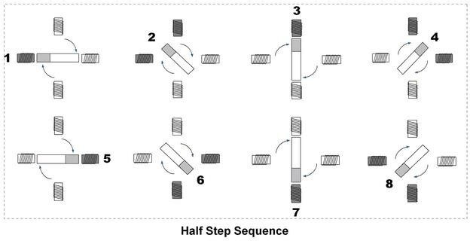
Stepper Motor Interfacing with LPC2148
How to Rotate Stepper Motor
Half Step Sequence
Here motor moves half of its basic step angle.
Half step can be achieve by exciting both current and next coil.
Step | A | B | C | D
1 | 0 | 0 | 0 | 1
2 | 1 | 0 | 0 | 1
3 | 1 | 0 | 0 | 0
4 | 1 | 1 | 0 | 0
5 | 0 | 1 | 0 | 0
6 | 0 | 1 | 1 | 0
7 | 0 | 0 | 1 | 0
8 | 0 | 0 | 1 | 1

Slide 45
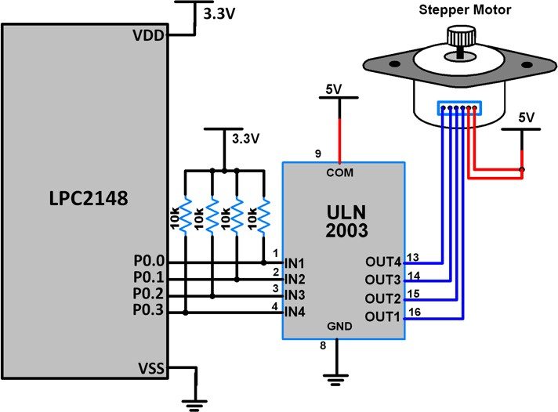
Stepper Motor Interfacing with LPC2148

Slide 46
Stepper Motor Interfacing with LPC2148
#include <LPC214x.h>
#include <stdio.h> void delay(int);
unsigned char STEP[] = {0x09, 0x08, 0x0C, 0x04, 0x06, 0x02, 0x03, 0x01};
int main(void)
{
unsigned int i=0;
PINSEL0 &= 0xFFFFFF00; // P0.3 - P0.0 as GPIO IODIR0 = 0x0000000F; // P0.3 - P0.0 as Output
while(1){
while (STEP[i] != '\0')
{
IOSET0 = STEP[i];
delay(1);
IOCLR0 = STEP[i];
delay(1);
i++;
} i=0;
}
void delay(int n)
{
int i,j; for(i=0;i<n;i++)
{
for(j=0;j<0x3FF0;j++) {;}
}
}
return 0;
}

Slide 47
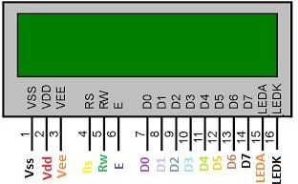
LCD Interfacing with LPC2148
The LCDs are normally used in different embedded syustems due to its low cost, easy access and flexibility
to get programmed.
Almost each and every electronic device has this kind of display
LCD that has sixteen column and two rows so it is known as 16 x 2 LCD modules.
LCD also available in different arrangements like (8 x 1), (10 x 2), (16 x 1), but the 16 x 2 is normally used in
embedded systems.

Slide 48
LCD Interfacing with LPC2148
Pin Number | Symbol | Pin Function
1 | VSS | Ground
2 | VCC | +5v
3 | VEE | Contrast adjustment (VO)
4 | RS | Register Select(RS) 0:Command, 1: Data
5 | R/W | Read/Write, R/W=0: Write & R/W=1: Read
6 | EN | Enable. Falling edge triggered
7 | D0 | Data Bit 0
8 | D1 | Data Bit 1
9 | D2 | Data Bit 2
10 | D3 | Data Bit 3
11 | D4 | Data Bit 4
12 | D5 | Data Bit 5
13 | D6 | Data Bit 6
14 | D7 | Data Bit 7/Busy Flag
15 | A/LED+ | Back-light Anode(+)
16 | K/LED- | Back-Light Cathode(-)

Slide 49
LCD Interfacing with LPC2148
Sr. No. | Hex Code | Command to LCD
1 | 01 | Clear display screen
2 | 02 | Return home
3 | 04 | Decrement cursor (shift cursor to left)
4 | 06 | Increment cursor (shift cursor to right)
5 | 05 | Shift display right
6 | 07 | Shift display left
7 | 08 | Display off, cursor off
8 | 0A | Display off, cursor on
9 | 0C | Display on, cursor off
10 | 0E | Display on, cursor blinking
11 | 0F | Display on, cursor blinking
12 | 10 | Shift cursor position to left
13 | 14 | Shift cursor position to right
14 | 18 | Shift the entire display to the left
15 | 1C | Shift the entire display to the right
16 | 80 | Force cursor to beginning ( 1st line)
17 | C0 | Force cursor to beginning ( 2nd line)
18 | 38 | 2 lines and 5×7 matrix

Slide 50
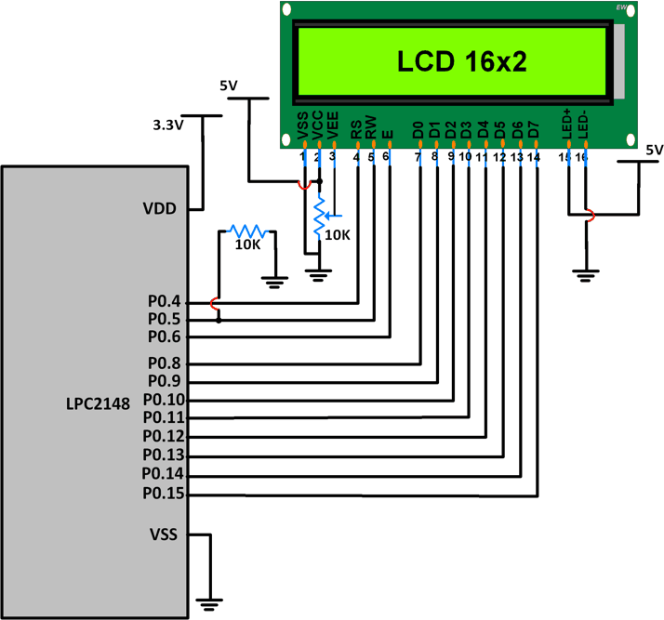
LCD Interfacing with LPC2148

Slide 51
LCD Interfacing with LPC2148
#include <lpc214x.h> #include <stdio.h>
void delay_ms(int j) /* Function for delay in milliseconds */
{
int x,i;
for(i=0;i<j;i++)
{
for(x=0; x<6000; x++); /* loop to generate 1 millisecond delay with Cclk = 60MHz */
}
}

Slide 52
LCD Interfacing with LPC2148
void LCD_CMD(char command)
{
IO0PIN = ( (IO0PIN & 0xFFFF00FF) | (command<<8) ); /* Put command on data pins */ delay_ms(2);
IO0SET = 0x00000040; /* EN = 1 */
IO0CLR = 0x00000030; /* RS = 0, RW = 0 */
delay_ms(2);
IO0CLR = 0x00000040; /* EN = 0, RS and RW unchaned(i.e. RS = RW = 0) */ delay_ms(5);
}
void LCD_INIT(void)
{
IO0DIR = 0x0000FFF0; /* P0.8 to P0.15 LCD Data. P0.4,5,6 as RS RW and EN */
delay_ms(20);
LCD_CMD(0x38); /* Initialize lcd */ LCD_CMD(0x0C); /* Display on cursor off */ LCD_CMD(0x06); /* Auto increment cursor */ LCD_CMD(0x01); /* Display clear */ LCD_CMD(0x80); /* First line first position */
}

Slide 53
LCD Interfacing with LPC2148
void LCD_CHAR(char msg)
{
IO0PIN = ( (IO0PIN & 0xFFFF00FF) | (msg<<8) ); /* Put msg on data pins */ delay_ms(2);
IO0SET = 0x00000050; /* RS = 1, , EN = 1 */ IO0CLR = 0x00000020; /* RW = 0 */
delay_ms(2);
IO0CLR = 0x00000040; /* EN = 0, RS and RW unchanged(i.e. RS = 1, RW = 0) */ delay_ms(5);
}
int main(void)
{
char msg[]="WELCOME";
int i=0; LCD_INIT();
while(msg[i]!=‘\0’)
{
LCD_CHAR(msg[i]);
i++;
}
return 0;
}

Slide 54
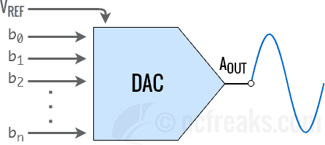
DAC Interfacing with LPC2148
DAC (Digital to Analog Converter)
DAC is a device for converting a digital (usually binary) code to an analog signal (current, voltage or charges)
These are the interface between the abstract digital world and the analog real life.
Simple switches, a network of resistors, current sources or capacitors may implement this
conversion.
A DAC inputs a binary number and outputs an analog voltage or current signal.

Slide 55
DAC Interfacing with LPC2148
LPC2148 DAC
DAC are mostly used to generate analog signals (e.g. sine wave, triangular wave etc.) from digital values.
LPC2148 has 10-bit DAC with resistor string architectureand provides buffered analog output.
Most simplest form of DAC consisting of 2^{N} resistors in series
o where N = no. of bits which simply forms a Kelvin-Varley Divider.
It also works in Power down mode.
LPC2148 has Analog output pin (AOUT) on chip, where we can get digital value in the form of Analog output voltage.
The Analog voltage on AOUT pin is calculated as
𝑉𝐴𝐿𝑈𝐸 ∗ 𝑉_{𝑅𝐸𝐹}
=
𝑉
𝐴𝑂𝑈𝑇
1024
Analog output voltage can be varied by changing VALUE(10-bit digital value) field in DACR (DAC Register)

Slide 56
DAC Interfacing with LPC2148
Pins relating to LPC2148 DAC block
Pin | Description
AOUT (P0.25) | Analog Output pin. Provides the converted Analog signal which is referenced to V_{SSA} i.e. the Analog GND. Set Bits[19:18] in PINSEL1 register to [10] to enable this function.
^{V}REF | This is the voltage reference pin used by DAC for conversion.
^{V}DDA^{, V}SSA | V_{DDA} is Analog Power pin and V_{SSA} is Ground pin used to power the DAC module. These are generally same as V_{DD} and V_{SS} but with additional filtering to reduce noise.
DACR register in LPC2148
This register is used to program the DAC block in ARM7 LPC2148.
Bit[5:0]: Reserved.
Bit[15:6] – VALUE: After a new VALUE is written to this field, given settling time selected using BIAS has elapsed, we get the converted Analog voltage at the output
Bit[16] – BIAS:
Setting this bit to 0 selects settling time of 1us max with max current consumption of 700uA.
Setting it to 1 will select settling time of 2.5us but with reduced max current consumption of 350uA.
Bits[31:17]: Reserved

Slide 57
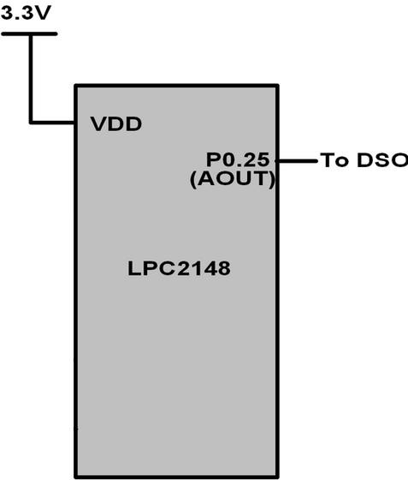
DAC Interfacing with LPC2148
/* Program to generate Square wave*/
#include <lpc2148.h> #include <stdint.h> int main (void)
{
int value; int i;
i = 0;
PINSEL1 = 0x00080000; /* P0.25 as DAC output */
IO0DIR = ( IO0DIR & 0xFFFFFFFF ); /*P0.25 as output pin*/ while(1){
value = 1023;
DACR = ( (1<<16) | (value<<6) );
delay_ms(100);
value = 0;
DACR = ( (1<<16) | (value<<6) );
delay_ms(100);
}
return 0;
void delay_ms(uint16_t j)
{
int x,i;
for(i=0; i<j; i++)
{
for(x=0; x<6000; x++);
}
}
}

Slide 58
DAC Interfacing with LPC2148
/* Program to generate Triangular wave*/
#include <lpc2148.h> #include <stdint.h> int main (void)
{
int value=0;
PINSEL1 = 0x00080000; /* P0.25 as DAC output */
IO0DIR = ( IO0DIR & 0xFFFFFFFF ); /*P0.25 as output pin*/
while(1)
{
while ( value != 1023 )
{
DACR = ( (1<<16) | (value<<6) );
value++;
}
while ( value != 0 )
{
DACR = ( (1<<16) | (value<<6) );
value--;
}
}
return 0;
}

Slide 59
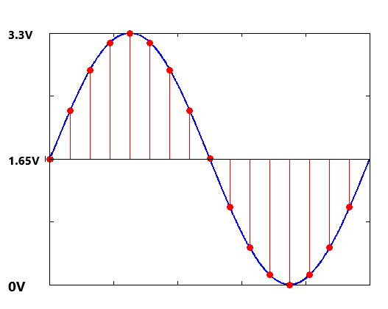
DAC Interfacing with LPC2148
/* Program to generate sine wave*/
Angle(θ) | VALUE
0 | 512
10 | 601
20 | 687
30 | 768
40 | 841
50 | 904
60 | 955
70 | 993
80 | 1016
90 | 1024
100 | 1016
. | .
. | .
360 | 512
V_{AOUT}=1.65 + 1.65 sinθ
𝑽𝑨𝑳𝑼𝑬 ∗ 𝑽_{𝑹𝑬𝑭}
=
𝑽
𝑨𝑶𝑼𝑻
𝟏𝟎𝟐𝟒
𝟏𝟎𝟐𝟒 ∗ (𝟏. 𝟔𝟓 + 𝟏. 𝟔𝟓 𝒔𝒊𝒏𝜽)
𝑽𝑨𝑳𝑼𝑬 =
𝟑. 𝟑

Slide 60
DAC Interfacing with LPC2148
/* Program to generate sine wave*/
#include <lpc2148.h> #include <stdint.h> int main (void)
{
int i=0;
PINSEL1 = 0x00080000; /* P0.25 as DAC output */ IO0DIR = ( IO0DIR & 0xFFFFFFFF ); /* P0.25 as output pin */
int sin_wave[36]={512, 601, 687, 768, 841, 904, 955, 993, 1016, 1024, 1016, 993, 955, 904, 841, 768, 687, 601, 512, 423, 337,
256, 183, 120, 69, 31, 8, 0, 8, 31, 69, 120, 183, 256, 337, 423};
while(1)
{
while(i !=36)
{
value = sin_wave[i];
DACR = ( (1<<16) | (value<<6) );
delay_ms(1); i++;
}
i = 0;
}
return 0;
}

Slide 61
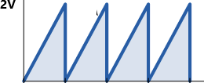
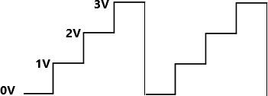
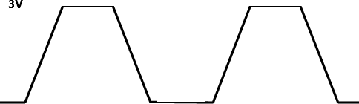
DAC Interfacing with LPC2148
Interface 3 switches to P0.0-P0.2 port lines of LPC2148 microcontroller. Write an assembly language program to generate the fallowing waveforms using internal DAC as per the condition mentioned.
Saw tooth wave SW1 is closed
b. Stair case wave when SW2 is closed
c. Trapezoidal wave when SW3 is closed

Slide 62
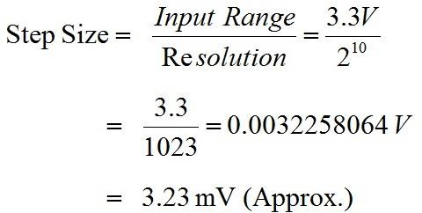
ADC Interfacing with LPC2148
ADC is used to convert analog voltage into its equivalent digital number
Resolution: Indicates the number of digital values.
LPC2148 microcontroller has in-built 10-bit ADC
So for 10-bit ADC resolution is 10-bit and maximum value will be 2¹⁰=1024.
The digital value or discrete level lies between 0 to 1023
Step size: It is the minimum change in input voltage which can be resolved by ADC.

Slide 63
ADC Interfacing with LPC2148
The ADC in LPC2148 is 10-bit successive approximation analog to digital converter.
The features are listed as:
LPC2148 has two inbuilt ADC Modules, named as ADC0 & ADC1.
ADC0 has 6-Channels (AD0.1-AD0.6).
ADC1 has 8-Channels (AD1.0-AD1.7).
ADC operating frequency is 4.5 MHz (max.), operating frequency decides the conversion time.
Supports power down mode.
Burst conversion mode for single or multiple inputs.
Both ADCs convert analog signals in the range of 0V to VREF (typically 3V; not to exceed VDDA voltage level).

Slide 64
ADC Interfacing with LPC2148
 | ADC Channel | Port Pin | Pin No. | Pin Functions | Associated PINSEL Register
ADC0 | AD0.1 | P0.28 | 13 | 0-GPIO, 1-AD0.1, 2-CAP0.2, MAT0.2 | 24,25 bits of PINSEL1
 | AD0.2 | P0.29 | 14 | 0-GPIO, 1-AD0.2, 2-CAP0.3, 3-MAT0.3 | 26,27 bits of PINSEL1
 | AD0.3 | P0.30 | 15 | 0-GPIO, 1-AD0.3, 2-EINT3, 3-CAP0.0 | 28,29 bits of PINSEL1
 | AD0.4 | P0.25 | 9 | 0-GPIO, 1-AD0.4, 2-AOUT, | 18,19 bits of PINSEL1
 | AD0.6 | P0.4 | 27 | 0-GPIO, 1-SCK0, 2-CAP0.1 , 3-AD0.6 | 08,09 bits of PINSEL0
 | AD0.7 | P0.5 | 29 | 0-GPIO, 1-MISO0, 2-MAT0.1 , 3-AD0.7 | 10,11 bits of PINSEL0
ADC1 | AD1.0 | P0.6 | 30 | 0-GPIO, 1-MOSI0, 2-CAP0.2, 3-AD1.0 | 12,13 bits of PINSEL0
 | AD1.1 | P0.8 | 33 | 0-GPIO, 1-TXD1, 2-PWM4, 3-AD1.1 | 16,17 bits of PINSEL0
 | AD1.2 | P0.10 | 35 | 0-GPIO, 1-RTS1, 2-CAP1.0, 3-AD1.2 | 20,21 bits of PINSEL1
 | AD1.3 | P0.12 | 38 | 0-GPIO, 1-DSR1, 2-MAT1.0, 3-AD1.3 | 24,25 bits of PINSEL1
 | AD1.4 | P0.13 | 39 | 0-GPIO, 1-DTR1, 2-MAT1.1 , 3-AD1.4 | 26,27 bits of PINSEL3
 | AD1.5 | P0.15 | 45 | 0-GPIO, 1-RI1, 2-EINT2 , 3-AD1.5 | 30,31 bits of PINSEL3
 | AD1.6 | P0.21 | 1 | 0-GPIO, 1-PWM5, 2-AD1.6, 3-CAP1.3 | 10,11 bits of PINSEL1
 | AD1.7 | P0.22 | 2 | 0-GPIO, 1-AD1.7, 2-CAP0.0, 3-MAT0.0 | 12,13 bits of PINSEL1

Slide 65
ADC Interfacing with LPC2148
ADC Registers
Table shows the registers associated with LPC1768 ADC.
Focus only on ADCR and ADGDR as these are sufficient for simple A/D conversion.
Register Name | Function
ADxCR | A/D Control Register: The ADCR register must be written to select the operating mode before A/D conversion can occurs.
ADxGDR | A/D Global Data Register: This register contains ADC’s DONE bit and the result of the most recent A/D conversion.
ADxSTAT | A/D Status Register: This register contains DONE and OVERRUN flag for all the A/D Channels, as well as the A/D interrupt flag.
ADGSR | A/D Global Start Register: This address can be written (in the AD0 address range) to start conversions in both A/D converters simultaneously.
ADxINTEN | A/D Interrupt Enable Register: This register contains enable bits that allow the DONE flag of each A/D channel to be included or excluded from contributing to the generation of an A/D interrupt.
ADxDR0-ADxDR7 | A/D Channel Data Register: Contains the recent ADC value for respective channel ‘x’ is 0 or 1

Slide 66
ADC Interfacing with LPC2148
1. A/D Control Register (AD0CR and AD1CR)
Used to control and monitors the ADC operation.
ADxCR is a 32-bit register.
This register must be written to select the operating mode before A/D conversion can occur.
It is used for selecting:
o channel of ADC
o clock frequency for ADC
o number of clocks or number of bits in result
o start of conversion and few other parameters.

Slide 67
ADC Interfacing with LPC2148
1. A/D Control Register (AD0CR and AD1CR)

Slide 68
ADC Interfacing with LPC2148
A/D Global Data Register (AD0GDR and AD1GDR)
AD0GDR is a 32-bit register.
This register contains the ADC’s DONE bit and the result of the most recent A/D conversion.

Slide 69
ADC Interfacing with LPC2148
3. A/D Global Start Register (ADGSR)
ADGSR is a 32-bit register.
Software can write to this register to simultaneously start conversions on both ADC.
BURST (Bit 16), START (Bit <26:24>) & EDGE (Bit 27)
These bits have same function as in the individual ADC control registers i.e. AD0CR & AD1CR. Only difference is that we can use these function for both ADC commonly from this register.

Slide 70
ADC Interfacing with LPC2148
4. A/D Status Register (ADC0:AD0STAT and ADC1:AD1STAT)
AD0STAT is a 32-bit register.
It allows checking of status of all the A/D channels simultaneously.
Bit 7:0 – DONE7:DONE0
These bits reflect the DONE status flag from the result registers for A/D channel 7 - channel 0.
Bit 15:8 – OVERRUN7:OVERRUN0
These bits reflect the OVERRUN status flag from the result registers for A/D channel 7-channel 0.
Bit 16 – ADINT
This bit is 1 when any of the individual A/D channel DONE flags is asserted and enables ADC interrupt if
any of interrupt is enabled in AD0INTEN register.
Bit 31:17 – RESERVED

Slide 71
ADC Interfacing with LPC2148
5. A/D Interrupt Enable (ADC0:AD0INTEN and ADC1:AD1INTEN)
AD0INTEN is a 32-bit register.
It allows control over which channels generate an interrupt when conversion is completed.
Bit 0 – ADINTEN0
0 = Completion of a A/D conversion on ADC channel 0 will not generate an interrupt 1 = Completion of a conversion on ADC channel 0 will generate an interrupt Remaining ADINTEN bits have similar description as given for ADINTEN0.
Bit 8 – ADGINTEN
0 = Only the individual ADC channels enabled by ADINTEN7:0 will generate interrupts 1 = Only the global DONE flag in A/D Data Register is enabled to generate an interrupt

Slide 72
ADC Interfacing with LPC2148
6. A/D Data Registers (ADC0:AD0DR0-AD0DR7 and ADC1:AD1DR0-AD1DR7)
These are 32-bit registers.
They hold the result when A/D conversion is completed.
They also include flags that indicate when a conversion has been completed and when a conversion overrun has occurred.
Bit 5:0 – RESERVED
Bits 15:6 – RESULT
When DONE bit is set to 1, this field contains 10-bit ADC result that has a value in the range of 0 (less than or equal to
VSSA) to 1023 (greater than or equal to VREF).
Bit 29:16 – RESERVED
Bit 30 – Overrun
This bit is set to 1 in burst mode if the result of one or more conversions is lost and overwritten before the conversion that produced the result in the RESULT bits.
This bit is cleared by reading this register.
Bit 31 – DONE
This bit is set to 1 when an A/D conversion completes. It is cleared when this register is read

Slide 73
Introduction to LPC2148 Microcontroller
ADC Operating modes in LPC214x :
Software controlled mode : In Software mode
only one conversion will be done at a time
conversion can be controlled in software.
To perform another conversion you will need to re-initiate the process.
In software mode only 1 bit in the SEL field of AD0CR can be 1 i.e. only 1 Channel(i.e. Pin) can be selected for conversion at a time. You can do conversions on multiple Channels (one at a time) by selecting a particular Channel along with appropriate bit in SEL field and then do the same for rest of the channels.
Burst or Hardware mode :
conversions are performed continuously on the selected channels in round-robin fashion.
Overrun may occur in this mode
Overrun is the case when a previous conversion result is replaced by new conversion result without previous result being read i.e. the conversion is lost.
Usually an interrupt is used in Burst mode to get the latest conversion results. This interrupt is
triggered when conversion in one of the selected channel ends.

Slide 74
ADC Interfacing with LPC2148
Steps for Analog to Digital Conversion
Configure the ADxCR (A/D Control Register) according to the need of application.
Start A/D conversion by writing appropriate value to START bits in ADxCR.
Monitor the DONE bit (bit number 31) of the corresponding ADxDRy (A/D Data Register) till it changes from 0 to 1. This signals completion of conversion. We can also monitor DONE bit of ADGSR or the DONE bit corresponding to the ADC channel in the ADCxSTAT register.
Read the ADC result from the corresponding A/D Data Register: ADxDRy.
Example: AD0DR1 contains ADC result of channel 1 of ADC0.

Slide 75
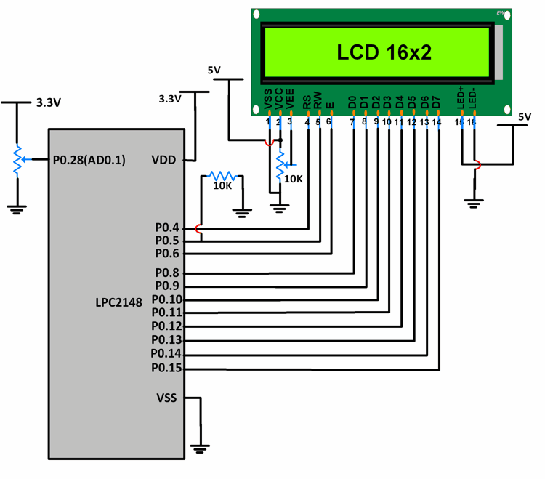
ADC Interfacing with LPC2148
Input signal is a DC signal which varies from 0 to
3.3V via a potentiometer.
Signal is given on P0.28.
P0.28 is configured as AD0.1 using PINSEL register.
10-bit ADC result is stored in a variable and its lower 8 bits are given to P0.8-P0.15. These pins are connected to the data pins of an LCD.
P0.4,5,6 are used as RS, RW, EN pins of the LCD.
As the potentiometer is varied, we can see the
variation in equivalent voltage value on the LCD.

Slide 76
ADC Interfacing with LPC2148
#include <lpc214x.h> #include <stdio.h> #include <stdint.h> #include <string.h>
void delay_ms(int j) /* Function for delay in milliseconds */
{
int x,i;
for(i=0;i<j;i++)
{
for(x=0; x<6000; x++); /* loop to generate 1 millisecond delay with Cclk = 60MHz */
}
}

Slide 77
ADC Interfacing with LPC2148
void LCD_CMD(char command)
{
IO0PIN = ( (IO0PIN & 0xFFFF00FF) | (command<<8) ); /* Put command on data pins */ delay_ms(2);
IO0SET = 0x00000040; /* EN = 1 */
IO0CLR = 0x00000030; /* RS = 0, RW = 0 */
delay_ms(2);
IO0CLR = 0x00000040; /* EN = 0, RS and RW unchaned(i.e. RS = RW = 0) */ delay_ms(5);
}
void LCD_INIT(void)
{
IO0DIR = 0x0000FFF0; /* P0.8 to P0.15 LCD Data. P0.4,5,6 as RS RW and EN */
delay_ms(20);
LCD_CMD(0x38); /* Initialize lcd */ LCD_CMD(0x0C); /* Display on cursor off */ LCD_CMD(0x06); /* Auto increment cursor */ LCD_CMD(0x01); /* Display clear */ LCD_CMD(0x80); /* First line first position */
}

Slide 78
ADC Interfacing with LPC2148
void LCD_CHAR(char msg)
{
IO0PIN = ( (IO0PIN & 0xFFFF00FF) | (msg<<8) ); /* Put msg on data pins */ delay_ms(2);
IO0SET = 0x00000050; /* RS = 1, , EN = 1 */ IO0CLR = 0x00000020; /* RW = 0 */
delay_ms(2);
IO0CLR = 0x00000040; /* EN = 0, RS and RW unchanged(i.e. RS = 1, RW = 0) */ delay_ms(5);
}

Slide 79
ADC Interfacing with LPC2148
int main(void)
{
int result,i=0; float voltage;
char volt[18];
LCD_INIT();
PINSEL1 = 0x01000000; /* P0.28 as AD0.1 */
AD0CR = 0x00200402; /* ADC operational, 10-bits, 11 clocks for conversion */ while(1){
AD0CR = AD0CR | (1<<24); /* Start Conversion */
while ( !(AD0DR1 & 0x80000000) ); /* Wait till DONE */ result = AD0DR1;
result = (result>>6);
result = (result & 0x000003FF);
voltage = ( (result/1023.0) * 3.3 ); /* Convert ADC value to equivalent voltage */

Slide 80
ADC Interfacing with LPC2148
result = (result & 0x000003FF);
voltage = ( (result/1023.0) * 3.3 ); /* Convert ADC value to equivalent voltage */ sprintf(volt, "Voltage=%.2f V ", voltage);
while(volt[i]!='\0')
{
LCD_CHAR(volt[i]); i++;
}
}
}

