Slide 1
Bootstrap

Slide 2
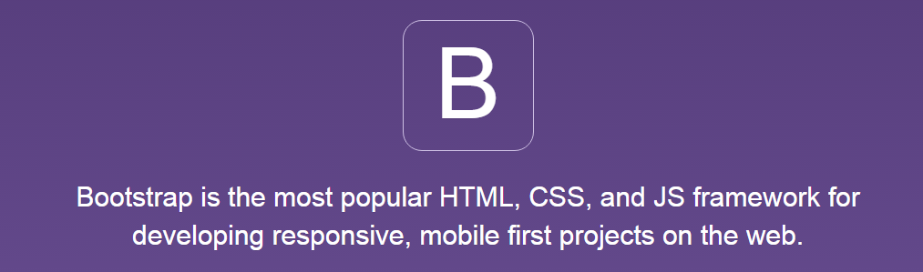
Was ist das?
HTML / CSS / JS Framework
Styled UI Controls
Design Guide / Layout Helpers
Responsive Basics

Slide 3
CSS
Grid System
Typgraphy
Code fragments
Tables
Forms
Buttons
Images

Slide 4
Components
Glyphicons
Dropdowns
Button groups
Button dropdowns
Input groups
Navs
Navbar
Breadcrumbs
Panels
Responsive embed
Wells
Pagination
Labels
Badges
Jumbotron
Page header
Thumbnails
Alerts
Progress bars
Media object
List group

Slide 5
JavaScript
Transitions
Modal
Dropdown
Scrollspy
Tab
Tooltip
Popover
Alert
Button
Collapse
Carousel
Affix

Slide 6
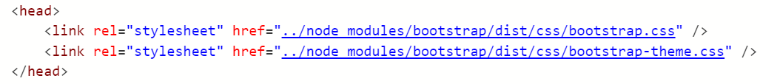
Setting up CSS
Link bootstrap stylesheet

Slide 7
Grid
12 Spalten
css Klassen
Spalte konfigurierbar abhängig von verfügbarem Platz
xs, sm, md, lg
Automatischer Umbruch in neue Zeile wenn „voll“
Voll == nächste Zelle würde mehr Spalten benötigen

Slide 8
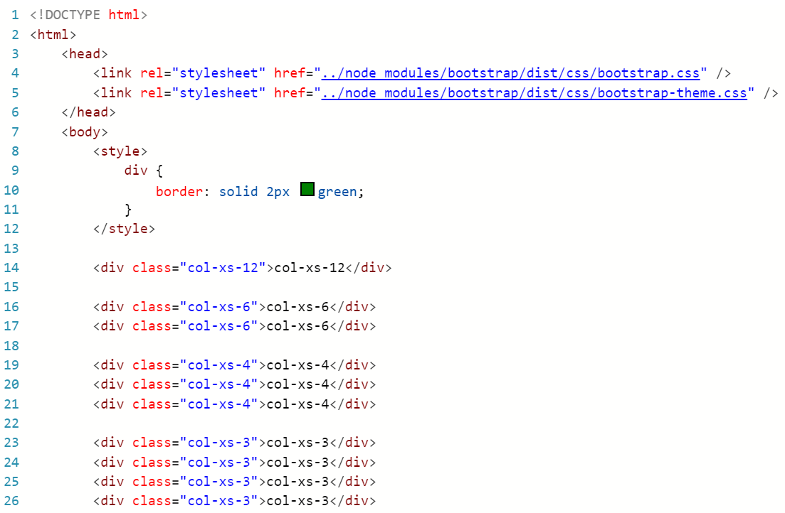
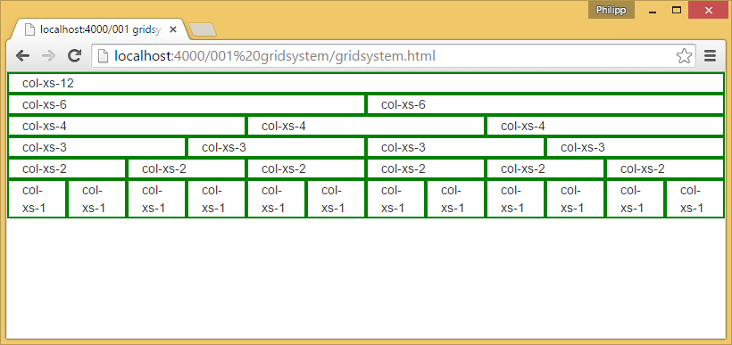
Grid

Slide 9
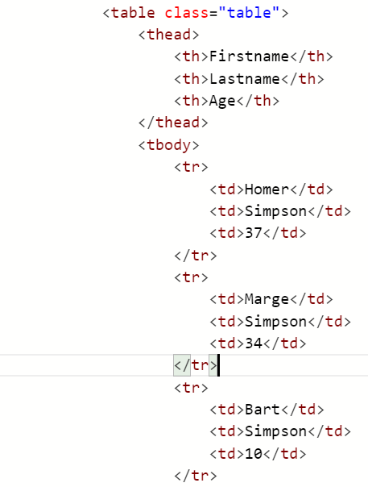
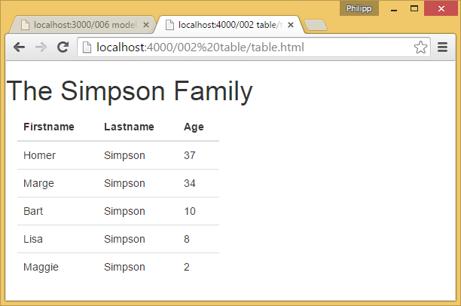
Table

Slide 10
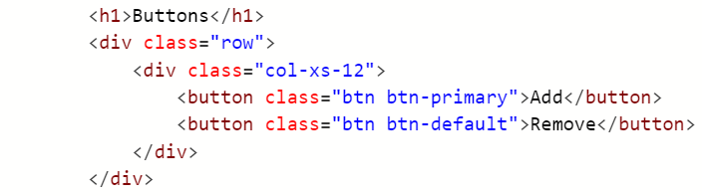
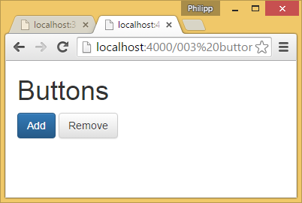
Buttons

Slide 11

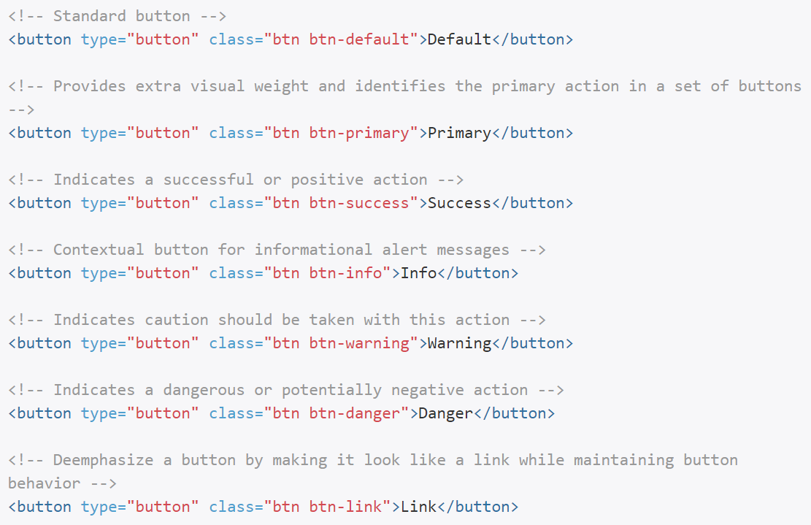
Contextual Classes
Additional class
btn-default
btn-primary
btn-success
btn-info
btn-warning
btn-danger
btn-link

Slide 12
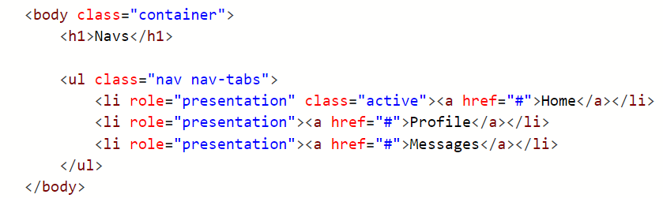
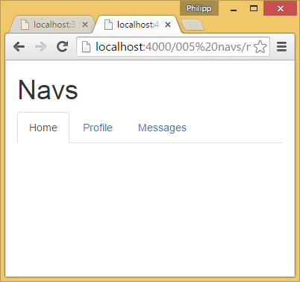
Navs

Slide 13
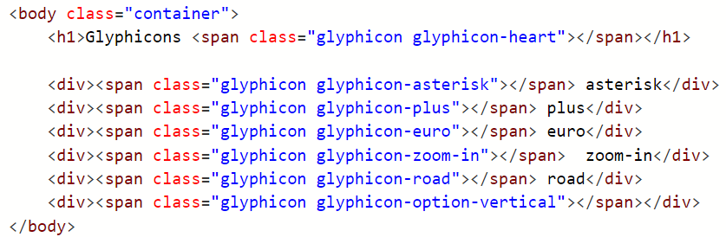
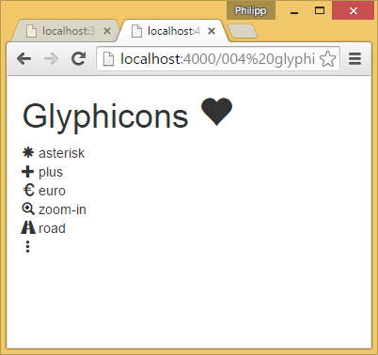
Glyphicons

