Slide 1

ECONOMIC GLOBALIZATION C.R.E.A.M.

Slide 2

Economic Globalization
The spread of trade, transportation, and communication systems around the world in the interest of promoting worldwide commerce
Can you think of ways that you have interacted with any of these things in the last 24 hours?

Slide 3
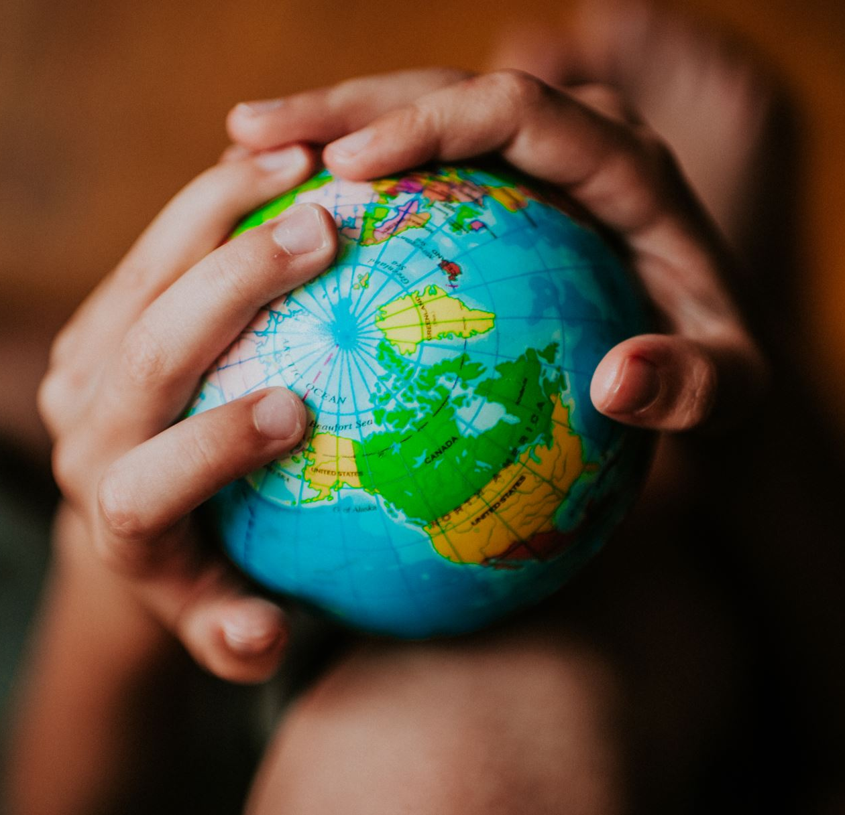
GLOBAL FACTORS
What “events” or “decisions” might affect the global economy?
Social 30 Prep!
Notes:
War Natural Disasters Famine Government Policies Investor Conﬁdence

Slide 4
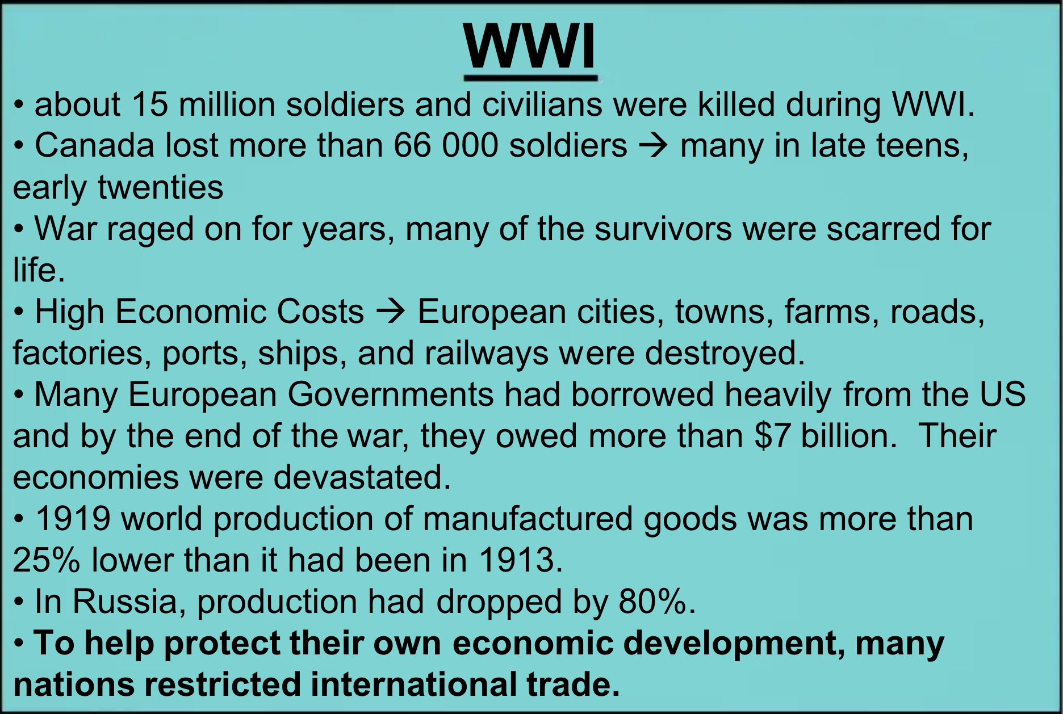
War and the Economy
How do you think World War 1 effected the global economy?

Slide 5
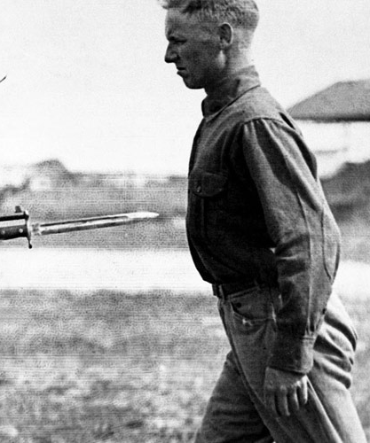
The War to end all Wars
Canada’s interest payments on the war debt were $164million per year, soldiers' pensions another $76million per year
Income tax became a permanent feature of Canadian life

Slide 6
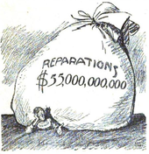
THE END OF THE WAR TO END ALL WARS
Treaty of Versailles
Imposed harsh conditions on Germany
forced to pay reparations and give up colonies. People in these colonies were not included in these decisions.
Economist John Maynard Keynes and other delegates warned conditions too severe and would lead to another war

Slide 7
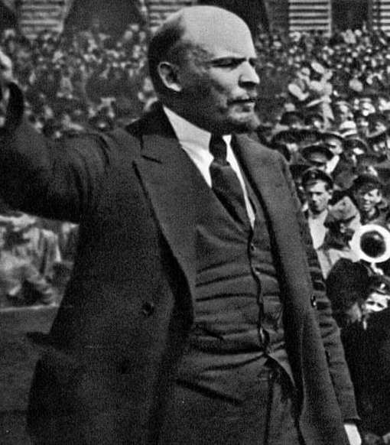
From Russia with Love - 1917
The Russian Revolution
Russia ruled by Czar Nicholas II who was an absolute monarch
Workers and peasants rebelled against food and fuel shortages, demanding better wages and working conditions
Economy destroyed by revolution and civil war; many people starved to death

Slide 8
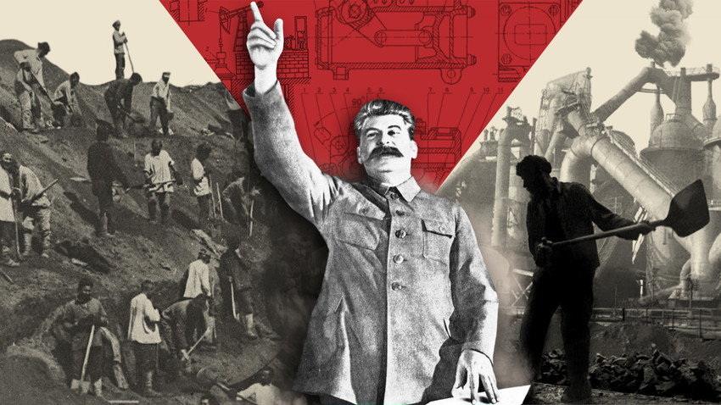
IN RUSSIA, NOTES WRITE YOU
Under Communist system, land and other property were to belong to everyone
Soviet Union became a one-party state, dictatorship
Joseph Stalin transformed the country’s economy, made Russia into industrial and military giant - the people suffered and starved

Slide 9
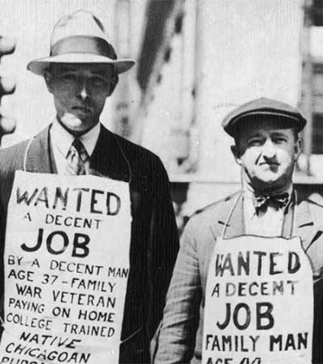
THE LARGE UNHAPPINESS
How does the stock market work?
Do you think countries should restrict trade when faced with tough economic times?
What would be a pro?
What’s a con?
https://www.youtube.com/watch?v=CiAO3iIeQ8w
Notes:
Honda $39 / 3,687,000
Tesla $127 / 1,808,581

Slide 10
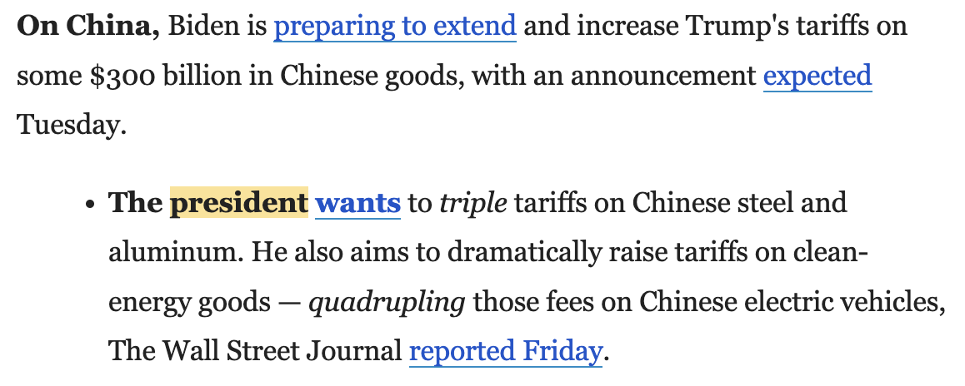
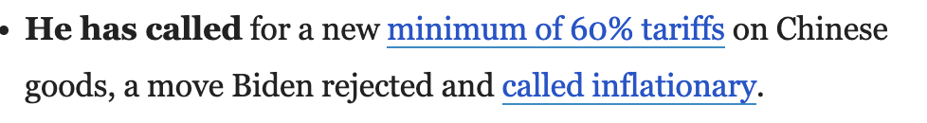
MAKE AMERICA FRIENDLESS AGAIN
Biden:
Trump:
What’s a tariff?
Let’s do some math.

Slide 11
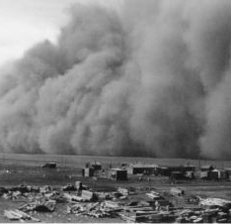
CANADIAN SADNESS
Canadian exports decreased by half
1933 more than a quarter of Canadians were unemployed
Prairies suffered greatly:
- price of grain fell, drought, topsoil blew away, grasshopper infestations
Social 30 Prep!

Slide 12
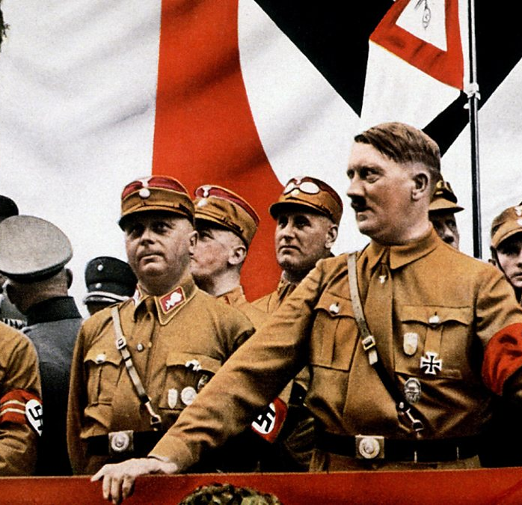
DIE GROßE DEPRESSION
Great Depression and reparation payments led to people electing Hitler and Nazi Party, who promised to make changes
Germany began conquest of European countries, invasion ofPoland led to war
Death tolls extremely large for countries involved
Over 10 million people died in German camps

Slide 13
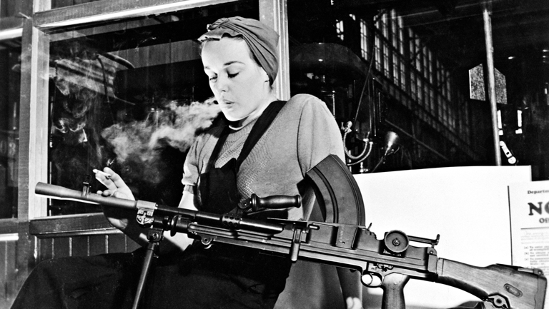
THE CURE FOR NAZIS AND THE ECONOMY: WAR!
Second World War had positive impact on Canada’s economy
Government spending increased; unemployment decreased – less than one percent at end of War
More than a million women joined workforce

Slide 14
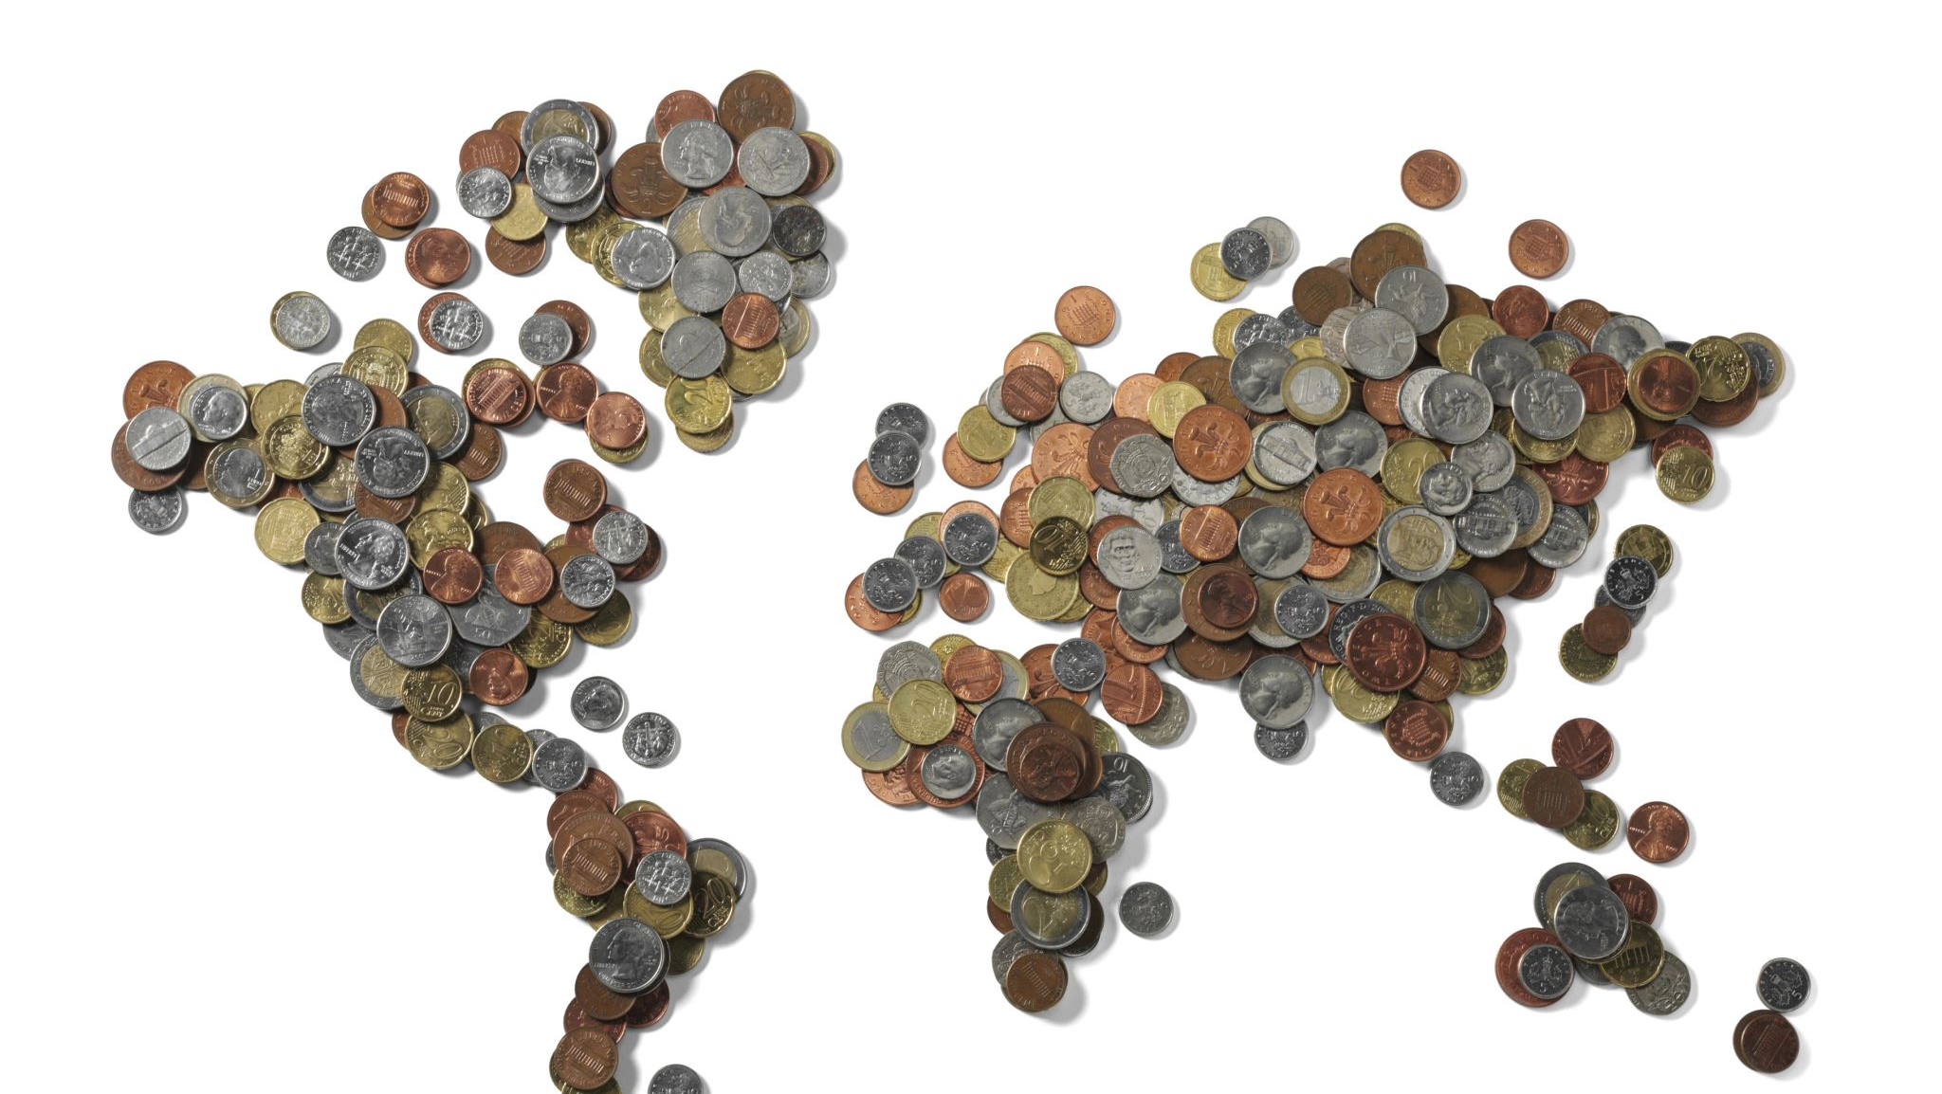
Bretton Woods
Four Achievements:
Reconstruction of Europe after the war
Establish a global money and trade system
Creation of the World Bank
Creation of the IMF

Slide 15

Bretton Woods
https://www.youtube.com/watch?v=GVytOtfPZe8
https://youtu.be/1rob7TJ1lVY

Slide 16
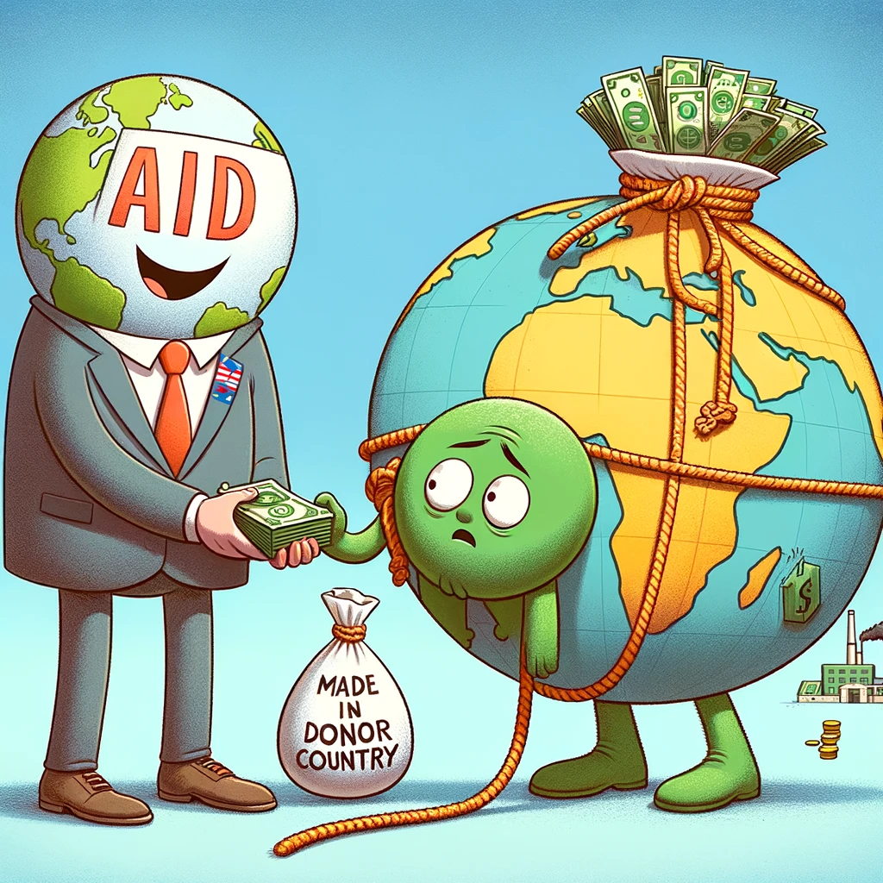
Loans
If you give a loan to someone, what conditions should you be able to set?

Slide 17
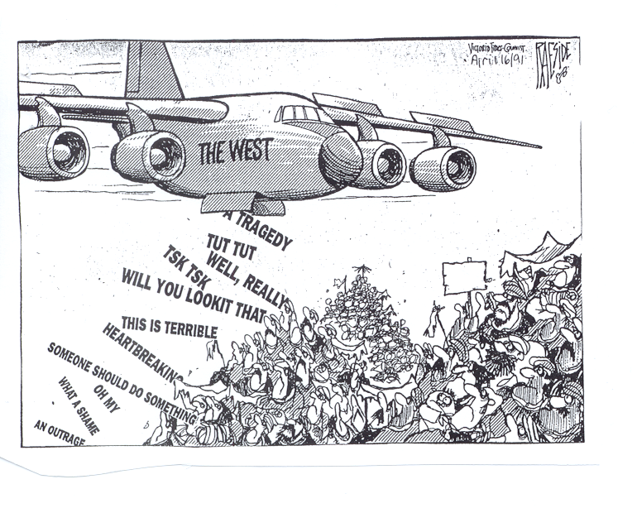

Slide 18
THE IMF AND WORLD BANK
https://youtu.be/lN3qrFA4jXc

Slide 19
