Slide 1

Extracting distance and arrival of angle information from CSI using DL methods

Slide 2
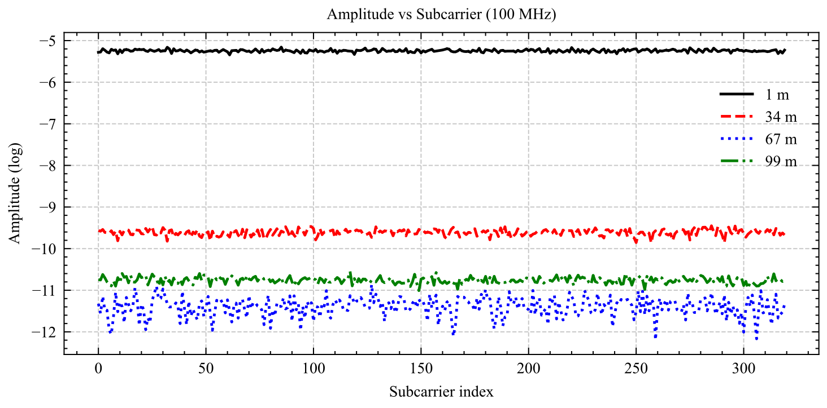
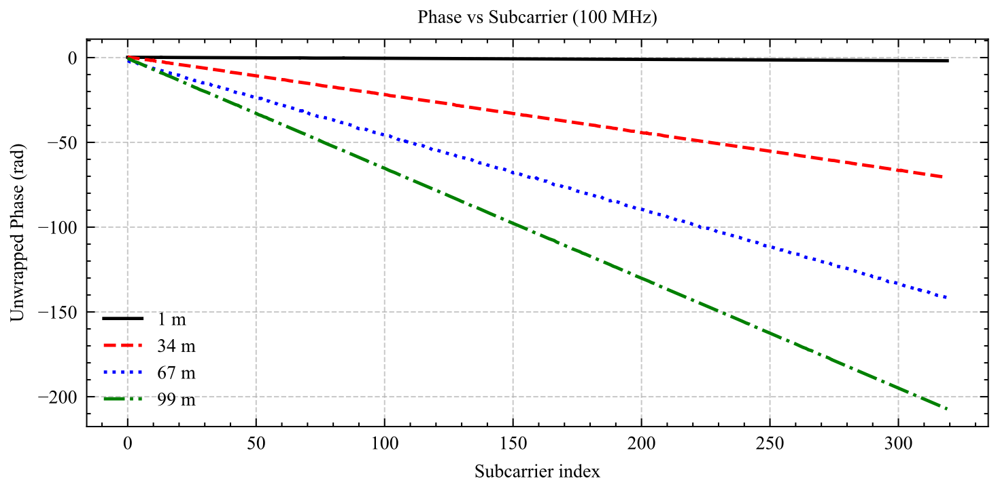
System Model
LOS(Line of Sight):
: transmitted signal
: symbol to be transmitted
: frequency of subcarrier
: index of subcarrier
: time delay
For the same subcarrier, phase and amplitude decreases when distance increases
Notes:
Our network architecture contains three components:
Trusted Authority (TA), Roadside Units and on-Board Units, which are for initialization and credentials, infrastructure and time synchronization, broadcasting safety messages, respectively.
For communcation model, V2X employs one-to-many broadcasting without acknowledgment, via RSUs synchronized time slot 10ms, Vehicles derive authentication keys from a master seed per epoch,
BOOT frames with signatures for trust establishment and DATA frames with symmetric authentication.

Slide 3
System Model
ULAs can’t distinguish and
Retangular Layout encode phase difference by using cos and sin, so angle ambiguous problem can be solved
: Rx antenna
: Array axis
: Signal
: Normal
(a) ULAs Layout
(b) Rectangular Layout
Notes:
Our network architecture contains three components:
Trusted Authority (TA), Roadside Units and on-Board Units, which are for initialization and credentials, infrastructure and time synchronization, broadcasting safety messages, respectively.
For communcation model, V2X employs one-to-many broadcasting without acknowledgment, via RSUs synchronized time slot 10ms, Vehicles derive authentication keys from a master seed per epoch,
BOOT frames with signatures for trust establishment and DATA frames with symmetric authentication.

Slide 4
System Model
Framework
Notes:
Our network architecture contains three components:
Trusted Authority (TA), Roadside Units and on-Board Units, which are for initialization and credentials, infrastructure and time synchronization, broadcasting safety messages, respectively.
For communcation model, V2X employs one-to-many broadcasting without acknowledgment, via RSUs synchronized time slot 10ms, Vehicles derive authentication keys from a master seed per epoch,
BOOT frames with signatures for trust establishment and DATA frames with symmetric authentication.

Slide 5
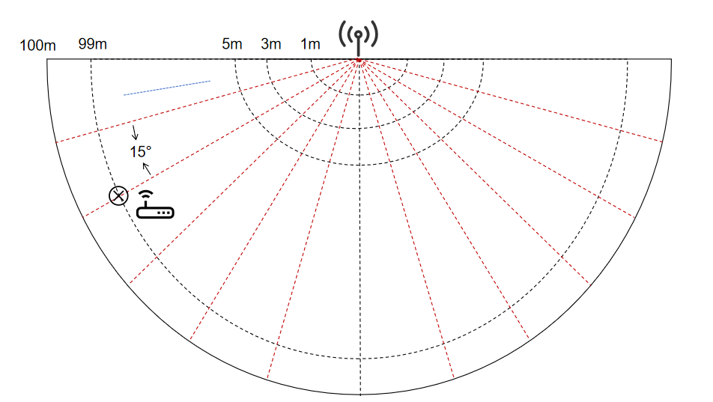
Data Generation
Traing data:
distance interval: 2m
Angle interval: 15°
Testing data:
Distance interval: 1m
Angle interval: 10°
Notes:
Our network architecture contains three components:
Trusted Authority (TA), Roadside Units and on-Board Units, which are for initialization and credentials, infrastructure and time synchronization, broadcasting safety messages, respectively.
For communcation model, V2X employs one-to-many broadcasting without acknowledgment, via RSUs synchronized time slot 10ms, Vehicles derive authentication keys from a master seed per epoch,
BOOT frames with signatures for trust establishment and DATA frames with symmetric authentication.

Slide 6
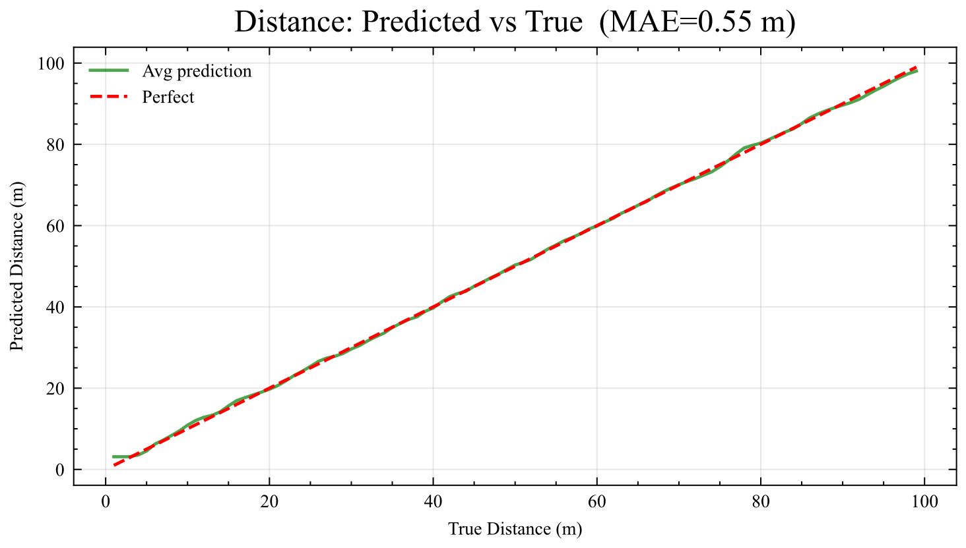
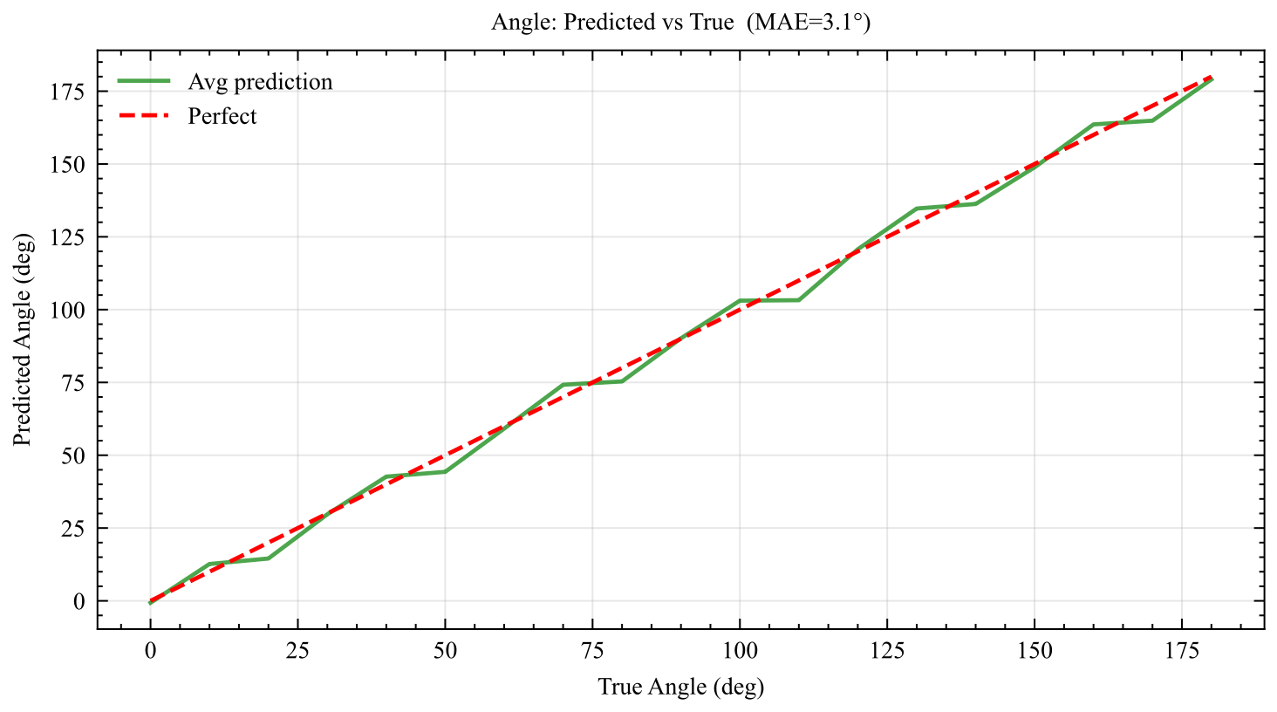
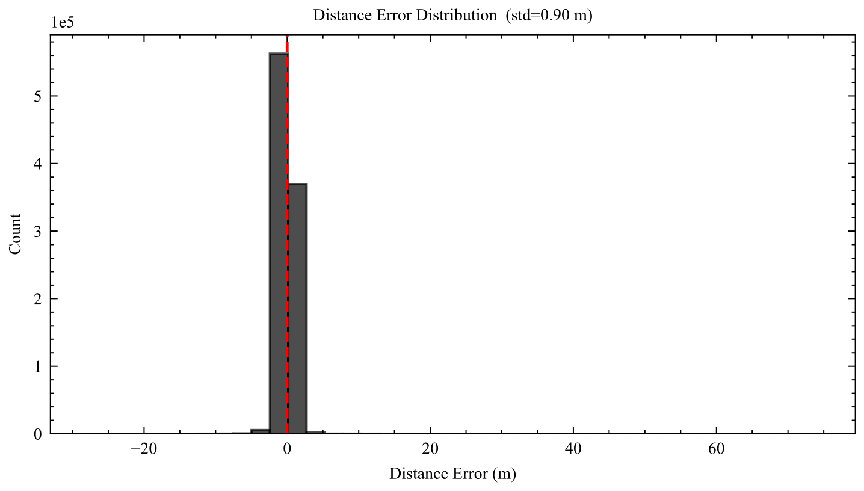
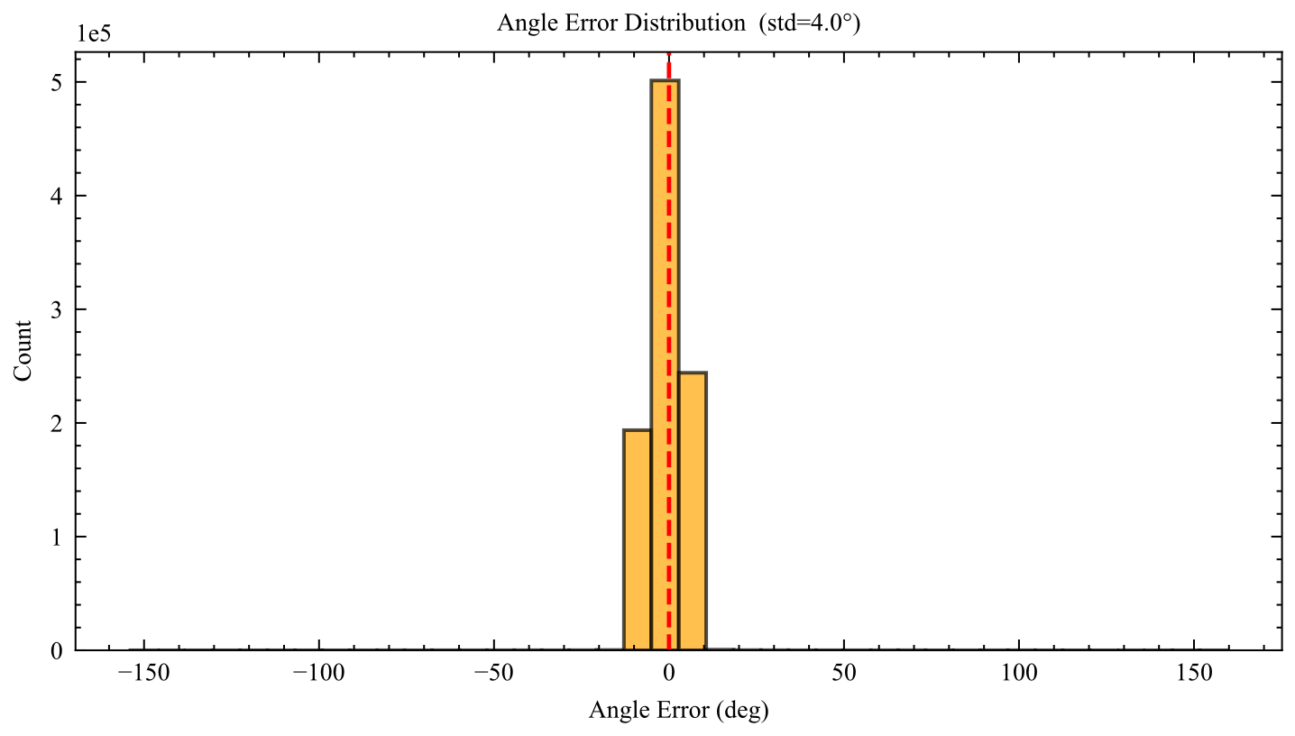
Results
Notes:
Vehicle-to-Everying(V2X) communication has very high standards for safety. To guarantee road safety, messages must be verified within 100ms. But there threee “security-efficieny dilemma”for current authentication methods:
ECDSA method can provide strong security and non-repudiation but require 2ms to compute verification, this can be bottlenecks in dense traffic
In comparsion with ECDSA method, TESLA method is more computationally effiecient, but it has “key disclosure delay”,which is from 20ms to 100ms
So the fact shows a gap, that is, V2X communication requires immediate verification, but the existing hybrid schemes are not able to provide high rates of immediate verification, it only provide about 1% immediate verification for non-signed messages.

Slide 7
Thank you for listening！
Notes:
Thank you for your listening.

