Slide 1

Multihop Sidelink In-door Location Using Wi-Fi CSI

Slide 2

Dataset Prepare
Training Dataset
Distance Range: 1~50m. Distance Interval: 2m.
Angle Range: 0~350°. Angle Interval: 10°
Testing Dataset
Distance Range: 2~50m. Distance Interval: 2m.
Angle Range: 5~350°. Angle Interval: 10°
Two Scenarios for Training and Testing Dataset
Without Wall
With Wall: Wall Loss [0, 90] dB
Confidence: [1.0, 0.1] corresponding to Wall Loss
50 m
: Distance Interval
0 m
: Angle Interval
: Node
Confidence =
Notes:
Our network architecture contains three components:
Trusted Authority (TA), Roadside Units and on-Board Units, which are for initialization and credentials, infrastructure and time synchronization, broadcasting safety messages, respectively.
For communcation model, V2X employs one-to-many broadcasting without acknowledgment, via RSUs synchronized time slot 10ms, Vehicles derive authentication keys from a master seed per epoch,
BOOT frames with signatures for trust establishment and DATA frames with symmetric authentication.

Slide 3
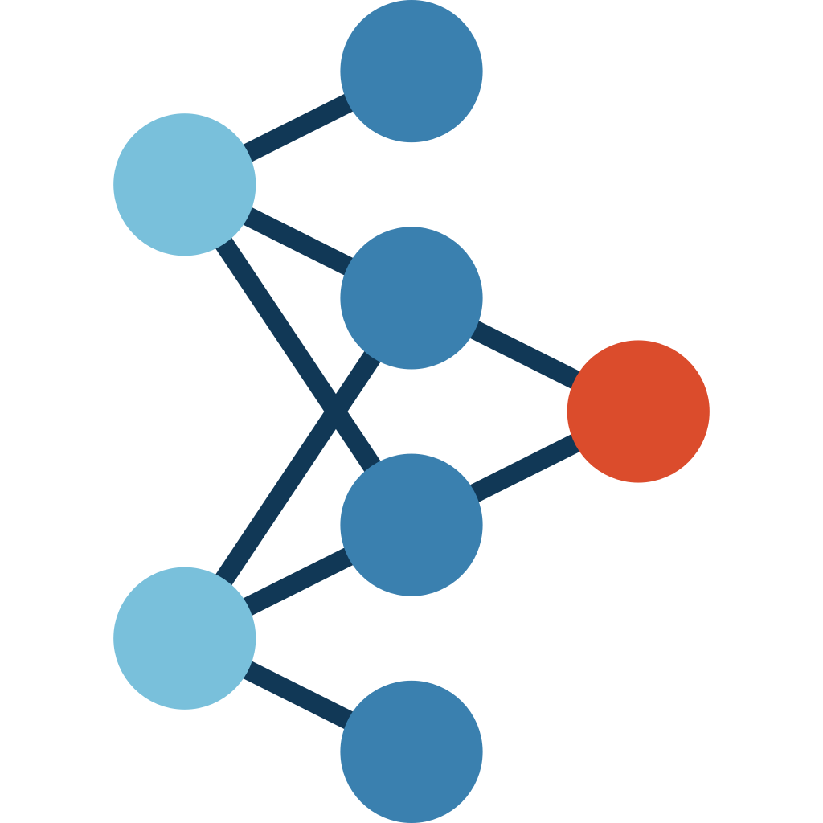
Model
Ability of Model
Predict distance and angle from node to node
Evaluate quality of CSI data
Scenario | dist_weight | angle_weight | conf_weight
conf = 1.0 | *1 | *5 | *2
1.0 < conf ≤ 0.5 | *1 | *2.5 | *2
0.1 ≤ conf < 0.5 | *1 | *0.5 | *2
dist_net
unwrapped CSI(NRx*NSub)
Rx_0
Flatten
dist_weight
Real
Imag
Phase_diff
angle_net
Sin
angle_weight
Flatten
loss
Cos
conf_net
conf_weight
Notes:
Our network architecture contains three components:
Trusted Authority (TA), Roadside Units and on-Board Units, which are for initialization and credentials, infrastructure and time synchronization, broadcasting safety messages, respectively.
For communcation model, V2X employs one-to-many broadcasting without acknowledgment, via RSUs synchronized time slot 10ms, Vehicles derive authentication keys from a master seed per epoch,
BOOT frames with signatures for trust establishment and DATA frames with symmetric authentication.

Slide 4
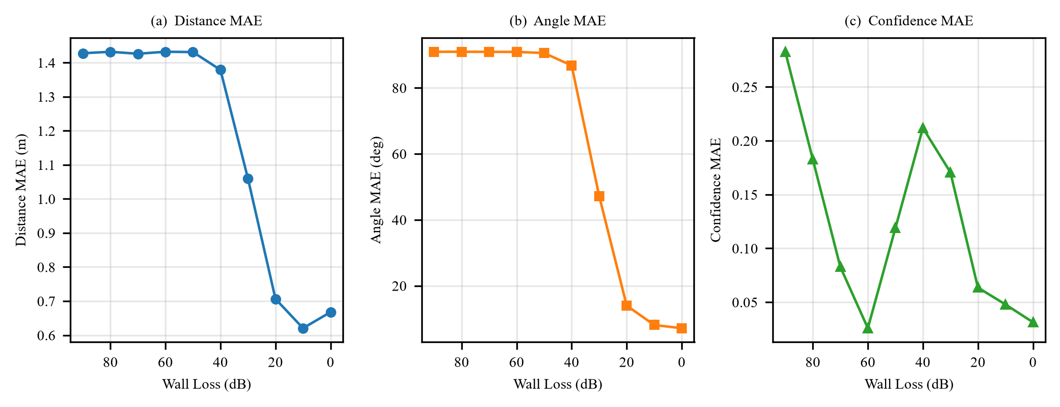
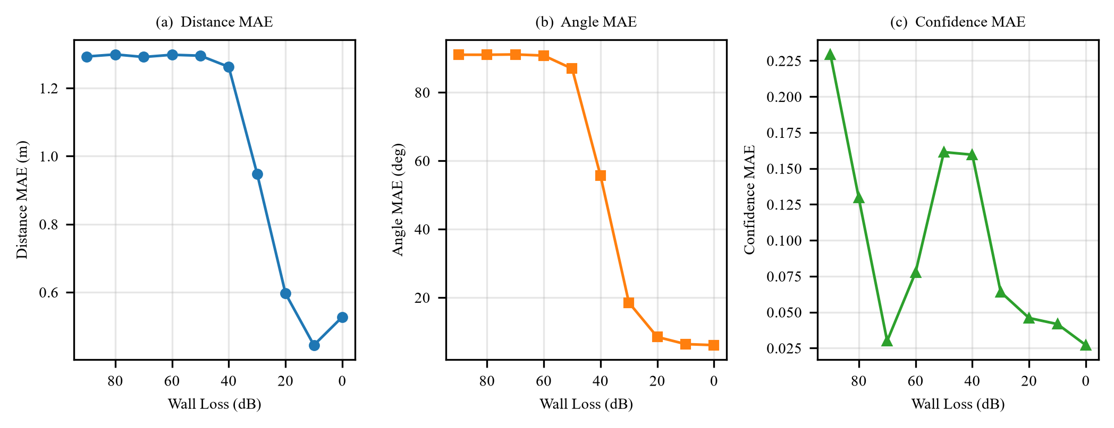
Test
Test result of DNN
Test result of Transformer
With Wall Loss decreasing, Distance/Angle decreases
Low Confidence, Distance, and MAE when Wall Loss < 20 dB (corresponding to Confidence within [0.8, 1.0]). So Confidence in this range is considered as reasonble.
Notes:
Our network architecture contains three components:
Trusted Authority (TA), Roadside Units and on-Board Units, which are for initialization and credentials, infrastructure and time synchronization, broadcasting safety messages, respectively.
For communcation model, V2X employs one-to-many broadcasting without acknowledgment, via RSUs synchronized time slot 10ms, Vehicles derive authentication keys from a master seed per epoch,
BOOT frames with signatures for trust establishment and DATA frames with symmetric authentication.

Slide 5


Scene
y
1. AP as original point (0, 0);
2. AP receive CSI data from neighbor nodes;
3. AP chose the node N1 with the highest Confidence;
4. AP computes coordinate of N1 and transmit it to N1;
5. N1 opperates as anchor node and repeat step 2-4
until target node get its coordinate.
N1
x
How to compute coordinate of next node?
node_2
Target node
Sidelink model 1
Sidelink model 2
node_1
Notes:
Vehicle-to-Everying(V2X) communication has very high standards for safety. To guarantee road safety, messages must be verified within 100ms. But there threee “security-efficieny dilemma”for current authentication methods:
ECDSA method can provide strong security and non-repudiation but require 2ms to compute verification, this can be bottlenecks in dense traffic
In comparsion with ECDSA method, TESLA method is more computationally effiecient, but it has “key disclosure delay”,which is from 20ms to 100ms
So the fact shows a gap, that is, V2X communication requires immediate verification, but the existing hybrid schemes are not able to provide high rates of immediate verification, it only provide about 1% immediate verification for non-signed messages.

Slide 6
Optimization
Graph-based Optimization
: Error Vector
: Vector of node i and j
: Displacement Vector between node i and j
Methode:
Gauss-Newton
Levenberg-Marquardt
Notes:
Vehicle-to-Everying(V2X) communication has very high standards for safety. To guarantee road safety, messages must be verified within 100ms. But there threee “security-efficieny dilemma”for current authentication methods:
ECDSA method can provide strong security and non-repudiation but require 2ms to compute verification, this can be bottlenecks in dense traffic
In comparsion with ECDSA method, TESLA method is more computationally effiecient, but it has “key disclosure delay”,which is from 20ms to 100ms
So the fact shows a gap, that is, V2X communication requires immediate verification, but the existing hybrid schemes are not able to provide high rates of immediate verification, it only provide about 1% immediate verification for non-signed messages.

Slide 7
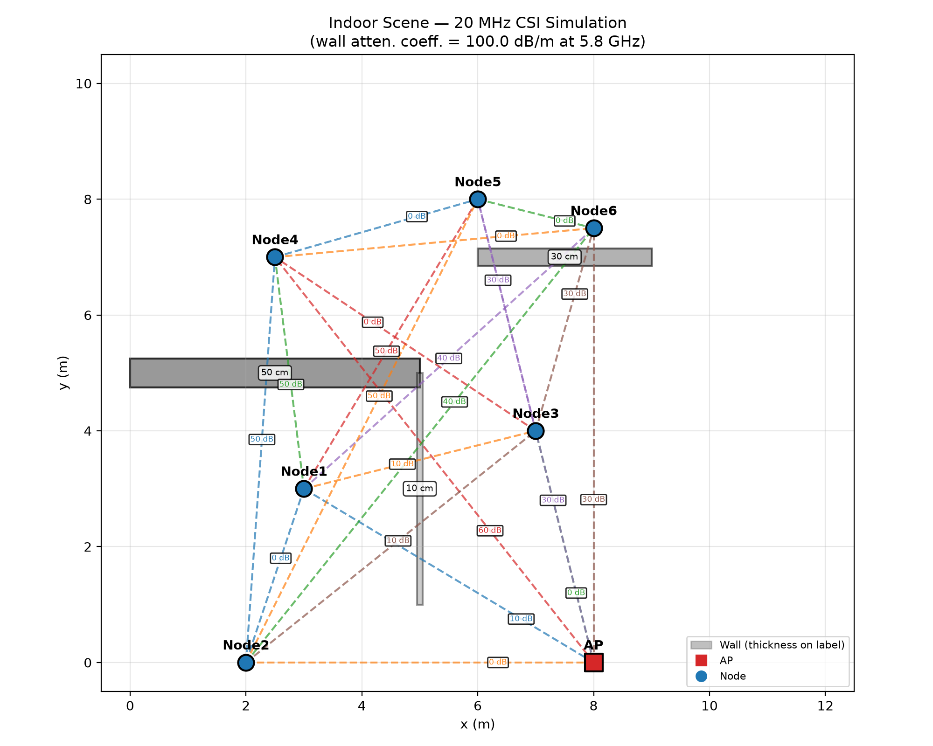


Simulation(DNN)
node_6
node_5
w2
node_4
w1
node_3
w3
node_1
node_2
AP
Notes:
Vehicle-to-Everying(V2X) communication has very high standards for safety. To guarantee road safety, messages must be verified within 100ms. But there threee “security-efficieny dilemma”for current authentication methods:
ECDSA method can provide strong security and non-repudiation but require 2ms to compute verification, this can be bottlenecks in dense traffic
In comparsion with ECDSA method, TESLA method is more computationally effiecient, but it has “key disclosure delay”,which is from 20ms to 100ms
So the fact shows a gap, that is, V2X communication requires immediate verification, but the existing hybrid schemes are not able to provide high rates of immediate verification, it only provide about 1% immediate verification for non-signed messages.

Slide 8
──────────────────────────────────────────────────────────────────────────────────────────
Node True (x,y) Sequential (x,y) Err Optimized (x,y) Err Δ
──────────────────────────────────────────────────────────────────────────────────────────
BS (50.0, 10.0) (50.00, 10.00) 0.00 (50.00, 10.00) 0.00 +0.00
UE1 (62.0, 28.0) (60.91, 28.05) 1.09 (61.72, 28.24) 0.37 +0.72
UE10 (80.0, 90.0) (79.83, 89.89) 0.20 (79.97, 90.85) 0.85 -0.64
UE11 (35.0, 70.0) (31.96, 69.47) 3.08 (31.93, 69.43) 3.12 -0.04
UE12 (30.0, 80.0) (26.86, 79.53) 3.17 (26.90, 79.57) 3.13 +0.04
UE13 (55.0, 30.0) (55.28, 29.91) 0.29 (55.04, 30.00) 0.04 +0.25
UE14 (45.0, 40.0) (45.18, 40.31) 0.36 (45.00, 40.38) 0.38 -0.01
UE15 (62.0, 62.0) (61.51, 61.69) 0.59 (61.79, 62.49) 0.53 +0.06
UE2 (65.0, 50.0) (63.54, 50.17) 1.47 (64.62, 50.22) 0.44 +1.02
UE3 (80.0, 55.0) (79.55, 54.99) 0.45 (80.18, 55.50) 0.53 -0.08
UE4 (90.0, 40.0) (89.86, 39.52) 0.50 (90.63, 39.94) 0.63 -0.13
UE5 (35.0, 50.0) (35.24, 49.75) 0.35 (35.39, 50.14) 0.41 -0.07
UE6 (25.0, 48.0) (25.18, 47.26) 0.76 (25.07, 47.69) 0.32 +0.44
UE7 (20.0, 30.0) (19.88, 28.71) 1.30 (20.08, 29.30) 0.70 +0.59
UE8 (50.0, 60.0) (50.47, 60.21) 0.52 (50.04, 60.37) 0.37 +0.15
UE9 (70.0, 80.0) (69.75, 79.66) 0.42 (69.93, 80.57) 0.58 -0.16
──────────────────────────────────────────────────────────────────────────────────────────
MEAN 0.97 0.83 +0.14
──────────────────────────────────────────────────────────────────────────────────────────
Notes:
Vehicle-to-Everying(V2X) communication has very high standards for safety. To guarantee road safety, messages must be verified within 100ms. But there threee “security-efficieny dilemma”for current authentication methods:
ECDSA method can provide strong security and non-repudiation but require 2ms to compute verification, this can be bottlenecks in dense traffic
In comparsion with ECDSA method, TESLA method is more computationally effiecient, but it has “key disclosure delay”,which is from 20ms to 100ms
So the fact shows a gap, that is, V2X communication requires immediate verification, but the existing hybrid schemes are not able to provide high rates of immediate verification, it only provide about 1% immediate verification for non-signed messages.

Slide 9
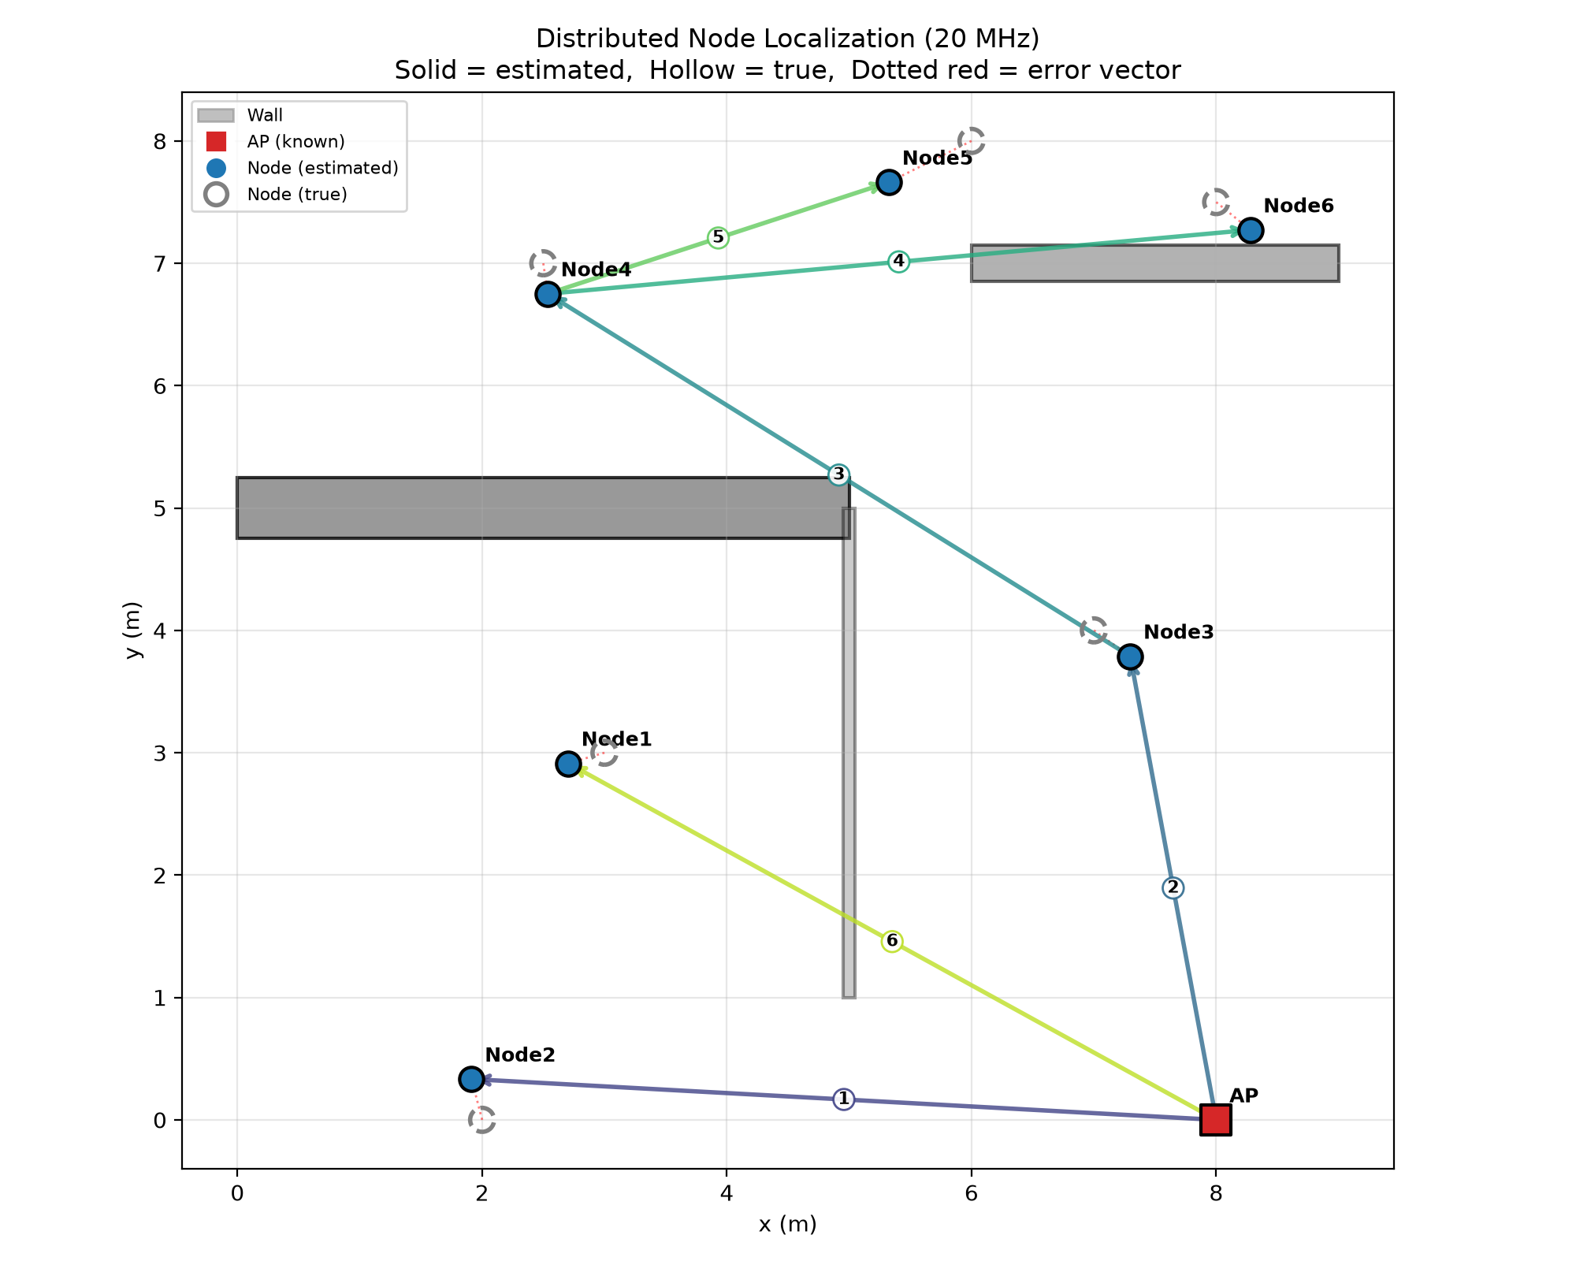
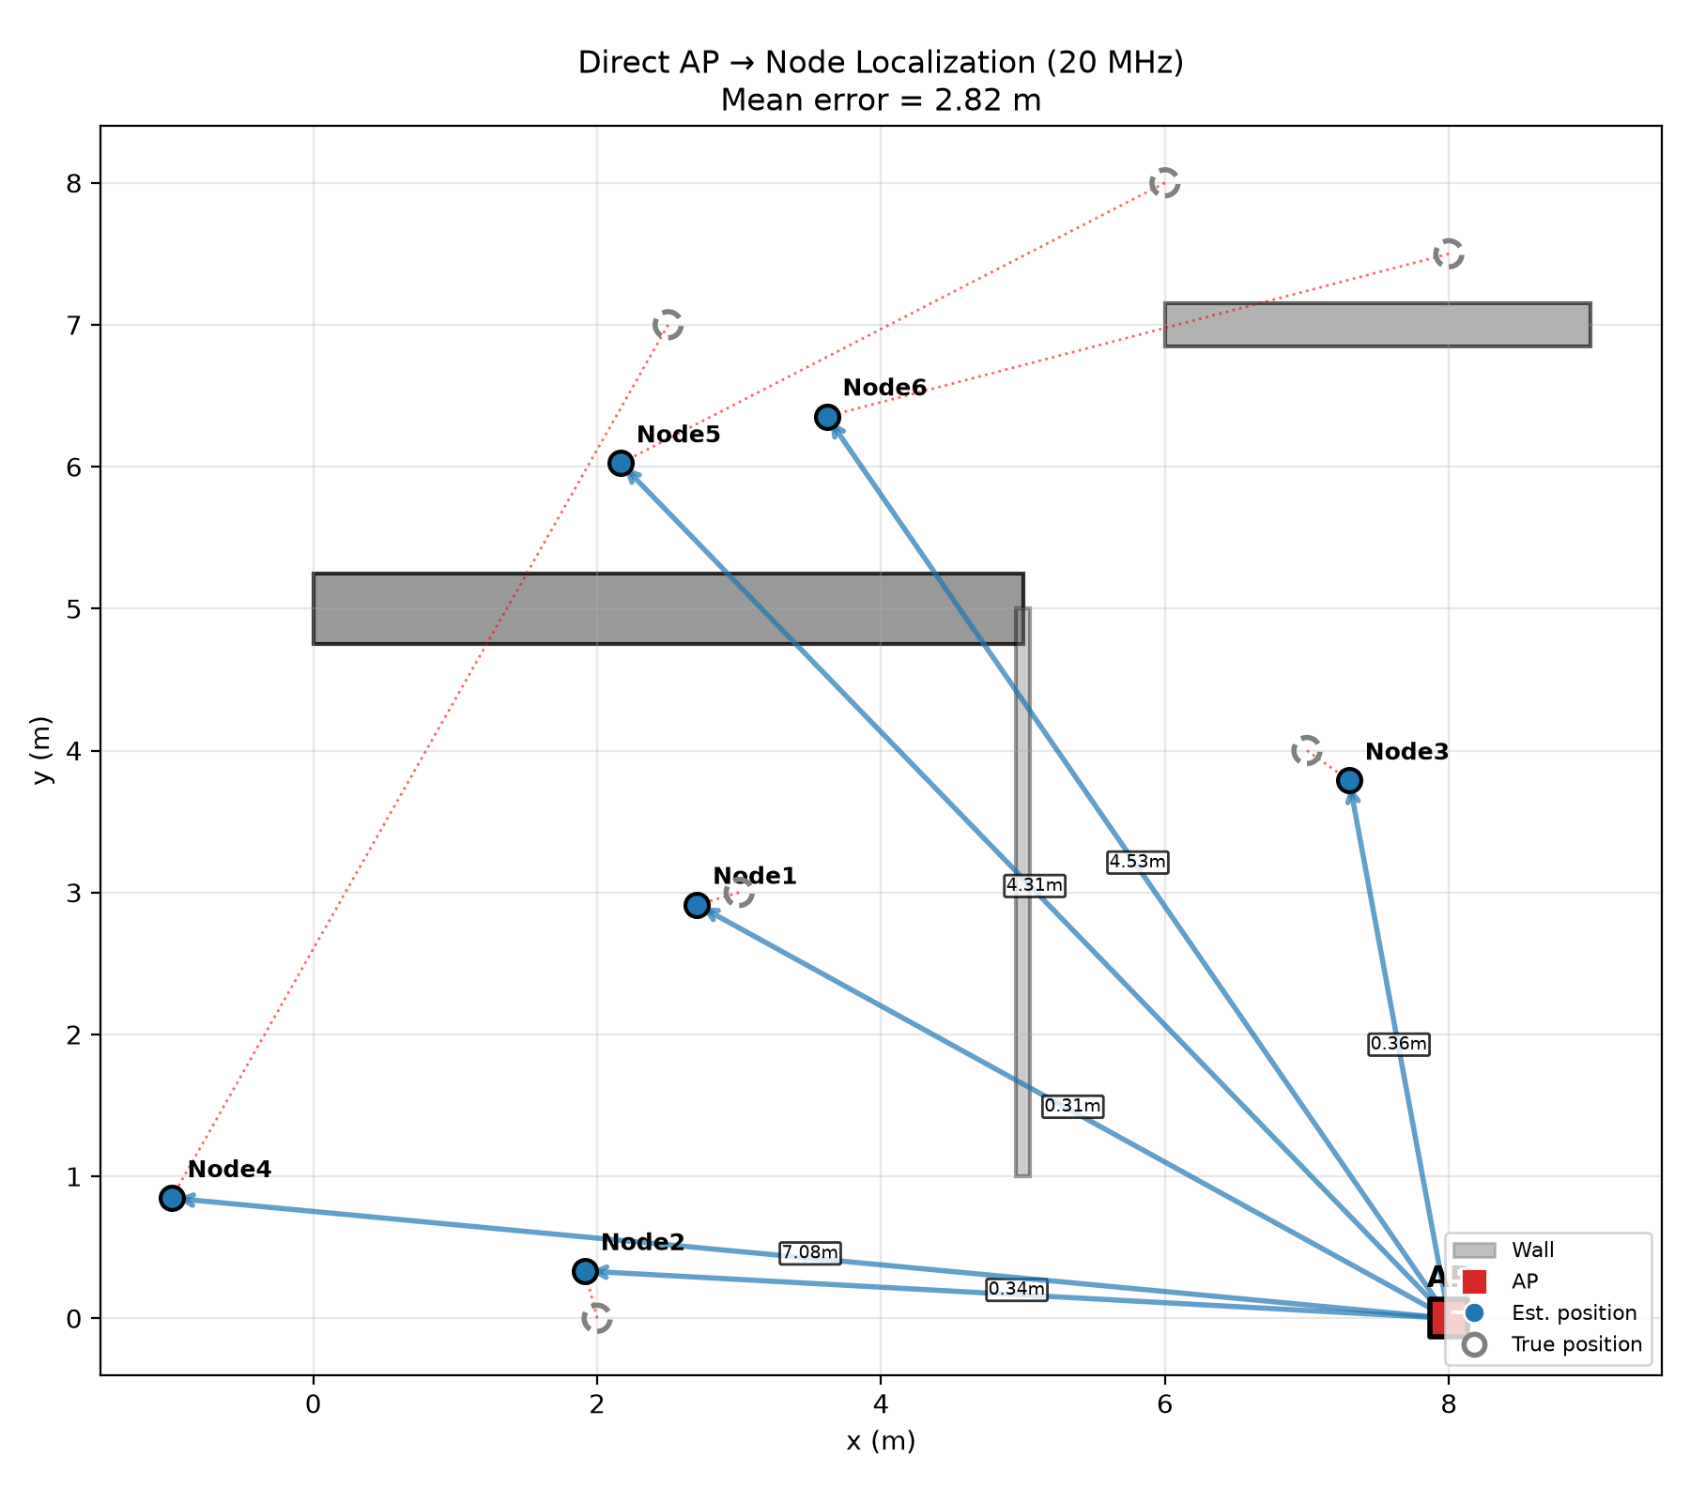
Simulation(DNN)
Node | est_location | true_location | error
1 | (2.70, 2.91) | (3.00, 3.00) | 0.31
2 | (1.91, 0.33) | (2.00, 0.00) | 0.34
3 | (7.30, 3.79) | (7.00, 4.00) | 0.36
4 | (2.54, 6.75) | (2.50, 7.00) | 0.25
5 | (5.33, 7.66) | (6.00, 8.00) | 0.75
6 | (8.28, 7.27) | (8.00, 7.50) | 0.36
With multi-hop mechnisim(
before optimization):
Average error: 0.40
Node | est_location | true_location | error
1 | (2.86, 2.68) | (3.00, 3.00) | 0.31
2 | (1.91, 0.33) | (2.00, 0.00) | 0.34
3 | (7.30, 3.79) | (7.00, 4.00) | 0.36
4 | (-1.00, 0.85) | (2.50, 7.00) | 7.08
5 | (2.17, 6.02) | (6.00, 8.00) | 4.31
6 | (3.62, 6.35) | (8.00, 7.50) | 4.53
Without multi-hop mechnisim:
Average error: 2.81
Notes:
Vehicle-to-Everying(V2X) communication has very high standards for safety. To guarantee road safety, messages must be verified within 100ms. But there threee “security-efficieny dilemma”for current authentication methods:
ECDSA method can provide strong security and non-repudiation but require 2ms to compute verification, this can be bottlenecks in dense traffic
In comparsion with ECDSA method, TESLA method is more computationally effiecient, but it has “key disclosure delay”,which is from 20ms to 100ms
So the fact shows a gap, that is, V2X communication requires immediate verification, but the existing hybrid schemes are not able to provide high rates of immediate verification, it only provide about 1% immediate verification for non-signed messages.

Slide 10
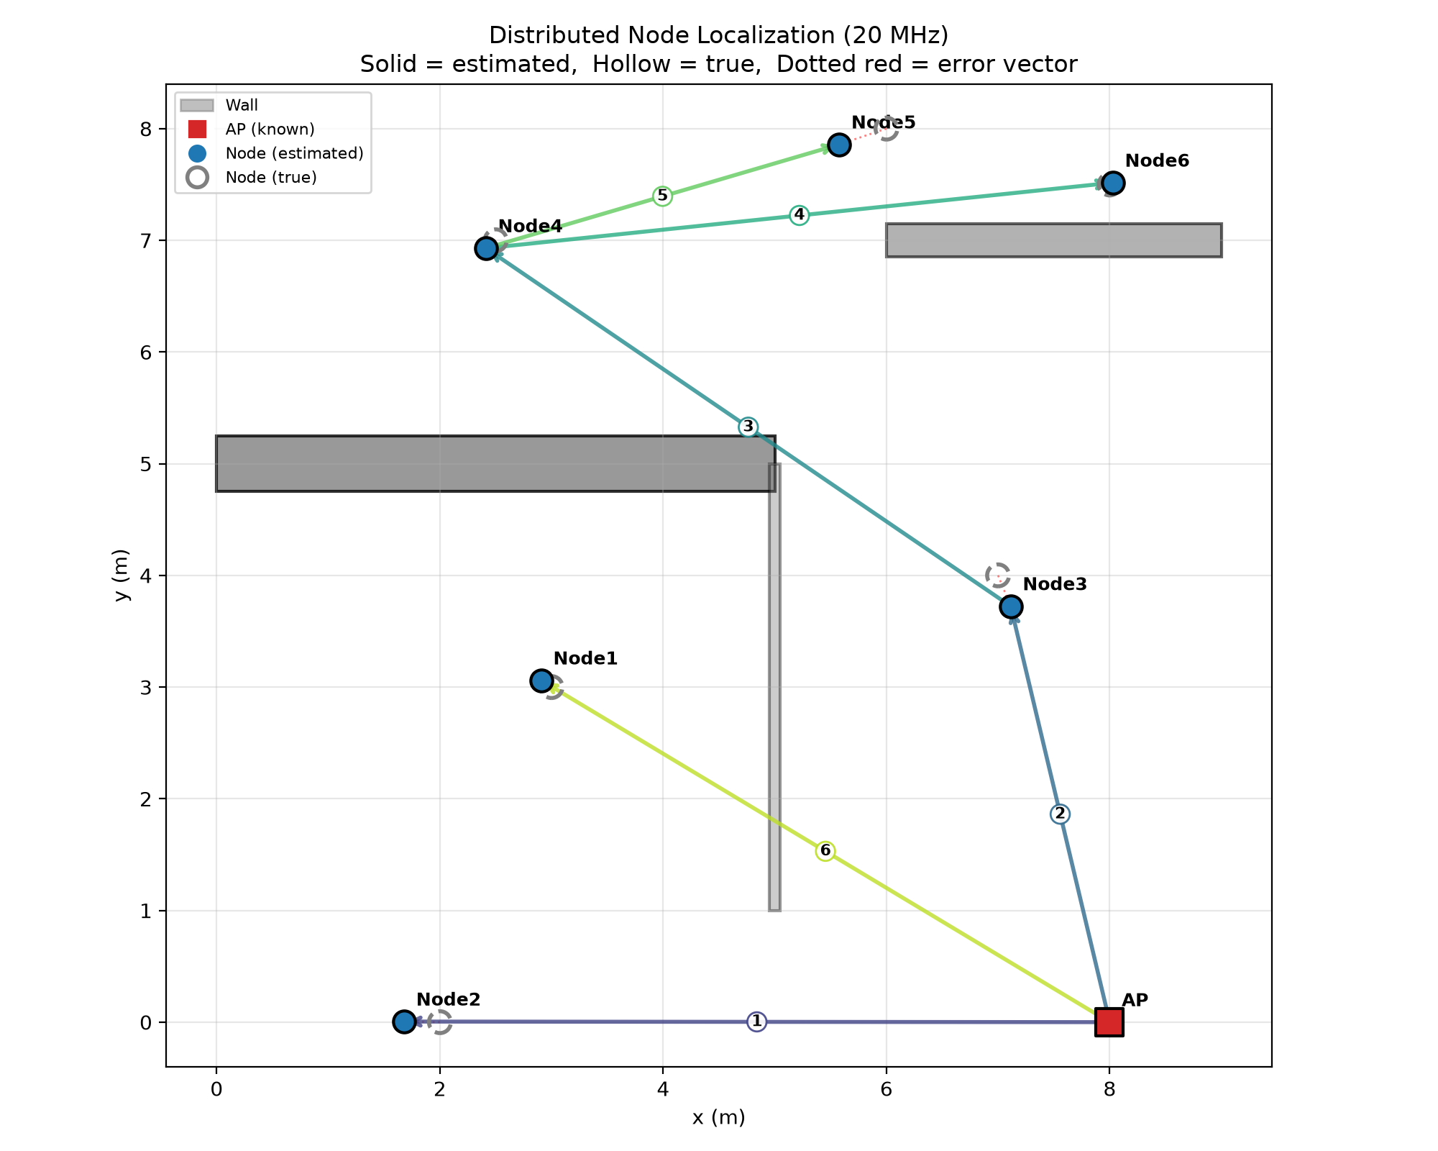

Simulation(DNN)
Node | est_location | true_location | error
1 | (2.70, 2.91) | (3.00, 3.00) | 0.31
2 | (1.91, 0.33) | (2.00, 0.00) | 0.34
3 | (7.30, 3.79) | (7.00, 4.00) | 0.36
4 | (2.54, 6.75) | (2.50, 7.00) | 0.25
5 | (5.33, 7.66) | (6.00, 8.00) | 0.75
6 | (8.28, 7.27) | (8.00, 7.50) | 0.36
With multi-hop mechnisim(before optimization):
Average error: 0.40
Node | est_location | true_location | error | diff
1 | (2.86, 2.68) | (3.00, 3.00) | 0.35 | -0.04
2 | (1.96, 0.24) | (2.00, 0.00) | 0.24 | +0.10
3 | (7.13, 4.07) | (7.00, 4.00) | 0.15 | +0.22
4 | (2.37, 7.03) | (2.50, 7.00) | 0.14 | +0.12
5 | (5.50, 8.04) | (6.00, 8.00) | 0.50 | +0.25
6 | (7.78, 7.46) | (8.00, 7.50) | 0.23 | +0.13
With multi-hop mechnisim(after optimization):
Average error: 0.27
Notes:
Vehicle-to-Everying(V2X) communication has very high standards for safety. To guarantee road safety, messages must be verified within 100ms. But there threee “security-efficieny dilemma”for current authentication methods:
ECDSA method can provide strong security and non-repudiation but require 2ms to compute verification, this can be bottlenecks in dense traffic
In comparsion with ECDSA method, TESLA method is more computationally effiecient, but it has “key disclosure delay”,which is from 20ms to 100ms
So the fact shows a gap, that is, V2X communication requires immediate verification, but the existing hybrid schemes are not able to provide high rates of immediate verification, it only provide about 1% immediate verification for non-signed messages.

Slide 11
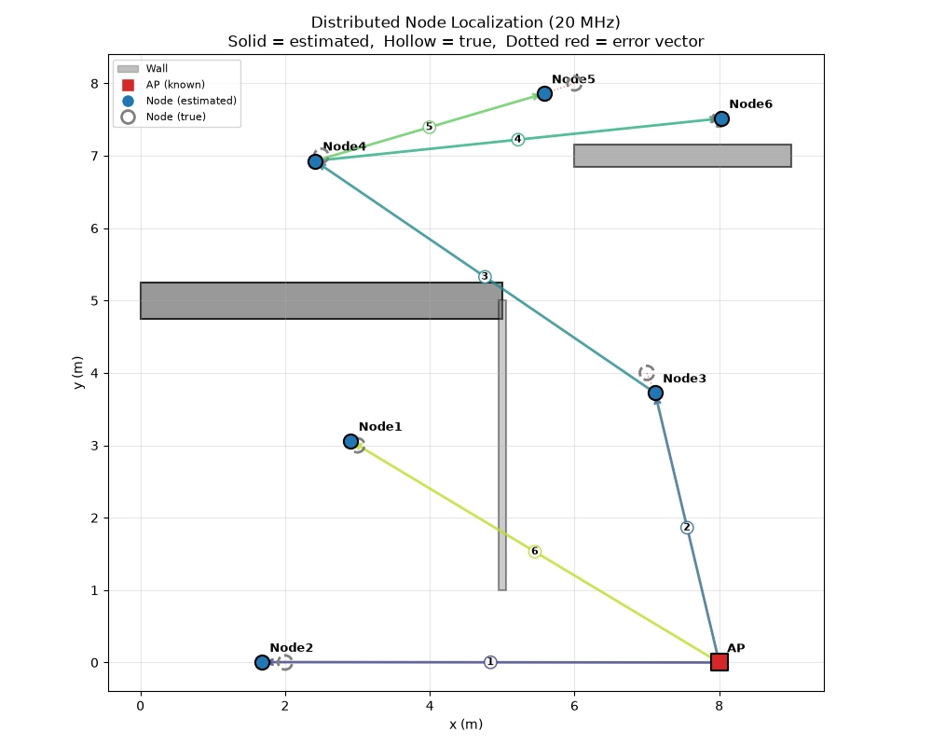
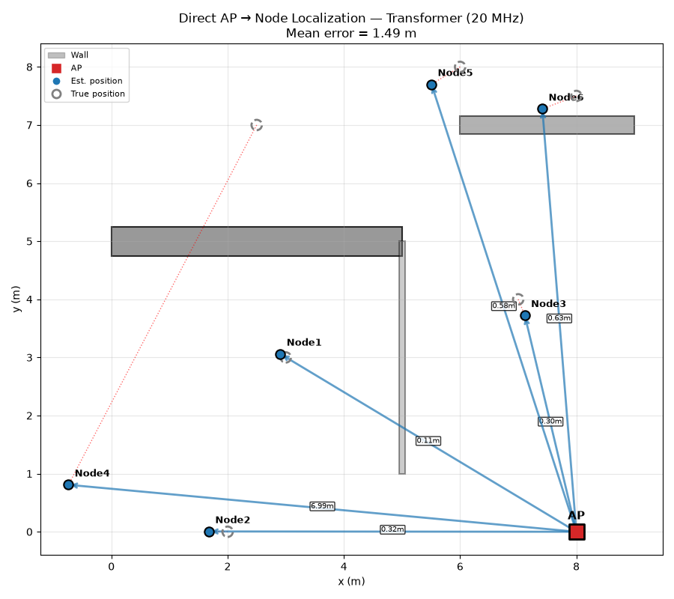
Simulation(Transformer)
Node | est_location | true_location | error
1 | (2.95, 2.95) | (3.00, 3.00) | 0.07
2 | (1.72, -0.08) | (2.00, 0.00) | 0.29
3 | (7.03, 3.53) | (7.00, 4.00) | 0.48
4 | (2.45, 6.51) | (2.50, 7.00) | 0.49
5 | (5.30, 7.37) | (6.00, 8.00) | 0.94
6 | (7.71, 7.14) | (8.00, 7.50) | 0.46
With multi-hop mechnisim(before
optimization):
Average error: 0.22
Node | est_location | true_location | error | diff
1 | (2.91, 3.06) | (3.00, 3.00) | 0.11 | 0.00
2 | (1.68, 0.01) | (2.00, 0.00) | 0.32 | 0.00
3 | (7.11, 3.72) | (7.00, 4.00) | 0.30 | 0.00
4 | (-0.74, 0.81) | (2.50, 7.00) | 6.99 | -6.88
5 | (5.51, 7.70) | (6.00, 8.00) | 0.58 | -0.13
6 | (7.41, 7.28) | (8.00, 7.50) | 0.63 | -0.60
Without multi-hop mechnisim(before
optimization):
Average error: 1.49
Notes:
Vehicle-to-Everying(V2X) communication has very high standards for safety. To guarantee road safety, messages must be verified within 100ms. But there threee “security-efficieny dilemma”for current authentication methods:
ECDSA method can provide strong security and non-repudiation but require 2ms to compute verification, this can be bottlenecks in dense traffic
In comparsion with ECDSA method, TESLA method is more computationally effiecient, but it has “key disclosure delay”,which is from 20ms to 100ms
So the fact shows a gap, that is, V2X communication requires immediate verification, but the existing hybrid schemes are not able to provide high rates of immediate verification, it only provide about 1% immediate verification for non-signed messages.

Slide 12
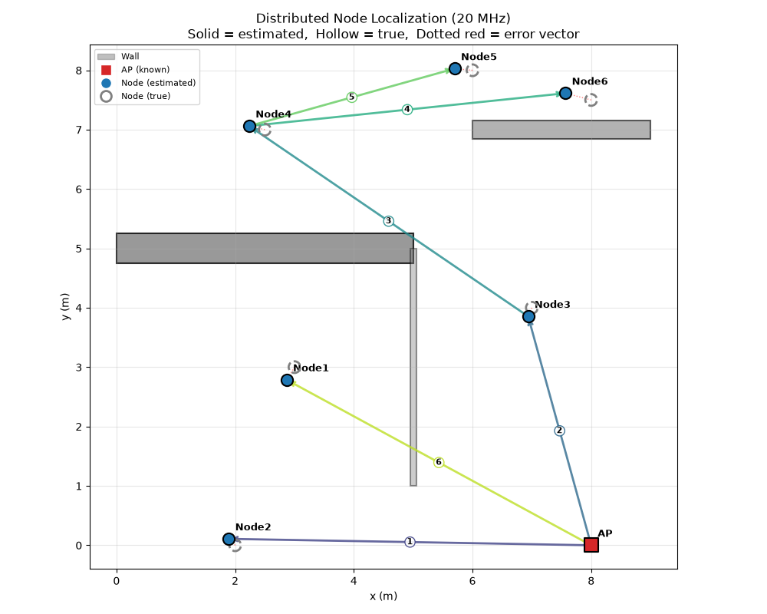
Simulation(Transformer)
Node | est_location | true_location | error
1 | (2.95, 2.95) | (3.00, 3.00) | 0.07
2 | (1.72, -0.08) | (2.00, 0.00) | 0.29
3 | (7.03, 3.53) | (7.00, 4.00) | 0.48
4 | (2.45, 6.51) | (2.50, 7.00) | 0.49
5 | (5.30, 7.37) | (6.00, 8.00) | 0.94
6 | (7.71, 7.14) | (8.00, 7.50) | 0.46
With multi-hop mechnisim(before
optimization):
Average error: 0.22
Node | est_location | true_location | error | diff
1 | (2.94, 2.70) | (3.00, 3.00) | 0.31 | -0.14
2 | (1.90, -0.09) | (2.00, 0.00) | 0.13 | +0.16
3 | (6.86, 3.76) | (7.00, 4.00) | 0.28 | +0.20
4 | (2.28, 6.74) | (2.50, 7.00) | 0.34 | +0.16
5 | (5.48, 7.68) | (6.00, 8.00) | 0.61 | +0.33
6 | (7.21, 7.30) | (8.00, 7.50) | 0.82 | -0.35
With multi-hop mechnisim(after
optimization):
Average error: 0.26
Notes:
Vehicle-to-Everying(V2X) communication has very high standards for safety. To guarantee road safety, messages must be verified within 100ms. But there threee “security-efficieny dilemma”for current authentication methods:
ECDSA method can provide strong security and non-repudiation but require 2ms to compute verification, this can be bottlenecks in dense traffic
In comparsion with ECDSA method, TESLA method is more computationally effiecient, but it has “key disclosure delay”,which is from 20ms to 100ms
So the fact shows a gap, that is, V2X communication requires immediate verification, but the existing hybrid schemes are not able to provide high rates of immediate verification, it only provide about 1% immediate verification for non-signed messages.

Slide 13
Thank you for listening！
Notes:
Thank you for your listening.

